Slide 1
Building Adaptive and Agile Applications Using Intrusion Detection and Response
Joseph P. Loyall, Partha P. Pal, and Richard E. Schantz
{jloyall, ppal, schantz}@bbn.com
BBN Technologies
Franklin Webber
franklin.webber@computer.org
http://www.dist-systems.bbn.com/tech/QuO

Slide 2
Outline
Motivation & Context
Overview of QuO technology
Building adaptive, intrusion-aware applications using
QuO
Conclusions and Issues
QuO

Slide 3
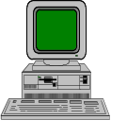
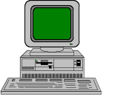


As applications become more distributed and complex, their needs for adaptability, security, and survivability increase
CINC
CINC Operations
Planning Group
CJTF
Planners
J2
Missions
Centers of Gravity
Task refinement
Forces refinement
Phases refinement
COA evaluation
COA selection
IDB
Crisis
assessment
OPS/ INTEL
WORKSTATION
TARGET
TARGET
COA
eval
Air
COA
Mar
eval
FLTCINC Maritime
Planning Center
Missions
COAs
Strategy
JOINT FORCE MARITIME
COMPONENT CMDR
JOINT FORCE AIR
COMPONENT CMDR
Maritime & Air
Campaign Assess
ment
Refinement
& eval
Refinement
& eval
XIDB
Task refinement
Integrated Target Priorities
Forces refinement
Schedule refinement
COA evaluation
TMS
CASES & HPC
CASES
TARGET
TARGET
ACPT
Target data / Weaponeering
Master
Target
List
TAMPS/
COMPASS
ATO
JFACC
Combat Ops
Rear-echelon
Sim Center
JMCIS
IDB
rehearse
XIDB
collaborative
development
to
NATO
OPS/INTEL
WORKSTATION
Air Tasking Order
(ATO)
APS/FLEX
Target Nomination List
Master Attack Plan
Attack Plan Status
APS/FLEX
RAAP
SHAPE
Target Nomination List
Weaponeering

Slide 4
Large scale information systems are vulnerable to attack
Increasingly so because of their distributed, networked nature
Distributed object systems and wide-area networks offer increased chances of failure or attack
Increasing reliance on COTS increases possibility of attacks and ease of propagating attacks
Homogeneity in architectures, platforms, OSs, components, algorithms increase vulnerability to attack

Slide 5
We are building upon research that we’re conducting in adaptive distributed systems
Developing technology to support specification, control, and measurement of QoS in distributed systems, including security, survivability, dependability, performance, and resource management
Addressing the following problems of critical, networked applications:
  No effective way to control behavior of critical applications in today’s highly networked environment
  Gap between low-level mechanisms that control resources and high-level strategies appropriate for critical applications
  Researchers generally working on one piece of the solution, e.g.,
    Focus on one critical QoS property: security, real time behavior, fault tolerance, ...
    Focus on implications of one time epoch
    Functional integration has taken precedence over system properties
End goal is to support building integrated QoS adaptive applications (with varying requirements on granularity of changing behavior):
  adaptable: change at runtime while application/service running
  reconfigurable: change at runtime while application/service halted
  evolvable: change at development time

Slide 6
Simplified DOC (CORBA) Runtime Components
Client
Logical Method Call
Object
Application
Developer
ORB Proxy
ORB Proxy
Mechanism
Developer
Specialized ORB
Specialized ORB
Network
Client
Network
Server
Notes:
7

Slide 7
QuO adds specification, measurement, and adaptation into the distributed object model
Client
Logical Method Call
Object
Application
Developer
SysCond
SysCond
Contract
Contract
Delegate
SysCond
Delegate
SysCond
SysCond
QuO
Developer
SysCond
SysCond
ORB Proxy
Mechanism/Property
Manager
ORB Proxy
Mechanism
Developer
Specialized ORB
Specialized ORB
Network
Client
Network
Server
Notes:
7

Slide 8
A QuO application contains additional components (from traditional DOC applications)
Contracts summarize the possible states of QoS in the system and behavior to trigger when QoS changes
  Regions can be nested, representing different epochs at which QoS information becomes available, e.g., negotiated regions represent the levels of service a client expects to receive and a server expects to provide, while reality regions represent observed levels of service
  Regions are defined by predicates over system condition objects
  Transitions specify behavior to trigger when the active regions change
System condition objects are used to measure and control QoS
  Provide interfaces to system resources, client and object expectations, mechanisms, managers, and specialized ORB functions
  Changes in system condition objects observed by contracts can cause region transitions
  Methods on system condition objects can be used to access QoS controls provided by resources, mechanisms, managers, and ORBs
Delegates implement the QoS specific adaptivity behavior
  Upon method call/return, delegate can check the current contract state and choose behavior based upon the current state of QoS
  For example, delegate can choose between alternate methods, alternate remote object bindings, perform local processing of data, or simply pass the method call or return through

Slide 9
QuO applications specify, control, monitor, and adapt to QoS in the system
Application
Specification of operating regions, alternate implementations, and adaptation strategies using QuO’s QDL
Alternate Implementations
Multiple layers of adaptation
managers and mechanisms can adapt to changes in the system
QuO contracts provide another layer of adaptation
Client and user can also adapt
Contract (operating regions)
System
Condition
Objects
System condition objects monitor QoS in the system
  system condition objects recognize changes in the system and notify the contracts that observe them
  QuO contracts notify client programs, users, managers, and other system condition objects through transition behavior
Mechanisms and managers control QoS in the system
  a layer below QuO that provides ORB-level services, such as managed communi-cation, replication, or security
  contracts and delegates interface to these services through system condition objects
Replication Mgr
IDS
Access Control
Manager
ORB
Network
Servers

Slide 10
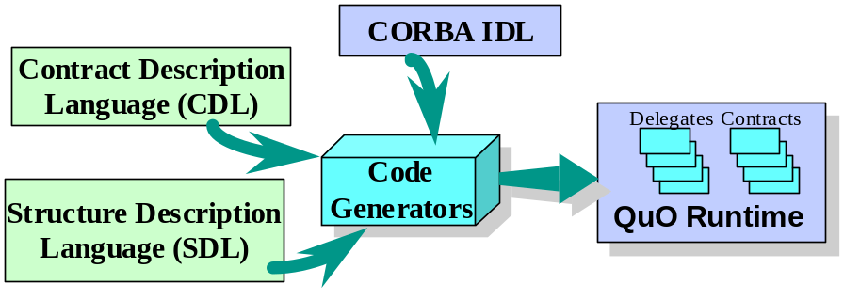
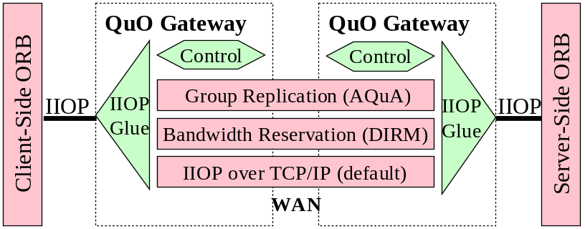
The QuO Toolkit provides tools for building adaptive applications
Quality Description Languages (QDL)
  Contract description language, adaptive behavior description language, connector setup language
  Code generators that generate Java and C++ code for contracts, delegates, creation, and initialization
System Condition Objects, implemented as CORBA objects
QuO Runtime Kernel
  Contract evaluator
  Factory object which instantiates contract and system condition objects
Instrumentation library
QuO gateway
  Insertion of special purpose transport layers and adaptation below the ORB
Notes:
7

Slide 11
Benefits of QuO adaptable software to IA, survivability, and security
Development of intrusion- and security-aware applications
  Can recognize application-level patterns of usage and attack to aid IDSs and security managers, e.g., denials of service, corrupted data
  Probes in applications can gather information that traditional IDSs and security systems (which treat applications as black boxes) don’t have
Development of survivable applications
  Applications that can adapt to changes in their environment to continue execution in the face of potential attacks
Integration and interfacing of IDSs at the application level
  Receive alerts from complementary IDSs
  Dynamically engage IDSs to increase coverage and security
Integration and interfacing of IDSs and security managers with other resource managers
  Some managers, such as dependability managers and resource managers, provide services useful for security, survivability, and intrusion detection

Slide 12
An example survivable application using QuO as an adaptive integration framework
Intrusion detection systems (IDSs)
  Tripwire, a COTS file system integrity checker (Purdue/Tripwire Security)
  A simple directory access checker
Access controls enforcing a global policy in each CORBA ORB
  Object Oriented Domain Type Enforcement (OO-DTE) (TIS Labs at NAI)
Dependability property manager
  AQuA dependabilitysystem (DARPA/ITO Quorum), uses Proteus replication manager (UIUC), Maestro/Ensemble group communication (Cornell)
  Provides replication, group communication, fault tolerance
  Restarts replicas when they fail, votes to mask value faults, balances load across available hosts
  Added a notification and control API to notify a system condition object when faults occur and provide parameters to Proteus to control replica placement
All of these were integrated using QuO sysconds and contracts

Slide 13
Application-level intrusion awareness illustrated by the example system
Application encodes its normal, expected behavior (in a contract); QuO middleware recognizes when application is operating outside normal ranges
Recognizes alerts triggered by Tripwire and directory access checker
System condition object records faults (value, replica, and host) reported by Proteus and looks for patterns that could represent attacks
  failures on a particular host
  failures of a particular replica or implementation; CORBA supports multiple implementations of an interface, in different languages and for different platforms
  failures on a particular platform, e.g., OS, hardware, language, COTS component

Slide 14
Adaptation and control illustrated by the example system
Access control provided by OO-DTE
  IDS alerts trigger automatic changes in security policy
QuO middleware provides parameters to dependability manager to control fault tolerance policy
  When patterns of failure are detected, QuO requests that the dependability manager
    Avoid a host where repeated failures have occurred
    Kill replicas that have repeatedly provided incorrect values
  When patterns of failure on a particular OS or in a particular language are recognized
    QuO reconfigures to replace objects with others implemented in different language, running on different platform, or using different COTS components
Application code enters different operating mode

Slide 15
QuO technologies are equally applicable to overall intrusion detection and correction defenses
Our infrastructure for adaptable control is applicable to both the “overall defense of a system” view and the “survivable application” view
Same tools
  Contracts and regions
  System conditions, probes, and instrumentation
  Encoding of adaptive behavior
Different point of view
  Encoding of policies – ID&R, security
  Tradeoffs between systems and applications
Including QuO technologies in both the overall defense system and in the applications facilitates interoperation

Slide 16
QuO integrated property managers and mechanisms for survivability
Suspicious delay would trigger detailed QoS instrumentation and interaction with intrusion detection systems for identification, isolation and possible change in policy
Adapt in response to host/replica (dependability) crashes & value faults
  Use of Proteus Dependability Manager to obtain fault notification and to reconfigure replicas in case of intrusions
In case of a certain kind of intrusion, reserve bandwidth to ensure survivability
  Use of DIRM style instrumentation and management
Real-time components adapt to intrusions and heightened security
  As more cycles are used for security and ID, policies adapt to schedule the most critical operations
  As recovery mechanisms kick in or more resources become available, scheduling policies adapt to utilize them

Slide 17
Adaptive software raises several interesting issues for IA and security
Tradeoff between critical application survivability and system security
  System security policy manager has ultimate authority over security issues
  Critical applications that are adapting to survive must take priority over other applications
What security holes will adaptable frameworks, applications, and systems introduce
  Can adaptation be exploited?
  Will adaptation, measurement, and control APIs be exploitable?
If good guys can adapt, then so can bad guys
  If our applications are adapting to make it more difficult to compromise them and to increase their chances for survival;
  Can attackers adapt making it more difficult to detect them, defend against them, and recover from their attacks?

Slide 18
Conclusions
We have developed middleware that supports adaptable software that can measure and control changing system properties
  Supports software that has critical resource needs and can be deployed in unpredictable WAN environments
  Instrumentation, triggers and effects can be defined and employed in an application in a structured manner as opposed to ad-hoc exception handling
  Enables the combination and trade-off of multiple QoS dimensions, e.g., dependability and security
This is useful for survivability and security
  Supports applications that can reconfigure to avoid and recover from attacks
  Supports application-level interfacing of IDSs, security managers, and other property managers
  Enables applications to provide information, such as DOS information, useful for IDSs and security managers

Slide 19
Where to find more information
QuO
  http://www.dist-systems.bbn.com/tech/QuO
To get the QuO Toolkit v2.1 software, send e-mail to
  jloyall@bbn.com

