Slide 1
Red Teams
&
Other Experiment Process Headaches
NDSS 2000 Symposium, 4 February 2000
Brad Wood
(bjwood@sandia.gov)
Information Design Assurance Red Team
http://www.sandia.gov/idart
Sandia National Laboratories
Albuquerque, NM 87185-0449

Slide 2
Experimentation Emphasis
Inspired by DARPA
Objectives
    Support or refute the some hypothesis
    Probe the “dark spaces”
    Evaluate approaches and assumptions quickly
Develop and execute experiments which are…
    Motivated by programmatic goals
    Scientifically well-posed
    Quantitative and repeatable
Collect hard data
    on an “illusive” adversary and hard issues

Slide 3
Why use a Red Team?
Opportunity to study a pervasive influence
    “The Adversary”
Add realism to the experimentation process
Gather some hard data
    Support or refute program & researcher assertions.
    Develop relevant metrics
Provide limited checks and balances

Slide 4
Basic Concepts
The Red Team is a model adversary
    A Red Team can model different adversaries.
    The Red Team attempts to model a real adversary
Differs from a real adversary.
    Limits potential for destruction
    Potential for accountability
    Discloses all tools and techniques
    Part of a team to achieve some common goal
The Red Team is your friend! ³

Slide 5
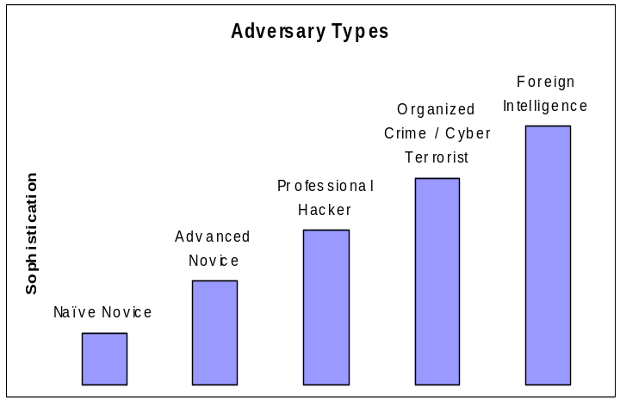
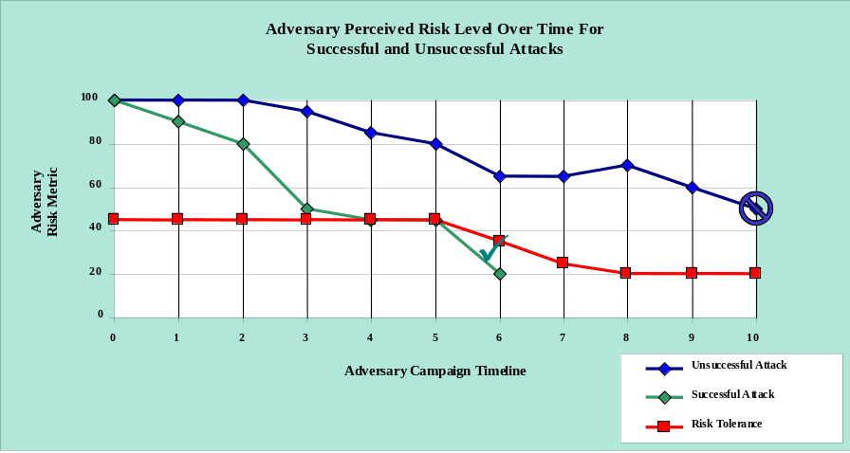
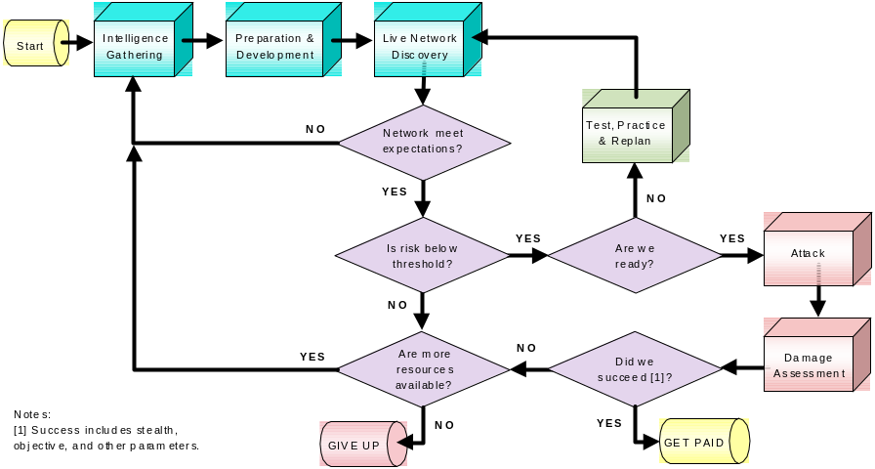
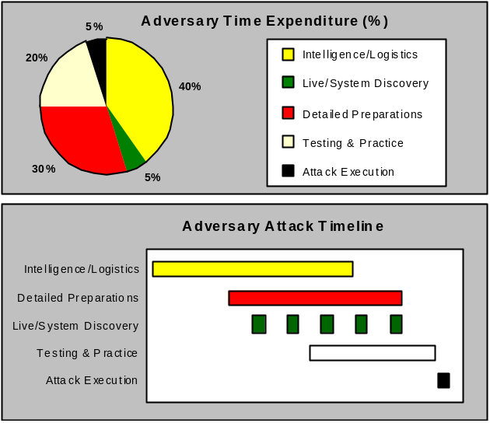
Cyber-terrorist Model

Slide 6
Red Teams are...
Goal oriented
    Typically have some goal or mission when attacking.
Well-informed
    They have read all the documents.
Well-financed
    Access to commercial technology & consulting
Lazy
Shy
    Seeks to avoid premature detection
Creative & Sneaky
    Often accused of cheating

Slide 7
When to use a red team?
Evaluating developmental systems
Studying a particular adversary
    How often do you get to pick a bad guy’s brain?
Studying adaptations & interactions
    both human or cyber
Planning experiments
Scripting or planning attacks
    even when you are NOT interested in adaptation.
Non-traditional Exercises
    War gaming on a white board
    “Ask the Adversary”, with your host …

Slide 8
Tips for using Red Teams
Good communication between all parties is essential!
Realistic operational scenario helps.
    Drives selection of appropriate “flags”
    Flag selection is critical!
    Rules of engagement
      Consistent with Operational Scenario
Clear Exercise Goals
    So everyone cooperates toward the same goals!
“I before E (Integration before Experimentation) , always!”
    System needs to be working when the Red Team arrives
Arbitrator function
    Consistent rulings from test director, white team, or judge.

Slide 9
Current Challenges
Promoting & preserving diversity within the team
Developing & comparing different teams
Appropriate applications of Red Team methods
Effective experimentation methods & metrics
Transferring “lessons learned”

Slide 10
In summary…
Experimentation can be fun!
    Even with information systems.
    Even with Red Teams :-)
Experiments need lots of planning & cooperation.
Good data is the ultimate goal.
This is new territory
    We are making up the rules as we go!
    We can make a lot of progress!
Let’s rock & roll!

