Slide 1
Constant Quality Asking Rent Index

Slide 2
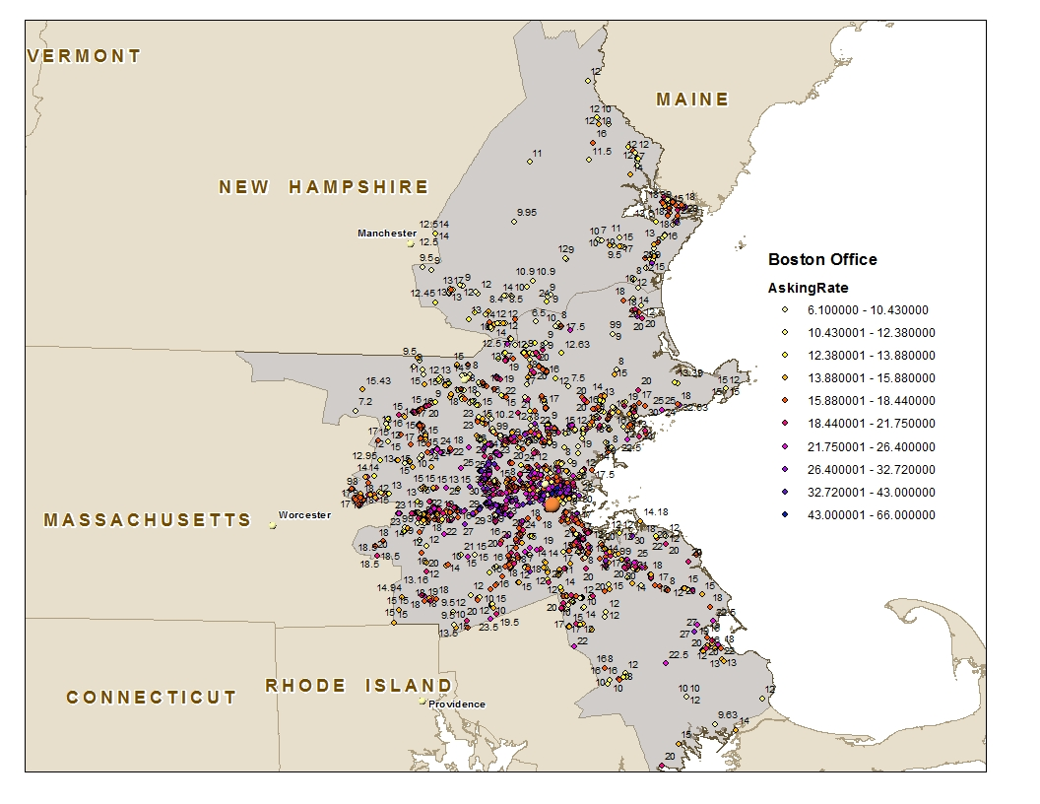
How Asking Rent Looks like?

Slide 3
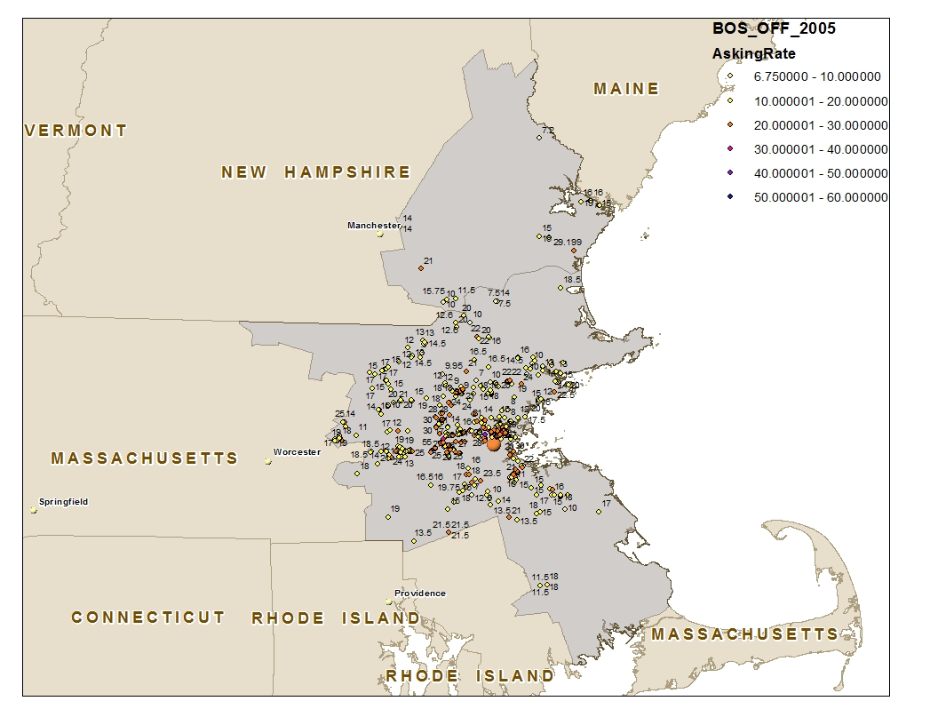
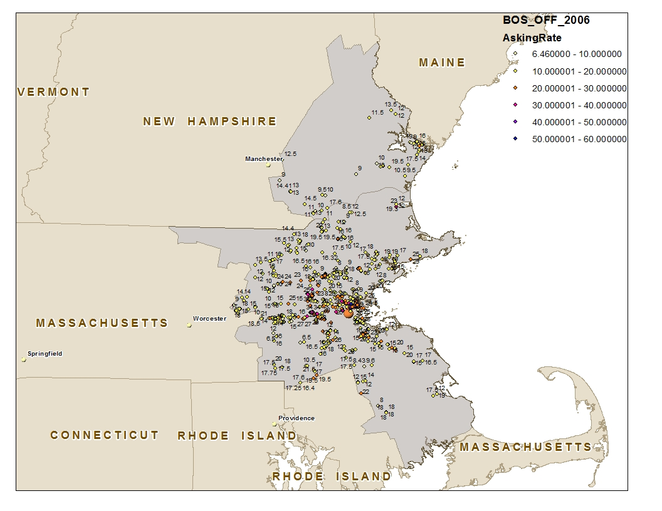
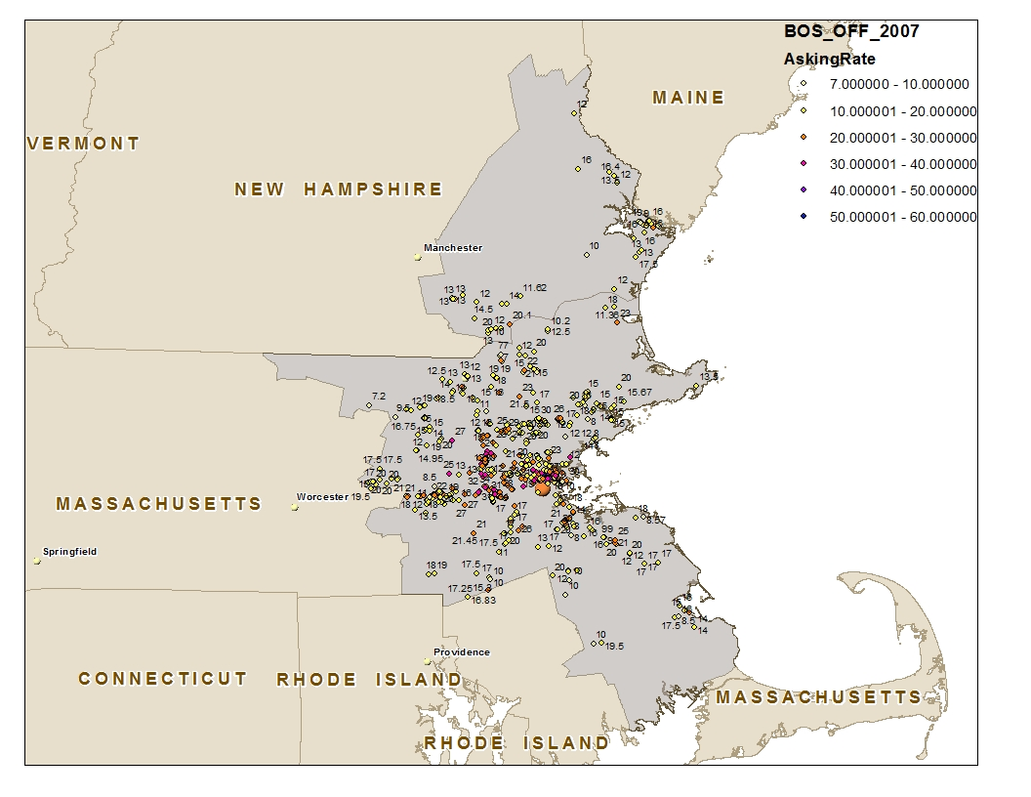



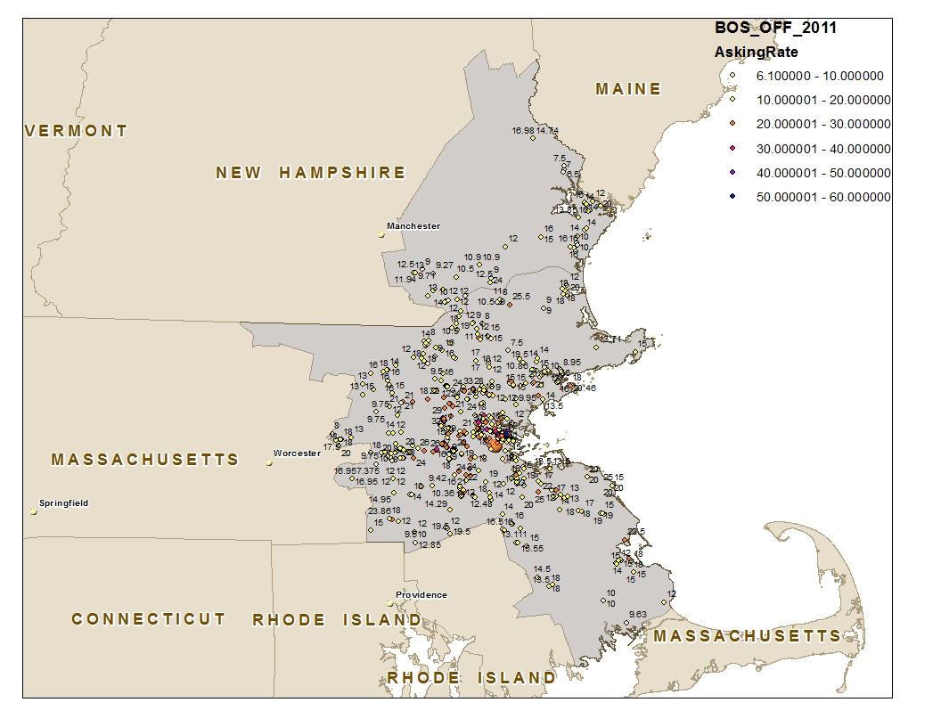
Demystify Rent Change Trend

Slide 4
What is Rent Index and Why it Matters?
Rent Index describes the rent change trend over time.
It serves as an important economic indicators.
It help investors to investigate the market and make critical decision
It serves as an important exogenous variable in many economic research fields.

Slide 5
The Choice of Rent Types
Various rent types
Asking Rent
Contract Rent
Effective Rent
…,etc.
Which one should be chosen for studying rent index
It totally depends on the needs/usage and data availability.
Asking Rent index will be our research focus.

Slide 6
What is the right methodology?
Current costar methodologies:
Simple average
Based on building-level
Equally-weighted
Vacant-weighted
Based on lease-level
Equally-weighted
Vacant-weighted
Regression based
Based on lease-level
Constant quality equally-weighted
Constant quality vacant-weighted
Which methodology is preferable?
Depending on the objective and data availability
Intuitively, rent is connected more close to lease.

Slide 7
What is the right methodology?
Simple average vs. regression based:
Simple average
Simple and straight-forward
Fast / Computation inexpensive
Regression based
Complex and powerful
Slow / Computation expensive

Slide 8
What is the right methodology?
Simple average
Building-level vs. lease-level
The result based on building-level is an approximation of that based on lease-level.
The building-level result is very close to lease-level result if the rents in the same building are very similar.
Define rent’s perturbation rate for specific building in specific time as following:
In Boston Office, the building with more than 50% perturbation rate has been detected. Over all, there are 5.3% of the buildings have more than 5% perturbation rate

Slide 9
What is the right methodology?
Simple average
Vacant-weight vs. Equal-weight
The choice may depend on needs/usage
Building level results
The vacant-weighted result is same as that on lease level.
The equally-weighted result will be quite different from that on lease level, unless the lease number in each building is same.

Slide 10
What is the right methodology?
Simple average
Vacant-weight vs. Equal-weight (Example)
Lease level result:
Equally weighted:
Vacant weighted:
The equally weight results and vacant weight result are different if the vacant for each lease is different.
Building level result:
Equally weighted:
Vacant weighted:

Slide 11
What is the right methodology?
Regression based result based on lease level
Why Regression based methodology?
Simple average usually apply to random variable. Different leases has different characteristics: (Building Class, Service Type, Amenity, etc.) Those leases with different characteristics have different rent patterns. They can not simply be considered as a random variable.
Simple average usually apply to independent samples. There are serious correlation between leases. They are not independent samples.
Not random distributed over metro: Spatial heterogeneity (location) and Anisotropy (direction)
…, etc.

Slide 12
What is the right methodology?
Regression based result based on lease level
Why not using building level?
Building level data lucks lease information
Duplication problem in building level data
Building level asking rent may not reflect market price well

Slide 13
What is the right methodology?
Asking Rent Index Comparison
Boston Office (2005Q2~2011Q4)

