Slide 1

Rent Index
Internal
Documents
R&D Group
2012
PROPERTY AND PORTFOLIO RESEARCH
NORTH AMERICA
EUROPE
ASIA-PACIFIC

Slide 2
Outline
Introduction
Data Preparation
Summary Statistics
Modeling and Analysis
Results and Model Validation

Slide 3
Introduction

Slide 4
Introduction
Objective
Why Rent Index is needed?
1
2
3
4
5
TBD

Slide 5
Introduction
Literature Review
Previous works by Researchers:
1
Xudong An (2011, San Diego State Univ.)
3
TBD

Slide 6
Introduction
Methodology
Comparison of different methodology
Bob Hargreaves (2000, New Zealand)
2
3
TBD

Slide 7
Introduction
Proposal
PPR’s methodology
1
Advantage and Disadvantage
Advantage:
1
2
Disadvantage
1

Slide 8
Data Preparation

Slide 9
Data Preparation
Key Issues
Rent Types
Data Source / Availability
Time Dummy
Control Variables

Slide 10
Data Preparation
Rent Types
Rent Types
Asking Rent
Contract Rent
Actual Rent
Effective Rent
Which type of rent to choose?
Choice is majorly based on data availability

Slide 11
Data Preparation
Data Source / Availability
Lease Data
Only 10% records have contract rent
Around 50% records have asking rent
The time dummy for asking rent has no clear definition
Listing Data
Most of lists has asking rent
Only lists that are off markets after 2005Q2 is available
Asking rent could vary along listing period
Building class Information could vary along listing period

Slide 12
Data Preparation
Time Dummy
Lease Data
Lease Signed Date will be considered as Time Dummy
Listing Data
“Date-On-Market” or “Date-Off-Market” or the period between “Date-On-Market” and “Date-Off-Market”
It depends on when asking rent is updated

Slide 13
Data Preparation
Time Dummy
How is rent aggregated in Costar Database
Rent is aggregated using vacant weighted asking rent.

Slide 14
Data Preparation
Time Dummy
How is rent aggregated in Costar Database
Pro:
Simple and low cost
Con:
Include both withdrawn list and leased list
Include many vacant duplication
For example: the list will be put into aggregation in ten quarters if its’ “DateOnMarket” is 2003Q4 and “DateOffmarket” is 2006Q1
One should assign a 1/10 weight in aggregation if each list is treated equally

Slide 15
Data Preparation
Control Variables
Appropriate choice of control variables is critical for hedonic methodology
Missing important control variable may greatly decrease the result accuracy
Too many insignificant control variables will make calculation expensive and lead to potential convergence/identification problems
For other methodology

Slide 16
Data Preparation
Control Variables
How to choose control variables for rent?
Do those variables affect the rent?
Do those variables affect the rent significantly?
Do the model has any limitation on control variables?
Is correlation allowed between control variables?
Does Costar database has enough information of those control variables?
Does Costar database cover all range (or random-selection) of those control variables? If not, will truncated or censored data cause sampling bias?

Slide 17
Data Preparation
Control Variables
Listing Data
Endogenous objective variable
Asking annual rent ( /sqft )
Candidates of exogenous control variables:
Building Class
Service Type
Spatial Information
Longitude
Latitude
Age after most recent renovation
Amenities
TBD

Slide 18
Data Preparation
Control Variables
Lease Data
Objective variable (endogenous)
Asking annual rent ( /sqft ) ?
Contract annual rent (/sqft) ?
Candidates of control variables (exogenous):
Building Class
Service Type
Spatial Information
Longitude
Latitude
Age after most recent renovation
Lease Term
Amenities

Slide 19
Data Preparation
Summary Statistics

Slide 20
Summary Statistics
Objective
Check the fineness of the data availability
Give information about the distribution of variables
Help removing the outliers
Give inference about endogenous variable, if all exogenous variables are included and correlation is not considered.

Slide 21
Summary Statistics
General Filters
Filters have to be applied before analysis
Ensure the choice of correct data
Remove the unreasonable outliers
General Filters:
USA Metros
Costar Type Properties
Building Class is Class A, Class B, Class C only
Not executive suite
Not sublet (direct leases / lists only)
Not month to month leases / lists
Time Domain Cut

Slide 22
Data Preparation
Summary Statistics
For Listing Data

Slide 23
Summary Statistics
Listing Data
Variable for Summary Statistics
Asking Annual Rent
Objective variable
Average Vacant (sqft)
For data cut only
Times On Market
For data cut only
Age of the Property
Control variable and for data cut
Number of Stories above Ground
Control variable

Slide 24
Summary Statistics
Listing Data
Additional Filters for Listing Data:
Listings that have been leased
Less than 30% of the Listings that have been withdrawn, which may be considered as not reflecting market price.
Asking rent is not missing
Square footage is not missing
Spatial coordinates are not missing
Service type is not missing
Ages from most recent renovation is not missing
TBD

Slide 25
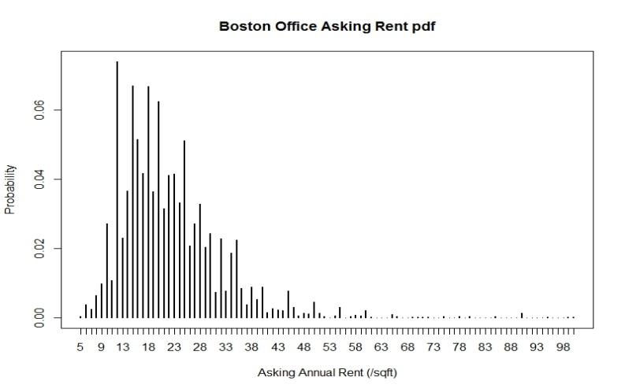
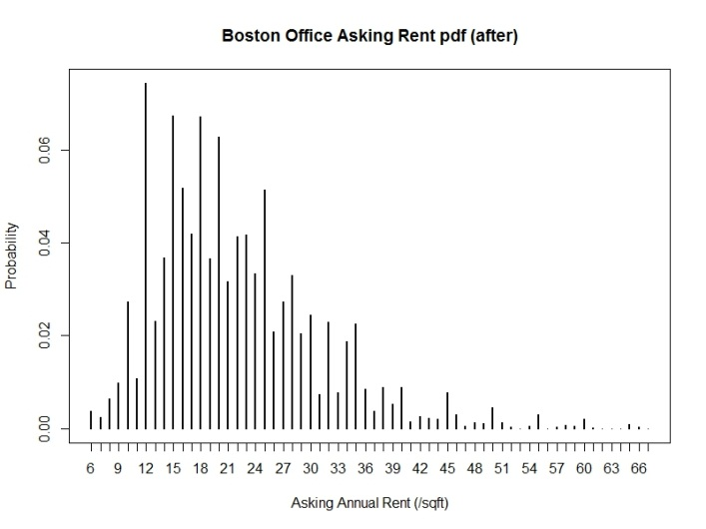
Summary Statistics
Listing Data
Data cut regarding to asking annual rent (/sqft):
99.5% winsorization has been performed on asking annual rent(/sqft)
Special case: Boston Office
Original asking annual rent(/sqft):
Min: $1
25% quartile: $15
Median: $19.00
75% quartile: $25.00
Max: $950
99.5% winsorization on original asking annual rent(/sqft):
Min: $6.1
25% quartile: $15
Median: $18.95
75% quartile: $25
Max: $66

Slide 26
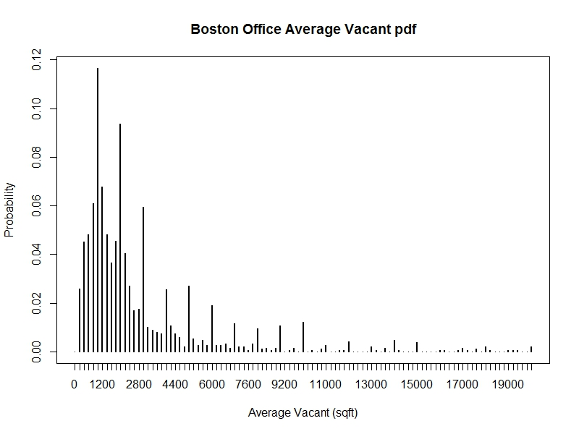
Summary Statistics
Listing Data
Data cut regarding to average vacant (sqft)
Office vacant should not be too small: 5% bottom winsorization has been performed on average leased area(sqft)
Special case: Boston Office
Original average leased area(sqft):
Min: 80
25% quartile: 1013
Median: 1926
75% quartile: 3900
Max: 121600
5% bottom winsorization on average leased area(sqft):
Min: 375
25% quartile: 1122
Mean: 2000
75% quartile: 4075
Max: 121600

Slide 27
Summary Statistics
Listing Data
Data cut regarding to “Times On Market”
Lists status
Still on market
Off market: withdrawn
Off market: leased
Which kind of lists should be selected
Off market lists:
The leased lists reflect its current market value and should been selected
The withdrawn lists may not reflect its current market value and should not been selected.
On market lists
It may be prone to be withdrawn if times on market is long enough
It could be leased or withdrawn if times on market is not that long. Ignoring them may lead to sample selection bias.

Slide 28
Summary Statistics
Listing Data
Data cut regarding to “Times On Market”
Lists Status vs. Entry Year to Markets
The following result is from Boston office lists.
Entry Year 2003 and 2004 have less records, it could lead to sampling bias if records is not random-selected.
Entry Year 2009 and 2010 may have sample selection bias due to the “times on market” truncation. (Around 97.5% of the leased lists will be off market after four years).

Slide 29
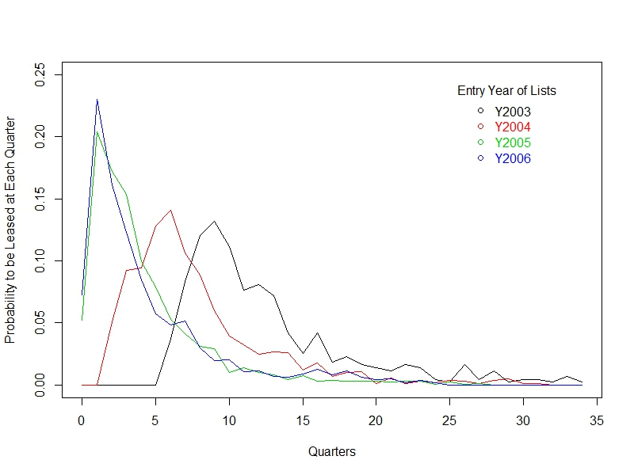
Summary Statistics
Listing Data
Data cut regarding to “Times On Market”
Leased Probability at Each Quarters by Entry Year

Slide 30
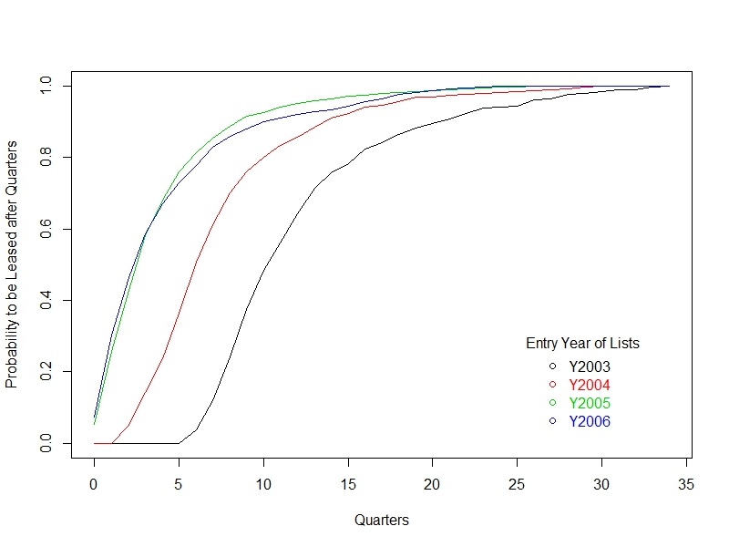
Summary Statistics
Listing Data
Data cut regarding to “Times On Market”
Leased Probability after quarters by Entry Year

Slide 31
Summary Statistics
Listing Data
Data cut regarding to “Times on Market”
“Times on Market” thresholds
The lists staying on market too long will be filtered
Average “Times on Market” varies along entry year.
In recession scenario, average “Times on market” could be up to 3 years from 3 quarters in normal scenario
The summary result for year 2007~2010 may only be reference (Their “on market” history is not long enough and there are more than 10% lists are still on markets)
The 97.5% quantiles of quarters on market from year 2005 is 16 quarters; that from year 2003 is 17 quarters.

Slide 32
Summary Statistics
Listing Data
Data cut regarding to “Times On Market”
Sampling Bias for Listing Data?
Question: Can the lists with entry year of 2003 and 2004 be claimed as biased sample?
Alternative question: Is the lists with entry year of 2003 and 2004 be claimed as random selected?
Sampling Bias Judgment
Entry year will be considered as a independent control variable.
The only difference between the samples from 2003/2004 and the remaining ones are entry year if they are randomly selected.
The control variable “entry year” may shift or scale the characteristics.
Are the characteristics has similar shapes?

Slide 33
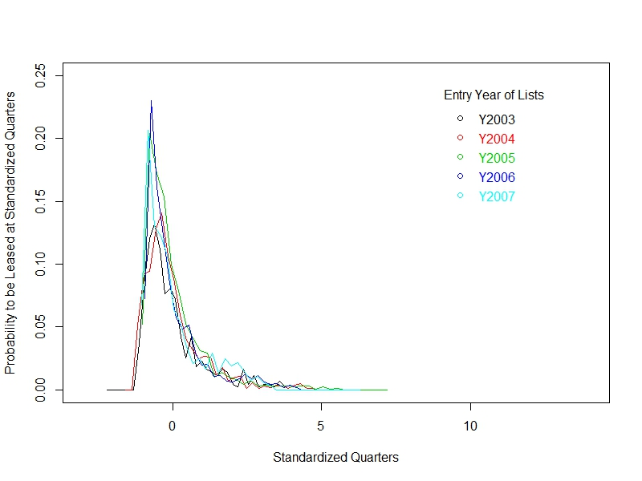
Summary Statistics
Listing Data
Data cut regarding to “Times On Market”
Leased Probability at Standardized Quarters by Entry Year

Slide 34
Summary Statistics
Listing Data
Data cut regarding to “Times On Market”
Based on the previous chart: leased probability at standardized quarters. One may be very hard to claim that the lists with entry year of 2003 and 2004 are biased samples.
Why the lists with entry year of 2003 and 2004 takes more time to be leased?
(Answer): It is caused by 2011 US recession. The unemployment rate reaches peak (6.3%) on 2003/06, which greatly extends the lists’ times on market.
The space market was recovering from year 2004, which greatly shorten lists’ average times on market.

Slide 35
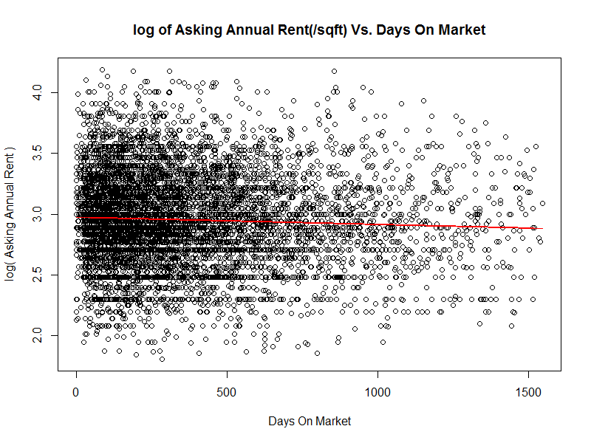
Summary Statistics
Listing Data
Asking Rent vs. Times On Market

Slide 36
Summary Statistics
Listing Data
Asking Rent vs. Times On Market
It indicates that the asking price will drop 0.53% if lists stay one more quarter(~90 days) on market (0.57%= [1-exp(-5.94e-5*90)] )

Slide 37
Summary Statistics
Listing Data
Asking Rent vs. Times On Market (Condition Cases)
Case one: One records the asking rent of two very similar lists on “DateOnMarket” and they have different asking rent. The one with higher asking rent used to stay longer on the market
Case two: One updates the asking rent of the same lists at different time points. The asking rent of the same lists will decrease upon the increase of the times on market

Slide 38
Summary Statistics
Listing Data
Asking Rent vs. Times On Market (Explanation)
In Costar databases, “LastResearchedDate” is recorded along with each lists. Generally, it is same as “DateOffMarket” if the list is off market and it will keep getting updated if the list is still on market
Very likely, the asking rent in costar database is reflecting the condition on “DateOffMarket”

Slide 39
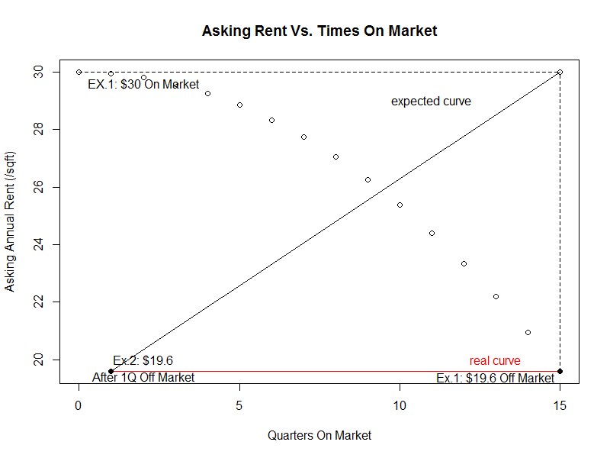
Summary Statistics
Listing Data
Asking Rent vs. Times On Market (Explanation)
Case one can not to be spotted. Assuming market equilibrium rent is $19.6 for specific kind of lists. Ex.1 list $30 as asking rent when it is on market and it takes 15 quarters to be off market with $19.6 as final rent. Ex.2 list $19.6 as asking rent and it is off market just after 1 quarter. One may only observe the red line is above chart due to record updating

Slide 40
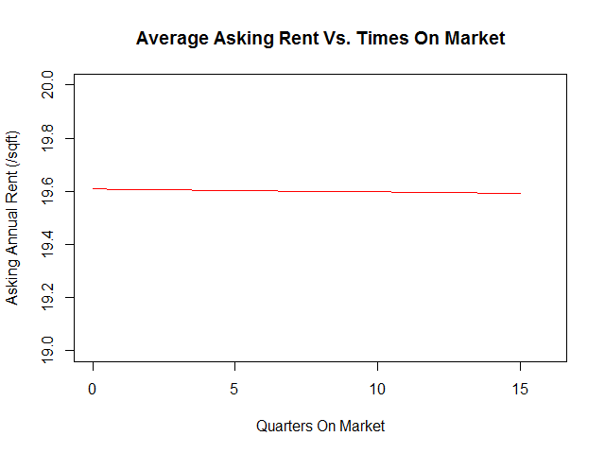
Summary Statistics
Listing Data
Asking Rent vs. Times On Market (Explanation)
Case two doesn’t exist in costar database either. If the asking rent keeps getting update in costar database and the lists is randomly selected, most likely people will observe a constant rent along times on markets.
The landlord may decrease the rent a little bit along time. The linear regression estimates a 0.53% price drop after one quarter.

Slide 41
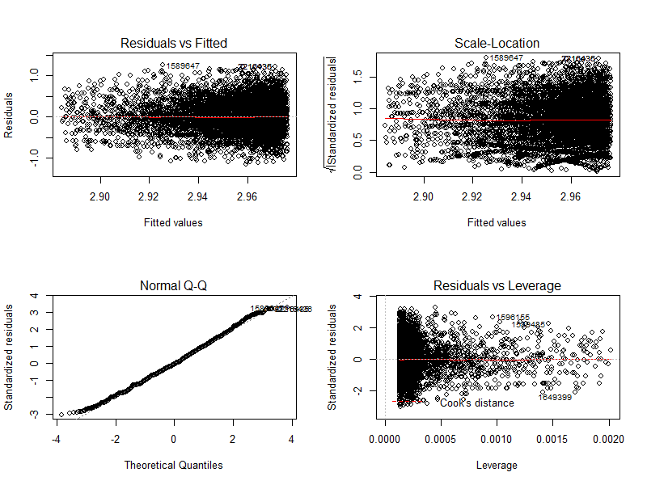
Summary Statistics
Listing Data
Asking Rent vs. Times On Market (Continued)

Slide 42
Summary Statistics
Listing Data
Data cut regarding to Age of the Property
Age plays as an important factor for rent index (mentioned by 1, 2, …)
The rent for old properties used to grow slowly, while that for new ones used to grow fast
The definition of Age:
Age from the delivery date of the property
Age from the most recent renovated date
For rent index, age from the most recent renovated date will be more appropriate

Slide 43
Summary Statistics
Listing Data
Data cut regarding to Age of the Property
The completion date of construction or renovation need to be earlier than “DateOnMarket” of specific list
Most lists has their age information available

Slide 44
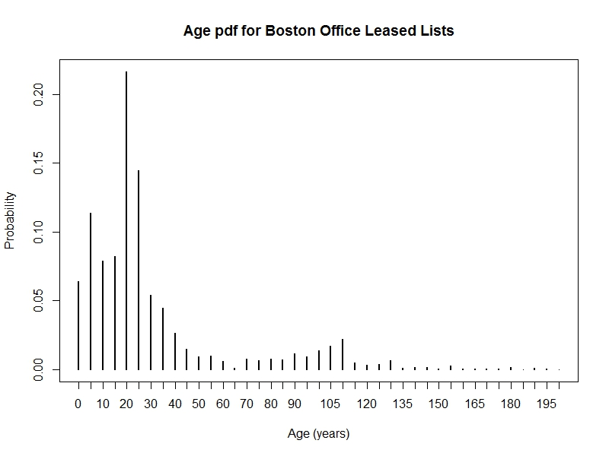
Summary Statistics
Listing Data
Data cut regarding to Age of the Property

Slide 45
Summary Statistics
Listing Data
Data cut regarding to Age of the Property
The lists for extreme old properties may need to be filtered out. 95% top winsorization has applied on the age of property
Special case: Boston Office Leased Lists
Original age of property (year):
Min: 0
25% quartile: 14.75
Median: 21
75% quartile: 30
Max: 245
95% top winsorization on age of property (year):
Min: 0
25% quartile: 14
Mean: 21
75% quartile: 27
Max: 108

Slide 46
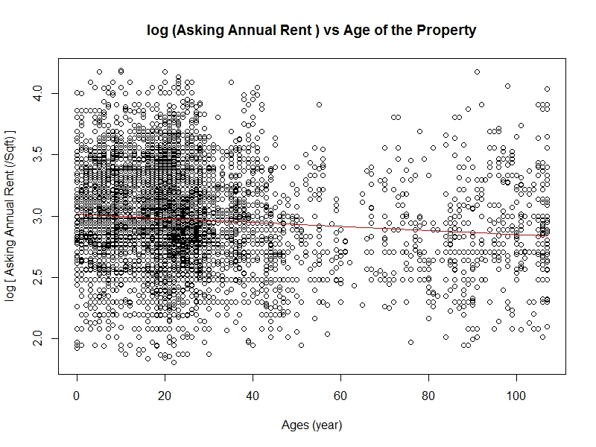
Summary Statistics
Listing Data
Asking Rent vs. Age of the Property

Slide 47
Summary Statistics
Listing Data
Asking Rent vs. Age of the Property
The old properties usually has lower rent and slow rent growth rate . The relationship between rent and age is not that significant though
It indicates that the asking price will drop 0.165% if the property of the list is one year older than others
(0.165%= [1-exp(-0.0016508)] )

Slide 48
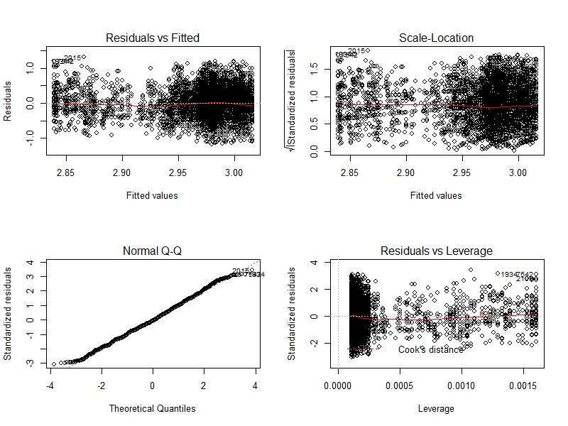
Summary Statistics
Listing Data
Asking Rent vs. Age of the Property (Continued)

Slide 49
Summary Statistics
Listing Data
Data cut regarding to number of stories above Ground
Number of stories serves as an important factor to asking rent

Slide 50
Summary Statistics
Listing Data
Asking Rent vs. Amenities
Amenity classification
Properties Amenities
TBD (important to rent)
Space Amenities
Freezer
Laboratory
Raised Floor
SCIF
Trading Floor
Underground Space

Slide 51
Summary Statistics
Listing Data
TBD

Slide 52
Modeling and Analysis

Slide 53
Modeling and Analysis
Key Issues
Assumptions
Linear Model
Spatial Model
Model Comparison

Slide 54
Modeling and Analysis
Assumptions
Constant Quality Rent Index
The following characteristics has been considered and their effect has been excluded from rent index:
Building Class
Service Type
Age
Floor
Amenities
Spatial Correlation
The above characteristics are independent of time dummy

Slide 55
Modeling and Analysis
Linear Model
Formulas:
Objective Variable ~ Control Variables
ε~N(0,σ²)
Objective Variable (Asking Rent)
Log(Asking_Rent) or Asking_Rent
The choice based on model fit
The result residuals ε that using log(asking_rent) are more close to a normal distribution

Slide 56
Modeling and Analysis
Spatial Model
Spatial Correlation?
Moran’s I is calculated as a ratio of the product of the variable of interest and its spatial lag, with the cross-product of the variable of interest, and adjusted for the spatial weights used:
where y_{i} is the i-th observation, is the mean of the variable of interest, and w_{ij} is the spatial weight of the link between I and j. Centering on the mean is equivalent to asserting that the correct model has a constant mean, and that any remaining patterning after centering is caused by the spatial relationships encoded in the spatial weights

Slide 57
Modeling and Analysis
Linear Model
The choice of control variables
formula0:log(AskingRate)~QuarterOff
formula1:log(AskingRate)~ST+QuarterOff
formula2:log(AskingRate)~BldgClass+ST+QuarterOff
formula3:log(AskingRate)~Floor+BldgClass+ST+QuarterOff
formula4:log(AskingRate)~ListAge+Floor+BldgClass+ST+QuarterOff
formula5:log(AskingRate)~Quarters+ListAge+Floor+BldgClass+ST+QuarterOff

Slide 58
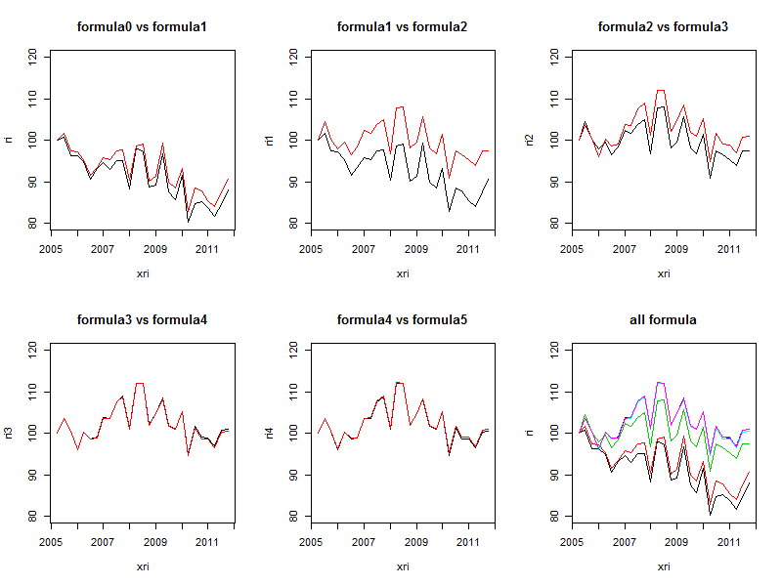
Modeling and Analysis
Linear Model
The choice of control variables

Slide 59
Modeling and Analysis
Linear Model
The choice of control variables (continued)
The control variables play a very important role in hedonic model
The control variables we picked generally can be considered to be independent of time dummy
Theoretically, the time dummies are independent of control variables and the rent index should not be changed for formula0~5. However, too few control variables will lead to large residual and thus affect the rent index
After enough control variables has been added, the rent index will keep stable. One should avoid adding too much control variables, which may make computation expensive and convergence difficult

Slide 60
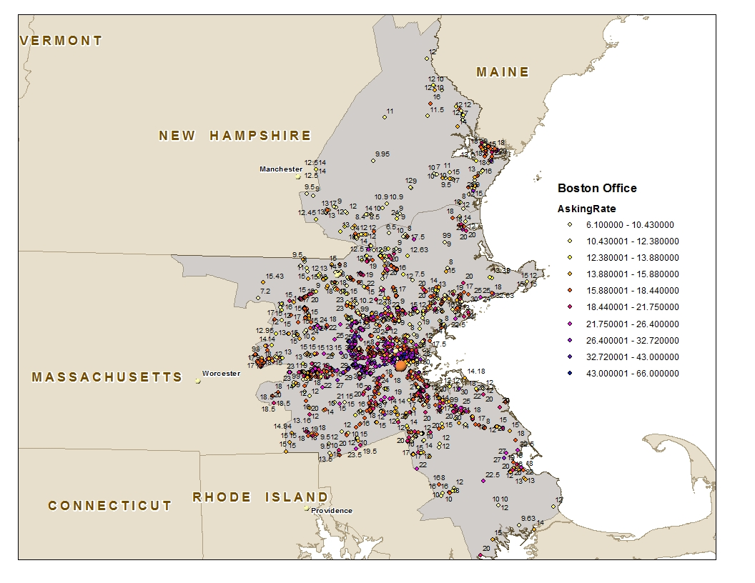
Modeling and Analysis
Spatial Model
Boston Office Asking Rent Distribution

Slide 61
Modeling and Analysis
Spatial Model
Spatial autocorrelation
Why spatial model is needed?
In most applied data analysis, the observations were not mutually independent
A wide range of scientific disciplines have encountered spatial autocorrelation among areal entities
Positive spatial dependence tends to reduce the amount of information contained in the observations, because proximate observations can in part be used to predict each other

Slide 62
Modeling and Analysis
Spatial Model
Spatial autocorrelation
Fit models with spatial autocorrelation is challenging.
The spatial autocorrelation may actually come from model misspecification
Heteroskedasticity
Missing covariates
Function form

Slide 63
Modeling and Analysis
Spatial Model
Spatial autocorrelation
Constant quality Moran’s I test

Slide 64
Modeling and Analysis
Spatial Model
Spatial autocorrelation
Do spatial weights affect Moran’s I?
All kinds of spatial weights indicate significant spatial correlation
Parametric bootstrapping or tests specifically tuned to the setting are sometimes needed

Slide 65
Modeling and Analysis
Spatial Model
Spatial autocorrelation
Spatial autocorrelation does exist
Different spatial weights lead to different spatial autocorrelation and may affect the final rent index
Does the choice of spatial weights significantly affect the rent index results? If it does, how to choose appropriate spatial weights?
Further investigation of spatial weights is needed

Slide 66
Modeling and Analysis
Spatial Model
Spatial Weights
The spatial weights depend on two factors:
Definition of spatial neighborhood
Definition of spatial weight style

Slide 67
Modeling and Analysis
Spatial Model
Spatial Neighborhood
Distance-based neighbors
The k nearest points
All the points that have the distance of k km or less from the point
Contiguity neighbors
Contiguity queen neighbors
Contiguity rook neighbors
Graph/Grid neighbors

Slide 68
Modeling and Analysis
Spatial Model
Spatial Neighborhood
Contiguity rook neighbors
It is defined as tracts sharing more than one boundary point
The neighbors of area 1 are area 2 and 3
1
2
3
4

Slide 69
Modeling and Analysis
Spatial Model
Spatial Neighborhood
Contiguity queen neighbors
Tracts sharing boundary point are taken as neighbors
The neighbors of area 1 are area 2, 3 and 4
1
2
3
4

Slide 70
Modeling and Analysis
Spatial Model
Spatial weights style
There are lots of spatial weights style available:
“W”: row standardized
“B”: basic binary coding
“C”: globally standardized
“U”: equal to “C” divided by the number of neighbors
“S”: variance-stabilizing coding scheme proposed by Tiefelsdorf

Slide 71
Modeling and Analysis
Spatial Model
Spatial weights style
“W” style spatial weights using rook neighbors
1
2
3
Area ID
4
5
6
7
8
9

Slide 72
Modeling and Analysis
Spatial Model
Spatial weights style
Spatial Lag from “W” style spatial weights using rook neighbors
$10
$11
$12
Rent Matrix
$11
$12
$13
$12
$13
$14
$11
$11.33
$12
Spatial Lag of Rent Matrix
$11.33
$12
$12.67
$12
$12.67
$13

Slide 73
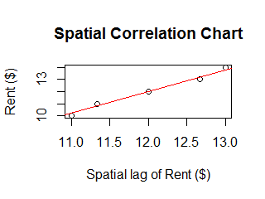
Modeling and Analysis
Spatial Model
Spatial correlation chart
Moran’s I
Moran’s I statistic: 0.5556
p-value: 0.002538

Slide 74
Modeling and Analysis
Spatial Model
Does neighbors definition affect spatial correlation?
The spatial correlation and its significance will be changed
How will it affect the result of whole model?
How to choose the right neighbors definition?

Slide 75
Modeling and Analysis
Spatial Model
Does spatial weights style affect spatial correlation?
The spatial correlation and its significance change as well. The change is not as big as that from different neighbor definition
How will it affect the result of whole model?
How to choose the right spatial weights?

Slide 76
Modeling and Analysis
Spatial Model
Advanced topic of spatial weights
The different spatial weights, no matter it is caused by neighbor definition or spatial weights’ style, will give different spatial correlation
Further advanced research could be directionally spatial weights or even geographic spatial weights
Heterogeneity (vary along location)
Anisotropy (vary along direction)

Slide 77
Modeling and Analysis
Spatial Model
Spatial Autocorrelation: Test
Issues need to be consider:
1. Does the mean model of the data remove systematic spatial patterning from the data? (choice of control variable)
2. Are the spatial weights we use are those that generated the autocorrelation. (choice of spatial weights: Is it appropriate of assuming homoscedasticity or regular shape? skewness and kurtosis? )

Slide 78
Modeling and Analysis
Spatial Model
Spatial Autocorrelation: Test
Global Tests
Moran’s I
Geary’s C
Global Getis-Ord G
Spatial general cross product Mantel test

Slide 79
Modeling and Analysis
Spatial Model
Spatial Autocorrelation: Test
Global Tests
Does higher order spatial correlation exist?
For contiguity neighbors, it indicates that the effect from higher order neighbors can not be ignored
For distance-based neighbors, it suggests to use large distance instead.

Slide 80
Modeling and Analysis
Spatial Model
Spatial Autocorrelation: Test
Global Tests
How distance affect spatial correlation?

Slide 81
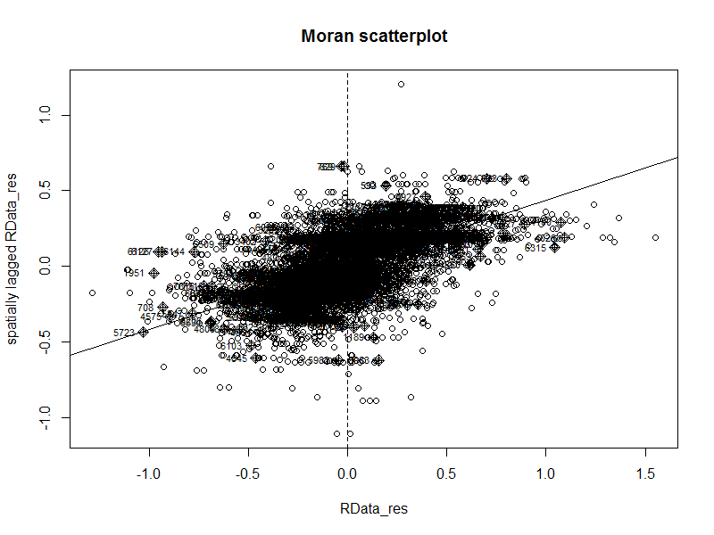
Modeling and Analysis
Spatial Model
Spatial Autocorrelation: Test
Local Tests: Local Moran’s I

Slide 82
Results and Model Validation

Slide 83
Results
Spatial Model
Model Comparison

Slide 84
Results
Spatial Model
Spatial Error Model Results

Slide 85
Results
Spatial Model
Spatial Error Model Results
Lambda vs. Moran’s I
Lambda: 0.7947
Moran’s I: 0.396
Why the results of spatial correlation are not compatible?
Moran’s I is based on results from linear regression, while treating the covariates’ coefficients as constants
Lambda is simultaneously estimated from spatial error model
Lambda is considered as real indicator of spatial correlation

