Slide 1
Java 5
EricJang 2012.12

Slide 2
Agenda
Generics
Enumeration
Metadata / Annotations
Autoboxing / Unboxing
Varargs
Static imports
for / in
Formatter

Slide 3
Generics
The purpose of generics
Type safety
Generified
Syntax
Examples
Generic Methods

Slide 4
Generics
- The purpose of generics
Enhancement to the type system
Allows a type method to operate on objects of various types while providing compile-time type safety
Generics are implemented by type erasure: generic type information is present only at compile time, after which it is erased by the compiler

Slide 5
Generics
- Type safety
//未使用泛型之前
List anyList = new ArrayList();
anyList.add("A");
anyList.add("B");
anyList.add(1); //<---------這裡不會編譯錯誤
//使用泛型後
List<String> strList = new ArrayList<String>();
strList.add("A");
strList.add("B");
strList.add(1); //<--------這裡會產生編譯錯誤
Notes:
com.bt.generic.type. TypeTest

Slide 6
Generics
- Generified
Before JDK 5.0 (Use Object class)
public class DocumentMaker {
private Object myDocument;
public void writeMyDocument (Object myDocument) {
System.out.println(“add Content to myDocument”);
this. myDocument = myDocument;
}
public Object getMyDocument () {
return myDocument;
}
}
Example: Before5.java
Notes:
com.bluetouch.tiger.generic.Before5

Slide 7
Generics
- Generified
After JDK 5.0 (Use Generics)
public class DocumentMaker<T> {
private T myDocument;
public void writeMyDocument(T myDocument) {
System.out.println(“add Content to myDocument”);
this. myDocument = myDocument;
}
public T getMyDocument () {
return myDocument;
}
}
Example: After5.java
Notes:
com.bluetouch.tiger.generic.After5

Slide 8
Generics
- Syntax
Declare generic syntax (class and referance)
  class class -name<type-param-list> { //…}
  class-name<type-arg-list> var-name =
  new class-name<type-arg-list>(cons-arg-list)
Example: After5.java

Slide 9
Generics
- Syntax
Many container types use E, for element
Map<K,V> is an example of a generic type that takes two type arguments, representing the keys and values of the map.Again, note the naming convention for formal type parameters - K for keys and V for values.

Slide 10
Generics
- Examples
Example1:
public interface List<E> {
void add(E x);
Iterator<E> iterator();
}
public interface Iterator<E> {
E next();
boolean hasNext();
}

Slide 11
Generics
-Examples
Example 2:
public class GenericSampleBean2<T1, T2> {
private T1 property1;
private T2 property2;
public T1 property1 and T2 property2 getter and setter…
}
GenericSampleBean2<Integer, String> sampleBean =
new GenericSampleBean2<Integer, String>();

Slide 12
Generics
- Examples
Example 3 : The key word “extends” is used for class extends and interface implementation
import java.util.List;
public class GenericSampleList4<T extends List> {
private T[] propertyArray;
public T[] propertyArray getter and setter…
}
GenericSampleList4<ArrayList> sampleList4 =
new GenericSampleList4<ArrayList>();
GenericSampleList4<HashMap> sampleList4 =
new GenericSampleList4<HashMap>();

Slide 13
Generics
- Examples
Example 4 : Inheritance of generic classes
(O) class Document<T> …….
class ProgramSpec <T, D> extends Document<T>
(O)class ProgramSpec <T> extends Document
(X) class ProgramSpec extends Document<T>
Notes:
com.bluetouch.tiger.generic.modules.ProgramSpec

Slide 14
Generics
- Generic Methods
When a generic class is defined, the type parameter can be used in the definitions of the methods for that generic class.
In addition, a generic method can be defined that has its own type parameter that is not the type parameter of any class
  A generic method can be a member of an ordinary class or a member of a generic class that has some other type parameter.
  The type parameter of a generic method is local to that method, not to the class.

Slide 15
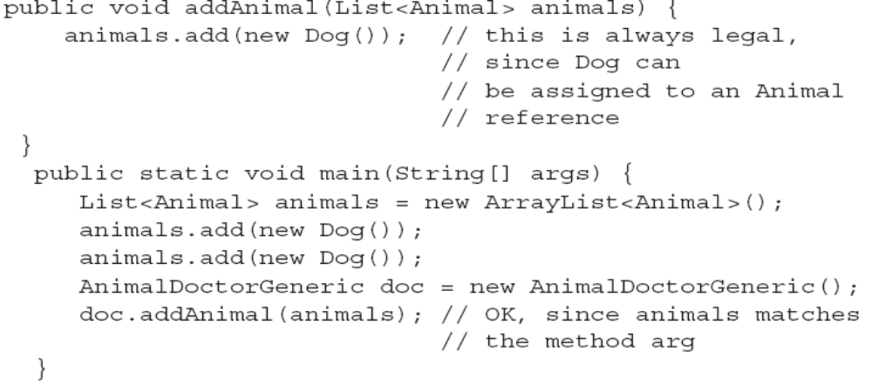
Generics
- Generic Methods

Slide 16

Generics
- Wildcard
Using “ ? ” to be the wildcard symbol, simply means "any type." So that means any type can be assigned to the argument.
What difference ?

Slide 17
Generics
- Wildcard for Generic Methods
a
  This method can be assigned a collection that is a subtype of List and typed for <Animal> or anything that extends Animal
  In this method, you can’t ADD anything into the collection
A
  This method can accept any List with a generic type that is of type Dog, or a supertype of Dog
  You can only add Dog into the collection
Example : com.bt.generic.animal.AnimalDR

Slide 18
Generics
Attention:
Generic parameter can’t be used to create new instance
class Document<T> {
T ob
Gen() {
ob = new T(); //Error, because T doesn’t exist
}
}

Slide 19
練習1
狀況描述 : 公司有一個倉庫拿來存放A貨物，而且倉庫都有存放與取出兩項作業，但隨著業務增加，公司需要其它倉庫來存放B貨物
需求 : 公司需要一個倉庫模板在不變動作業的情況下，提供不同貨物的存放倉庫。

Slide 20

Tiger (Java 5.0)‏
Enumeration
BLUETOUCH DIGITAL TECHNOLOGY

Slide 21
Enumeration
建構 Enum
public enum Grade { A, B, C, D, F, INCOMPLETE };
Ex: Student.java

Slide 22
Enumeration
在 Java 1.5 之前撰寫 enum
public class OldGrade {
public static final int A = 1;
public static final int B = 2;
public static final int C = 3;
public static final int D = 4;
public static final int F = 5;
public static final int INCOMPLETE = 6;
}

Slide 23
Enumeration
Inline 宣告 Enum
public class Downloader {
public enum DownloadStatus { INITIALIZING, IN_PROGRESS, COMPLETE };
// Class body
}

Slide 24
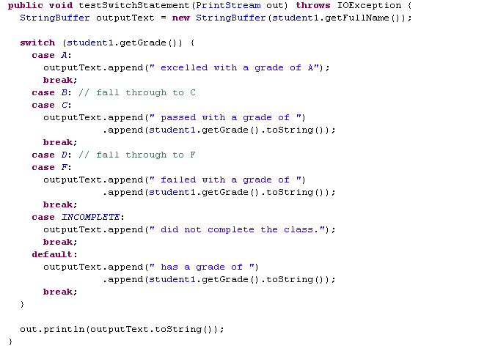
Enumeration
Switch 分支的 Enum Ex:GradeTester.java

Slide 25
Enumeration
練習二
  使用 Inline 宣告 Enum
  Switch 分支的 Enum
  實做出 一個 可判斷學生的成績的 Sample

Slide 26
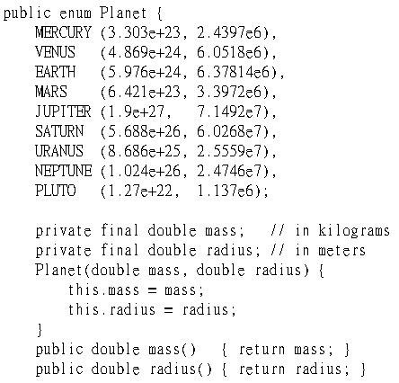
Enumeration
在Enum 中加入Method

Slide 27
Tiger (Java 5.0)
Metadata / Annotations

Slide 28
Metadata / Annotations
What is Annotation
Creating Annotation
Single value Annotation
Meta-Annotations
Most used annotations

Slide 29
Metadata / Annotations
- What is Annotation
Annotations do not directly affect program semantics, but they do affect the way programs are treated by tools and libraries
Many APIs require “side files” to be maintained in parallel with programs
  Hibernate、Spring

Slide 30
Metadata / Annotations
- Creating Annotation
An at-sign (@) precedes the interface keyword
Each method declaration defines an element of the annotation type
Method declarations must not have any parameters or a throws clause
Return types are restricted to primitives, String, Class, enums, annotations, and arrays of the preceding types
Methods can have default values
package onlyfun.caterpillar;
public @interface Debug {
public enum Level {NONE, UNIT, INTEGRATION, FUNCTION};
Level level() default Level.NONE;
String name();
String tester();
}
@Debug(
level = Debug.Level.UNIT,
name = "some test",
tester = "justin“
)
public void doSomething() { // .... }

Slide 31


Metadata / Annotations
- Single value Annotation
In annotations with a single element, the element should be named value
It is permissible to omit the element name and equals sign (=) in a single-element annotation

Slide 32
Metadata / Annotations
- Meta-Annotations
The annotation type declaration is itself annotated. Such annotations are called meta-annotations
@Retention (RetentionPolicy.RUNTIME) @Target (ElementType.METHOD)
public @interface Test { }

Slide 33
Metadata / Annotations
- Meta-Annotations
Meta-Annotation
java.lang.annotation.Target
java.lang.annotation.Retention
java.lang.annotation.Documented
java.lang.annotation.Inherited

Slide 34
Metadata / Annotations
- Meta-Annotations
java.lang.annotation.Target
package java.lang.annotation;
public enum ElementType {
TYPE, //use to class, interface, enum
FIELD, //use to field
METHOD, //use to method
PARAMETER, //use to parameter of method
CONSTRUCTOR, //use to constructor
LOCAL_VARIABLE, //use to local variable
ANNOTATION_TYPE, //use to annotation type
PACKAGE //use to package
}
@Target({ElementType.CONSTRUCTOR, ElementType.METHOD})
public @interface Debug {}

Slide 35
Metadata / Annotations
- Meta-Annotations
java.lang.annotation.Retention
If custom annotation doesn’t define “@Retention”, means to keep informations in class file and JVM skip to read .
package java.lang.annotation;
public enum RetentionPolicy {
SOURCE, //Keep informations in source (.class no)
CLASS, //Keep informations in class (default)
RUNTIME //Keep informations in class and JVM read at runtime
}
@Retention(RetentionPolicy.RUNTIME)
public @interface Debug {}

Slide 36
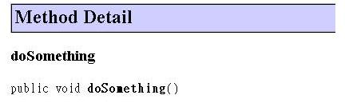
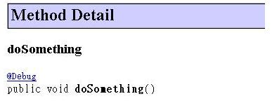
Metadata / Annotations
- Meta-Annotations
java.lang.annotation.Documented
@Documented
@Retention(RetentionPolicy.RUNTIME)
public @interface Debug {}

Slide 37
Metadata / Annotations
- Meta-Annotations
java.lang.annotation.Inherited
SubClass extends SuperClass annotation type
@Retention(RetentionPolicy.RUNTIME)
@Inherited
public @interface Debug {
String value();
String name();
}

Slide 38
Metadata / Annotations
- Most used annotations
Most used annotations
java.lang.Override
java.lang.Deprecated
java.lang.SuppressWarnings
Notes:
com.bluetouch.tiger.annotation.AnnotationDemo

Slide 39
Metadata / Annotations
- Most used annotations
java.lang.Override
Purpose: Compiler checking for override superclass method which must exist.
Only use to method. (useless to classes, package declarations or constructors)
Marker Annotation.
public class CustomObject {
@Override
public String toString() {
return "customObject";
}
}

Slide 40
Metadata / Annotations
- Most used annotations
java.lang.Deprecated
Purpose: Documentation
Useless to special method or element.
Marker Annotation.
public class CustomObject {
@Deprecated
public String getSomething() {
return "something";
}
}

Slide 41
Metadata / Annotations
- Most used annotations
java.lang.SuppressWarnings
Purpose: skip code analysis.
Close warning for class, method, filed, variable.
Single-value annotation.
public class SomeObject {
@SuppressWarnings(value={"unchecked"})
public void doSomething() {
Map map = new HashMap();
map.put("some", "thing");
}
}

Slide 42
Autoboxing / Unboxing

Slide 43
Autoboxing / Unboxing
Autoboxing: transfer primitive type to wrapper type.
Auto-unboxing：transfer wrapper type to primitive type.
Before JDK 5.0
Integer wrapper = new Integer(1);
int primitive = wrapper.intValue();
After JDK 5.0
Integer int = 1;

Slide 44
Autoboxing / Unboxing
Attention:
Use autoboxing or auto-unboxing carefully.
If overuse, performance will be lower.
for(Integer i = 0 ; i < 10000 ; i++) {
//do something
}

Slide 45
Variable argument (Varargs)

Slide 46
Varargs
Varargs allow method or constructor to use the same class type object and only one varargs class at end of parameters site.
Syntax:
method(constructor) (param-type… type-name)
public Project(User s, Schedule s, Locate l, Cost c, Risk r, Member… pmember);
One particularly nice feature about varargs is that a variable-length argument can take from zero to n arguments.

Slide 47
Varargs
Fuzzy overload:
class VarArgs {
void varTest(int…i) {
//doSonthing…
}
void varTest(boolean…i) {
//doSonthing…
}
}
If call varTest() method, what happen??
Example: VarArgs.java
Notes:
com.bluetouch.tiger.vararg.Varargs

Slide 48
Varargs
Fuzzy overload:
class VarArgs1 {
void varTest(double… d) {
System.out.println(“call VarArgs1.varTest”);
}
}
class VarArgs2 extend VarArgs1 {
void varTest(Integer… iObj) {
System.out.println(“call VarArgs2.varTest”);
}
}
class VarArgs3 extend VarArgs2 {
void varTest(int…i) {
System.out.println(“call VarArgs3.varTest”);
}
}
If call VarArgs3.varTest(10), what happen??
Example: VarArgs3.java
Notes:
com.bluetouch.tiger.vararg.Varargs3

Slide 49

Tiger (Java 5.0)
Static imports
BLUETOUCH DIGITAL TECHNOLOGY

Slide 50
Static imports
The static import construct allows unqualified access to static members without inheriting from the type containing the static members
import static java.lang.System.err;
import static java.lang.System.out;
public void test1() {
out.println(“Test”);
err.println(“Error”);
}
import static java.lang.Math.*;
public void test2() {
float foo = sqrt(abs(sin(bar)));
}
Example: StaticImportDemo.java
Notes:
com.bluetouch.tiger.staticImport. StaticImportDemo

Slide 51
for / in

Slide 52
for / in
Before JDK 5.0
List list = getList( ); // initialize this list elsewhere
for (Iterator i = list.iterator( ); i.hasNext( );) {
Object listElement = i.next( );
out.println(listElement.toString( ));
// Do something else with this list object
}
for(int i = 0; i < list.size(); i++) {
out.println(list.get(i).toString( ));
}

Slide 53
for / in
After JDK 5.0
List<String> list = getList( ); // initialize this list elsewhere
for (String listElement : list) {
out.println(listElement);
// Do something else with this list element
}

Slide 54
for / in
for / in Syntax
for (declaration : expression) {
statement
}

Slide 55
for / in
for / in Syntax
for (declaration : expression) {
statement
}
expression: must be Array object or object implements java.lang.Iterable.
expression object type must be used to declaration object type.
It only use variable which declare in for loop, so can’t use global
or local variable.
Example : ForInDemo.java

Slide 56
for / in
Example:
String[] s = {“1”,”2”,”3”,”4”,”5”};
for(String str : s) {
System.out.println(str);
}
List<String> list = getSomeList();
for(String str : list) {
System.out.println(str);
}
Example: ForInDemo.java

Slide 57
for / in
Defect:
Can’t access Array or List object by the index of site.
Can’t reverse to iterate.
Performance is lower than used size() or get().

Slide 58
Formatter

Slide 59
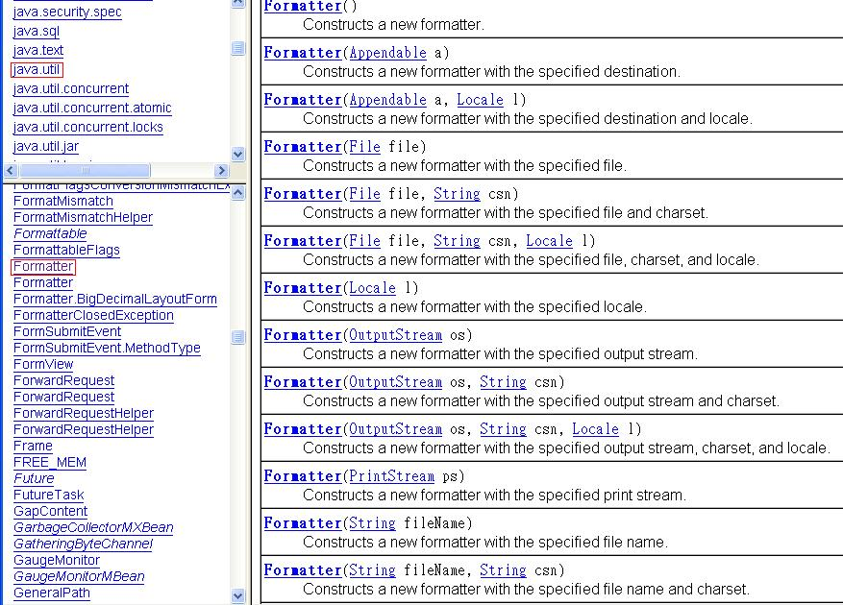
Formatter

Slide 60
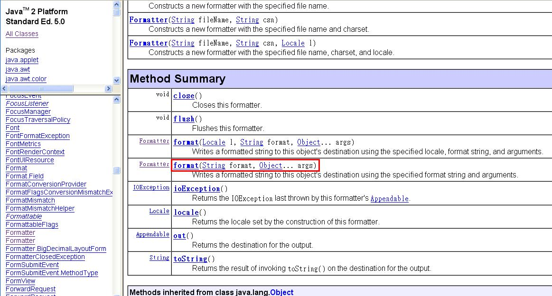
Formatter

Slide 61
Formatter
The format specifiers for general, character, and numeric types have the following syntax:
%[argument_index$][flags][width][.precision]conversion
The optional argument_index is a decimal integer indicating the position of the argument in the argument list. The first argument is referenced by "1$", the second by "2$", etc.
The optional flags is a set of characters that modify the output format. The set of valid flags depends on the conversion.
The optional width is a non-negative decimal integer indicating the minimum number of characters to be written to the output.
The optional precision is a non-negative decimal integer usually used to restrict the number of characters. The specific behavior depends on the conversion.
The required conversion is a character indicating how the argument should be formatted. The set of valid conversions for a given argument depends on the argument's data type.

Slide 62
Formatter
Examples:
Formatter fmt = new Formatter(System.out);
fmt.format(“I am %s, %d years old”, “Genius”, 27);
//-> " I am Genius, 27 years old "
Explicit argument indices may be used to re-order output. fmt.format("%4$2s %3$2s %2$2s %1$2s", "a", "b", "c", "d")
// -> " d c b a"
fmt.format(Locale.TAIWAN, "e = %+10.4f", Math.PI);
// -> "e = +3.1416"

Slide 63
Formatter
Table 9-3. Format flags
Flag | Description
- | Indicates that the formatted value should be left-justified, based on width .
# | Indicates that the formatted output should appear in alternate form. For %o, this means a leading 0. For %x and %X, output will include a leading 0x (0X). For %s and %S, the flag is passed on to the object's formatTo( ) method.
+ | Indicates that numeric output should always include a sign (+ or -).
' ' | The space value (which is hard to show in a book) indicates that non-negative values should be prefixed with a space. This is generally used for alignment with negative numbers.
( | Indicates that negative numbers should appear in parentheses.
0 | Indicates that numeric values should be padded on the left.
, | Indicates that the locale-specific grouping character should be used for numeric values.

Slide 64
Formatter
轉換符號 | 說明
%% | 插入%符號
%a, %A | 16進位的浮點數(參數必需是Float, Double或是BigDecimal)
%b, %B | 格式化boolean值
%c, %C | 格式化字元(參數必需是Byte, Short, Character或Integer)
%d | 格式化成10進位整數(Byte,Short,Integer,Long,BigInteger)
%e, %E | 格式化成10進位浮點數，以科學記號(指數)表示
%f | 格式化成10進位浮點數，不以科學記號(指數)表示
%g, %G | 格式化成10進位浮點數，不超過6位有效數字
%h, %H | 將格式化成值的hashcode以16進位表示
%n | 換行
%s, %S | 格式化成字串
%x, %X | 格式化成16進位整數

Slide 65
Formatter
轉換符號 | 說明
%tA | 周日的縮寫
%ta | 周日的全名
%tB | 月份的縮寫
%tb | 月份的全名
%tC | 世紀，從00到99(除以100的商)
%tc | 完整的時間與日期
%tD | 短數字型式的日期
%td | 日，從01到31的兩位數字
%tE | 從1970/1/1起算的毫秒日期
%te | 日，沒有前置的0
%tF | ISO8601格式的數值日期
%tH | 2位數的時，以24小時計從00到23

Slide 66
Formatter
轉換符號 | 說明
%th | 簡寫的月份名稱(與%tb同)
%tI | 2位數的時，以12小時計從01到12
%tj | 3位數的年日，從001到366
%tk | 以24小時計的時，從0到23
%tL | 3位數毫秒，從000到999
%tM | 2位數分，從00到59
%tm | 2位數月，從01到12
%tN | 奈秒，以9位數表示
%tp | 對應的AM,PM，以小寫表示(%tP是以大寫表示)
%tR | 以24小時計的時與分
%tr | 以12小時計的時分秒與上下午表示
%tS | 2位數秒，從00到59
%ts | 從1970/1/1起算的秒數

Slide 67
Formatter
轉換符號 | 說明
%tT | 以24小時計的時分秒
%tY | 4位數年
%ty | 2位數年，從00到99
%tZ | 時區的簡寫名稱
%tz | 與GMT的時差

Slide 68
Formatter
import static java.lang.System.out;
out.printf("Stanly is %s, Geoge is %1$s too...", "Max");
String s = String.format("Stanly is %s, Geoge is %1$s too...", "Max");

