Slide 1
What Fabric is the warmest?
By Tim Ling

Slide 2
Introduction
When I went to other countries with higher latitudes, the temperature is extremely low, and I have to wear so many layers of thick clothes. Can I wear only a little amount of cloth and have the same effect? In this Experiment, I will test many well-known fabric and test which fabric is the warmest.

Slide 3
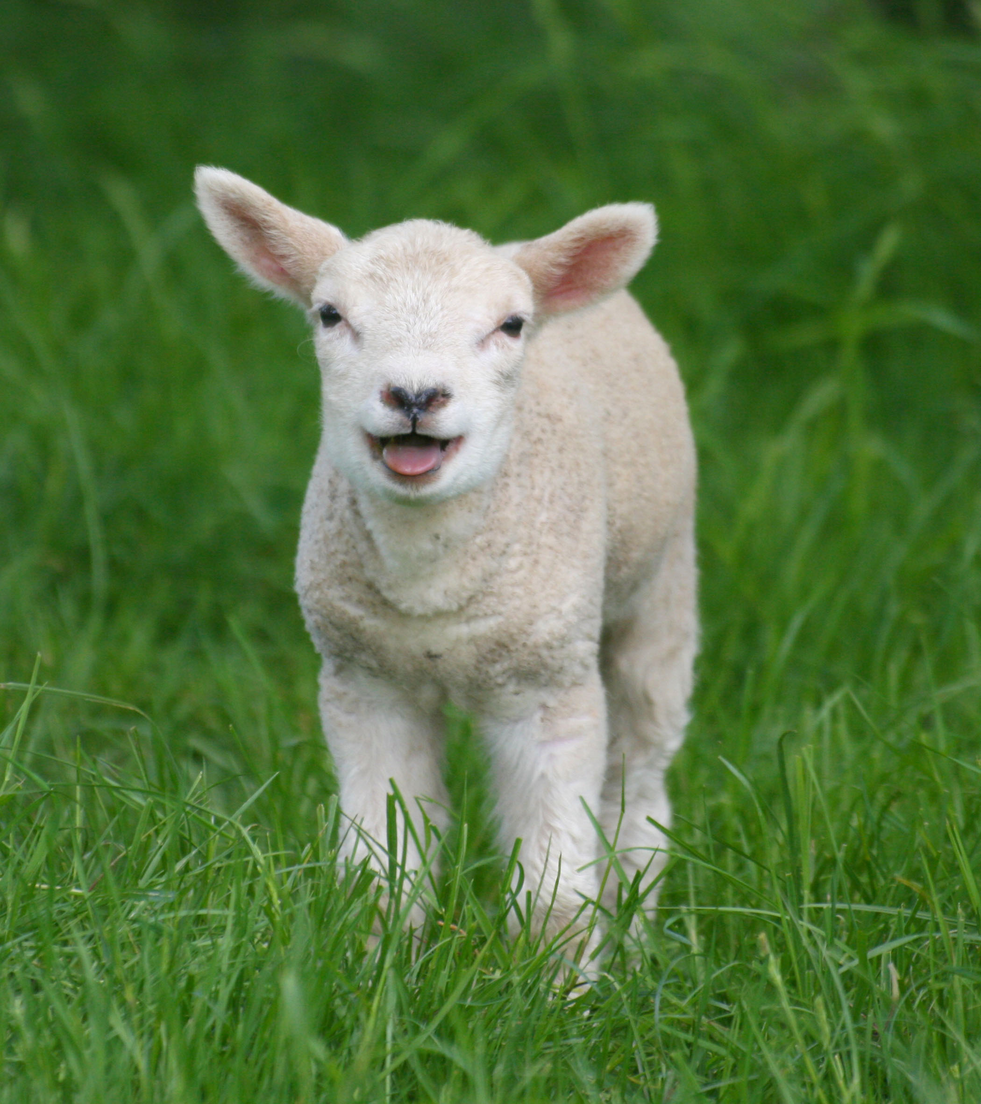
Research
Cotton? Wool?
Meh!
Acrylic fabric is a fabric made by acrylic.
Wool is a fabric from sheep’s fur.
Nylon is a lightweight fabric with a lot of strength.
Cotton is a fabric made from cotton plant.

Slide 4
Hypothesis
I guess that wool is the warmest fabric. Because sheep can use it to keep from cold, and many people thinks so. Also, maybe cotton will have a good effect, because it is the most popular fabric, too.

Slide 5
Materials
Stop Watch×1
Glass Cup×5
Nylon Fabric×1
Acrylic Cloth×1
Wool Hat×1
Cotton Shirt×1
Refrigerator×1
Water
Thermometer×1

Slide 6
Procedures
Place a same amount of water in every glass cup
Cover every glass cup with same width of fabric
Put them in a refrigerator
Measure the temperature of the water every 12 minutes

Slide 7
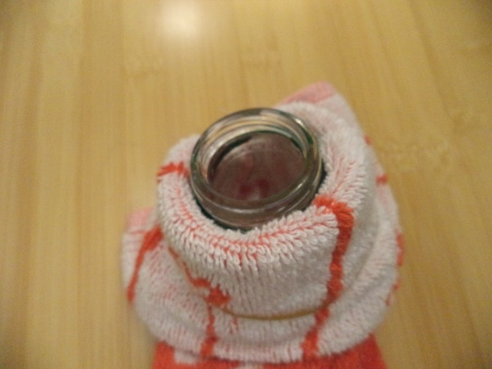
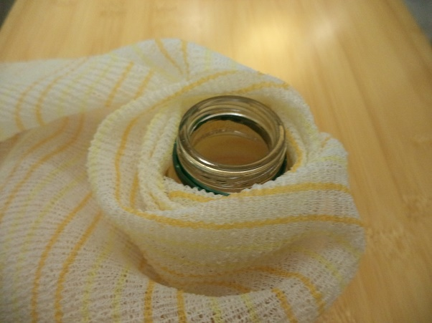
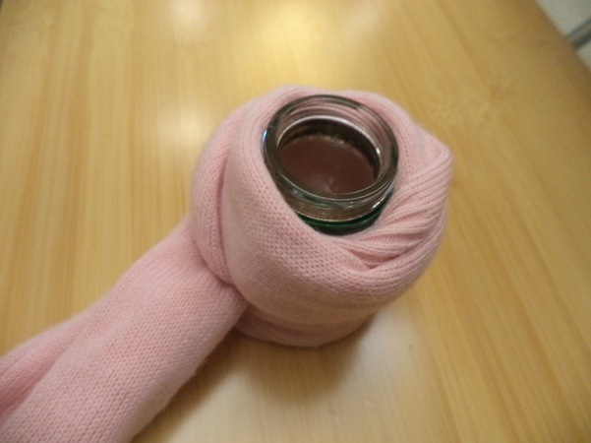
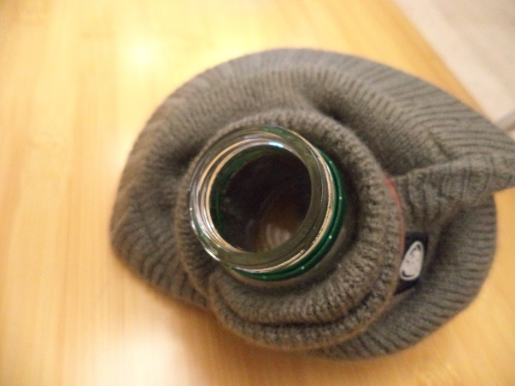


Experiment

Slide 8
Data

Slide 9
Conclusion
My hypothesis is correct. I learn that Wool is the warmest fabric, Acrylic the second, and Nylon the third.

Slide 10

References
https://nyulocal.com/which-fabrics-will-keep-you-warmest-this-winter-344ab4f1e16e
http://www.answers.com/Q/What_is_the_difference_between_cotton_and_nylon
http://www.answers.com/Q/Why_is_nylon_warmer_than_cotton
https://www.reference.com/beauty-fashion/warmer-cotton-polyester-acbf1046c68db809
https://www.quora.com/Which-fabric-is-the-best-for-winter-clothing-Wool-Polyester-Cotton-or
No More Chattering!

