Slide 1

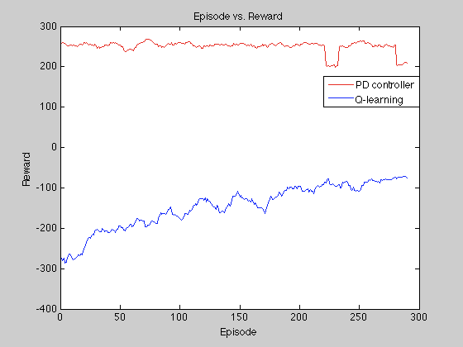
Rocket Landing Game with Deep Learning
Stanley Jacob, Lingjie Kong
Motivation
Pd controller
Q-learning
Model optimal ways to land a rocket
Allow the rocket to learn from its performance over many simulations
Avoid directly deriving a model for the system’s dynamics
Feedback Control: Use the difference between the target horizontal, vertical position, and angular orientation state and the current state as input to choose which engine to fire
Control Gain: Determine the gains for the proportional term and derivative term in order to properly scale the difference
Function approximation is used to speed up learning by forcing the agent to move more towards the successful landing state
Due to the complexity of finding the correct function used for approximation, a neural network is used to capture the non-linearity between different features
Algorithm
Problem Definition
The rocket landing game can be described as a state-space Markov Decision Process:
State: horizontal position, horizontal velocity, vertical position, vertical velocity, angular orientation, angular speed
Action: Firing the main engine or firing the left or right engine
Transition Probability: Probability distribution over state space, initially uniform
Reward: -100 for crash, 300 for successfully landing, -0.3 for firing engine at each frame, 10 for leg contact,
Discount Factor: Usually set close to 1
MDP Model-based Monte Carlo
Initialize Multi-layer perception
The simplest way to solve a continuous-state MDP is to discretize the state space:
Select n ways to discretize each state component
Discretized States: n horizontal positions, n horizontal velocities, n vertical positions, n vertical velocities, n angular orientations, n angular speeds
Discretized Actions: Firing the main (bottom) engine, firing the left engine, firing the right engine, or no engine is fired
Algorithm:
SGD to update W by Q, V, and ϕ(x)
Time step
Average Reward < 200
End of trial
Average Reward > 200
Final Weight (W)
Initial reward, transition probability, and value
Analysis
Policy evaluation
The MDP model has an exponentially large number of possibilities to consider as more states are discretized
More layers in the neural network generally leading to better results
Time step
Challenge
Not converge
Monte Carlo Count
Discretize actions and states effectively to split up the continuous rocket actions and states
Minimize the amount of fuel used to land the rocket successfully
Choose optimal features for function approximation
End of trial & count normalize
Value iteration
Hard to pinpoint the effects of choosing different activation functions for the hidden layers
Converge
Final reward, transition probability, and value

