Slide 1

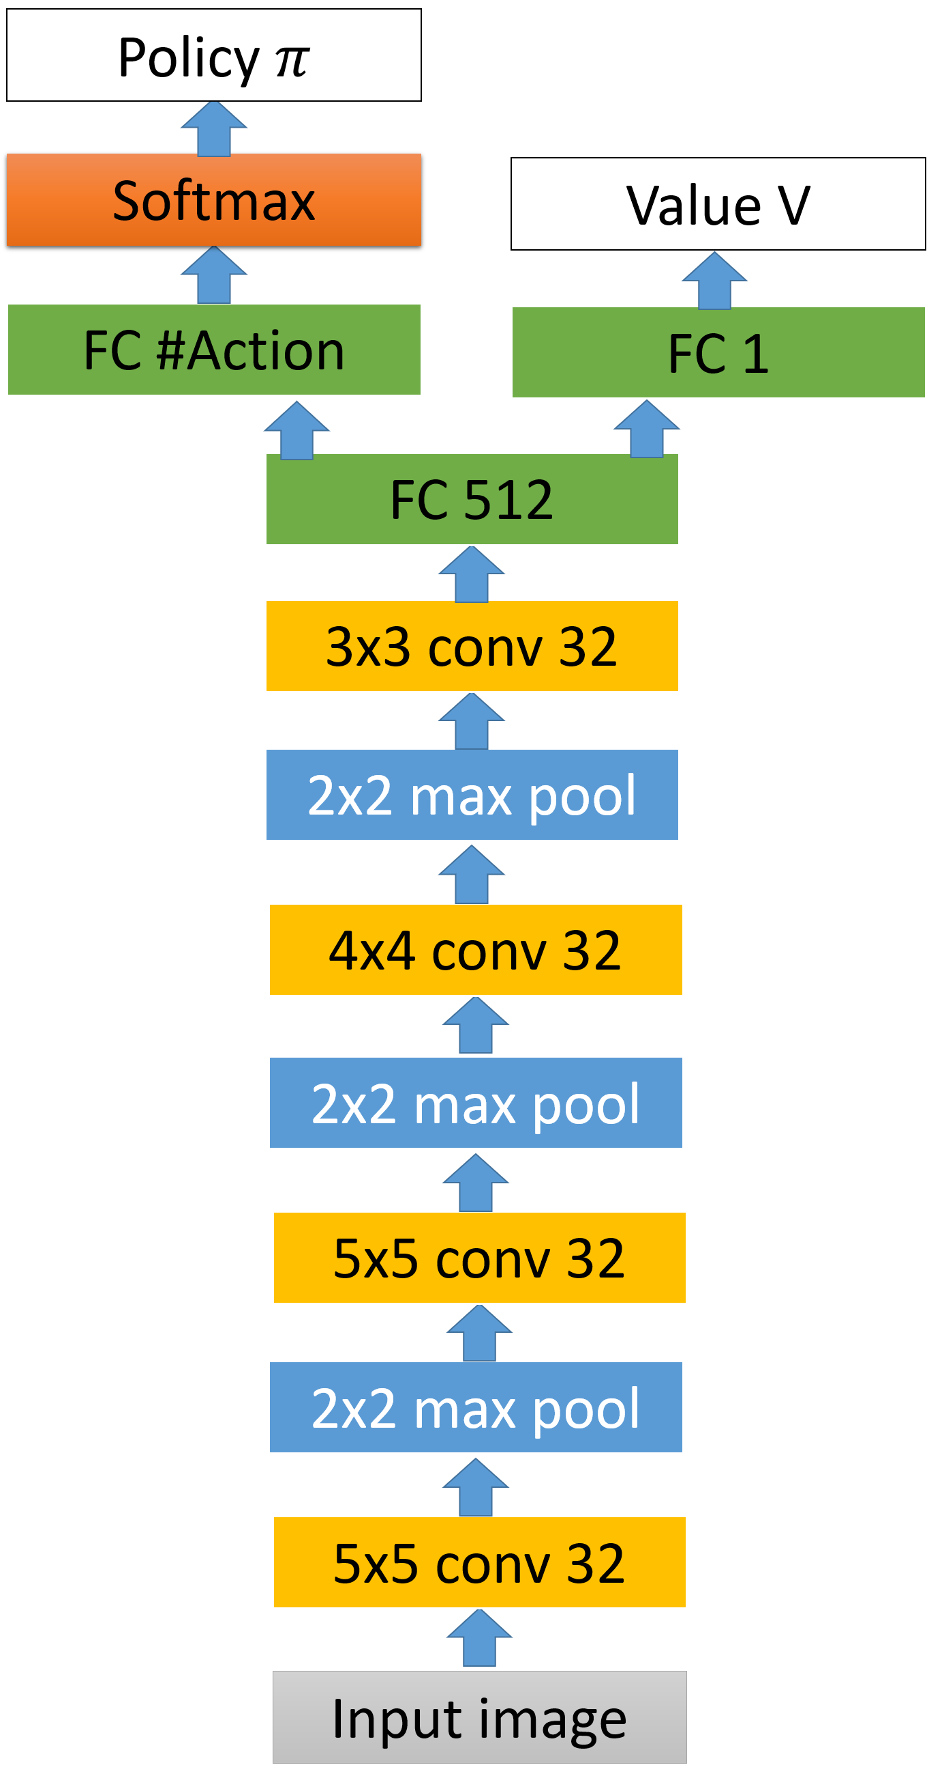
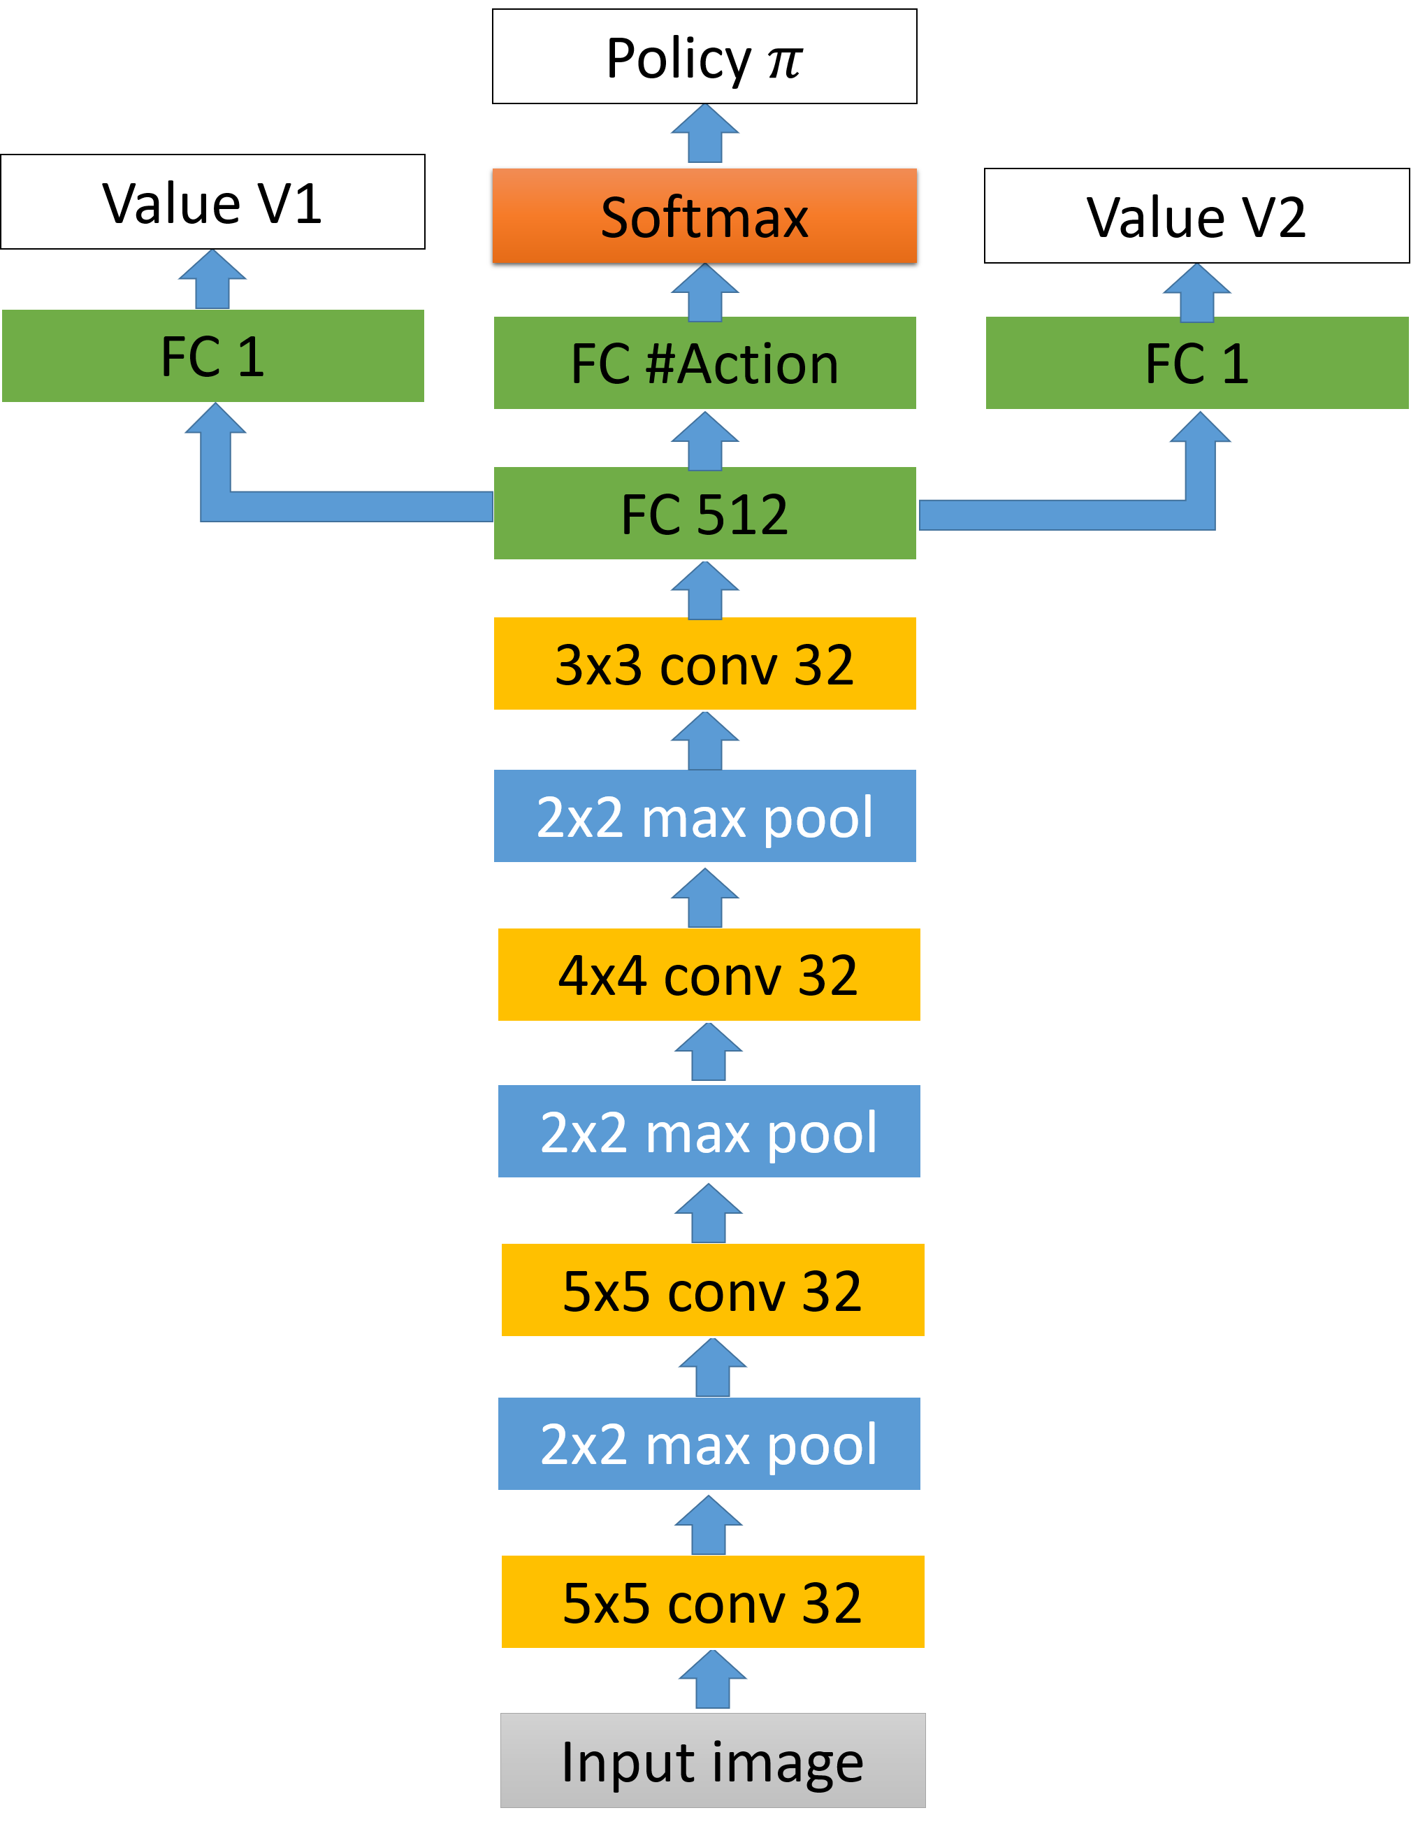
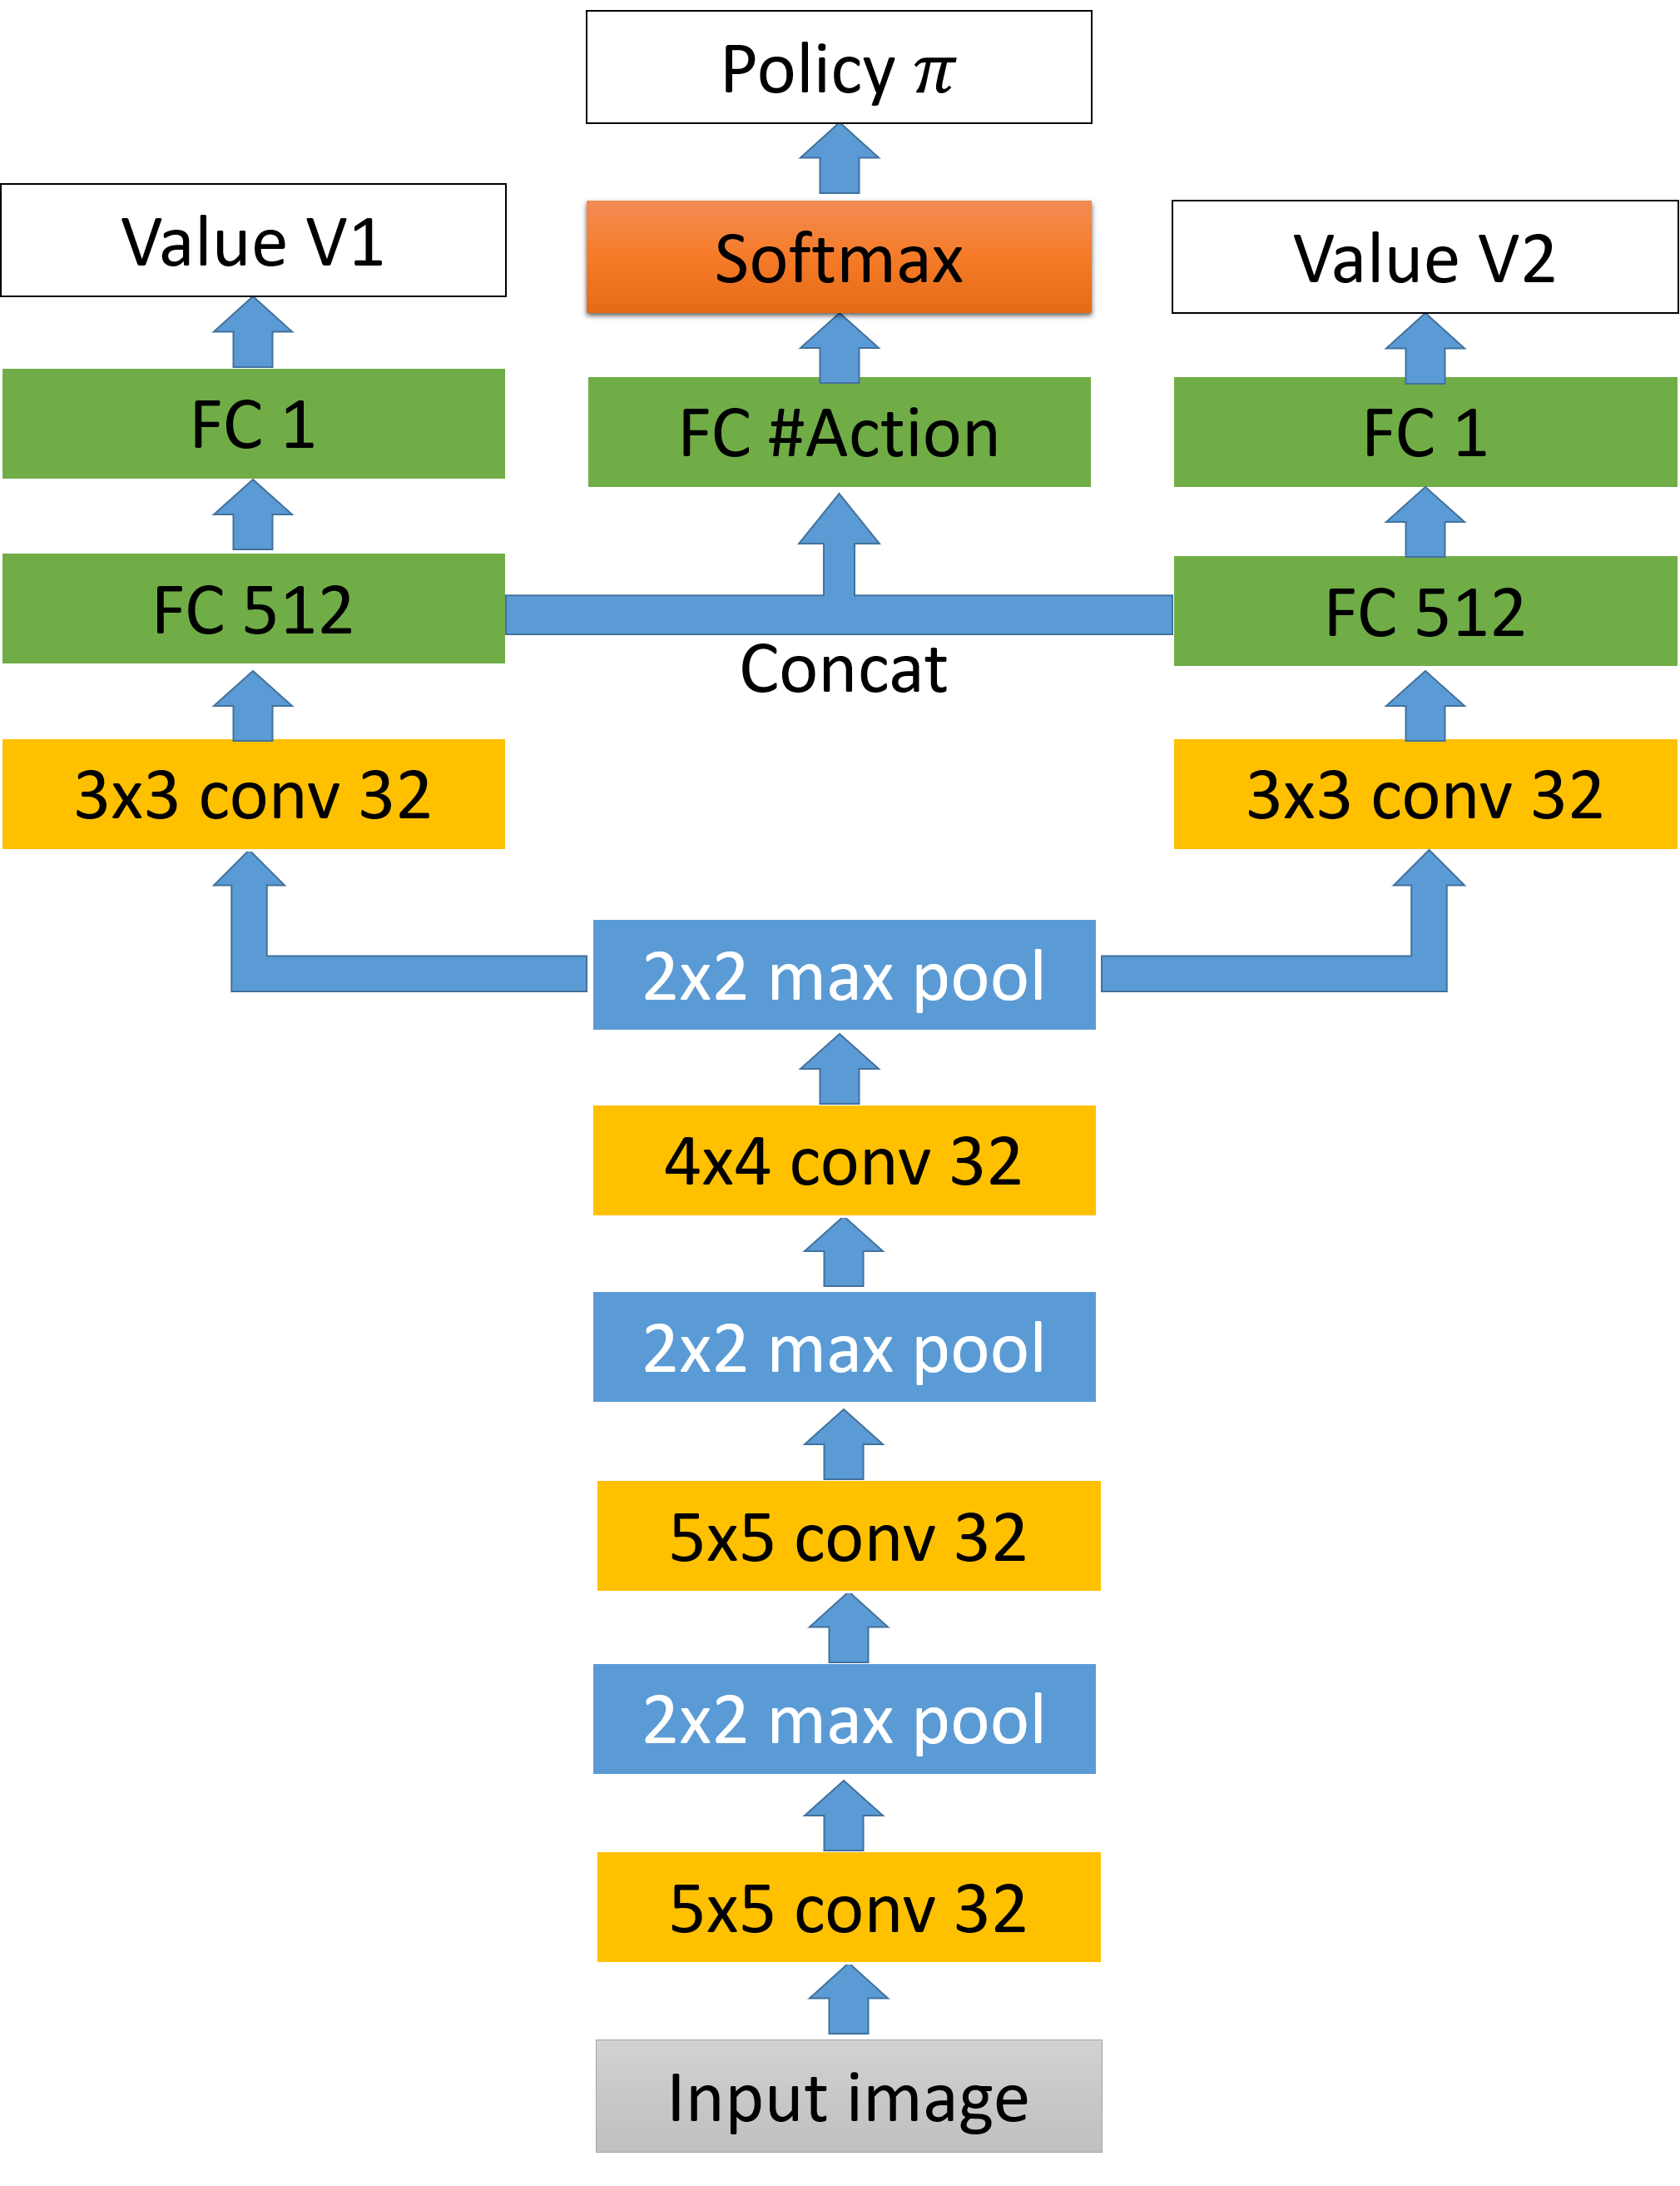
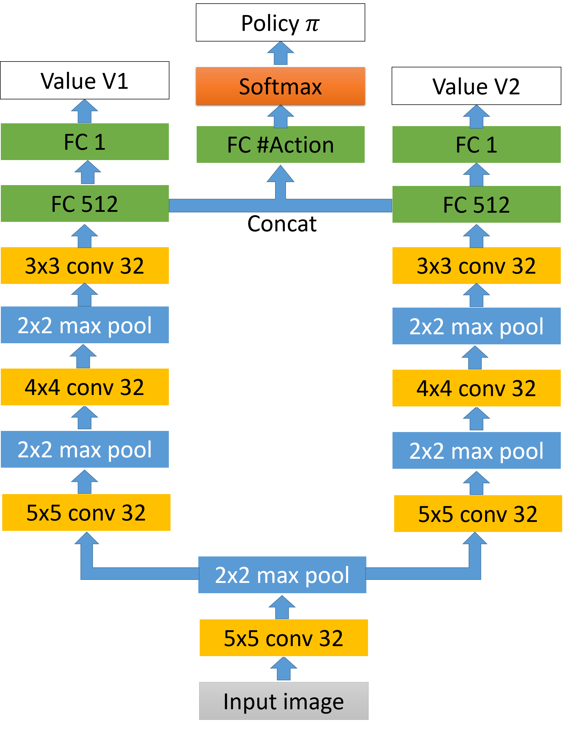
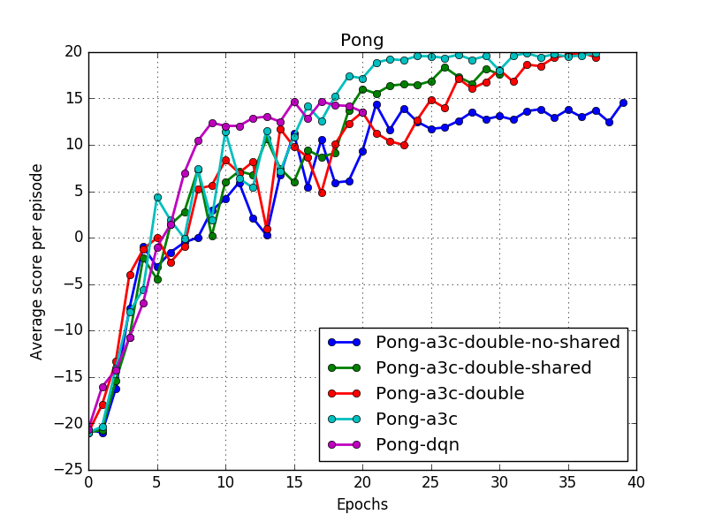
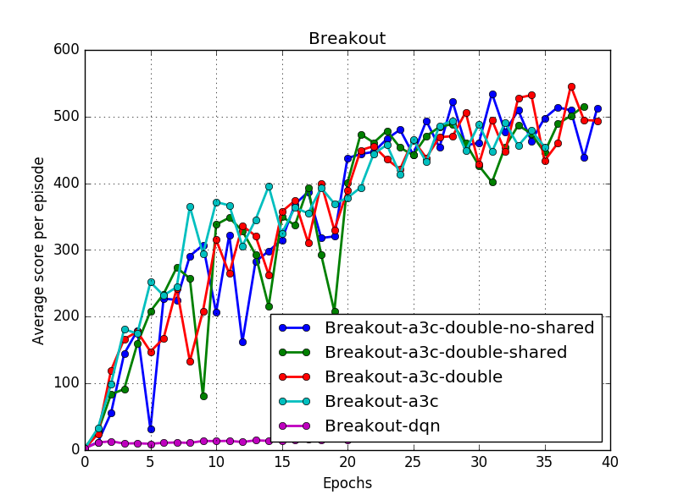
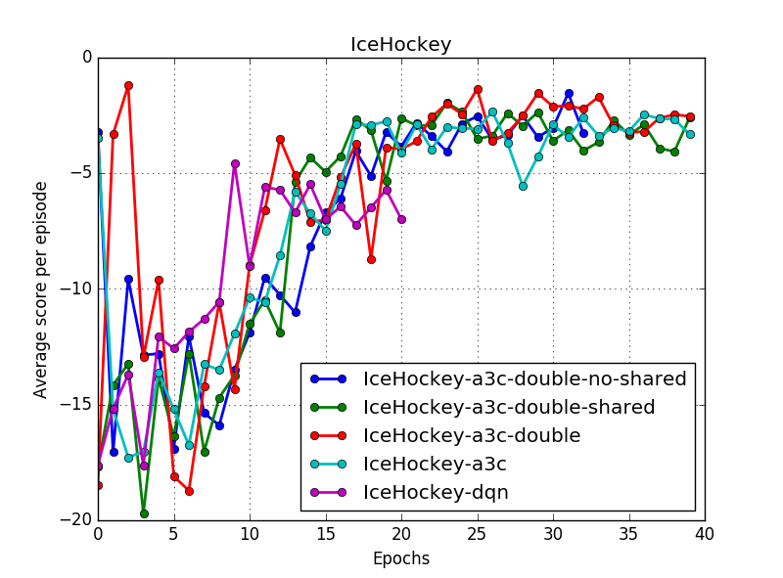

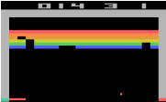
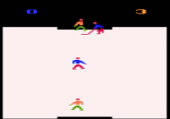
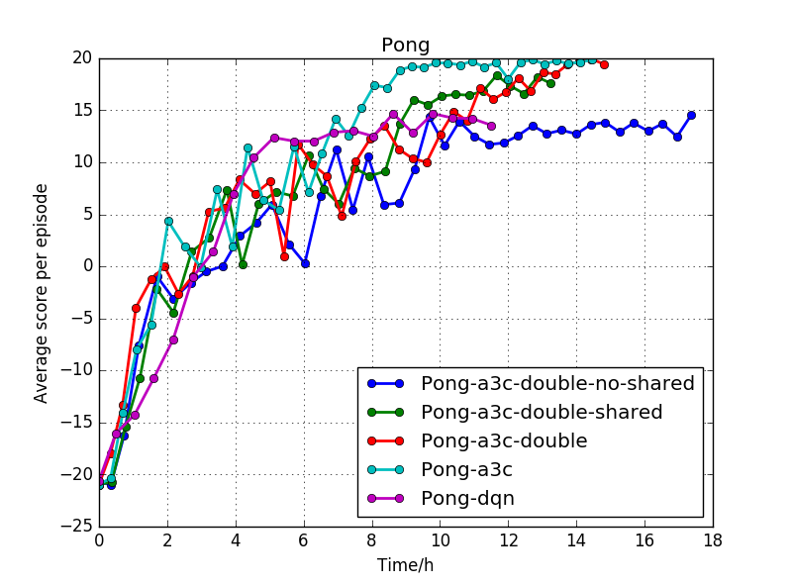
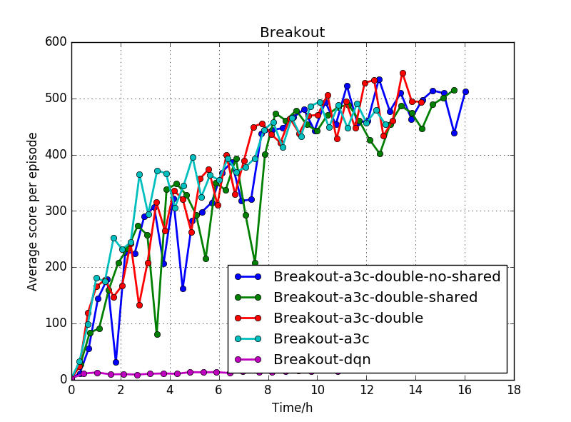
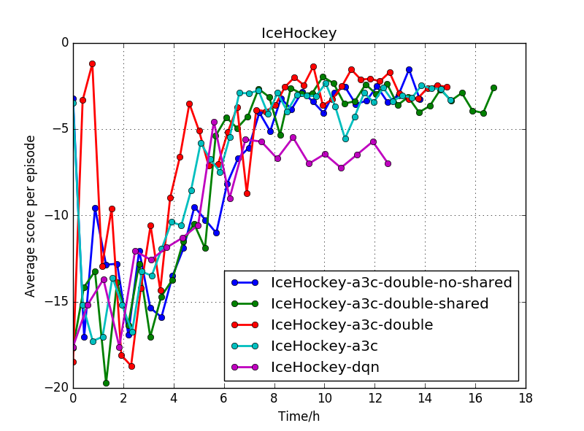
Double A3C on Playing Atari Game
Lingjie Kong, Ruixuan Ren
Video Link: https://drive.google.com/file/d/1nIwGI2CbrmnOKAOgaDvY4Rz6kFkhr9B9/view?usp=sharing
Motivation
A3C Network Structure
Deep reinforcement learning has been successfully applied to training Atari game agents. A lot of interests have been cast on designing new algorithms to improve performance. Here, we propose a new algorithm – double A3C and compare its performance with popular benchmarks.
Improved classical A3C network structure by introducing double A3C
Double A3C maintains two independent value functions
Double A3C concatenates the fully connected layers before value function output layers to generate one policy
Randomly pick one value function to update during training
Varied shared number of layers between two value functions
Problem Definition
Reinforcement learning is an area regarding how agents act to an unknown environment for maximizing its rewards. Unlike Markov Decision Process in which agent has full knowledge of its state, rewards, and transitional probability, RL agent utilizes exploration and exploitation to cover model uncertainty. Because the model usually has a large input feature space, a neural network (NN) is often used to summarize the correlation between input feature and output state action value. Our goal is to improve state-of-the-art A3C (Asynchronous Advantage Actor-Critic) algorithm by implementing our own “double A3C”. We compare its performance with Deep Q-network (DQN) and vanilla A3C on three Atari games: Pong, Ice Hockey and Breakout.
A3C
Double A3C
Less Shared Double A3C
No Shared Double A3C
Result
Analysis
Evaluated the performance by comparing average score over each epoch and over training time
Double A3C outperforms DQN in most environment
Double A3C is more resistant to environment variation compared to DQN
Performances of classical A3C and double A3C are at the same level
We hope to use double A3C to break the correlations between states for achieving better performance. However, A3C already used multiple parallel agents during update. Such parallel agents have already removed correlation in certain degree. Therefore, adding a second value function does not significantly improve the performance.
Double A3C is inspired by double DQN to remove bias. However, classical A3C does not introduce maximization bias.
Implement V-trace to reduce policy lag
Pong
Breakout
Ice hockey
Challenge
Requires large amount of hand-labelled data
Sparse, noisy and delayed rewards
Highly correlated sequence of states

