Slide 1

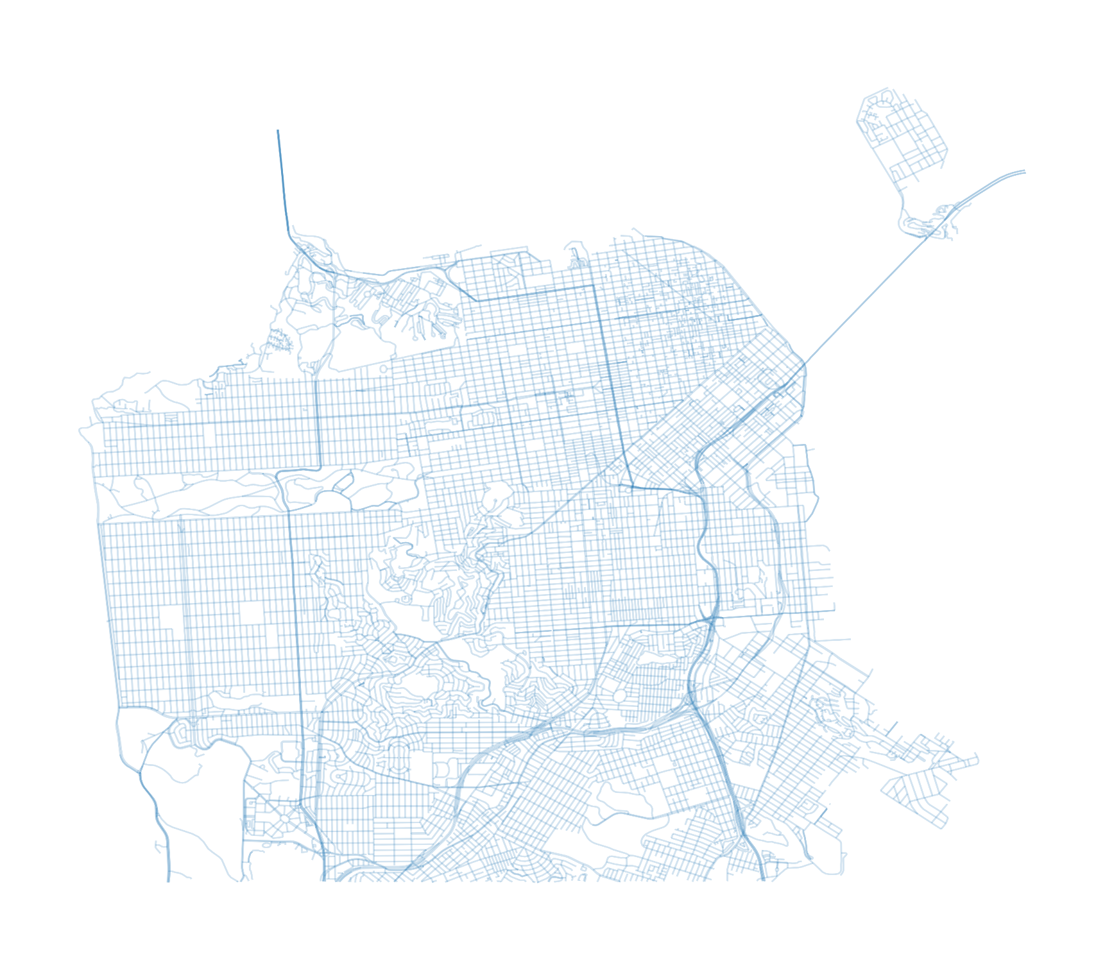


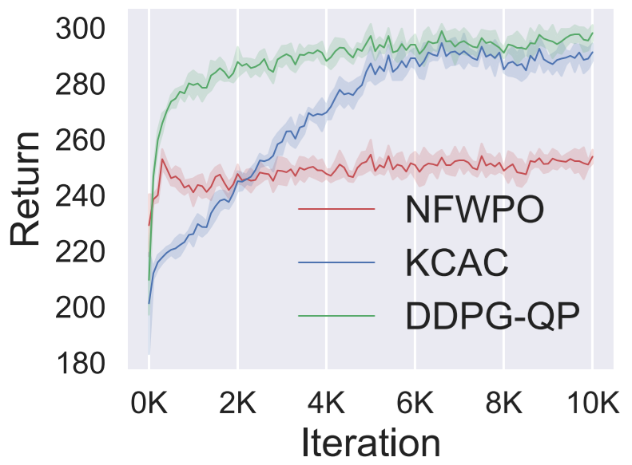
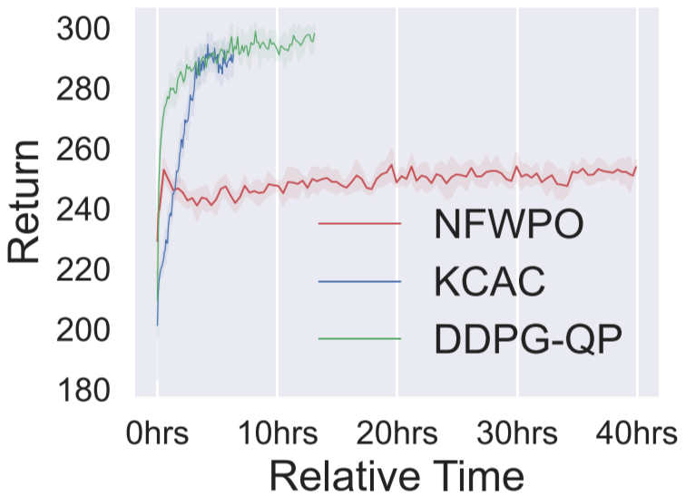
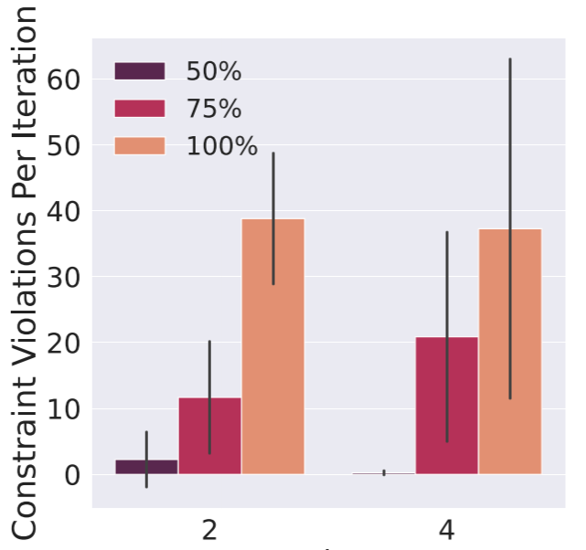
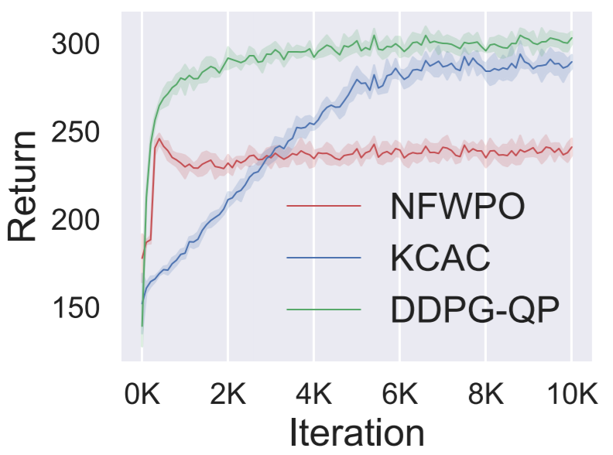
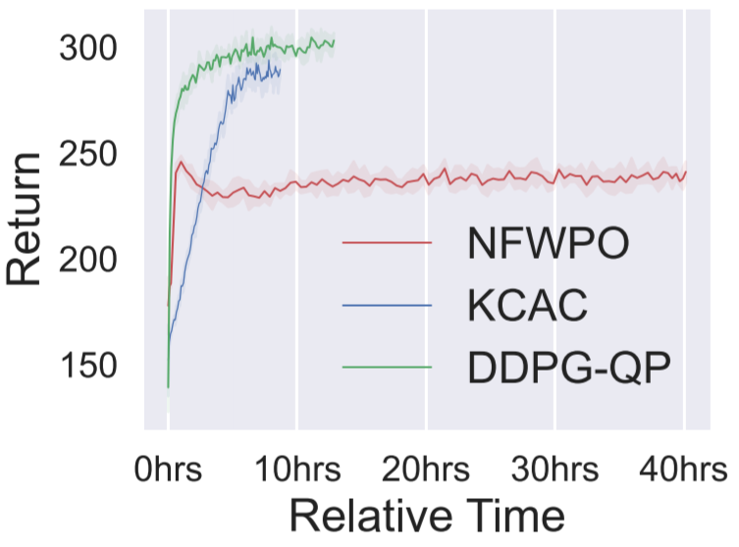











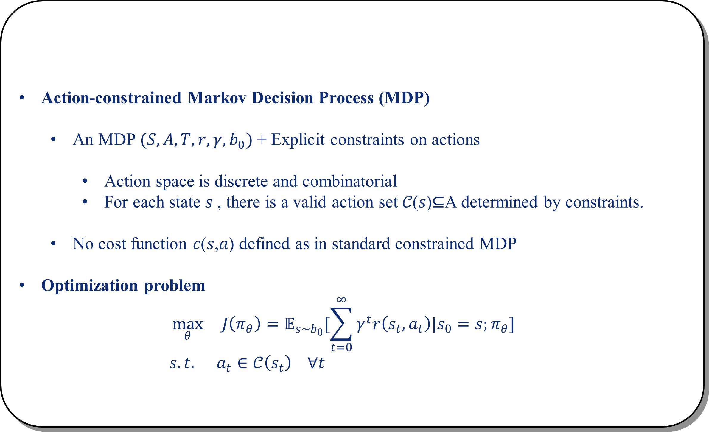
















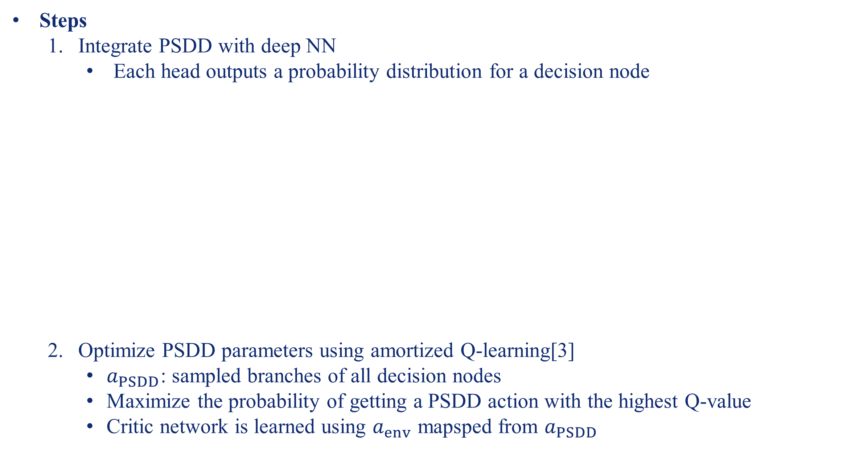



















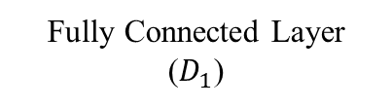















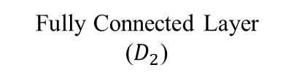


























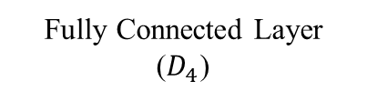













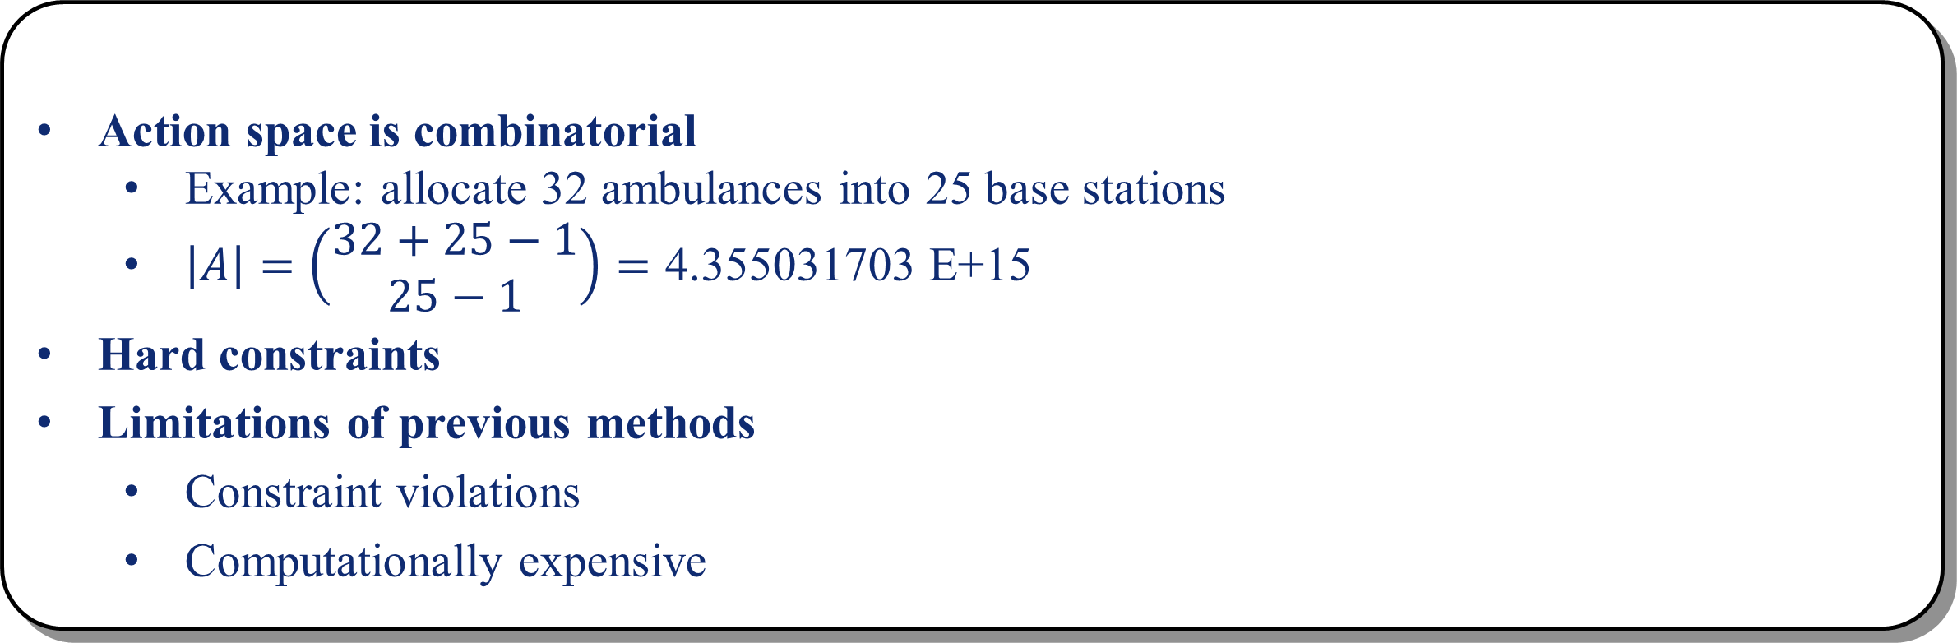













Knowledge Compilation for Constrained Combinatorial
Action Spaces in Reinforcement Learning
Jiajing Ling*, Moritz Lukas Schuler*, Akshat Kumar, Pradeep Varakantham
{jjling.2018, akshatkumar, pradeepv}@smu.edu.sg, m-schuler@mailbox.org
Motivating Example
Problem Formulation
Emergency Response System:
Serve ambulance request due to emergency incidents using the limited resources
Action-constrained Markov Decision Process (MDP)
An MDP $(S, A,T, r, γ, b_{0})$+ Explicit constraints on actions
Action space is discrete and combinatorial
For each state 𝑠 , there is a valid action set 𝒞(𝑠)⊆A determined by constraints.
No cost function 𝑐(𝑠,𝑎) defined as in standard constrained MDP
Optimization problem
$$\max_{θ}{ J\left(π_{θ}\right)=𝔼_{s\sim b_{0}}[\sum_{t=0}^{∞}{γ^{t}r\left(s_{t},a_{t}\right)|s_{0}=s;π_{θ}}]}$$
$$s.t. a_{t}∈𝒞\left(s_{t}\right) ∀t$$
Base1
Base2
Monthly traffic incidents occurring in San Francisco in 2021.
Source: https://smoosavi.org/datasets/us_accidents
Key Challenges
Contributions
Action space is combinatorial
Example: allocate 32 ambulances into 25 base stations
$\left|A\right|=\left(\begin{matrix}32+25−1 \\ 25−1\end{matrix}\right)=\text{4.355031703 }\text{E}\text{+15}$
Hard constraints
Limitations of previous methods
Constraint violations
Computationally expensive
We propose a neuro-symbolic method to address action-constrained RL
Symbolic Representation
Compile action constraints using (P)SDDs
Able to compactly represent a distribution over all valid actions
Neural Optimization
Integrate PSDD with deep NN
Optimize PSDD parameters using deep RL
$$Valid Action Space$$
$$Action Space$$
Symbolic Representation
Neural Optimization
Steps
Define state and action using propositional variables $X_{S}$, $X_{A}$
Define constraint using Boolean functions $C_{k}(X_{S},X_{A})$
Compile Boolean functions into a Sentential Decision Diagram (SDD)[1]
Parameterize the SDD to obtain a Probabilistic SDD(PSDD)[2]
Fast sampling actions from the PSDD
Select a branch for decision nodes
$P\left(¬A,¬B,C,¬D\right)=0.7×0.2×0.4=0.056$
Linear complexity in depth
Benefits of using PSDDs
Decomposition of complex constraints
Fast sampling of an action
Actions guaranteed to be valid
Tractable number of parameters
Steps
Integrate PSDD with deep NN
Each head outputs a probability distribution for a decision node
Optimize PSDD parameters using amortized Q-learning[3]
$a_{PSDD}$: sampled branches of all decision nodes
Maximize the probability of getting a PSDD action with the highest Q-value
Critic network is learned using $a_{env}$ mapsped from $a_{PSDD}$
$$s$$
$$0.7$$
$$D_{1}$$
$$0.3$$
Fully Connected Layer
$$¬A$$
$$⋅$$
$$A$$
$$⋅$$
Step2
Step1
ReLU
$$D_{2}$$
$$D_{3}$$
Resource Constraints
$$A+B+C+D=1$$
$$A≤1, B≤1,C≤1, D≤1$$
Boolean Function
$$\left(A∧¬B∧¬C∧¬D\right)$$
$$∨\left(¬A∧B∧¬C∧¬D\right)$$
$$∨\left(¬A∧¬B∧C∧¬D\right)$$
$$∨\left(¬A∧¬B∧¬C∧D\right)$$
$$a_{1}$$
Fully Connected Layer
$$0.2$$
$$0.8$$
$$1$$
$$0$$
ReLU
$$¬B$$
$$⋅$$
$$B$$
$$⋅$$
$$¬B$$
$$⋅$$
$$B$$
$$⊥$$
$$A$$
$$B$$
$$C$$
$$D$$
`
$$D_{4}$$
$$D_{5}$$
$$b_{1}$$
$$b_{2}$$
$$b_{3}$$
$$b_{4}$$
Fully Connected Layer
($D_{1}$)
Fully Connected Layer
($D_{2}$)
Fully Connected Layer
($D_{4}$)
$$0.4$$
$$0.6$$
$$1$$
$$0$$
Example: allocate one ambulance into four stations
Softmax (2 units)
Softmax (2 units)
Softmax (2 units)
$$C$$
$$¬D$$
$$¬C$$
$$D$$
$$¬C$$
$$¬D$$
$$C$$
$$⊥$$
Step3
1
Step4
$$0.7$$
1
$$0.3$$
Experiments
$$¬A$$
$$⋅$$
$$A$$
$$⋅$$
$$¬A$$
$$⋅$$
$$A$$
$$⋅$$
3
3
$$0.2$$
3
3
$$0.8$$
$$1$$
$$0$$
Emergency Response System
Allocate 32 ambulances into 25 base stations
Constraints:
Global sum, local min and max, group min and max
Baselines
NFWPO
The state-of-the-art approach for ACRL with continuous action space
Involve solving an Integer Quadratic Program (IQP)
DDPG+QP
Results
$$¬B$$
$$⋅$$
$$B$$
$$⋅$$
$$¬B$$
$$⋅$$
$$B$$
$$⊥$$
$$¬B$$
$$⋅$$
$$B$$
$$⋅$$
$$¬B$$
$$⋅$$
$$B$$
$$⊥$$
5
5
$$0.4$$
5
$$0.6$$
5
$$C$$
$$¬D$$
$$¬C$$
$$D$$
$$¬C$$
$$1$$
$$0$$
$$C$$
$$¬D$$
$$¬C$$
$$D$$
$$¬C$$
$$¬D$$
$$C$$
$$⊥$$
$$¬D$$
$$C$$
$$⊥$$
$$0.7$$
$$D_{1}$$
$$0.3$$
$$¬A$$
$$⋅$$
$$A$$
$$⋅$$
$$0.2$$
$$D_{2}$$
$$D_{3}$$
$$0.8$$
$$1$$
$$0$$
Solution Quality
Running Speed
Constraint Violation (DDPG+QP)
$$¬B$$
$$⋅$$
$$B$$
$$⋅$$
$$¬B$$
$$⋅$$
$$B$$
$$⊥$$
Lower bound 1
$$D_{4}$$
$$D_{5}$$
Lower bound 2
$$0.4$$
`
$$0.6$$
$$1$$
$$0$$
Setting 1
Lower bound 3
$$C$$
$$¬D$$
$$¬C$$
$$D$$
$$¬C$$
$$¬D$$
$$C$$
$$⊥$$
References
Setting 2
Setting 1
Setting 2
[1] Adnan Darwiche. 2011. SDD: A new canonical representation of propositional knowledge bases. In IJCAI
[2] Doga Kisa et. al. 2014. Probabilistic sentential decision diagrams. In PKRR.
[3] TomVan de Wiele et. al. 2020. Q-Learning in enormous action spaces via amortized approximate maximization.

