Slide 1
MaskGAN for Musical Phrases
Ling Lin and Gregory Johnsen
COMS 4995 – Spring 2018 – Professor Iddo Drori

Slide 2
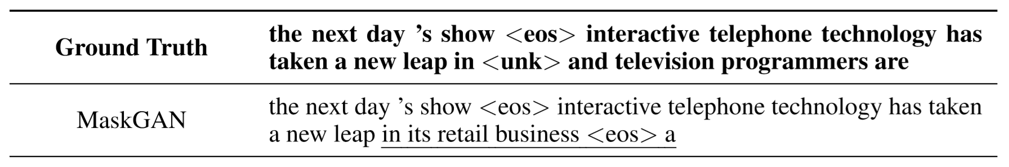
Intro to MaskGAN & Problem Definition
Given a discrete sequence with a masked out portion, infill the missing data
Not merely autoregressive, but also conditioned on the context
$$G(x_{t}) ≡ P({\hat{x}}_{t}|{\hat{x}}_{1},··· ,{\hat{x}}_{t−1},m(x))$$
Notes:
Greg

Slide 3
Intro to MaskGAN & Problem Definition
Special case: Run it fully unconditioned to generate novel sequences
Challenges: lack of differentiability, loss only observed with complete sequence, large action space
Notes:
Greg

Slide 4
Application to Music
Infill or generate discrete musical sequences
Multidimensionality of music is difficult to model (key, chords, notes, note duration, structure of a song)
Related work: MidiNet, popular tutorials
Applications: Spotify, YouTube, etc.
Notes:
Greg

Slide 5
Our Data Set
Midi files encode note instrument, pitch, duration, and velocity (as opposed to waveform) and computer renders that to audio
MFile 1 3 96
MTrk
0 KeySig 255 major
0 TimeSig 8/4 24 8
0 Tempo 599704
42240 Meta TrkEnd
TrkEnd
MTrk
0 PrCh ch=1 p=0
0 On ch=1 n=62 v=64
42240 Meta TrkEnd
TrkEnd
Notes:
Greg

Slide 6
Our Data Set
Scraped 223 Bach compositions
Trained model using three different corpora
Original
Normalized: transpose pieces to the same musical key
Augmented: transpose pieces to all major keys
Notes:
Greg

Slide 7
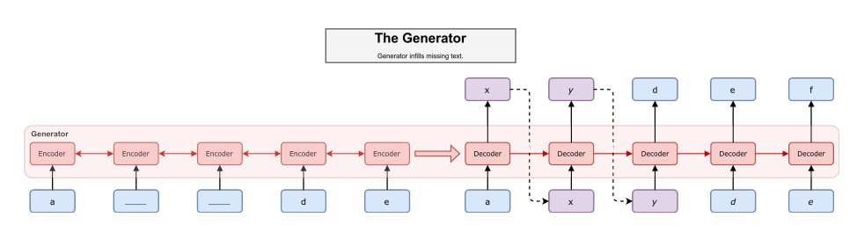
seq2seq Generator Architecture

Slide 8
Network Parameters
Generator: 32 nodes, 2 layers
Discriminator: 32 nodes, 2 layers
Training Batch Size: 20
Training Sequence Size: 20
Present Rate: 0.5
gen_learning_rate: 0.00038877
gen_vd_keep_prob: 0.33971
dis_learning_rate: 0.0005
dis_vd_keep_prob: 0.71940

Slide 9
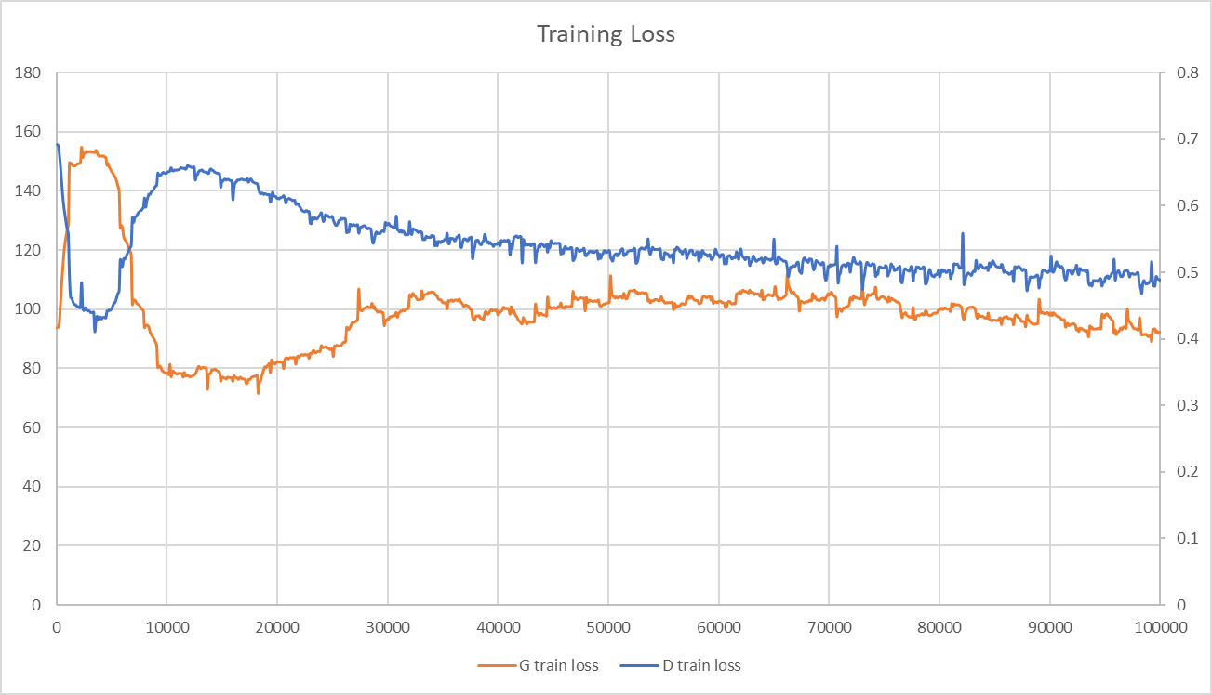
Training & Test Results

Slide 10
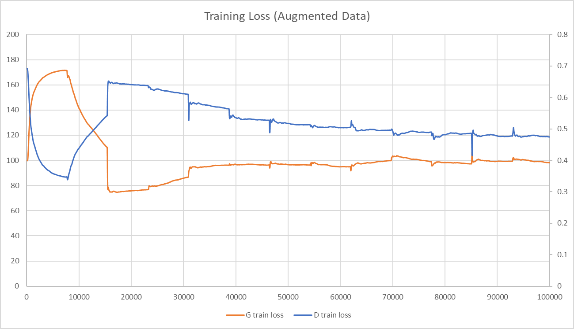
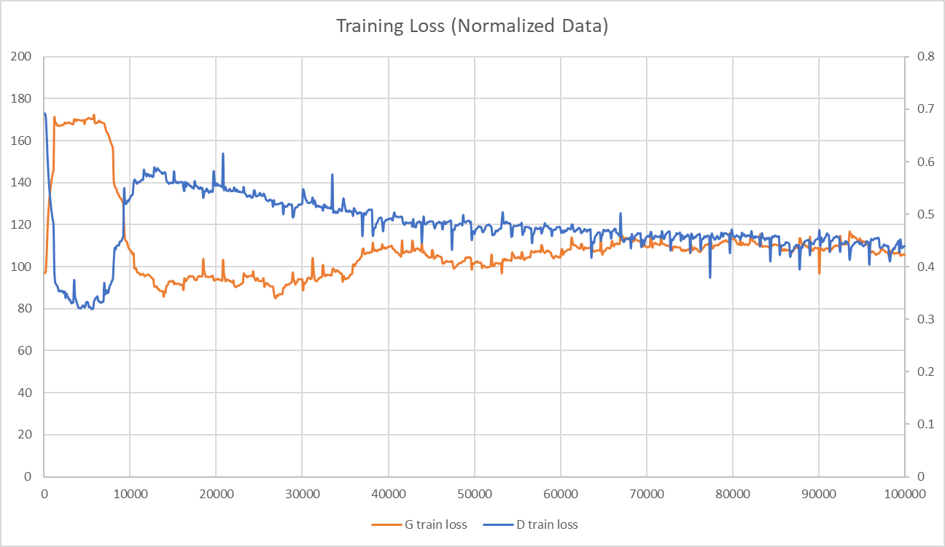
Training & Test Results

Slide 11
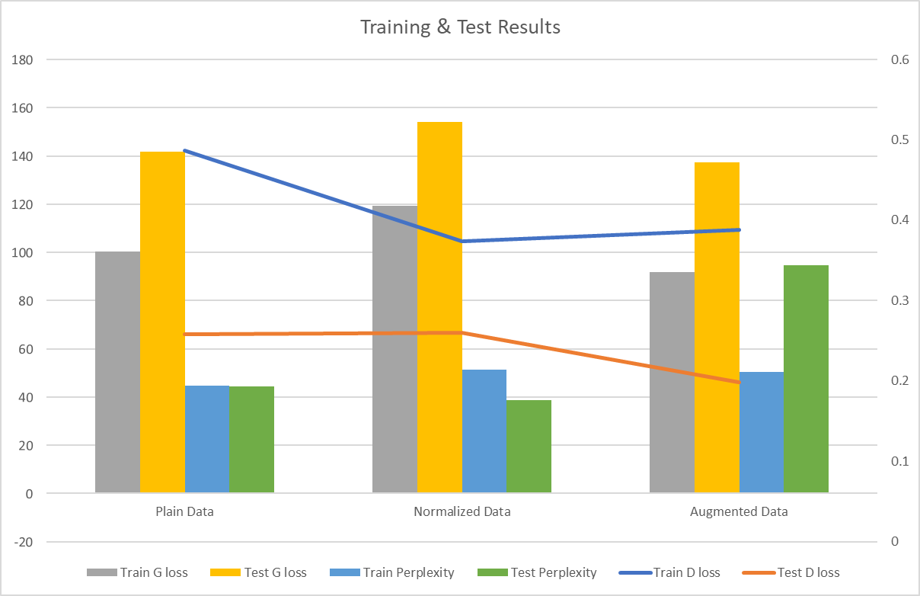
Training & Test Results

Slide 12
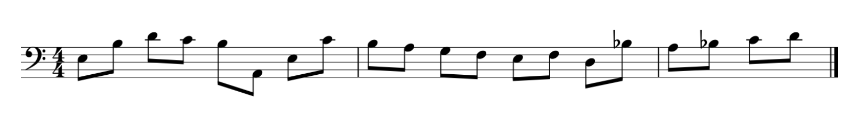

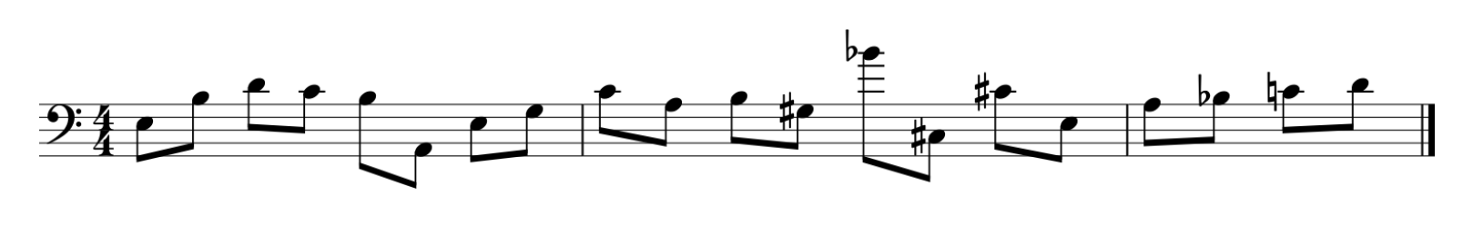
Results for Conditional Sequence Completion
Infilled Sequence
Original
MaskGAN
Notes:
Gregsn

Slide 13
Uniformly Random Sample

Slide 14
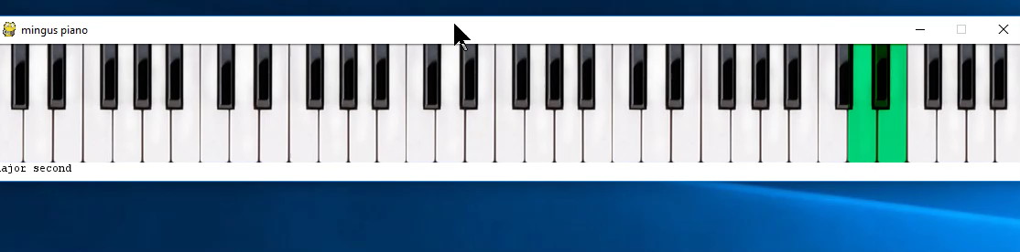
Results for Unconditional Sequence
Notes:
Ling

Slide 15
Next Steps
May not be the best model for music—look at other sequence models
More training data
Other regularization options
Pretraining
Curriculum learning
Need to capture multidimensionality of music
Hierarchical models
Notes:
Ling

Slide 16
Questions?

