Slide 1


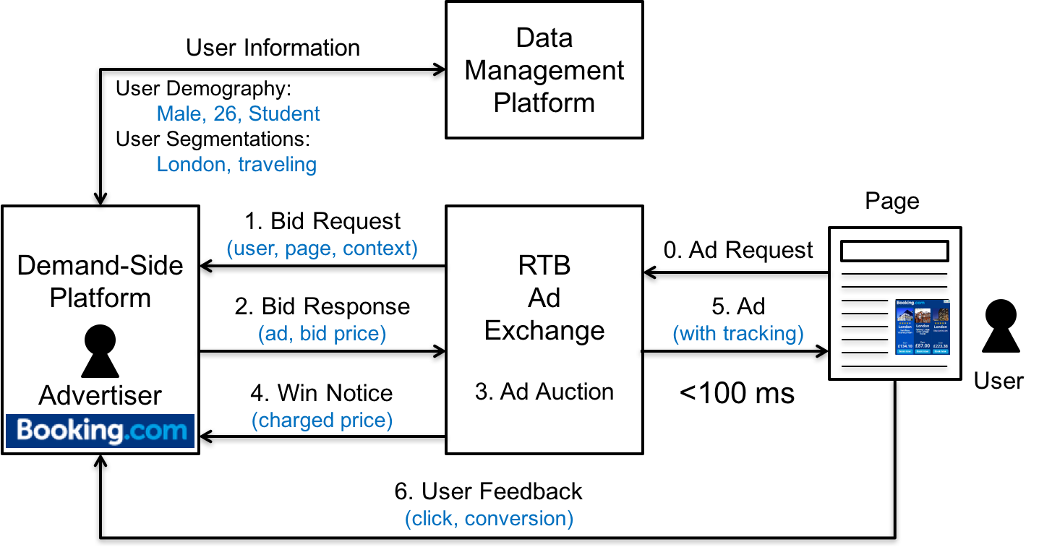
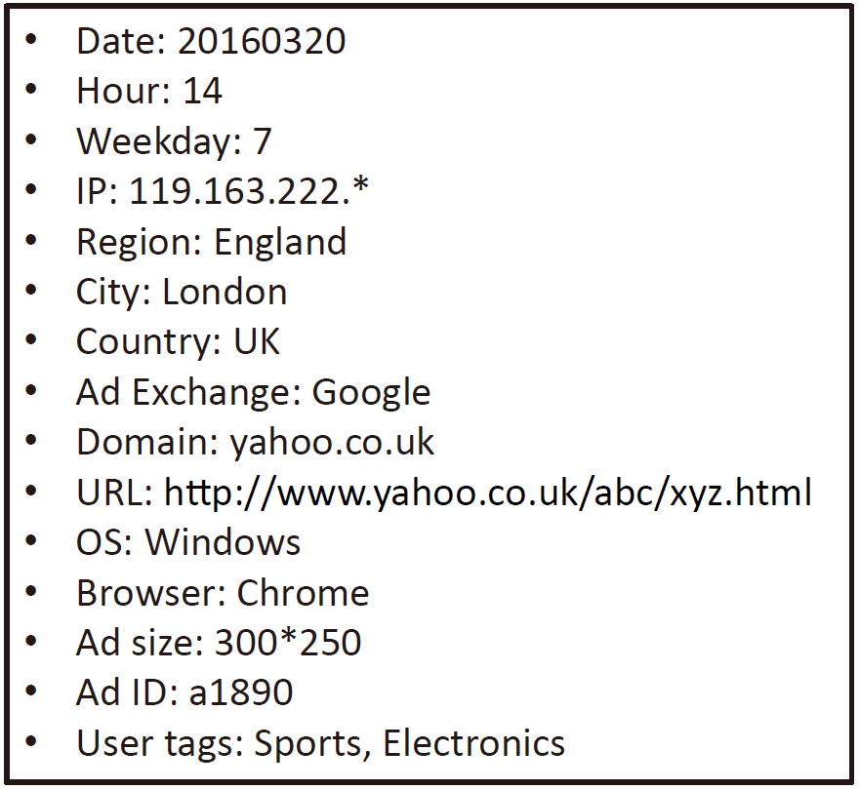
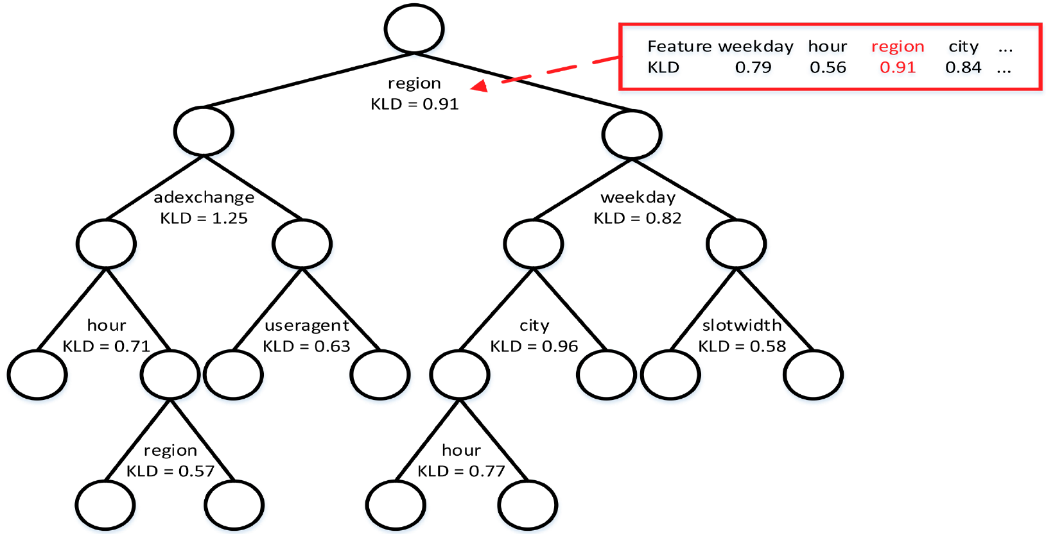
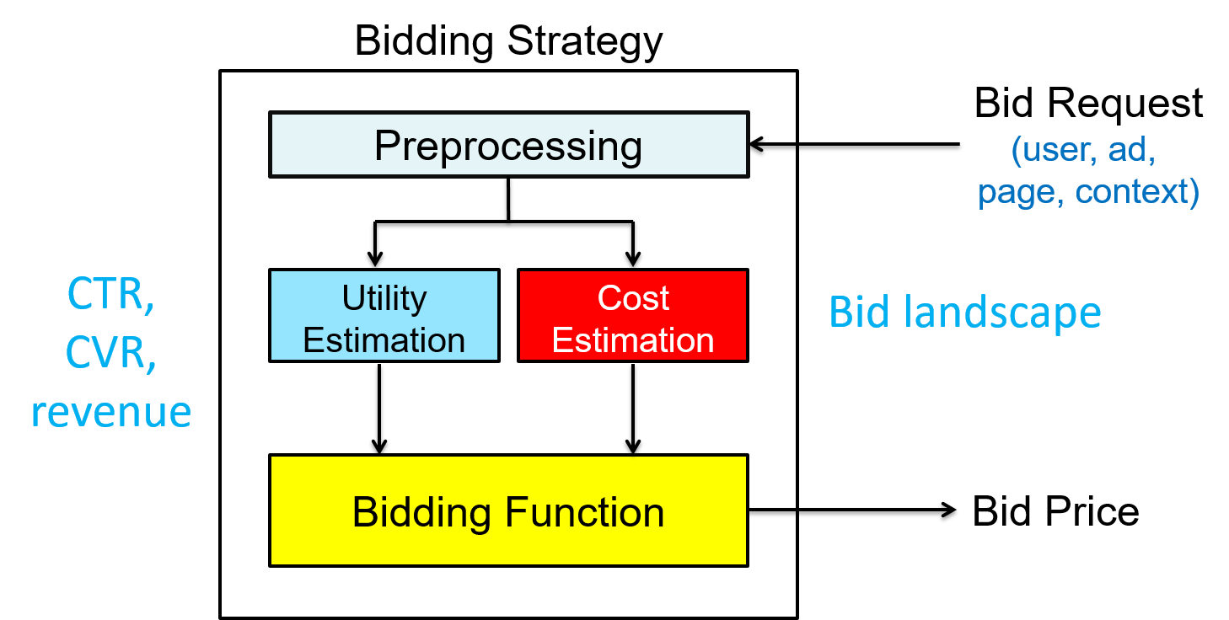
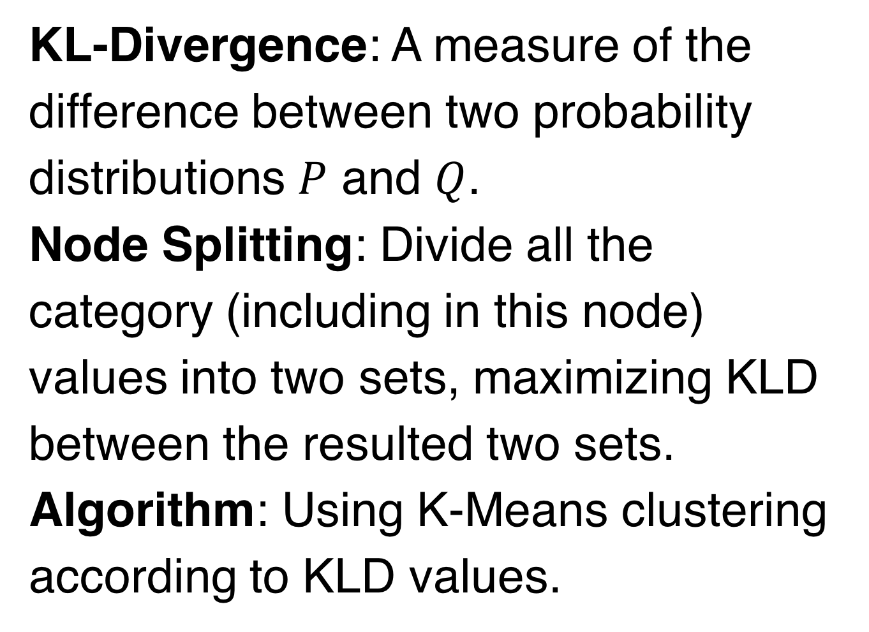
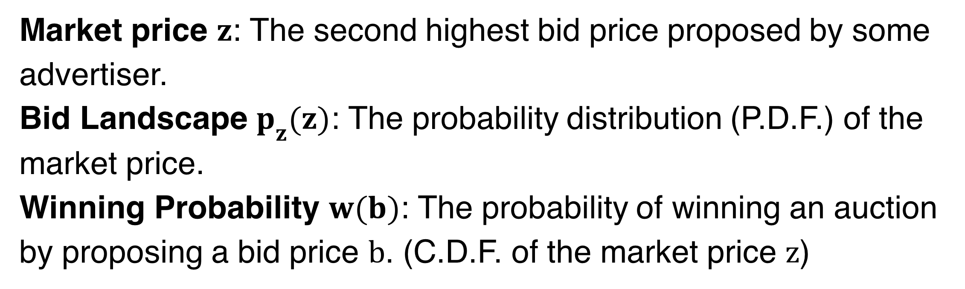
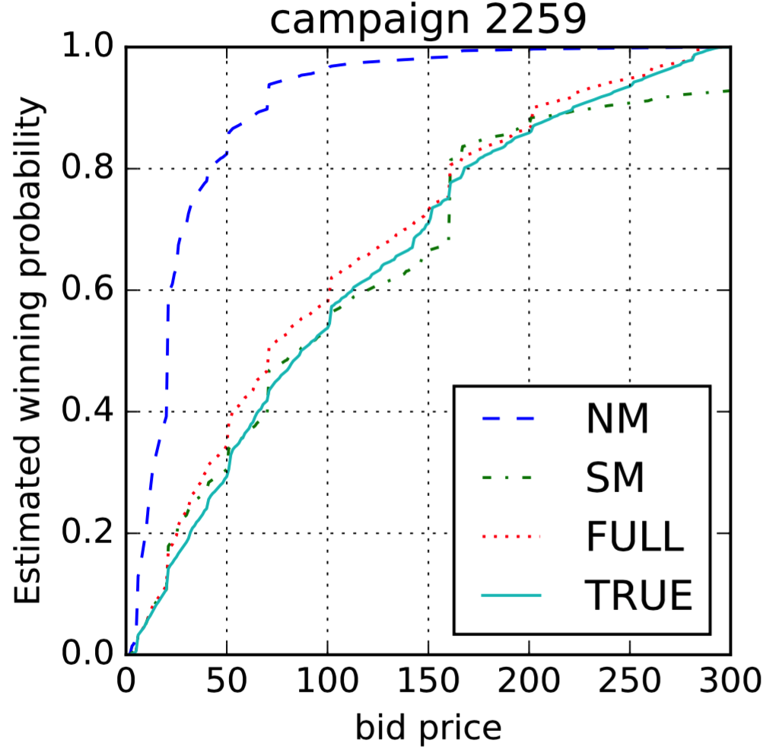
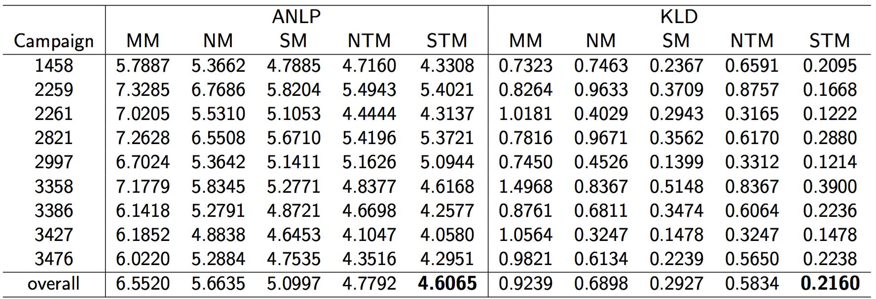
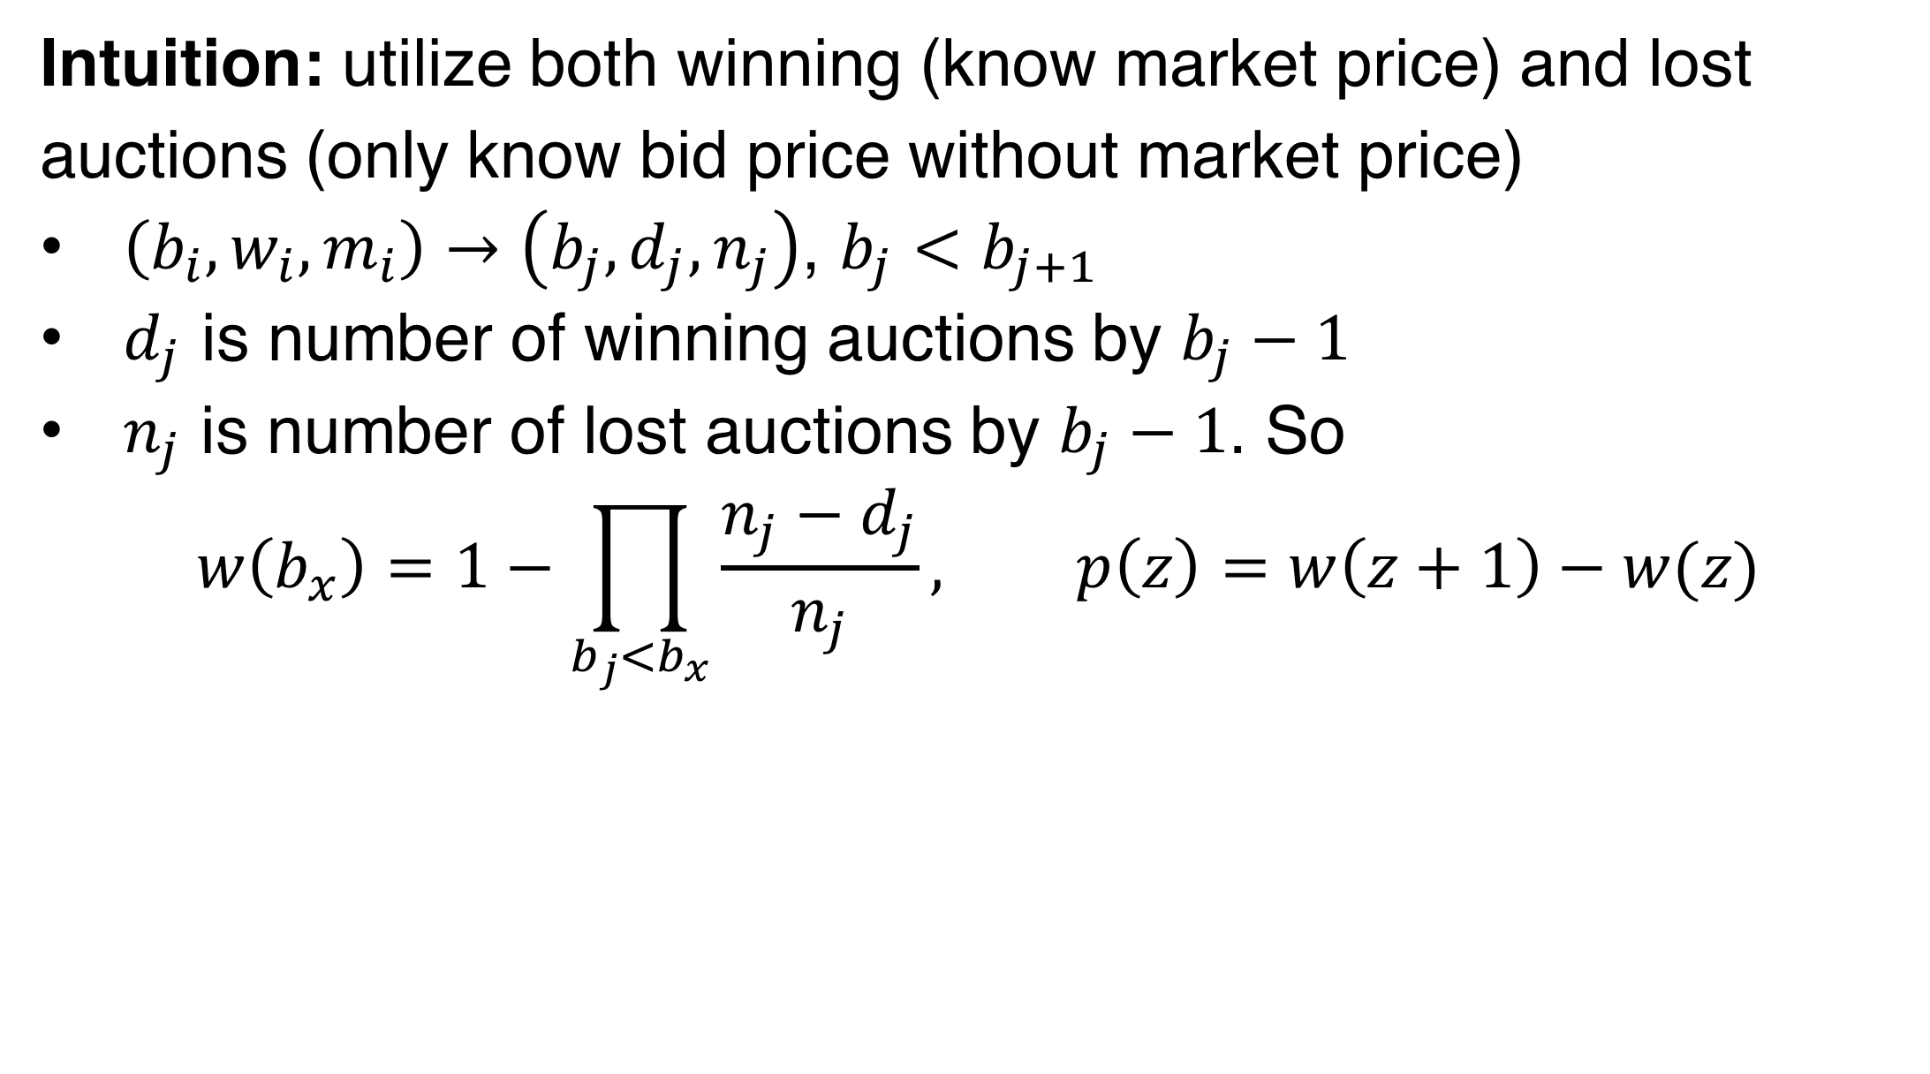
Functional Bid Landscape Forecasting
for Display Advertising
Yuchen Wang, Kan Ren (kren@apex.sjtu.edu.cn), Weinan Zhang, Jun Wang, Yong Yu
Apex Data & Knowledge Management Lab, Shanghai Jiao Tong University
Background
Our Approach
Real-time Bidding
Functional Landscape Forecasting (Tree-based Mapping)
Bid Landscape Forecasting
Node Splitting
City
New York
Honolulu
…
Los Angeles
…
Indianapolis
New Orleans
Philadephia
Weekday
…
Monday
…
Friday
…
Tuesday
Saturday
Sunday
Thursday
Terminologies
Survival Model for handling Censorship
Intuition: utilize both winning (know market price) and lost auctions (only know bid price without market price)
$\left(b_{i},w_{i},m_{i}\right)→\left(b_{j},d_{j},n_{j}\right)$, $b_{j}<b_{j+1}$
$d_{j}$ is number of winning auctions by $b_{j}−1$
$n_{j}$ is number of lost auctions by $b_{j}−1$. So
$$w\left(b_{x}\right)=1−\prod_{b_{j}<b_{x}}{\frac{n_{j}−d_{j}}{n_{j}}}, p\left(z\right)=w\left(z+1\right)−w(z)$$
Task
Auction Feature
Bid Landscape
Experiments
Setup
Forecasting
Dataset: iPinYou Bidding Logs (64.7M auction samples)
Metrics: to measure the error between the forecasted distributions with the true one.
ANLP: Average Negative Log Probability
KLD: KL-Divergence
Compared Models
NM: Normal Model, only make statistics on the winning auctions.
SM: Survival Model, additionally utilize the lost auctions.
MM: Linear Mixture Model, implemented as KDD 2015 paper.
NTM: Normal Tree Model, forecast the bid landscape using only tree model.
STM: Survival Tree Model, the proposed tree Model with survival analysis.
Forecast the market price distribution of the specific auction.
Challenges
Distribution Prediction: not a traditional prediction task.
Sparse Categorical Feature: long-tail sparse data, with categories.
Censored Data: advertisers have no idea about the true market price when they lost the auction (only winning advertiser knows it).
Demand-Side Platform
Advertiser
RTB
Ad
Exchange
Results
Bid Response
(bid price)
Largest
Lose
Win
Do nothing, only know market price is larger
Deliver ads, record the market price
Apex Data & Knowledge Management Lab
http://apex.sjtu.edu.cn

