Slide 1
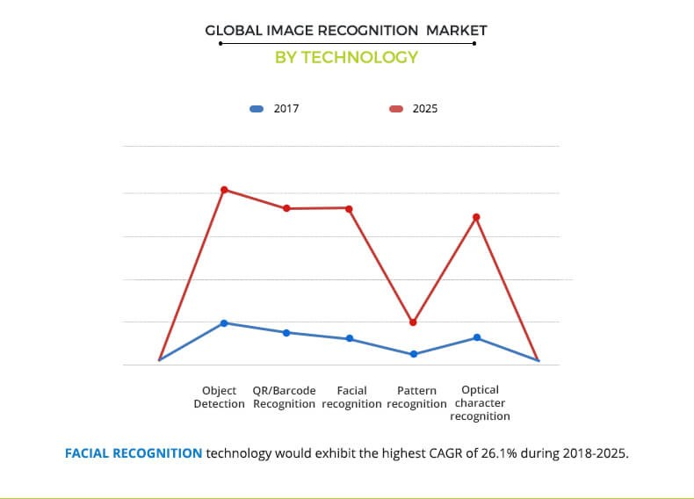
Image Recognition
The image recognition market is estimated to grow from USD 15.95 billion in 2016 to USD 38.92 billion in 2021.

Slide 2
How it works?
Images are data in the form of 2-dimensional matrices.
Image recognition is classifying data into one category out of many.
The major steps in image recognition process are gather and organize data, build a predictive model and use it to recognize images.

Slide 3
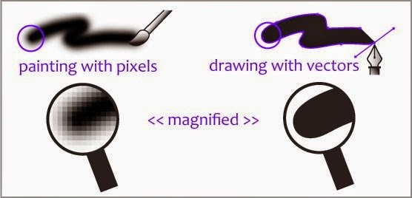
Gather and organize data
Computer perceives an image as either a raster or a vector image. Raster images are a sequence of pixels with discrete numerical values for colors while vector images are a set of color-annotated polygons.

Slide 4
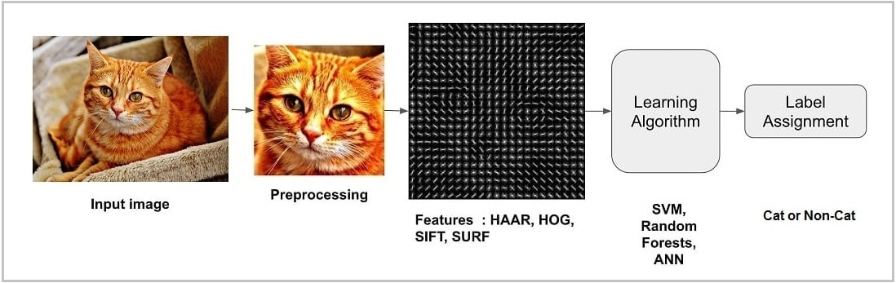
Gather and organize data
Convert image into feature vector

Slide 5
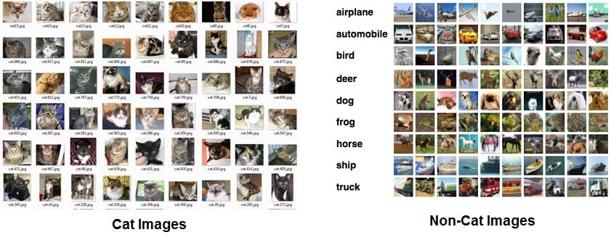
Build a predictive module
A classification algorithm takes this feature vector as input and outputs a class label
Before a classification algorithm can do its magic, we need to train it by showing thousands of cat
and non-cat images.

Slide 6
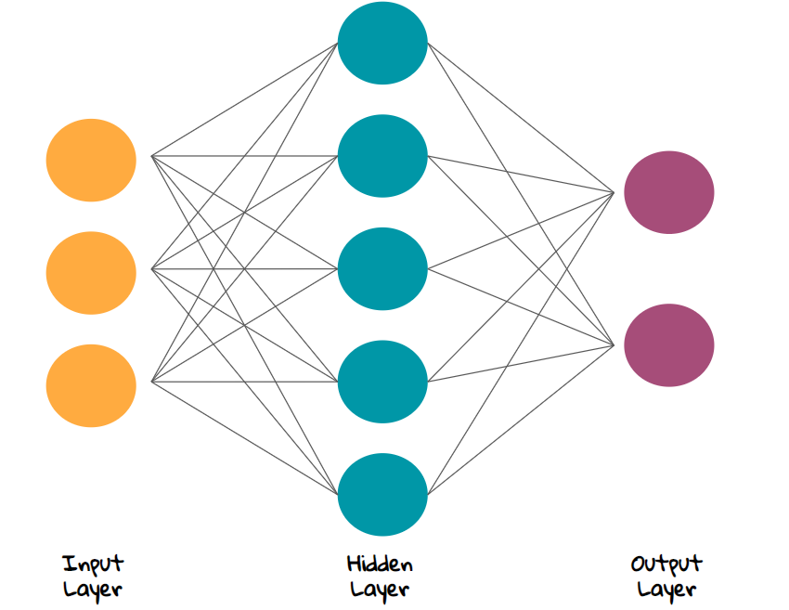
Build a predictive module
To build a predictive module, a neural net work is needed. A neural network is a function that learns the expected output for a given input from training datasets
A neural network is an interconnected group of nodes. Each processing node has its own small sphere of knowledge, including what it has seen and any rules it was originally programmed with or developed for itself. The neural network would require one learning algorithm.

Slide 7
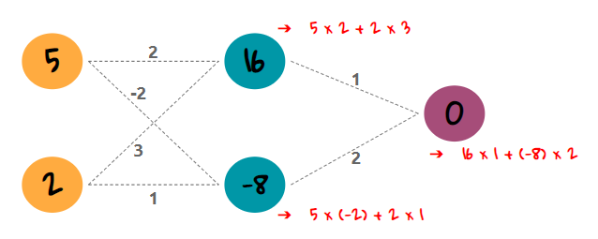
Neural Network

Slide 8
Recognize images
The image data, both training, and test are organized. Training data is different from test data, which also means we remove duplicates (or near duplicates) between them. This data is fed into the model to recognize images. We have to find the image of a cat in our database of known images which has the closest measurements to our test image. All we need to do is train a classifier that can take the measurements from a new test image and tells us about the closest match with a cat. Running this classifier takes milliseconds. The result of the classifier is the ‘Cat’ or ‘Non-cat’.

