Slide 1
Aheym Corpus and ASR for Transcription
Damir Cavar
Indiana University
ClingDing, May 2014

Slide 2
Motivation
Making recording of endangered languages is a time-consuming task. Transcribing recordings is even more demanding and can take 10 to 100 times real-time.
Can speech technologies, such as speech-to-text conversion, or automatic speech recognition (ASR), be included in the loop to automate some of the tasks?

Slide 3
Viable Options
Automatically transcribe speech phonetically may not be feasible, though some more restricted tasks are within reach
  Adopt more robust speech technologies such as English ASR to languages with less resources
  Collect resources to build language-specific ASR systems

Slide 4
Outlines
ASR system overview (following the modules and system design of the HTK Toolkit)
Forced Aligner
Sample ASR corpus design

Slide 5
ASR
speech
ASR
text

Slide 6
HTK: The Hidden Markov Model Toolkit
Originally developed by Steve Young at Cambridge University
Use statistical models for ASR, in particular Hidden Markov Model (HMM)
Distribute C library modules and tools. Can plug in new data to train new ASR systems
Many current ASR systems are built using the HTK platform

Slide 7
HMM
Hidden Markov Model estimates the next state with information in the current state
  If I see united, what is the probability that the next word is states?
Not using global information or long distance information, but uses n-gram models (sequence of sounds/words with length n)
It is a drastically simplified model of language, even so, the model is still very complex and data are sparse for rare events
In language, most events are rare, thus the need for large corpus

Slide 8
Components of a Speech-to-Text
Systems
A Speech-to-Text system, or Automatic Speech Recognition (ASR) system, typically has three main components: Acoustic model, dictionary, and language model
ASR
Acoustic Model
Dictionary
Language Model

Slide 9
Dictionary
Dictionary is needed for both training and recognition
Sound symbols are the same in the dictionary and acoustic model
Multiple pronunciations of a word are entered on separate lines
HELLO HH EH L OW
HELLO HH AH L OW
AARDVARK AA R D V AA R K
VASE V EY S
VASE V AA Z

Slide 10
Acoustic Model
An acoustic model is trained with speech corpora with text transcription
A dictionary maps words to their pronunciation annotated with pre-defined sound symbols
One of the ASR challenges is to recognize variations of sound including co-articulation, speaker, dialect, reduction, emphasis, mic, environment etc
ASR acoustic model are statistical models of sounds with probabilities of pronunciation variations and phone to phone transitions
An ASR system will have better recognition result if the speech corpora is rich in speech variations

Slide 11
Language Model
Language model is trained from large text databases
Learn the probability distribution of words and sequence of words, and use this information in recognition
Provides context to differentiate words, word sequences or phrases that may sound similar

Slide 12
Forced Aligner
ASR takes speech as input and produces transcription as output
Forced aligner takes speech and transcription as input and produces time marks for sounds and words
Popular systems include P2FA built by Jia-hong Yuan and distributed via UPenn Phonetics Lab
P2FA is trained using HTK

Slide 13
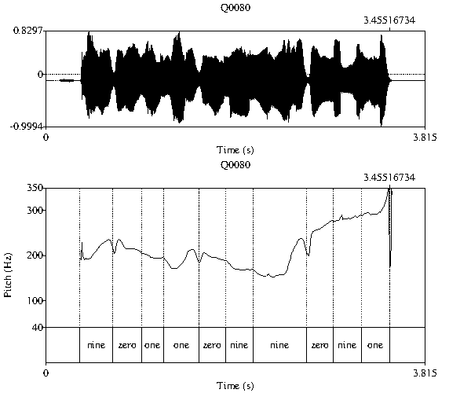
Speech with f0 and word labels

Slide 14
Word Annotation with Duration
in Praat Format
intervals [2]:
xmin = 0.3440803178338985
xmax = 0.6709413596973404
text = "nine"
intervals [3]:
xmin = 0.6709413596973404
xmax = 0.9623596379852283
text = "zero"
intervals [4]:
xmin = 0.9623596379852283
xmax = 1.1868304739637365
text = "one"

Slide 15
Organization of speech-related information
Speech
  Attributes derived from speech
Other time-synchronized channels
  Articulatory movements
  Physical measurements (breathing, heart rate …)
  Cognitive measurements
Text
  Transcriptions
  Annotations
Alignment of speech and text attributes

Slide 16
Time marks
Speech, speech attributes, text and annotation are coordinated by time marks
Time can be
  Convert to and inferred by sample number
  Annotated

Slide 17
Re-purpose the Forced Aligner
It is possible to “borrow” the acoustic model of one language to align speech of a different language
The main step is to build a dictionary of the target language and annotate pronunciation with similar sounds from the existing acoustic model
  Using English to label Hindi, Mandarin …
Some dictionaries that are easy to build
  Experiments with known words
  Specific text
  Syllable dictionary of a language with a small syllable inventory

Slide 18
Types of English speech corpora used to train ASR or TTS
Read speech
  TIMIT (designed for ASR)
  ARCTIC (designed for TTS)
Lab-recorded spontaneous speech
  ATIS
  Trains
  Map Task
  Buckeye
Natural spontaneous speech
  Switchboard
  British National Corpus—Audio BNC
  Santa Barbara Corpus of Spoken American English

Slide 19
Design, Requirements, and the Organization of Speech Corpora
Spontaneous speech corpora needs transcription before they can be used for ASR and TTS
  Very high accuracy rate, covers all details
  Annotation of all sound events, including speech events such as disfluencies, events such as cough, laughter, door closing
Read speech follows a pre-designed script, and the script serves as the transcription (speech deviated from script needs correction and annotation), thus it is convenient to use read speech to bootstrap the development of speech technologies for languages with less resources

Slide 20
TIMIT
The first widely used annotated speech corpus for English speech to text technology
Designed to provide speech data for
  The acquisition of acoustic-phonetic knowledge
  The development and evaluation of automatic speech recognition systems (ASR)
Developed by a consortium including MIT, Texas Instruments (TI) (hence TIMIT), Stanford Research Institute (SRI), and the National Institute of standards and Technology (NIST)
Sponsored by the Defense Advanced Research Projects Agency (DARPA)

Slide 21
TIMIT Design
  The database includes 6300 sentences spoken by 630 speakers
  Phonetically balanced text
  Balanced selection of dialects and speakers
    8 US dialect regions following Language Files
    Aimed at having 50 male and 50 female speakers for each dialect regions
    Speakers covering a range of ages and educational backgrounds

Slide 22
TIMIT dialect regions and codes
      Dr1: New England
      Dr2: Northern
      Dr3: North Midland
      Dr4: South Midland
      Dr5: Southern
      Dr6: New York City
      Dr7: Western
      Dr8: Army Brat (moved around)

Slide 23

Materials Design: Three strata
2 dialect “shibboleth” sentences designed by SRI which are read by all speakers
  She had your dark suit in greasy wash water all year
  Don’t ask me to carry an oily rag like that
450 phonetically-compact sentences designed by MIT for good coverage of English diphones, as well as difficult or interesting cases
1890 phonetically-diverse sentences selected by TI from existing text sources including the Brown Corpus and the Playwrights Dialog to add diversity in sentence types and phonetic contexts.

Slide 24
TIMIT Sentences
Sentence type | # Sentences | #Speakers | Total | #Sentences/Speaker
Dialect (SA) | 2 | 630 | 1260 | 2
Compact (SX) | 450 | 7 | 3150 | 5
Diverse (SI) | 1890 | 1 | 1890 | 3
Total | 2342 |  | 6300 | 10

Slide 25
TIMIT Examples
The filename convention
  dr3-madc0/sa1.wav
  Directory name codes region, gender, speaker
  Filename codes sentence type, sentence number
Annotation files share the same basename: sa1.wrd
  2240 5472 she
  5472 10110 had
  10110 11800 your
  11800 16690 dark
  16690 22390 suit
  22390 24519 in
  24519 31471 greasy
  31471 37000 wash
  37347 42187 water
  43636 48110 all
  48110 53320 year

Slide 26
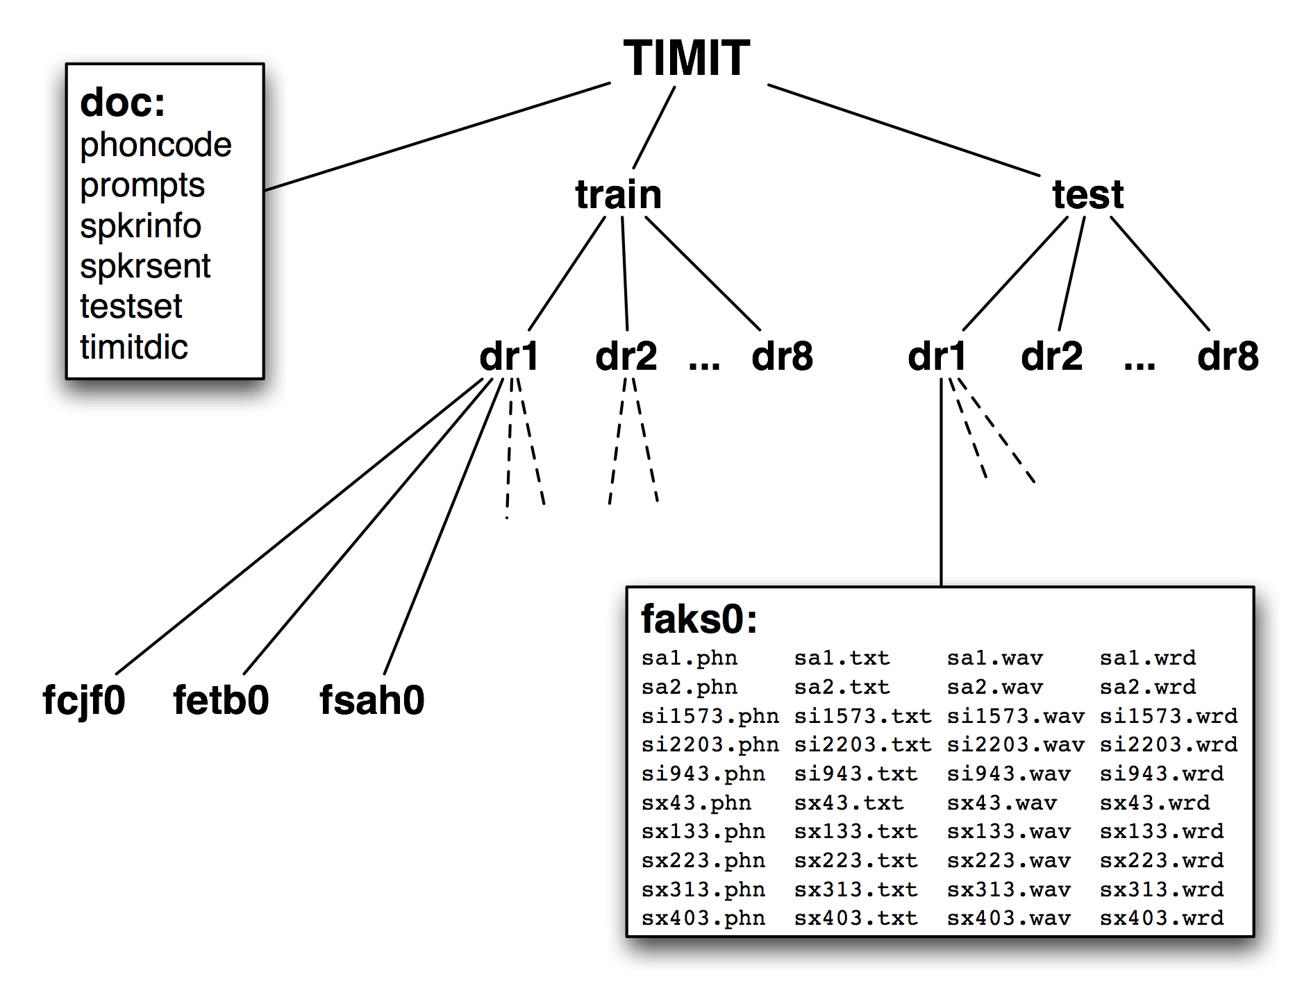
TIMIT Database Structure
Natural Language Processing with Python, Steven Bird,
Ewan Klein and Edward Loper. O’Reilly Media, 2009

Slide 27
Summary
TIMIT demonstrated many best practices of corpus construction. It is still used today.
  Collaboration
  Text design and selection reflect dialectal and phonetic knowledge
  Balanced design, large scale given its time
  Multiple annotations
  Quality control
  Clear structure and documentation. Easy to navigate

Slide 28
Concluding Remarks
Building speech technologies requires data, and data annotation is faster and more consistent with the right technologies. The two tasks support and enhance each other.
Better data leads to better speech technologies, and better speech technologies lead to better data, faster.
To build an ASR system for a new language requires a dictionary, a speech corpus with transcription, and a text corpus
TIMIT represents an cost-effective database design for ASR

