Slide 1
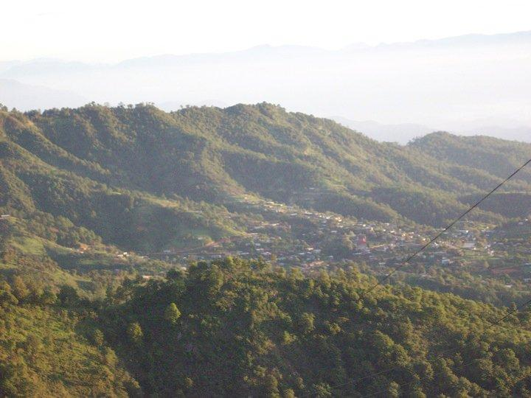
Endangered Language Documentation: Bootstrapping a Chatino Speech Corpus, Forced Aligner, ASR
Malgorzata Cavar, Damir Cavar, Hilaria Cruz
University of Indiana and University of Kentucky
10th edition of the Language Resources and Evaluation Conference, 27 May 2016, Portorož (Slovenia)

Slide 2
Agenda
Work based on the NSF-funded AARDVARC project (http://info.linguistlist.org/aardvarc/) (NSF #1244713)
Creating the first San Juan Quiahije Eastern Chatino (CTP) Speech Corpus
Experiment with Forced Alignment
Why?

Slide 3
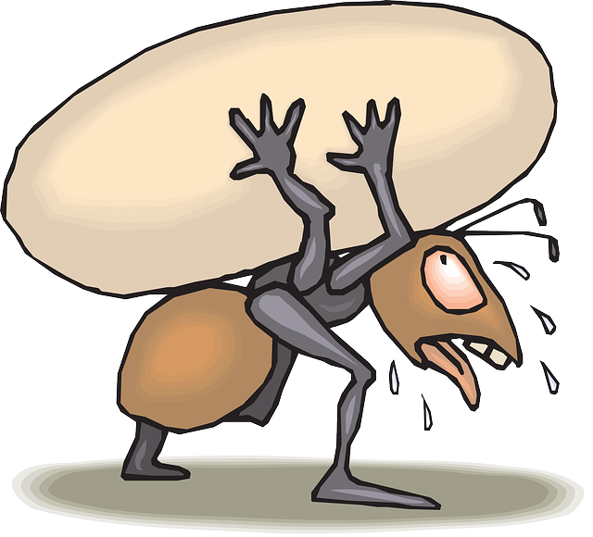
The Problems
The Language Resource Bottleneck
Large Data Collections in Archives
The Transcription Bottleneck
From: http://fitforprostatesurgery.com/get-fit-get-healthy/establish-an-exercise-routine/

Slide 4
Endangered Language Documentation
Large collections of recordings over the last decades
Limited amount of transcribed, translated, or analyzed data
Ethnologue lists 7,097 living languages (yesterday)
1% of those languages are well-resourced.
Biodiversity and language diversity threatened in a similar way.
Large number of languages: unwritten, partially qualitatively documented, etc.
Growing gap between the low 99% and the 1% highly resourced languages.

Slide 5
Language Resources
Audio and Video from documentary linguistic work
The Archive of the Indigenous Languages of Latin America at UT Austin (AILLA)
The Alaska Native Language Archive
DOBES, Max Planck Institute
SOAS, London
many more
Lack of transcription, effort
50 to 100 x real-time, i.e. one hour of recording requires 50 to 100 hours of work

Slide 6
Possible Approach
Speech and video technologies (AARDVARC project)
Forced Alignment to speed up the production of speech corpora
Automatic Speech Recognition (ASR) for the recordings could speed up the transcription task.
Low number of speakers and longer spoken sequences = less signal variation.
Task to estimate effort for:
Initial speech corpus for Forced Aligner (approx. 2 to 5 hours).
Effective corpus size for ASR.

Slide 7
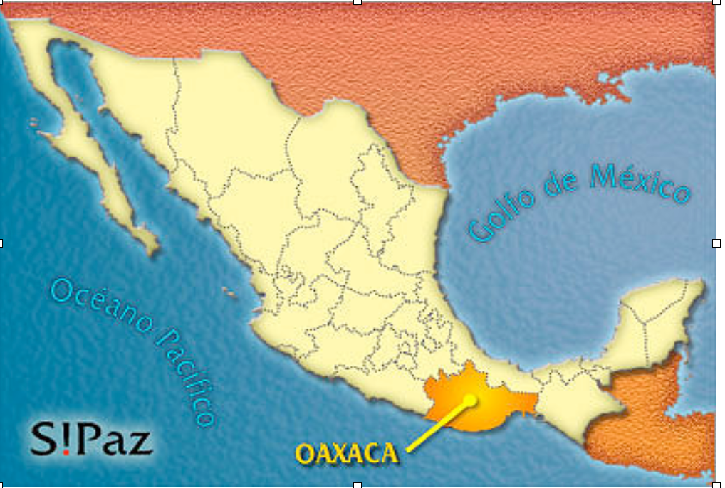
The Chatino languages spoken in Oaxaca, Mexico

Slide 8
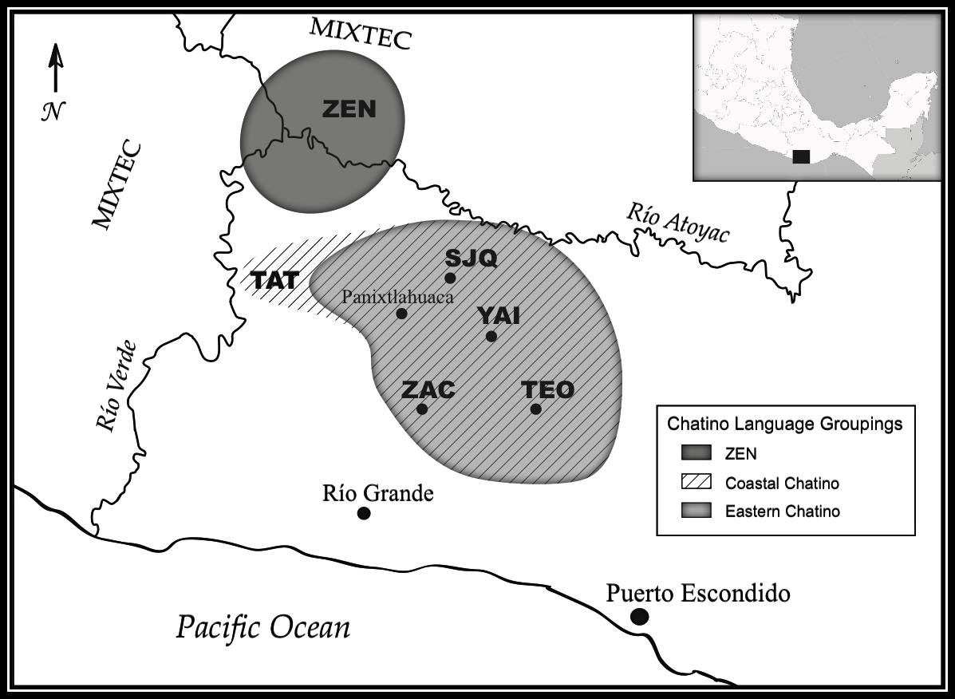
Chatino is a group of three languages

Slide 9
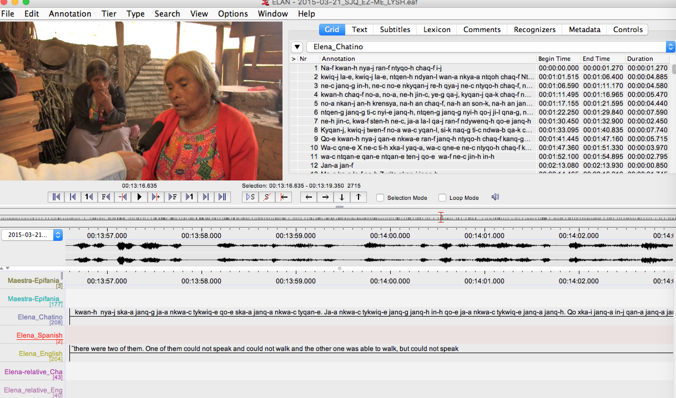
The shown scene was recorded by Lynn Hou.

Slide 10
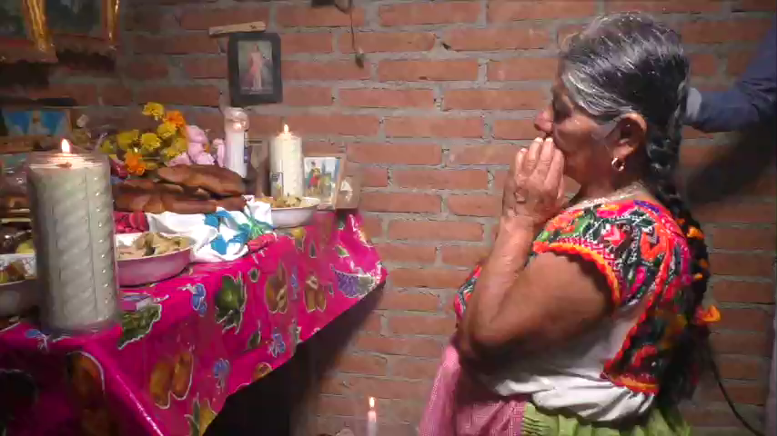
This is how Chatino sounds
Margarita Balthazar Garcia, Cienequilla.

Slide 11
Typological features of the Chatino Languages
Highly tonal (Especially Eastern Chatino)
Strongly head-marking
Head-initial syntax
VSO word order
Alienable vs. inalienable possession
complex verbal inflection classes
Vigesimal numeral system
no plural marking on nouns
Excl vs. Incl. pronouns

Slide 12
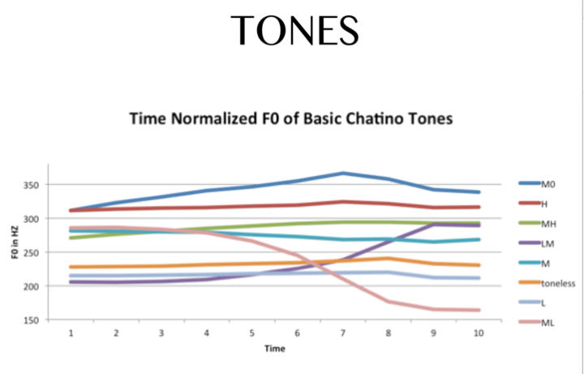

Slide 13

Representation of tone
 | Number | Tonal group | gloss
Level tones | ska1+0 | skaK | sugar
 | kla1 | klaE | Weaving loom
 | kla2 | klaC | water pool
 | kla3 | klaF | dream
 | kla4 | klaA | fish, old, star
descending | kla24 | klaJ | twenty
 | tqwa14 | tqwaB | cold
 | tyuq04 | tyuqM | term of endearment
ascending | kla42 | klaG | you will arrive
 | sqen32 | sqenI | scorpion
 | kla20 | klaH | you will sing
 | xkwan40 | xkwanL | I will throw it

Slide 14
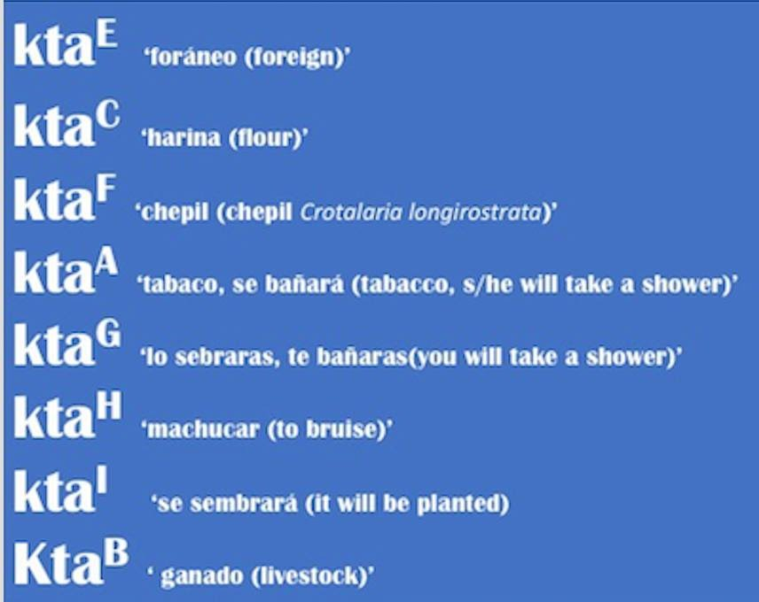

Slide 15
Approach
Identification of text for reading and recording
Recording initial speech corpus of 5 hours
Transcription and time alignment
Training a Forced Aligner
Prosodylab Aligner (PLA, Python module using HTK)
ELAN2split (https://bitbucket.org/dcavar/elan2split) corpus creation for PLA
Pronunciation dictionary (tokens plus tokenized phonetic transcription)
Espeak for Praat: Language model for TXT2Speech
Extending the speech corpus

Slide 16
Outcome
Initial speech corpus:
Approx. 5 hours speech transcribed and time aligned, PoS-tagged and translated
Initial annotation in ELAN (time-alignment correction in Praat)
Workload (ignoring previous investment in text, transcription schema)
Ford Assembly Line approach: bootstrapping initial corpus, FA-training, …
4 to 6 person weeks
Estimate $ 24,000 – 50,000
If we would do that for 3,500 languages: < $ 84 mil.

Slide 17
Resources
GORILLA site (http://gorilla.linguistlist.org/)
Audio, ELAN and Praat transcription/annotation files
Corpus licenses: CC BY-SA, i.e. free for commercial use (donation-ware and copyright free resources)
Code and software: Apache 2.0 licensed, i.e. free for commercial use
Every resource comes with a paper to cite
LLOD-linked
CLARIN-linked
…

Slide 18
Resources
Internships at LINGUIST List and Indiana University:
Work on LL resources, but also: corpus creation, speech and language technologies, qualitative and quantitative language related research
Corpora created with colleagues, students, native speakers and community members:
Chatino, Burmese, Turkic (Baharlu, Khorasan, Iran), Croatian, Russian, Spanish, …
Welcoming students from all over the world!

Slide 19
WaC xqweF qwanJ Hvala!

