Slide 1
Generating speech tools and corpora for unwritten endangered languages: Chatino
Damir Cavar
Indiana University

Slide 2
Audio data without transcription
Example:
Chatino in AILLA
files: 130, restricted files: 5%
audio recordings: 26, length of audio: 7:53:5
video recordings: 72, length of video 4:26:4
digital texts: 12, pages: 156
resources that include transcriptions: 2%
Collection “Chatino Documentation of Hilaria Cruz” in AILLA

Slide 3
Issues
Licensing and availability of resources
Quality of resources
Transcription effort
Available transcriptions

Slide 4
Chatino
Transcriptions and texts (using particular transcription schema, Woodbury & Cruz)
Collected by Hilaria Cruz
Recording of Hilaria under studio conditions
96 kHz, 24 bit, WAV using Zoom H6
Transcription reduced to:
Copy and paste
Time alignment at utterance level in ELAN
Corpus licensed:
CC BY-SA (free for commercial and other use)

Slide 5
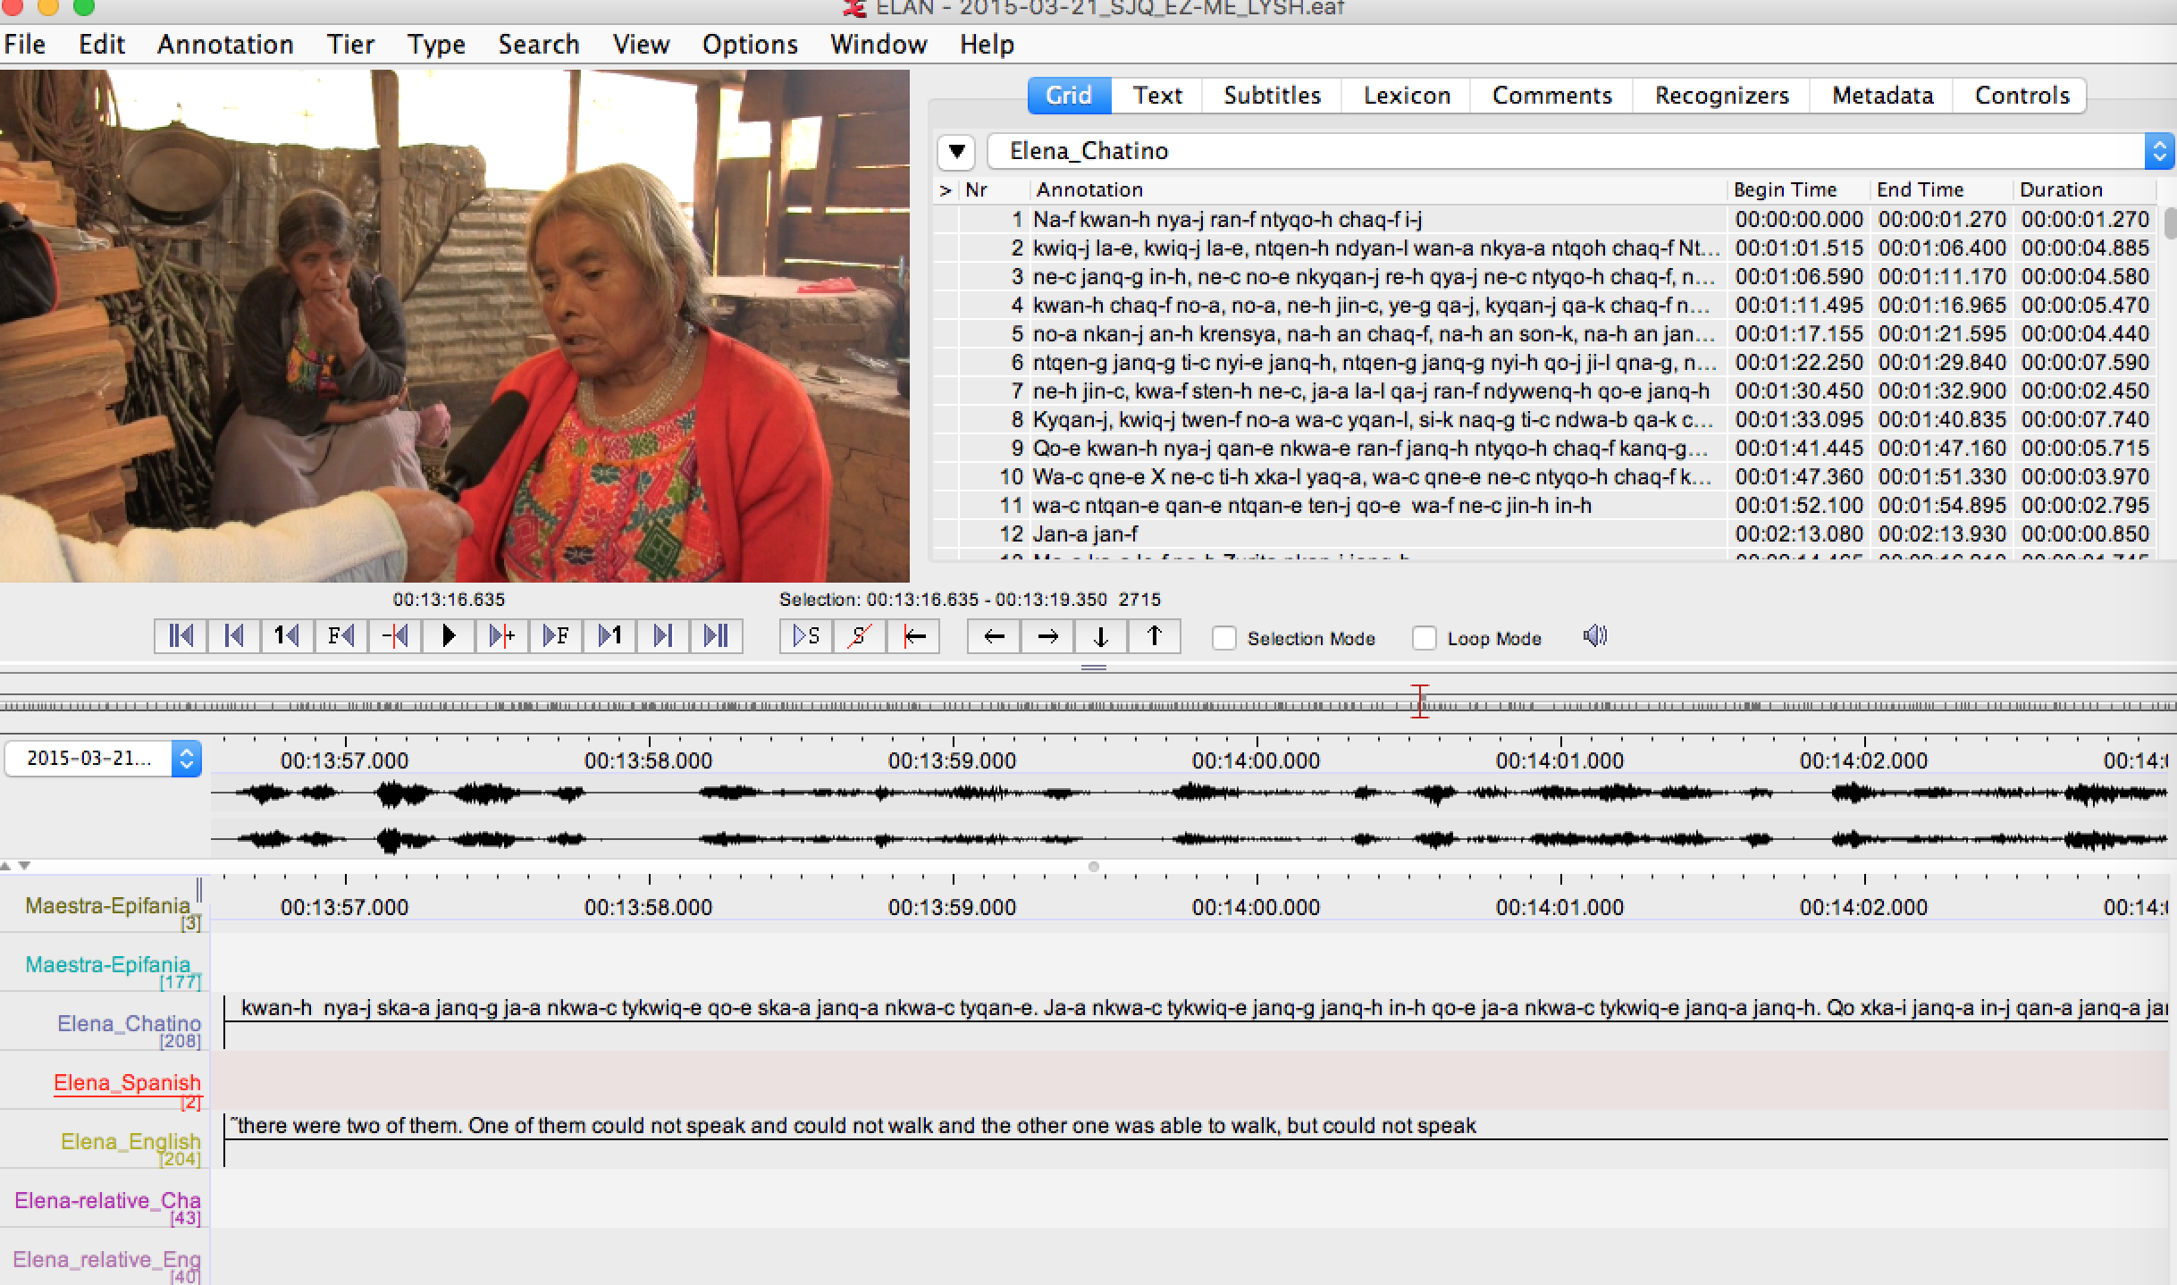

Slide 6
Chatino
Recording more voices:
Native-speakers cannot read the Chatino transcription schema
Presenting stimuli to speakers via headphones
Recording repetition of audio stimuli (and possible errors)
Goals:
Variation of voices by gender and age
Collection >10 hours of audio (affecting signal feature extraction, not vocabulary or language model)
Transcription: copy and paste + time alignment using Forced Aligner
Subsequent transcription and FA of more data

Slide 7
Previous experience with audio repetition
Stimuli containing variation in word order to test gradual grammaticality judgements, and acoustic perception/articulation:
Neo-Shtokavian
Chakavian
Error rate could be used to rank grammaticality or complexity at respective linguistic level.

Slide 8
Forced Alignment
Speech recognition without Language Model
Im-/Explicit in the transcription to be aligned
Simplified process using:
Prosodylab Aligner
ELAN2split
Tokenizer script for unwritten languages or lexicon for written ones

Slide 9
Prosodylab Aligner
Requirements
HTK
SoX
Python
Useful additions:
ELAN2split (C++11 tool, using Xerces-C++ lib and SoX)
https://bitbucket.org/dcavar/elan2split
Platforms:
Mac or Linux (in principle doable on Windows, too)

Slide 10
Prosodylab Aligner
Comes with English or French, some dictionaries available (e.g. German, Dutch)
For new acoustic model:
Min. one hour of audio with corresponding word-level transcription
Pronunciation dictionary
Alignments are learned during training phase
That is:
One only needs utterance, sentence, or breath group segmentation (length not really relevant)

Slide 11
Pronunciation dictionary
ASCII (or Unicode) text (see HTK tutorial)
AABERG AA1 B ER0 G AACHEN AA1 K AH0 N AACHENER AA1 K AH0 N ER0 AAKER AA1 K ER0 AALSETH AA1 L S EH0 TH AAMODT AA1 M AH0 T AANCOR AA1 N K AO2 R

Slide 12
Pronunciation dictionary
For unwritten languages (e.g. Chatino):
Phonemic transcription of word followed by tokenized sequence of phonemes
For written languages:
Use phonemic/phonetic transcription from dictionaries or manually transcribe
Raphael Finkel’s Yiddish dictionary for our Yiddish corpus
Manual for Croatian corpus
etc.

Slide 13
ELAN2split output
Corpus of utterance tuples:
WAV-section that is marked up in ELAN
Corresponding transcript in a particular tier
Deep parsing of ELAN EAF-XML
SoX-based cutting of WAV-file and segment generation

Slide 14
Praat aligner
Analysis via Synthesis
Espeak based text-to-speech module (in Annotate, see Interval)
Declarative rule-based text-to-speech language model
Phone inventory
Exception dictionary
Stress, tone, contours, breath, etc.
Generation of Wave from transcription-token and fitting into the recorded Wave
Rich collection of language models
Our models:
Yiddish, Burmese, ...

Slide 15
Burmese TXT2Speech
Example: Burmese (Lwin Moe)
How are you? (Espeak): https://www.youtube.com/watch?v=Cr7JbO3SlIM
How are you? (Lwin Moe): https://www.youtube.com/watch?v=THu6957qebU
I am fine (Espeak): https://www.youtube.com/watch?v=ryupSFaJdUk
I am fine (Lwin Moe): https://www.youtube.com/watch?v=i6Vm-SaPDkw
How are you? (In English): https://www.youtube.com/watch?v=I5tl3l63b3g

