Slide 1
Lingvin snakegame
TIMMATES:
MAkhmudov sherzodbek 2016116885
Le xuan huy 2017117323
Wang Jigang 2017116855
Lee Jae ho 2008038063

Slide 2
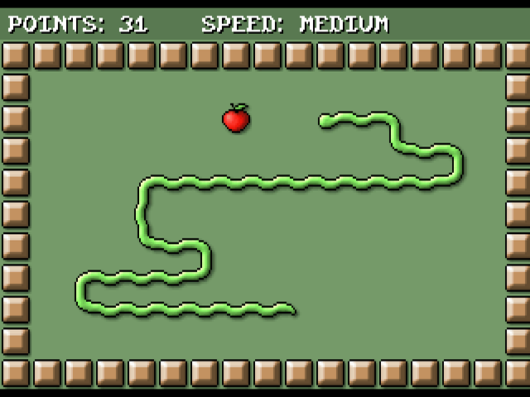
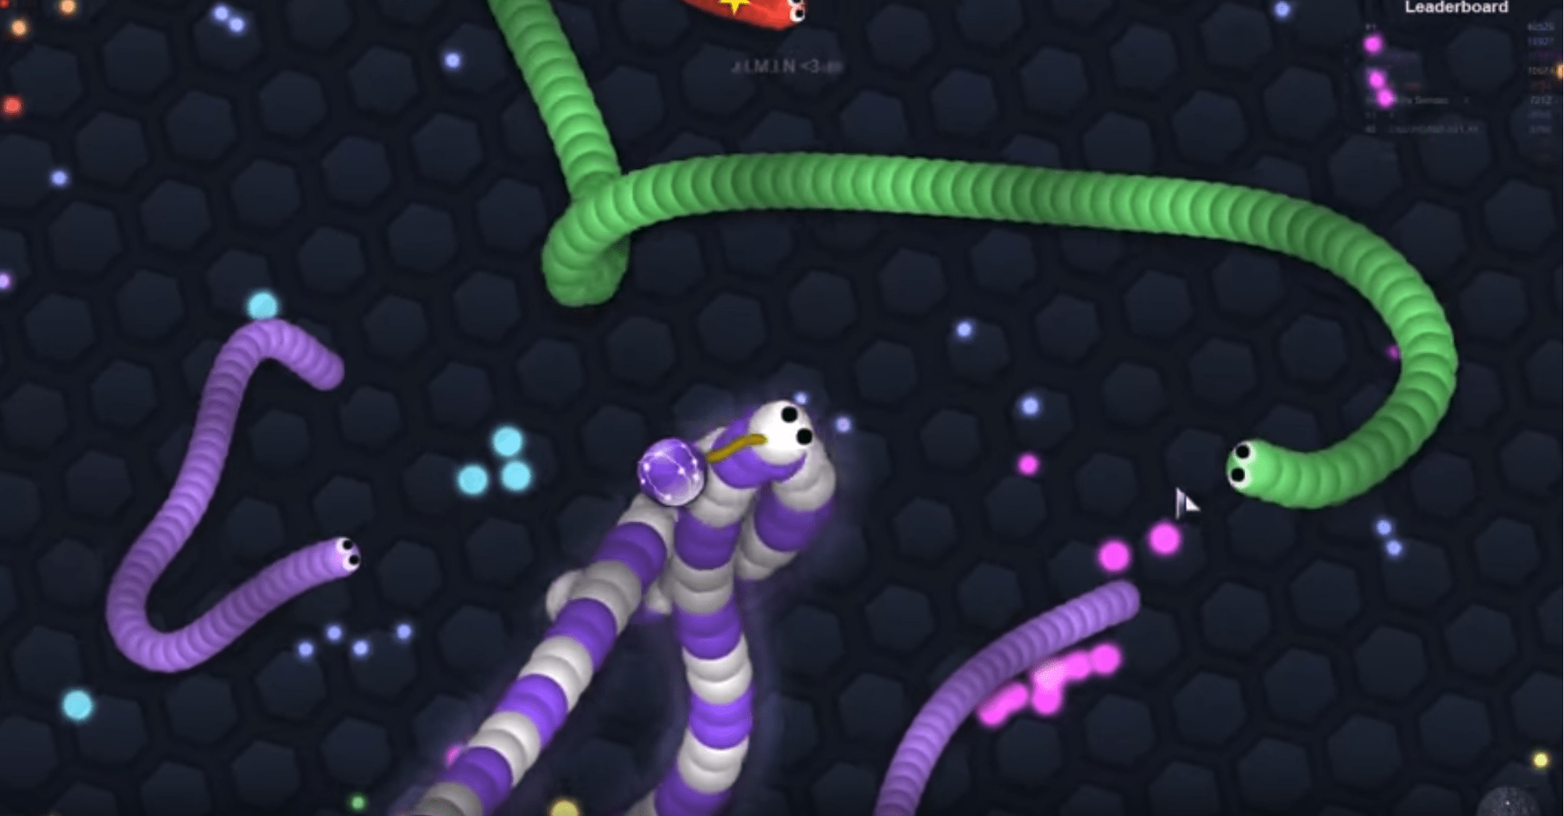
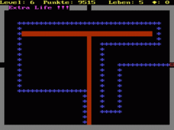
Evolution of snake game
The first snake game from nokia
2006
2018
1997 year

Slide 3


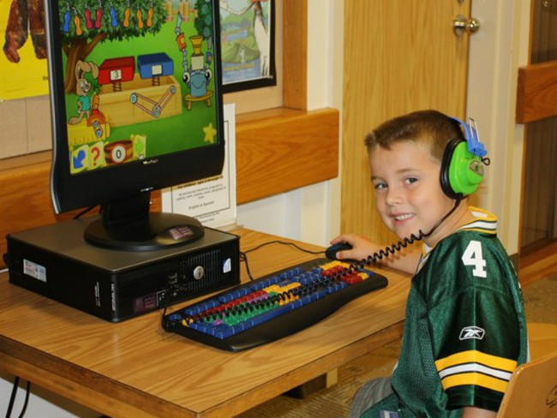



Why snake game?

Slide 4
Run The Game!

Slide 5
Structure of game
Libraries
Functions
Main
void initsnake();
void interface();
void getInput();
void CreatFood();
void creatLink();
void insertNode(int x , int y);
void deleteNode();
void deleteLink();
int set_ticker(int);
void printS_b();
void printrefresh();
void snakeInformation();
void gameover(int i);
#include<stdio.h>
#include <curses.h>
#include <stdlib.h>
#include <malloc.h>
#include <sys/time.h>
#include <unistd.h>
#include <signal.h>
#include <time.h>
int main()
{
initscr();
initsnake();
signal(SIGALRM,printrefresh);
getInput();
endwin();
return 0;
}

Slide 6
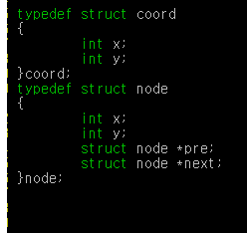
coord
node
x
x
y
y
pre
next

Slide 7
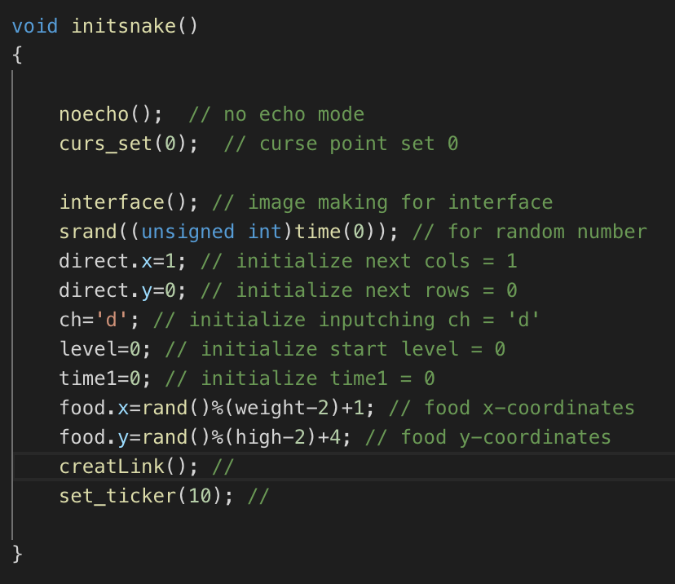
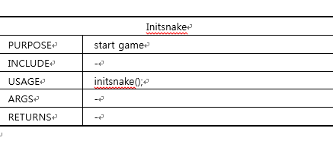

Slide 8
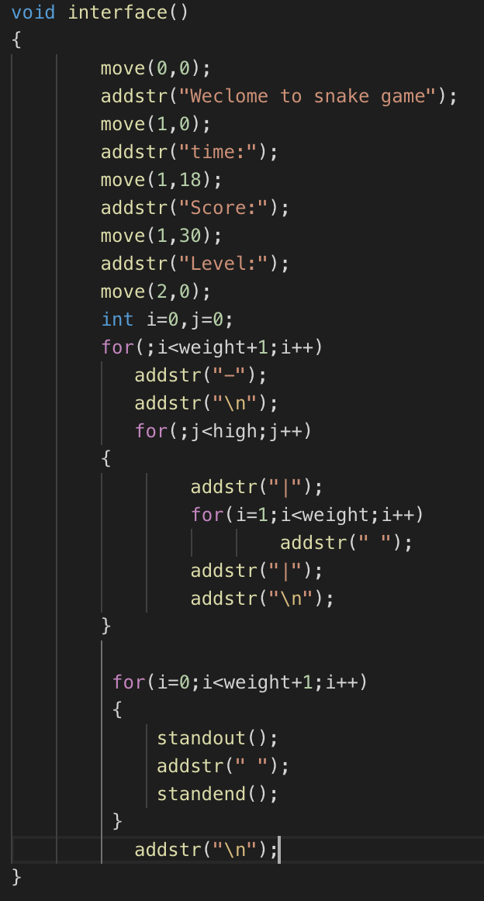
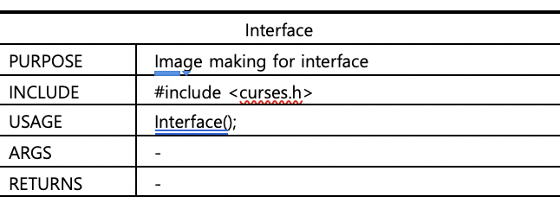

Slide 9
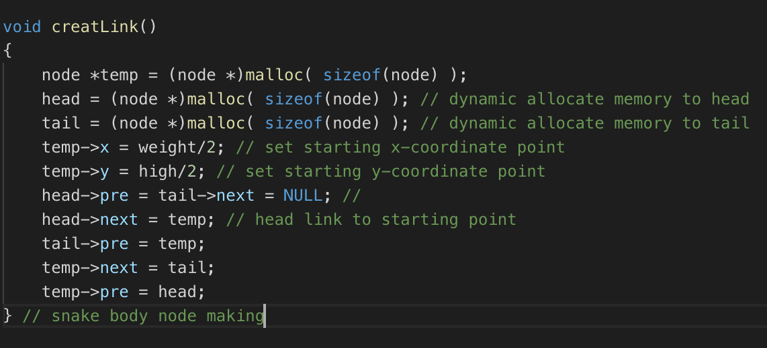
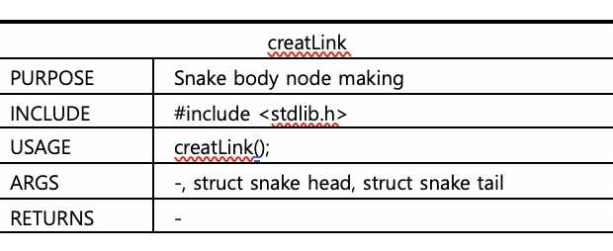
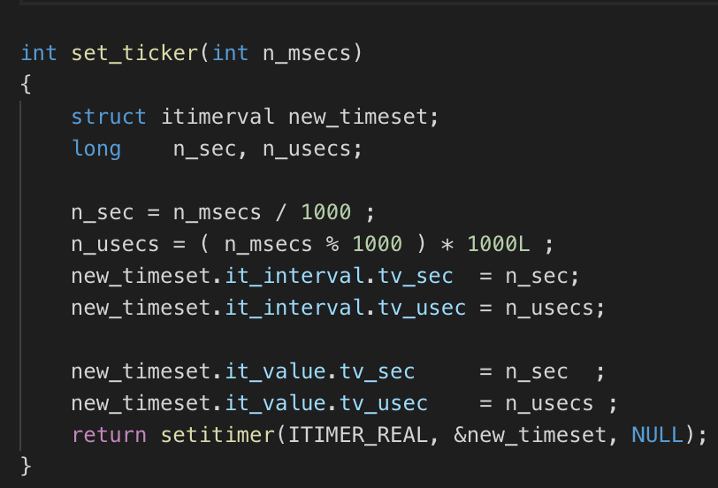
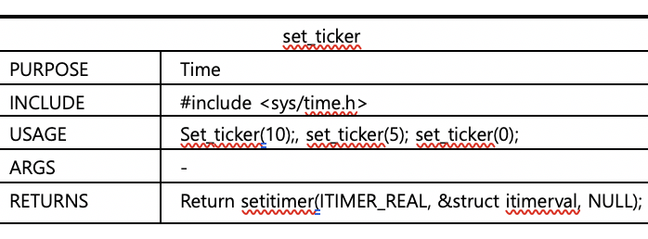

Slide 10
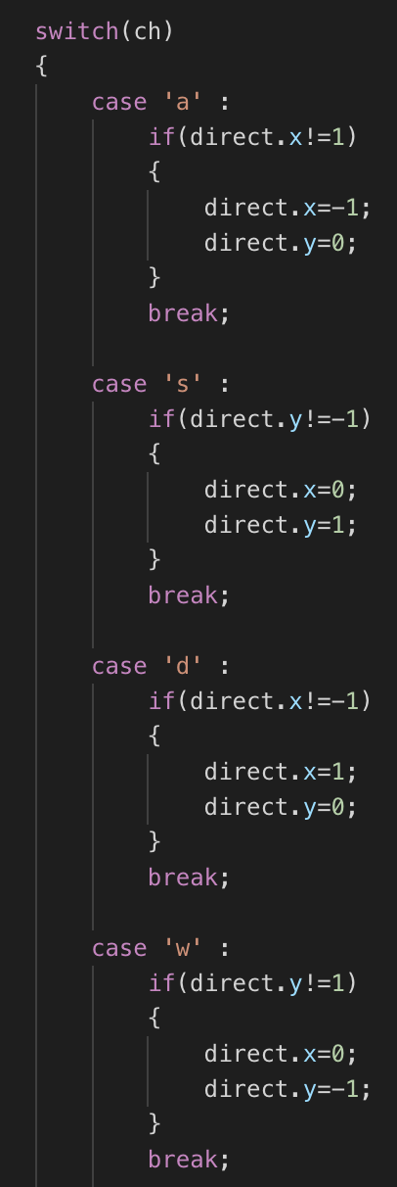
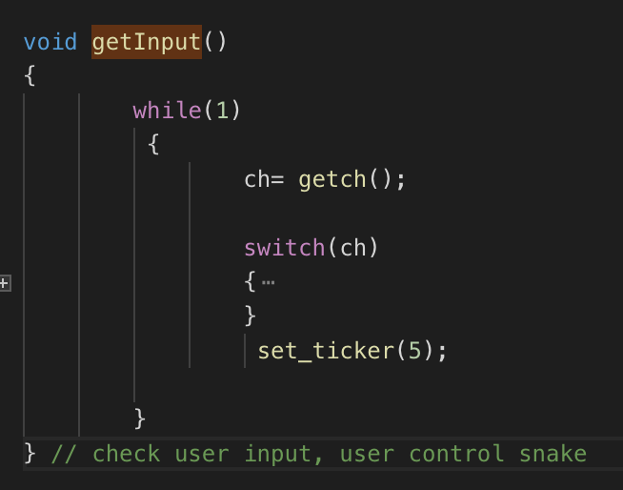
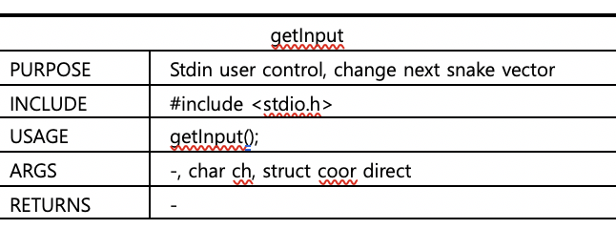

Slide 11
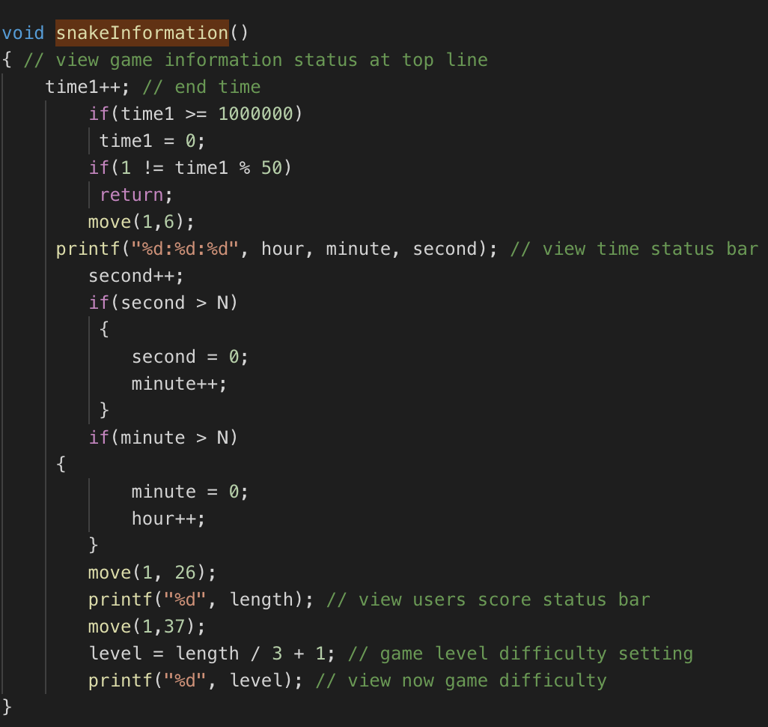
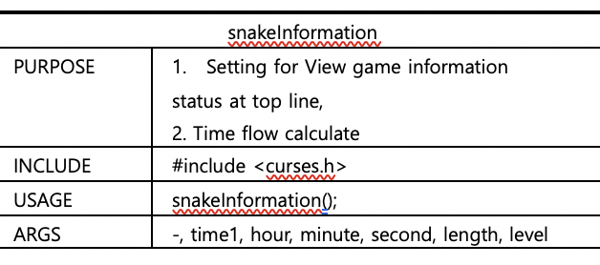

Slide 12
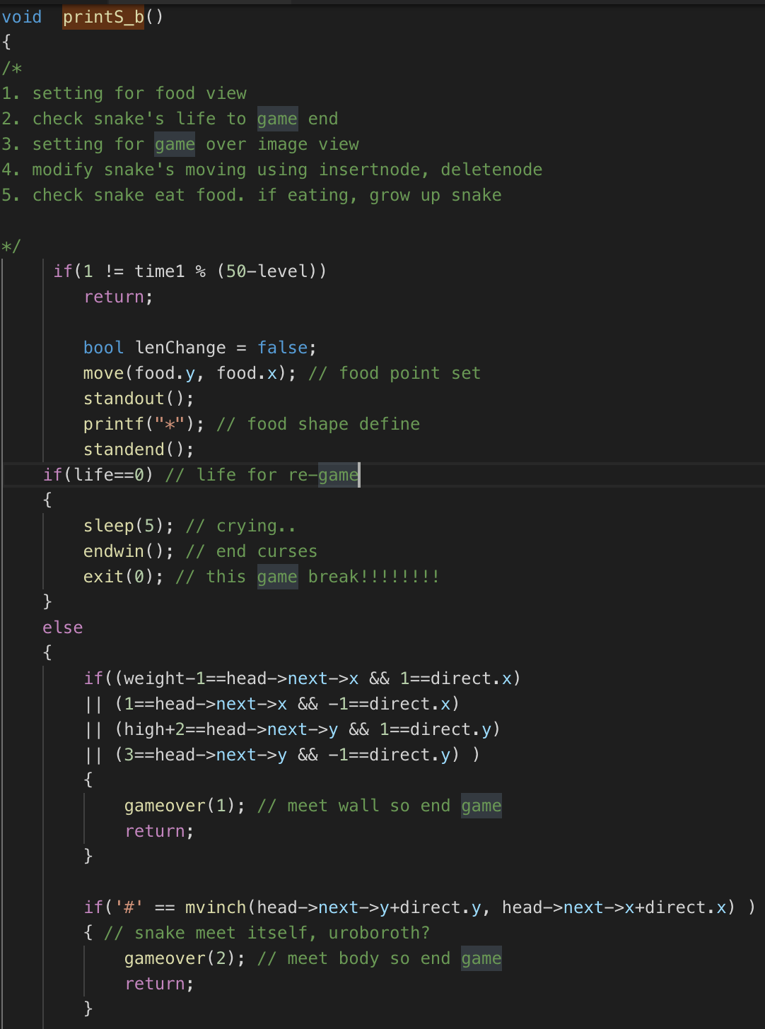
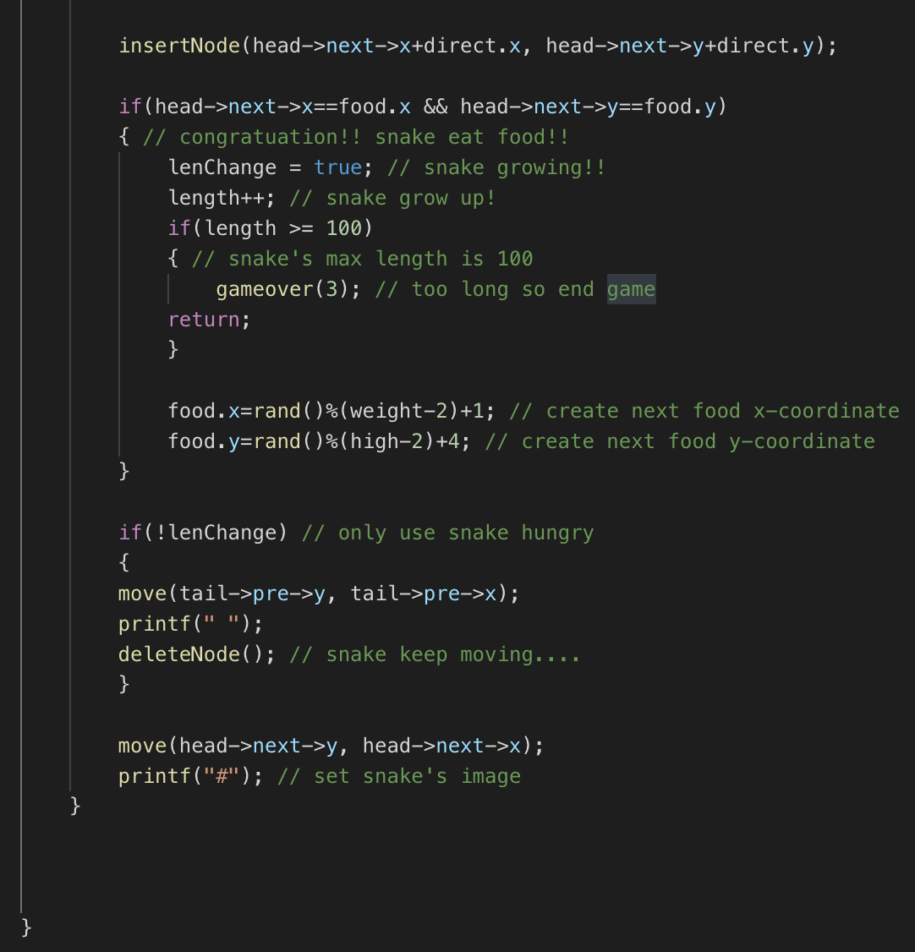
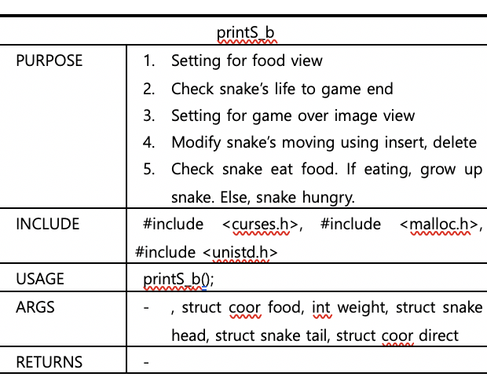

Slide 13
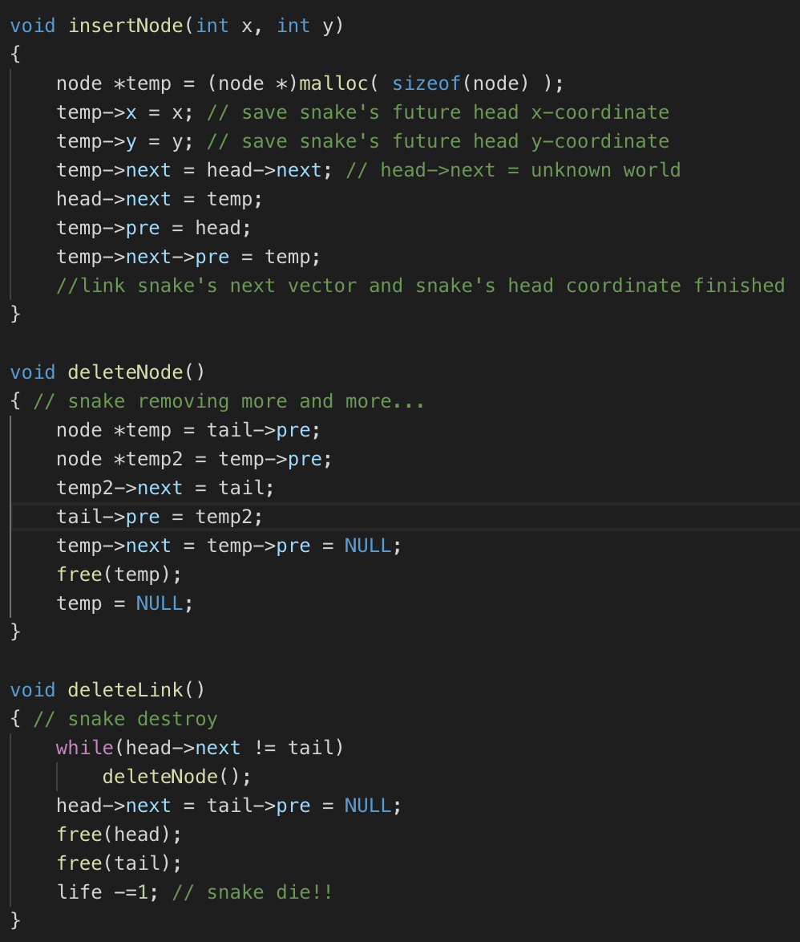
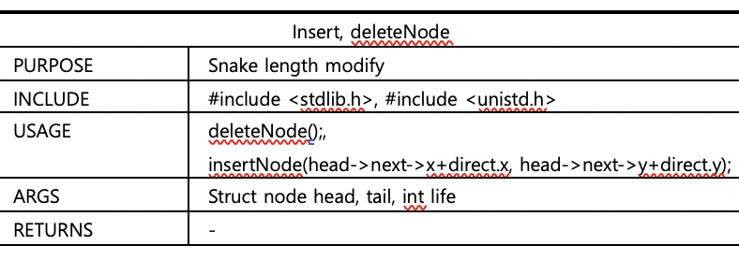

Slide 14
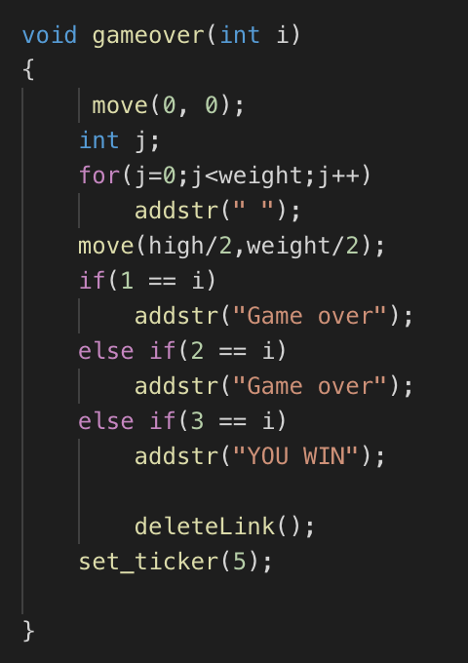
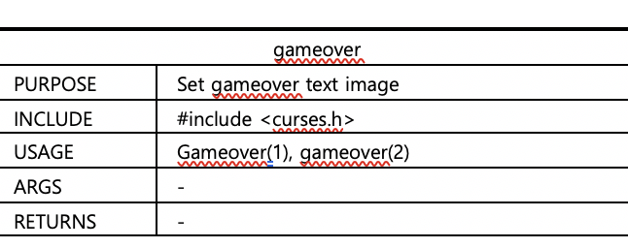

Slide 16
