Slide 1

Intrusion Detection System
and
Impact of IDS on Humans
pre: 王曦、孙沐阳、钟志炫、黄灿彬
ppt: 王曦、孙沐阳、钟志炫、黄灿彬、黄睦泰

Slide 2

Foreword
1. era of the Internet of Things (IoT)
devices <-> digital services
number of devices ↑
-> network vulnerabilities ↑
-> network attacks ↑
2. intrusion detection system (IDS)
low-latency & high accuracy
multi-objective evolutionary convolutional
neural network (MECNN)
run on the fog nodes of Fog Computing on IoT

Slide 3
01
02
Fog Computing
MECNN
content
03
04
Intrusion Detection System
Impact of IDS on Humans

Slide 4

01
MECNN
pre: 钟志炫

Slide 5
01
MECNN---why to create it
The traditional CNN model couldn’t meet our requirements.
1、The design of a CNN model is complicated and involves plenty of parameters
2、the search for optimal topological architectures and hyperparameters of CNN requires professional knowledge and practical experience

Slide 6


03
MECNN
What is MECNN?
A CNN network using MOEA/D to optimize and buid CNN model automatically.And parameters will then be transformed into a chromosome of MOEAs.

Slide 7
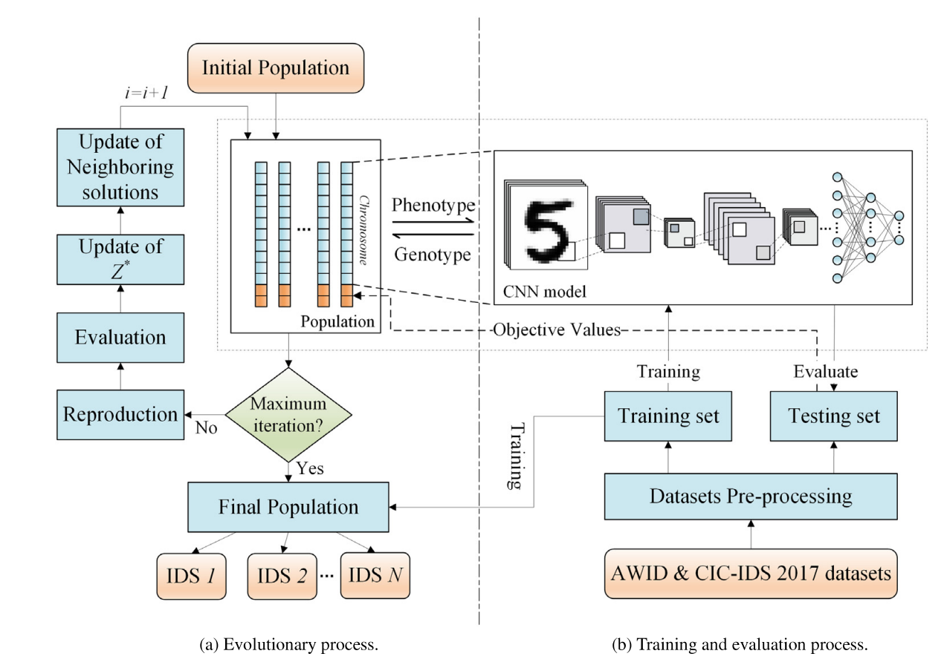
The general flow path of MECNN(Fig 1.)
Fig 1.

Slide 8
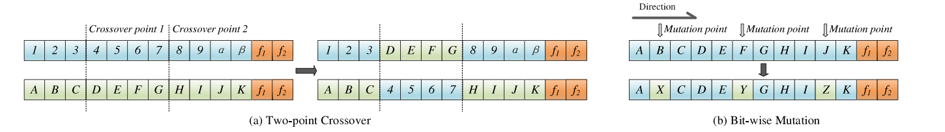
The general flow path of MECNN
Initialize initial population
Crossover(交叉) and Mutation(突变)(Fig 2.)
Update population

Slide 9
02
Fog Computing
pre: 黄灿彬

Slide 10
01
Fog Computing
What is FogComputing
Fog computing is a paradigm developed by Cisco that transfers the data and services to the edge of the network in the cloud
What's difference between Fog computing and Cloud computing
Seen as an extension of the concept of Cloud computing
the most important feature that distinguish it from other computing architectures is its closer distance to end-users, thus leading to lower latency service

Slide 11
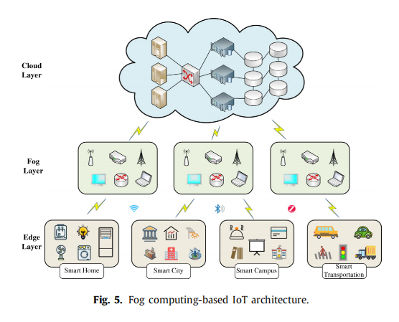
Fog computing-based IoT architecture
02

Slide 12
03
Why do we need Fog Computing
First
Meet the demand of low-latency
Second
real-time requirements

Slide 13
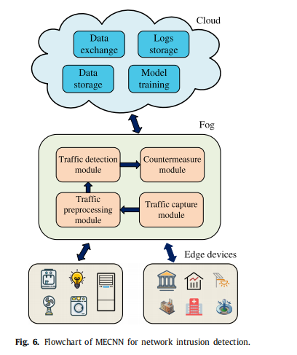
Flowchart of MECNN for network intrusion detection
03
fog node consists of four main components
The Flowchart

Slide 14
03
Intrusion Detection System
pre: 孙沐阳

Slide 15
01
IDS
Suffering from cyber attacks
Results of IDS
improved method
Data leakage, property damage, and hardware damage
causing system downtime
DNS
HTTP
MQTT
RF
AODE
SDAE
GRU
Using an improved multi-target immunization algorithm to reduce the feature dimension

Slide 16
03
IDS
15%
55%
100%
Multi-target evolutionary convolutional neural networks
The topology and hyperparameters of the CNN were transformed into the chromosomes of the MOEAs
The model complexity and detection performance of CNN are considered as two targets for MOEAs

Slide 17
04
Impact of IDS on Humans
pre: 王曦

Slide 18



04
Impact of IDS on Humans
Positive Impact
Real-time Monitoring
Customization
Reduced Risk
monitor network traffic
allow immediate
identification and
response to
potential threats
fit the specific needs
allow to tailor security
measures to
unique environment
and requirements
detect and response to
potential attacks early
reduce the risk of
data breaches, theft,
cyber-attacks...

Slide 19
04
Impact of IDS on Humans
Cost
expensive to implementing and maintaining
particulaly for small or medium-sized
organizations with limited budgets
Privacy Concerns
capture and analyse sensitive data
concerns about privacy and
compliance with data protection laws
Complexity
complex to configure and maintain
require expertise and recources
Negative
Impact

Slide 20
Reference
[1] Q. Zhang, H. Li, MOEA/D: a multiobjective evolutionary algorithm based on decomposition, IEEE Trans. Evol. Comput. 11 (6) (2007) 712–731.
[2] F. Bonomi, R. Milito, J. Zhu, S. Addepalli, Fog computing and its role in the internet of things, in: Proceedings of the First Edition of the MCC Workshop on Mobile Cloud Computing, 2012, pp. 13–16.
[3] Yi. Shanhe, et al., Fog computing: Platform and applications, in: 2015 Third IEEE Workshop on Hot Topics in Web Systems and Technologies, HotWeb,IEEE, 2015.
[4] Y. Imrana, Y. Xiang, L. Ali, Z. Abdul-Rauf, A bidirectional LSTM deep learning approach for intrusion detection, Expert Syst. Appl. 185 (2021) 115524.
[5] C. Kolias, G. Kambourakis, A. Stavrou, S. Gritzalis, Intrusion detection in 802.11 networks: empirical evaluation of threats and a public dataset, IEEE Commun. Surv. Tutor. 18 (1) (2015) 184–208.
[6] I. Sharafaldin, A.H. Lashkari, A.A. Ghorbani, Toward generating a new intrusion detection dataset and intrusion traffic characterization, in: ICISSp,Vol, 1, 2018, pp. 108–116.
[7] M. Jabbar, R. Aluvalu, RFAODE: A novel ensemble intrusion detection system, Procedia Comput. Sci. 115 (2017) 226–234.
[8] S.U. Jan, S. Ahmed, V. Shakhov, I. Koo, Toward a lightweight intrusion detection system for the internet of things, IEEE Access 7 (2019) 42450–42471.
[9] E. Anthi, L. Williams, M. Słowińska, G. Theodorakopoulos, P. Burnap, A supervised intrusion detection system for smart home IoT devices, IEEE Internet Things J. 6 (5) (2019) 9042–9053.
[10] M. Al-Omari, M. Rawashdeh, F. Qutaishat, A.H. Mohammad, N. Ababneh,An intelligent tree-based intrusion detection model for cyber security, J. Netw. Syst. Manage. 29 (2) (2021) 1–18.
[11] H. Hindy, E. Bayne, M. Bures, R. Atkinson, C. Tachtatzis, X. Bellekens, Machine learning based IoT intrusion detection system: An MQTT case study (MQTT-IoT-IDS2020 dataset), 2020, arXiv preprint arXiv:2006.15340.
[12] P.F. de Araujo-Filho, G. Kaddoum, D.R. Campelo, A.G. Santos, D. Macêdo, C. Zanchettin, Intrusion detection for cyber-physical systems using generative adversarial networks in fog environment, IEEE Internet Things J. (2020).
[13] M. Abdel-Basset, V. Chang, H. Hawash, R.K. Chakrabortty, M. Ryan, DeepIFS: Intrusion detection approach for IIoT traffic in fog environment, IEEE Trans. Ind. Inf. (2020).
[14] Y. Chen, N. Ashizawa, C.K. Yeo, N. Yanai, S. Yean, Multi-scale self-organizing map assisted deep autoencoding Gaussian mixture model for unsupervised intrusion detection, Knowl.-Based Syst. 224 (2021) 107086.
[15] M. Habib, I. Aljarah, H. Faris, A modified multi-objective particle swarm optimizer-based Lévy flight: An approach toward intrusion detection in internet of things, Arab. J. Sci. Eng. 45 (8) (2020) 6081–6108.

Slide 21
Intrusion Detection System
and
Impact of IDS on Humans
Thank You

