Slide 1
Rocket and Planets Study Planner
Here is where your presentation begins

Slide 2
Contents of this template
You can delete this slide when you’re done editing the presentation
Fonts | To view this template correctly in PowerPoint, download and install the fonts we used
Used and alternative resources | An assortment of graphic resources that are suitable for use in this presentation
Thanks slide | You must keep it so that proper credits for our design are given
Colors | All the colors used in this presentation
Icons and infographic resources | These can be used in the template, and their size and color can be edited
Editable presentation theme | You can edit the master slides easily. For more info, click here
For more info: SLIDESGO | BLOG | FAQs
You can visit our sister projects: FREEPIK | FLATICON | STORYSET | WEPIK | VIDEVO

Slide 3
Table of contents
01
Schedules
02
Reminders
You can describe the topic of the section here
You can describe the topic of the section here
03
Goal planners
04
Calendars
You can describe the topic of the section here
You can describe the topic of the section here
01
02
03
04

Slide 4
Some tips to keep organised!
Do you know what helps you make your point clear? Lists like this one:
They’re simple
You can organize your ideas clearly
You’ll never forget to buy milk!
And the most important thing: the audience won’t miss the point of your presentation ever again

Slide 5
Manage your time!
Personal time
Work time
Mercury is the closest planet to the Sun and the smallest one in the Solar System—it’s a bit larger than the Moon
Venus has a beautiful name and is the second planet from the Sun. It’s hot and has a poisonous atmosphere

Slide 6
Three types of educational goals
Subject-area
Specific
Behavioural
Mercury is the closest planet to the Sun and the smallest one in the entire Solar System
Venus has a beautiful name and is the second planet from the Sun. It’s even hotter than Mercury
Earth is the third planet from the Sun and the only one that harbors life in the Solar System

Slide 7
01
Schedules
01
You can enter a subtitle here if you need it

Slide 8
Main subjects of the course
Science
Math
Art
Mercury is the closest planet to the Sun and the smallest of them all
Venus has a beautiful name and is the second planet from the Sun
Earth is the third planet from the Sun and the only one that harbors life
Literature
Physics
Chemistry
Despite being red, Mars is actually a cold place. It's full of iron oxide dust
Jupiter is a gas giant and the biggest planet in the Solar System
Saturn is a gas giant and it's composed mostly of hydrogen and helium

Slide 9
Weekly schedule
TIME | MON | TUE | WED | THU | FRI
9:00 | Science | Art | Literature | Biology | Science
10:00 | Math | Math | Biology | English | Math
11:00 | English | Physics | Art | Chemistry | Physics
11:30 | LET'S TAKE A BREAK!
12:00 | Art | Chemistry | English | Physics | Art
13:00 | Biology | English | Math | Math | Literature
14:00 | Literature | Biology | Science | Art | Biology

Slide 10
Remember to…
Notes
Write something important you need to do here…
Make some notes about something you need to do here…
Write something important you need to do here…
Write something important you need to do here…
Write something important you need to do here…
Write something important you need to do here…
Write something important you need to do here…

Slide 11
Reminders
MON
TUE
WED
Something I need to do
Something I need to do
Something I need to do
Something I need to do
Something I need to do
Something I need to do
Something I need to do
Something I need to do
Something I need to do
THU
FRI
Make some notes here…
Something I need to do
Something I need to do
Something I need to do
Something I need to do
Something I need to do
Something I need to do
Done
To do

Slide 12
Goal planner
Date
XX / XX
Goal
Mercury is the closest planet to the Sun and the smallest one in the Solar System
Objective 01
Objective 02
Venus has a beautiful name and is the second planet from the Sun. It’s terribly hot
Earth is the third planet from the Sun and the only one that harbors life
Difficulties
Despite being red, Mars is actually a cold place. It’s full of iron oxide dust, which gives the planet its reddish cast

Slide 13
Birthdays
JAN
FEB
MAR
APR
MAY
JUN
1.
2.
3.
4.
1.
2.
3.
4.
1.
2.
3.
4.
1.
2.
3.
4.
1.
2.
3.
4.
1.
2.
3.
4.
JUL
AUG
SEP
OCT
NOV
DEC
1.
2.
3.
4.
1.
2.
3.
4.
1.
2.
3.
4.
1.
2.
3.
4.
1.
2.
3.
4.
1.
2.
3.
4.

Slide 14
Student list
Student name here…
XX/XX/XXX
Student address here…
Student name here…
XX/XX/XXX
Student address here…
Student name here…
XX/XX/XXX
Student address here…
Student name here…
XX/XX/XXX
Student address here…
Student name here…
XX/XX/XXX
Student address here…
Student name here…
XX/XX/XXX
Student address here…

Slide 15
Exams calendar
JAN
WEEK 1
WEEK 2
WEEK 3
WEEK 4
DAY
M
T
W
T
F
M
T
W
T
F
M
T
W
T
F
M
T
W
T
F
9:00
10:00
11:00
12:00
13:00
14:00
Science
Math
Chemistry
Physics
No exam

Slide 16
Student marks
Student | Science | Math | Art | Physics | Notes
Student name here… | A+ | B | A | C | Your notes here…
Student name here… | B | D | C- | B- | Your notes here…
Student name here… | B+ | B | C | A | Your notes here…
Student name here… | A | B+ | B- | C- | Your notes here…
Student name here… | A+ | B | A | C | Your notes here…
Student name here… | A | A | A+ | A+ | Your notes here…

Slide 17
Subjects
SUBJECT | MON | TUE | WED | THU | FRI
Science
Math
English
Art
Biology
Physics
Chemistry

Slide 18
Important events/dates
Exams
Tutoring
Mercury is the closest planet to the Sun and the smallest one
Venus has a beautiful name and is the second planet from the Sun
Tips
Conferences
The Earth is the third planet and the only one that harbors life
Despite being red, Mars is actually a cold place

Slide 19
Trimester planner
JAN
FEB
MAR
M | T | W | T | F | S | S
 | 1 | 2 | 3 | 4 | 5 | 6
7 | 8 | 9 | 10 | 11 | 12 | 13
14 | 15 | 16 | 17 | 18 | 19 | 20
21 | 22 | 23 | 24 | 25 | 26 | 27
28 | 29 | 30 | 31
M | T | W | T | F | S | S
 |  |  |  | 1 | 2 | 3
4 | 5 | 6 | 7 | 8 | 9 | 10
11 | 12 | 13 | 14 | 15 | 16 | 17
18 | 19 | 20 | 21 | 22 | 23 | 24
25 | 26 | 27 | 28
M | T | W | T | F | S | S
 |  |  |  | 1 | 2 | 3
4 | 5 | 6 | 7 | 8 | 9 | 10
11 | 12 | 13 | 14 | 15 | 16 | 17
18 | 19 | 20 | 21 | 22 | 23 | 24
25 | 26 | 27 | 28 | 29 | 30 | 31
Exam
Tutoring
Trip
Conference

Slide 20
Planning future trips
France
Mercury is small the closest planet to the Sun
USA
Venus has a cute name and high temperatures

Slide 21
Anticipation guide
AGREE | DISAGREE | STATEMENT
 |  | You can write your statement here…
 |  | You can write your statement here…
 |  | You can write your statement here…
 |  | You can write your statement here…
 |  | You can write your statement here…
 |  | You can write your statement here…

Slide 22
Hypothesis guide
1
Question
Ask a question here…
2
Information
Gather information here…
3
Hypothesis
Write a hypothesis draft here…
4
Data
Revise your hypothesis here…
5
Results
Write your results here…
6
Conclusions
Write your conclusions here…

Slide 23
Summary organizer
Idea 1
Idea 2
Idea 3
Write an idea here…
Write an idea here…
Write an idea here…
Write some details here…
Write some details here…
Write some details here…
Write the summary of your ideas here…

Slide 24
Awesome words

Slide 25
“This is a quote, words full of wisdom that someone important said and can make the reader get inspired.”
—Someone Famous

Slide 26
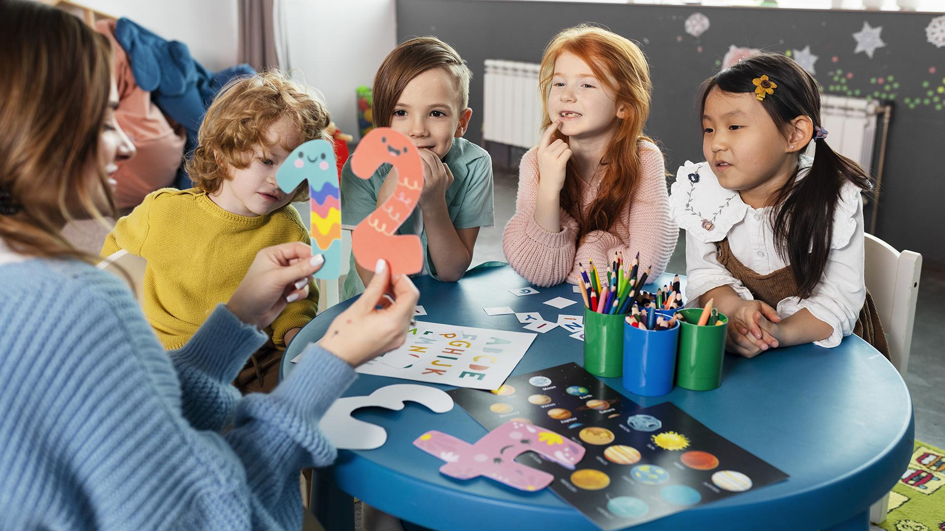
A picture is worth a thousand words

Slide 27
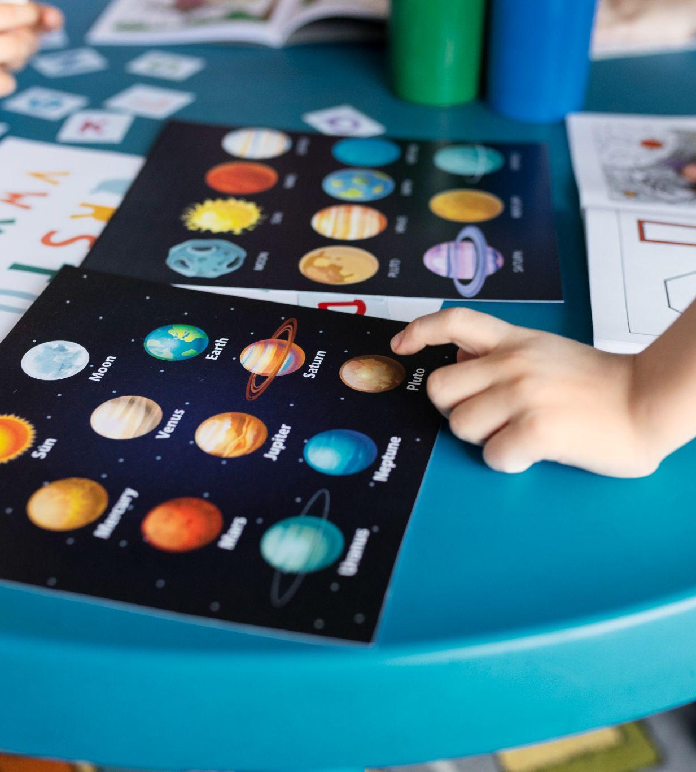
To reinforce the concept, try using an image
Images reveal large amounts of data, so remember: use an image instead of a long text. Your audience will appreciate it

Slide 28
150,000
Big numbers catch your audience’s attention

Slide 29
9h 55m 23s
333,000
386,000 km
Jupiter's rotation period
The Sun’s mass compared to Earth’s
Distance between Earth and the Moon

Slide 30
Thanks!
Do you have any questions?
addyouremail@freepik.com
+91 620 421 838
yourwebsite.com
Please keep this slide for attribution

Slide 31
Alternative resources
Here’s an assortment of alternative resources whose style fits the one of this creative template:
VECTORS
Paper style galaxy background I
Paper style galaxy background II
Paper style galaxy background III
Paper style galaxy background IV

Slide 32
Resources
Did you like the resources in this template? Get them for free at our other websites:
PHOTOS
Medium kids sitting together at table
High angle kids learning planets
VECTORS
Paper style galaxy background I
Paper style galaxy background II
Paper style galaxy background III
Paper style galaxy background IV

Slide 33
Instructions for use
If you have a free account, in order to use this template, you must credit Slidesgo by keeping the Thanks slide. Please refer to the next slide to read the instructions for premium users.
As a Free user, you are allowed to:
Modify this template.
Use it for both personal and commercial projects.
You are not allowed to:
Sublicense, sell or rent any of Slidesgo Content (or a modified version of Slidesgo Content).
Distribute Slidesgo Content unless it has been expressly authorized by Slidesgo.
Include Slidesgo Content in an online or offline database or file.
Offer Slidesgo templates (or modified versions of Slidesgo templates) for download.
Acquire the copyright of Slidesgo Content.
For more information about editing slides, please read our FAQs or visit our blog:
https://slidesgo.com/faqs and https://slidesgo.com/slidesgo-school

Slide 34
Instructions for use (premium users)
As a Premium user, you can use this template without attributing Slidesgo or keeping the "Thanks" slide.
You are allowed to:
Modify this template.
Use it for both personal and commercial purposes.
Hide or delete the “Thanks” slide and the mention to Slidesgo in the credits.
Share this template in an editable format with people who are not part of your team.
You are not allowed to:
Sublicense, sell or rent this Slidesgo Template (or a modified version of this Slidesgo Template).
Distribute this Slidesgo Template (or a modified version of this Slidesgo Template) or include it in a database or in any other product or service that offers downloadable images, icons or presentations that may be subject to distribution or resale.
Use any of the elements that are part of this Slidesgo Template in an isolated and separated way from this Template.
Register any of the elements that are part of this template as a trademark or logo, or register it as a work in an intellectual property registry or similar.
For more information about editing slides, please read our FAQs or visit our blog:
https://slidesgo.com/faqs and https://slidesgo.com/slidesgo-school

Slide 35
Fonts & colors used
This presentation has been made using the following fonts:
Space Grotesk Bold
(https://fonts.google.com/specimen/Space+Grotesk)
Lato
(https://fonts.google.com/specimen/Lato)
#ffffff
#152849
#2a4d7c
#57a0cf
#70cde2
#87d38c
#cfe88b
#f8e459
#ea9e44
#cc6164

Slide 36



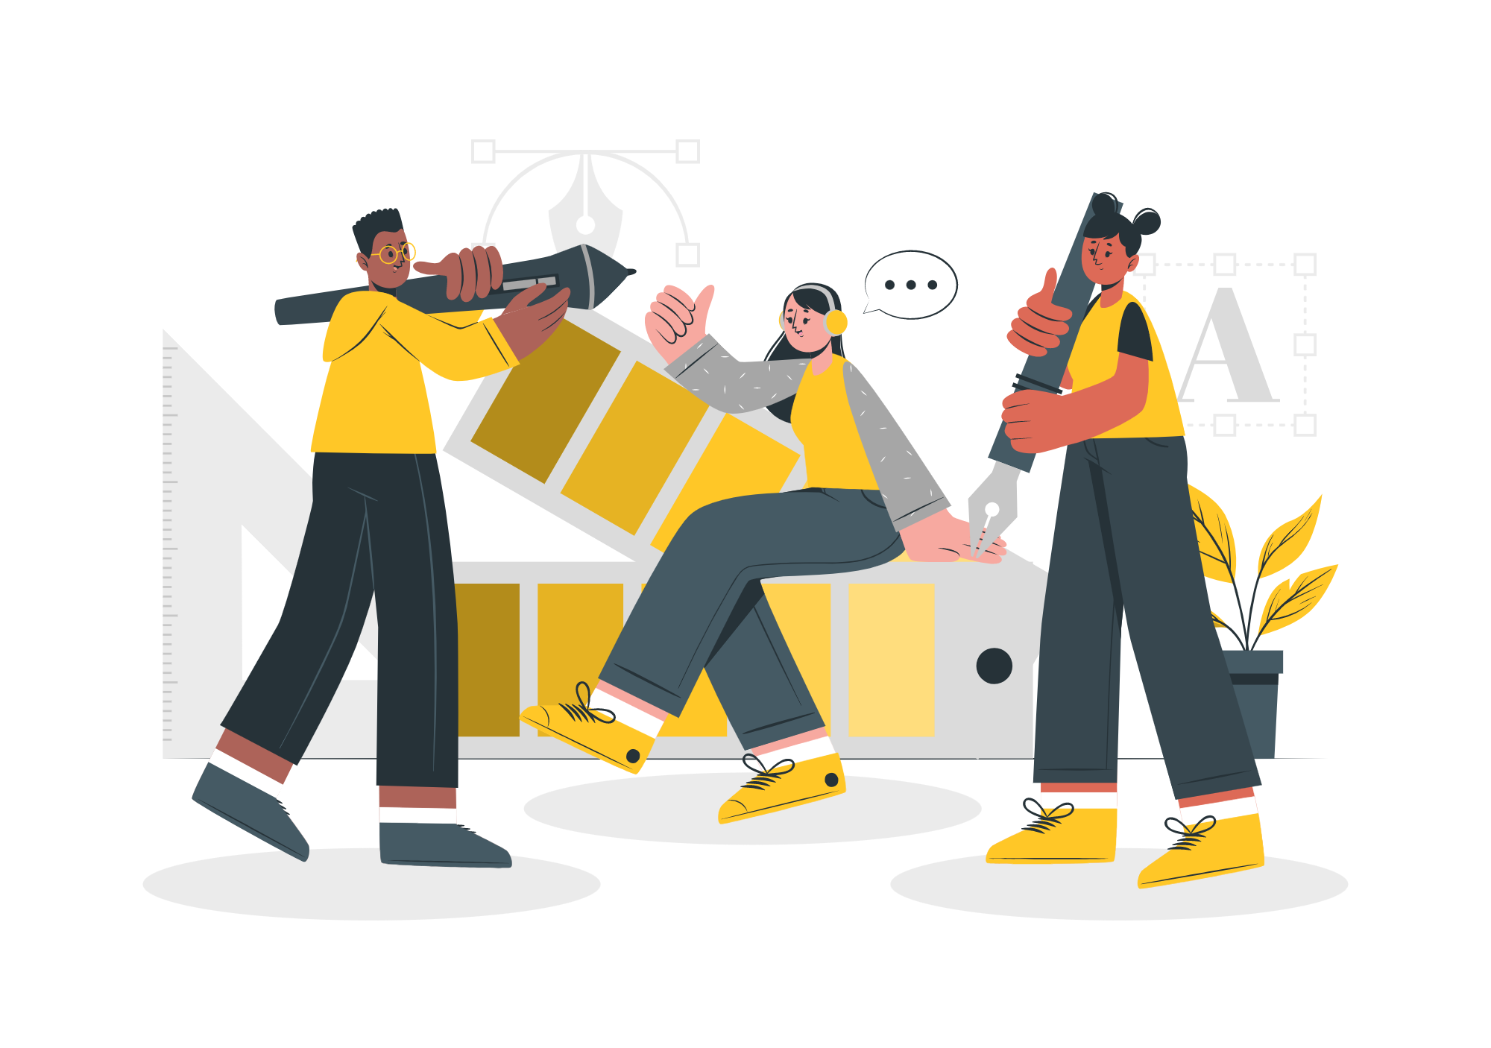

Storyset
Create your Story with our illustrated concepts. Choose the style you like the most, edit its colors, pick the background and layers you want to show and bring them to life with the animator panel! It will boost your presentation.
Check out how it works.
Pana
Amico
Bro
Rafiki
Cuate

Slide 37
Use our editable graphic resources...
You can easily resize these resources without losing quality. To change the color, just ungroup the resource and click on the object you want to change. Then, click on the paint bucket and select the color you want. Group the resource again when you’re done. You can also look for more infographics on Slidesgo.

Slide 40
JANUARY
FEBRUARY
MARCH
APRIL
MAY
JUNE
PHASE 1
Task 1
Task 2
PHASE 2
Task 1
Task 2
JANUARY
FEBRUARY
MARCH
APRIL
PHASE 1
Task 1
Task 2

Slide 43
...and our sets of editable icons
You can resize these icons without losing quality.
You can change the stroke and fill color; just select the icon and click on the paint bucket/pen.
In Google Slides, you can also use Flaticon’s extension, allowing you to customize and add even more icons.

Slide 44
Educational Icons
Medical Icons

Slide 45
Business Icons
Teamwork Icons

Slide 46
Help & Support Icons
Avatar Icons

Slide 47
Creative Process Icons
Performing Arts Icons

Slide 48
Nature Icons

Slide 49
SEO & Marketing Icons

Slide 50
Premium infographics
Text 1
Text 2
Text 3
“Mercury is the smallest planet in the Solar System”
“Despite being red, Mars is actually a very cold place”
Add the title here
2016
2017
2018
2019
2020
“Venus is the second planet from the Sun and is terribly hot”
“Neptune is the farthest planet from the Sun”
“Saturn is a gas giant and has several rings”
Text 4
Text 5
Text 6

Slide 51
Premium infographics
75%
“Despite being red, Mars is actually a very cold place”
75%
“Jupiter is the biggest planet in the entire Solar System”
TITLE 1
“Mercury is the smallest planet in the Solar System”
“Saturn is a gas giant and has several rings”

Slide 52
Premium Icons
Digital Marketing

Slide 53
Premium Icons
Online Learning

Slide 54
Premium Icons
Laboratory

Slide 55
Premium Icons
Goals & Results

Slide 56
Premium Icons
Infographic Elements

Slide 57


