Slide 1
“Very Acoustic Singing Synthesizer”
Ling-Xiao Yang

Slide 2
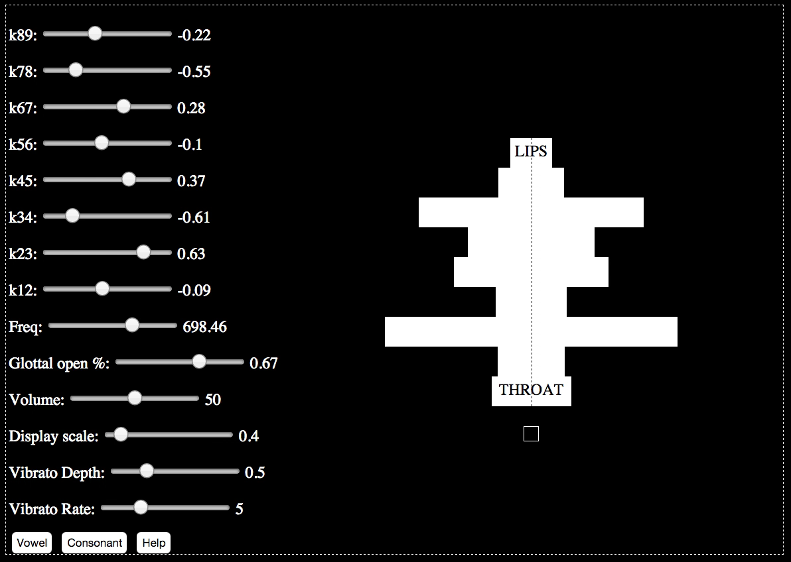

Slide 3
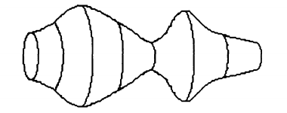
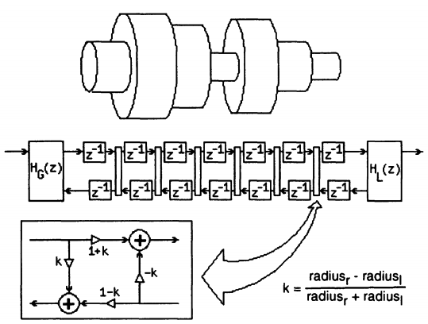
Overview
A physical modeling synthesizer (Cook 1992)

Slide 4
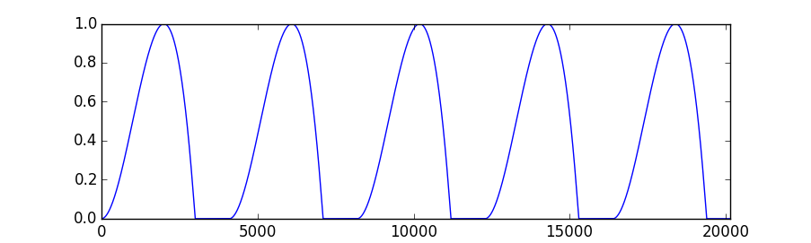
Overview
Kelly and Lochbaum (1962)
Glottal Source (Rosenberg 1971)
Image Source: Cook 1992

Slide 5
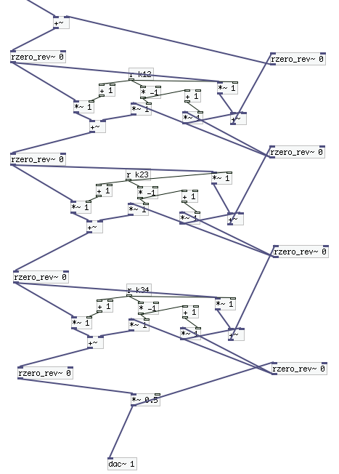
Pure Data Implementation Trial #1
Use one-zero filter for delay line.
y[n] = x[n-1]
“Signal loop”

Slide 6
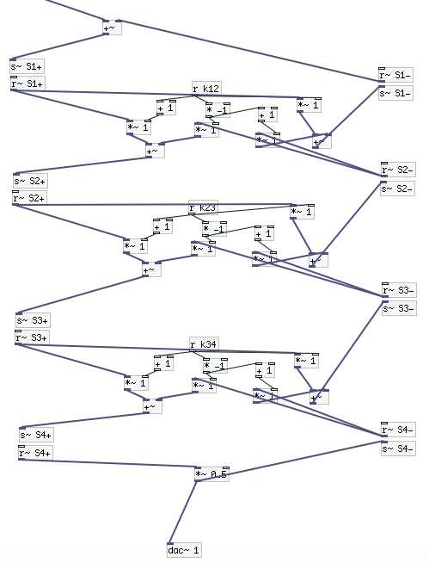
Pure Data Implementation Trial #2
1-block delay between send~ and receive~
Block size → 1
Not bad, but too much overhead for WebPd.

Slide 7
Pure JavaScript Implementation
Block-based processing
Call singer.tick() N times to compute an N-sample block.
Controls are updated between blocks.
1-sample delay line → a temporary variable

Slide 8
Pure JavaScript Implementation
Glottal source and vibrato are stored in wave tables.
Parameters are found manually.
Controls
Visualization

Slide 9
Live Demo

Slide 10
Lessons Learned
It is difficult to implement sample-based calculation in a block-based environment.
Vibrato has a considerable effect in perceived synthesis quality.
Singing synthesis controllers are hard to design.

Slide 11
References
Cook, P. 1991. Identification of Control Parameters in an Articulatory Vocal Tract Model, with Applications to the Synthesis of Singing. PhD dissertation.
Cook, P. 1992. SPASM: A Real-Time Vocal Tract Physical Model Editor/Controller and Singer: the Companion Software Synthesis System. Computer Music Journal 17(1): 30-44.
Kelly, J., and C. Lochbaum. 1962. Speech Synthesis: 1-4.
Rosenberg, A. 1971. Effect of glottal pulse shape on the quality of natural vowels. Journal of the Acoustical Society of America 49(2B): 583-90.

