Slide 1
QVDO: QAT Accelerated Compression in Block Layer for Filesystem Agnostic Storage
Helin Guo

Slide 2
Brief Intro
Block-layer compression
File system agnostic
Virtual Data Optimizer(VDO)
Hardware-assisted compression
High compression ratio with low CPU utilization
Hardware-software coordination
Asynchronous mode
Parallel optimization
Multi-thread handling

Slide 3
Background
Data center with massive storage I/O
Performance and efficiency of storage subsystem
Data compression
Compute resources
Different lossless algorithm
System layers
Block layer vs application and file system layer
Hardware-assisted accelerators
ASIC vs GPU, FPGA
Hardware-software coordination

Slide 4
Design
Deduplicate->Compress->Packer->Journal->Block Map
Data will be sent to physical device after packed successfully
Data works as 4K unit
DataKVIO works at physical layer
DataVIO works at logical layer
Each module works on several threads
Assert to ensure working on correct thread
Data will be sent to a waiting queue on next module thread

Slide 5
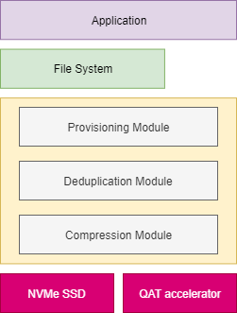
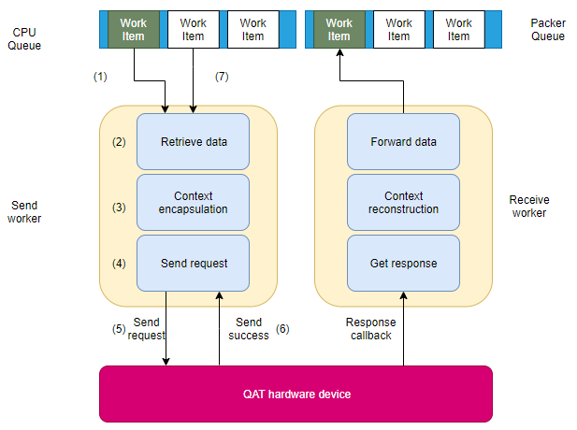
Design

Slide 6
Hardware-software coordination
Compress module
Retrieve data from CPU queue
Compress data
Send data to Packer queue
Traditional synchronous mode
Using CPU to compress data
Wait for result and handle next work
Not suit for hardware

Slide 7
Asynchronous mode
Sender worker
Retrieve a block of data from CPU queue
Select compression method
Construct a data structure saving context
QATCallbackTag
Send data to a QAT instance
Receive worker
Receive data from QAT instance
Reconstruct data context from tag
Send data to packer queue

Slide 8
QAT compress module
Data stored in DataKVIO
Scatter Buffer List
Partition by page frames
QATCallbackTag
Storing a pointer to data
Storing pointers to metadata
Storing a pointer to allocated memory
Hardware configuration
Instances
Interrupt and polling
Core affinity

Slide 9
Multi-thread
Scalable thread in system
CPU, Hash, Logical, Physical, Ack, Bio, etc
Single thread in system
Packer and Journal
Convert Packer thread to multi-thread
Marks each block of data with a packer number
Send works to several Packer thread after compression
Inform each Packer thread after writing to disk

Slide 10
Future works
Journal
Multi-thread to reduce CPU utilization
Hash Optimization
Hash-compress chain
Collision using compressed result to compare
Efficient Block Management
Avoid ineffective packed block
Compressed 3.5k/4k

Slide 11
Performance
 | Sum of 1 partition | Cpu*2 | packer | jounal | Configuration
Only NVMe SSD | 1875MB/s | / | / | / | /
VDO without compress | 1495MB/s | 61% | / | 83% | 2-1-2-1-2-2
VDO with LZ4 | 1284MB/s | 94% | 47% | 93% | 1-2-2-2-2-2
VDO with zlib | 124MB/s | 98% | 15% | 50% | 1-1-2-1-2-2
VDO with QAT | 170MB/s | 23% | 19% | 53% | 1-2-2-1-2-1
VDO with QAT async | 1424MB/s | 70% | 43% | 94% | 2-1-2-2-2-2
VDO with QAT async multi | 1427MB/s | 76% | 38% | 99% | 2-1-2-1-2-2-2

Slide 12
Conclusion
Block-layer compression
Based on VDO
Hardware-assisted technology
Intel QAT technology
Hardware-software coordination
Asynchronous mode
Parallel processing
Multi-packer thread
High performance

