Slide 1
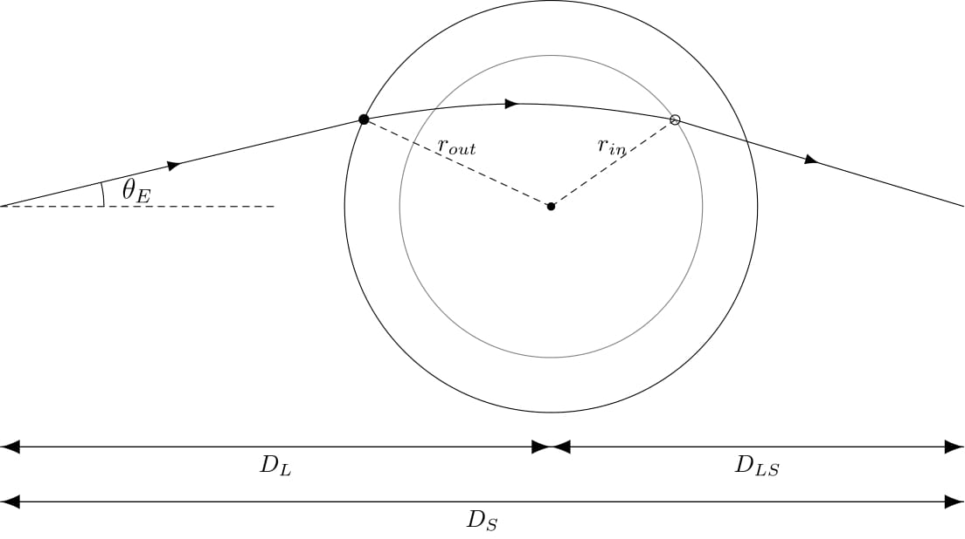
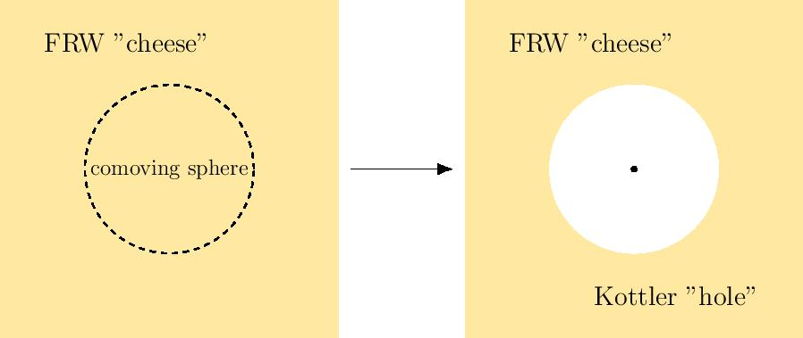
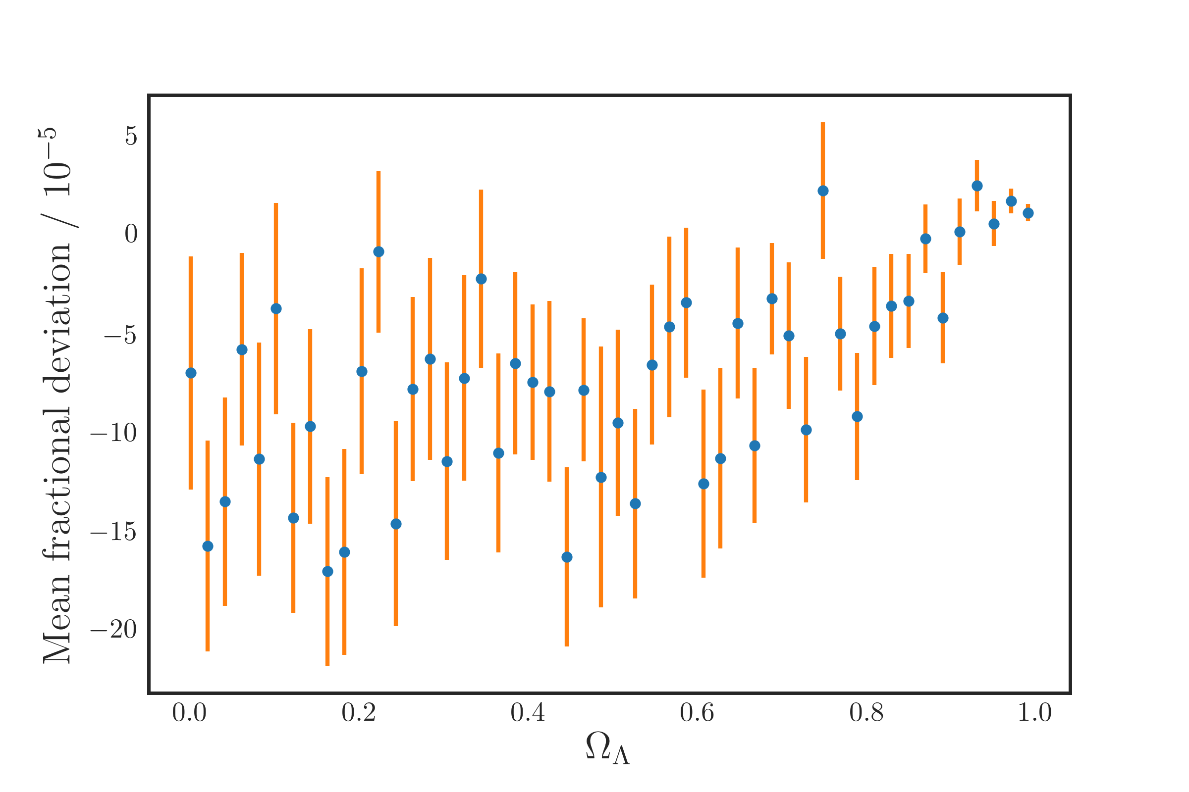
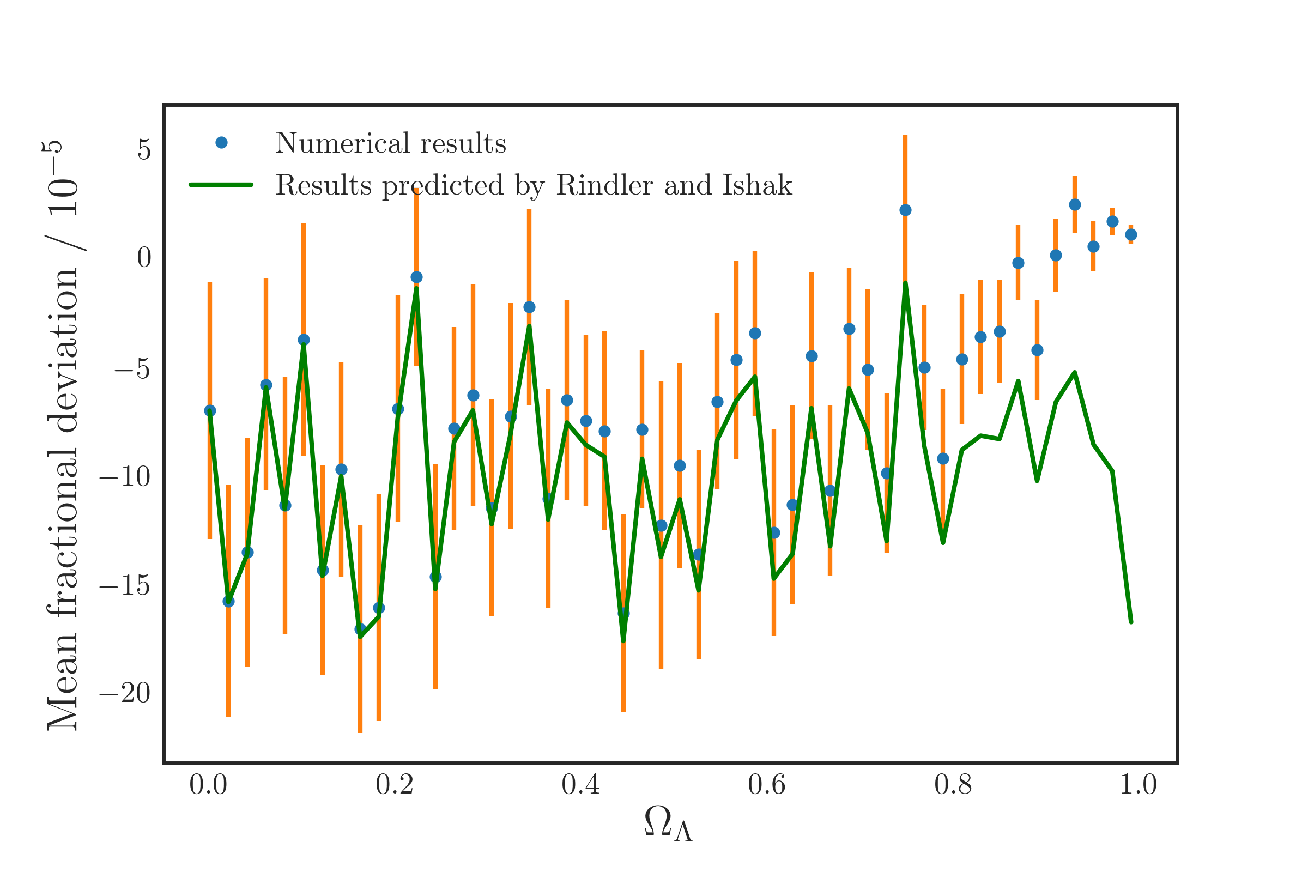
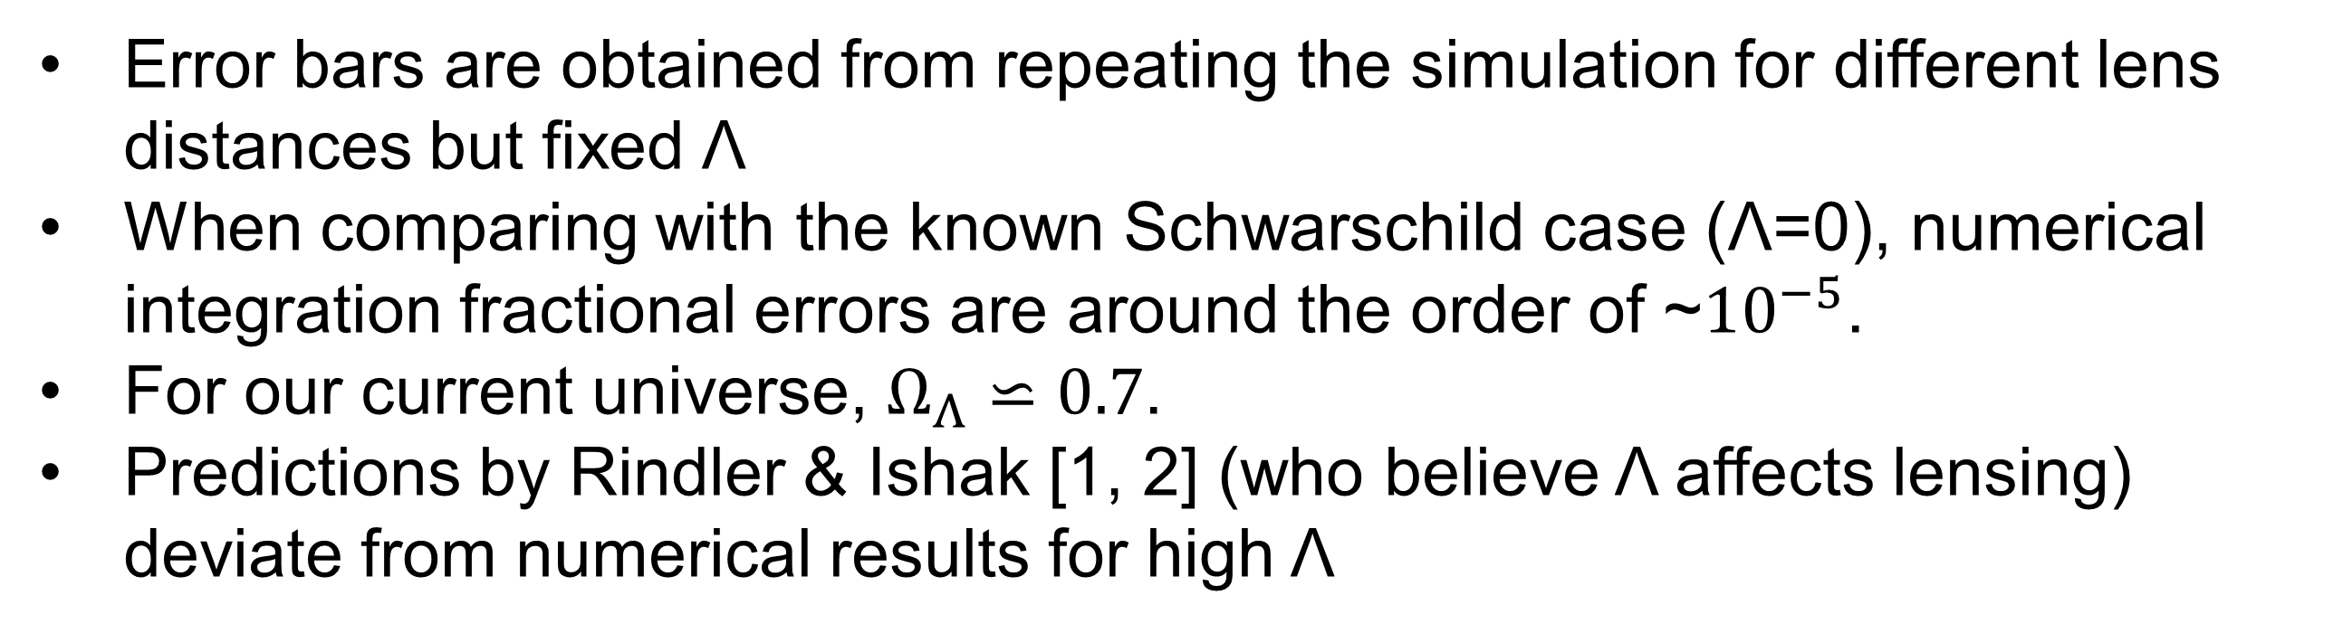
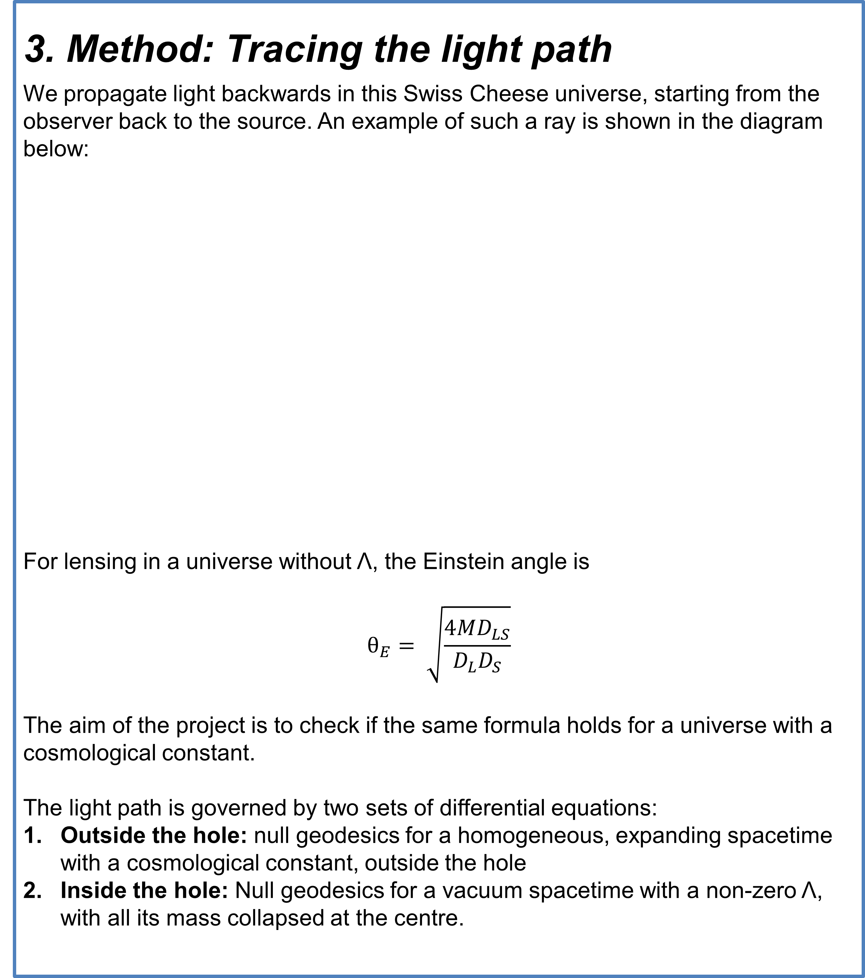
Does the cosmological constant affect gravitational lensing?
Lingyi Hu
Supervisor: Alan Heavens
Astrophysics group
1. Introduction and Aims
The Universe is expanding at an accelerating rate, parameterized by a cosmological constant Λ. An active dispute that has been the subject of previous papers is whether Λ alters the bending of light.
Most of the work done so far is analytical, but there have been disagreements on the approximations used and whether the effect of Λ is already accounted for in the standard lensing formula.
This project hopes to give an answer to this debate using numerical methods.
This project aims to answer:
Does the cosmological constant affect our calculation of the light bending angle?
How does our result compare with existing analytical analysis and predictions?
3. Method: Tracing the light path
We propagate light backwards in this Swiss Cheese universe, starting from the observer back to the source. An example of such a ray is shown in the diagram below:
For lensing in a universe without Λ, the Einstein angle is
$$θ_{E}= \sqrt{\frac{4MD_{LS}}{D_{L}D_{S}}}$$
The aim of the project is to check if the same formula holds for a universe with a cosmological constant.
The light path is governed by two sets of differential equations:
Outside the hole: null geodesics for a homogeneous, expanding spacetime with a cosmological constant, outside the hole
Inside the hole: Null geodesics for a vacuum spacetime with a non-zero Λ, with all its mass collapsed at the centre.
2. Method: The Swiss Cheese Model of the Universe
We use a Swiss Cheese method to model our Universe. This embeds a point mass within a homogeneous spacetime and is an exact solution to Einstein's equations. It consists of taking the mass from a spherical comoving region (a "hole") from a uniform Friedmann-Robert-Walker (FRW) spacetime (the "cheese") and collapsing it to a point mass in the centre of the sphere. This is shown below:
The hole expands with the expansion of the Universe
In the cheese (outside the hole), spacetime is homogeneous and expanding, described by the Friedmann-Robertson-Walker (FRW) metric.
Inside the hole, spacetime is vacuum everywhere with a positive cosmological constant, except for the point mass at the centre. This is described by the Kottler metric, an extension of the Schwarzschild metric to include a cosmological constant.
4. Results
Error bars are obtained from repeating the simulation for different lens distances but fixed Λ
When comparing with the known Schwarschild case (Λ=0), numerical integration fractional errors are around the order of ~${10}^{−5}$.
For our current universe, $Ω_{Λ}⋍0.7$.
Predictions by Rindler & Ishak [1, 2] (who believe Λ affects lensing) deviate from numerical results for high Λ
5. Conclusion
The results give a preliminary indication that the cosmological constant has a negligible effect on gravitational lensing, up to the precision of the numerical simulation. Further work is required to investigate the phenomenon using more realistic mass distributions.
[1] Ishak, M., Rindler, W., Dossett, J., Moldenhauer, J., & Allison, C. (2008). A new independent limit on the cosmological constant/dark energy from the relativistic bending of light by galaxies and clusters of galaxies. Monthly Notices of the Royal Astronomical Society, 388(3), 1279-1283.
[2] Rindler, W., & Ishak, M. (2007). Contribution of the cosmological constant to the relativistic bending of light revisited. Physical Review D, 76(4), 043006.

