Slide 1
Does the cosmological constant affect gravitational lensing?
Lingyi Hu

Slide 2
Our project: Determining dust properties in galaxies
 | Different stellar populations galaxies produce and inject metals into the stellar medium that congregate to form dust particles of different size and composition. Approximately half of the radiative energy produced by galaxies is absorbed by dust grains and emitted in the infrared regime.
 | Allows us to characterize the properties of cosmic dust Powerful tool for understanding variations of dust properties with other galaxy characteristics, especially among high redshift galaxies. Important insights into physical processes regulating galaxy evolution
 | Davies et al. (2012) Grossi et al. (2010), di Serego Alighieri et al. (2013) and De Looze et al. (2013) Cortese et al. (2014) and Ciesla et al. (2012)
 | Use data from Planck, Herschel, and IRAS data to estimate properties of dust such as dust mass and temperature for the compact sources in the Planck catalogue
Why this research is important
What the sub-mm SED fluxes can tell us
Previous similar studies
Our project
Notes:
During their evolution, the different stellar populations galaxies produce and inject into the stellar medium metals that congregate to form dust particles of different size and composition.
This dust, heated by the general stellar radiation field, re-emit the absorbed energy in the far-infrared (FIR).
The amount of dust in a galaxy is a measure of the quantity of heavy elements in the interstellar medium, since ~ 50% of the heavy elements are locked up in dust and there is some evidence that this fraction is constant from galaxy to galaxy.
Davies et al. (2012) fitted modified blackbodies to a sample of SPIRE 500 µm selected galaxies, Auld et al. (2013) and Davies et al. (2013) used them to study the dust characteristics of a samples of optically selected galaxies, and Grossi et al. (2010), di Serego Alighieri et al. (2013) and De Looze et al. (2013) applied mod- ified blackbody fits to smaller samples of star-forming dwarfs, early-type galaxies and transition-type galaxies.
In normal galaxies, the emitting dust can be modelled by a modified blackbody spectrum with a peak at ~ 200μm rapidly decreasing at longer wavelengths.
The amount of dust in a galaxy is a measure of the quantity of heavy elements in the interstellar medium
HRS is a sample of 313 galaxies (15 < D < 25Mpc) spanning the whole range in morphological type (from ellipticals to late-type spirals)

Slide 3
Method: Sources of Data
Herschel (250, 350, 500μm)
Planck (Aperflux217, Aperflux353, Aperflux545, Aperflux857)
Each source in the Planck catalogue has four different measures of the flux density, depending on the source detection algorithm: Detflux, Aperflux, Psfflux, Gauflux
Aperflux (Aperture photometry flux density) is obtained by integrating the data in a circular aperture centred at the position of the source, with the average FWHM of the effective beam as radius for the aperture.
IRAS (12, 25, 60, 100 microns)
Akari (65, 90, 140, 160 microns)
Notes:
Majority of planck sources are late-type spiral galaxies, belonging to the Virgo cluster

Slide 4
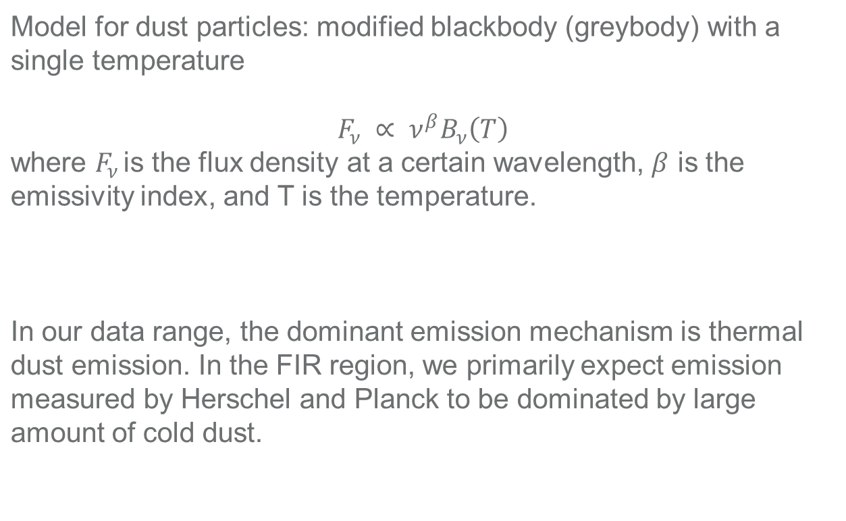
Method: Fitting data using a modified blackbody
Model for dust particles: modified blackbody (greybody) with a single temperature $$F_{ν} ∝ ν^{β}B_{ν}\left(T\right)$$ where $F_{ν }$is the flux density at a certain wavelength, $β$ is the emissivity index, and T is the temperature.
In our data range, the dominant emission mechanism is thermal dust emission. In the FIR region, we primarily expect emission measured by Herschel and Planck to be dominated by large amount of cold dust.

Slide 5
Using Markov chain monte carlo method to find the best fit temperature and beta
Initialize
We use Nelder-Mead’s method for minimization using scipy.optimize to obtain approximate results before using the results as input for the Markov Chain Monte Carlo (MCMC) sampler.
Run MCMC
Run the MCMC using the python package emcee which implements the affine-invariant ensemble sampler of Goodman & Weare (2010) to perform the MCMC algorithm.
Notes:
As a result, given a set of SED data, we have 3 free parameters to fit. To determine the best fit parameters and their uncertainties, we used Nelder-Mead's method (cite) for minimization provided by scipy.optimize and then used a Markov Chain Monte Carlo (MCMC) sampler to sample the posterior distribution function, obtained by multiplying the likelihood function in Eq. (??) with flat logarithmic priors for the priors to find the $\beta$ and temperature distributions using the model above for the SEDs. We used the python package emcee which implements the affine-invariant ensemble sampler of Goodman \& Weare (2010) (cite from emcee), to perform the MCMC algorithm.

Slide 6
How MCMC works
Initialize the walkers
The sampler explores the parameter space using a set of walkers. Each walker starts at a point in the parameter space, distributed according to the preset distribution of the parameter space.
Take steps in parameter space
At each iteration of the MCMC, each walker takes a step in the parameter space by choosing another walker and stepping along the line in parameter space connecting itself to another walker.
Draw samples from the distribution
After a large number of steps, we can then draw fair samples from the distribution by selecting points from the history of the walkers.
After each step is taken, the posterior probability distribution at the new point in parameter space is evaluated.

Slide 7
How MCMC works
 | 100 walkers Each takes 1000 steps
 | We take the best fit parameter values (β, T) as the mean over the last 700 steps of all the walkers First 300 iterations at the beginning were treated as the burn in, intended to give the Markov Chain time to reach its equilibrium. We took 68% confidence interval as the standard deviation of that parameter
Parameters for the Markov chain
Extracting information from the Markov chain distribution

Slide 8
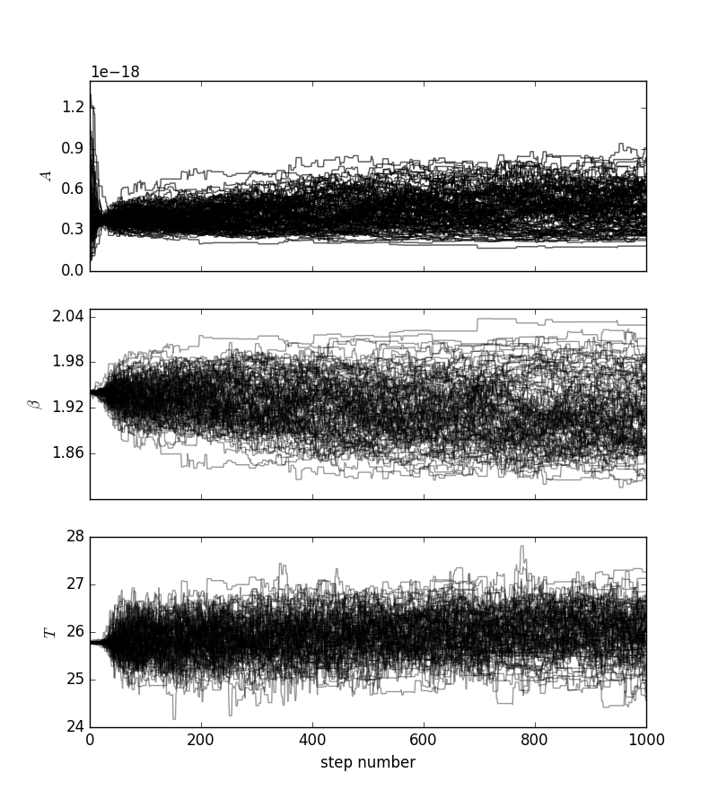
Example of a MCMC simulation with 1000 steps for 3 parameters

Slide 9
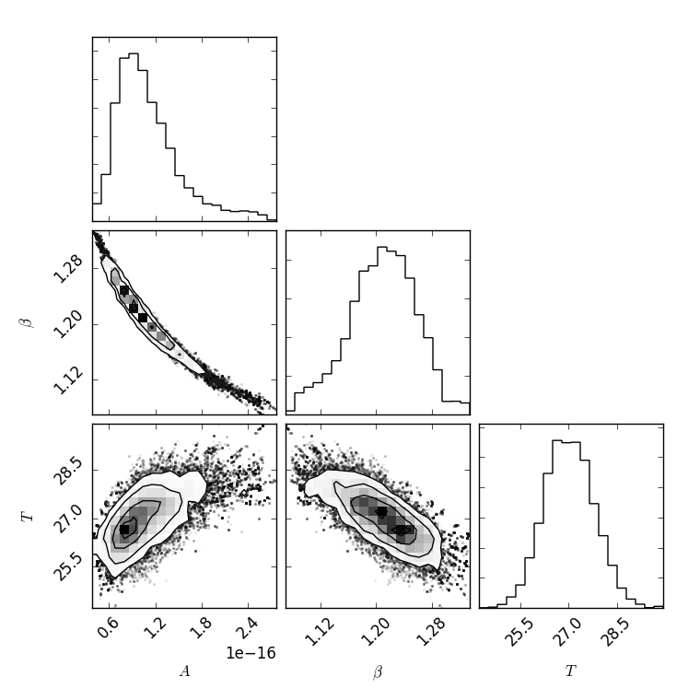
Visualization of walkers in the Markov chain: Corner plot of IC 4040

Slide 10
Early SED fitting: Process and road blocks
 | Issues in reconciling the flux densities from Planck and Herschel, due to the different beam sizes used for the Planck and Herschel fluxes. After examining Herschel images for bright companions inside the Planck beam, we decided to exclude some sources which have large discrepancy between the Herschel and Planck fluxes. Planck beam size: ~4.33 arcmin Herschel beam size: in the range of 20 arcsec to 1 arcmin
 | IRAS measurements were made using a larger beam size than Planck, so in the case of extended sources, the Planck beam is merely looking at the core of an extended object. Thus, the addition of the IRAS data caused some of the temperature values to be unusually high. There were other objects in the non-compact sources that are not suitable for fitting a thermal blackbody spectrum as well (e.g. blazar). To avoid this problem, we only used compact sources for our fitting.
Difference in Planck and Herschel beam sizes
IRAS data for non-compact sources

Slide 11
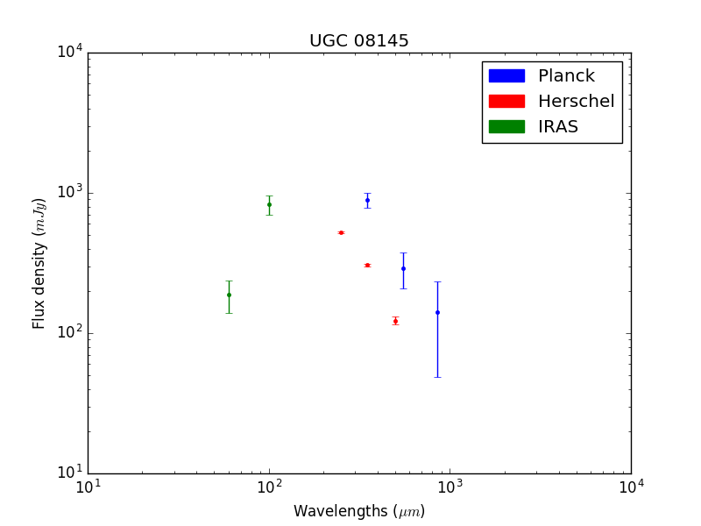
Example of Planck and Herschel Offset: Raw data plot of UCG 8145

Slide 12
Early SED fitting: Process and road blocks
 | Issues in reconciling the flux densities from Planck and Herschel, due to the different beam sizes used for the Planck and Herschel fluxes. After examining Herschel images for bright companions inside the Planck beam, we decided to exclude some sources which have large discrepancy between the Herschel and Planck fluxes. Planck beam size: ~4.33 arcmin Herschel beam size: in the range of 20 arcsec to 1 arcmin
 | IRAS measurements were made using a larger beam size than Planck, so in the case of extended sources, the Planck beam is merely looking at the core of an extended object. Thus, the addition of the IRAS data caused some of the temperature values to be unusually high. There were other objects in the non-compact sources that are not suitable for fitting a thermal blackbody spectrum as well (e.g. blazar). To avoid this problem, we only used compact sources for our fitting.
Difference in Planck and Herschel beam sizes
IRAS data for non-compact sources
Notes:
Blazar: Bright in the radio band, when looking directly down a jet which is emitting synchrotron radiation

Slide 13
Early SED fitting: Process and road blocks
 | Akari data requires a surface brightness/flux correction for compact extended sources (Ueta et al., 2016) We only had Akari data for some sources
 | We used the Nelder-Mead method in scipy.optimize to find the points for initializing the MCMC. For some cases, max iteration number was reached before it reached convergence, and in some rare cases there was false convergence. For these cases, we fell back on the initial guess.
Problems with Akari data
Convergence of the Nelder-Mead

Slide 14
Early SED fitting: Process and road blocks
 | Akari data requires a surface brightness/flux correction for compact extended sources (Ueta et al., 2016) We only had Akari data for some sources
 | We used the Nelder-Mead method in scipy.optimize to find the points for initializing the MCMC. For some cases, max iteration number was reached before it reached convergence, and in some rare cases there was false convergence. For these cases, we fell back on the initial guess.
Problems with Akari data
Convergence of the Nelder-Mead

Slide 15
Results: Comparisons with literature (HRS)
 | Herschel Reference Survey (HRS) is a sample of 313 galaxies (15 < D < 25Mpc) spanning the whole range in morphological type (from ellipticals to late-type spirals) To verify that our code and algorithm is working as expected
 | Applied the fitting algorithm to the same galaxies in the HRS data (100,160, 250, 350, 500μm) Temperatures and betas agree within the margin of error to the results in the Cortese 2014 paper.
What is HRS and purpose of comparison
Comparison results
Notes:
During their evolution, the different stellar populations galaxies produce and inject into the stellar medium metals that congregate to form dust particles of different size and composition.
This dust, heated by the general stellar radiation field, re-emit the absorbed energy in the far-infrared (FIR).
The amount of dust in a galaxy is a measure of the quantity of heavy elements in the interstellar medium, since ~ 50% of the heavy elements are locked up in dust and there is some evidence that this fraction is constant from galaxy to galaxy.
In normal galaxies, the emitting dust can be modelled by a modified blackbody spectrum with a peak at ~ 200μm rapidly decreasing at longer wavelengths.
The amount of dust in a galaxy is a measure of the quantity of heavy elements in the interstellar medium

Slide 16
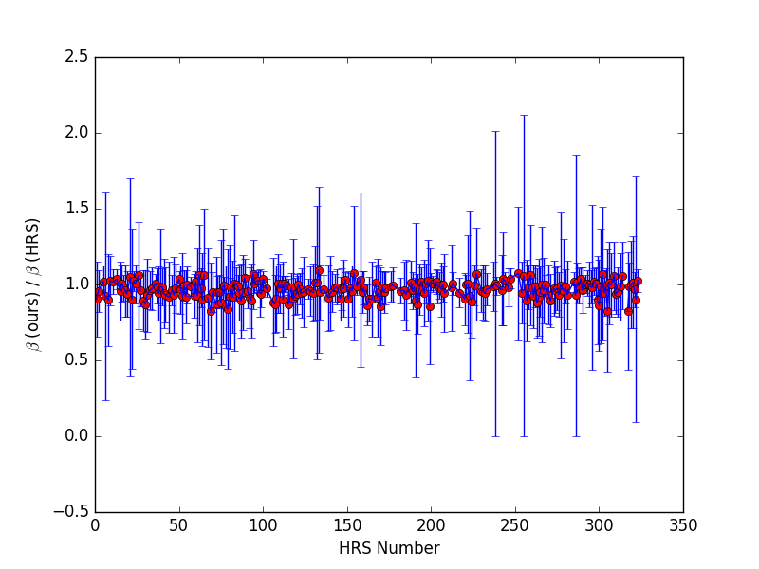
HRS comparison: ratio of beta obtained by us to beta obtained by Cortese paper

Slide 17
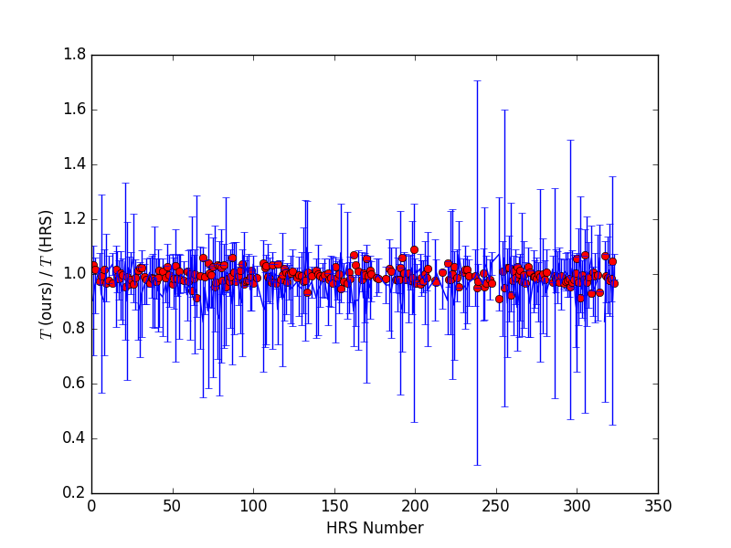
HRS comparison: ratio of temperature obtained by us to beta obtained by Cortese paper

Slide 18
Results on Planck Data
Applied the fitting to the compact Planck sources
Mean temperature and emissivity index were similar, with a few with unusually high temperatures
Comparisons:
HRS mean beta: 1.76 +/- 0.47
Our mean beta: 1.83 +/- 0.23
HRS mean temperature: 22.7 +/- 3.5
Our mean temperature: 22.7 +/- 9.2
Greater temperature variations than HRS objects
Calculated dust mass from temperature and beta values

Slide 19
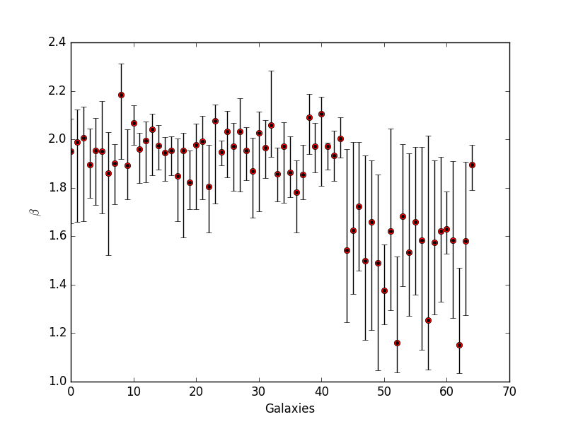
Beta distribution from our results
Mean β of 1.83 ± 0.23 of the compact Planck sources is similar to the mean β of HRS galaxies of 1.76 ± 0.47
There are a few galaxies with unusually low β, some of these roughly corresponds to the galaxies with unusually high temperature points as well.

Slide 20
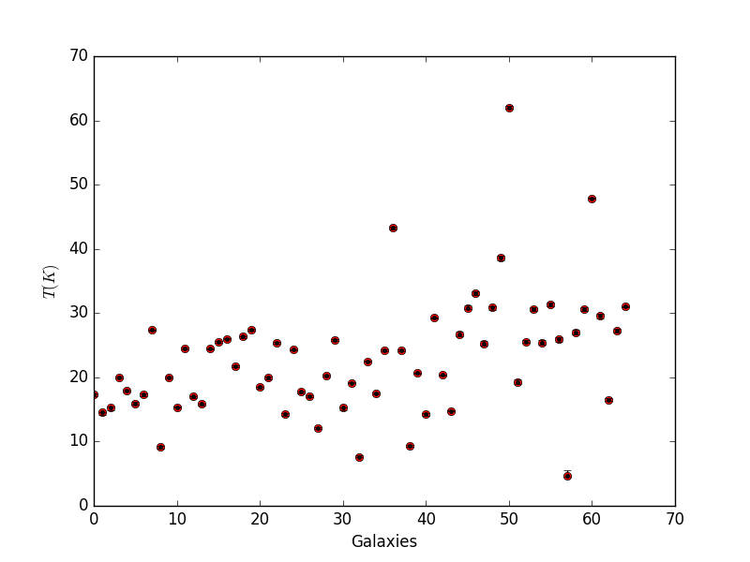
Temperature distribution from our results
Mean T of 22.7 ± 9.2 of the compact Planck sources is similar to the mean T of HRS galaxies of 22.7 ± 3.5, but there is much larger variation in temperature in the Planck compact sources.
There were galaxies with unusually high temperatures (>40K) —we identified those and looked into possible explanations.
62.04K
47.88K
43.26K

Slide 21
Possible explanations
IC 0860
These 2 had the same association; they belong to the same object.
It is classified (on Simbad) as a possible quasar (QSO_Candidate). Quasars are quasi-stellar radio sources, hence not suitable for a thermal fit and that may explain the unusual temperature.
62.04K
47.88K
43.26K

Slide 22
Possible explanations
NGC 4922 (T = 62.04K)
Classified on Simbad as a Seyfert Galaxy. Seyfert galaxies have small, intensely bright quasar-like nucleus.
62.04K
47.88K
43.26K

Slide 23
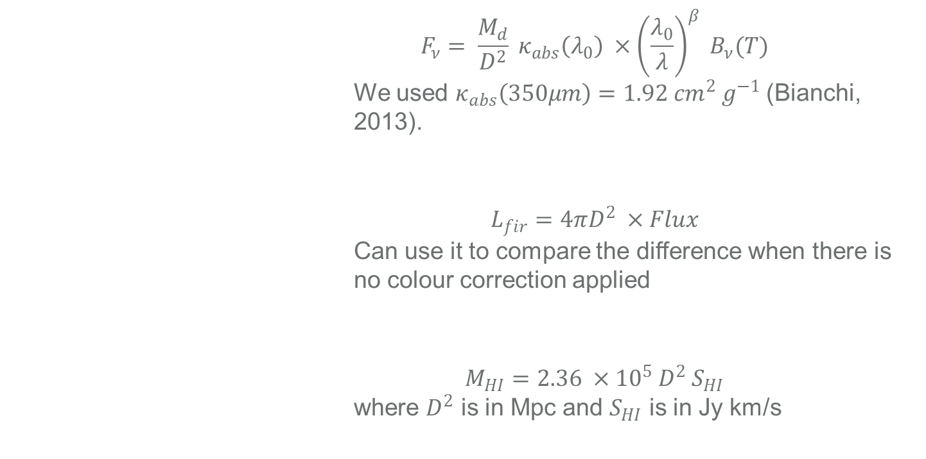
Additional properties of dust that can be derived: mass and luminosity
 | $$F_{ν}= \frac{M_{d}}{D^{2}} κ_{abs}\left(λ_{0}\right) ×{\left(\frac{λ_{0}}{λ}\right)}^{β} B_{ν}(T)$$ We used $κ_{abs}\left(350μm\right)=1.92 {cm}^{2} g^{−1}$ (Bianchi, 2013).
 | $$L_{fir}=4πD^{2} ×Flux$$ Can use it to compare the difference when there is no colour correction applied
 | $$M_{HI}=2.36 ×{10}^{5} D^{2} S_{HI}$$ where $D^{2}$ is in Mpc and $S_{HI}$ is in Jy km/s
Dust masses
Infrared Luminosities
Gas masses (future)
Notes:
During their evolution, the different stellar populations galaxies produce and inject into the stellar medium metals that congregate to form dust particles of different size and composition.
This dust, heated by the general stellar radiation field, re-emit the absorbed energy in the far-infrared (FIR).
The amount of dust in a galaxy is a measure of the quantity of heavy elements in the interstellar medium, since ~ 50% of the heavy elements are locked up in dust and there is some evidence that this fraction is constant from galaxy to galaxy.
In normal galaxies, the emitting dust can be modelled by a modified blackbody spectrum with a peak at ~ 200μm rapidly decreasing at longer wavelengths.
The amount of dust in a galaxy is a measure of the quantity of heavy elements in the interstellar medium

Slide 24
Possible sources of error / improvements
In this approach we use a simple modified blackbody fit, allowing us to identify the most fundamental properties of the dust medium: dust temperature and dust mass.
However, modified blackbodies are simple models and cannot properly reproduce real dust properties--complex multi-component methods have been developed to take into account the entire range from mid-infrared to mm wavelengths (e.g., Draine & Li 2007; Compiegne et al. 2011; Galliano et al. 2011)
This can improve the accuracy of our results since Planck has data extending into the mm range.

Slide 25
References
Baes, M., Herranz, D., Bianchi, S., Ciesla, L., Clemens, M., Zotti, D. G., … Vlahakis, C. (2014). The Herschel Virgo Cluster Survey, 562, A106. doi:10.1051/0004-6361/201322384
Bianchi, S. (2013). Vindicating single-T modified blackbody fits to Herschel SEDs, 552, A89. doi:10.1051/0004-6361/201220866
Boselli, A., Eales, S., Cortese, L., Bendo, G., Chanial, P., Buat, V., … Zeilinger, W. (2010). The Herschel Reference Survey. doi:10.1086/651535
Boselli, A., & group, the. (2006). The Herschel galaxy reference survey.
Clements, D. L., Dunne, L., & Eales, S. (2010). The submillimetre properties of ultraluminous infrared galaxies. Mon Not R Astron Soc, 403(1), 274–286. doi:10.1111/j.1365-2966.2009.16064.x
Clements, D. L., Rigby, E., Maddox, S., Dunne, L., Mortier, A., Pearson, C., … Verma, A. (2010). The Herschel-ATLAS: Extragalactic Number Counts from 250 to 500 Microns. doi:10.1051/0004-6361/201014581
Planck Collaboration, Abergel, Ade, Aghanim, Arnaud, Ashdown, … Zonca. (2011). Planckearly results. XXV. Thermal dust in nearby molecular clouds. Astronomy & Astrophysics, 536, A25. doi:10.1051/0004-6361/201116483

Slide 26
References
Cortese, Fritz, Bianchi, Boselli, Ciesla, Bendo, … Vlahakis. (2014). PACS photometry of the Herschel Reference Survey – far-infrared/submillimetre colours as tracers of dust properties in nearby galaxies★. Monthly Notices of the Royal Astronomical Society, 440(1), 942–956. doi:10.1093/mnras/stu175
Dunne, L., & Eales, S. A. (2001). The SCUBA Local Universe Galaxy Survey – II. 450‐μm data: evidence for cold dust in bright IRAS galaxies. Mon Not R Astron Soc, 327(3), 697–714. doi:10.1046/j.1365-8711.2001.04789.x
Dunne, L., Eales, S., Edmunds, M., Ivison, R., Alexander, P., & Clements, D. L. (2000). The SCUBA Local Universe Galaxy Survey – I. First measurements of the submillimetre luminosity and dust mass functions. Mon Not R Astron Soc, 315(1), 115–139. doi:10.1046/j.1365-8711.2000.03386.x
Kelly, B., Shetty, R., Stutz, A., Kauffmann, J., Goodman, A., & Launhardt, R. (2012). Dust Spectral Energy Distributions In The Era Of Herschel And Planck: A Hierarchical Bayesian-fitting Technique. The Astrophysical Journal, 752(1), 55. doi:10.1088/0004-637x/752/1/55

Slide 27
References
Roberge, Kamp, Montesinos, Dent, Meeus, Donaldson, … Woitke. (2013). HERSCHEL OBSERVATIONS OF GAS AND DUST IN THE UNUSUAL 49 Ceti DEBRIS DISK. The Astrophysical Journal, 771(1), 69. doi:10.1088/0004-637x/771/1/69
Ueta, T., Tomasino, R. L., Takita, S., Izumiura, H., Shirahata, M., Fullard, A., … Matsuura, S. (2016). Surface Brightness Correction for Compact Extended Sources Observed by the AKARI Far-Infrared Surveyor (FIS) in the Slow-Scan Mode.
Vlahakis, C., Dunne, L., & Eales, S. (2005). The SCUBA Local Universe Galaxy Survey - III. Dust along the Hubble sequence. doi:10.1111/j.1365-2966.2005.09666.x

Slide 28
Thank you!

