Slide 1
Investigating the role of the cosmological constant in gravitational lensing using a numerical approach
Lingyi Hu

Slide 2
Introduction: motivation
Key question
Does the cosmological constant directly affect gravitational lensing?
Motivation
Both the cosmological constant and gravitational lensing form important parts of our understanding of the universe
Can become important for future precision cosmology measurements
Most approaches in literature have been analytical rather than numerical

Slide 3
Introduction: overview of the literature
Key question
Does the cosmological constant directly affect gravitational lensing?
Key papers
Islam, 1983 (Conventional view)
Rindler and Ishak, 2007 (Challenging the conventional view)

Slide 4








Introduction: gravitational lensing
$$α_{}$$
$$R=D_{L}θ$$
$$θ_{E}$$
$$M$$
O
S
$$D_{L}$$
$$D_{LS}$$
$$D_{S}$$

Slide 5
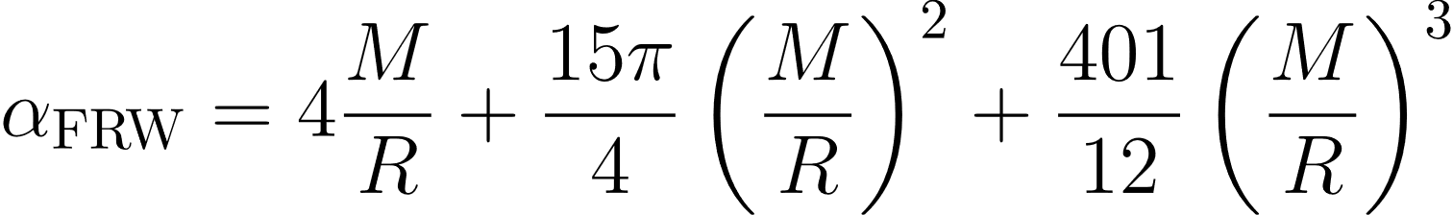
Introduction: gravitational lensing

Slide 6
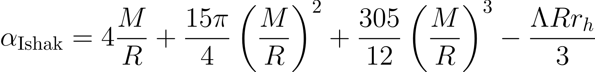
Introduction: gravitational lensing

Slide 7
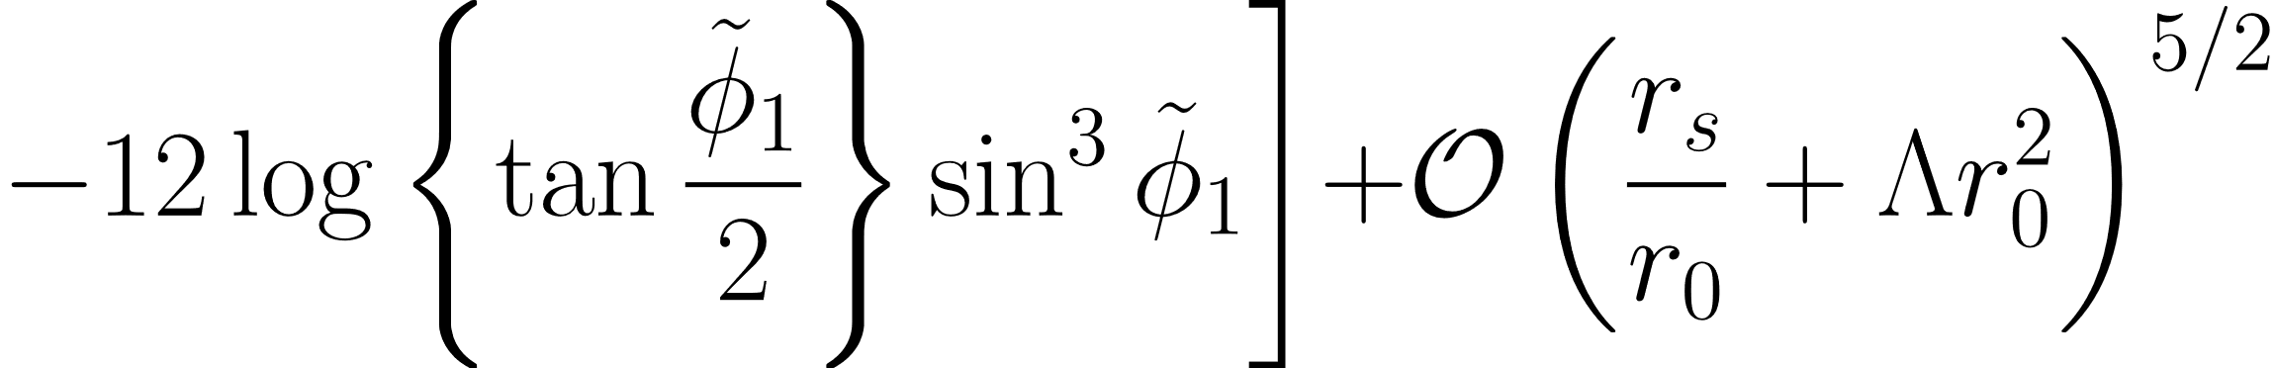
Introduction: gravitational lensing

Slide 8
Method: our approach
Numerical approach in a Swiss-Cheese model
Previous similar research:
Schücker (2009): partially numerical approach in a Swiss-Cheese model
Kantowski et al (2010) analytical estimation of the effect in a Swiss Cheese universe
Aghili et al (2017) investigated numerical approach in a McVittie metric

Slide 9
The Swiss Cheese Model
FRW “Cheese”
FRW “Cheese”
Kottler “hole”
comoving sphere
Cheese:
Homogeneous and expanding
Filled with pressureless matter (dust)
Hole:
Point mass at the centre
Vacuum everywhere else with a cosmological constant
Notes:
matching conditions specify that the value point mass inside the hole must be the total mass within the origin comoving sphere.

Slide 10
Propagation of light
light propagation
our calculations
Observer (us)
Source

Slide 11
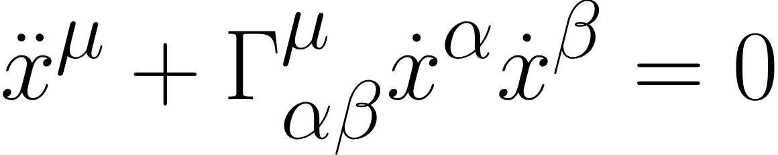
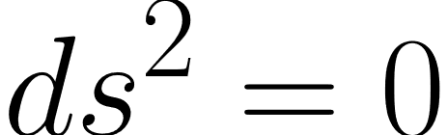
Propagation of light: an overview
1. FRW (cheese)
General method
To find light path in each region,
Write down the metric
Calculate the Christoffel symbols and hence the equations of motion using
and the null condition
Solve the resulting differential equations (numerically or analytically)
2. Kottler (hole)
3. FRW (cheese)

Slide 12
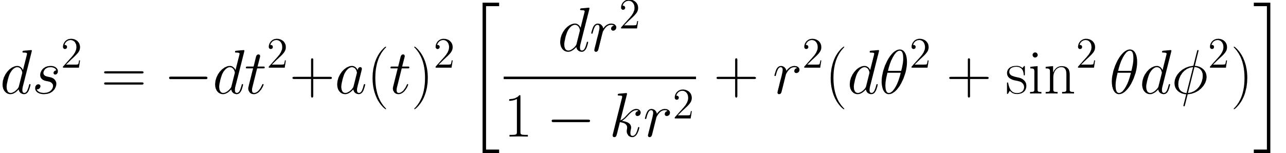
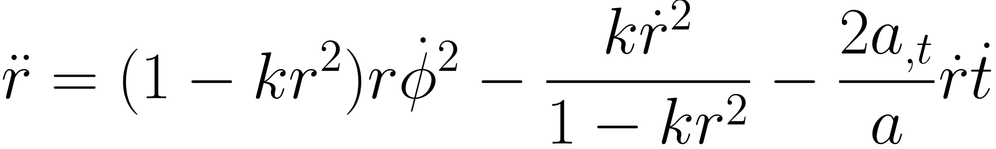
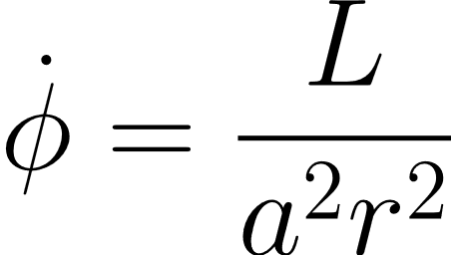
Propagation of light
Friedmann-Robertson-Walker metric
1. FRW (cheese)
Null geodesics
2. Kottler (hole)
3. FRW (cheese)

Slide 13
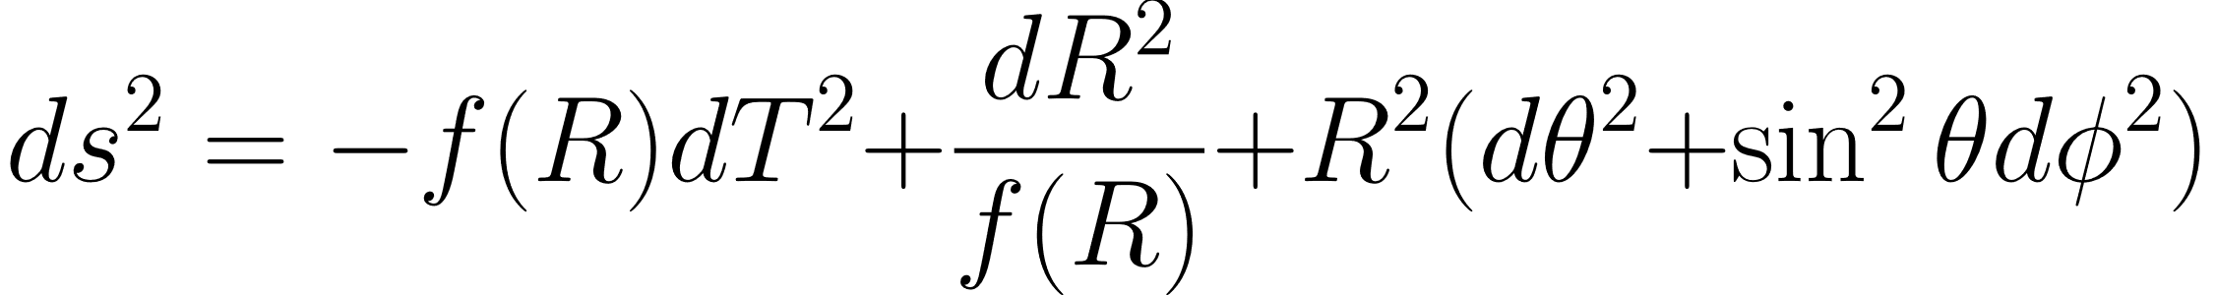
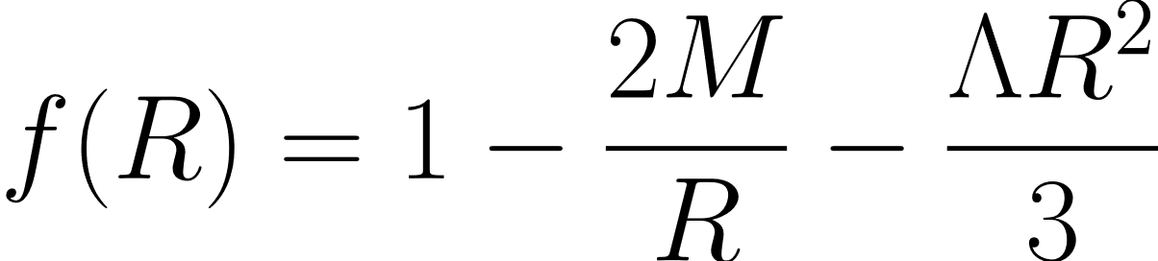
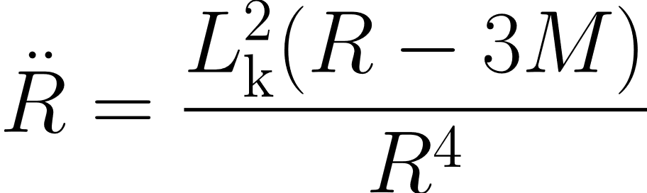
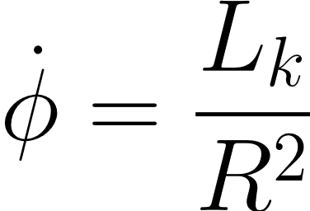
Propagation of light
Kottler metric
1. FRW (cheese)
where
2. Kottler (hole)
Null geodesics
3. FRW (cheese)

Slide 14
Propagation of light
Gluing the two metrics together
1. FRW
A spacetime obtained by gluing two different geometries via a hypersurface Σ is well defined if it satisfies the Israel junction conditions (Israel, 1966):
Both geometries must induce, on Σ,
the same 3-metric, and
the same extrinsic curvature
2. Kottler
3. FRW

Slide 15
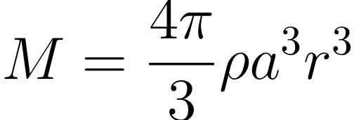
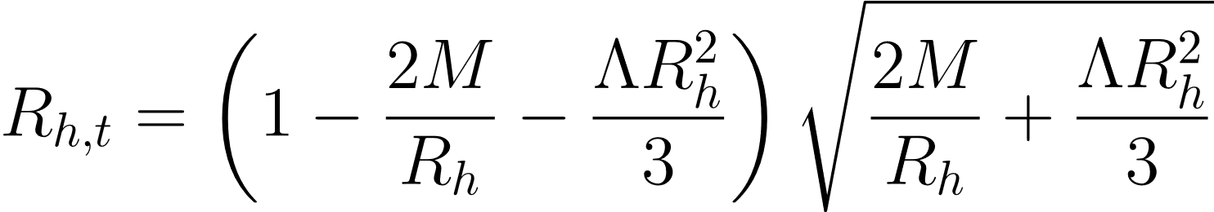
Propagation of light
Gluing the two metrics together
1. FRW
A spacetime obtained by gluing two different geometries via a hypersurface Σ is well defined if it satisfies the Israel junction conditions (Israel, 1966):
These junction conditions tell us:
The size of the hole is related to the mass by
The rate of expansion of the hole in Kottler coordinates:
the Jacobian for transforming velocities from one coordinate to the other
2. Kottler
3. FRW

Slide 16
Propagation of light: the full picture
1. FRW (cheese)
Start off light ray with a fixed θ
Propagate light rays until it reaches the boundary of the hole
Convert from FRW coordinates to Kottler coordinates using the Jacobian obtained from matching conditions
2. Kottler (hole)
Propagate light rays in hole using null geodesic equations
At the same time, the boundary of the hole is also changing
Stop when it has reached the boundary of the hole
Convert from Kottler coordinates back to FRW coordinates
3. FRW (cheese)
Continue propagating light rays until it crosses the axis
Record the coordinate at which it crosses the axis
Notes:
At first, this was done numerically as well, but the numerical errors were too big, and we can do it analytically by geometry

Slide 17
Propagation of light: the full picture
1. FRW (cheese)
Start off light ray with a fixed θ
Propagate light rays until it reaches the boundary of the hole
Convert from FRW coordinates to Kottler coordinates using the Jacobian obtained from matching conditions
2. Kottler (hole)
Propagate light rays in hole using null geodesic equations
At the same time, the boundary of the hole is also changing
Stop when it has reached the boundary of the hole
Convert from Kottler coordinates back to FRW coordinates
3. FRW (cheese)
Continue propagating light rays until it crosses the axis
Record the coordinate at which it crosses the axis
Notes:
At first, this was done numerically as well, but the numerical errors were too big, and we can do it analytically by geometry

Slide 18
Propagation of light: the full picture
1. FRW (cheese)
Start off light ray with a fixed θ
Propagate light rays until it reaches the boundary of the hole
Convert from FRW coordinates to Kottler coordinates using the Jacobian obtained from matching conditions
2. Kottler (hole)
Propagate light rays in hole using null geodesic equations
At the same time, the boundary of the hole is also changing
Stop when it has reached the boundary of the hole
Convert from Kottler coordinates back to FRW coordinates
3. FRW (cheese)
Continue propagating light rays until it crosses the axis
Record the coordinate at which it crosses the axis
Notes:
At first, this was done numerically as well, but the numerical errors were too big, and we can do it analytically by geometry

Slide 19
Results

Slide 20
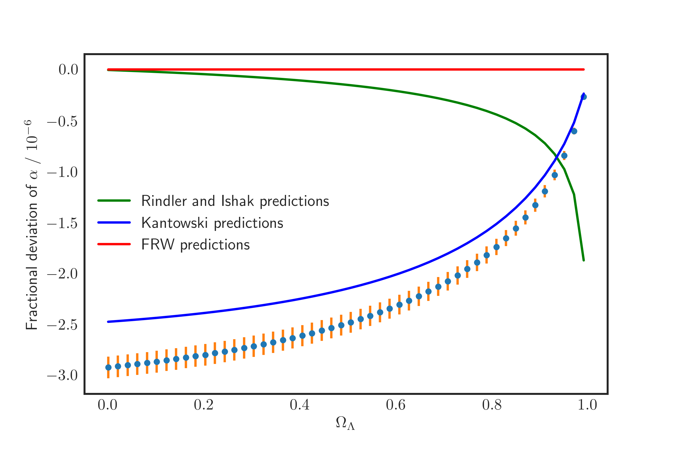
Results: Keeping the mass fixed
Notes:
These are mean deviations from FRW predictions

Slide 22
Results: Keeping the mass fixed
Notes:
These are mean deviations from FRW predictions

Slide 23
Results: Keeping the mass fixed
A few factors at play:
Size of the hole is increased as Λ increases
Increasing size of hole, constant mass
Notes:
These are mean deviations from FRW predictions

Slide 24
Results: Keeping the mass fixed
A few factors at play:
Size of the hole is increased as Λ increases
Expansion rate of the hole boundary depends on Λ
Increasing size of hole, constant mass
Notes:
These are mean deviations from FRW predictions

Slide 25
Results: Keeping the mass fixed
A few factors at play:
Size of the hole is increased as Λ increases
Expansion rate of the hole boundary depends on Λ
Jacobian at the boundary depends on Λ
Increasing size of hole, constant mass
Notes:
These are mean deviations from FRW predictions

Slide 26
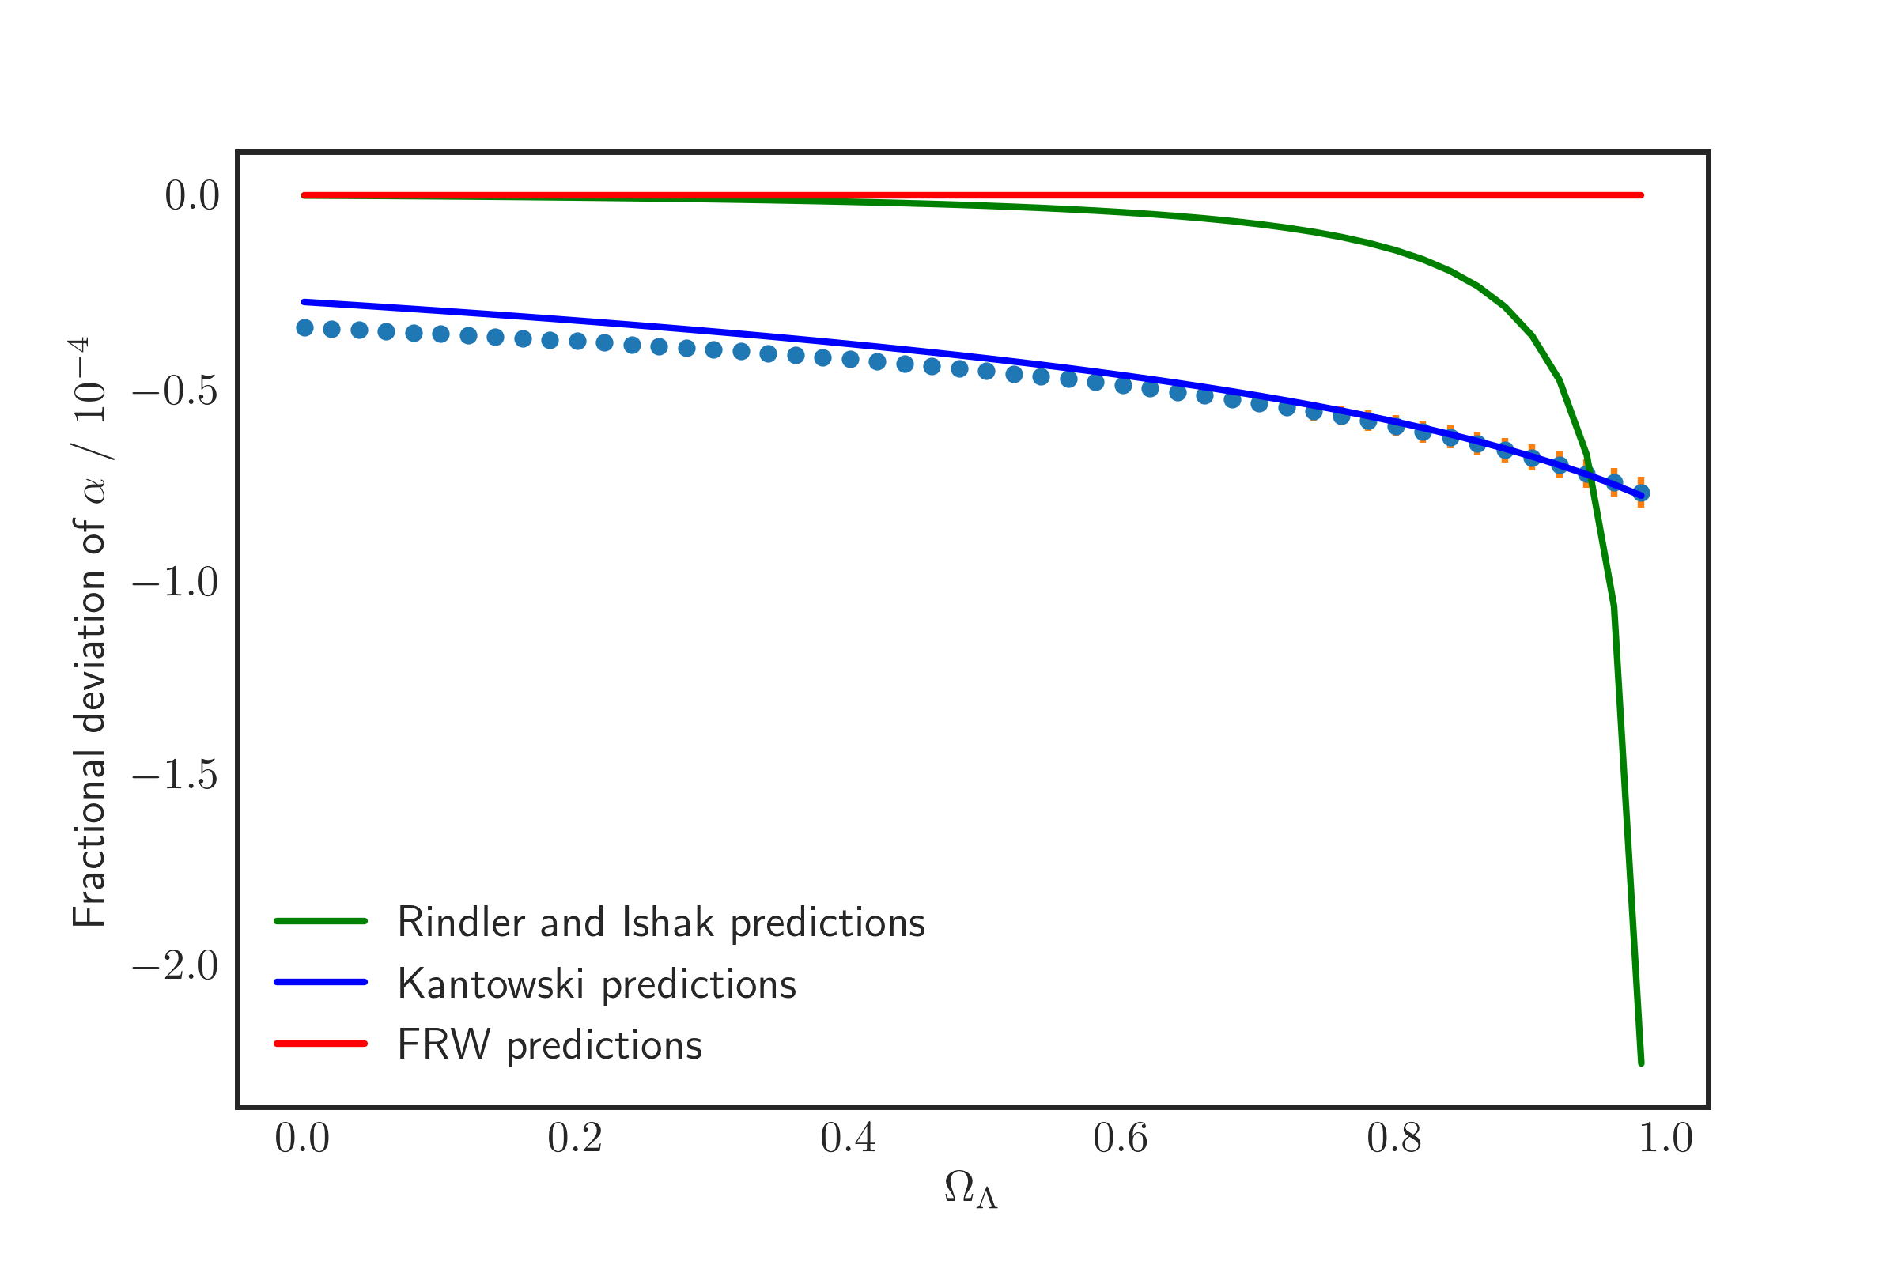
Results: Keeping size of the hole fixed
A few factors at play:
Size of the hole is increased as Λ increases
Expansion rate of the hole boundary depends on Λ
Jacobian at the boundary depends on Λ
Constant size of hole, decreasing mass
Notes:
These are mean deviations from FRW predictions

Slide 27
Currently working on / future work
Curved space
Better estimation of numerical errors
Extend the model to a general mass distribution instead of a point mass

Slide 28
References
Aghili, M. E., Bolen, B., & Bombelli, L. (2017). Effect of accelerated global expansion on the bending of light. General Relativity and Gravitation, 49(1), 10.
Islam, J. N. (1983). The cosmological constant and classical tests of general relativity. Physics Letters A, 97(6), 239-241.
Israel, W. (1966). Singular hypersurfaces and thin shells in general relativity. Il Nuovo Cimento B (1965-1970), 44(1), 1-14.
Kantowski, R., Chen, B., & Dai, X. (2010). Gravitational lensing corrections in flat ΛCDM cosmology. The Astrophysical Journal, 718(2), 913.
Rindler, W., & Ishak, M. (2007). Contribution of the cosmological constant to the relativistic bending of light revisited. Physical Review D, 76(4), 043006.
Schücker, T. (2009). Strong lensing in the Einstein–Straus solution. General Relativity and Gravitation, 41(7), 1595-1610.

Slide 29
Thank you!

Slide 31
Extension: A generalized static mass distribution

Slide 32
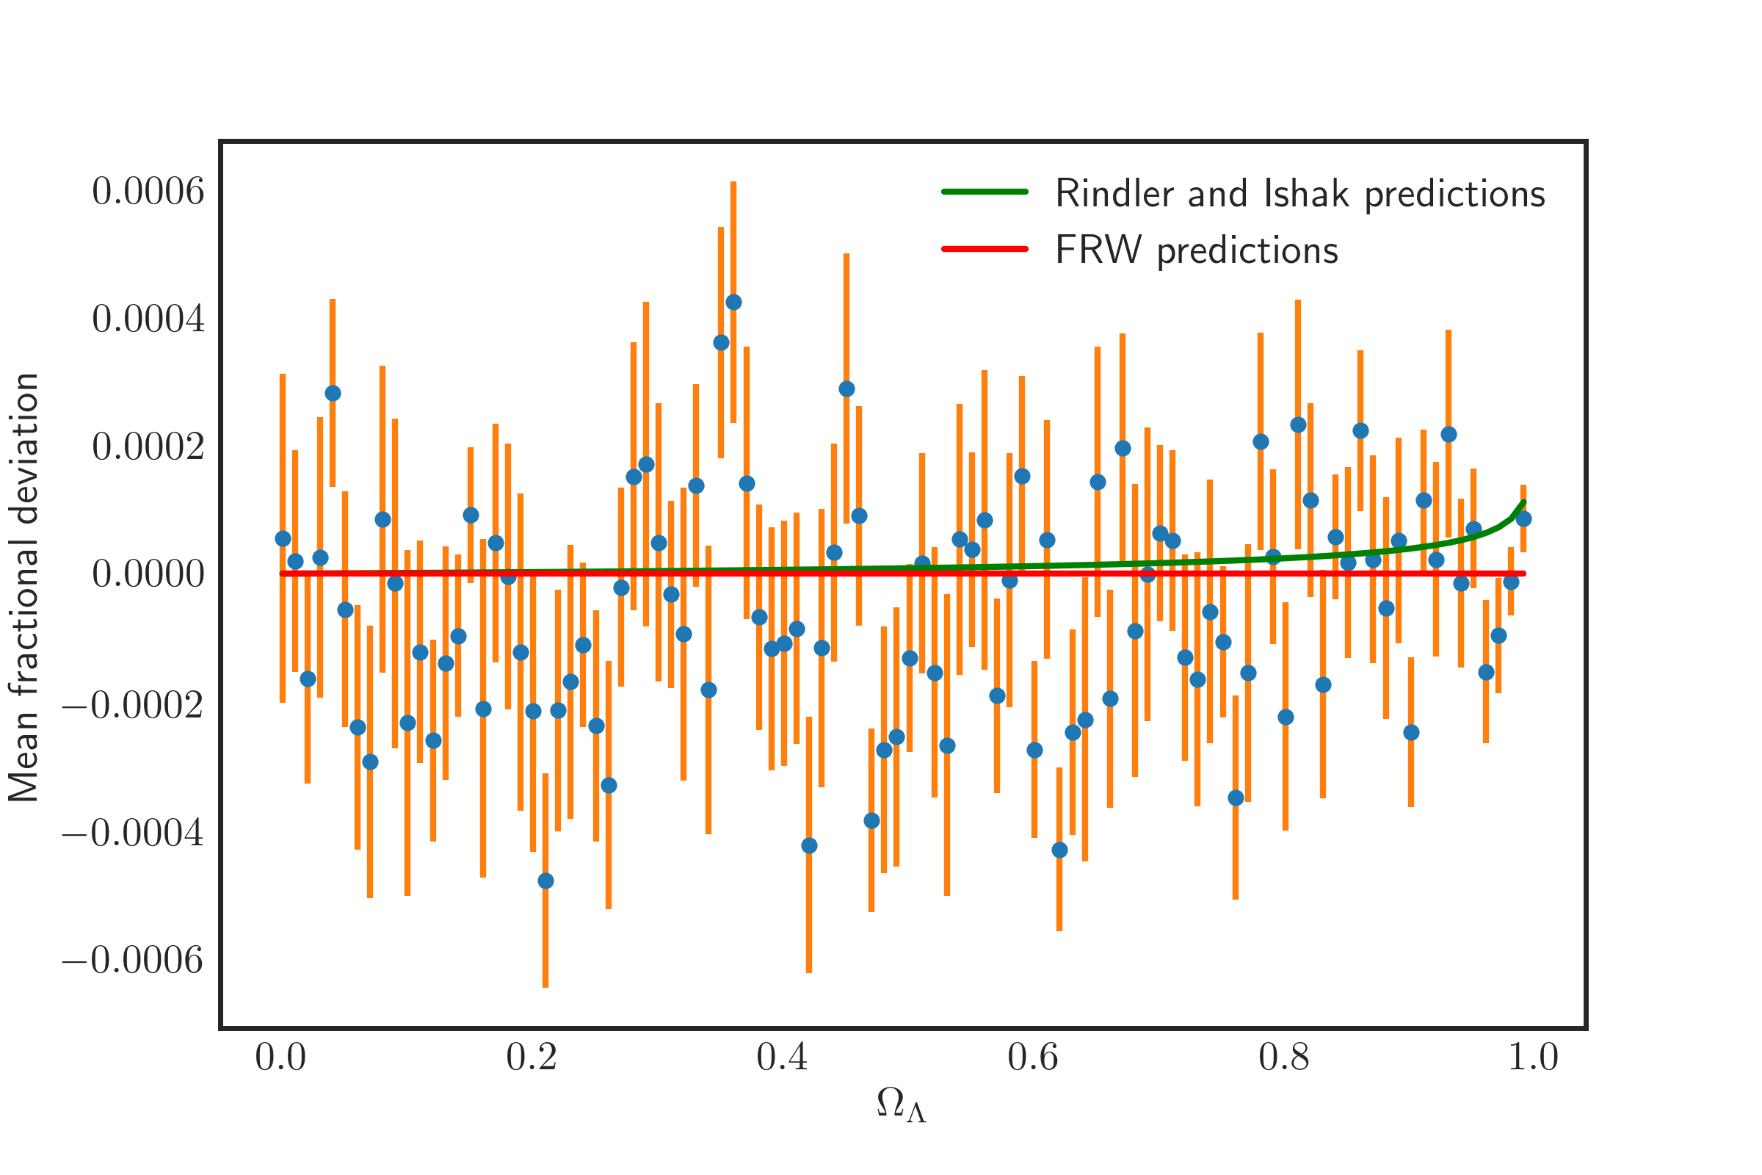
Preliminary results
Numerical errors need to be reduced
Light ray is in FRW most of the time
Replace FRW numerical integration with analytical calculation from geometry considerations

Slide 33
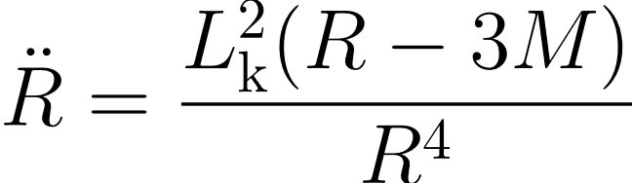
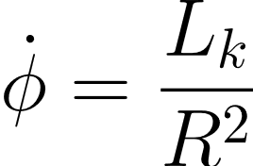
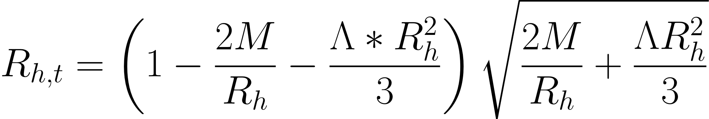
Propagation of light
1. FRW (cheese)
Kottler metric
2. Kottler (hole)
where
3. FRW (cheese)

Slide 34
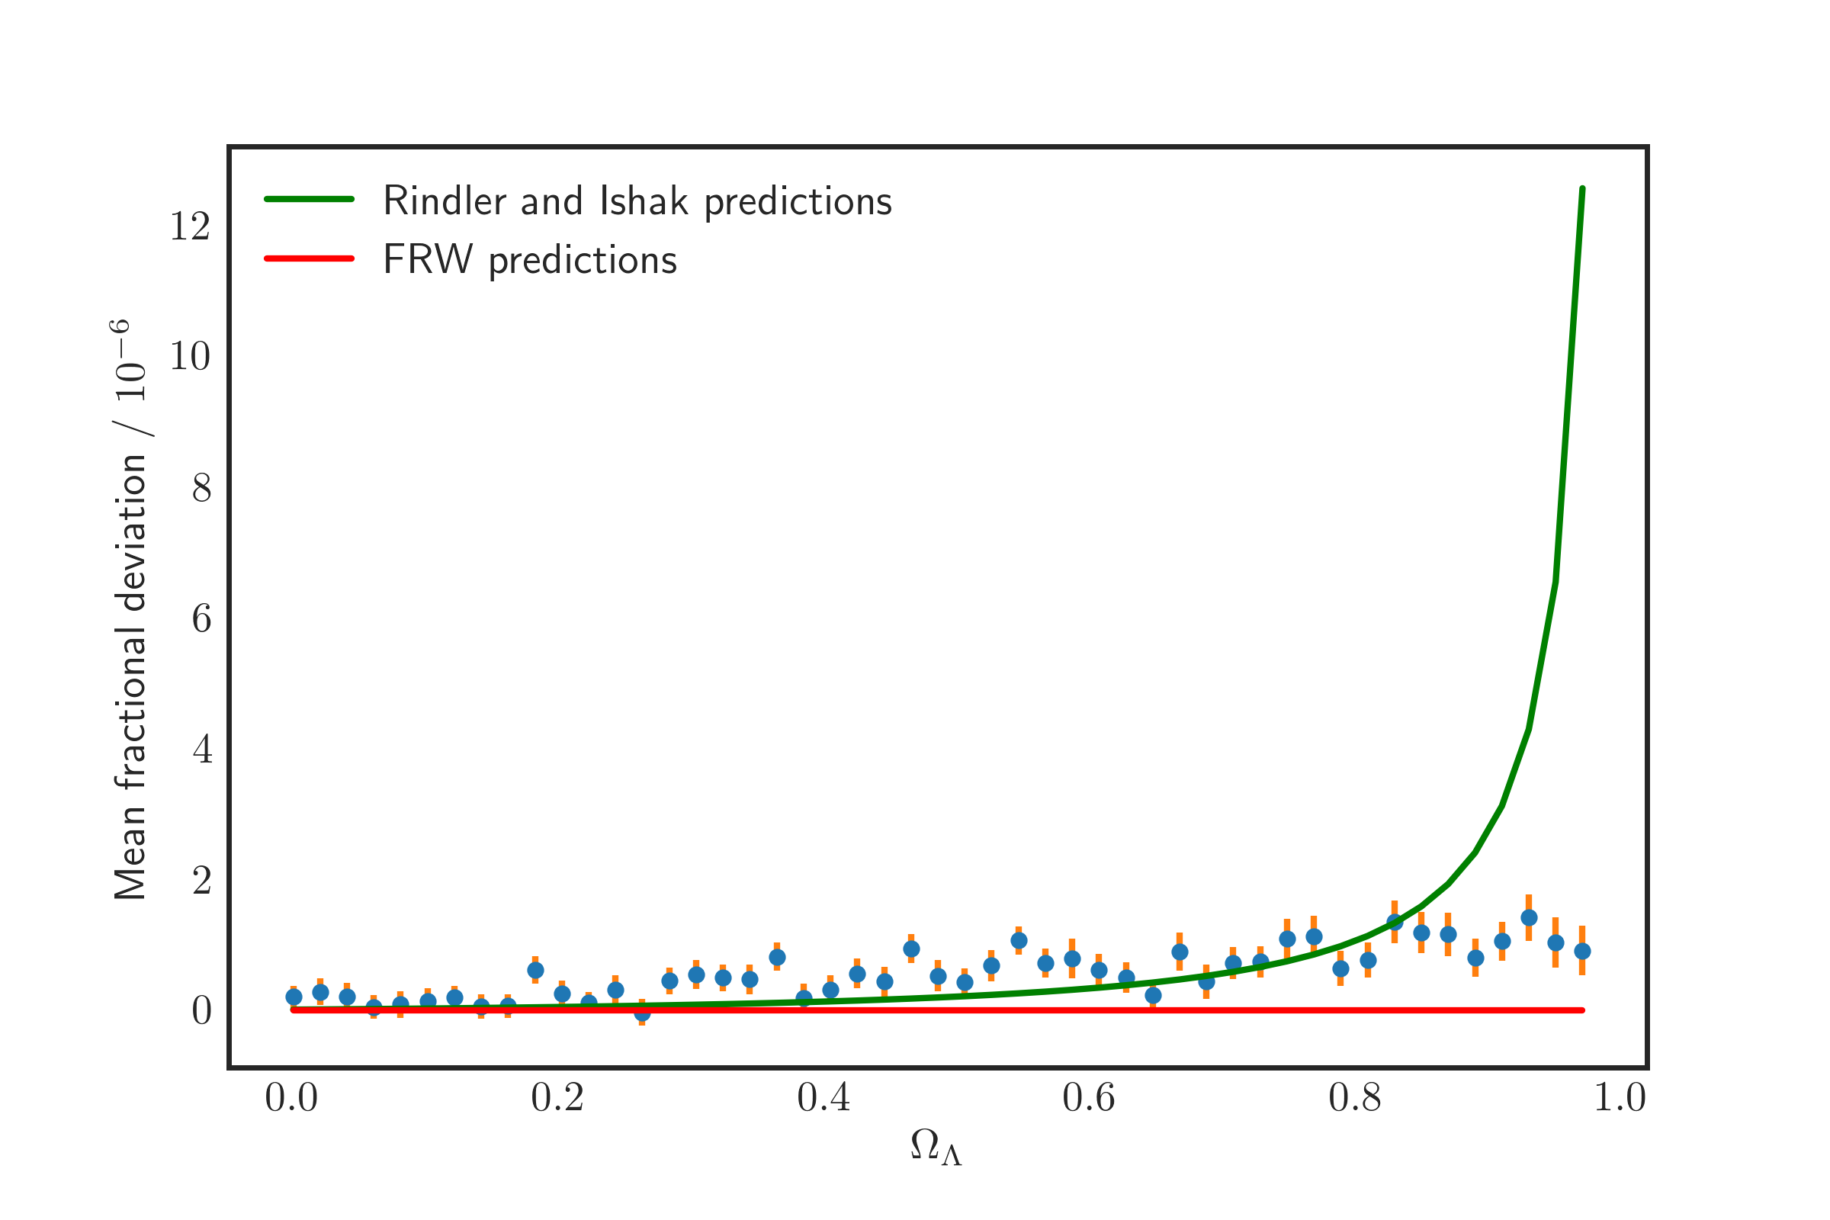
Results: Keeping the size of the hole fixed
Constant size of hole, decreasing mass
Notes:
These are mean deviations from FRW predictions

Slide 35





Gravitational lensing equations
$$α_{}$$
$$θ_{E}$$
$$D_{L}$$
$$D_{LS}$$
$$D_{S}$$

Slide 36
Introduction: gravitational lensing
$$α_{}$$
$$R=D_{L}θ$$
$$θ_{E}$$
$$M$$
$$D_{L}$$
$$D_{LS}$$
$$D_{S}$$

Slide 37
The project: Investigating the role of the cosmological constant in gravitational lensing
Both the cosmological constant and gravitational lensing form important parts of our understanding of the universe
If there is an effect of the cosmological constant in gravitational lensing that is not accounted for, it might come important for future precision cosmology measurements.
Mostly analytical
Islam (1983): Conventional view
Rindler and Ishak (2007): Challenged the conventional view
Numerical approach
Swiss-cheese model

Slide 38
Results: Keeping the size of the hole fixed
Notes:
These are mean deviations from FRW predictions

Slide 39
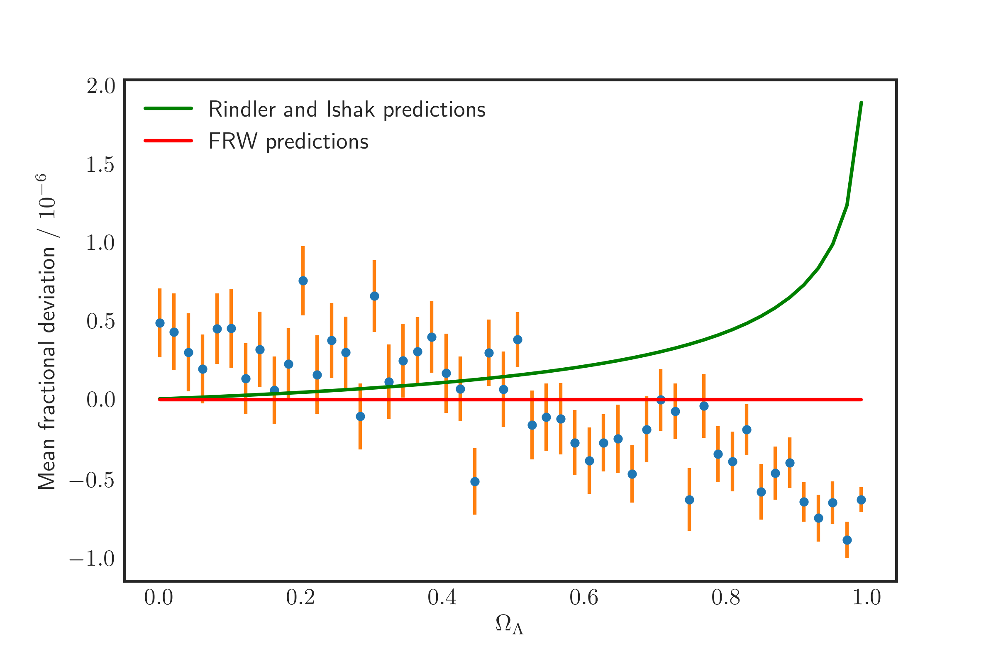
Results: Keeping the central mass fixed
Notes:
These are mean deviations from FRW predictions

Slide 40
Results: Keeping the central mass fixed
Increasing size of hole, constant mass
Notes:
These are mean deviations from FRW predictions

Slide 41
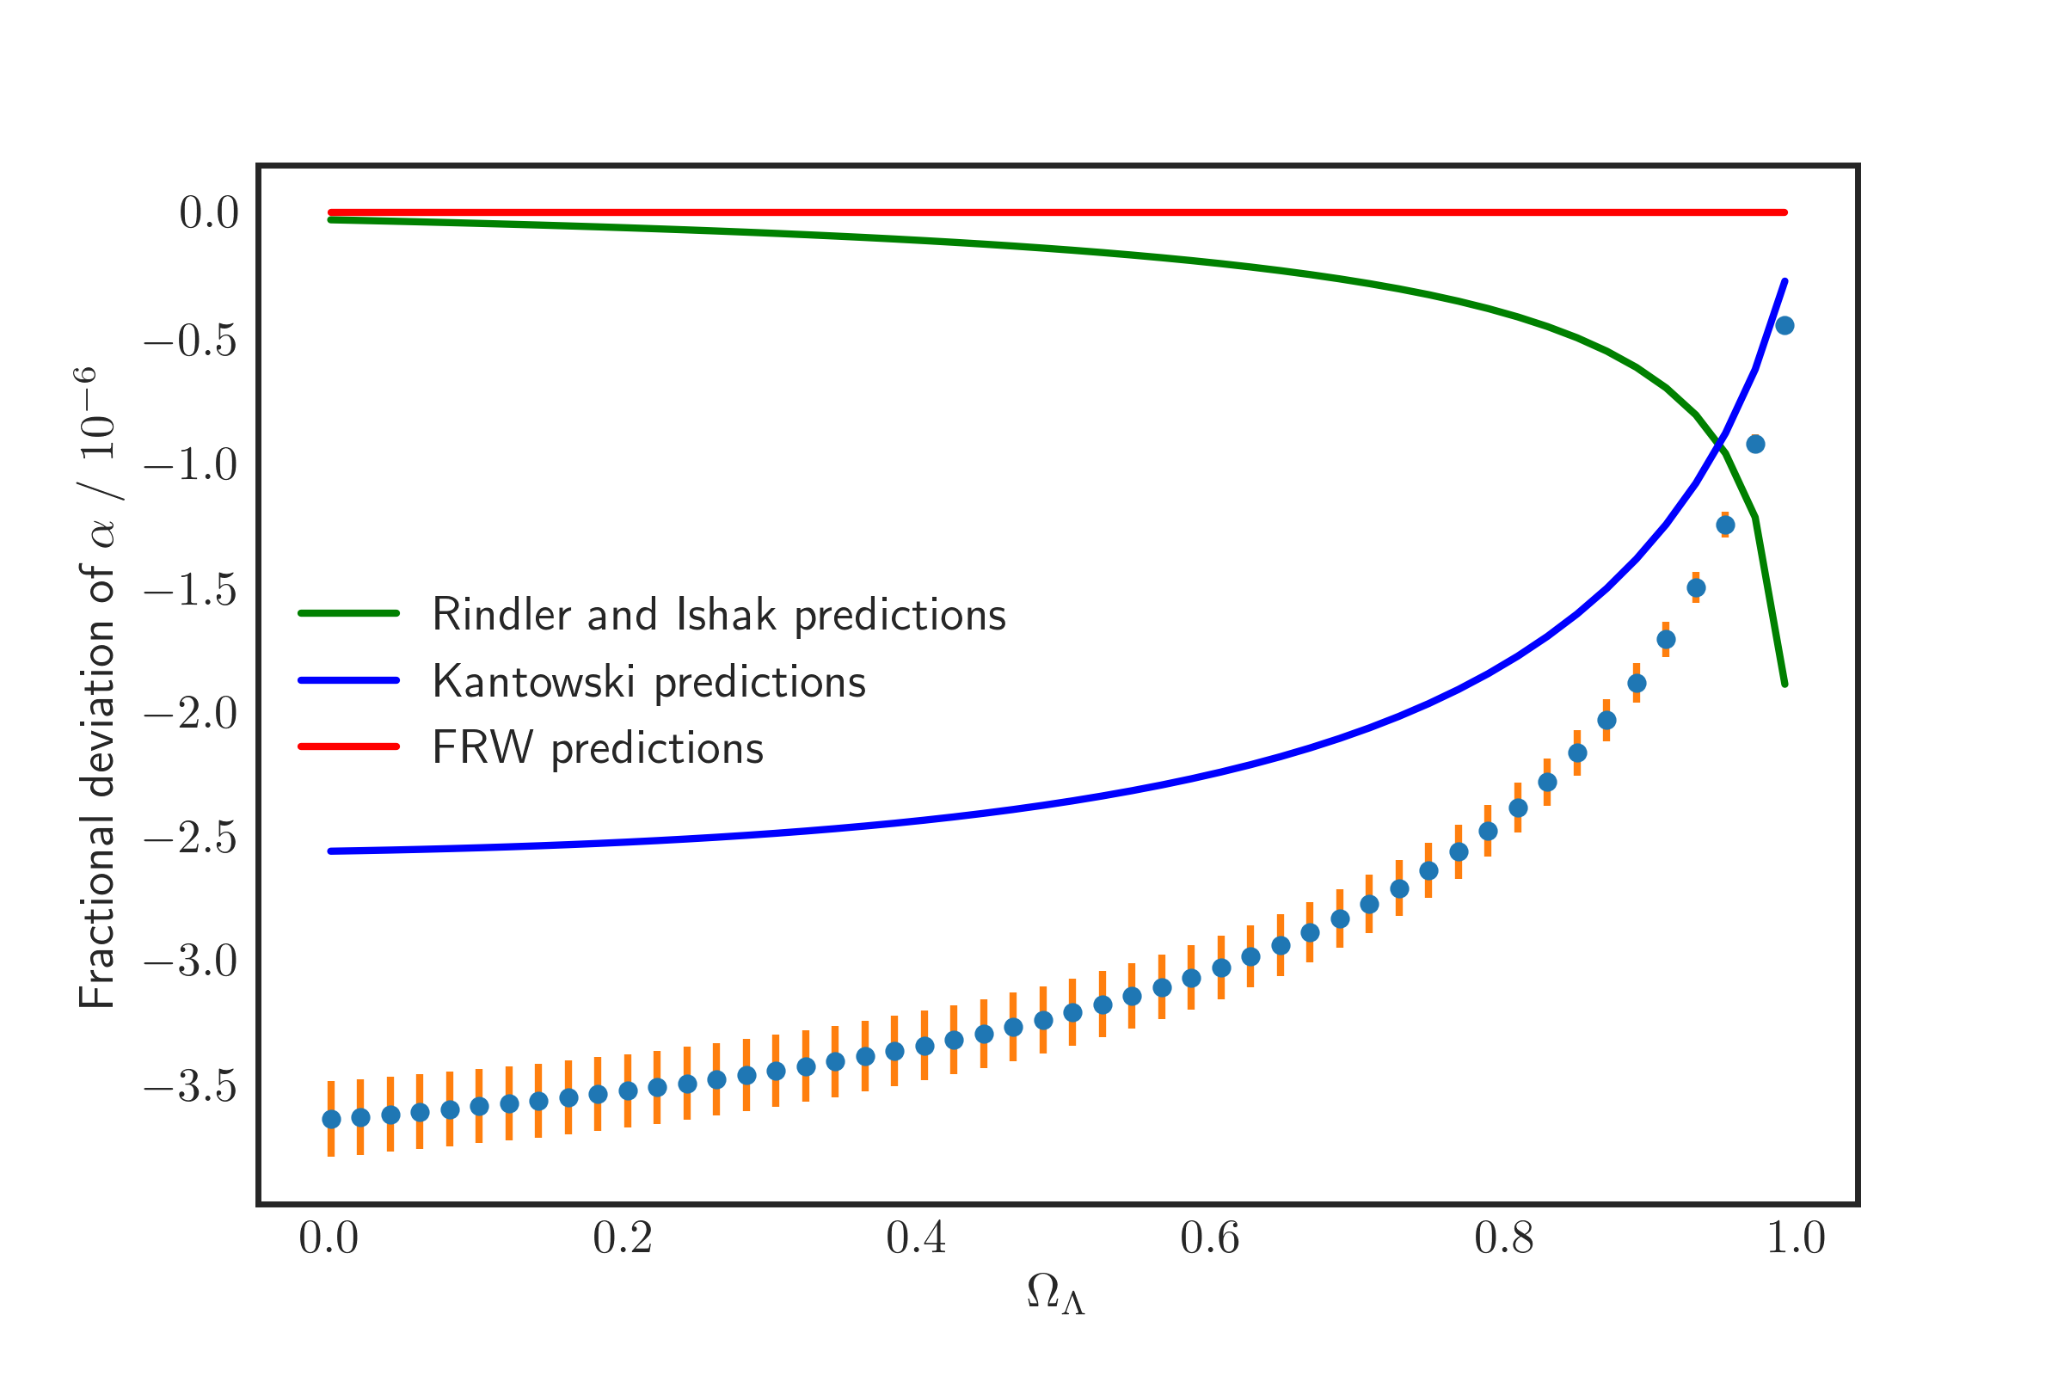
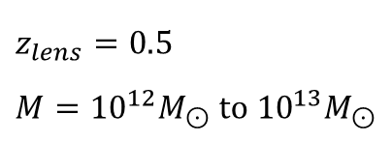
Results: Keeping the lens redshift fixed
$$z_{lens}=0.5$$
$$M={10}^{12}M_{⊙} to {10}^{13}M_{⊙}$$
Notes:
These are mean deviations from FRW predictions

Slide 42
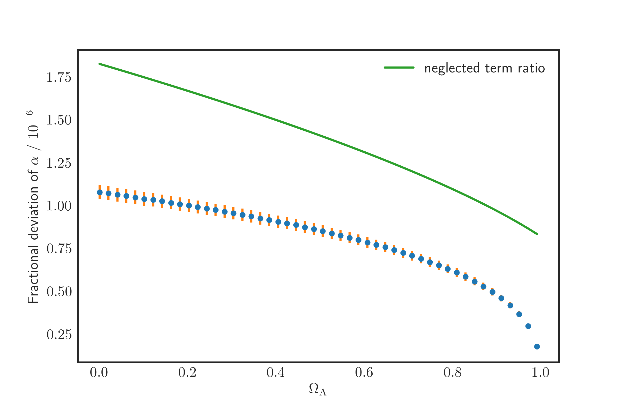
Results: Keeping the lens redshift fixed
Notes:
These are mean deviations from FRW predictions

Slide 43
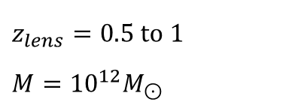
Results: Keeping the mass fixed
$$z_{lens}=0.5 to 1$$
$$M={10}^{12}M_{⊙}$$
Notes:
These are mean deviations from FRW predictions

Slide 44
Results: Keeping the mass fixed
Increasing size of hole, constant mass
$$z_{lens}=0.5 to 1$$
$$M={10}^{12}M_{⊙}$$
Notes:
These are mean deviations from FRW predictions

Slide 45
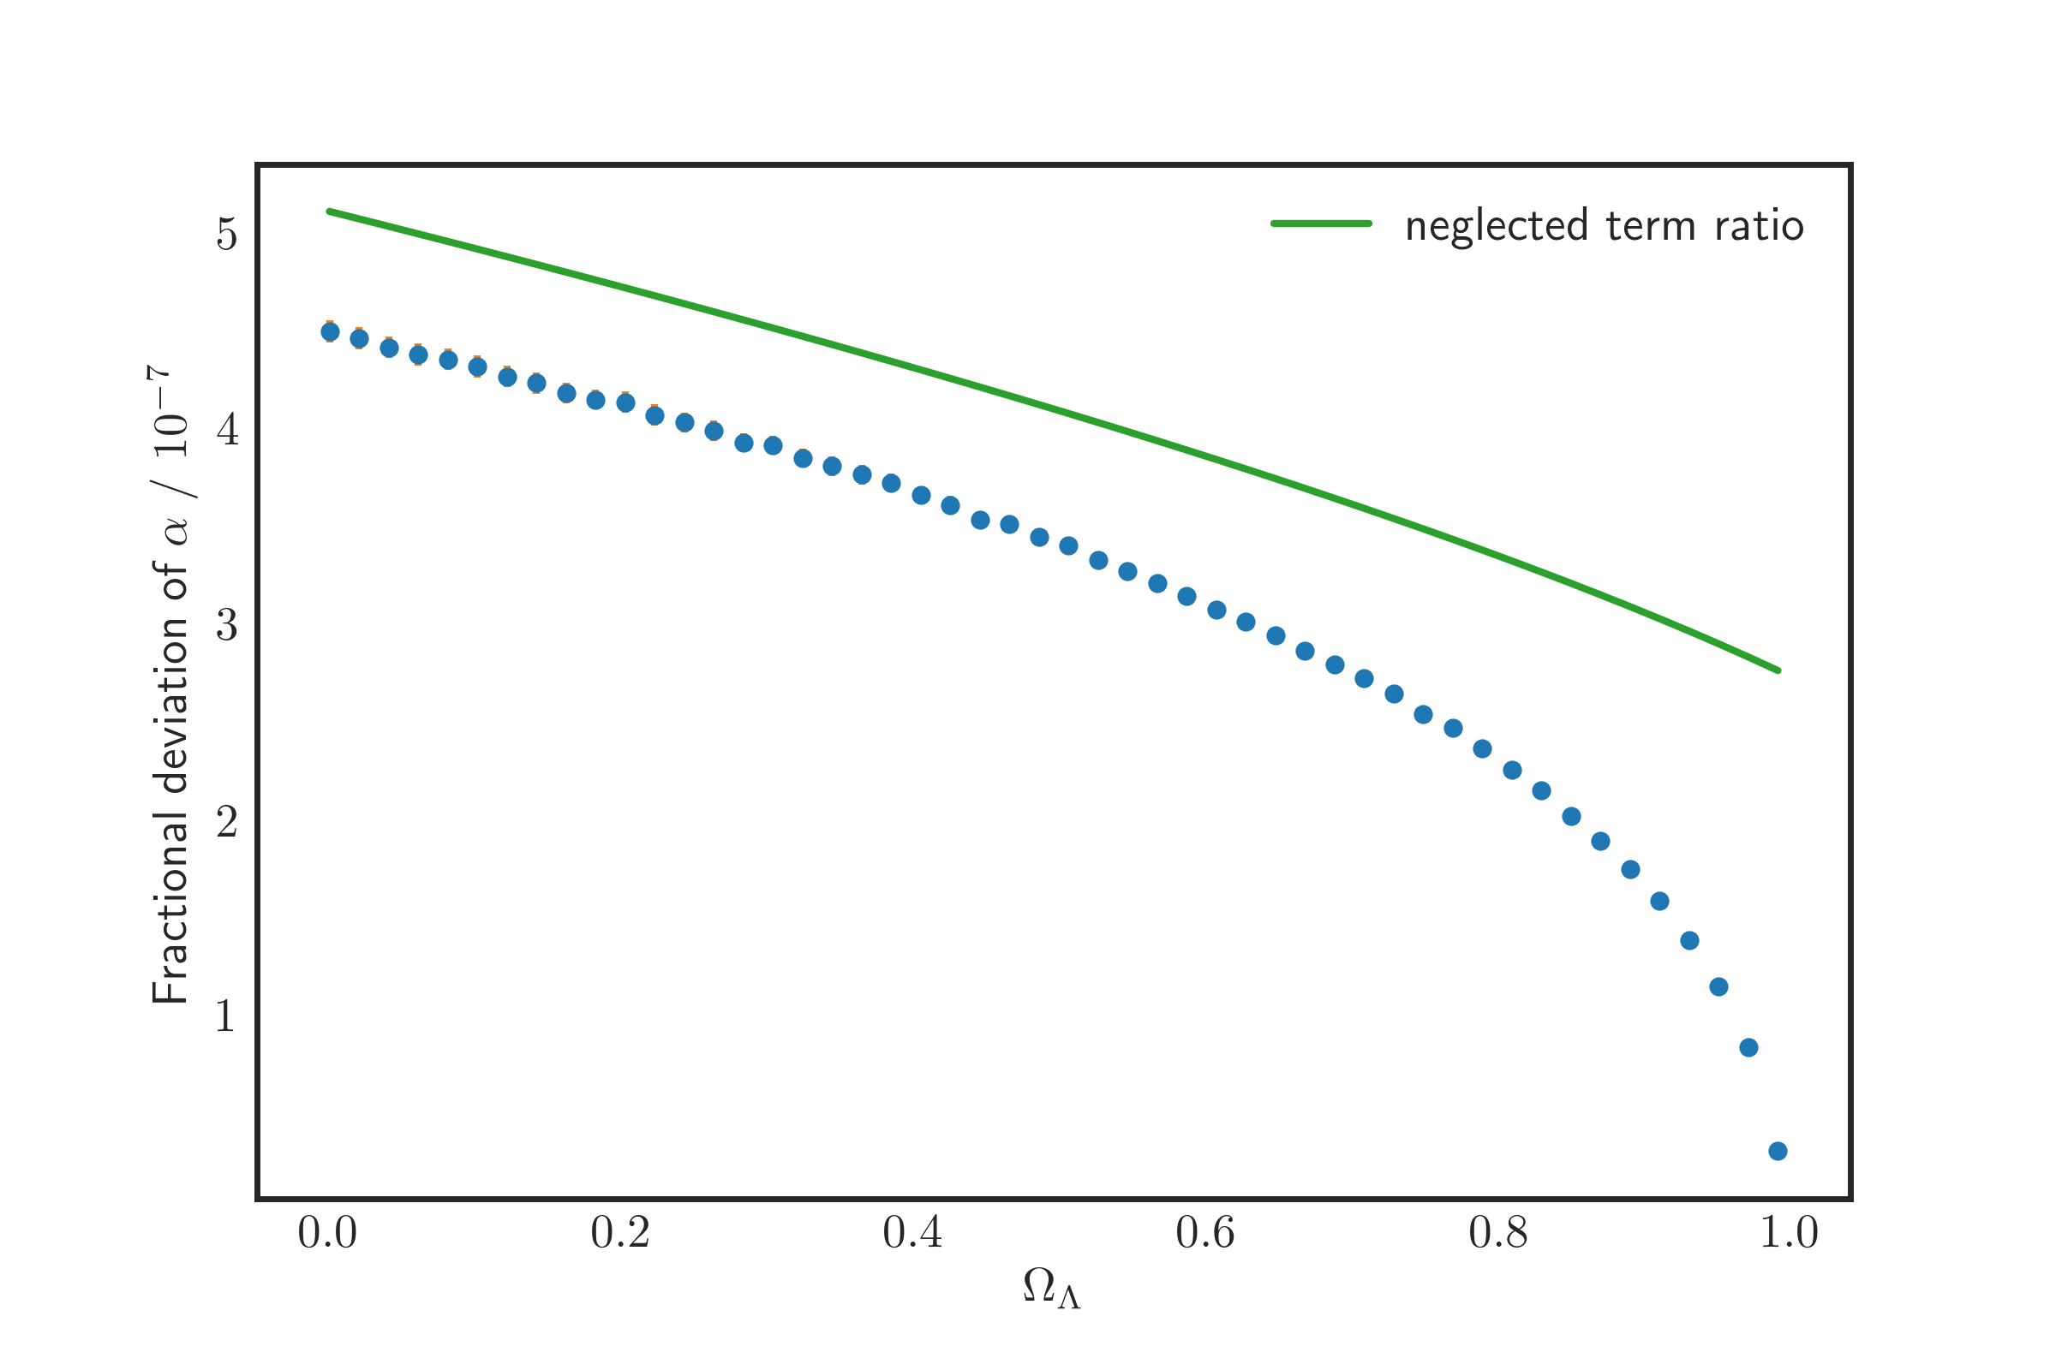
Results: Keeping the mass fixed
Notes:
These are mean deviations from FRW predictions

Slide 46
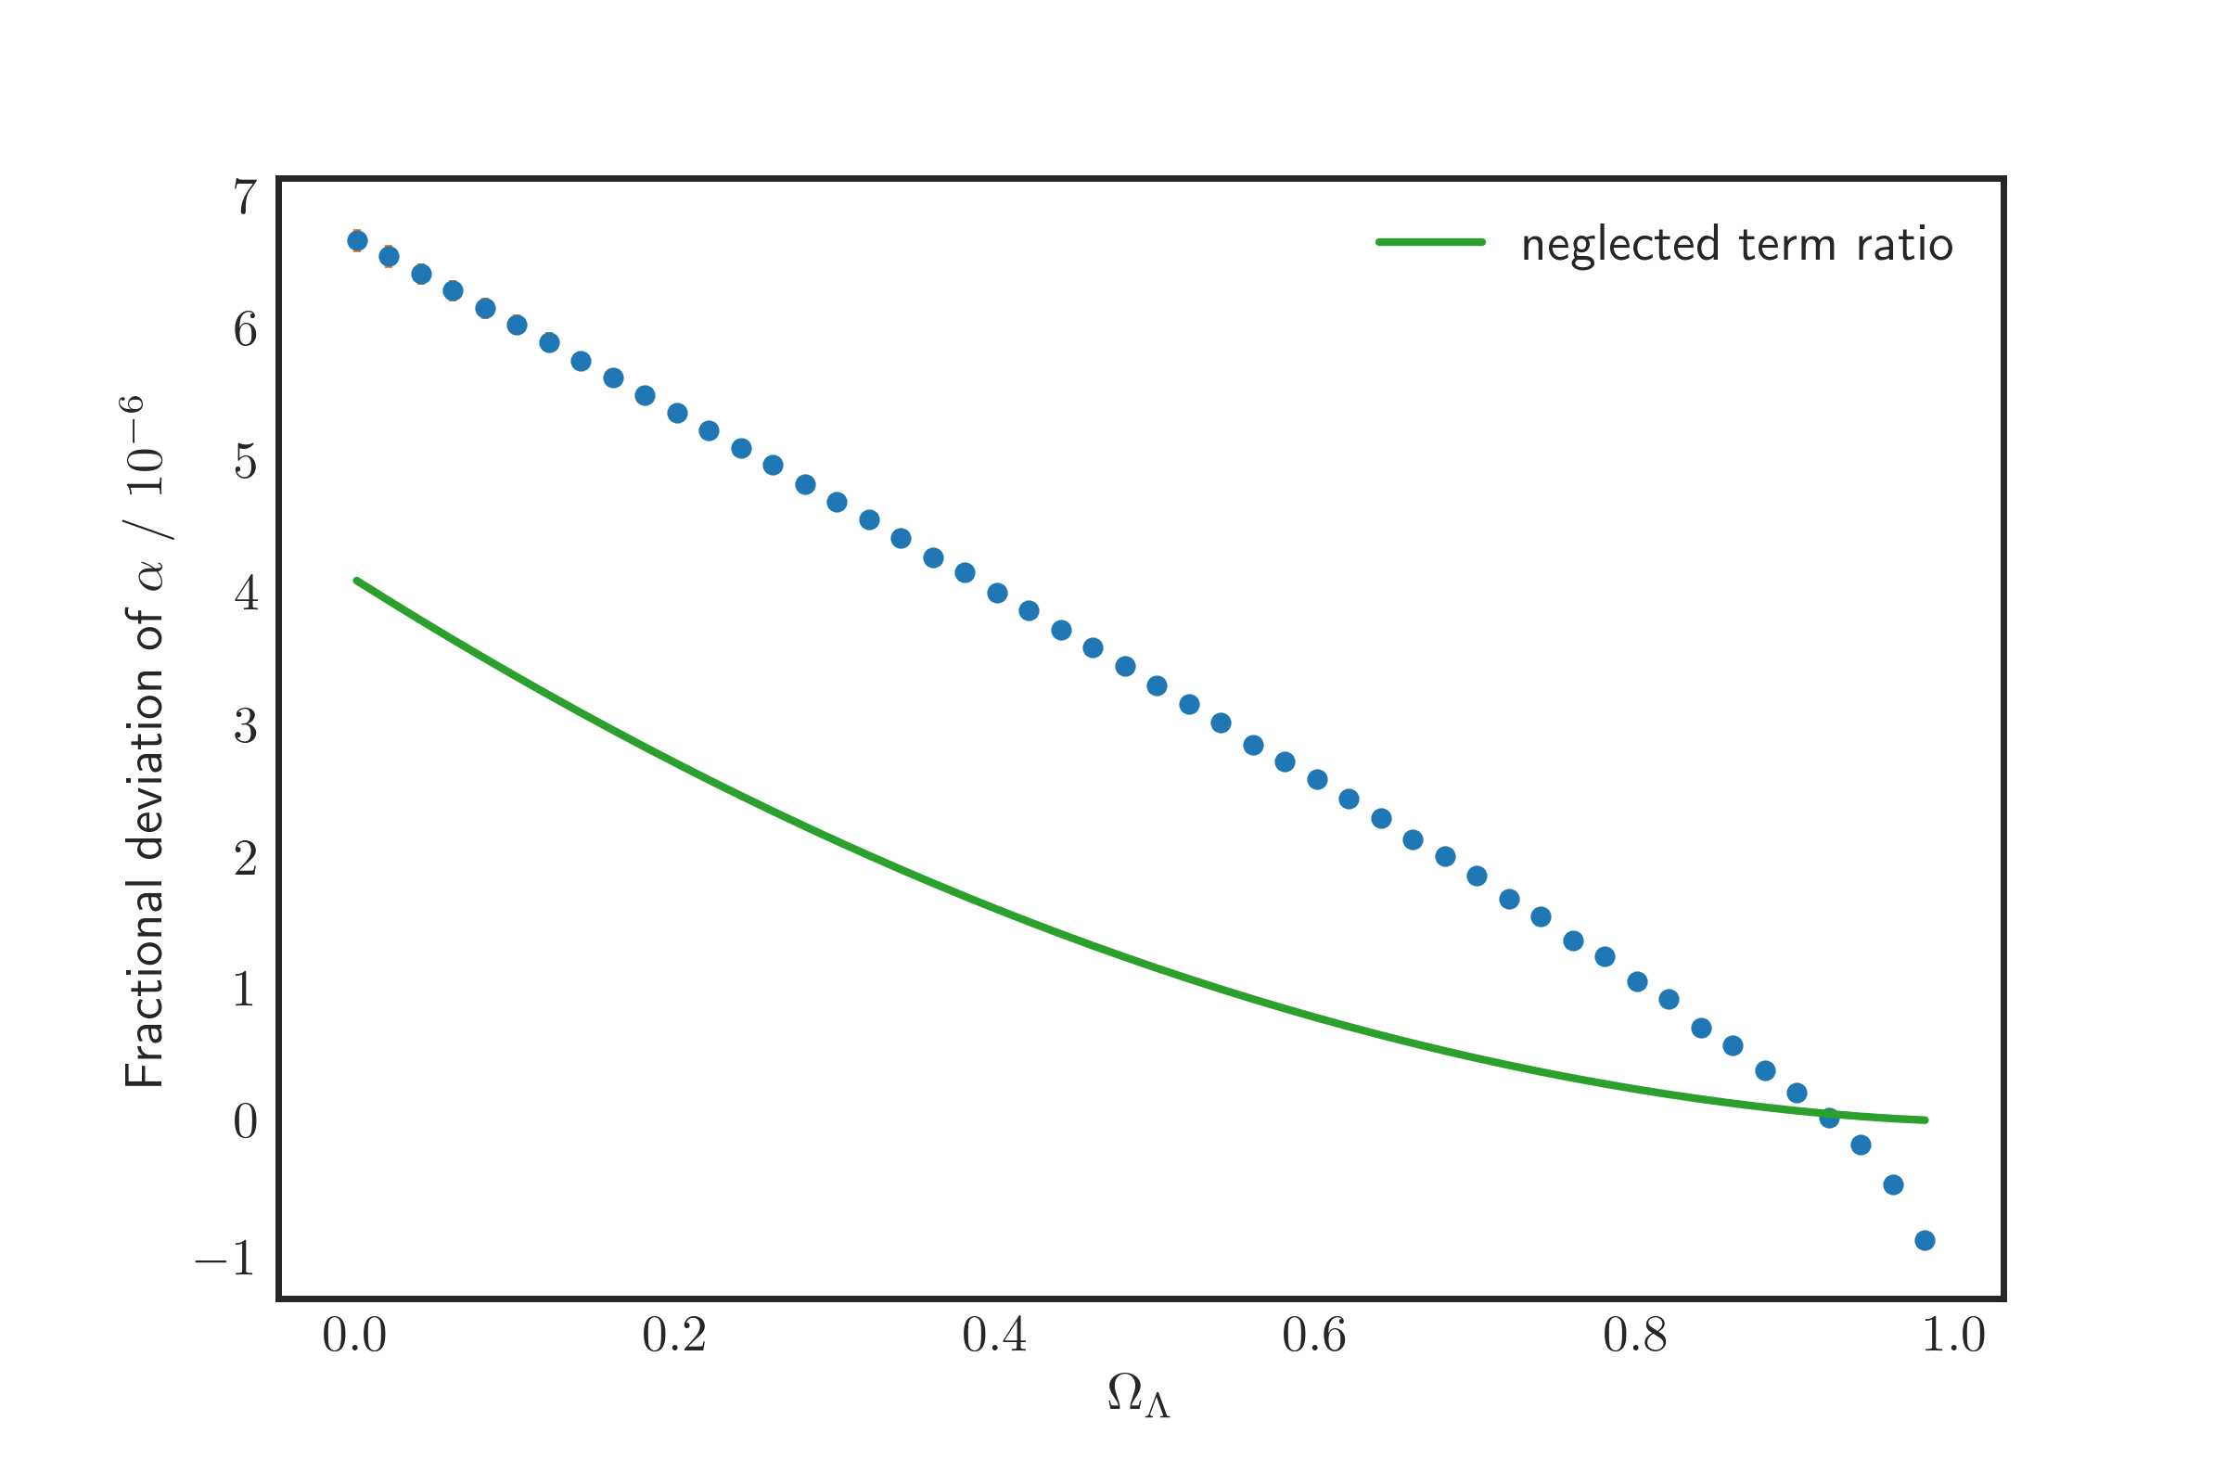
Results: Keeping size of the hole fixed
Notes:
These are mean deviations from FRW predictions

Slide 47
Results: Keeping size of the hole fixed
Constant size of hole, decreasing mass
Notes:
These are mean deviations from FRW predictions

