Slide 1
The Role of the Cosmological Constant in Gravitational Lensing
Lingyi Hu

Slide 2
The project: Investigating the role of the cosmological constant in gravitational lensing
 | Both the cosmological constant and gravitational lensing form important parts of our understanding of the universe If there is an effect of the cosmological constant in gravitational lensing that is not accounted for, it might come important for future precision cosmology measurements.
 | Mostly analytical Islam (1983): Conventional view Rindler and Ishak (2007): Challenged the conventional view
 | Numerical approach Swiss-cheese model
Why this research is important
Previous literature on the topic
Our project
Notes:
conventional view: Lambda does not directly enter into the lensing equation, because it cancels out in the null geodesic equations

Slide 3
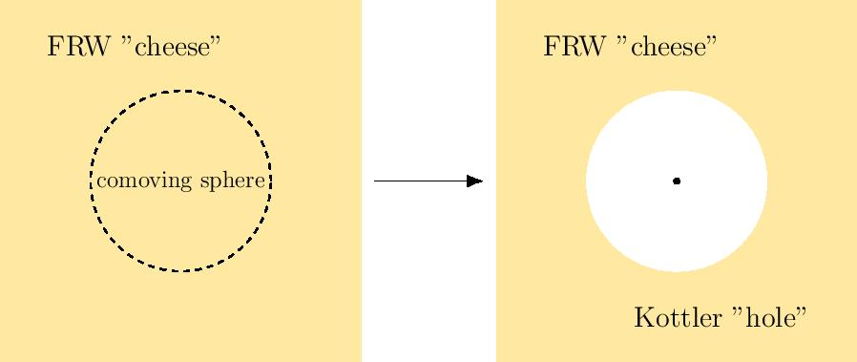
Method: Swiss-Cheese Model
Notes:
Majority of planck sources are late-type spiral galaxies, belonging to the Virgo cluster

Slide 4
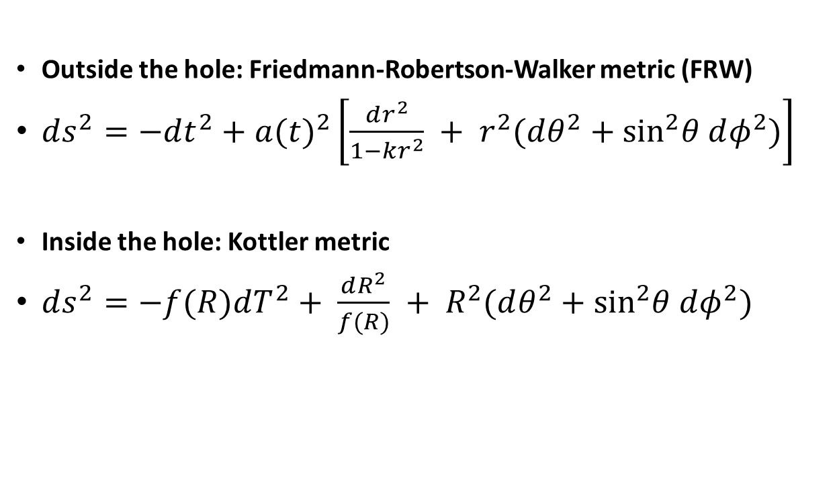
Outside the hole: Friedmann-Robertson-Walker metric (FRW)
$ds^{2}=−dt^{2}+a(t)^{2}\left[\frac{dr^{2}}{1−kr^{2}} + r^{2}(dθ^{2}+{\text{sin}}^{2}θ dφ^{2})\right]$
Inside the hole: Kottler metric
$ds^{2}=−f(R)dT^{2}+ \frac{dR^{2}}{f(R)} + R^{2}(dθ^{2}+{\text{sin}}^{2}θ dφ^{2})$

Slide 5
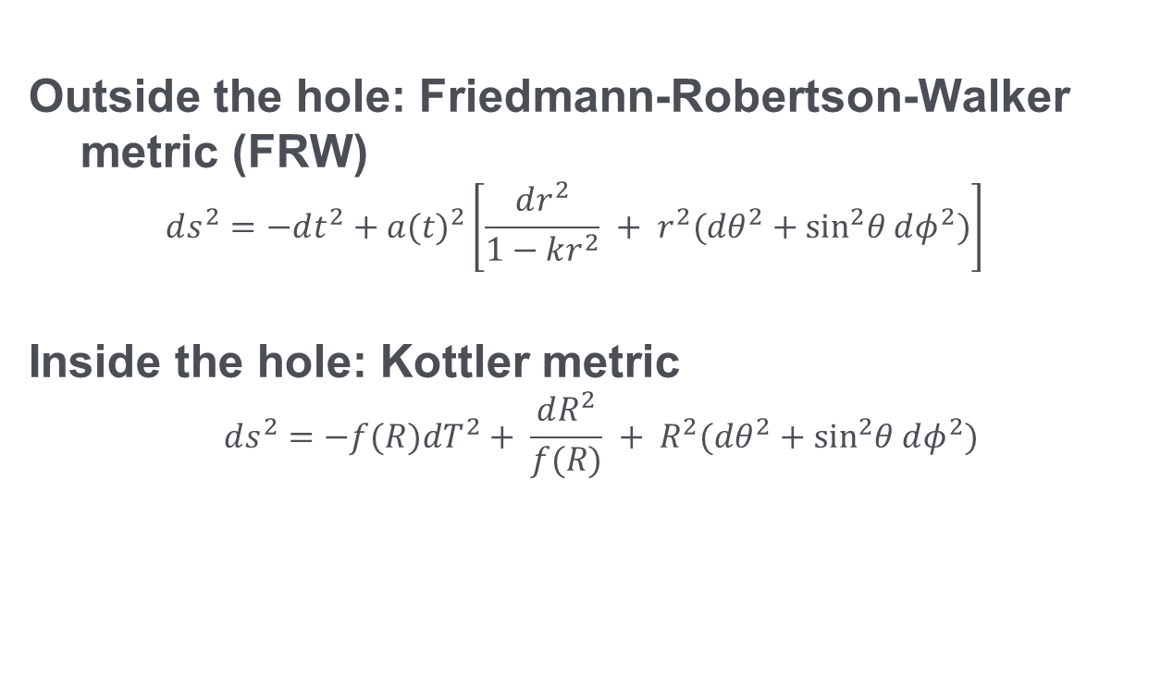
Method: Swiss-Cheese Model
Outside the hole: Friedmann-Robertson-Walker metric (FRW)
$$ds^{2}=−dt^{2}+a(t)^{2}\left[\frac{dr^{2}}{1−kr^{2}} + r^{2}(dθ^{2}+{\text{sin}}^{2}θ dφ^{2})\right]$$
Inside the hole: Kottler metric
$$ds^{2}=−f(R)dT^{2}+ \frac{dR^{2}}{f(R)} + R^{2}(dθ^{2}+{\text{sin}}^{2}θ dφ^{2})$$

Slide 6
Gluing the two metrics together
A spacetime obtained by gluing two different geometries via a hypersurface Σ is well defined if it satisfies the Israel junction conditions [??].
Both geometries must induce
the same 3-metric, and
induce the same extrinsic curvature on Σ

Slide 7
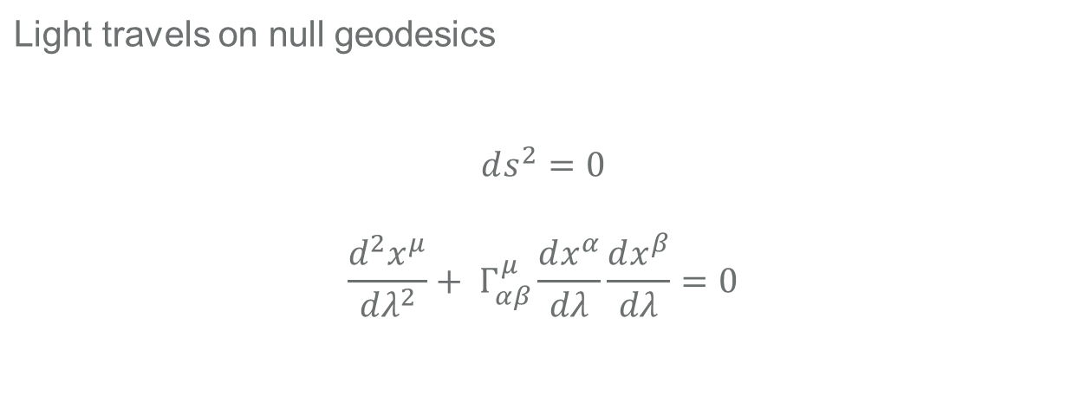
Method: Swiss-Cheese Model (continued)
Light travels on null geodesics $$ds^{2}=0$$ $$\frac{d^{2}x^{μ}}{dλ^{2}}+ Γ_{αβ}^{μ}\frac{dx^{α}}{dλ}\frac{dx^{β}}{dλ}=0$$

Slide 8
Light propagation
Initialize the walkers
Shoot off light rays in a given angle
Take steps in parameter space
At each iteration of the MCMC, each walker takes a step in the parameter space by choosing another walker and stepping along the line in parameter space connecting itself to another walker.
Draw samples from the distribution
After a large number of steps, we can then draw fair samples from the distribution by selecting points from the history of the walkers.
After each step is taken, the posterior probability distribution at the new point in parameter space is evaluated.

Slide 9
How MCMC works
 | 100 walkers Each takes 1000 steps
 | We take the best fit parameter values (β, T) as the mean over the last 700 steps of all the walkers First 300 iterations at the beginning were treated as the burn in, intended to give the Markov Chain time to reach its equilibrium. We took 68% confidence interval as the standard deviation of that parameter
Parameters for the Markov chain
Extracting information from the Markov chain distribution

Slide 10
Early SED fitting: Process and road blocks
 | Akari data requires a surface brightness/flux correction for compact extended sources (Ueta et al., 2016) We only had Akari data for some sources
 | We used the Nelder-Mead method in scipy.optimize to find the points for initializing the MCMC. For some cases, max iteration number was reached before it reached convergence, and in some rare cases there was false convergence. For these cases, we fell back on the initial guess.
Problems with Akari data
Convergence of the Nelder-Mead

Slide 11
Results: Comparisons with literature (HRS)
 | Herschel Reference Survey (HRS) is a sample of 313 galaxies (15 < D < 25Mpc) spanning the whole range in morphological type (from ellipticals to late-type spirals) To verify that our code and algorithm is working as expected
 | Applied the fitting algorithm to the same galaxies in the HRS data (100,160, 250, 350, 500μm) Temperatures and betas agree within the margin of error to the results in the Cortese 2014 paper.
What is HRS and purpose of comparison
Comparison results
Notes:
During their evolution, the different stellar populations galaxies produce and inject into the stellar medium metals that congregate to form dust particles of different size and composition.
This dust, heated by the general stellar radiation field, re-emit the absorbed energy in the far-infrared (FIR).
The amount of dust in a galaxy is a measure of the quantity of heavy elements in the interstellar medium, since ~ 50% of the heavy elements are locked up in dust and there is some evidence that this fraction is constant from galaxy to galaxy.
In normal galaxies, the emitting dust can be modelled by a modified blackbody spectrum with a peak at ~ 200μm rapidly decreasing at longer wavelengths.
The amount of dust in a galaxy is a measure of the quantity of heavy elements in the interstellar medium

Slide 12
Possible sources of error / improvements
In this approach we use a simple modified blackbody fit, allowing us to identify the most fundamental properties of the dust medium: dust temperature and dust mass.
However, modified blackbodies are simple models and cannot properly reproduce real dust properties--complex multi-component methods have been developed to take into account the entire range from mid-infrared to mm wavelengths (e.g., Draine & Li 2007; Compiegne et al. 2011; Galliano et al. 2011)
This can improve the accuracy of our results since Planck has data extending into the mm range.

Slide 13
References
Baes, M., Herranz, D., Bianchi, S., Ciesla, L., Clemens, M., Zotti, D. G., … Vlahakis, C. (2014). The Herschel Virgo Cluster Survey, 562, A106. doi:10.1051/0004-6361/201322384
Bianchi, S. (2013). Vindicating single-T modified blackbody fits to Herschel SEDs, 552, A89. doi:10.1051/0004-6361/201220866
Boselli, A., Eales, S., Cortese, L., Bendo, G., Chanial, P., Buat, V., … Zeilinger, W. (2010). The Herschel Reference Survey. doi:10.1086/651535
Boselli, A., & group, the. (2006). The Herschel galaxy reference survey.
Clements, D. L., Dunne, L., & Eales, S. (2010). The submillimetre properties of ultraluminous infrared galaxies. Mon Not R Astron Soc, 403(1), 274–286. doi:10.1111/j.1365-2966.2009.16064.x
Clements, D. L., Rigby, E., Maddox, S., Dunne, L., Mortier, A., Pearson, C., … Verma, A. (2010). The Herschel-ATLAS: Extragalactic Number Counts from 250 to 500 Microns. doi:10.1051/0004-6361/201014581
Planck Collaboration, Abergel, Ade, Aghanim, Arnaud, Ashdown, … Zonca. (2011). Planckearly results. XXV. Thermal dust in nearby molecular clouds. Astronomy & Astrophysics, 536, A25. doi:10.1051/0004-6361/201116483

Slide 14
References
Cortese, Fritz, Bianchi, Boselli, Ciesla, Bendo, … Vlahakis. (2014). PACS photometry of the Herschel Reference Survey – far-infrared/submillimetre colours as tracers of dust properties in nearby galaxies★. Monthly Notices of the Royal Astronomical Society, 440(1), 942–956. doi:10.1093/mnras/stu175
Dunne, L., & Eales, S. A. (2001). The SCUBA Local Universe Galaxy Survey – II. 450‐μm data: evidence for cold dust in bright IRAS galaxies. Mon Not R Astron Soc, 327(3), 697–714. doi:10.1046/j.1365-8711.2001.04789.x
Dunne, L., Eales, S., Edmunds, M., Ivison, R., Alexander, P., & Clements, D. L. (2000). The SCUBA Local Universe Galaxy Survey – I. First measurements of the submillimetre luminosity and dust mass functions. Mon Not R Astron Soc, 315(1), 115–139. doi:10.1046/j.1365-8711.2000.03386.x
Kelly, B., Shetty, R., Stutz, A., Kauffmann, J., Goodman, A., & Launhardt, R. (2012). Dust Spectral Energy Distributions In The Era Of Herschel And Planck: A Hierarchical Bayesian-fitting Technique. The Astrophysical Journal, 752(1), 55. doi:10.1088/0004-637x/752/1/55

Slide 15
References
Roberge, Kamp, Montesinos, Dent, Meeus, Donaldson, … Woitke. (2013). HERSCHEL OBSERVATIONS OF GAS AND DUST IN THE UNUSUAL 49 Ceti DEBRIS DISK. The Astrophysical Journal, 771(1), 69. doi:10.1088/0004-637x/771/1/69
Ueta, T., Tomasino, R. L., Takita, S., Izumiura, H., Shirahata, M., Fullard, A., … Matsuura, S. (2016). Surface Brightness Correction for Compact Extended Sources Observed by the AKARI Far-Infrared Surveyor (FIS) in the Slow-Scan Mode.
Vlahakis, C., Dunne, L., & Eales, S. (2005). The SCUBA Local Universe Galaxy Survey - III. Dust along the Hubble sequence. doi:10.1111/j.1365-2966.2005.09666.x

Slide 16
Thank you!

