Slide 1
The Role of the Cosmological Constant in Gravitational Lensing
Lingyi Hu

Slide 2
The project: Investigating the role of the cosmological constant in gravitational lensing
Both the cosmological constant and gravitational lensing form important parts of our understanding of the universe
If there is an effect of the cosmological constant in gravitational lensing that is not accounted for, it might come important for future precision cosmology measurements.
Mostly analytical
Islam (1983): Conventional view
Rindler and Ishak (2007): Challenged the conventional view
Numerical approach
Swiss-cheese model

Slide 3
The Swiss Cheese Model
Kottler “hole”
comoving sphere
FRW “cheese”: Homogeneous and expanding

Slide 4
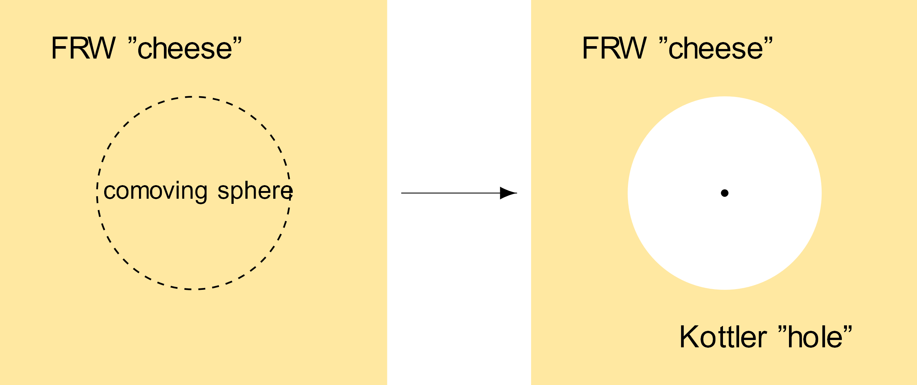
The Swiss Cheese Model
Schwarzschild metric with a cosmological constant
Homogeneous and expanding universe

Slide 5
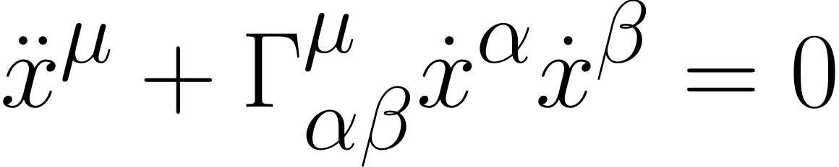
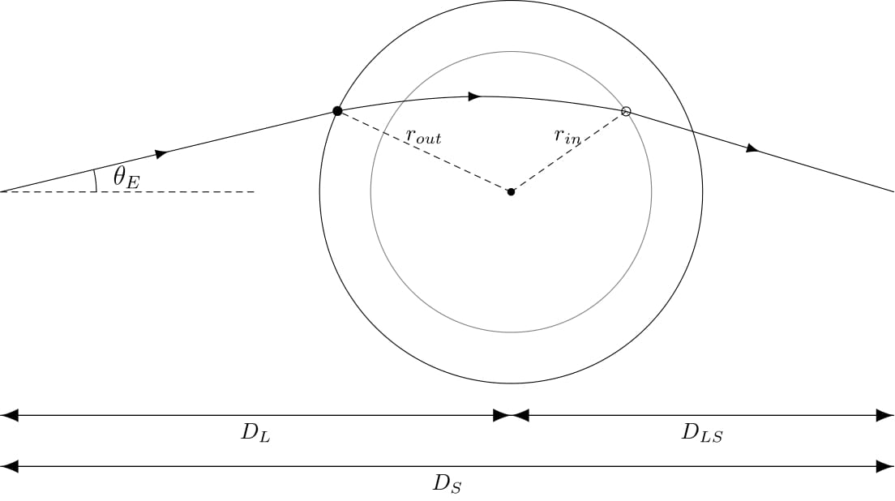
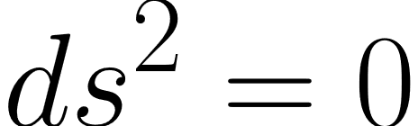
Propagation of light

Slide 6
Propagation of light
1. FRW (cheese)
2. Kottler (hole)
3. FRW (cheese)

Slide 7
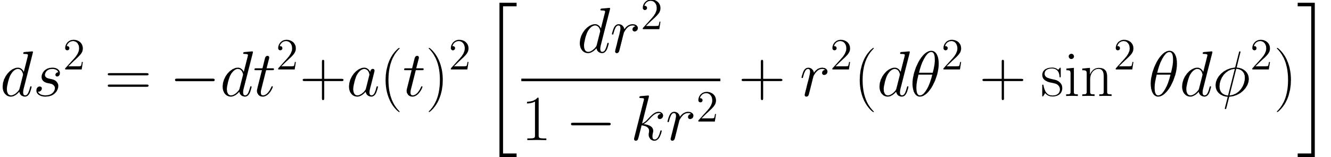
Propagation of light
1. FRW
FRW metric
2. Kottler
3. FRW

Slide 8
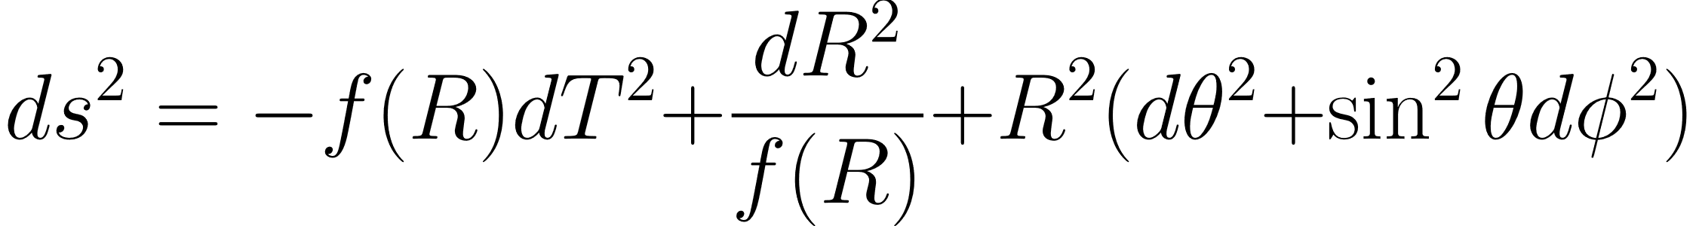
Propagation of light
1. FRW
Kottler metric
2. Kottler
3. FRW

Slide 9
Propagation of light
1. FRW
Gluing the two metrics together
A spacetime obtained by gluing two different geometries via a hypersurface Σ is well defined if it satisfies the Israel junction conditions [??]:
Both geometries must induce, on Σ,
the same 3-metric, and
the same extrinsic curvature
2. Kottler
3. FRW

Slide 10
Propagation of light
1. FRW (cheese)
Start off light ray with a fixed θ
Propagate light rays until it reaches the boundary of the hole
Convert from FRW coordinates to Kottler coordinates using the Jacobian obtained from matching conditions
2. Kottler (hole)
Propagate light rays in hole using null geodesic equations
At the same time, the boundary of the hole is also changing
Stop when it has reached the boundary of the hole
convert from Kottler coordinates back to FRW coordinates
3. FRW (cheese)
Continue propagating light rays until it crosses the axis
Record the coordinate at which it crosses the axis

Slide 11
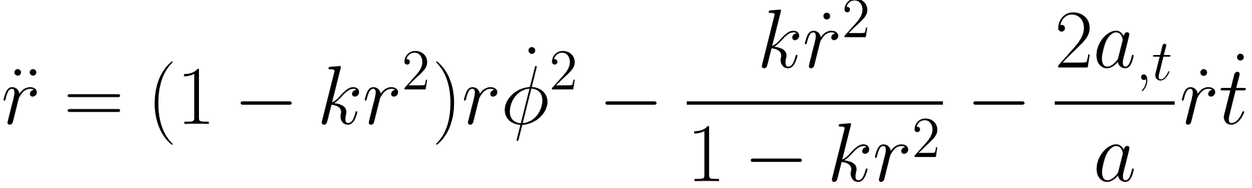
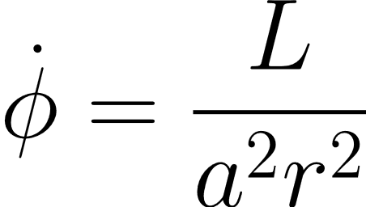
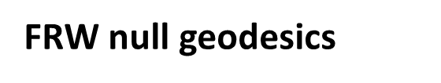
Propagation of light
1. FRW
FRW null geodesics
2. Kottler
3. FRW

Slide 12
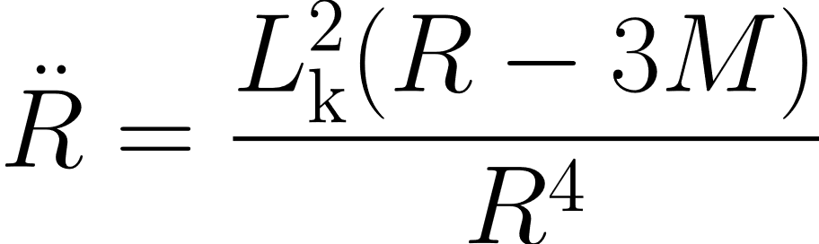
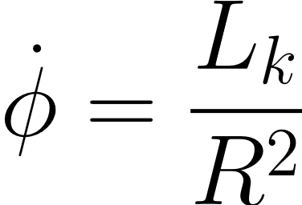
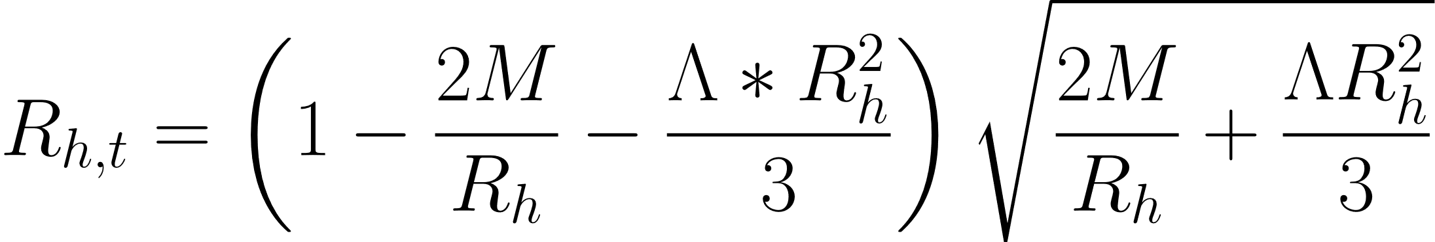
Propagation of light
1. FRW
Kottler null geodesics
2. Kottler
3. FRW

Slide 13

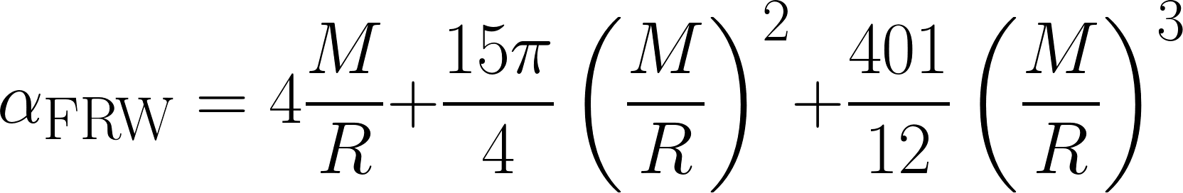
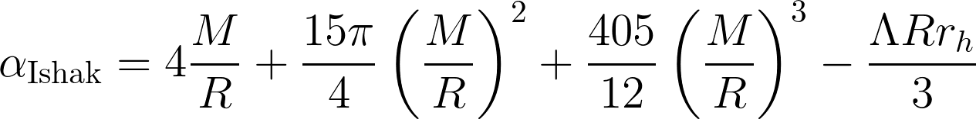
Gravitational lensing equation

Slide 14
Preliminary results

Slide 15
Improvements
Most of the time, light travels in the FRW

Slide 16
Calculating trajectories in flat FRW spacetime

Slide 17
Results

Slide 18
Results
Choose a lens redshift

Slide 19
Extension: A generalized static mass distribution

Slide 20
Thank you!

