Slide 1
Personalized Federated Learning on Non-IID Data
Yutao Huang*, Lingyang Chu*, Zirui Zhou, Lanjun Wang, Jiangchuan Liu, Jian Pei and Yong Zhang
（* : equal contribution）

Slide 2
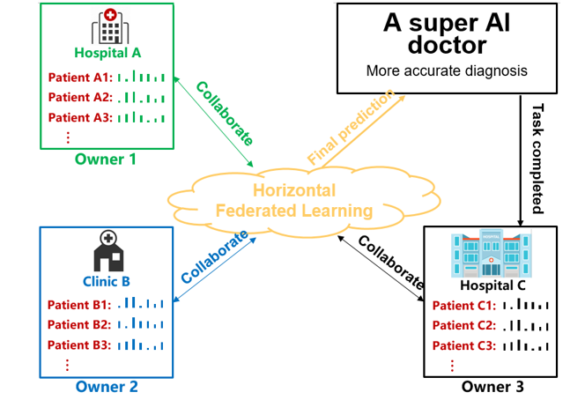
Potential Applications of Federated Learning
Applications:
Collaborative Medical Diagnosis: collaboration between hospitals.
Collaborative Credit Score Evaluation: collaboration between banks.
Collaborative Targeted Advertisement: collaboration between retailers.
…….
Practical Issues:
Data privacy: data owners do not want to share their private data with each other.
Non-IID data: different data distribution on different clients.
Client 1
Client 2
Client 3
Collaboration → More information → Better Models

Slide 3
Why Do We Need Personalized Federated Learning?
Challenges:
Data privacy is strictly required by many regulations such as GDPR if Europe and the Cyber Security Law of China. [1]
A single model cannot fit the different distributions of different clients well.
Not all collaborations are useful on non-IID data. Uniform collaboration among all clients easily collapses.
Goal:
Protected data privacy: no infringement on data privacy.
Personalized models: personalize models for different clients to produce a better model for every client.
Customized collaboration: encourage useful collaborations and depress harmful collaborations.

Slide 4
Related Works
Methods | Protected Data Privacy | Personalized Models | Customized Collaboration
FedAMP (our method) | Protected data privacy | Each client has a personalized model. | Allows each client to adaptively form useful collaborations with some of the other clients.
FedAvg [2] | Protected data privacy | All clients share one global model. | Forcing all clients to collaborate uniformly is ineffective on non-IID data.
FedProx [3] | Protected data privacy | All clients share one global model. | Forcing all clients to collaborate uniformly is ineffective on non-IID data.
MOCHA [4] | Protected data privacy | Each client has a personalized model. | Complicated collaboration limited to convex problems. Not suitable for neural networks.

Slide 5
Two Versions of Federated Learning
Horizontal Federated Learning
Vertical Federated Learning
Client 1
Client 1
Features
Features
Horizontally partitioned data
Client 2
Client 2
Vertically partitioned data
Data Samples
Data Samples
Our work focuses on horizontal federated learning.

Slide 6
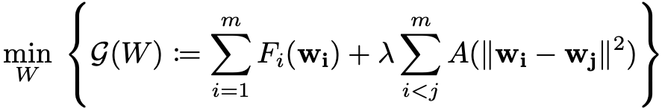

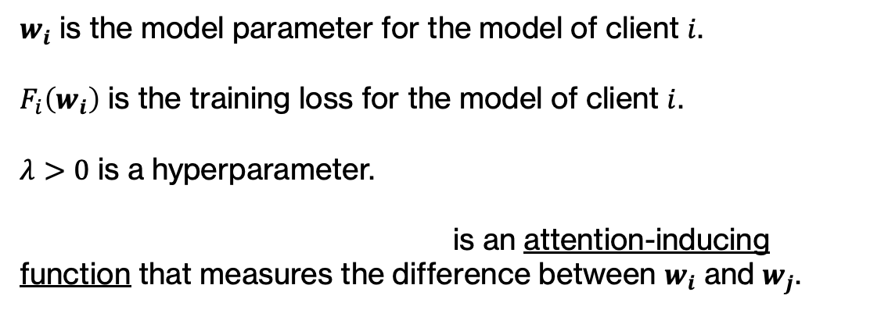



Problem Formulation
Model 1
Optimization problem:
Collaboratively updated model 1
Client 1
Fully Access
Data 1
Locally updated model 2
Model 2
$w_{i}$ is the model parameter for the model of client $i$.
$F_{i}\left(w_{i}\right)$ is the training loss for the model of client $i$.
$λ>0$ is a hyperparameter.
is an attention-inducing function that measures the difference between $w_{i}$ and $w_{j}$.
Client 2
Fully Access
Adaptive Group-wise collaboration
Collaboratively updated model 2
Data 2
Cloud
…
Locally updated model $k$
Model $k$
Collaboratively updated model $k$
Client k
Fully Access
Data $k$

Slide 7


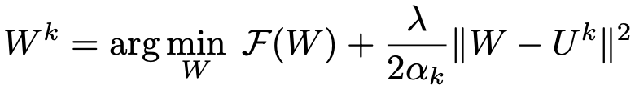

A Centralized Solution
Rewrite the optimization problem:
➔
Solve the optimization problem (Centralized version):
Step 1: randomly initialize $W^{0}$.
Does the centralized solution protect data privacy?
Step 2: optimize by:
Step 3: optimize by:
Iterate between step 2 and step 3 until convergence.

Slide 8
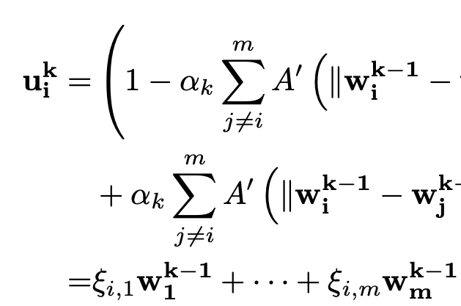



FedAMP: Our Federated Solution
Equivalent
Centralized
Federated
Objective:
Objective:
Step 1: randomly initialize $W^{0}$.
Step 1: randomly initialize $w_{1}^{0}, w_{2}^{0},…, w_{m}^{0}$ on each client.
Step 2:
Step 2:
,
where
Step 3:
Step 3:
NO, it infringes data privacy!
Because it requires centralized data.
Does FedAMP protect data privacy?

Slide 9
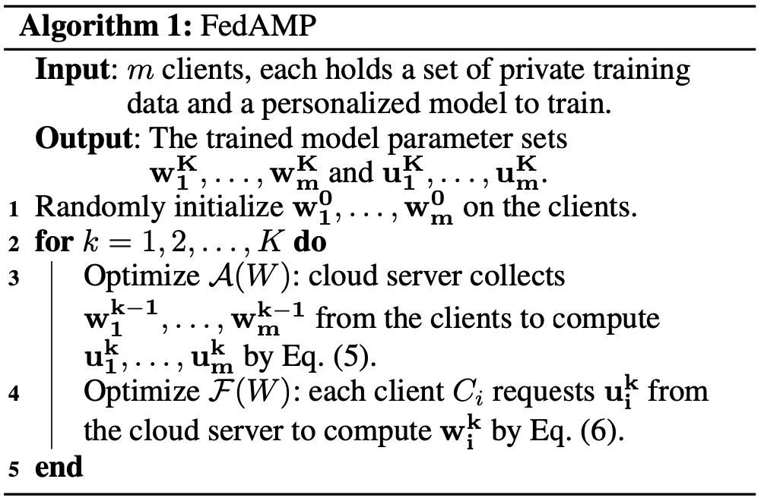
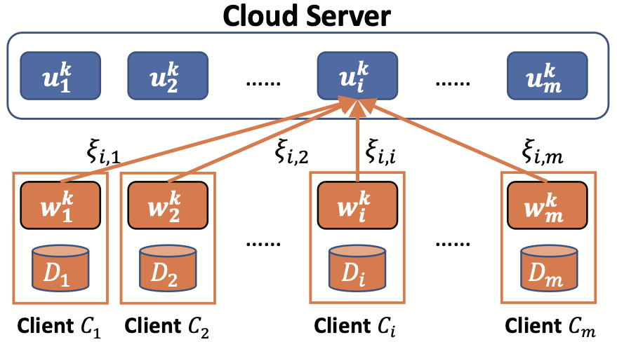

Does FedAMP Protect Data Privacy?
Step 1
Step 2
YES, it protects data privacy.
Step 1: each client initializes its own model parameter $w_{i}^{k}$.
Step 2: each client to send its model parameter $w_{i}^{k}$ to the cloud server, but no client sends data to the cloud server.
Step 3: each client retrieves the the shadow model parameter $u_{i}^{k}$ from the cloud server and uses $u_{i}^{k}$ to update $w_{i}^{k}$.
Step 3

Slide 10

Does FedAMP Allow Model Personalization?
YES, it allows model personalization.
$w_{i}^{k}$ largely relies on the private data of client $C_{i}$.
$w_{i}^{k}≈u_{i}^{k}$, but $w_{i}^{k}≠u_{i}^{k}$.
$u_{i}^{k}≠u_{j}^{k}$ for $i≠j$.
Every client has a unique model

Slide 11

Does FedAMP Induce Collaboration?
YES, it induces collaboration.
$u_{i}^{k}$ depends on $w_{1}^{k−1},w_{2}^{k−1}$, …, $w_{m}^{k−1}$.
$w_{i}^{k}≈u_{i}^{k}$.
$w_{i}^{k}$ leverages $u_{i}^{k}$ to collect useful information contributed by $w_{1}^{k−1},w_{2}^{k−1}$, …, $w_{m}^{k−1}$.
Who to collaborate more?
Who to collaborate less?

Slide 12
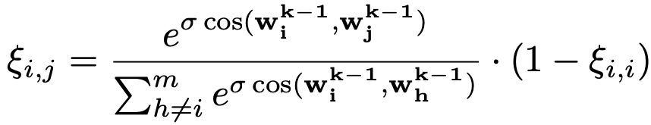

Adaptively Discover Useful Collaboration
Attentive message passing (AMP):
Messages: $w_{1}^{k−1},w_{2}^{k−1}$, …, $w_{m}^{k−1}$.
Weights of messages: ${\{ξ}_{i,j}\}$.
$ξ_{i,j}$ controls the collaboration strength between clients $C_{i}$ and $C_{j}$.
where
Insight:
Clients with similar models contribute more to each other, because they tend to have similar data distributions.

Slide 13
























Customized Collaboration of FedAMP
$$w_{3}^{k^{′}}$$
$$w_{4}^{k^{′}}$$
$$w_{5}^{k^{′}}$$
Recall that
$$w_{4}^{k}$$
$$w_{3}^{k}$$
$$w_{1}^{k^{′}}$$
$$w_{5}^{k^{′}}$$
,
$$w_{5}^{k}$$
$$w_{2}^{k^{′}}$$
and
$$w_{2}^{k}$$
$$w_{1}^{k}$$
$$w_{6}^{k}$$
distributes the message weights in a non-linear manner.
$$w_{12}^{k}$$
$$w_{7}^{k}$$
Customized Collaboration:
$$w_{9}^{k}$$
$$w_{11}^{k}$$
$$w_{9}^{k^{′}}$$
$$w_{11}^{k^{′}}$$
$$w_{7}^{k^{′}}$$
Encourage useful collaborations: similar models become more similar and collaborate even more.
Reduce harmful collaborations: dissimilar models become more dissimilar and collaborate even less.
$$w_{10}^{k}$$
$$w_{12}^{k^{′}}$$
$$w_{8}^{k}$$
$$w_{8}^{k^{′}}$$
$$w_{10}^{k^{′}}$$
Current iteration
After a few iterations

Slide 14
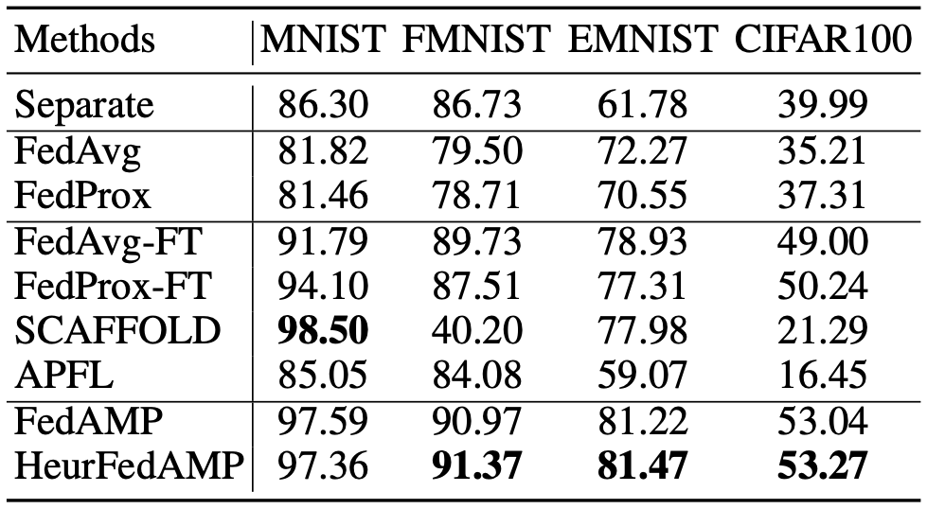
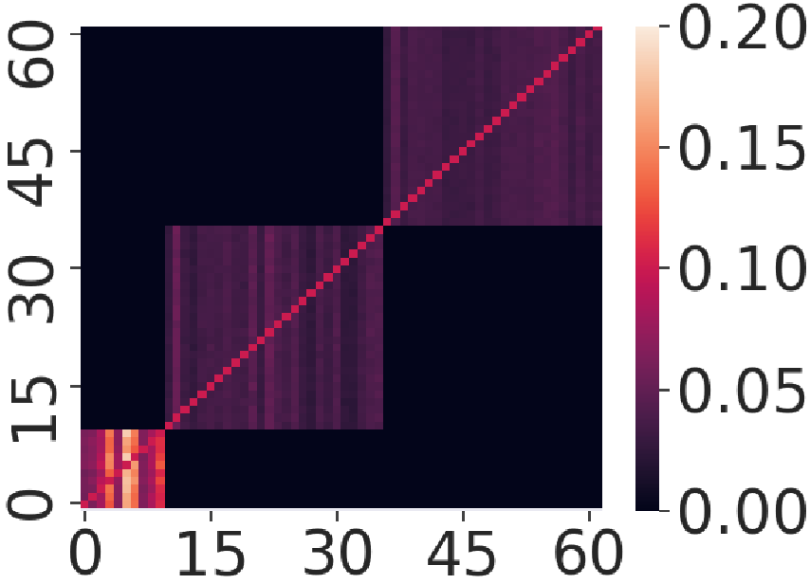
A Sample of Experiment Results
More experimental results are provided in the full version of our AAAI 2021 paper.
Our methods
The outstanding performance of FedAMP and HeurFedAMP
Collaboration strength between clients discovered by FedAMP
HeurFedAMP is a simplified heuristic version of FedAMP.
We cannot prove the convergence of HeurFedAMP, but it is much simpler to implement and achieves better performance.
Data setting: there are three groups of clients; clients in the same group have similar data distribution.
FedAMP accurately identifies the three groups of clients.

Slide 15
References
[1] Qiang Yang, Yang Liu, Tianjian Chen and Yongxin Tong. Federated machine learning: Concept and applications[J]. ACM Transactions on Intelligent Systems and Technology (TIST), 2019, 10(2): 12.
[2] McMahan, H. Brendan, Eider Moore, Daniel Ramage, and Seth Hampson. "Communication-efficient learning of deep networks from decentralized data." AISTATS (2017).
[3] Li, Tian, Anit Kumar Sahu, Manzil Zaheer, Maziar Sanjabi, Ameet Talwalkar, and Virginia Smith. "Federated optimization in heterogeneous networks." SysML 2020.
[4] Smith, Virginia, Chao-Kai Chiang, Maziar Sanjabi, and Ameet S. Talwalkar. "Federated multi-task learning." In Advances in Neural Information Processing Systems (NeurIPS), pp. 4424-4434. 2017.

Slide 16
Thanks Q & A

Slide 17
Personalized Federated Learning
Model
Practical issues:
Training large models requires large amount of data.
Data privacy regulations prohibits data integration.
Independent and identically distributed (IID) data is too good to be true.
Centralized Learning
Federated Learning
A giant set of public data
Private data A
Private data B
Goal:
Protect data privacy: no infringement on data privacy.
Personalization: personalized models for different clients.
Attentive Collaboration: not all collaborations are useful.
Private data C
Usually not available
Non-IID & Private

