Slide 1
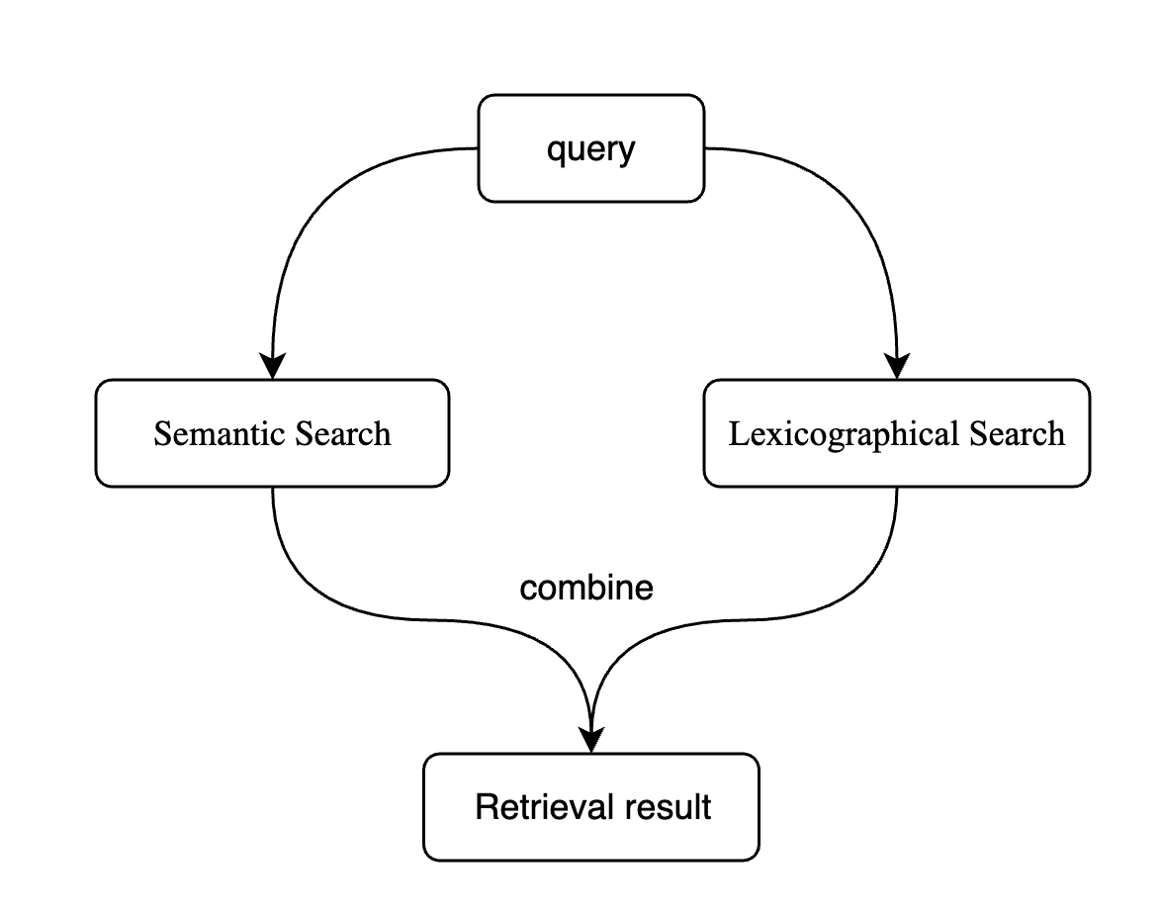
Text Retrieval

Slide 2
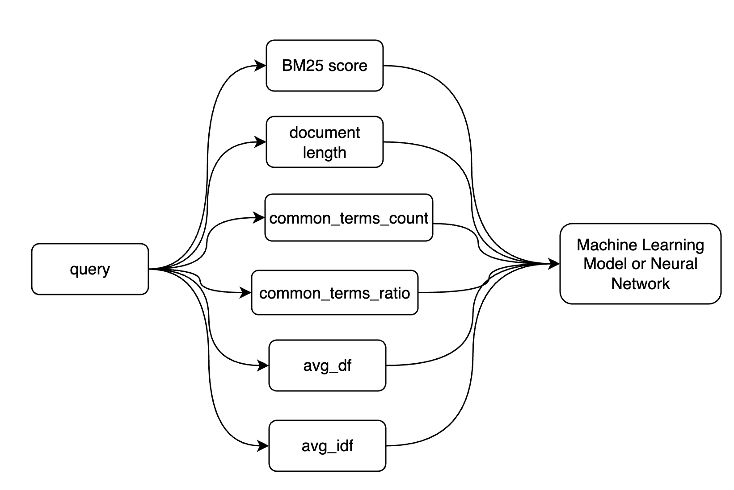
Lexicographical Search
Baseline Algorithm: BM25
BM25 combined with Machine Learning:

Slide 3
Lexicographical Search
Baseline Algorithm: BM25
BM25 combined with Machine Learning:
baseline
BM25 | BM25 + LR | BM25 + SVM | BM25 + NN | BM25 + LambdaMART
73% | 76% | 32% | 77% | 73%
64% | 64% | null | 62% | 55.33%
69% | 71% | null | 69% | 70%
Top5 Recall

Slide 4
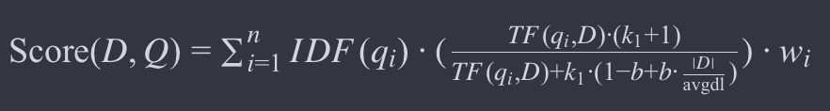
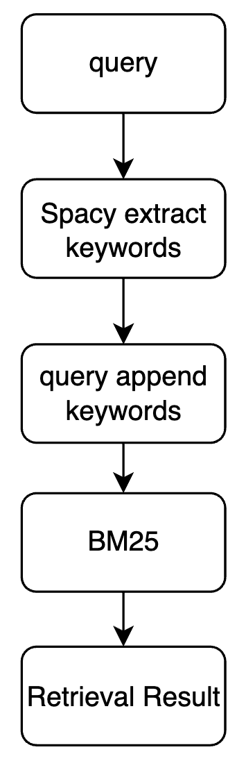
Lexicographical Search
Weighted BM25:
From abstracts published in 2022, in the context of cancer classification, what did the proposed hybrid approach consisting of ANFIS, FCM, and SA algorithm demonstrate?
['did', 'hybrid', 'consisting', 'fcm', 'approach', 'anfis', 'classification', 'cancer', 'context', 'proposed', 'demonstrate', 'abstracts', 'sa’,
'2022', 'algorithm', '2022', '2022', '2022', '2022', '2022', 'did', 'hybrid', 'consisting', 'fcm', 'approach', 'anfis', 'classification', 'cancer’,
'context', 'proposed', 'demonstrate', 'abstracts', 'sa', '2022', 'algorithm', '2022', '2022', '2022', '2022', '2022', 'did', 'hybrid', 'consisting’,
'fcm', 'approach', 'anfis', 'classification', 'cancer', 'context', 'proposed', 'demonstrate', 'abstracts', 'sa', '2022', 'algorithm']
opensearch | Weighted BM25
73% | 75%
75% | 78%
70% | 73%

Slide 5
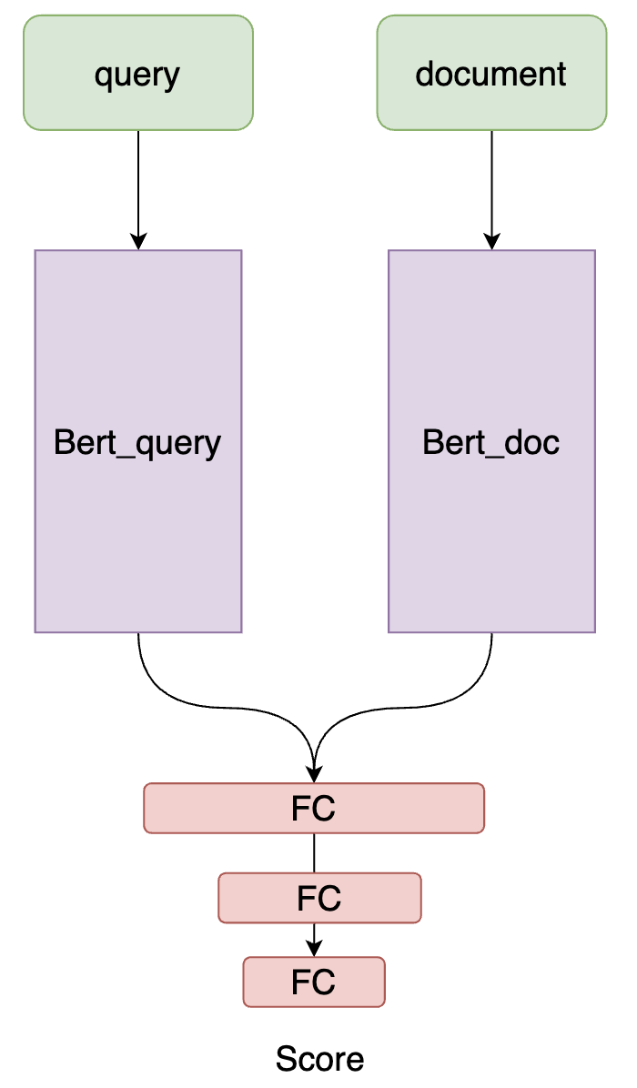

Semantic Search
Candidate improvement methods:
Negative sampling strategy
Cross-tower interaction
Attention!

