Slide 1







Steaming Hot 🔥
A Recommendation Engine for Game Developers
Alex,Eduardo,Joseph,Kanishk,Ling,Rohit
Mentor: James Bramante

Slide 2



Problems and Goals
Development:
What features should game developers focus on?
Deployment:
How to present a game in a Steam library store? What is the expected revenue?
Down The Road
How will the game perform in the future? What is the next decision?
Notes:
Help developers at three stages :
During development : Selecting what features to put in the game
On deployment : Based on their marketing strategy on Steam, predicting number of sales/owners
Down the road (after a year or so) : Short timescale (a few months) prediction of popularity of the game

Slide 3

Approach and Summary
Data Scraping
50k+ games
Text
Platform
etc
Requirement
1
[Alex, Kanishk, Ling]
Genres
Categories
70+ features
Price
Game Owners
Age
Scores
etc
[1]: files from https://github.com/CraigKelly/steam-data has been used.
Notes:
From websites displayed here, we scraped more than 70 features over 50 thousands games. We keep genres, categories and so on for analysis and modelling.

Slide 4
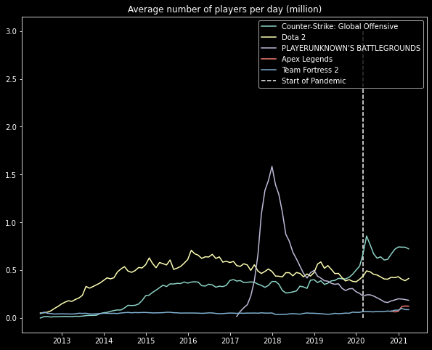
Approach and Summary
Data Scraping
10k+ games
[Alex, Kanishk, Ling]
106 months
Notes:
Also, we scraped the past 9-year time series data for 1 fifth of the games.

Slide 5
Approach and Summary
Models
Results
Data Scraping
Feature Importance [Alex & Rohit]
Sales Prediction [Kanishk]
Time series Predictions [Ling]
& Comparison [Joseph]
Survival analysis [Eduardo]
Provide importance scores of features
Predict monthly sales for games
Compare popularity trends and find games similar to each other
Provide feature prognostic factor
Exploratory Data Analysis
[by All]
Models
&
Results
WebApp [Alex]
Notes:
We built several models to solve problems mentioned before. Today we focus on presenting feature important and time series comparison.

Slide 6
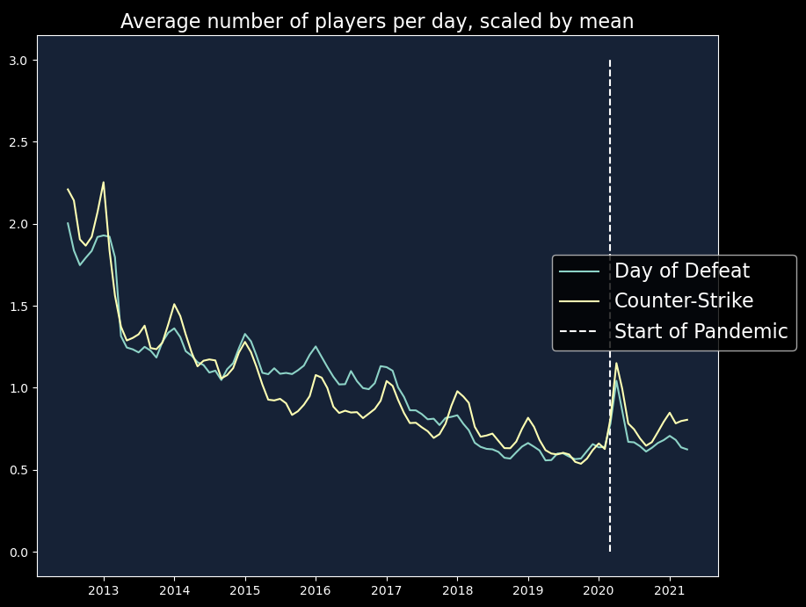
Exploratory Data Analysis
Text
Platform
etc
Requirement
# Players
Genres
Price
Game Owners
Scores
Age
Notes:
As a part of EDA, we look at daily player engagement of different games and find trajectory overlaps scaled by the means, and exploit this for our timeseries model.

Slide 7
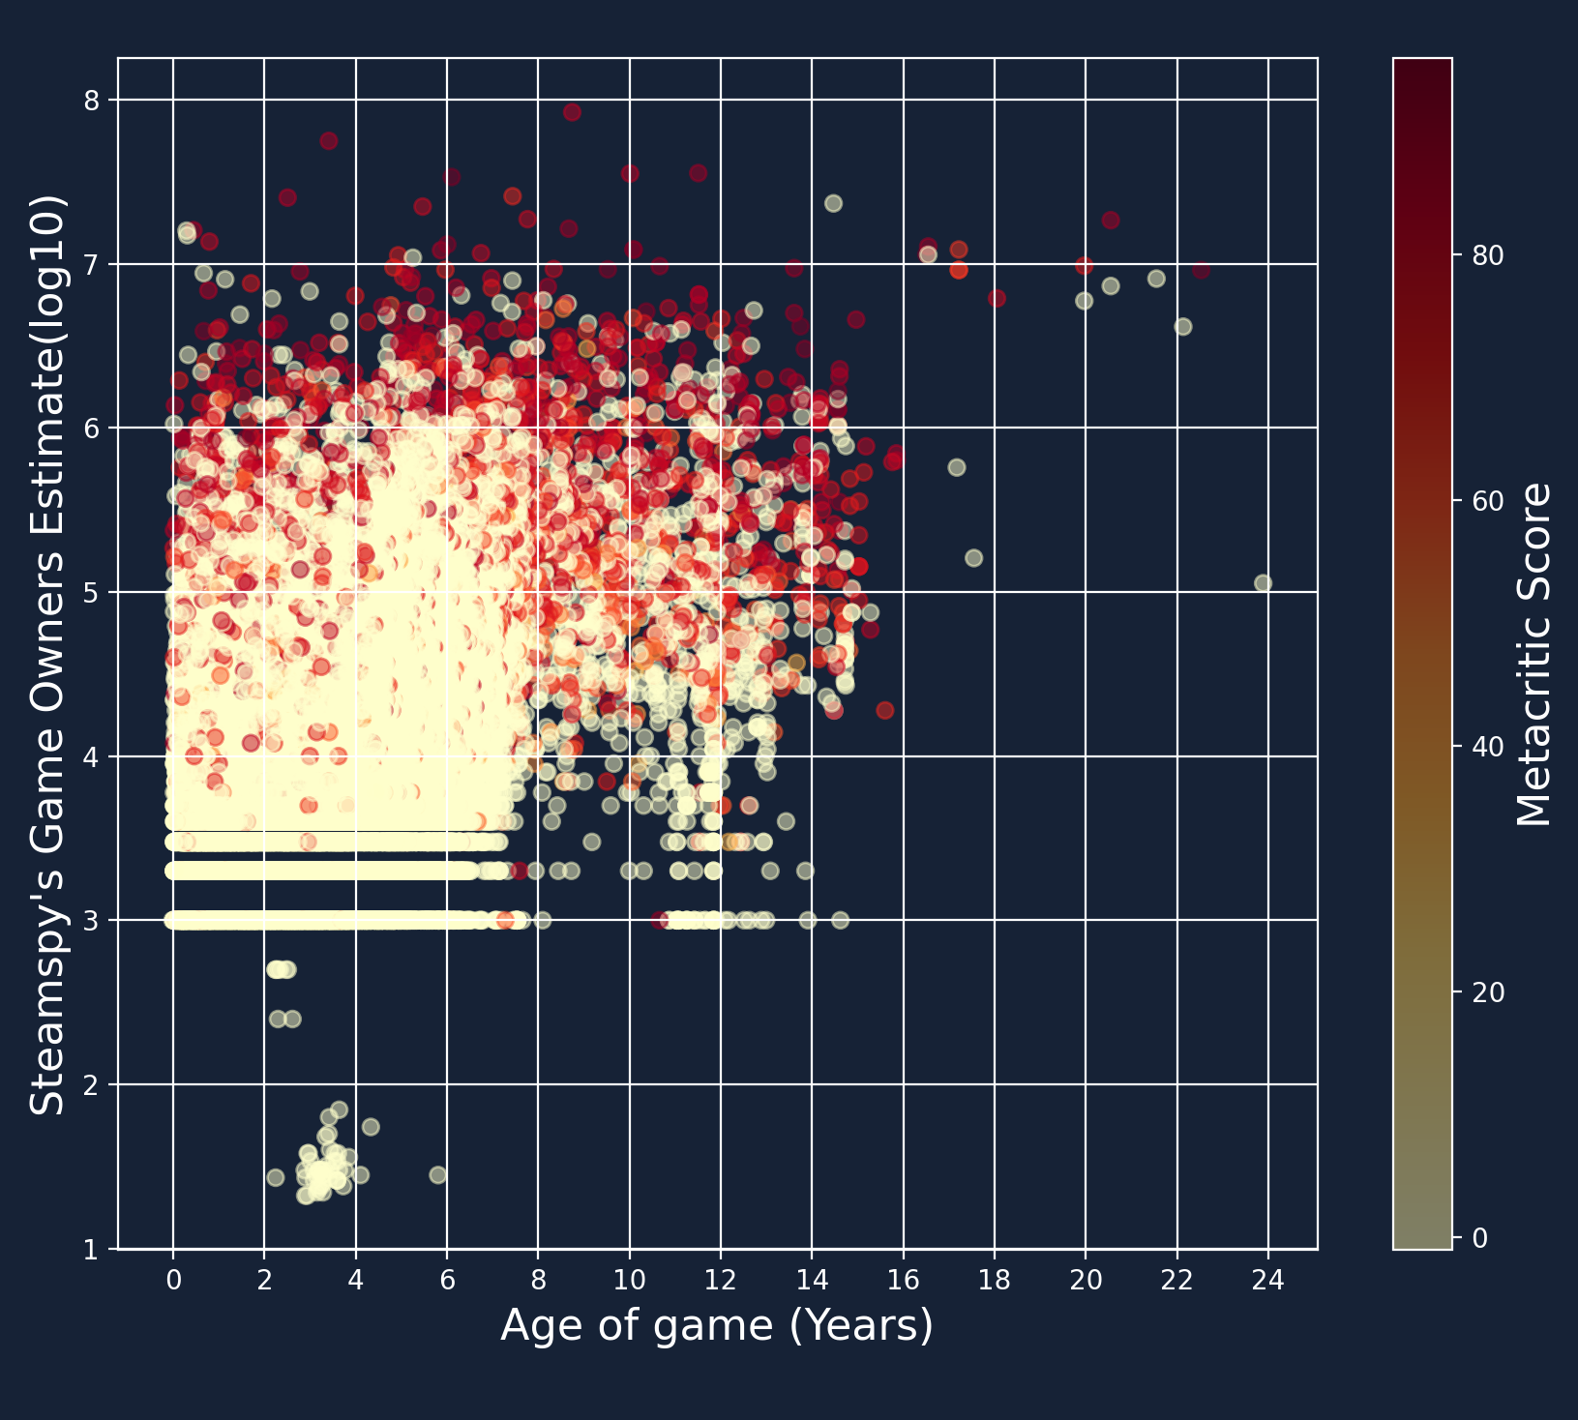
Exploratory Data Analysis
Text
Platform
etc
Requirement
Genres
Categories
Price
Game Owners
Age
Scores
*0 when metacritic score is missing
Notes:
We also find a lack of correlation between #owners vs age of different games, and also find that some values such as metacritic scores are missing for 90% of the game data.

Slide 8
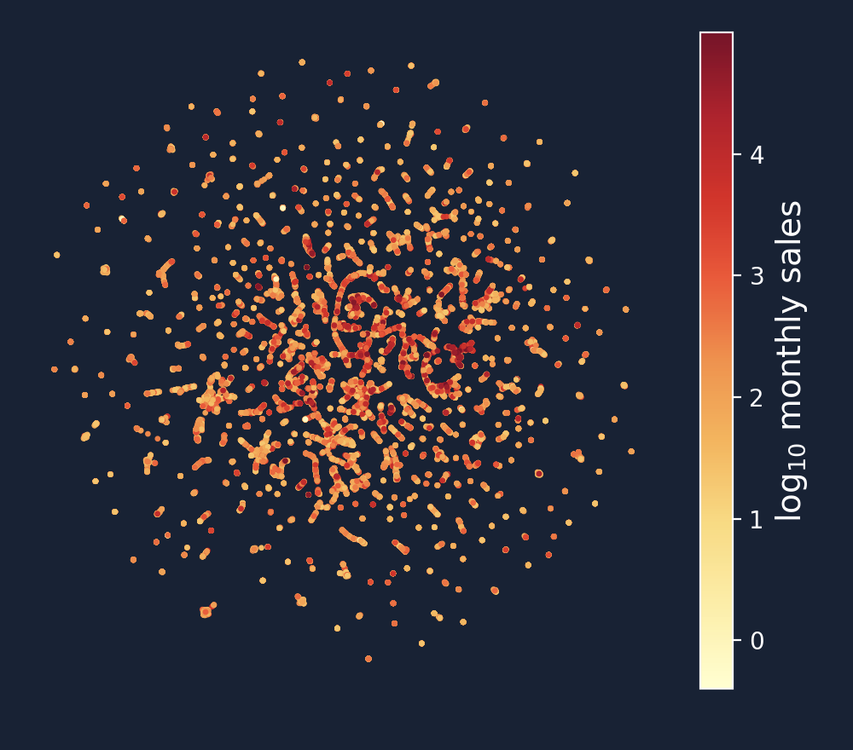
Exploratory Data Analysis
34,337
games
UMAP Embedding
Text
Platform
etc
Requirement
Game trailers
Screenshots
Price
Total
Owners
Packages
Game
Age
In-game
achievements
Sales per month
Notes:
To make the most of this incomplete data we looked at embed numerical features related to a game’s presentation on steam such as number of screenshots, game trailer, price etc and use UMAP to find non-linear 2-dimensional embeddings. We observe games with similar monthly sales cluster together,

Slide 9

Sales prediction Model
60 clusters
*using cyclic colormap
Notes:
And we find these cluster using k-means

Slide 10
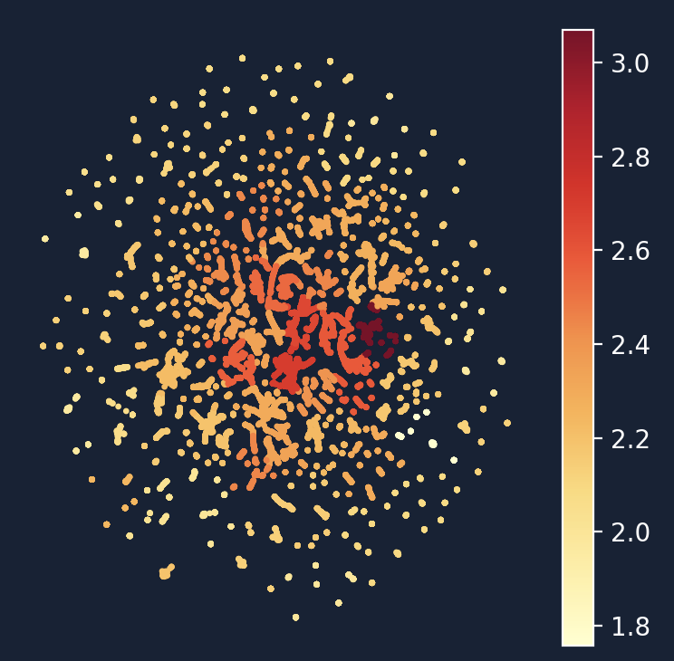
Sales prediction Model
Errors
Mean 3.8x
Median 3.1x
Notes:
And chose the median monthly sales in the clusters as our prediction for a test set of games. Our median error was 3x the true values, the best we could get from a model.

Slide 11
Categorical features!
Requirements
Platform
etc
Age
# Players
Subscriptions
Controllers
Genres
Price
Scores
Notes:
The dataset also contains a lot of categorical features like genres, input controllers, and system platforms, and Rohit will share his efforts with those next!

Slide 12
How To Select Features of a New Game?
Heuristic Approach
35 categorical features
Target variable:“Popularity Rating”
Machine Learning
  Classification
  Survival Analysis
Most Popular (5.0)
Popular (4.0)
Somewhat Popular (3.0)
Unpopular (2.0)
Most Unpopular (1.0)
IsFree
GenreIsAction
PlatformMac
CategoryMMO
ControllerSupport
See our Github page for more!

Slide 13
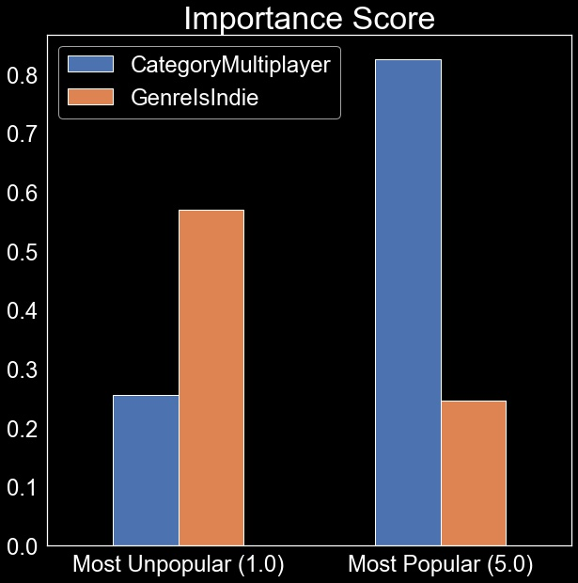
I_{i}(F) = Fraction of games in class C_{i} with feature F
Heuristic Scores For Feature Selection

Slide 14
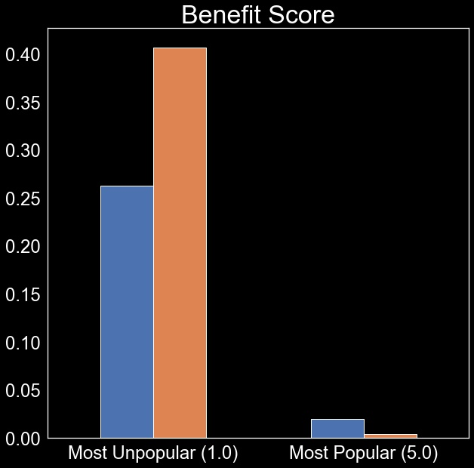
I_{i}(F) = Fraction of games in class C_{i} with feature F
B_{i}(F) = Fraction of games with feature F in class C_{i}
Heuristic Scores For Feature Selection

Slide 15
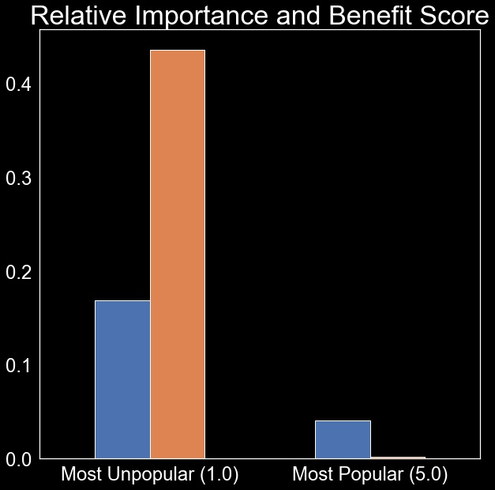
I_{i}(F) = Fraction of games in class C_{i} with feature F
B_{i}(F) = Fraction of games with feature F in class C_{i}
RBI_{i}(F) = I_{i}(F)*B_{i}(F)
Heuristic Scores For Feature Selection

Slide 16
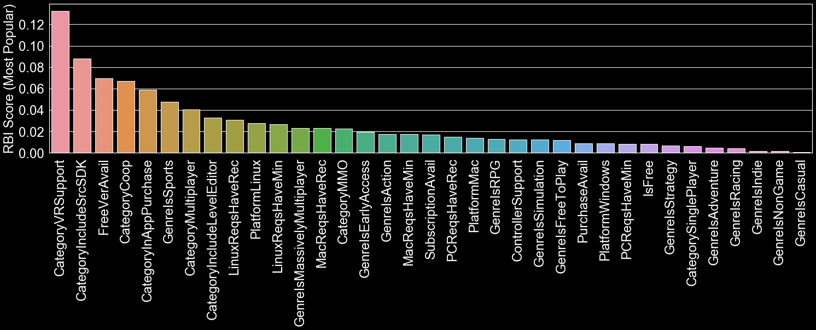



Heuristic Feature Selection
Looking for the next
?
This way, please

Slide 17
Time Comparison
My game is 1 year old, what to do next?
Learn from the past you must, find guidance you will.
Notes:
Suppose your game is 1 year old, what to do next?
Our answer is learn from the past

Slide 18
Time Comparison
Objective: Given first 12-month data of average no. of players,
find close games in the past and compare.
01
Computing Distance
Set of close games!
Smooth Scaled Training data
(18 months)
Small Distance
First 12 months
Euclidean Distance
Weight
Gaussian Kernel
Smooth Scaled Test Data
(12 months)
Notes:
To do so, we compute the distance between your game and the past games. Pick up the close games and compute their weights

Slide 19
Time Comparison
Objective: Given first 12-month data of average no. of players,
find close games in the past and compare.
02
Compute Weighted Average
Weighted Average
(12 + 6 Months)
Σ
Scaling
Weight X
Training Data
Scaled Training Data
(18 Months)
Notes:
Then, we compute the weighted average.

Slide 20
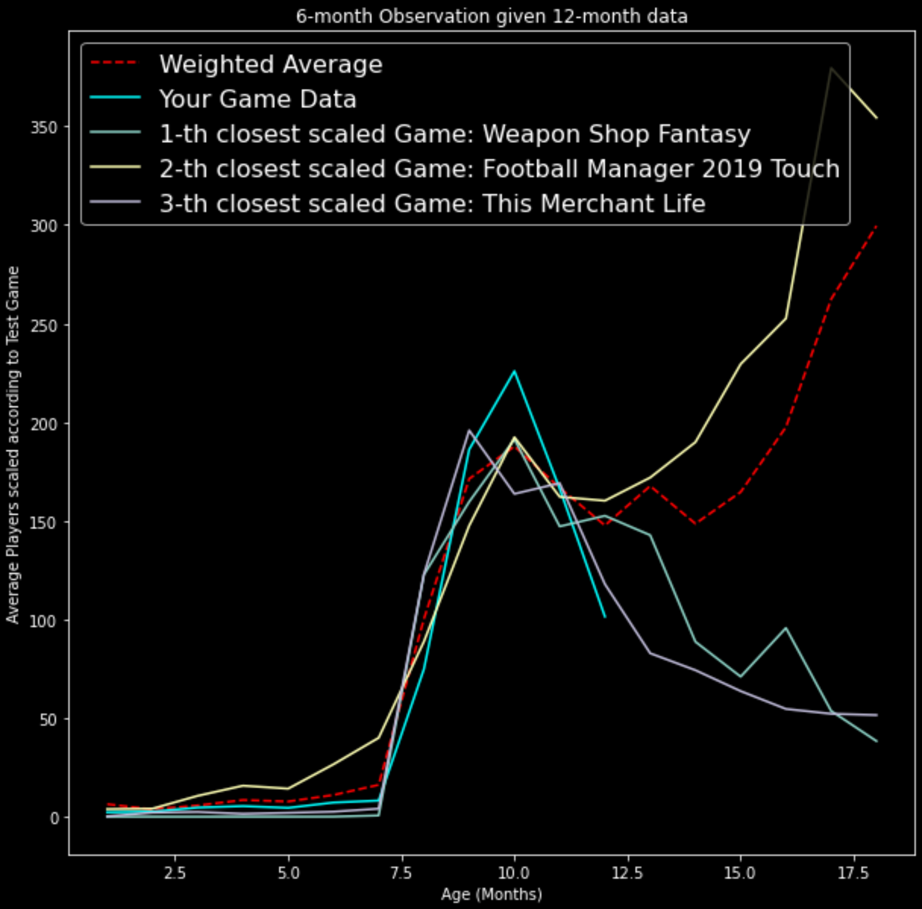
Time Comparison
What we achieved:
Time series data from ALL past games as guidance
Games with similar history obtained
Learn from the History!
Notes:
What we’ve achieved is we use all past games as guidance, and we picked up those with similar history

Slide 21
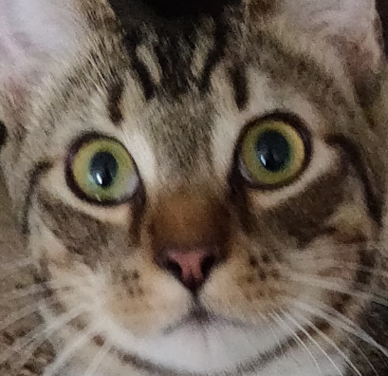
Time Comparison
What’s good about this?
 | Naive/SES/ARIMA | Weighted Average
Average % Error | ~ 50% | ~80% (Can adjust model to ~60%, but loses average meaning)
Provide index of success: weighted average
Case study
  Timed-Features selection
    e.g. DLC, Updates, Price change
  Mimic events in past successful games with similar starting history
    e.g. Tournaments, Conventions, Promotions
Notes:
So what’s good about this model? In terms of prediction, basic methods seem to perform better.
However, our weighted average method has several other amazing features.
In short, the weighted average curve guides us on what cases to study. From this, we pick up the good timed-features, such as when to change the price or when to hold big events to boost popularity.

Slide 22

Web app
A user friendly web app that allows you to try three of our algorithms:
Time Comparison
Feature Score
Owners Prediction
https://share.streamlit.io/alexcasella/streamlit/main/main.py

Slide 23
Challenges...
...and future work!
Clean the data: only relevant informations!
Interpret the data: are we answering the questions?
Determine the correct methods: adapt and create to better fit our context.
Better predictions with more and new data.
Link methods to improve each algorithm.
Update the Web App to create the Ultimate Weapon for game developers.

Slide 24
Thank you!
Team 45: Steaming Hot 🔥
https://github.com/steaming-hot/steaming-hot
Alex Casella
acasella@fsu.edu
FSU
Eduardo Medina
medin215@umn.edu
UMN
Wing Hong Leung
leung.179@osu.edu
OSU
Kanishk Jain
kanishkbjain@gmail.com
Emory University
Ling Zhou
zhou.2568@osu.edu
OSU
Rohit Satija
rsatija@berkeley.edu
UC Berkeley

Slide 25
Backup slides

Slide 26
Popularity Rating
Most Popular (5.0) | mean_players>10,000
Popular (4.0) | 10,000>mean_players>1,000
Somewhat Popular (3.0) | 1,000>mean_players>100
Unpopular (2.0) | 100>mean_players>10
Most Unpopular (1.0) | 10>mean_players>1

Slide 27
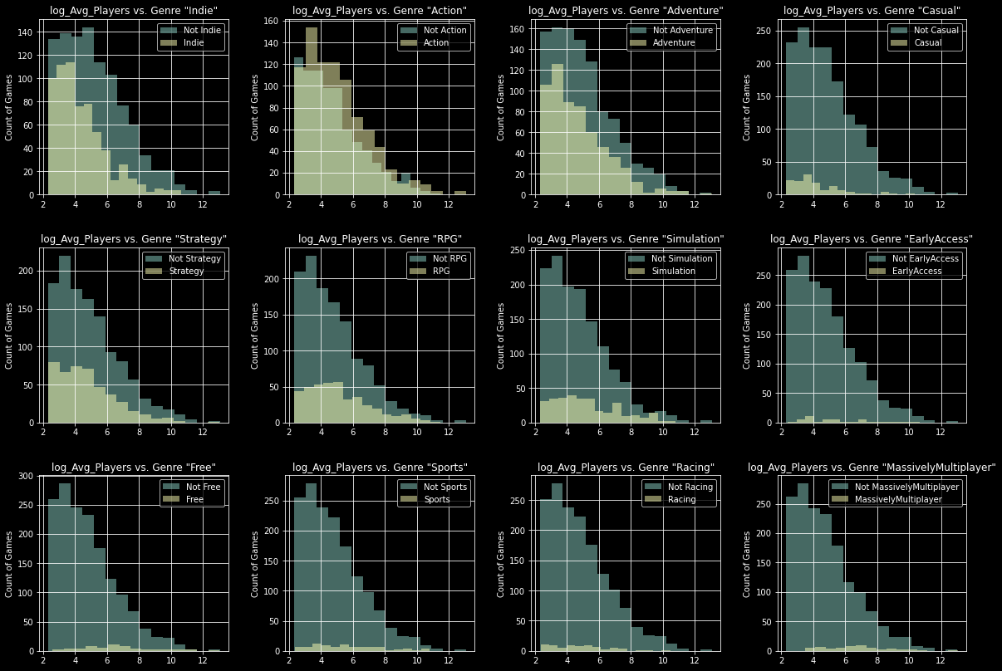
More EDA

Slide 28
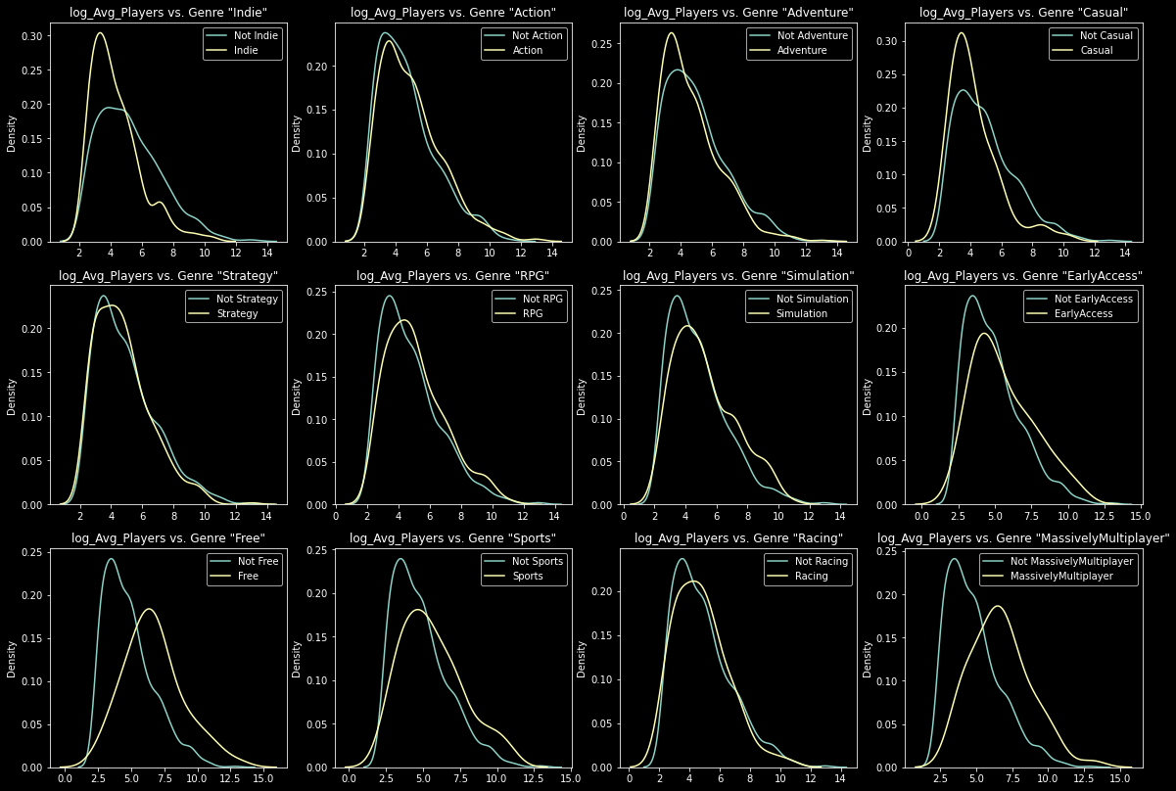
More EDA

Slide 29
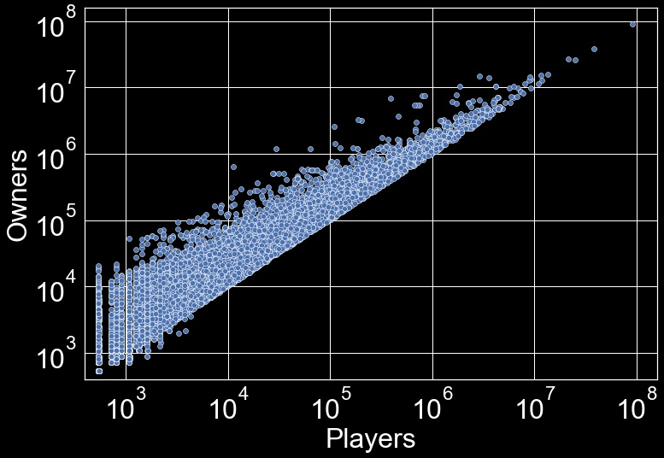
N=10,364

Slide 30
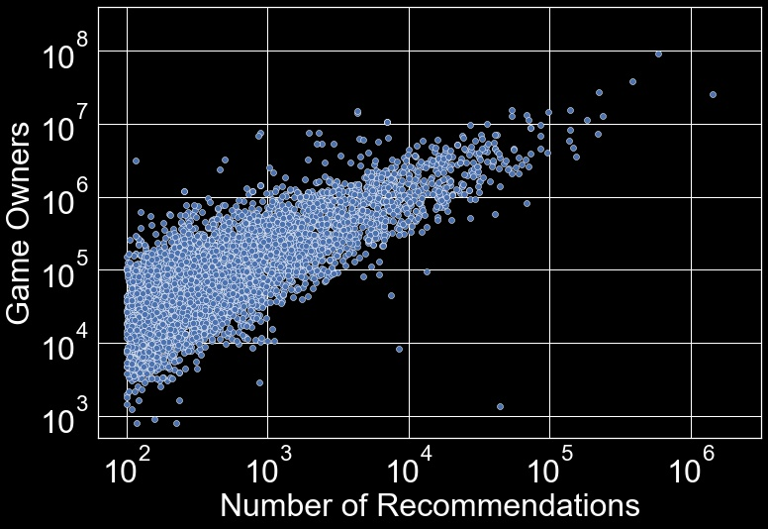
N=4,840

Slide 31
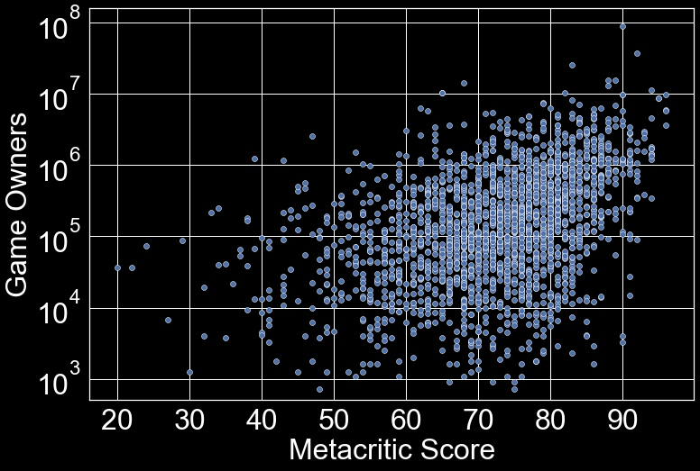
N=2,224

Slide 32
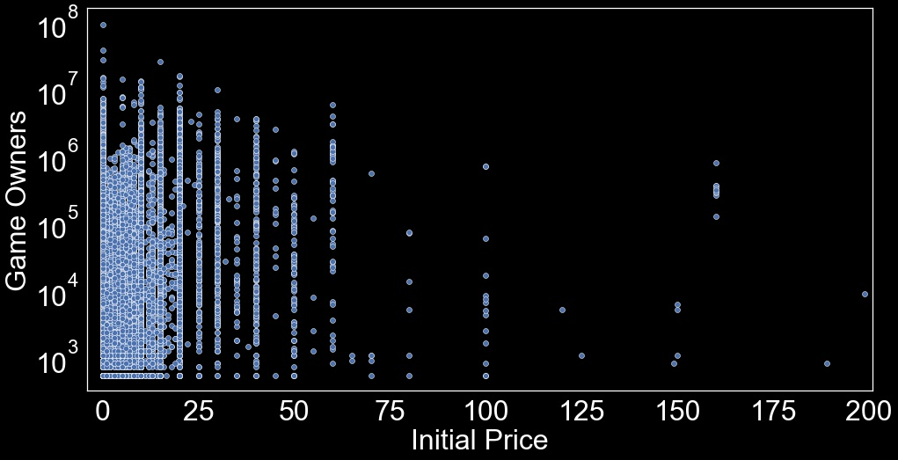
N=10,617

Slide 33
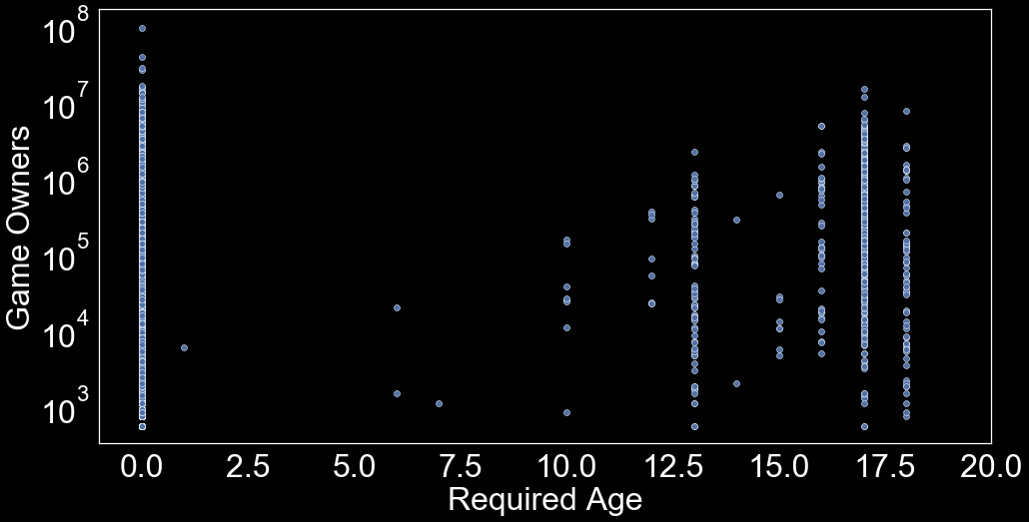
N=10,619

Slide 34
Time Comparison
Objective: Given first 12-month data of average no. of players,
find close games in the past and compare.
01
Scaling and Smoothing
Smoothing
Scaling

Slide 35
Time Comparison
Objective: Given first 12-month data of average no. of players,
find close games in the past and compare.
02
Computing Weights according to Distance
Set of close games!
Smooth Scaled Training data
(18 months)
Small Distance
First 12 months
Euclidean Distance
Weight
Gaussian Kernel
Smooth Scaled Test Data
(1 year)

Slide 36
Time Comparison
Objective: Given first 12-month data of average no. of players,
find close games in the past and compare.
03
Compute Weighted Average
Weighted Average
(12 + 6 Months)
Σ
Scaling
Weight X
Training Data
Scaled Training Data
(18 Months)

Slide 37
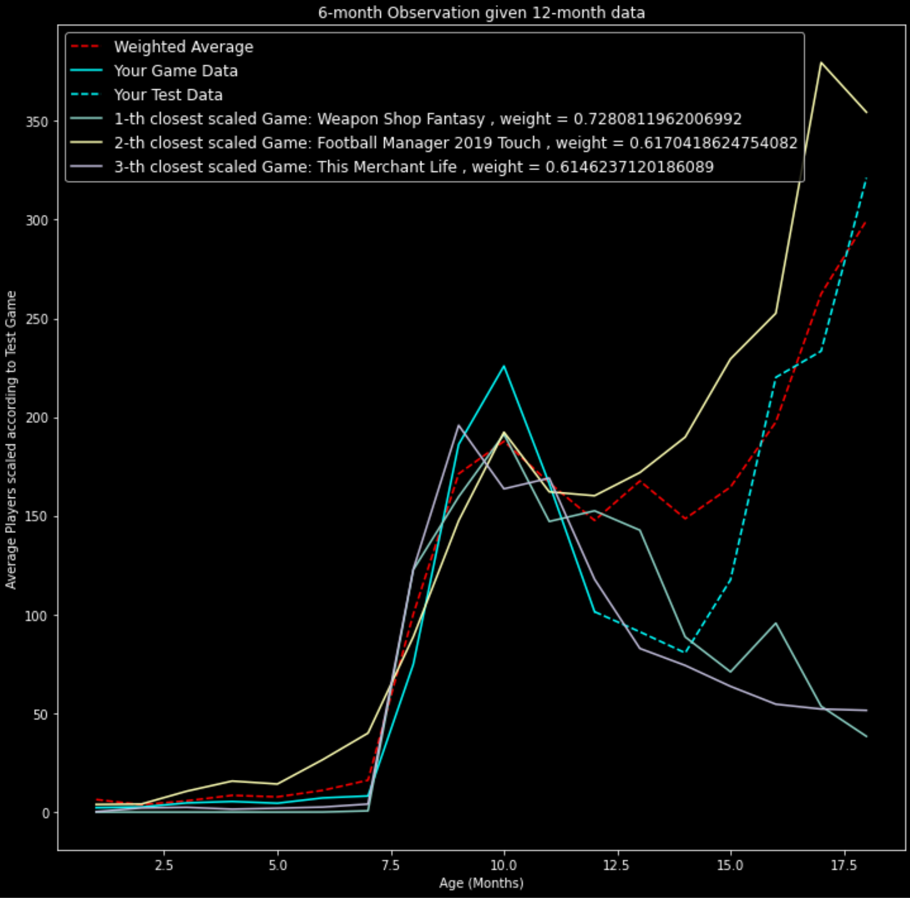
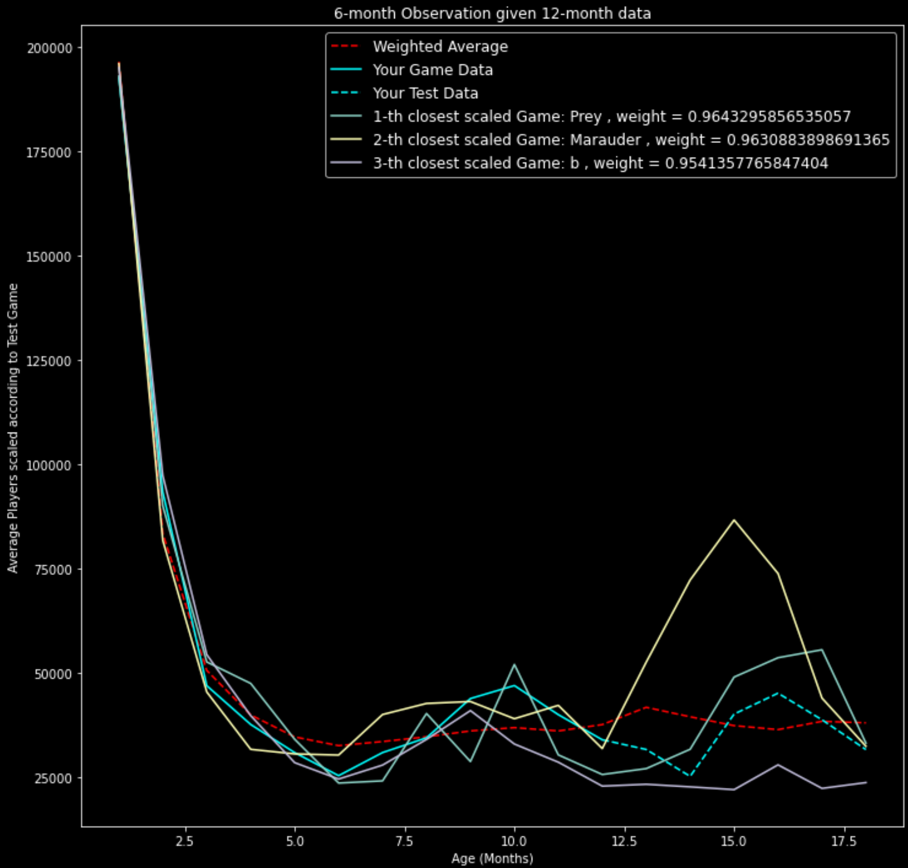
Time Comparison
Among Us
GTA V

Slide 38
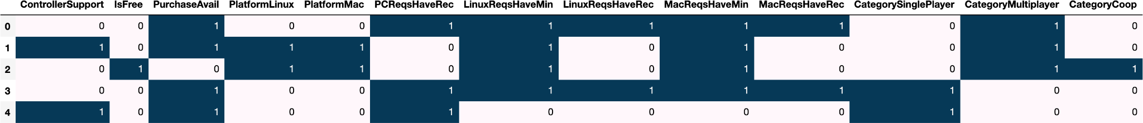
Machine Learning: Classification
N_features = 47, N_observations = 3,597
Target variable:“Popularity Grade”
mean_players>100:1.0
1<Avg_Players<5:0.0

Slide 39
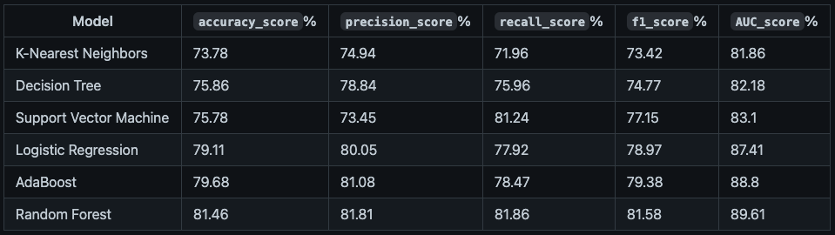

Slide 40
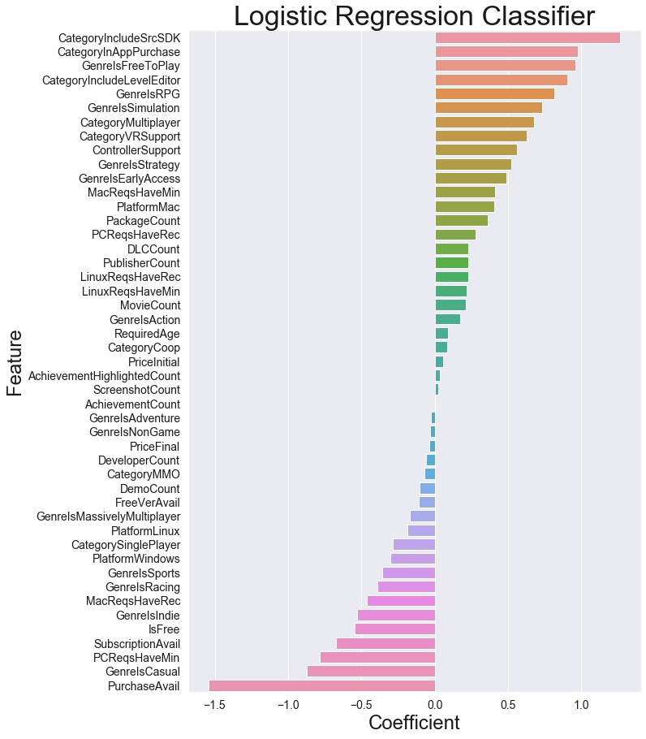

Slide 41
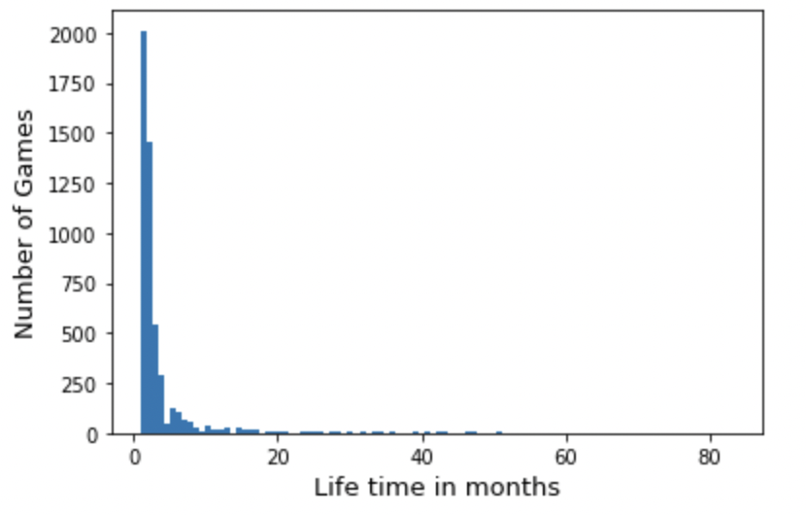
Total Games | Died Less Than 6 Months | Still Alive | Die in More than 6 Months
6059 | 4468 | 978 | 613
%100 | %73.74 | %16.14 | %10.12

Slide 42
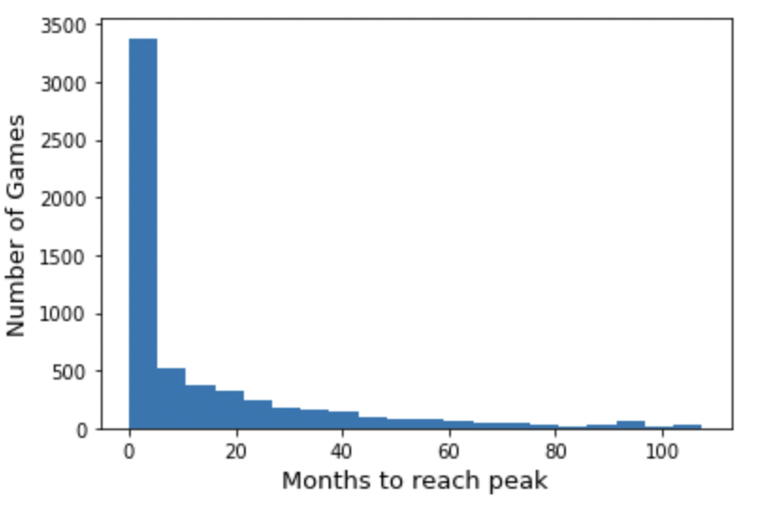

Slide 43
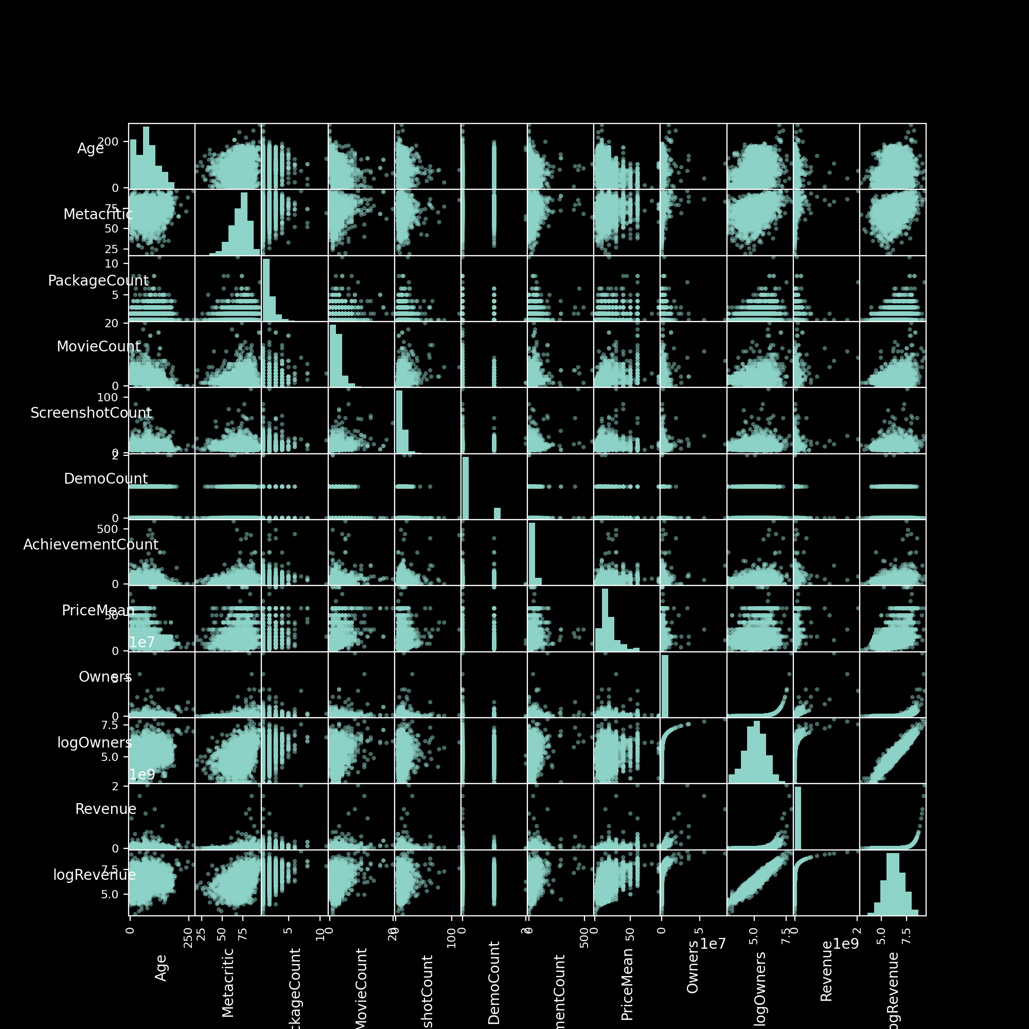
More EDA
paid, metacritic-reviewed games

Slide 44
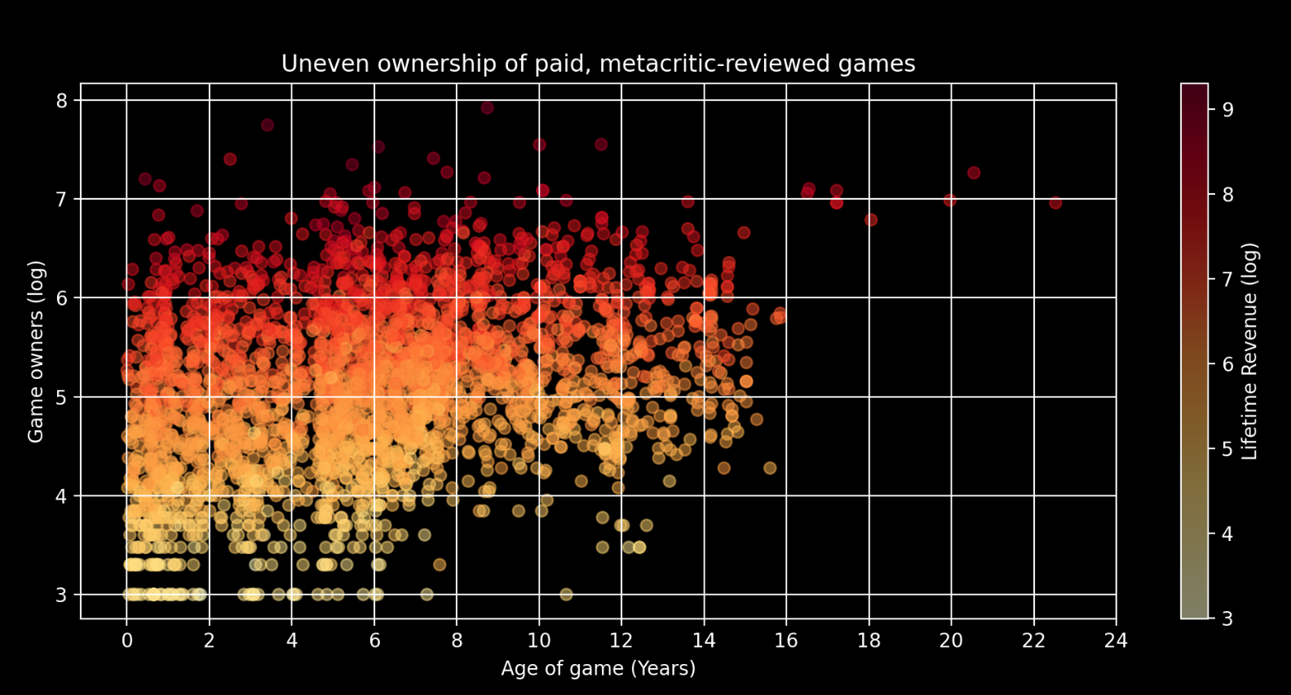
Cyberpunk 2077
Hexodius

Slide 45
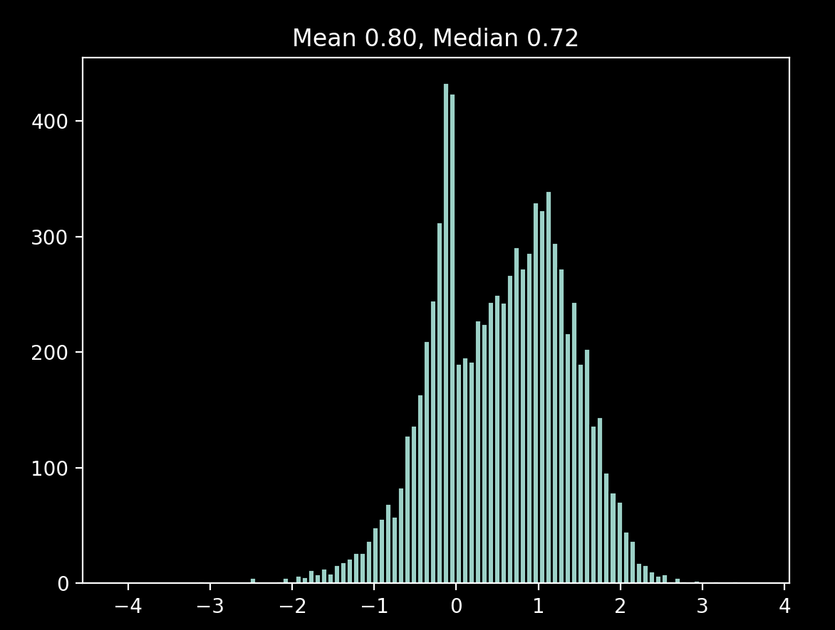
Decision tree regressor on games with monthly owners less than 100,000

Slide 46
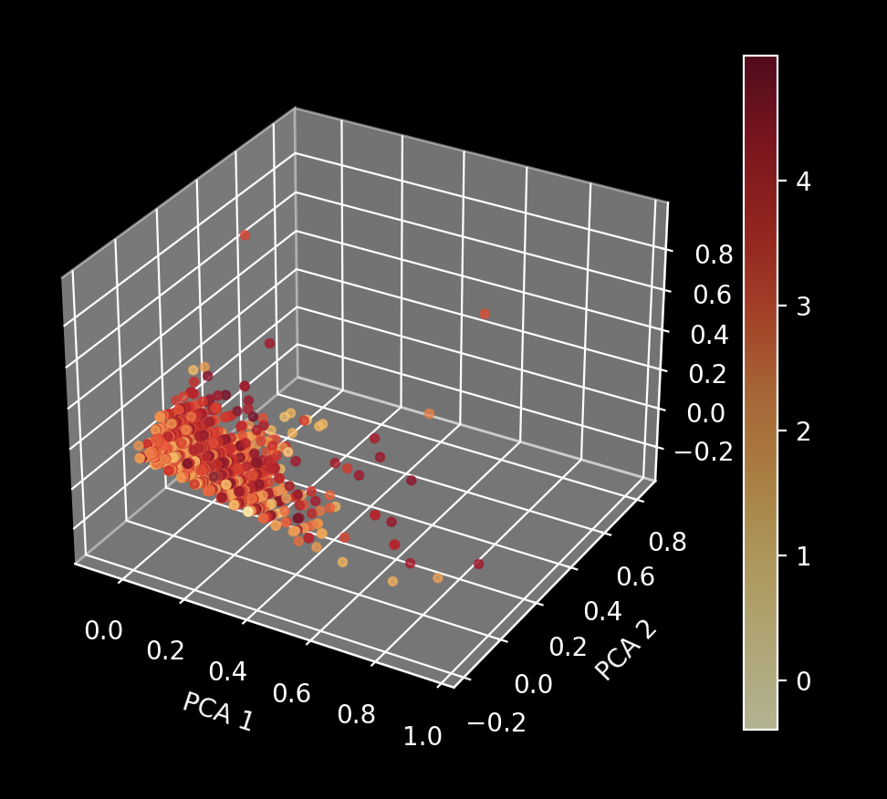
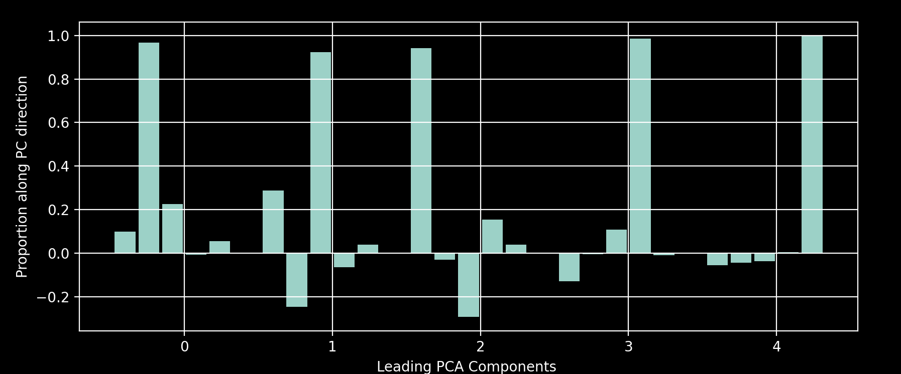
PCA Monthly owners colorbar
'PackageCount', 'MovieCount', 'ScreenshotCount', 'AchievementCount', 'PriceMean'

Slide 47
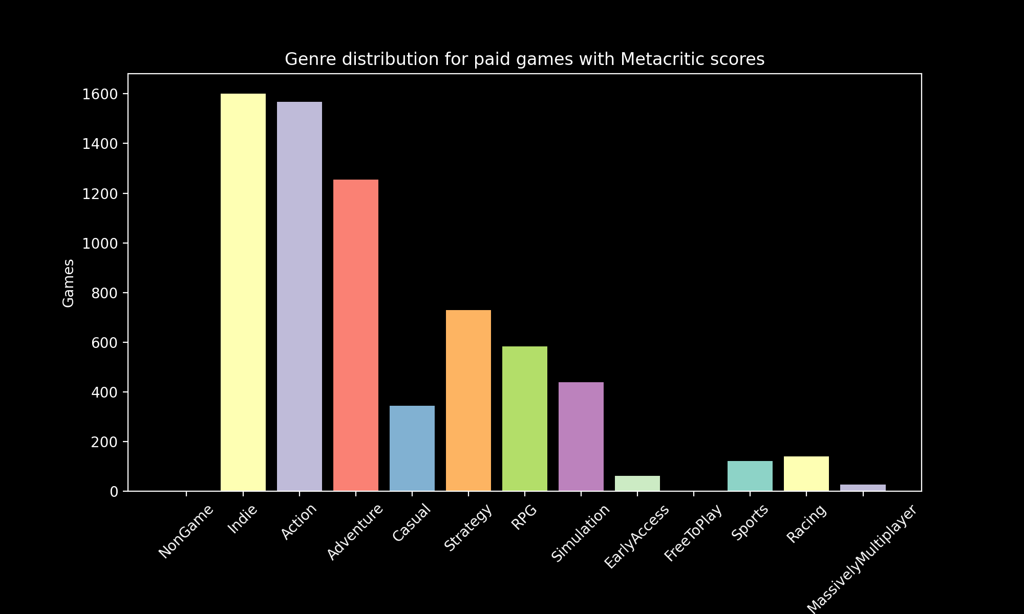

Slide 48
Image sources:
https://www.lynda.com/Marketing-tutorials/Online-Marketing-Foundations/693114-2.html
https://gameanalytics.com/blog/8-areas-you-should-focus-your-game-development-in-2018/
https://medium.com/@Momentum_London/sales-forecasting-8c5a0b61ac5a
https://www.lynda.com/Business-Skills-tutorials/Select-forecasting-technique/548711/601858-4.html
https://learningsolutionsmag.com/articles/metafocus-choosing-a-serious-game-development-strategy

Slide 49
Problems and Goals
Questions: How can game developers increase sales on online gaming platforms like Steam? How can they predict demand of a game? Lot of choices to make/features to choose from. How to present your game on Steam library to maximize sales?
Development
Deployment
Down The Road
Notes:
Help developers at two stages :
During development : Selecting what features to put in the game
On deployment : Based on their marketing strategy on Steam, predicting number of sales/owners
Down the road (after a year or so) : Short timescale (a few months) prediction of popularity of the game

Slide 50

Problems and Goals
Questions: How can game developers increase sales on online gaming platforms like Steam? How can they predict demand of a game? Lot of choices to make/features to choose from. How to present your game on Steam library to maximize sales?
Help predict revenue
Classify a game’s popularity based on their features.
Time series analysis to predict future popularity of a game given their history.
Notes:
Help developers at two stages :
During development : Selecting what features to put in the game
On deployment : Based on their marketing strategy on Steam, predicting number of sales/owners
Down the road (after a year or so) : Short timescale (a few months) prediction of popularity of the game

Slide 51
CReqsHaveMin -0.455764
PCReqsHaveRec 0.057429
LinuxReqsHaveMin 0.065472
LinuxReqsHaveRec -0.033339
MacReqsHaveMin -0.028826
MacReqsHaveRec -0.116675
CategorySinglePlayer -0.325486
CategoryMultiplayer -0.112083
CategoryCoop -0.011081
CategoryMMO -0.898058
CategoryInAppPurchase 0.010689
CategoryIncludeSrcSDK -0.338294
CategoryIncludeLevelEditor -0.393233
CategoryVRSupport 0.013538
GenreIsNonGame -0.197014
GenreIsIndie 0.353426
GenreIsAction 0.304676
GenreIsAdventure 0.025963
GenreIsCasual 0.362374
GenreIsStrategy 0.003225
GenreIsRPG 0.068681
GenreIsSimulation -0.180593
RequiredAge -0.008818
DemoCount 0.025099
DeveloperCount 0.127606
DLCCount -0.002965
Metacritic 0.000101
MovieCount 0.065993
PackageCount 0.073392
RecommendationCount -0.000005
PublisherCount -0.372406
ScreenshotCount -0.001193
AchievementCount 0.000083
AchievementHighlightedCount 0.013701
ControllerSupport 0.177140
IsFree 0.144621
FreeVerAvail 1.049263
PurchaseAvail -0.265359
SubscriptionAvail -0.478384
GenreIsEarlyAccess 0.226580
GenreIsFreeToPlay -0.356964
GenreIsSports 0.382582
GenreIsRacing 0.061259
GenreIsMassivelyMultiplayer 0.222382
PriceInitial -0.014243
PriceFinal 0.010934

