Slide 2
Topics
Introduction to File Input and Output
Using Loops to Process Files
Processing Records
Exceptions

Slide 3
Introduction to File Input and Output
For program to retain data between the times it is run, you must save the data
  Data is saved to a file, typically on computer disk
  Saved data can be retrieved and used at a later time
“Writing data to”: saving data on a file
Output file: a file that data is written to

Slide 4
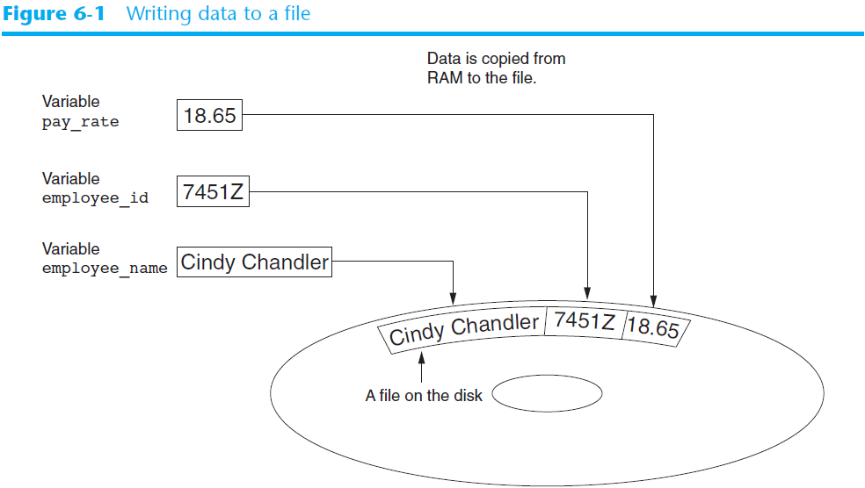

Slide 5
Introduction to File Input and Output (cont’d.)
“Reading data from”: process of retrieving data from a file
Input file: a file from which data is read
Three steps when a program uses a file
  Open the file
  Process the file
  Close the file

Slide 6
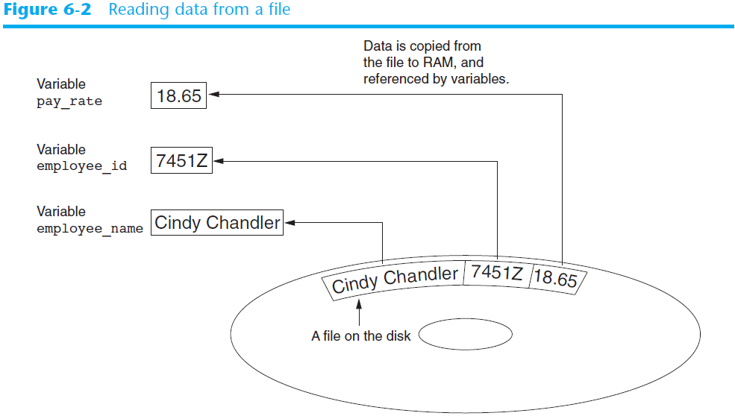

Slide 7
Types of Files and File Access Methods
In general, two types of files
  Text file: contains data that has been encoded as text
  Binary file: contains data that has not been converted to text
Two ways to access data stored in file
  Sequential access: file read sequentially from beginning to end, can’t skip ahead
  Direct access: can jump directly to any piece of data in the file

Slide 8
Filenames and File Objects
Filename extensions: short sequences of characters that appear at the end of a filename preceded by a period
  Extension indicates type of data stored in the file
File object: object associated with a specific file
  Provides a way for a program to work with the file: file object referenced by a variable

Slide 9
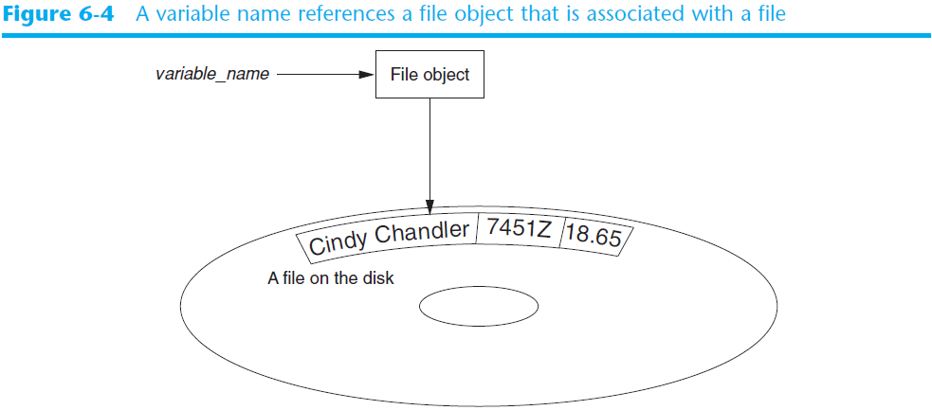
Filenames and File Objects (cont’d.)

Slide 10
Opening a File
open function: used to open a file
  Creates a file object and associates it with a file on the disk
  General format:
  file_object = open(filename, mode)
Mode: string specifying how the file will be opened
  Example: reading only ('r'), writing ('w'), and appending ('a')

Slide 11

Specifying the Location of a File
If open function receives a filename that does not contain a path, assumes that file is in same directory as program
If program is running and file is created, it is created in the same directory as the program
  Can specify alternative path and file name in the open function argument
    Prefix the path string literal with the letter r

Slide 12
Writing Data to a File
Method: a function that belongs to an object
  Performs operations using that object
File object’s write method used to write data to the file
  Format: file_variable.write(string)
File should be closed using file object close method
  Format: file_variable.close()

Slide 13
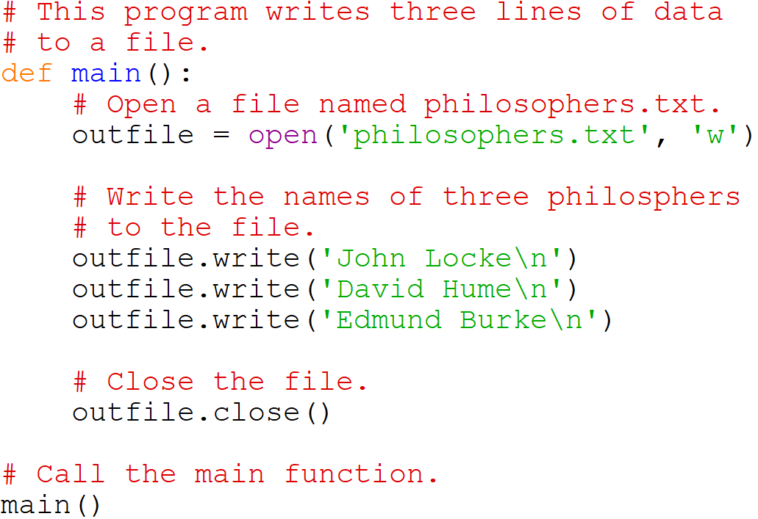




Writing Data to a File

Slide 14
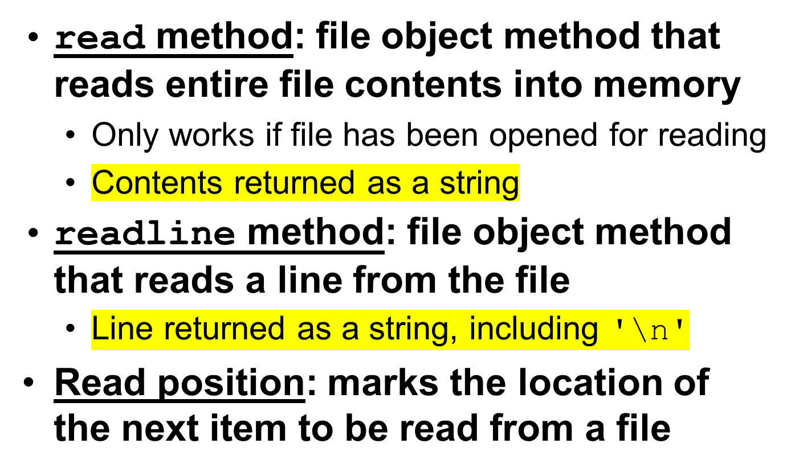
Reading Data From a File

Slide 15
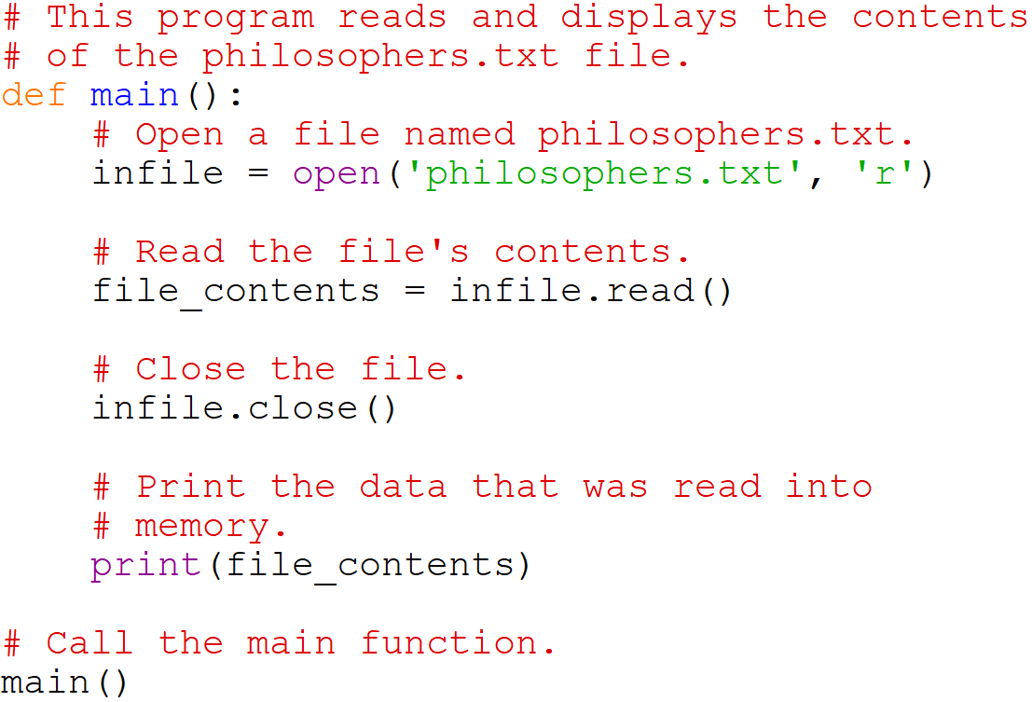



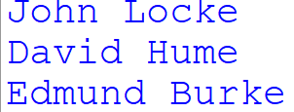
Reading Data From a File

Slide 16
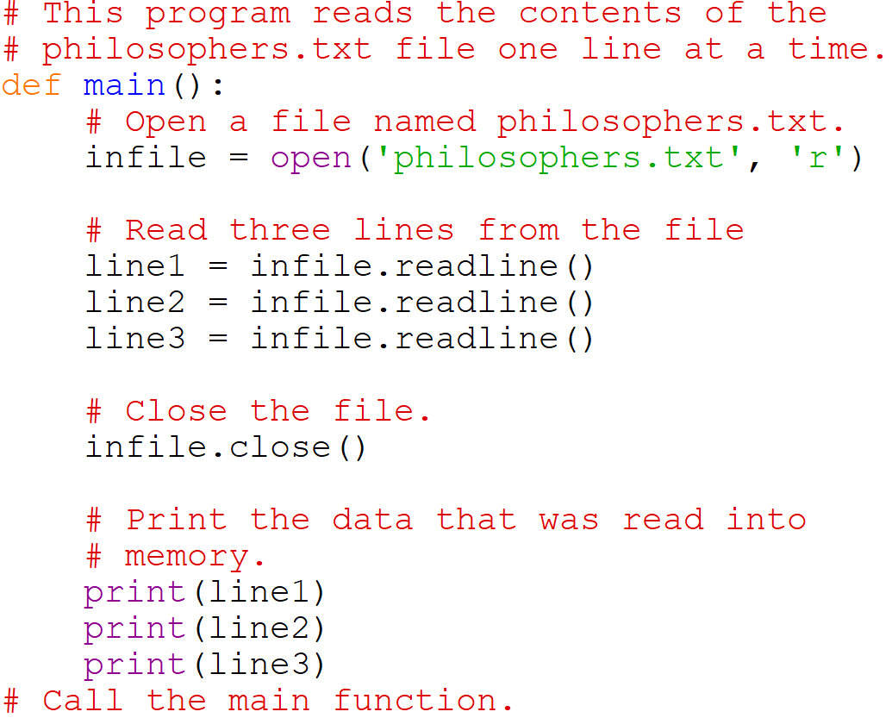
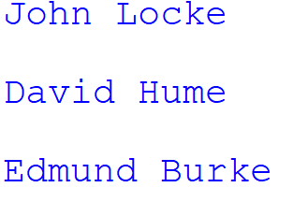
Reading Data From a File

Slide 17
Concatenating a Newline to and Stripping it From a String
In most cases, data items written to a file are values referenced by variables
  Usually necessary to concatenate a '\n' to data before writing it
    Carried out using the + operator in the argument of the write method
In many cases need to remove '\n' from string after it is read from a file
  rstrip method: string method that strips specific characters from end of the string

Slide 18
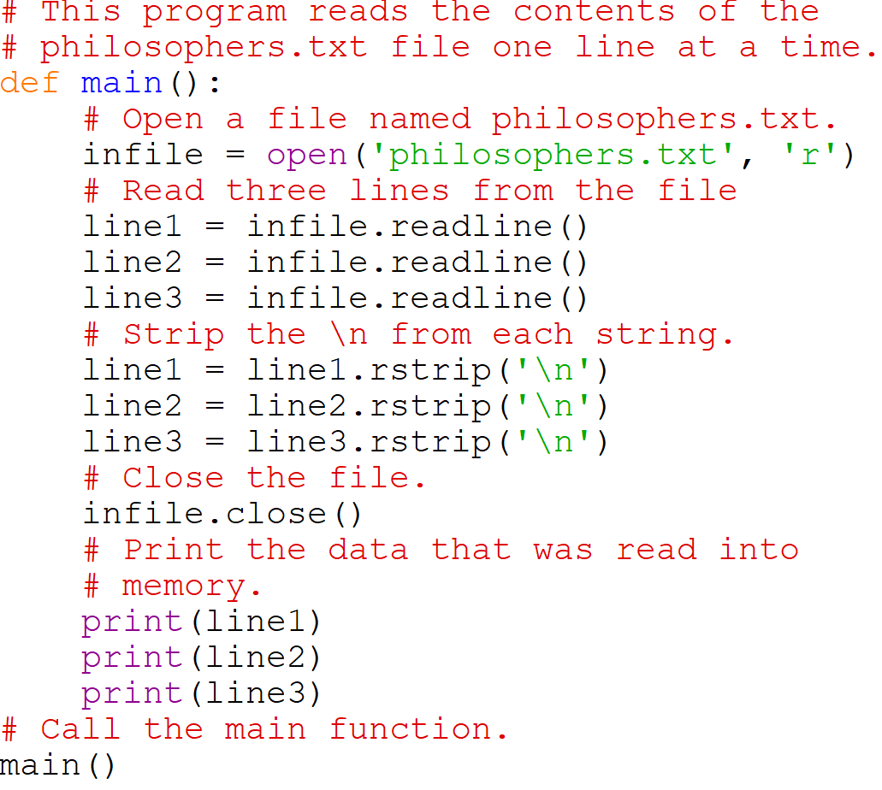

Concatenating a Newline to and Stripping it From a String

Slide 19
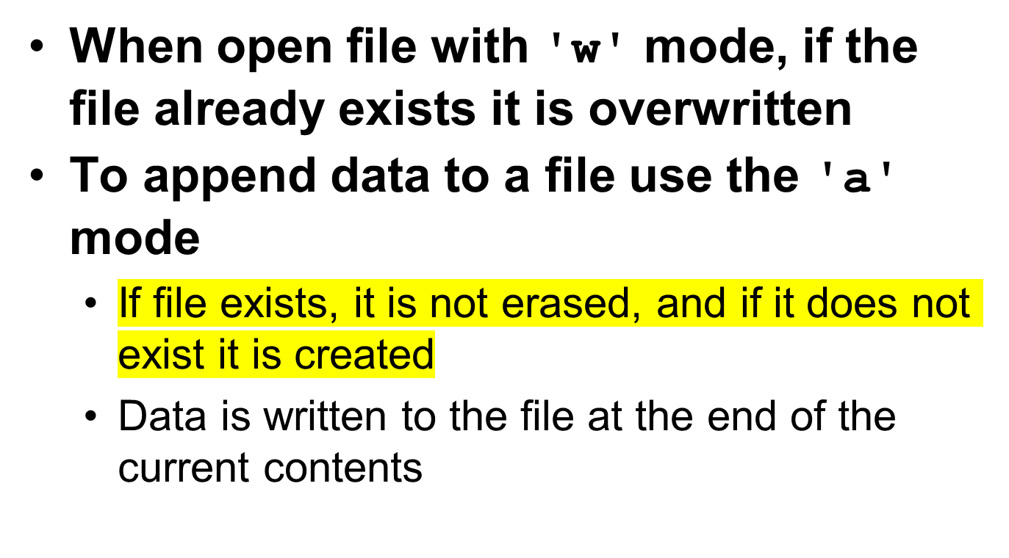
Appending Data to an Existing File

Slide 20
Writing and Reading Numeric Data
Numbers must be converted to strings before they are written to a file
str function: converts value to string
Number are read from a text file as strings
  Must be converted to numeric type in order to perform mathematical operations
  Use int and float functions to convert string to numeric value

Slide 21
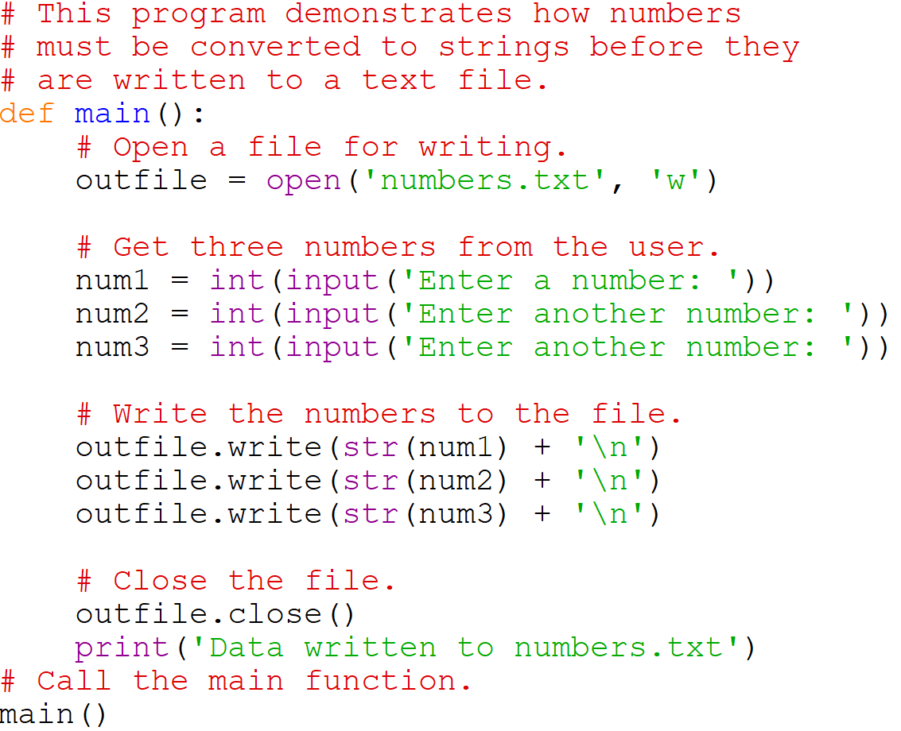

Writing Numeric Data

Slide 22
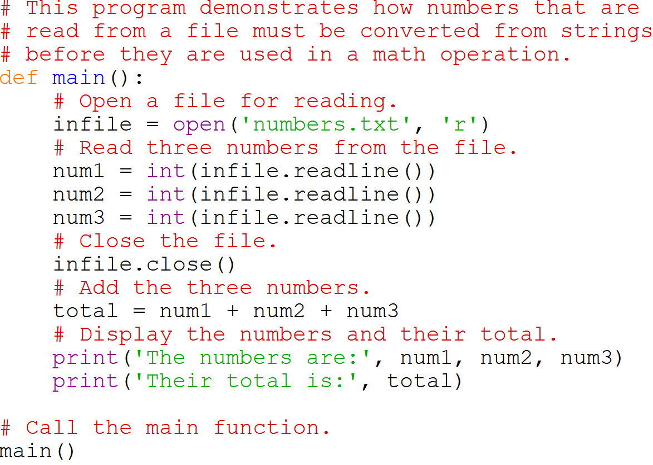



Reading Numeric Data

Slide 23
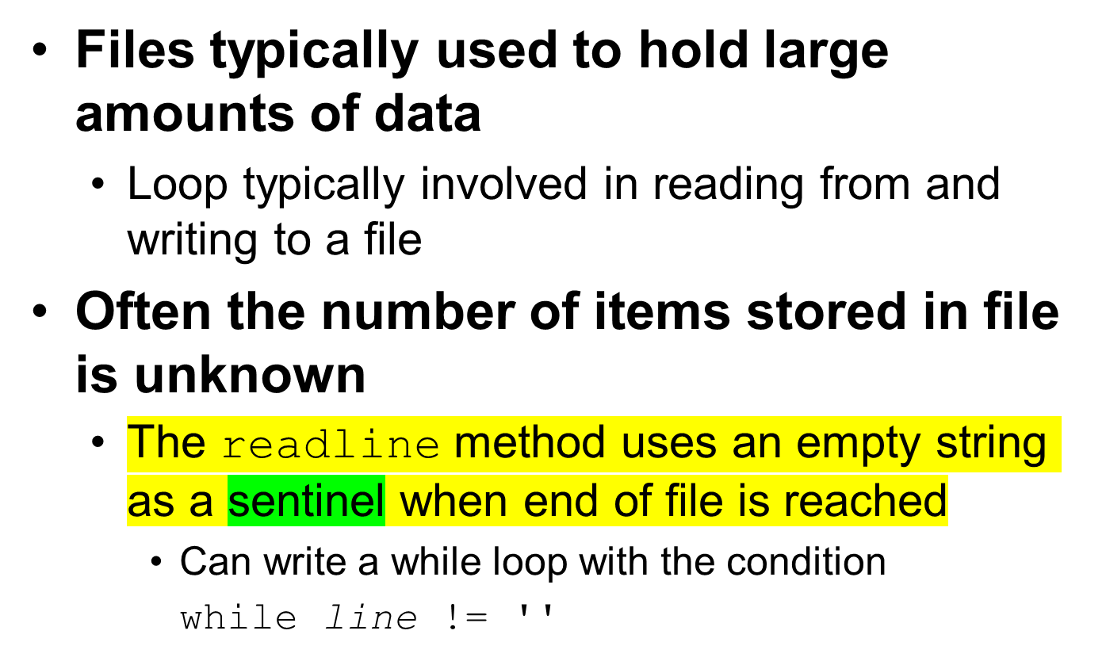
Using Loops to Process Files

Slide 24
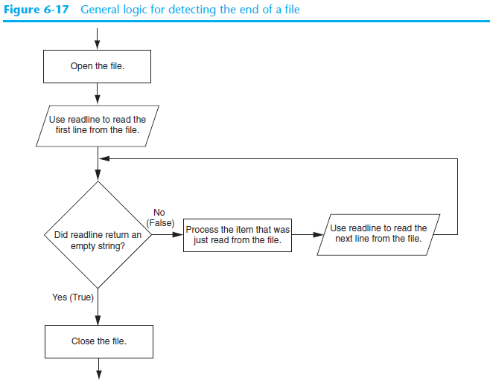

Slide 25
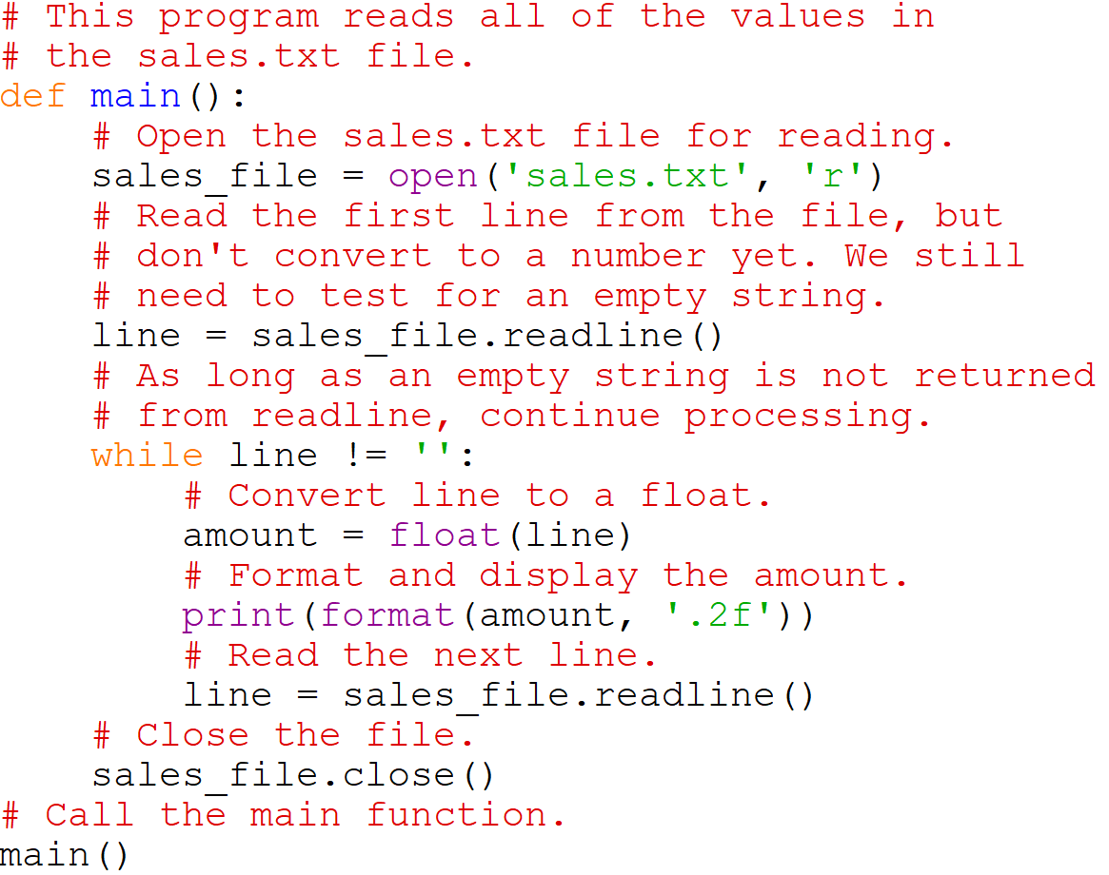



Using Python’s while Loop to Read Lines

Slide 26
Using Python’s for Loop to Read Lines
Python allows the programmer to write a for loop that automatically reads lines in a file and stops when end of file is reached
  Format: for line in file_object:
  statements
  The loop iterates once over each line in the file

Slide 27
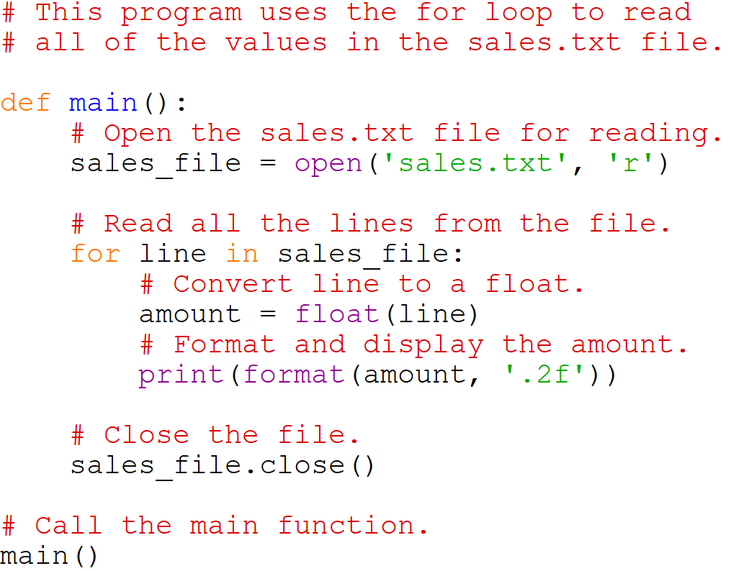

Using Python’s for Loop to Read Lines

Slide 28
Processing Records
Record: set of data that describes one item
Field: single piece of data within a record
Write record to sequential access file by writing the fields one after the other
Read record from sequential access file by reading each field until record complete

Slide 29
Processing Records (cont’d.)
When working with records, it is also important to be able to:
  Add records
  Display records
  Search for a specific record
  Modify records
  Delete records

Slide 30
Exceptions
Exception: error that occurs while a program is running
  Usually causes program to abruptly halt
Traceback: error message that gives information regarding line numbers that caused the exception
  Indicates the type of exception and brief description of the error that caused exception to be raised

Slide 31
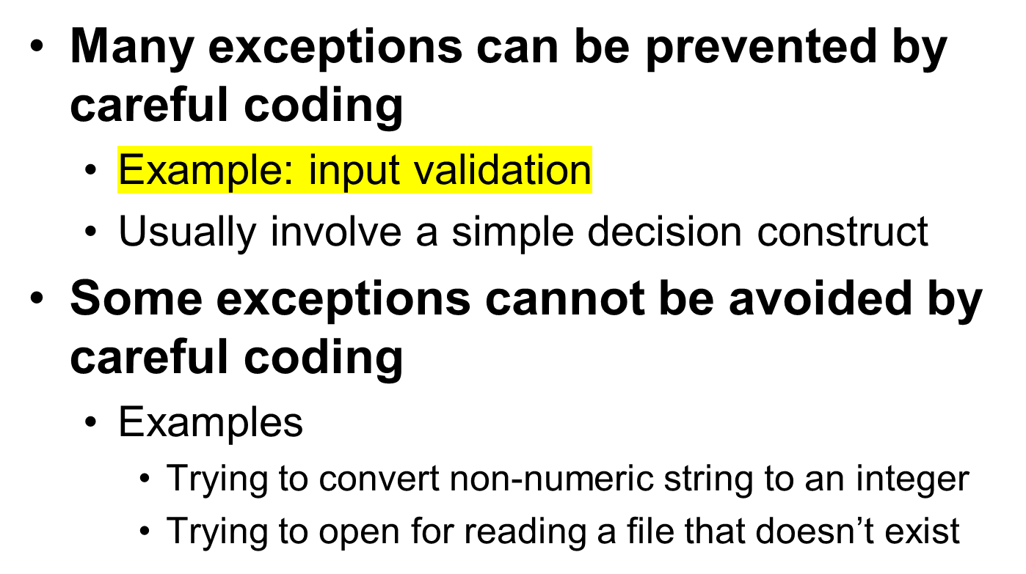
Exceptions (cont’d.)

Slide 32
Exceptions (cont’d.)
Exception handler: code that responds when exceptions are raised and prevents program from crashing
  In Python, written as try/except statement
    General format: try:
      statements
      except exceptionName:
      statements
    Try suite: statements that can potentially raise an exception
    Handler: statements contained in except block

Slide 33
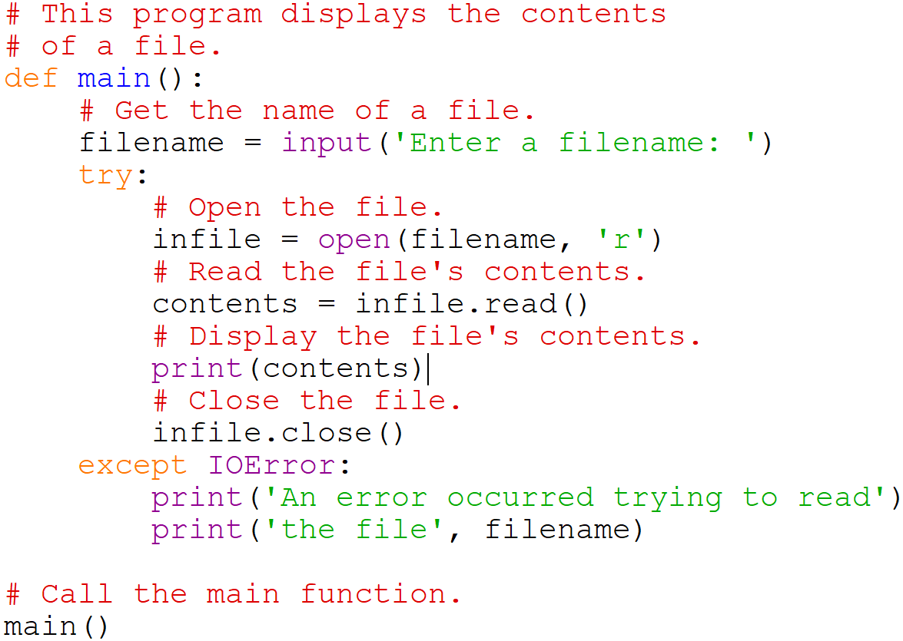


Exceptions (cont’d.)

Slide 34
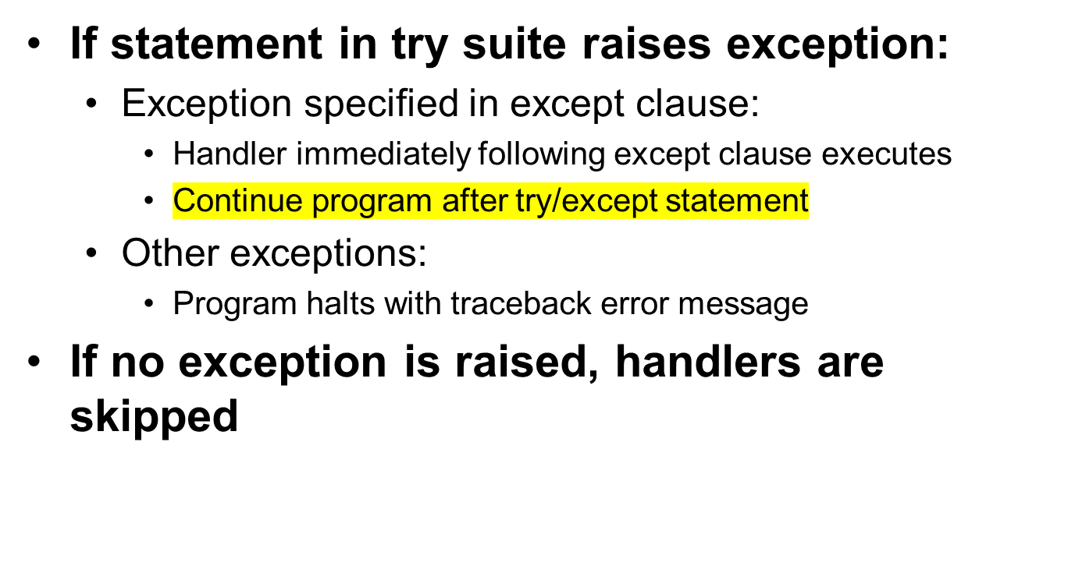
Exceptions (cont’d.)

Slide 35
Handling Multiple Exceptions
Often code in try suite can throw more than one type of exception
  Need to write except clause for each type of exception that needs to be handled
An except clause that does not list a specific exception will handle any exception that is raised in the try suite
  Should always be last in a series of except clauses

Slide 36
Displaying an Exception’s Default Error Message
Exception object: object created in memory when an exception is thrown
  Usually contains default error message pertaining to the exception
  Can assign the exception object to a variable in an except clause
    Example: except ValueError as err:
  Can pass exception object variable to print function to display the default error message

Slide 37
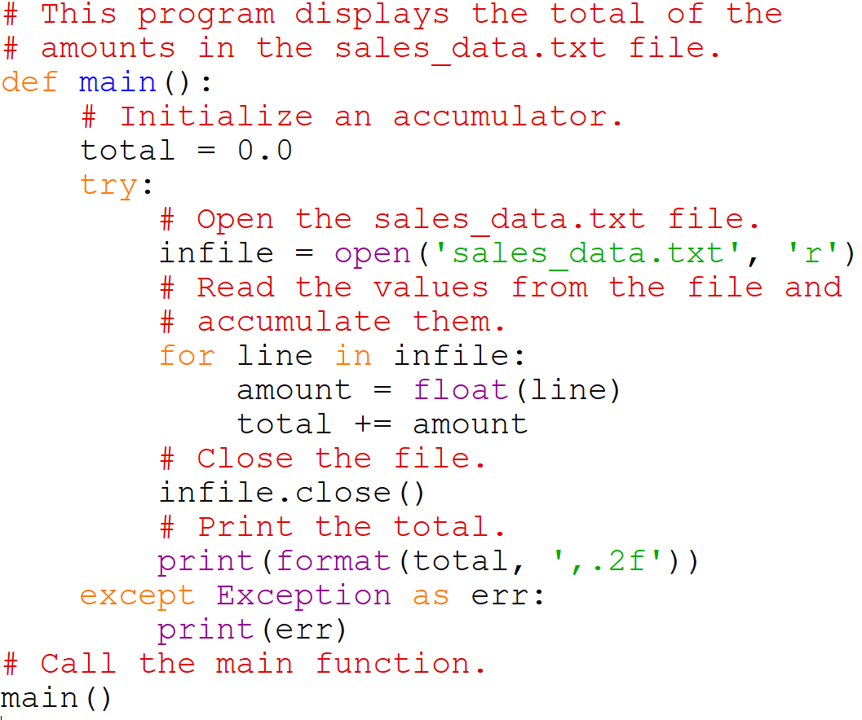


Displaying an Exception’s Default Error Message

Slide 38
The else Clause
try/except statement may include an optional else clause, which appears after all the except clauses
  Aligned with try and except clauses
  Syntax similar to else clause in decision structure
  Else suite: block of statements executed after statements in try suite, only if no exceptions were raised
    If exception was raised, the else suite is skipped

Slide 39
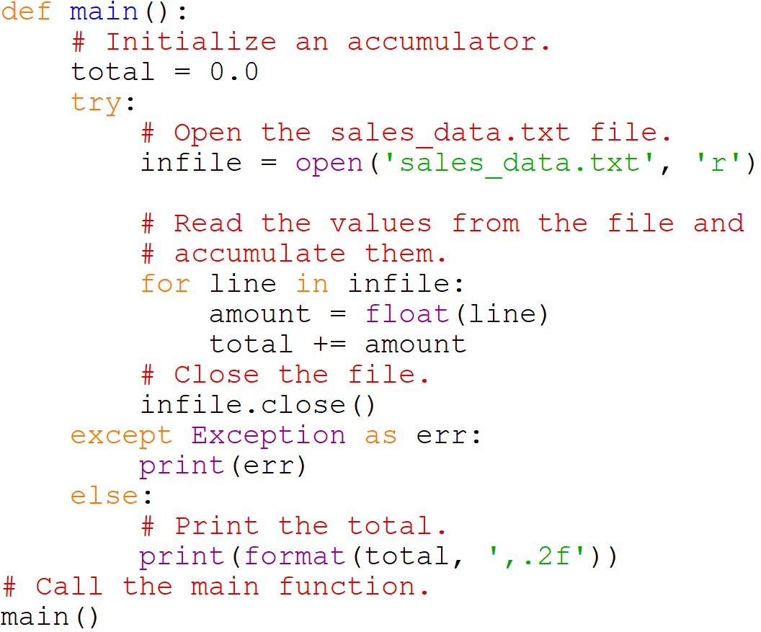



The else Clause

Slide 40
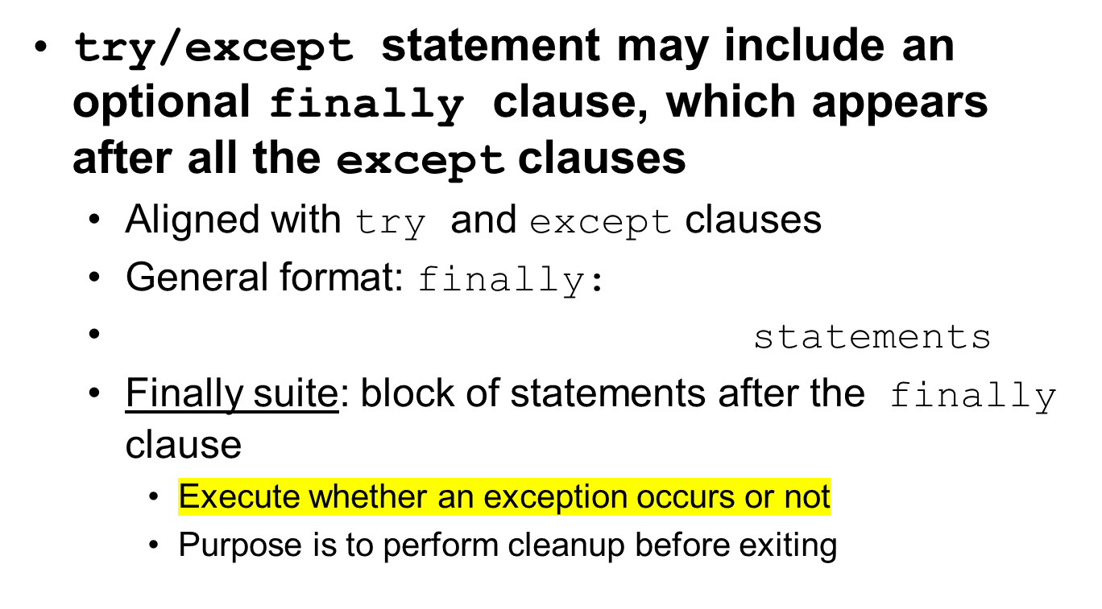
The finally Clause

Slide 41
The finally Clause

Slide 42
What If an Exception Is Not Handled?
Two ways for exception to go unhandled:
  No except clause specifying exception of the right type
  Exception raised outside a try suite
In both cases, exception will cause the program to halt
  Python documentation provides information about exceptions that can be raised by different functions

Slide 43
Summary
This chapter covered:
  Types of files and file access methods
  Filenames and file objects
  Writing data to a file
  Reading data from a file and determining when the end of the file is reached
  Processing records
  Exceptions, including:
    Traceback messages
    Handling exceptions

