Slide 1
SCIENTIFIC RESEARCH / PROJECT REPORT
Does explicit cross-modal interaction help?
QUESTION
PROTOCOL
A controlled DTI classification benchmark · presentation design demo
EVIDENCE
NEXT TEST
Scientific PPT Designer | V1.0
SYNTHETIC DEMO · not real experimental evidence
01 / 12
Notes:
Every metric and example in this deck is synthetic and illustrative; this deck demonstrates visual structure only.

Slide 2
RESEARCH / EVIDENCE-LED
Three decisions determine whether the comparison is useful
01
02
03
A fair split
An isolated change
Evidence beyond AUC
Separate chemistry and target generalization rather than reporting one random split.
Hold encoders and training protocol fixed when changing the interaction block.
Report class imbalance, AUPRC, and error patterns alongside AUROC.
Research question → matched experiment → interpretable decision
SYNTHETIC DEMO · not real experimental evidence
SOURCE DEMO-M01
02 / 12
Notes:
SOURCE IDs: DEMO-M01

Slide 3
RESEARCH / EVIDENCE-LED
A controlled pipeline localizes the interaction contribution
01
02
03
04
05
Datasets
Split audit
Shared encoders
Interaction
Evaluation
Input labels and target sequences
Random versus cold-target
Drug and protein representations
Swap one comparison operator
AUROC · AUPRC · leakage check
Only one component changes inside an otherwise matched evaluation setup.
SYNTHETIC DEMO · not real experimental evidence
SOURCE DEMO-M01 · DEMO-M02
03 / 12
Notes:
SOURCE IDs: DEMO-M01, DEMO-M02

Slide 4
RESEARCH / EVIDENCE-LED
The illustrative method tops the matched synthetic benchmark
CENTRAL FINDING
0.843
0.806
A stronger pooled metric is encouraging, but not sufficient to claim target transfer.
Illustrative test AUROC
Illustrative test AUPRC
3
Open
All quantities shown here are synthetic. No statistical testing is implied.
Assessed settings
Target-transfer claim
SYNTHETIC DEMO · not real experimental evidence
SOURCE DEMO-R01
04 / 12
Notes:
SOURCE IDs: DEMO-R01

Slide 5
RESEARCH / EVIDENCE-LED
An identical split reveals variation across interaction variants
INTERPRETATION
No interaction
0.778
The illustrative focal variant has the highest value in this toy comparison.
Bilinear variant
0.819
Cross-attention
0.831
Proposed variant
0.843
Synthetic values; uncertainty and statistical tests were not supplied.
0.00
0.25
0.50
0.75
1.00
Synthetic test AUROC (0–1)
SYNTHETIC DEMO · not real experimental evidence
SOURCE DEMO-R01
05 / 12
Notes:
SOURCE IDs: DEMO-R01

Slide 6
RESEARCH / EVIDENCE-LED
Different operators show different illustrative data-efficiency trends
1.00
INTERPRETATION
Toy curves suggest a testable label-efficiency hypothesis.
0.88
0.75
0.62
The y-axis starts at 0.50 (explicitly labeled). Curves are not experimental learning curves.
0.50
10%
25%
50%
75%
100%
Baseline
Cross-attn
Focal
SYNTHETIC DEMO · not real experimental evidence
SOURCE DEMO-R02
06 / 12
Notes:
SOURCE IDs: DEMO-R02

Slide 7
RESEARCH / EVIDENCE-LED
A transparent evidence table is more useful than a universal winner
Synthetic model
AUROC
AUPRC
Target holdout
Status
No interaction
0.778
0.732
Not tested
Reference
Bilinear
0.819
0.771
Not tested
Candidate
Cross-attention
0.831
0.790
Not tested
Candidate
Focal method
0.843
0.806
Not tested
Follow-up
No cold-target evidence is present in this synthetic example.
SYNTHETIC DEMO · not real experimental evidence
SOURCE DEMO-R01 · DEMO-M02
07 / 12
Notes:
SOURCE IDs: DEMO-R01, DEMO-M02

Slide 8
RESEARCH / EVIDENCE-LED
Random and cold-target splits answer different generalization questions
Random pair holdout
Cold-target holdout
Estimates interpolation within observed targets
Tests transfer to unseen protein targets
VS
Can retain drug/target family overlap
Requires transparent target grouping
Useful baseline, limited transfer claim
Higher bar for deployment claims
Split definitions are part of the scientific claim, not a footnote.
SYNTHETIC DEMO · not real experimental evidence
SOURCE DEMO-M02
08 / 12
Notes:
SOURCE IDs: DEMO-M02

Slide 9
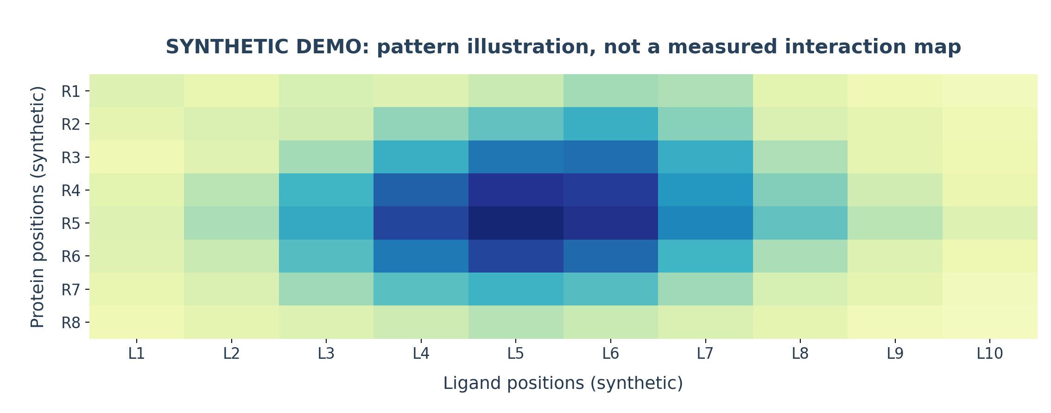
RESEARCH / EVIDENCE-LED
Use original research images without distorting the scientific labels
Illustrative synthetic interaction map. Original image embedded without changing its data.
SYNTHETIC DEMO · not real experimental evidence
SOURCE DEMO-F01
09 / 12
Notes:
This image was generated for layout testing and must not be presented as real attention or contact evidence.
SOURCE IDs: DEMO-F01

Slide 10
RESEARCH / EVIDENCE-LED
The main conclusion is narrower than the performance ranking
1
2
3
Within-protocol variation
Transfer not established
Explanation still open
Toy numbers show a ranking on one matched setting, not across all DTI tasks.
An unseen-target evaluation and overlap audit are still required.
Attention scores alone cannot validate molecular contact mechanisms.
SYNTHETIC DEMO · not real experimental evidence
SOURCE DEMO-R01 · DEMO-M02
10 / 12
Notes:
SOURCE IDs: DEMO-R01, DEMO-M02

Slide 11
RESEARCH / EVIDENCE-LED
Next experiments should target the weakest current inference
01
Run cold-target benchmark
Predefined holdout and hyperparameter policy
02
Report seed-level dispersion
Actual repetitions and uncertainty estimates
03
Add contact-level sanity checks
Use structural annotations, where available
04
Investigate failure subgroups
Scaffold, target family, label prevalence
SYNTHETIC DEMO · not real experimental evidence
SOURCE DEMO-P01
11 / 12
Notes:
SOURCE IDs: DEMO-P01

Slide 12
TAKE-HOME MESSAGE
Move from a metric gain to a defensible scientific conclusion
A clear question makes every slide easier to design.
Matched evidence matters more than visual polish alone.
The next experiment should change a decision.
SYNTHETIC DEMO · not real experimental evidence
SOURCE DEMO-P01
12 / 12
Notes:
SOURCE IDs: DEMO-P01

