Slide 1
总结汇报
毛宽诚
2020/01/16

Slide 2
2019-2020学期总结
找工作
课题
大论文

Slide 3
2019-2020学期总结
找工作
复习面试知识、刷题、笔试、面试
8月初到10月底

Slide 4
2019-2020学期总结
课题
论文阅读
写了一个双光谱行人检测的论文综述，总结了16篇文章，其中5篇新阅读的。
阅读其他相关文献，包括fpn、efficientdet等
实验
deep mutual learning
Cross-modality interactive attention
多尺度多模态roi align
软著
可见光红外双波段行人检测系统V1.0

Slide 5
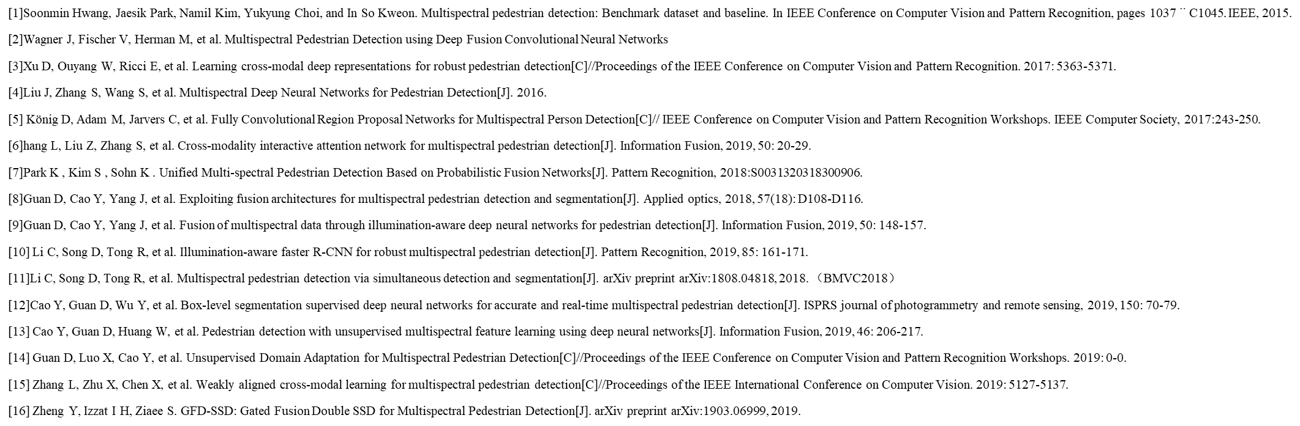
2019-2020学期总结
双光谱行人检测论文综述
相关论文阅读

Slide 6
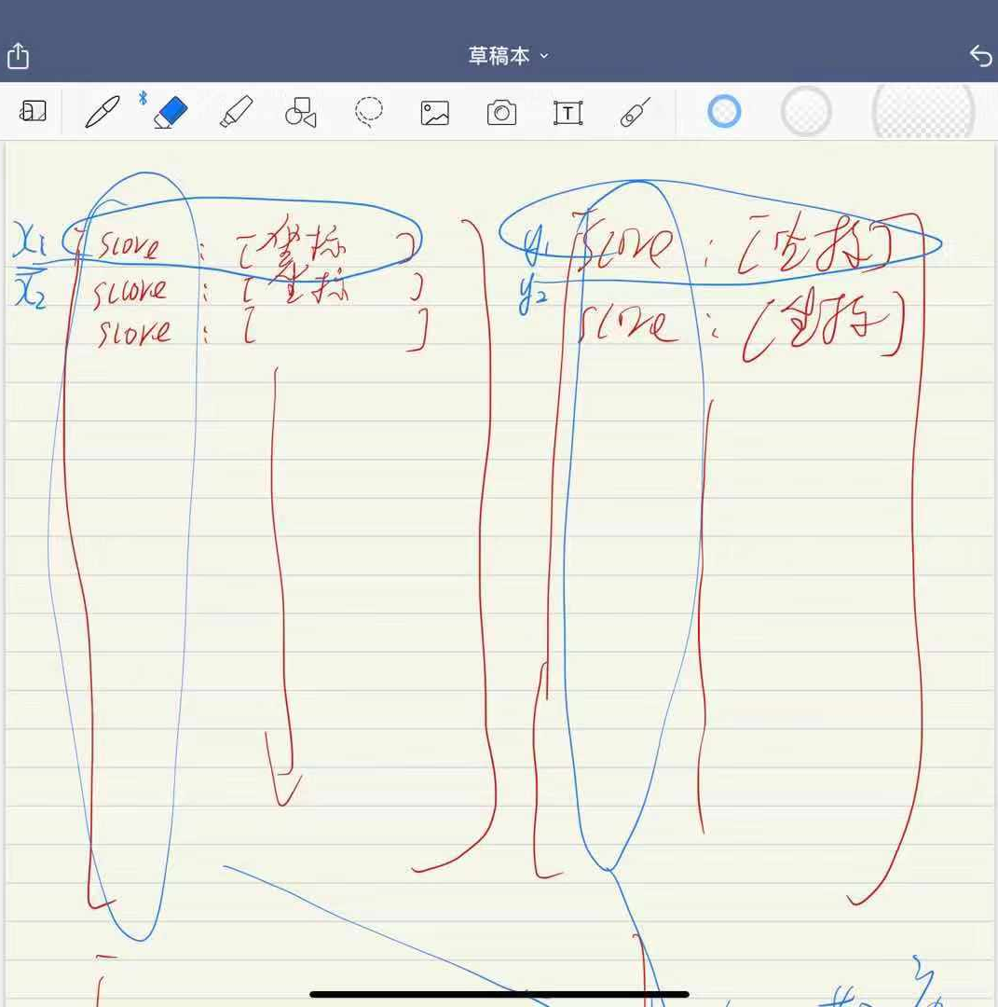
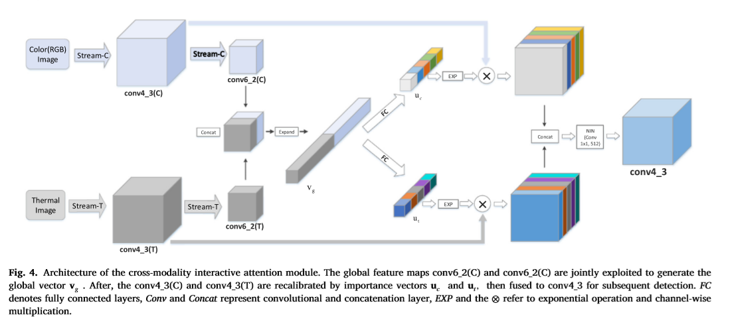
2019-2020学期总结
实验
Deep mutual learning
发现有问题，无法应用到检测问题。
交互attention
Loss降不下去，效果不好，放弃。
多尺度多模态roi align
Log average missrate 33.28%(18.77%)

Slide 7
2019-2020学期总结
大论文
列好框架
写了一些乱七八糟

Slide 8
实验汇报
单模态多尺度roi align、多模态多尺度roi align

Slide 9
测试集
训练集：train-all-02(set01-set05)
测试集：test-all-20(set06-set11)
2252张图片。
标签：person/people/people?/cyclist
训练：全部训练
测试：忽略 people/people?/cyclist
忽略 occlusion/小尺寸
仅统计person

Slide 10
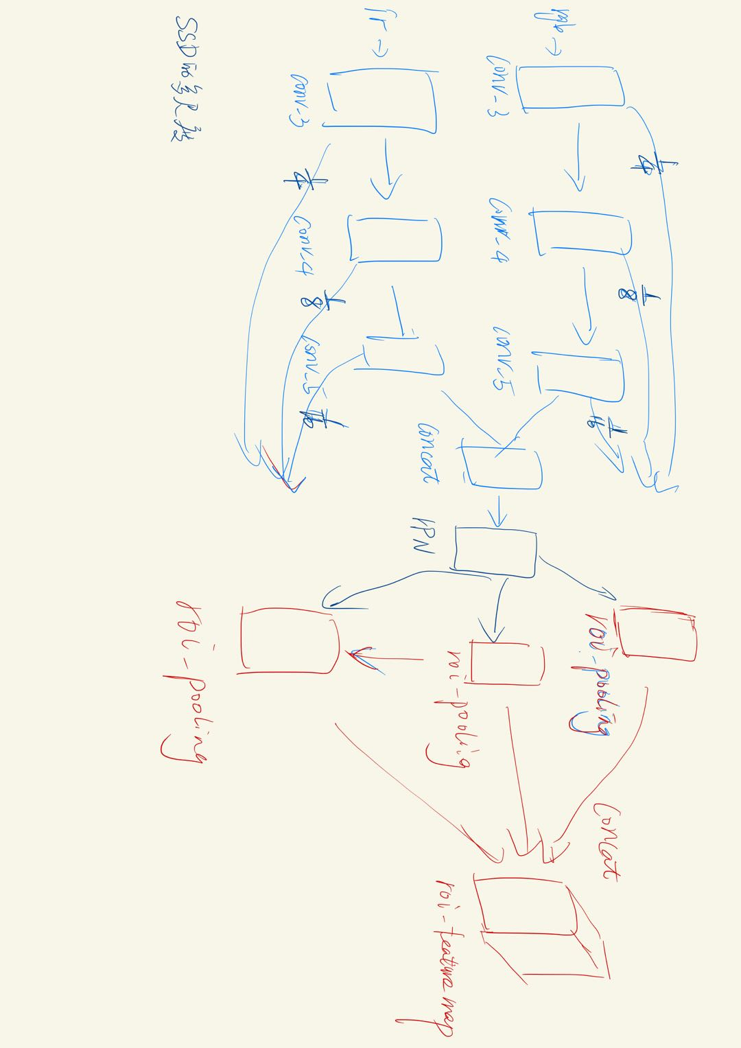
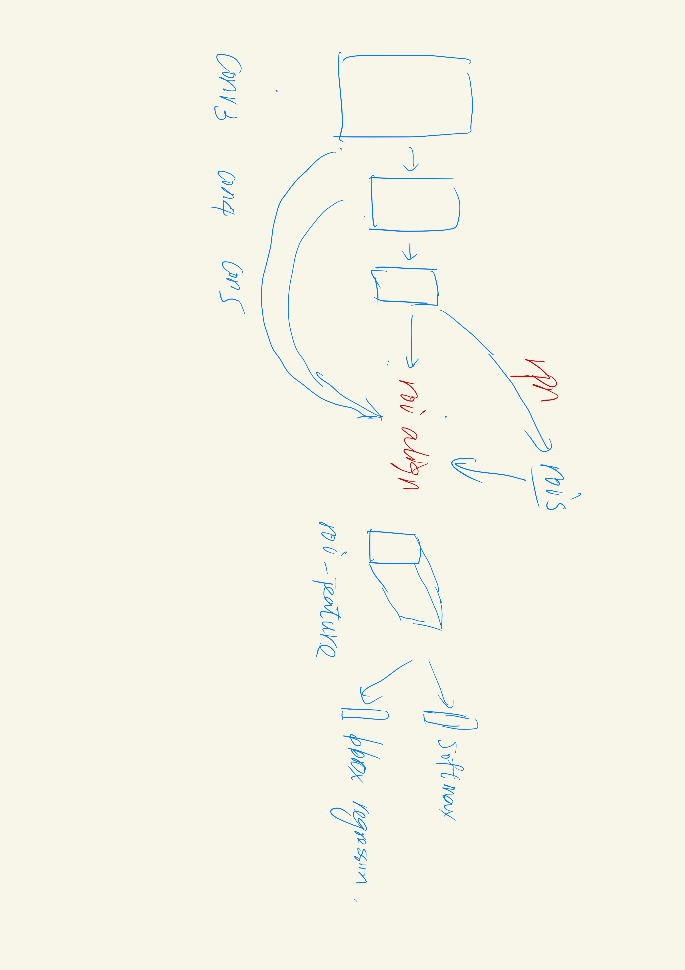
实验结果
多尺度双模态roi align:
Reasonable-all log-average miss rate = 38.15% (22.84%) recall = 83.76% (88.25%)
Reasonable-day log-average miss rate = 40.65% (24.12%) recall = 83.23% (87.97%)
Reasonable-night log-average miss rate = 33.04% (19.97%) recall = 85.07% (88.84%)
Scale=near log-average miss rate = 17.94% (2.46%) recall = 94.96% (99.50%)
Scale=medium log-average miss rate = 40.81% (29.21%) recall = 83.29% (85.50%)
Scale=far log-average miss rate = 72.75% (64.75%) recall = 66.38% (57.15%)
Occ=none log-average miss rate = 42.63% (39.73%) recall = 81.48% (77.30%)
Occ=partial log-average miss rate = 64.20% (52.66%) recall = 64.55% (68.49%)
Occ=heavy log-average miss rate = 79.24% (69.13%) recall = 40.74% (48.23%)
Reasonable-all log-average miss rate = 47.32% (44.42%) recall = 76.49% (7.08%)
Reasonable-day log-average miss rate = 44.03% (37.07%) recall = 80.67% (83.23%)
Reasonable-night log-average miss rate = 62.09% (59.46%) recall = 62.44% (65.45%)
Scale=near log-average miss rate = 22.32% (14.09%) recall = 90.76% (97.33%)
Scale=medium log-average miss rate = 53.41% (53.39%) recall = 72.78% (69.85%)
Scale=far log-average miss rate = 84.59% (83.32%) recall = 39.32% (35.66%)
Occ=none log-average miss rate = 54.50% (61.03%) recall = 70.62% (61.14%)
Occ=partial log-average miss rate = 79.66% (80.92%) recall = 52.12% (42.01%)
Occ=heavy log-average miss rate = 88.14% (83.60%) recall = 31.02% (34.07%)

Slide 11
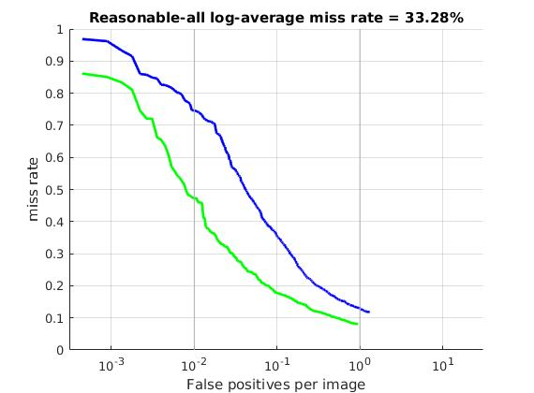
2019-2020学期总结
多尺度多模态roi align
Log average missrate 33.28%%(18.77%)
Reasonable-all log-average miss rate = 33.28% (18.77%) recall = 88.17% (91.85%)
Reasonable-day log-average miss rate = 34.62% (17.15%) recall = 88.07% (92.90%)
Reasonable-night log-average miss rate = 32.32% (21.87%) recall = 87.31% (89.62%)
Scale=near log-average miss rate = 12.21% (0.00%) recall = 97.06% (100.00%)
Scale=medium log-average miss rate = 37.77% (25.54%) recall = 85.87% (88.41%)
Scale=far log-average miss rate = 62.54% (53.58%) recall = 71.22% (68.39%)
Occ=none log-average miss rate = 39.53% (37.12%) recall = 84.38% (79.71%)
Occ=partial log-average miss rate = 59.36% (50.63%) recall = 73.94% (71.00%)
Occ=heavy log-average miss rate = 76.97% (69.11%) recall = 42.59% (53.98%)

Slide 12
方法 | Half fusion |  | rpn fusion |  | nms fusion | 多尺度rpn
 | Roi pooling | Roi align | Roi pooling | Roi align | Roi align | Roi align
All | 40.44%(28.11%) | 36.78%(22.91%) | 40.26%(27.90%) | 34.17%(19.17%) | 39.03% (26.46%) | 33.28% (18.77%)

