Slide 1
进度汇报
2020.4.9
胡敬玉

Slide 2
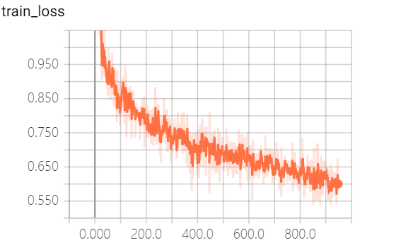
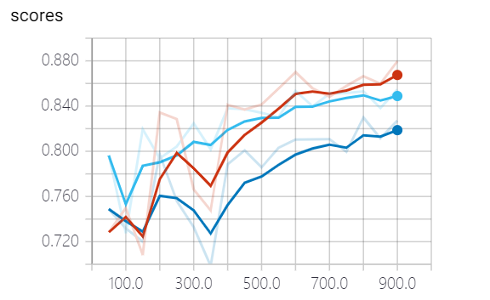
实验
Dice
Complete
Core
Enhancing

Slide 3
Method | Dice Coefficient
 | Complete | Core | Enhancing
Chen et al.[21] | 0.72 | 0.83 | 0.81
Qamar et al.[31] | 0.87 | 0.84 | 0.81
Dolz et al.[20] | 0.8389 | 0.7968 | 0.7987
Proposed | 0.8945 | 0.8483 | 0.8303
Re-implement(Pytorch) | 0.8748 | 0.8503 | 0.8082

Slide 4
Thank You!

