Slide 1
进度汇报
2020.4.16
胡敬玉

Slide 2
L. Yu et al., “Automatic 3D Cardiovascular MR Segmentation with Densely-Connected Volumetric ConvNets,” in MICCAI, 2017, pp. 287–295.

Slide 3
Motivation
ResNet
DenseNet
Shortcut
Feature reuse
Supervised by loss function through short connections

Slide 4
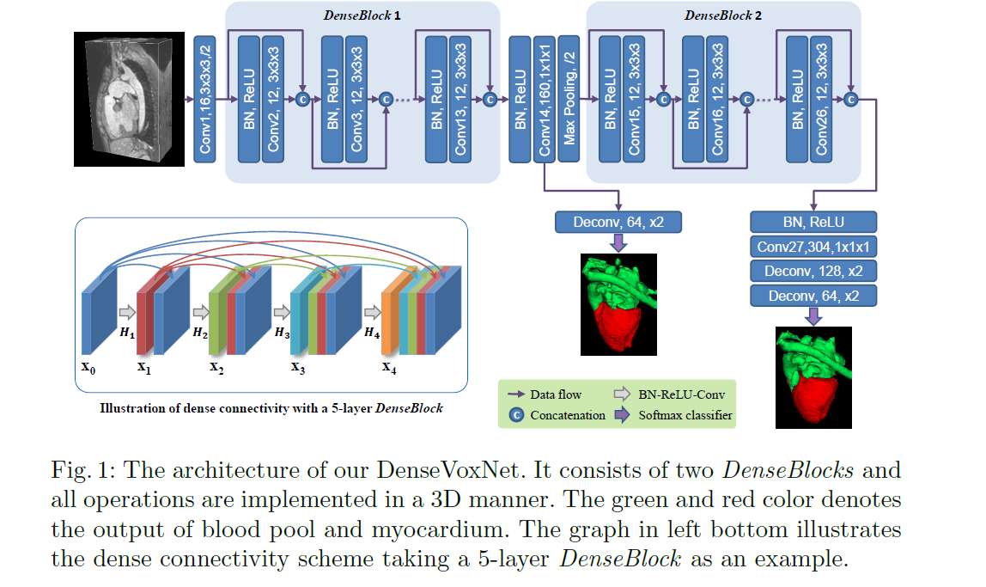

Slide 5
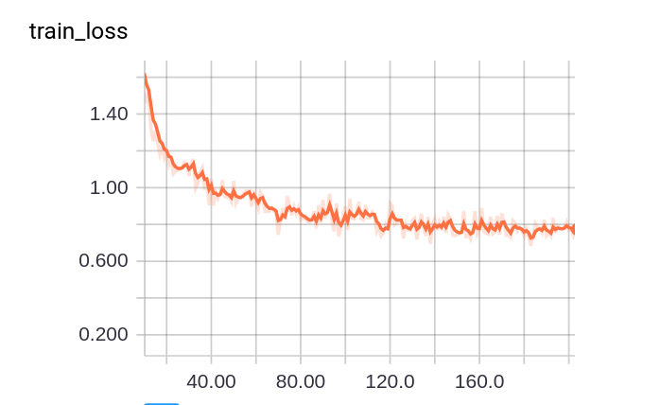
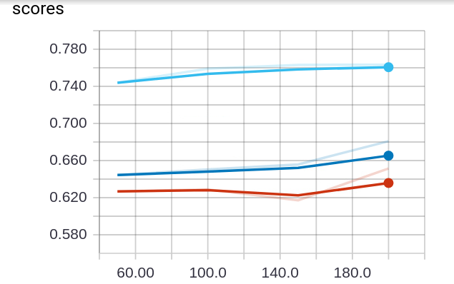
实验 DenseVoxNet
Optimizer: SGD
Dice
Complete
Core
Enhancing

Slide 6
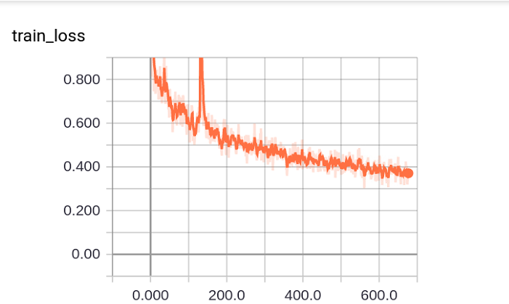
实验 DenseVoxNet
Optimizer: Adam

Slide 7
实验 DenseVoxNet
Method | Dice Coefficient
 | Complete | Core | Enhancing
DenseVoxNet | 0.8533 | 0.8352 | 0.7829
Chen et al.[21] | 0.72 | 0.83 | 0.81
Dolz et al.[20] | 0.8389 | 0.7968 | 0.7987
Proposed | 0.8945 | 0.8483 | 0.8303
Re-implement(Pytorch) | 0.8748 | 0.8503 | 0.8082

Slide 8
Thank You!

