Slide 1
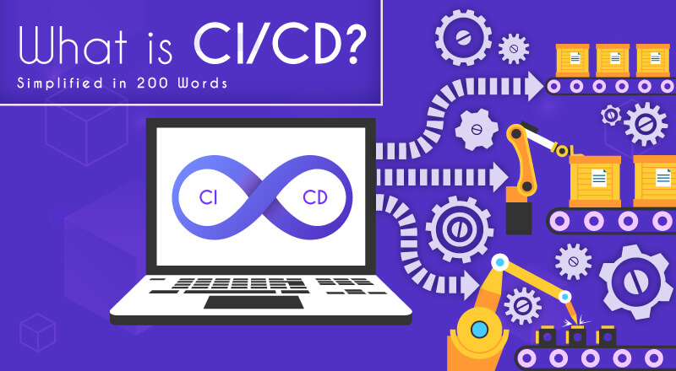
Revolutionizing
Udapeople
with CI/CD
Chu Nguyen Linh

Slide 2
OVERVIEW
What is CI / CD?
The CI / CD process
Benefit of CI / CD

Slide 3
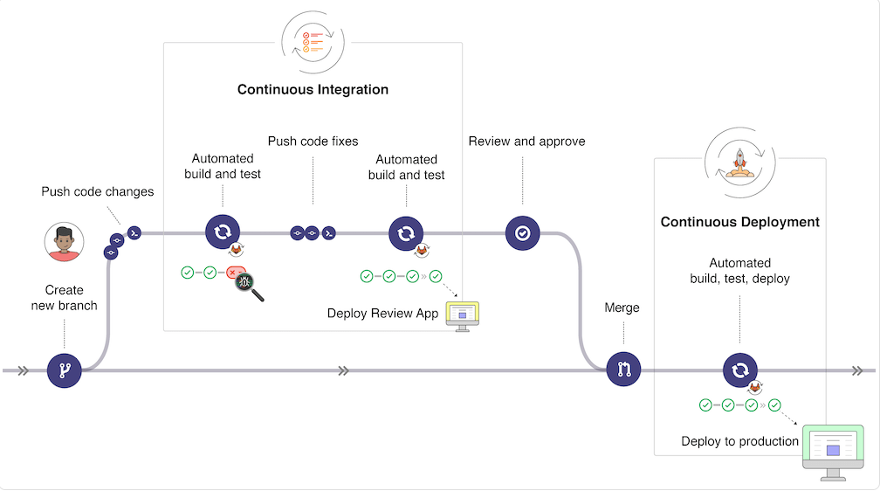


Slide 4
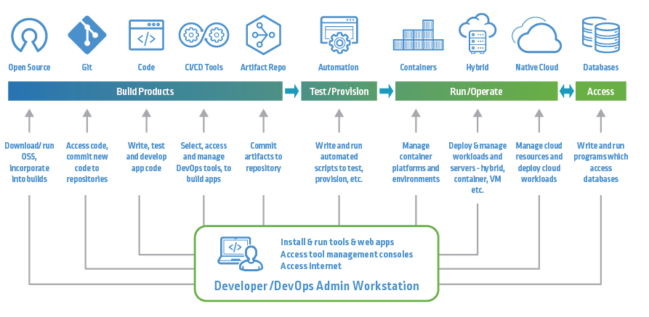
The CI/CD process

Slide 5









Slide 6

With continuous delivery, your team can automatically build, test, and prepare code changes for release to production, enabling a more efficient and rapid software delivery.
CI/CD practices improve your team’s productivity by freeing developers from manual tasks, reducing the number of errors and bugs deployed to customers.
With CI/CD, your team can perform more frequent and comprehensive testing and quickly identify and address bugs earlier.

Slide 7
Automation in the CI/CD pipeline minimizes the number of errors that can occur in the many repetitive steps of CI and CD.
Smaller code changes and quick fault isolation enabled by CI/CD practices reduce the Mean Time To Resolution (MTTR).
CI/CD promotes closer team communication by enabling development, operational, management, and QA teams to collaborate on technologies, practices, and priorities.
Continuous delivery enables faster and frequent delivery of updates to customers.

Slide 8


