Slide 1
Synthesis by Quartus

Slide 2
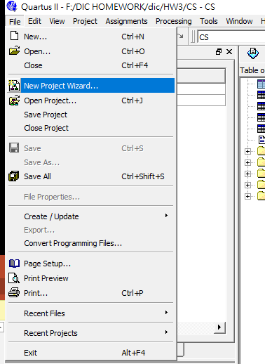
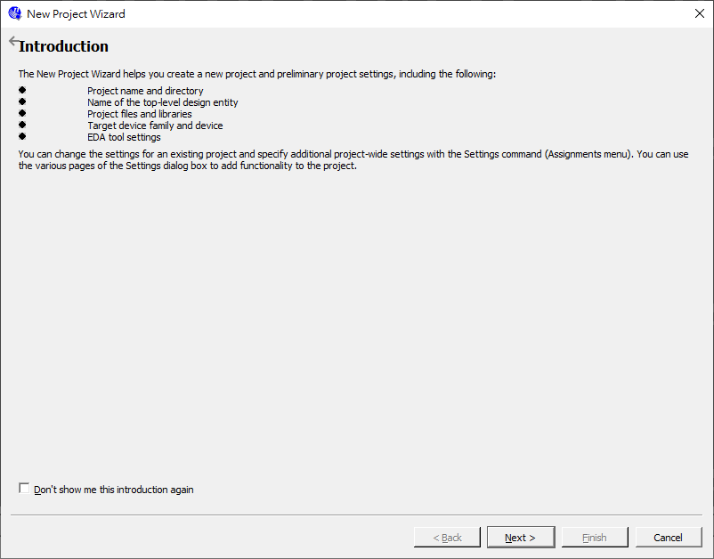
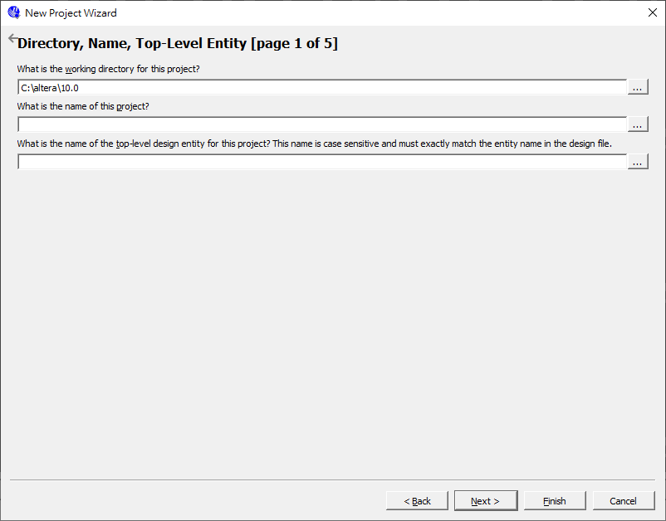
Synthesis by Quartus
Step1: Create a new project
File -> new project wizard
The project path
The project name should be
as same as the name of top module
Click here

Slide 3
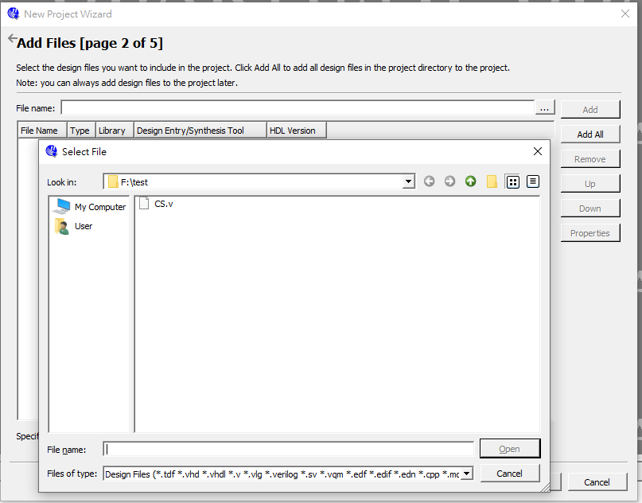
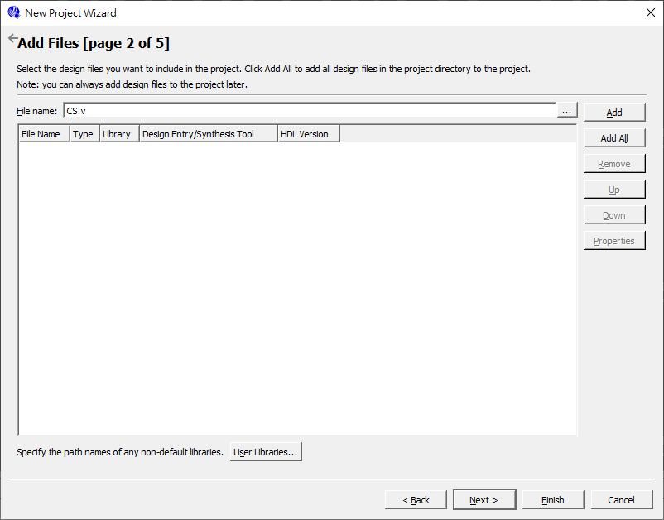
Synthesis by Quartus
Step1: Create a new project
Add the file excepting the testbench
Click here
Click here

Slide 4
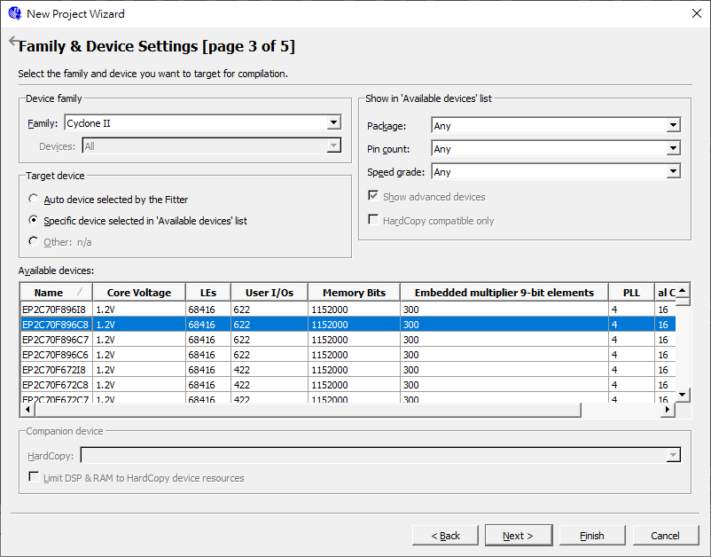
Synthesis by Quartus
Step2: Select the device : Cyclone II EP2C70F896C8

Slide 5
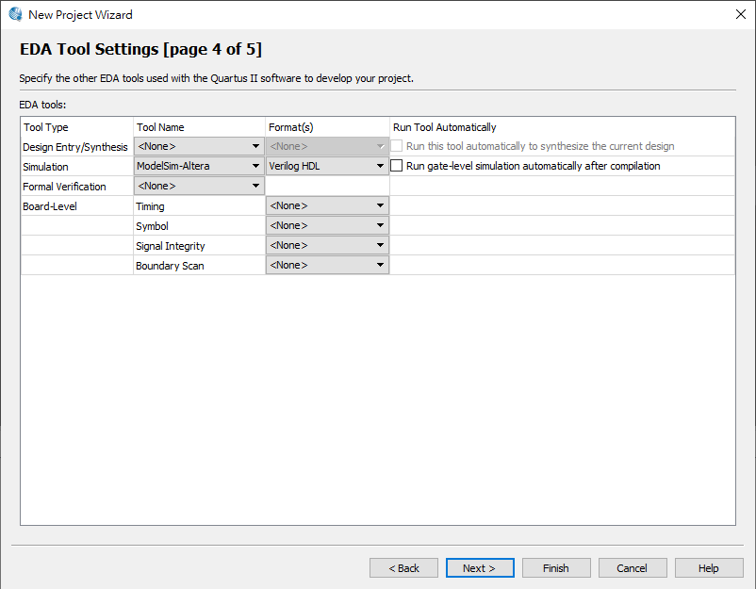
Synthesis by Quartus
Step 3 : Gate level simulation configuration
select ModelSim-Altera and Verilog HDL

Slide 6
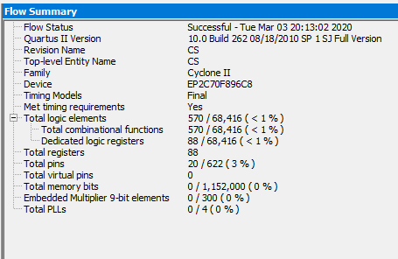
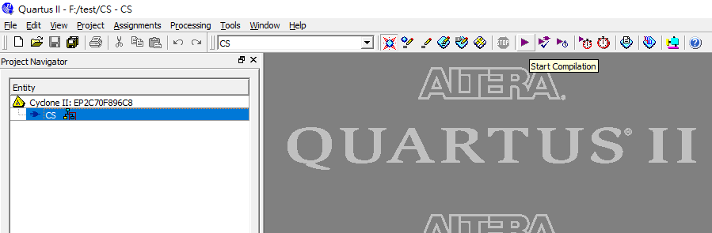
Synthesis by Quartus
Step 4 : compile and you will get the flow summary
Click here

Slide 7
Gate-Level Simulation by ModelSim

Slide 8
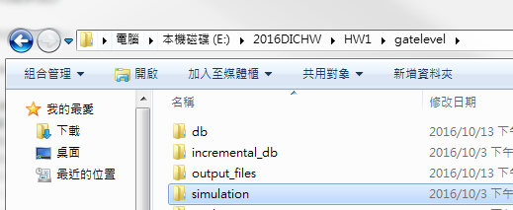
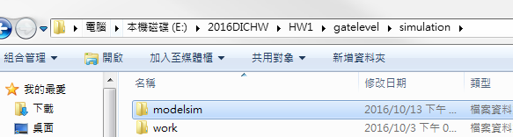
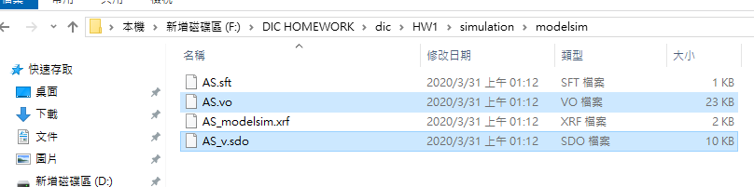
Gate-Level Simulation by ModelSim
Step 1 : the gate level file (*.vo,*.sdo) can be found in simulation/modelsim folder, and put them into modelsim project directory created in functional simulation section.
Simulation folder is in the Quartus project directory created in the synthesis section.

Slide 9
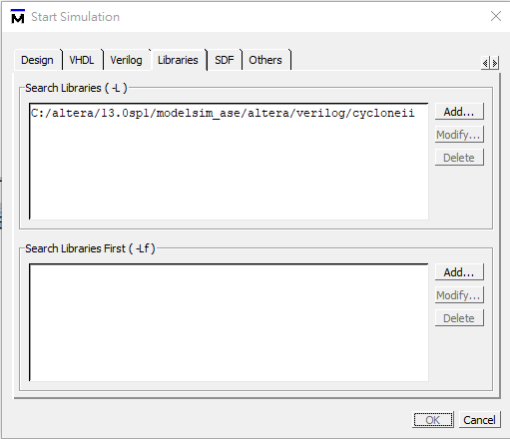
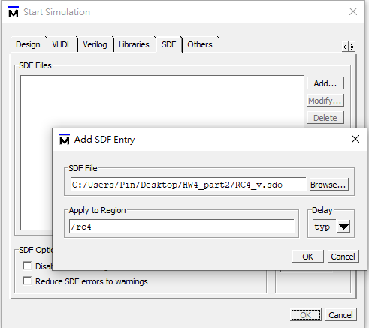
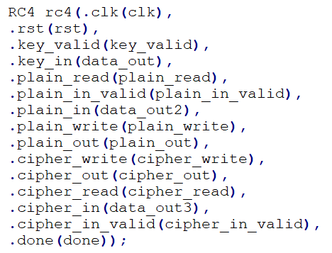
Gate-Level Simulation by ModelSim
Step 2: Gate Level Simulation (Simulate -> Start Simulation Window)
Add cycloneii to search libraries ( click Libraries to add )
your quartus installation disk/altera/13.0sp1/modelsim_ase/altera/Verilog/cycloneii
Add *.sdo to SDF Files and fill the instance name of your design in testbench.v in “apply to region” (click SDF to add)
Testbench file

Slide 10
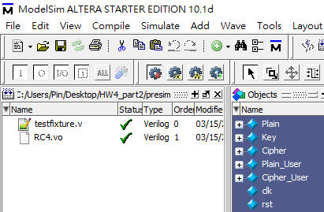
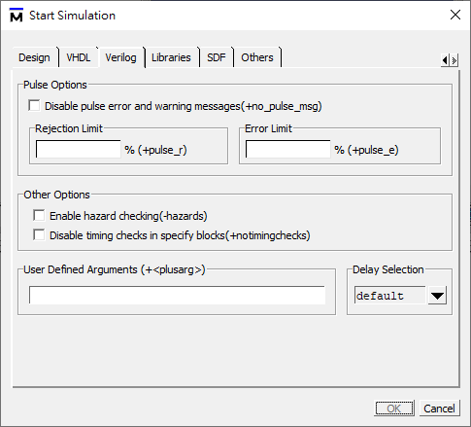
Gate-Level Simulation by ModelSim
Step 3 : gate level simulation
This time, use the *.vo for simulation ( Replace the original top_module.v with *.vo )
Repeat the steps in step 4 of functional simulation. ( Need to cancel the no timingchecks. )

