Slide 1
IoT COURSE PROJECT · 2026
Banking eKYC
Face-Recognition IoT System on Google Kubernetes Engine
Android · CameraX · ML Kit → Kong · FastAPI · Pub/Sub → DeepFace (ArcFace + Facenet512) → pgvector · FCM
SELF-ASSESSED
Yin Lin
100
Student · IoT: Communications and Networking
/ 100 marks

Slide 2
Problem & Motivation
Why a banking eKYC system is a perfect IoT-class project
◈
Remote onboarding
Banks need identity verification without a branch visit — the phone becomes the interface.
◉
The phone is the IoT sensor
Camera, touchscreen, microphone and network link — our IoT device is the customer's Android phone.
◆
Scale + cost matter
Many concurrent users, spiky traffic, and off-hours cost savings must all be handled by the cloud tier.
◎
Accuracy improves over time
User appearance drifts; the model must adapt per user without a full retrain or any downtime.
Banking eKYC · IoT Course Project · 2026
2

Slide 3
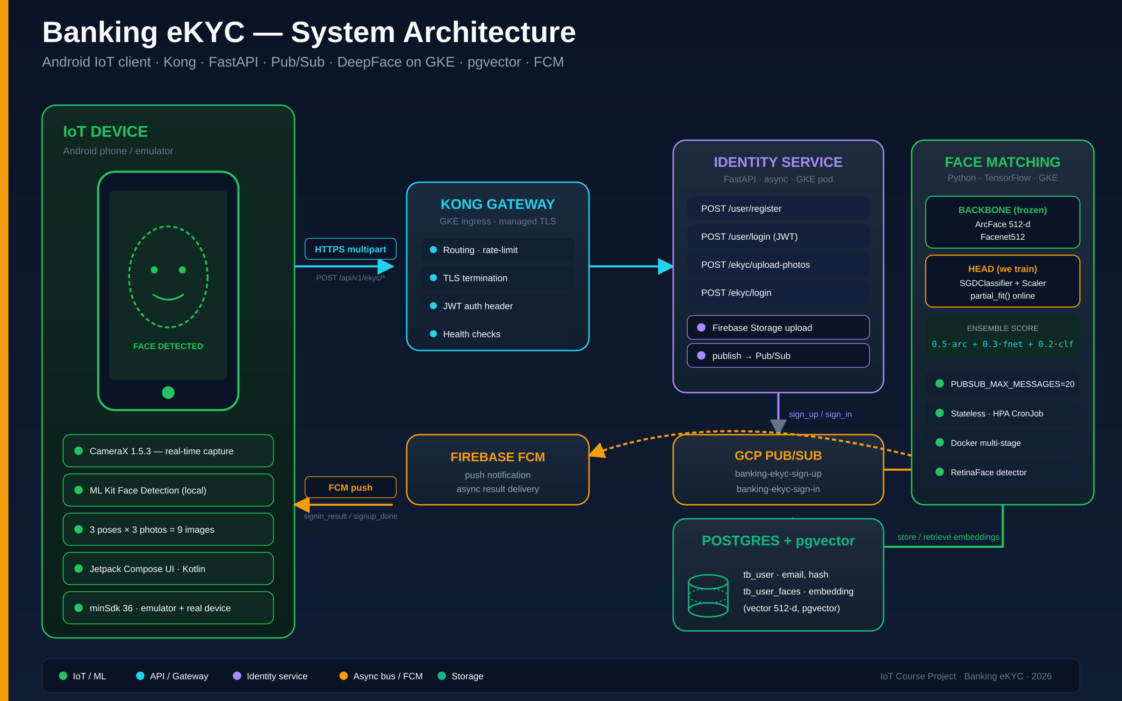
System Architecture
End-to-end request path from Android → Kong → FastAPI → Pub/Sub → DeepFace workers → FCM
Banking eKYC · IoT Course Project · 2026
3

Slide 4
Live Demo · Signup Flow
Real-time capture → 3 poses × 3 photos → multipart upload → enrolled
1
Launch & register
What the backend does
Email + password
POST /api/v1/ekyc/upload-photos
JWT verified · 9 multipart parts received
Photos persisted to Firebase Storage
Event published → banking-ekyc-sign-up
Worker pulls, runs DeepFace ensemble
512-d embedding stored in tb_user_faces
FCM push → device: 'eKYC complete'
2
Face scan — CENTER
ML Kit validates each frame
3
Face scan — LEFT
3 photos captured
4
Face scan — RIGHT
3 photos captured
5
Upload & push
Multipart POST + FCM 'enrolled'
Banking eKYC · IoT Course Project · 2026
4

Slide 5
Live Demo · Signin Flow
Single capture → ensemble match in the cloud → FCM result
1
Enter email
2
Capture face
3
Cloud match
4
FCM result
Device identifies user
Single front photo
Ensemble score computed
Push notification to device
Ensemble scoring — production code
final_score = 0.5 · ArcFace_dist + 0.3 · Facenet512_dist + 0.2 · (1 − classifier_proba)
MATCH ⇔ final_score < 0.50 (FINAL_THRESHOLD)
50%
30%
20%
ArcFace distance
Facenet512 distance
Classifier (1 − proba)
Banking eKYC · IoT Course Project · 2026
5

Slide 6
Criteria 1–3 · On the IoT Device
40 marks — capture, local inference, Android deployment
C1
10
C2
15
C3
15
marks
marks
marks
Collect user input
Infer locally + display
Runs on IoT device
CameraX 1.5.3 real-time capture
Phase-based: center / left / right
Touch to confirm, no stored input
ML Kit Face Detection on every frame
Bad captures rejected on-device
Result shown on-screen + FCM banner
Android app, minSdk 36
Android Studio emulator
Physical Android phone
FaceScanScreen.kt · FaceDetectionAnalyzer.kt
FaceScanScreen.kt :449–484
app/build.gradle.kts :17–18
Banking eKYC · IoT Course Project · 2026
6

Slide 7
Criteria 4–5 · On the Cloud
30 marks — cloud inference and IoT ↔ cloud communication
C4
10
C5
20
Run inference in cloud VM
IoT ↔ cloud comms (HTML path)
FastAPI async app, containerised multi-stage
Deployed to GKE in us-central1 Artifact Registry
DeepFace warms up ArcFace + Facenet512 on startup
RetinaFace detector · TensorFlow CPU
HTTPS multipart via Kong gateway
Google Cloud Managed TLS certificate
JWT-authenticated endpoints
Async FCM push back for inference result
face_matching/Dockerfile · embedding_service.py
AuthApiService.kt · ekyc_endpoints.py · ingress.yaml
Banking eKYC · IoT Course Project · 2026
7

Slide 8
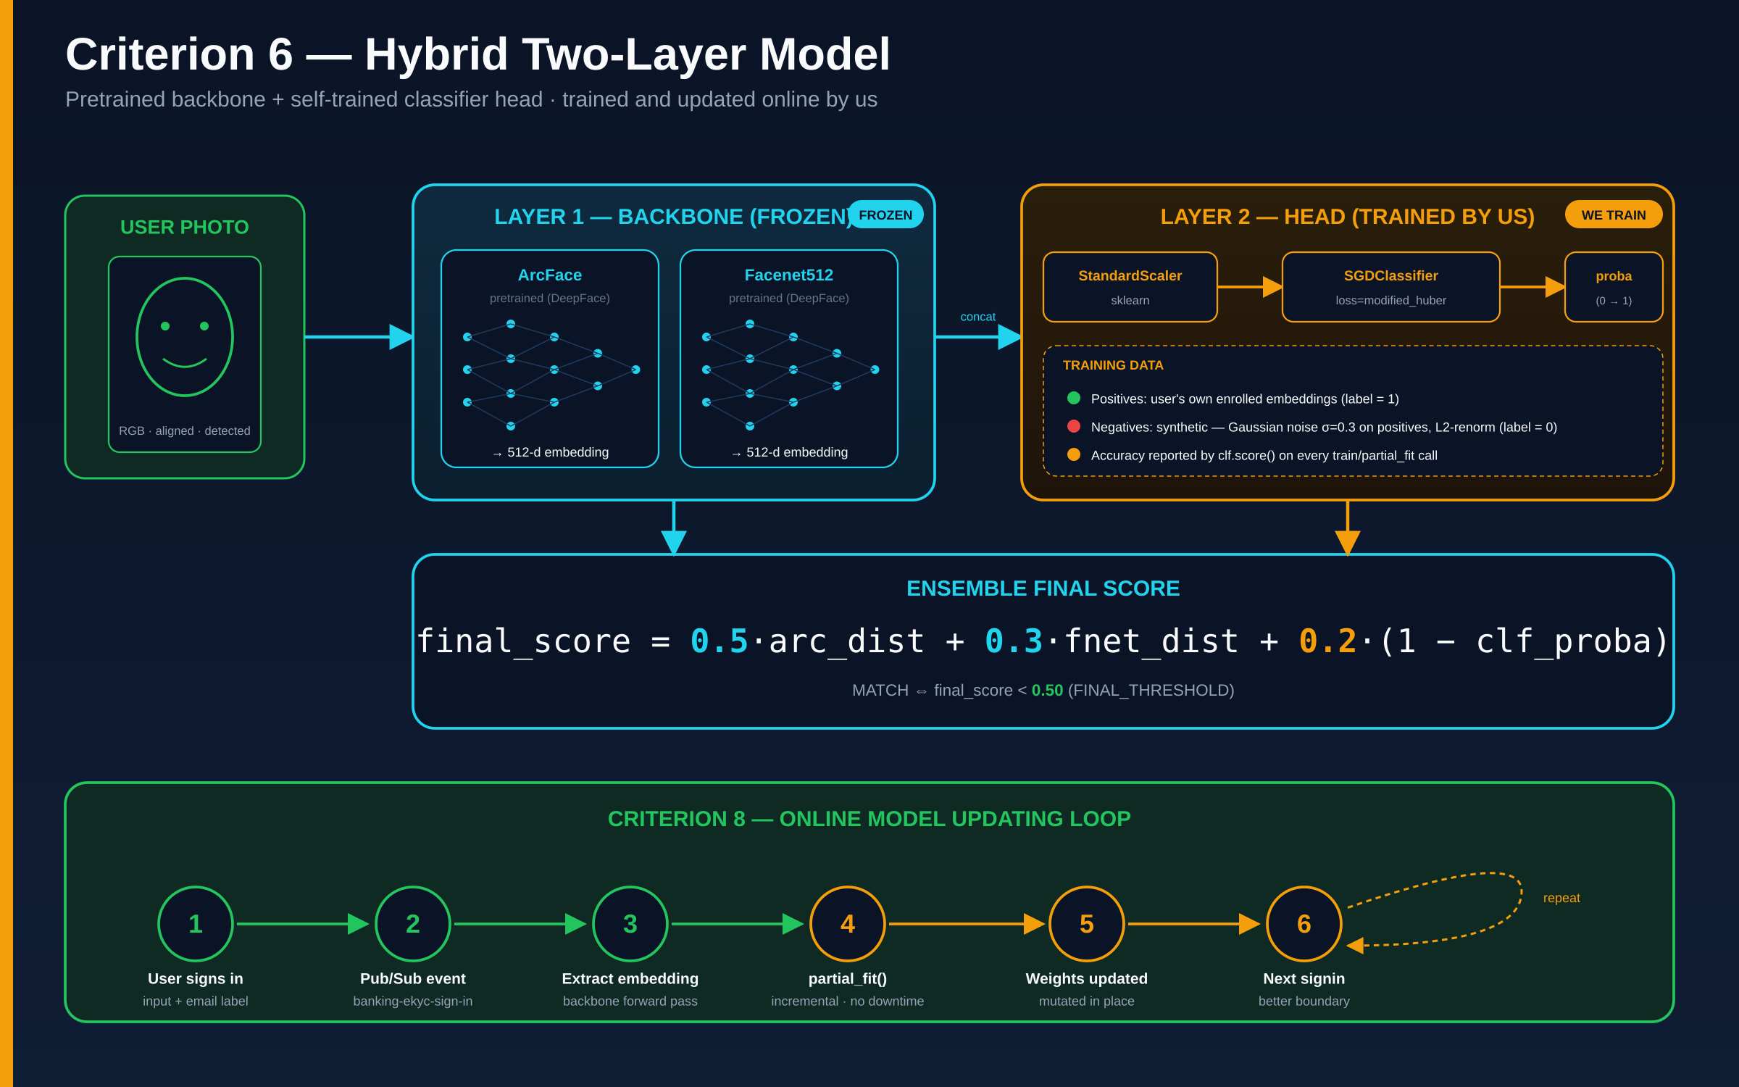
Criterion 6 · Train Your Own Model — Hybrid Two-Layer
10 marks — pretrained backbone + classifier head we train ourselves
Banking eKYC · IoT Course Project · 2026
8

Slide 9
Criterion 7 · Multiple Concurrent Users
10 marks — stateless pods, async I/O, Pub/Sub backpressure, horizontal scaling
Stateless pods
FastAPI async
Any replica can serve any request — shared state in Postgres
One pod multiplexes many in-flight uploads via asyncio event loop
Pub/Sub pull
HPA CronJob
PUBSUB_MAX_MESSAGES=20 in-flight per worker — built-in backpressure
Business-hours scale up, off-hours scale to zero — cost savings
Ready to scale: kubectl scale deploy/face-matching-signin --replicas=5 · no code change needed
Banking eKYC · IoT Course Project · 2026
9

Slide 10
Criterion 8 · Online Model Updating
10 marks — partial_fit() at runtime, no downtime, no file reload
classifier_service.py · partial_update()
Rubric alignment
def partial_update(self, positive_features):
if not self.is_trained:
self.train(positive_features); return
neg = self._generate_negative_samples(
positive_features)
features = np.vstack([positive_features, neg])
labels = np.array(
[1]*len(positive_features) + [0]*len(neg))
features_scaled = self.scaler.transform(features)
self.clf.partial_fit(features_scaled, labels)
"User input and label transmitted to cloud"
✓ signin photo + email go up on /ekyc/login
"The cloud retrains the model"
✓ partial_fit() mutates SGD weights live
No downtime
No file reload
Per-user boundary tightens over time
Banking eKYC · IoT Course Project · 2026
10

Slide 11
Summary · Rubric Mapping · Expected Score
All 8 criteria covered — defensible self-assessment
# | Criterion | Max | Ours
1 | Collect user input | 10 | 10
2 | Infer locally & display | 15 | 15
3 | Emulated / physical IoT device | 15 | 15
4 | Inference in cloud VM | 10 | 10
5 | Comms IoT ↔ cloud (HTML) | 20 | 20
6 | Train your own model (hybrid) | 10 | 10
7 | Multiple concurrent users | 10 | 10
8 | Online model updating | 10 | 10
EXPECTED SCORE
100
conservative 95 if hybrid rejected
Tech stack
Android · Kotlin · CameraX · ML Kit
FastAPI async · Kong · GKE
DeepFace (ArcFace + Facenet512)
scikit-learn · Pub/Sub · pgvector · FCM
TOTAL
100 / 100
Banking eKYC · IoT Course Project · 2026
11

