Slide 1
Odoo Coding Guidelines
Pham Thi Ngoc Mai

Slide 2
I. Introduction

Slide 3
1 - Why these?
Those aim to improve the quality of Odoo Apps code. Indeed proper code improves readability, eases maintenance, helps debugging, lowers complexity and promotes reliability.

Slide 4
2 - What these include?
Structure and naming conventions
Formating rule
Python standard
Programming in Odoo
Javascript & CSS
Git

Slide 5
3 - How?
Learn, Learn more, Noob forever?

Slide 6
II. Module structure

Slide 7
Directories
crm |-- data: demo and data xml |-- models: models def |-- controllers: HTTP routes |-- views: views and templates |-- static: web assets |-- security: access rights and record rules |-- report |-- security |-- tests |-- wizard |-- i18n: translations |-- __init__.py |-- __manifest__.py

Slide 8
File naming - models
models |-- crm_lead.py |-- crm_lost_reason.py |-- crm_stage.py |-- crm_team.py |-- res_partner.py |-- res_users.py ...
Split the business logic by sets of models belonging to a same main model

Slide 9
File naming - security
security |-- crm_security.xml |-- ir.model.access.csv

Slide 10
File naming - views
views |-- assets.xml |-- crm_lead_views.xml |-- crm_lost_reason_views.xml |-- crm_menu_views.xml |-- crm_stage_views.xml |-- crm_team_views.xml |-- res_partner_views.xml
backend views: <model>_views.xml
menus: <module>_menus.xml
templates: <model>_template.xml
bundles: assets.xml

Slide 11
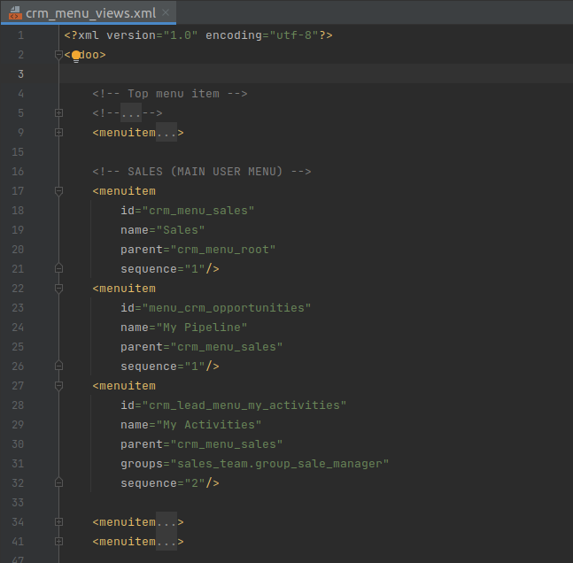
Views menu - CRM
crm_menu_views.xml

Slide 12
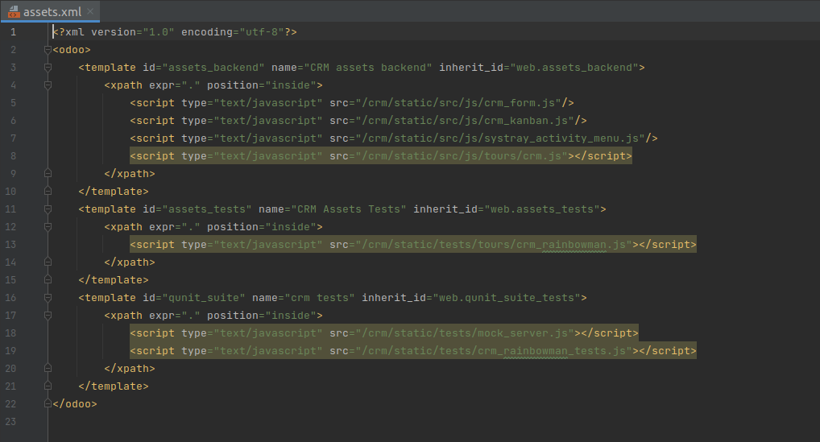
Views assets - CRM
crm/views/assets.xml

Slide 13
File naming - data
data |-- crm_lead_demo.xml |-- crm_lost_reason_data.xml |-- crm_stage_data.xml |-- crm_team_data.xml |-- crm_team_demo.xml ...
Split them by purpose:
demo: <model>_demo.xml
data: <model>_data.xml

Slide 14
File naming - controllers
outdated: main.py
now: <module_name>.py
inherit: <inherited_module_name>.py

Slide 15
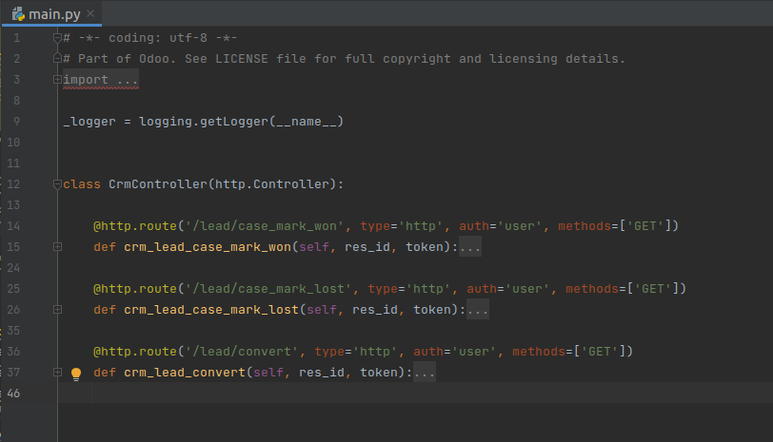
CRM Controllers

Slide 16
File naming - static
skip (->___->) ============>

Slide 17
File naming - wizard
wizard |-- crm_lead_lost.py |-- crm_lead_lost_views.xml |-- crm_lead_to_opportunity.py |-- crm_lead_to_opportunity_views.xml |-- crm_merge_opportunities.py |-- crm_merge_opportunities_views.xml

Slide 18
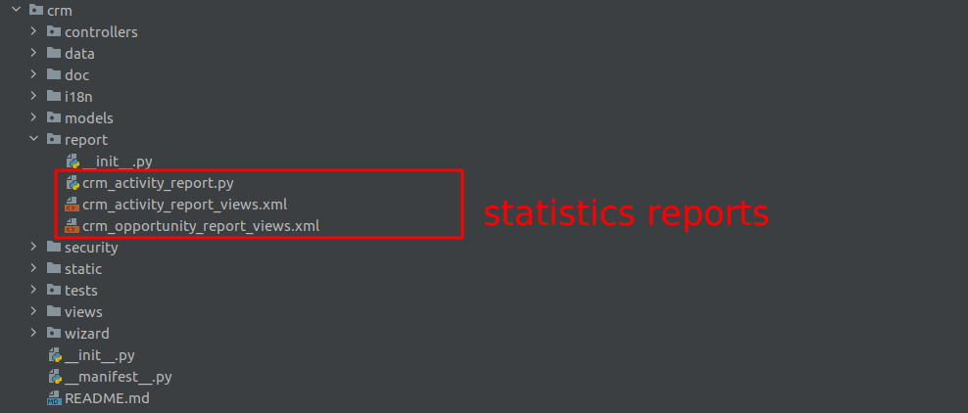
File naming - report
Statistics Reports

Slide 19
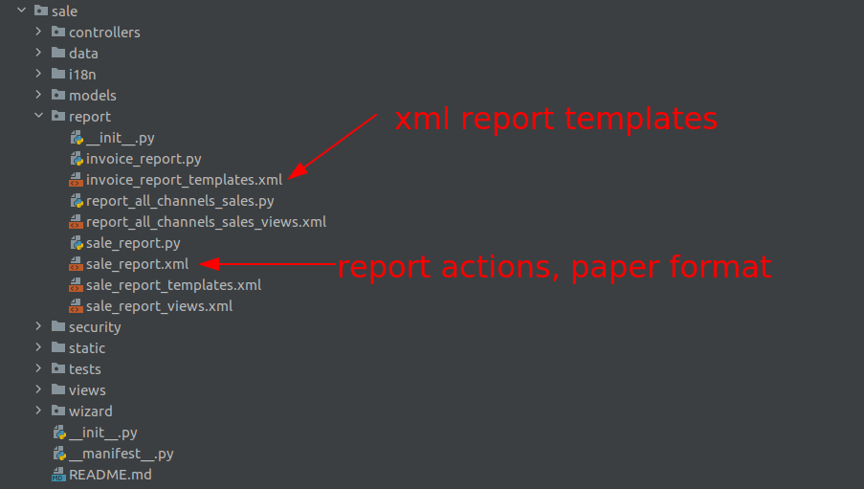
File naming - report
Printable Reports

Slide 20
File naming - Notes
NOTE: File names should only contain [a-z0-9_] (lowercase alphanumerics and _)

Slide 21
III. XML files

Slide 22
Format
id before model
fields: name then eval then others (widgets, options, …)
group records by model except dependencies between action/menu/views
naming convention (later)

Slide 23
Format
<record id="view_id" model="ir.ui.view"> <field name="name">view.name</field> <field name="model">object_name</field> <field name="priority" eval="16"/> <field name="arch" type="xml"> <tree> <field name="my_field_1"/> <field name="my_field_2" string="My Label" widget="statusbar" statusbar_visible="draft,sent,progress,done" /> </tree> </field> </record>

Slide 24
Format
syntactic sugar:
<menuitem>: ir.ui.menu
<template>: arch section of qweb view
<report>: report action (old)
<act_window>: action window (old)

Slide 25
XML IDs and naming
Security, View and Action
menu: <model_name>_menu.xml
submenu: <model_name>_menu_do_stuff.xml
<!-- menus and sub-menus --> <menuitem id="model_name_menu_root" name="Main Menu" sequence="5" /> <menuitem id="model_name_menu_action" name="Sub Menu 1" parent="module_name.module_name_menu_root" action="model_name_action" sequence="10" />
Security, View and Action
view: <model_name>_view_<view_type>
<!-- views --> <record id="model_name_view_form" model="ir.ui.view"> <field name="name">model.name.view.form</field> ... </record> <record id="model_name_view_kanban" model="ir.ui.view"> <field name="name">model.name.view.kanban</field> ... </record>
Security, View and Action
action: <model_name>_action
<!-- actions --> <record id="model_name_action" model="ir.act.window"> <field name="name">Model Main Action</field> ... </record> <record id="model_name_action_child_list" model="ir.actions.act_window"> <field name="name">Model Access Children</field> </record>
Security, View and Action
group: <module_name>_group_<group_name>
rule: <model_name>_rule_<concerned_group>
<!-- security --> <record id="module_name_group_user" model="res.groups"> ... </record> <record id="model_name_rule_public" model="ir.rule"> ... </record> <record id="model_name_rule_company" model="ir.rule"> ... </record>

Slide 26
Inheriting XML
name: suffix .inherit.{detail}
<record id="model_view_form" model="ir.ui.view"> <field name="name">model.view.form.inherit.module2</field> <field name="inherit_id" ref="module1.model_view_form"/> ... </record> <record id="module2.model_view_form" model="ir.ui.view"> <field name="name">model.view.form.module2</field> <field name="inherit_id" ref="module1.model_view_form"/> <field name="mode">primary</field> ... </record>

Slide 27
IV. Python

Slide 28
PEP8 options
Odoo source code tries to respect Python standard, but some of them can be ignored.

Slide 29
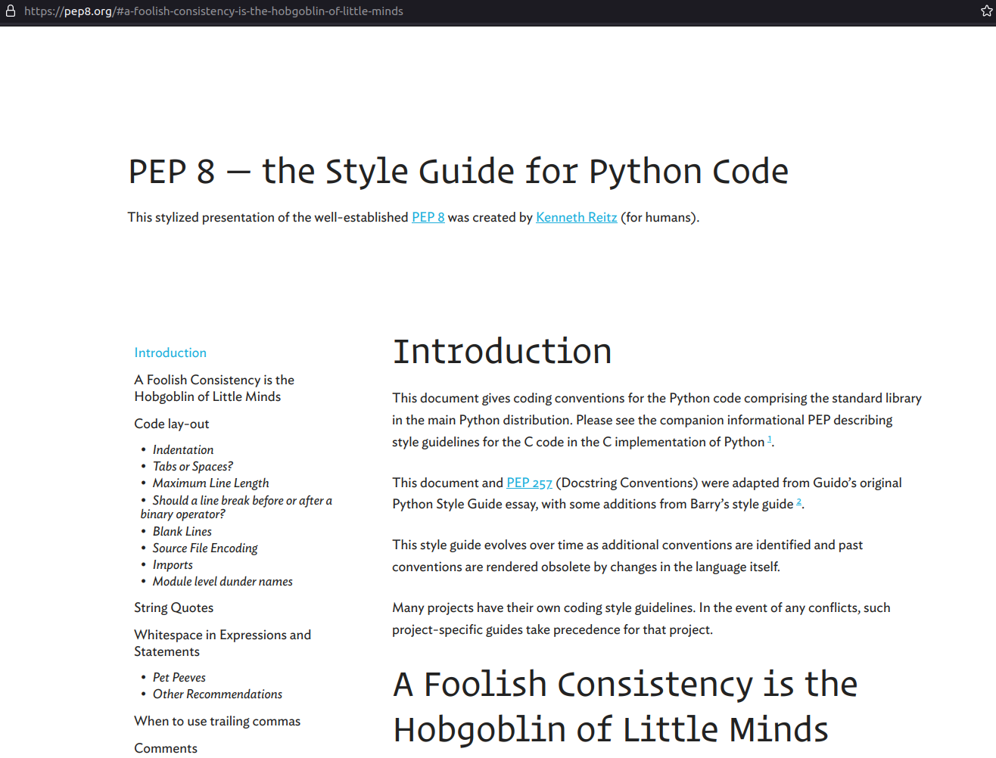
PEP8

Slide 30
Imports
# 1 : imports of python lib import base64 import re import time from datetime import datetime # 2 : imports of odoo import odoo from odoo import api, fields, models, _ from odoo.tools.safe_eval import safe_eval as eval # 3 : imports from odoo addons from odoo.addons.website.models.website import slug

Slide 31
Idiomatics of Programming (Python)
>>> import this The Zen of Python, by Tim Peters Beautiful is better than ugly. Explicit is better than implicit. Simple is better than complex. Complex is better than complicated. Flat is better than nested. Sparse is better than dense. Readability counts. Special cases aren't special enough to break the rules. Although practicality beats purity. Errors should never pass silently. Unless explicitly silenced. ...

Slide 32
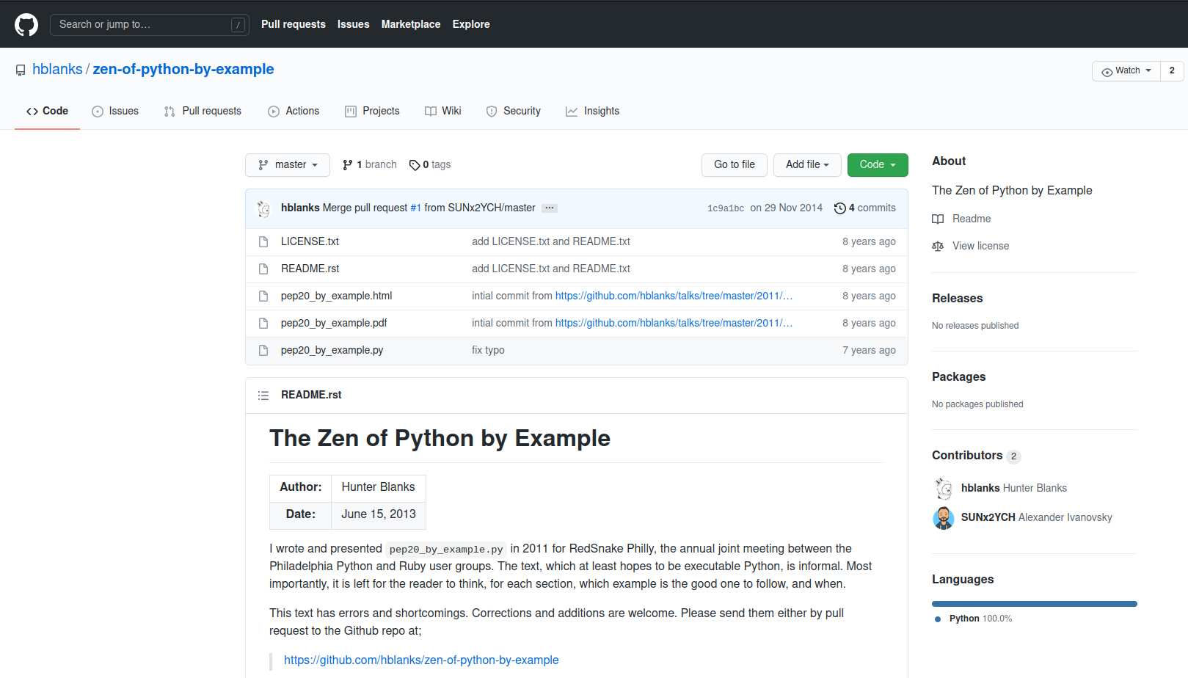
Idiomatics of Programming (Python)
The Zen of Python by Examples

Slide 33
Idiomatics of Programming (Python)
Use meaningful variable/class/method names
Useless variable
Know your builtins
Use list comprehension, dict comprehension, and basic manipulation using map, filter, sum, … They make the code easier to read.
Collections are booleans too

Slide 34
Idiomatics of Programming (Python)
You can’t learn to write good code only by following the rules.
To learn to write good code you have to write a shit-metric-ton of bad code. —- Going beyond the idiomatic Python

Slide 35
Programming in Odoo
Avoid to create generators and decorators
Use filtered, mapped, sorted, … methods to ease code reading and performance.

Slide 36
Programming in Odoo
Make your method work in batch
@api.depends('user_id') def _compute_date_open(self): for lead in self: lead.date_open = fields.Datetime.now() if lead.user_id else False

Slide 37
Programming in Odoo
Propagate the context
Passing parameter in context can have dangerous side-effects.
If you need to create a key context influencing the behavior of some object, choice a good name, and eventually prefix it by the name of the module to isolate its impact.

Slide 38
Programming in Odoo
Keep it Simple and Stupid
Split the method as soon as it has more than one responsibility
Never commit the transaction
You should NEVER call cr.commit() yourself, UNLESS…
Use translation method correctly

Slide 39
Symbols and Conventions
Variables
model name: singular form
suffix your variable name with _id or _ids if it contains a record id or list of id
Partner = self.env['res.partner'] partners = Partner.browse(ids) partner_id = partners[0].id

Slide 40
Symbols and Conventions
Variables
One2Many and Many2Many fields should always have _ids as suffix
Many2One fields should have _id as suffix

Slide 41
Symbols and Conventions
Method conventions
compute field: _compute_<field_name>
onchange method: _onchange_<field_name>
constraint method: _check_<constraint_name>

Slide 42
Symbols and Conventions
Model attribute order

Slide 43
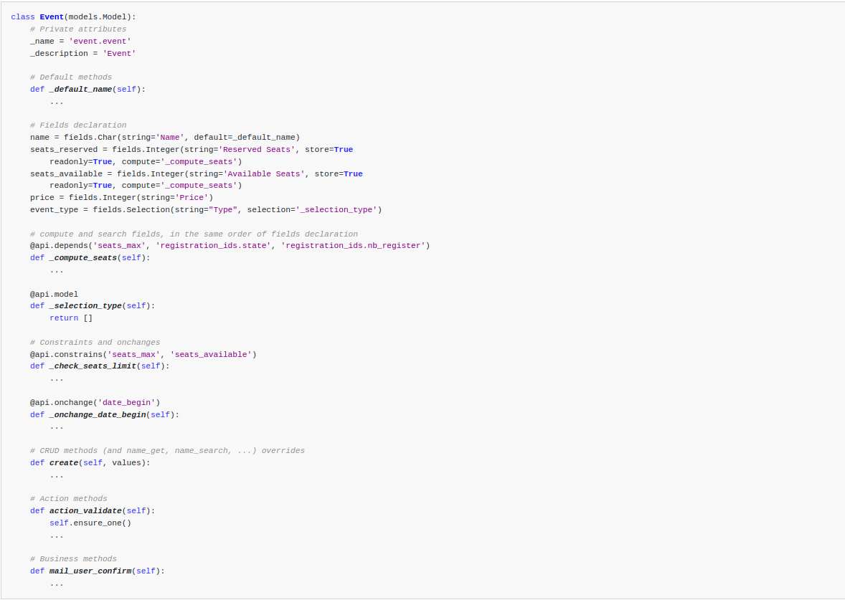
Attribute order in a model

