Slide 1
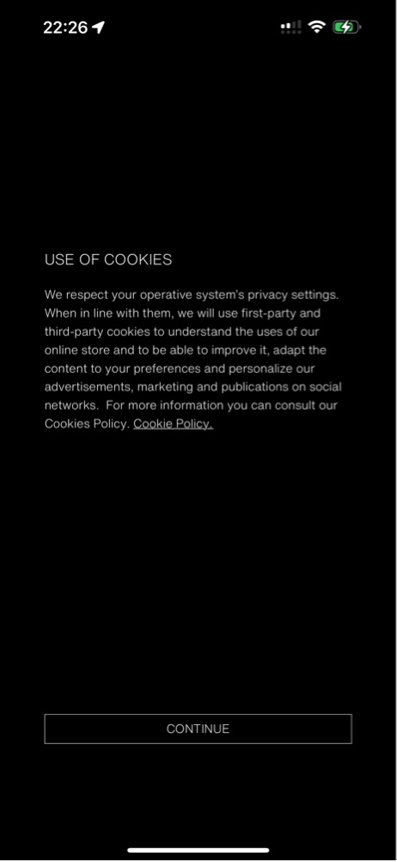
Zara app - Account & Returns redesign
UX AUDIT Â· FOLLOW-UP | ACCOUNT & RETURNS (PROBLEMS 21-28)
Granular consent, clear sign-in pathways, and a 4-step guided returns wizard.
Dang Trung Hieu Â· 20225003
Designing User Interfaces Â· Prof. Gerrit Meixner Â· HHN x VGU
Notes:
Redesign of the Account Lifecycle, Returns & Help Systems (problems 21-28). Every screen uses our audit findings and standardized UI tokens. 1

Slide 2
Eight audit problems, eight fixes
# | Problem in the audit | Severity | What the redesign changes
21 | First-Launch Cookie consent dark pattern | â—â—â—‹ Medium | Add prominent 'REJECT NON-ESSENTIAL' alongside 'ACCEPT ALL' (48 px) and a 3-tier granular privacy toggle center.
22 | Ambiguous Sign-in vs Register flow | â—â—â—‹ Medium | Separate 'LOG IN' and 'REGISTER' into distinct tabs; eliminate single-field guessing before typing.
23 | No inline validation checkmarks or hints | â—â—â—‹ Medium | Provide contextual input hints (RFC 5322) and dynamic instant green checkmarks upon typing a valid email.
24 | Raw OTP modal & no password meter | â—â—â— High | Integrate a dynamic 3-tier password strength bar and replace unstyled alert modals with inline OTP error recovery.
25 | Account menu touch targets < 32px | â—â—‹â—‹ Low | Enlarge row touch boundaries to 48 dp with chevron indicators; eliminate active dot collision on 'ACCOUNT'.
26 | Static empty returns state without stepper | â—â—â— High | Replace empty dead-end with a 4-step visual returns stepper, 30-day countdown badge, and drop-off map locator.
27 | Help search low contrast over photo | â—â—â—‹ Medium | Darken background scrim to ensure WCAG 4.5:1 contrast behind search; add fallback to 24/7 Live Support Chat.
28 | Inconsistent button styles across 6+ tokens | â—â—â—‹ Medium | Normalize into a 3-tier design system: Primary Solid White (48px), Secondary Outline (48px), Tertiary Ghost (44px min).
Notes:
Severity levels match our Report 1 heuristic audit. Touch targets are brought up to Apple HIG / Material Design standards (min 44-48 dp). 2

Slide 3
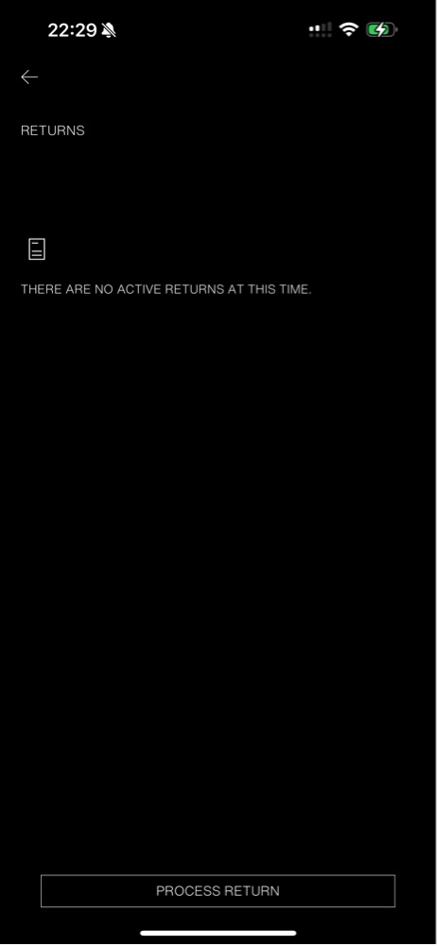
Account & returns: before and after
BEFORE Â· ORIGINAL
AFTER Â· REDESIGNED
21
Granular consent & privacy controls
Faint outline replaced by equal 48px Accept/Reject buttons and 3-tier category toggles.
23
22
Distinct Log in & Register pathways
Dedicated tabs eliminate guessing whether an account exists prior to submission.
21
23
Real-time inline checkmarks
Green checkmarks and RFC 5322 hints prevent silent registration failures.
24
24
Dynamic password meter & inline OTP
3-tier strength bar and non-blocking inline error recovery replace generic pop-ups.
22
25
25
48 dp account rows & fixed nav dot
Generous touch borders prevent mis-taps; active dot repositioned below label.
26
4-step guided returns wizard
Sequential stepper with 30-day countdown badge and embedded drop-off map locator.
26
Notes:
Numbers match the problem numbers in our audit (21-28). All 8 issues are directly addressed in our unified design system. 3

Slide 4
Clear consent & privacy control: from forced accept to granular choice
BEFORE Â· FORCED DARK PATTERN
AFTER Â· DEFAULT MODAL
AFTER Â· GRANULAR SETTINGS
48 px
touch height on both buttons, ensuring equal visual affordance and ending deceptive dark patterns.
Equal Affordance: 'Reject Non-Essential' shares identical 48px hit boundaries with 'Accept All'.
Granular Toggles: Users control Functional and Analytics cookies independently complying with GDPR.
Safe Exit: Transparent disclosures with clear affirmative consent and safe exit options.
Notes:
Directly resolves Issue 21. Complies with GDPR Art. 7(3) and Nielsen Heuristic #3 (User Control and Freedom). 4

Slide 5
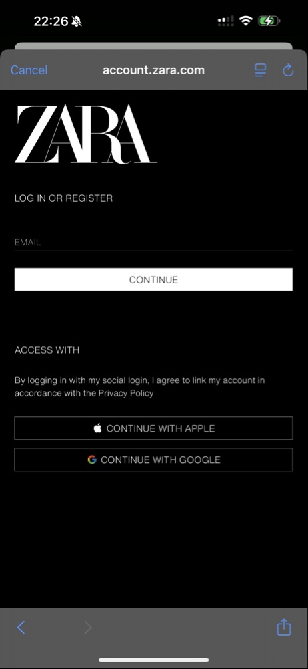
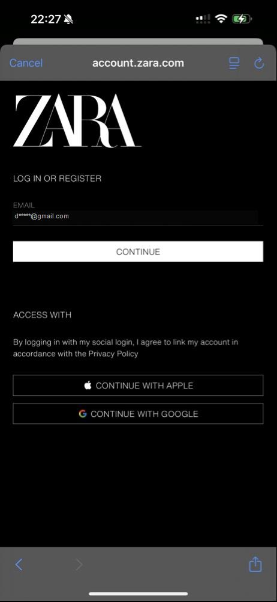
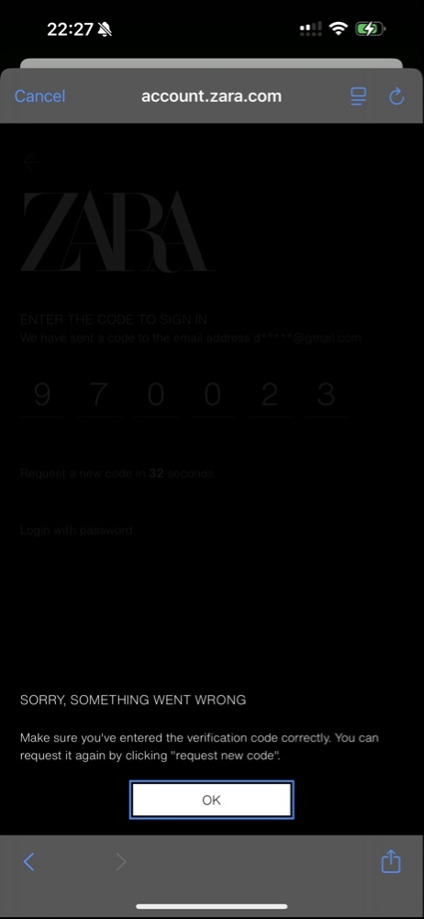
Authentication & verification: from blind guessing to instant feedback
BEFORE
Single ambiguous field
AFTER
Tabbed Onboarding
AFTER
Live Checkmark
AFTER
Password & OTP
Two distinct paths. Dedicated Log In and Register tabs eliminate cognitive friction before typing.
Instant feedback. Green checkmark confirms RFC 5322 email syntax immediately upon typing.
Dynamic guidance. 3-tier password strength bar and inline non-blocking OTP error recovery.
Notes:
Resolves Issues 22, 23, and 24. Implements Input Hints (p.489) and Password Strength Meter (p.497) patterns. 5

Slide 6
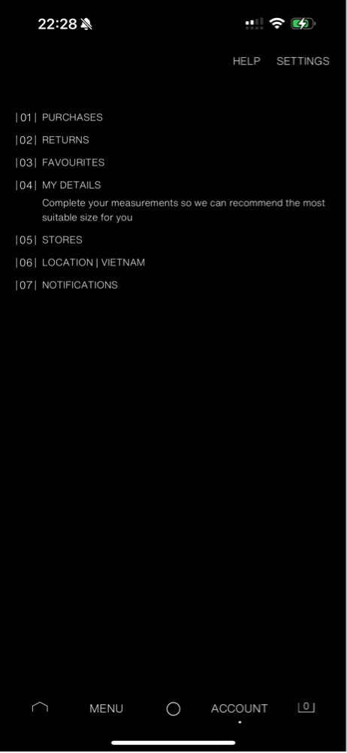
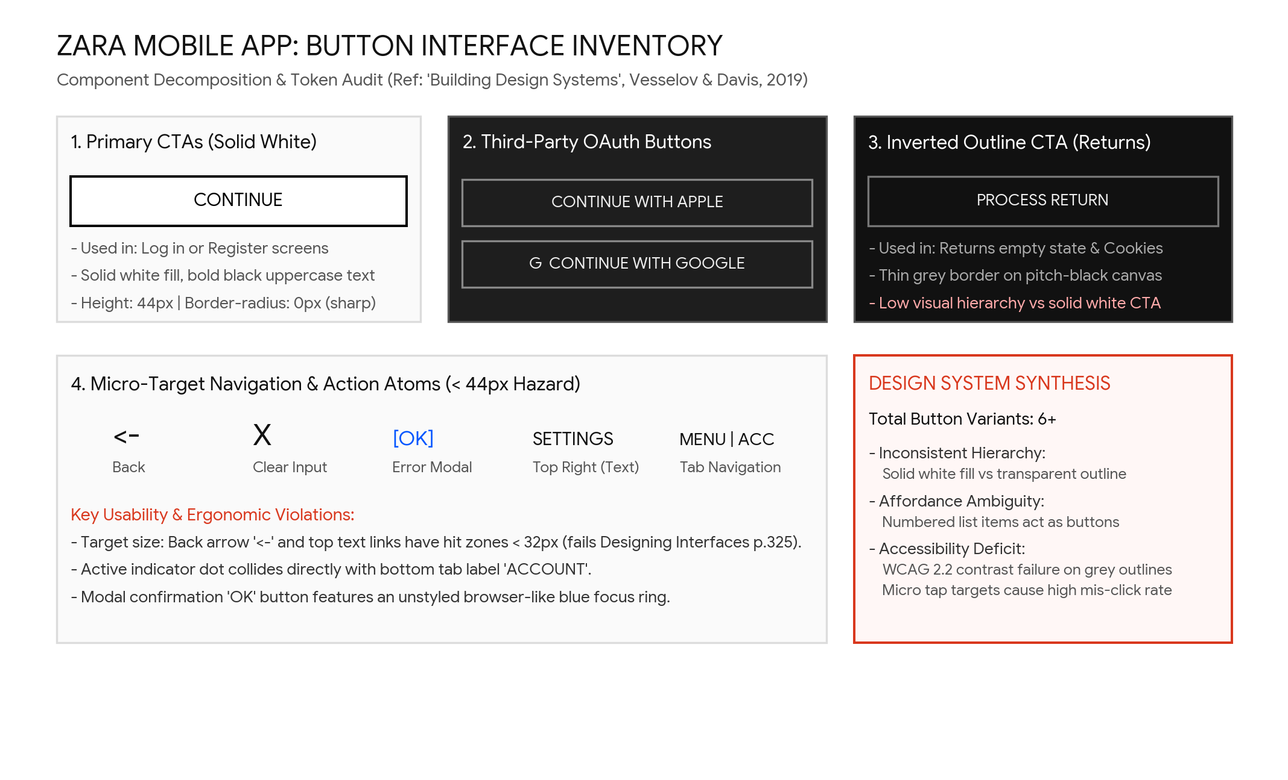
Returns wizard & button tokens: from empty dead-end to guided flow
BEFORE Â· STATIC EMPTY DEAD-END
AFTER Â· 4-STEP GUIDED STEPPER
Before: Static 'No returns' label leaves customers stranded without a sequential timeline.
After: 4-step sequential stepper (Items -> Reason -> Drop-off -> QR Code) with 30-day countdown.
Token System: Normalized 3-tier buttons (Primary 48px, Secondary 48px, Tertiary 44px) resolve text collisions.
Notes:
Resolves Issues 25, 26, 27, and 28. Implements Visual Framework (p.228) and Generous Borders (p.325). 6

Slide 7
Next: test old vs new
Usability test (Report 3 protocol)
Notes on this mock-up
Standardized benchmark tasks: T1 Cookie preferences, T2 Tabbed auth & OTP, T3 4-step returns flow.
Compare completion rate (target >= 90%), time on task (-35%), error frequency, and SUS score (>= 80).
Check consent: do users notice the equal 48px Reject button and understand granular toggles?
Check returns: does the 4-step stepper and map locator reduce dropout and cognitive hesitation?
All baseline screens come directly from our empirical audit (screenshots M5-01 through M5-09).
Redesigned mock-ups preserve Zara monochrome brand language while strictly adhering to WCAG 2.2 AA.
Standardized 48 dp touch boundaries eliminate mis-taps on one-handed mobile navigation.
Ready for the Report 3 iterative evaluation loop: What failed -> What changed -> Final design.
Notes:
Evaluation framework prepared for user testing in Report 3 to validate empirical improvements. 7

