Slide 1
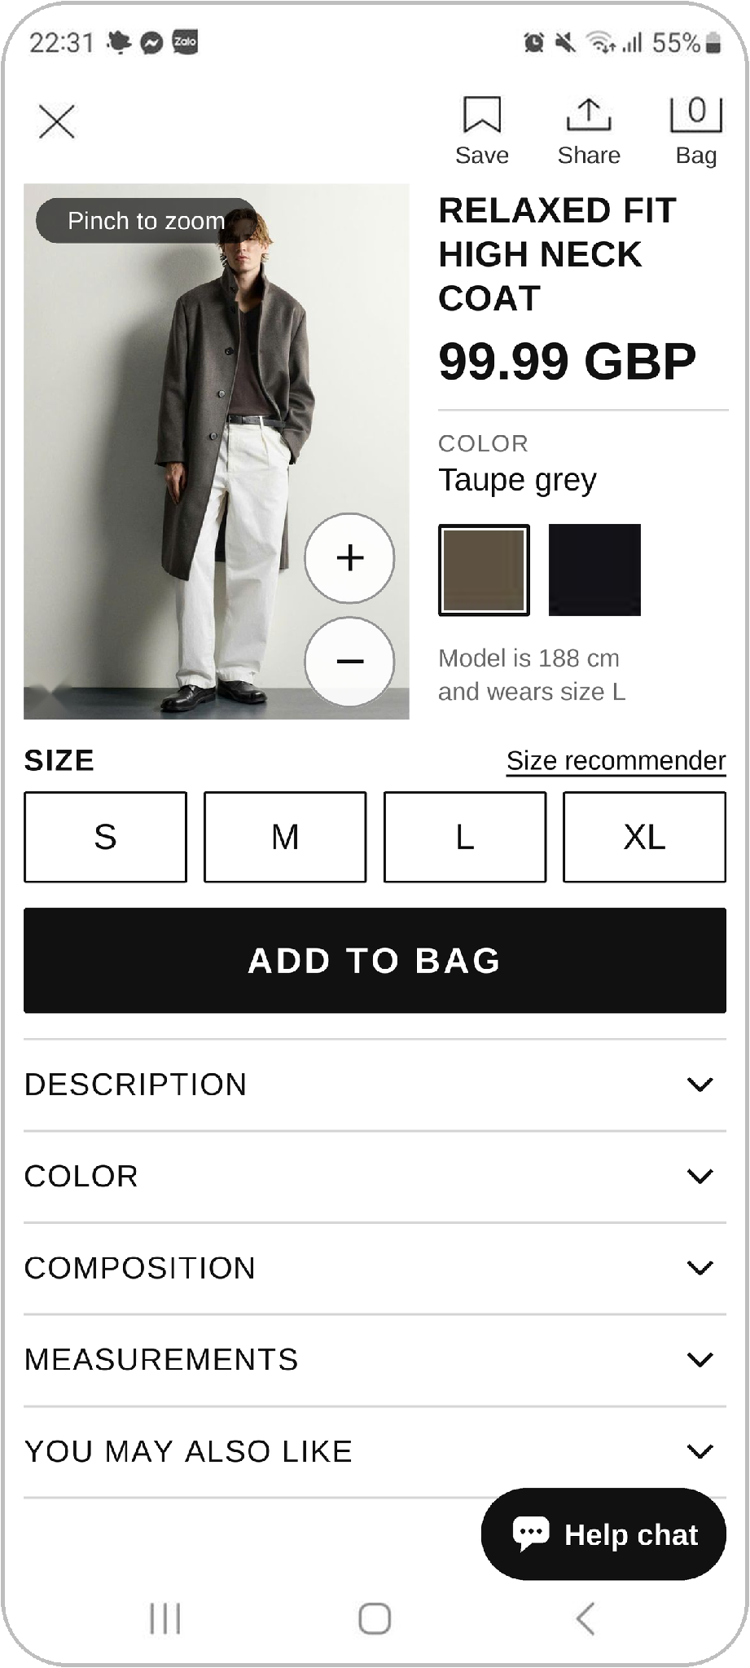
Zara app — Product page redesign
UX AUDIT · FOLLOW-UP | PRODUCT PAGE (PROBLEMS 11–16)
A smaller, zoomable photo; bigger and clearer product info; details that open one at a time.
Pham Chi Thuan · 20225018
Designing User Interfaces · Prof. Gerrit Meixner · HHN × VGU
Notes:
Redesign of the Product page part of our Zara UX audit (problems 11–16). Every screen uses our own screenshots.

Slide 2
Six audit problems, six fixes
# | Problem in the audit | Severity | What the redesign changes
11 | Photo hides price and colour | ●●○ Medium | Photo shrinks from 60% to 32% of the screen height and can be zoomed. Name, price and colours sit beside it, about 1.8× larger (swatches 2–3× larger).
12 | Weak “ADD” button | ●●● High | Solid black, full-width “ADD TO BAG” button, 88 px high (was a 60 px thin outline with a vague label).
13 | Top icons have no labels | ●●○ Medium | “Save · Share · Bag” labels under each icon; every icon has a 44 dp touch area.
14 | Sizes hidden inside the ADD sheet | ●●● High | S · M · L · XL buttons sit on the page, above ADD, with a “Size recommender” link and the model’s size (188 cm, L).
15 | Material and size info buried | ●●○ Medium | Description, Color, Composition and Measurements are collapsible rows with chevrons. Only one is open at a time.
16 | Small touch targets, no help chat | ●○○ Low | Buttons, swatches and rows are at least 44 dp; “+” quick-add enlarged; a floating “Help chat” button is added.
Notes:
Severity levels are the ones from our audit. Sizes are measured on the 630 × 1400 px screenshots (1.75 px per dp).

Slide 3
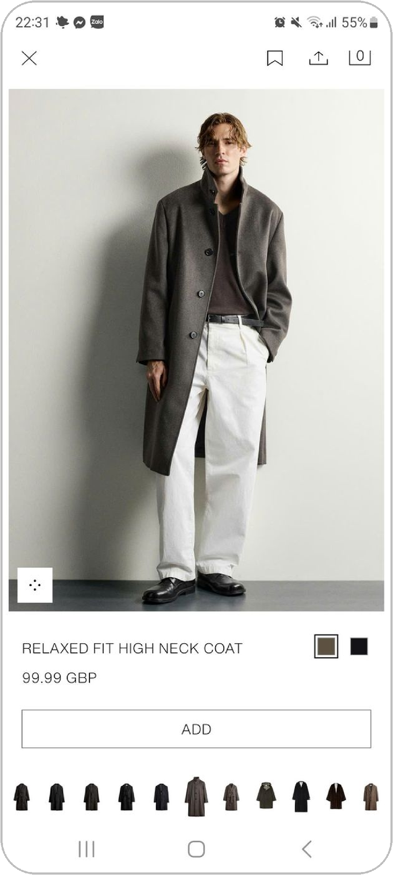
Product page: before and after
BEFORE · ORIGINAL
AFTER · REDESIGNED
11
Photo smaller, product info beside it
Photo 60% → 32% of the screen; pinch, double-tap or +/− to zoom. Name, price and colours are larger and next to the photo.
13
12
Strong “ADD TO BAG”
Solid black, full width, white bold text. It now reads as the main action.
11
13
Labelled top icons
Save · Share · Bag under each icon.
14
14
Sizes visible before ADD
S · M · L · XL buttons plus “Size recommender” and the model’s size.
12
15
15
Details open one at a time
Description, Color, Composition, Measurements, You may also like.
16
Bigger targets, help chat
Controls ≥ 44 dp and a floating “Help chat” button.
16
Notes:
Numbers match the problem numbers in the audit (11–16). The photo is the real product photo from our screenshot.

Slide 4
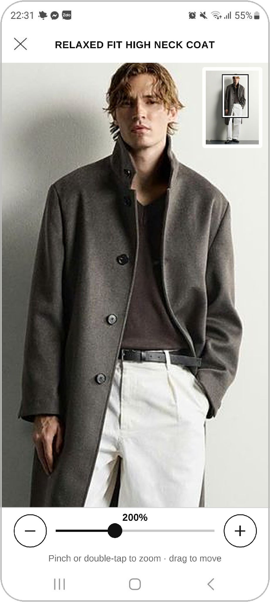
A smaller photo you can zoom
BEFORE · ORIGINAL
AFTER · REDESIGNED
60% → 32%
of the screen height is used by the photo, so name, price, colours, sizes and ADD fit in the same frame.
Three ways to zoom: pinch, double-tap, or the + / − buttons on the photo.
Never lost: the zoomed view has a mini-map of the full photo and a slider.
Clear hint: a “Pinch to zoom” label replaces the unlabelled expand icon.
Notes:
The zoomed view is cut from the same photo in our screenshot, so it is softer than a real high-resolution image would be.

Slide 5
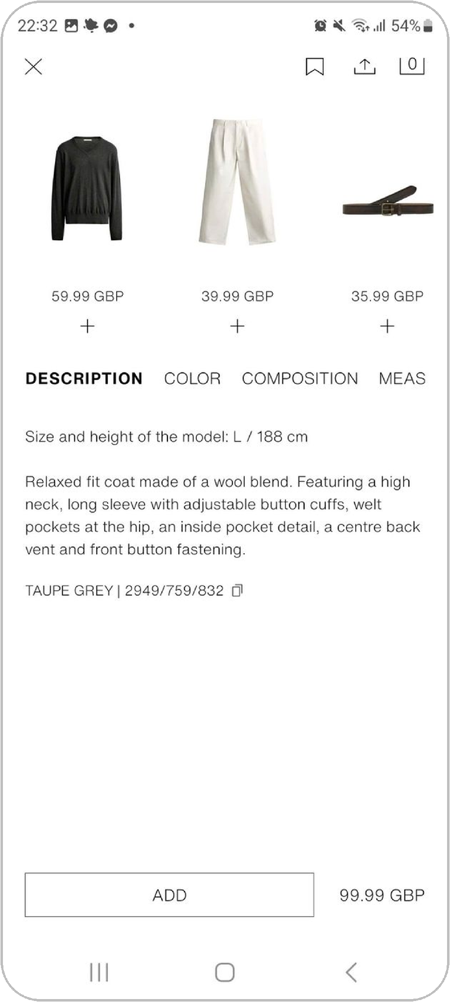
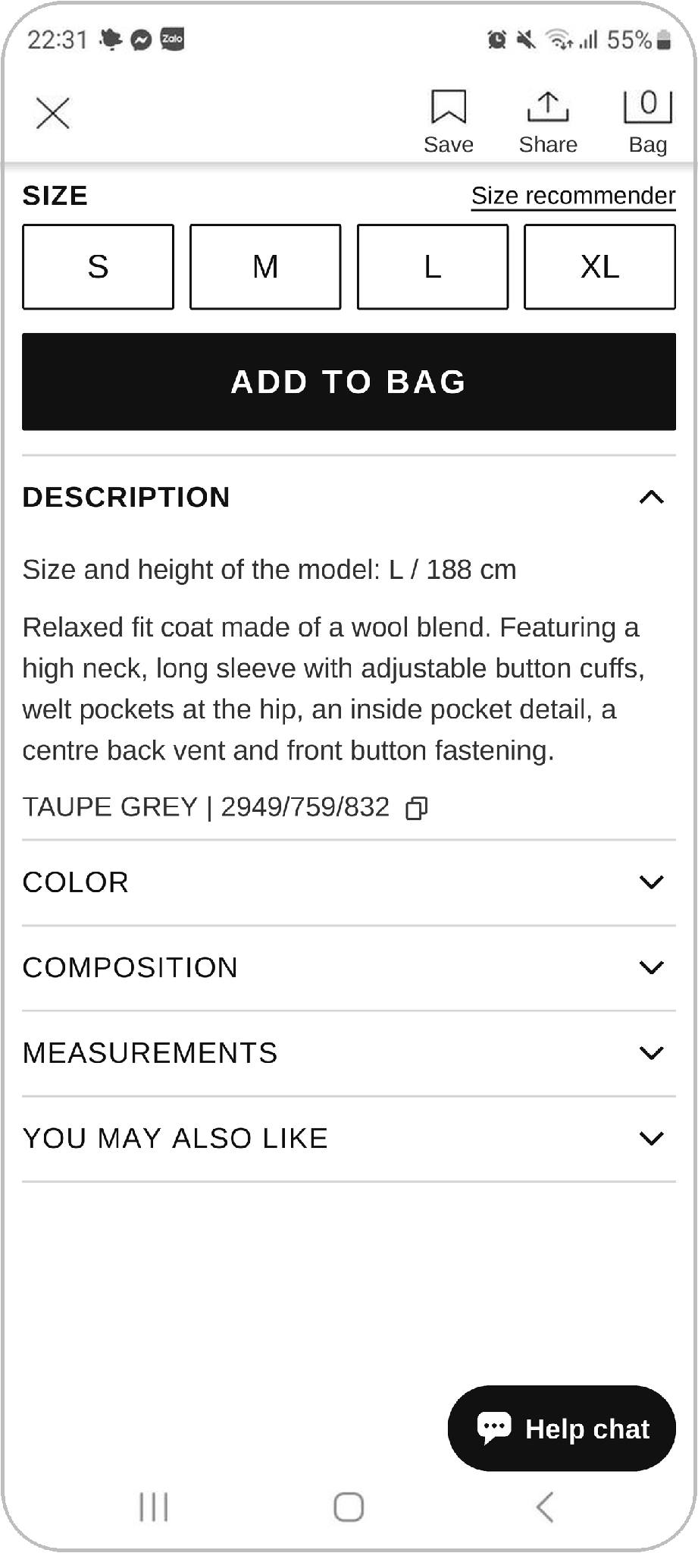
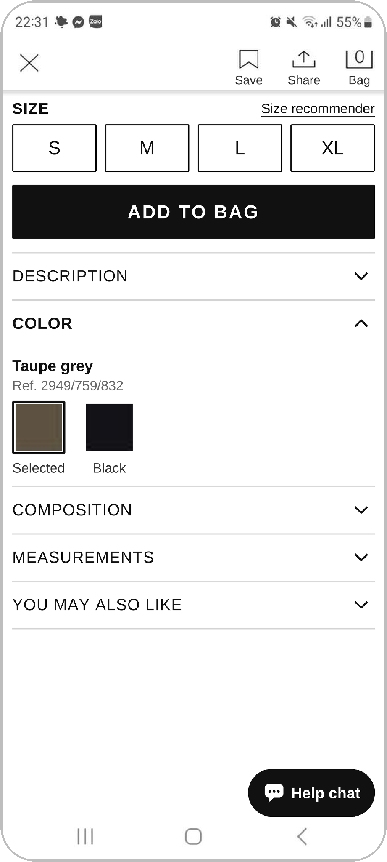
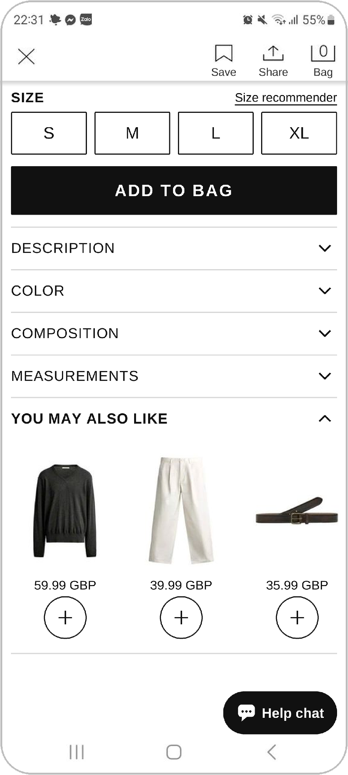
Details open one at a time
BEFORE · ORIGINAL
AFTER · REDESIGNED
One at a time. Tap a row to open it; opening another closes the first. The chevron ▾ / ▴ shows the state.
Own tab for suggestions. “You may also like” is now a row like Description, Color and Composition.
Easy to tap. Each row is full width and 44 dp high.
Notes:
Composition and Measurements use the same collapsible row. Their content is not visible in our screenshots, so they are shown closed.

Slide 6
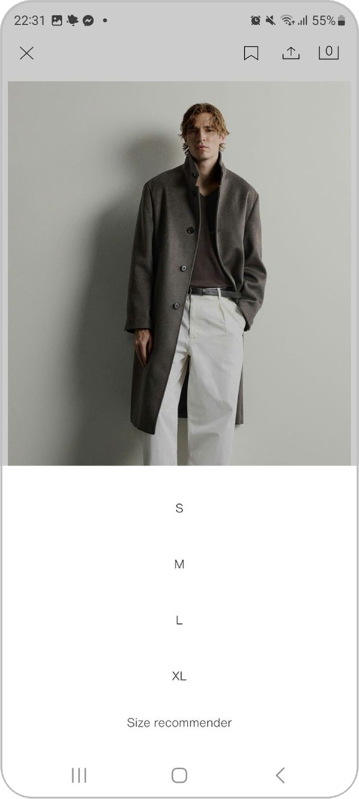
Choosing a size: from 2 screens to 1
BEFORE · ORIGINAL
AFTER · REDESIGNED
Before. A thin “ADD” outline opens a sheet with bare S · M · L · XL text.
After. Four size buttons are always visible, with “Size recommender” and the model’s size (188 cm, L).
ADD TO BAG is a solid black, full-width button, so the main action is obvious.
Notes:
Fixes problems 12 and 14: a prominent main button and sizes shown before ADD.

Slide 7
Next: test old vs new
Usability test (as in our audit)
Notes on this mock-up
Same tasks on the old and the new design, e.g. “add the coat in size M to the bag”.
Compare time on task, errors and satisfaction.
Check the zoom: can users find the collar, buttons and pockets?
Check the accordion: can users find composition and measurements?
All pictures come from our own screenshots; the app’s small expand icon was removed.
Composition and Measurements content is not in the screenshots, so those rows are shown closed.
The second colour is named “Black” as a placeholder.
Zoom uses screenshot resolution; the real app would load a high-resolution photo.

