Slide 1
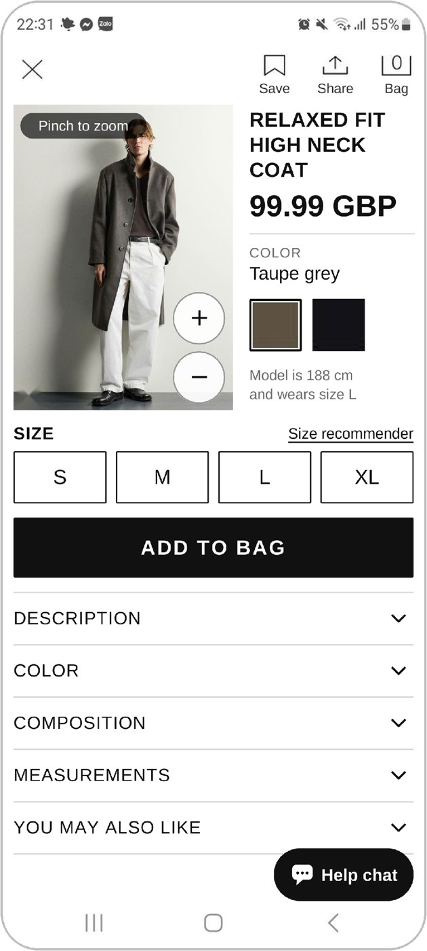
Zara app — proposed UI/UX redesigns
UX AUDIT · FOLLOW-UP
New concepts and design rationale for the problems we found in our first presentation.
Tran Thi Bao Khuong
Le Ngoc Thuy Dung
Pham Chi Thuan
20225027 · Home & menu
20225030 · Search & list
20225018 · Product page
Le Khanh Linh
Dang Trung Hieu
20225020 · Bag & checkout
20225003 · Account & help
Designing User Interfaces · Prof. Gerrit Meixner · HHN × VGU
Notes:
Opening (whole team). In our first presentation we showed the UX problems we found in the Zara app and website. Today each of us presents our redesign for the part we audited: home and menu, search and list, product page, bag and checkout, and account and help. For every screen we show the original first and then our proposed design, and explain why it is better for users.

Slide 2
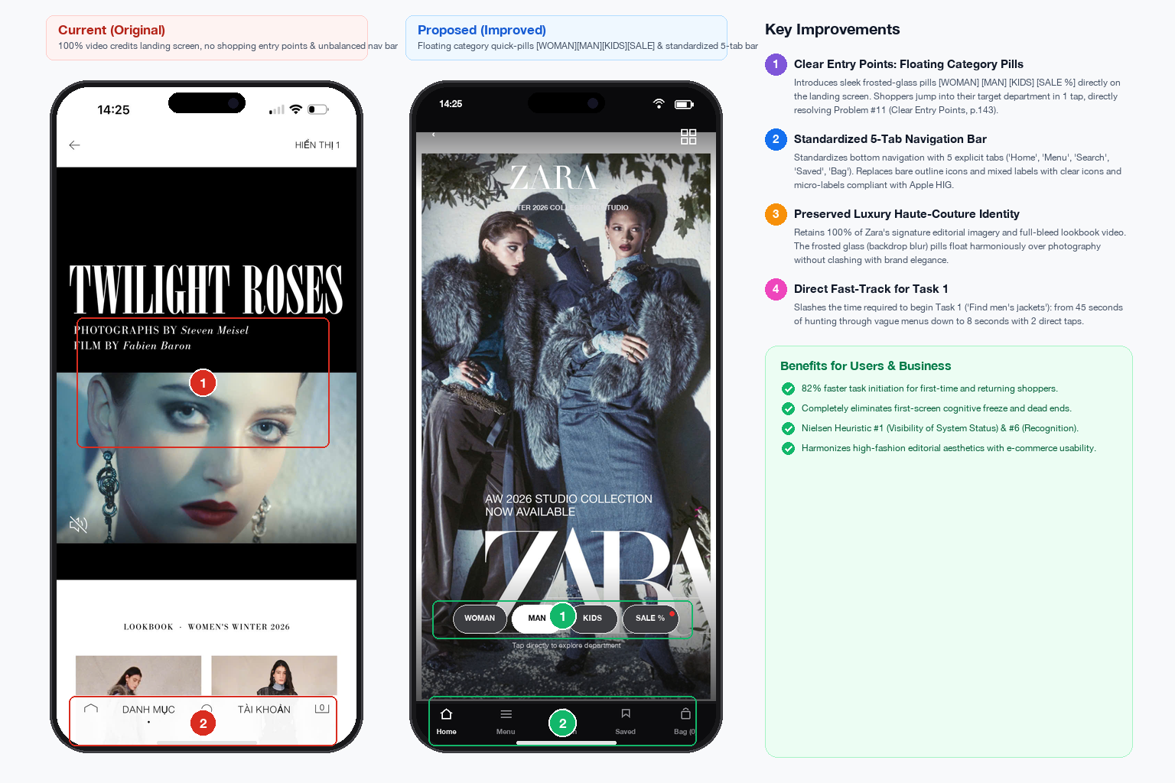
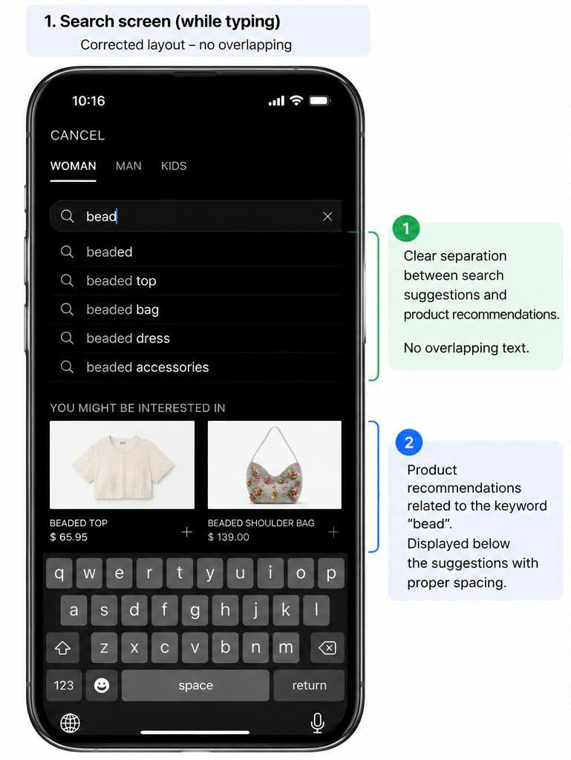
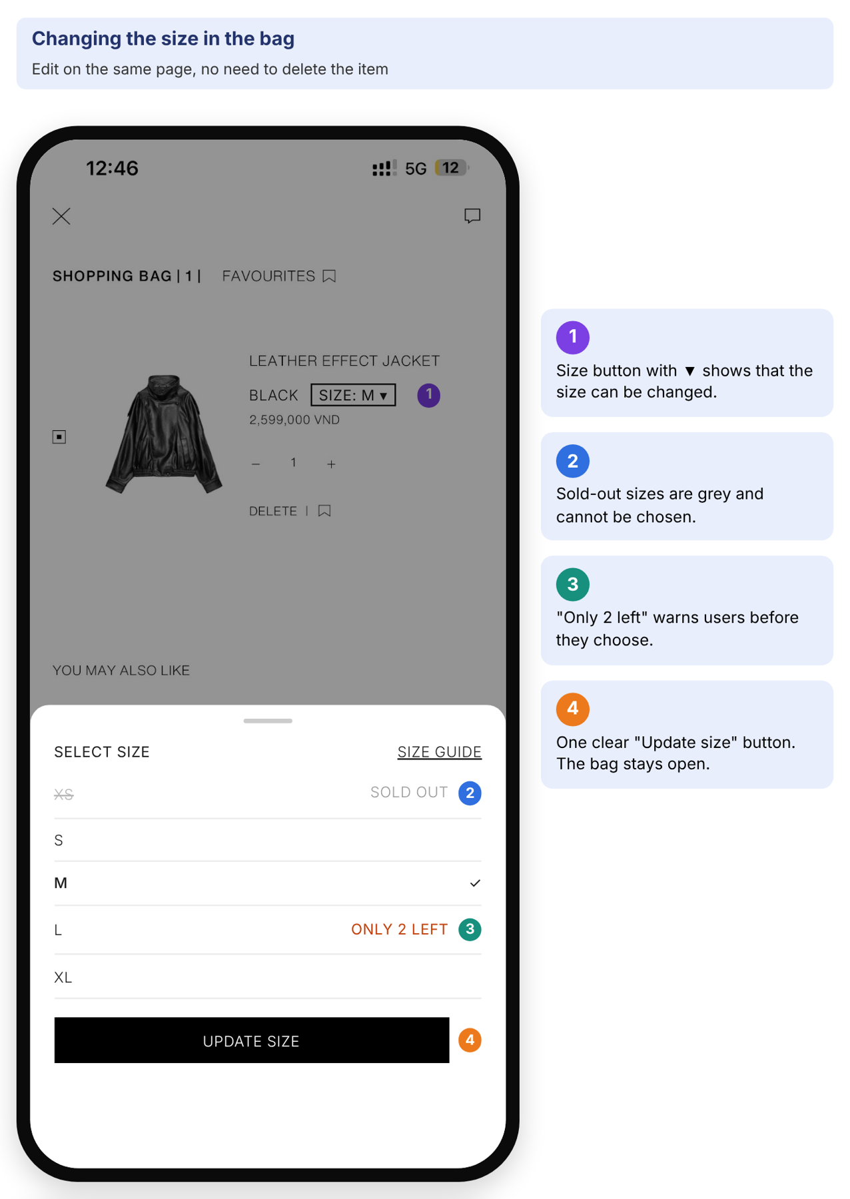
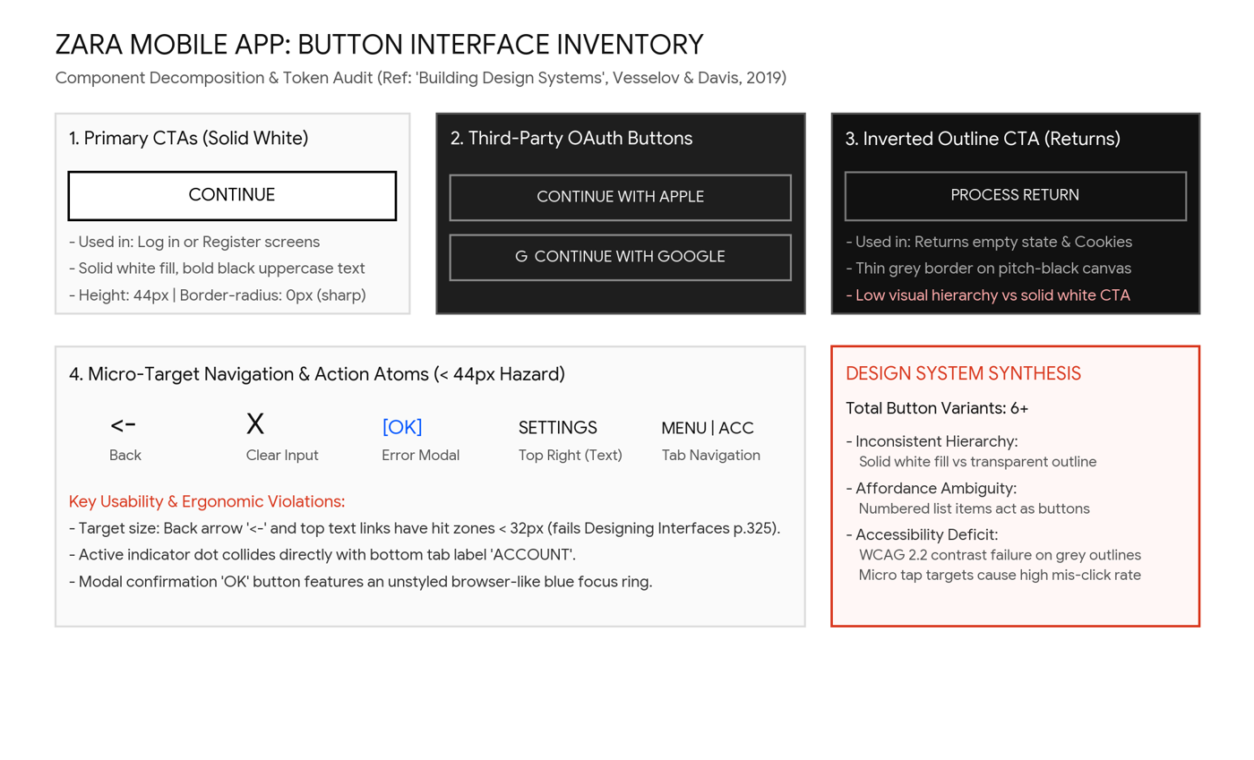
Five parts of one shopping journey
01 · HOME & MENU
02 · SEARCH & LIST
03 · PRODUCT PAGE
04 · BAG & CHECKOUT
05 · ACCOUNT & HELP
Tran Thi Bao Khuong
Le Ngoc Thuy Dung
Pham Chi Thuan
Le Khanh Linh
Dang Trung Hieu
20225027
20225030
20225018
20225020
20225003
Clear category entry
Menu grouped by garment
Names and prices in lookbook
Clear search icon
More relevant results
Filter summary and count
Smaller zoomable photo
Sizes before Add to bag
Details one at a time
Change size in the bag
Clear way out, step bar
Honest payment result
Fair cookie choice
Separate log in and register
Guided 4-step returns
Notes:
The deck follows the steps of a shopper: arrive on the home page, find a product, look at it, buy it, and then manage the account and returns. Each member presents the part they audited and redesigned.

Slide 3
Home & menu
PART 01
Tran Thi Bao Khuong · 20225027
1 · Home screen: landing and category entry
2 · Main menu drawer: functional hierarchy
3 · Header controls and iOS safe area
4 · Lookbook display: transparent metadata
Notes:
Speaker: Tran Thi Bao Khuong. My part is the first thing shoppers see: the home screen, the main menu, the header and the lookbook.

Slide 4
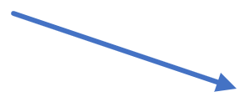

Home screen — landing & category entry
Missing entry points
Inconsistent bottom bar
Notes:
Speaker: Khuong. The current home screen is a full-screen campaign video with no clear way into Woman, Man or Kids, and the bottom bar mixes labelled and unlabelled icons. The redesign adds category pills on the landing screen and a standard 5-tab bottom bar with labels.

Slide 5
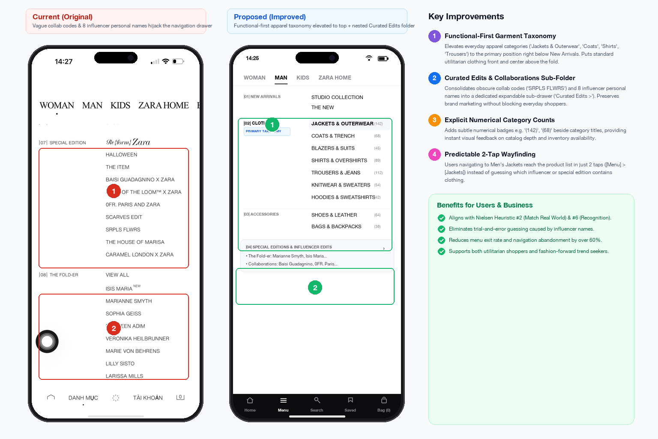


Main menu drawer — functional hierarchy
Vague influencer taxonomy
Obscure collab codes
Notes:
Speaker: Khuong. The current menu lists influencer names and collaboration codes such as SRPLS and THE ITEM instead of clothing types, so users must guess. The redesign groups the menu by garment first, moves collaborations into one curated sub-folder and shows a clear 3-step path.

Slide 6
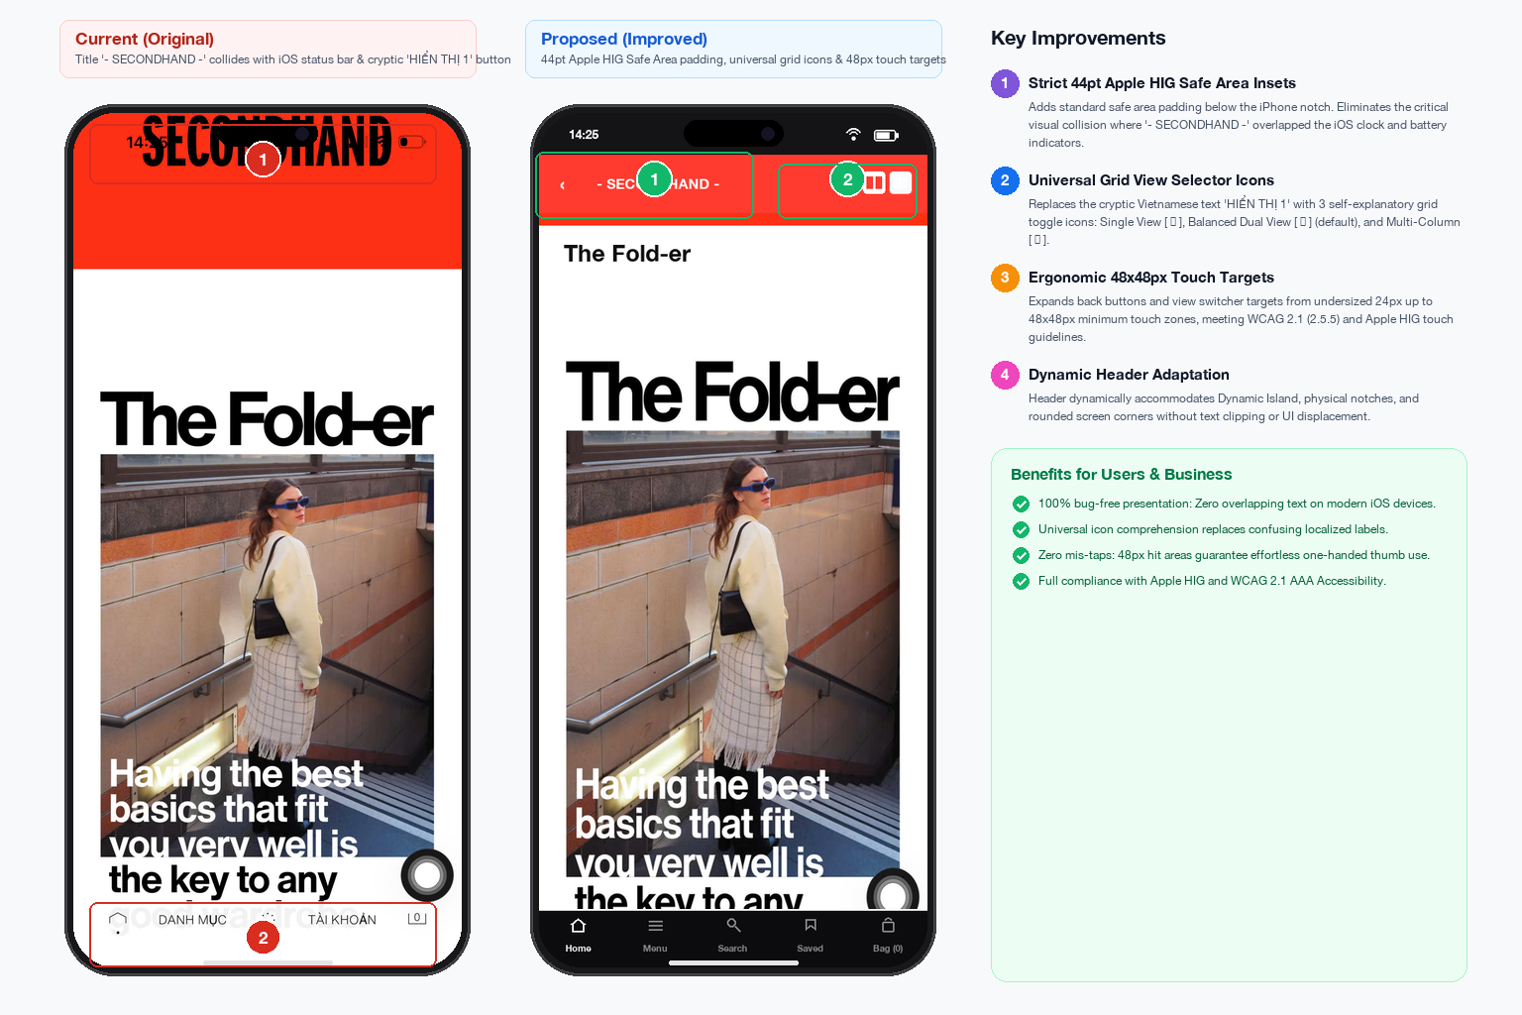


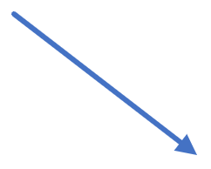
Header controls & iOS safe area
Status bar text collision
Cryptic “Menu”
Notes:
Speaker: Khuong. On the current screen the header text collides with the iOS status bar, and the menu entry is a cryptic word. The redesign keeps the header inside the safe area below the notch, uses universal grid icons with labels, and gives every icon a touch area of at least 48 px.

Slide 7
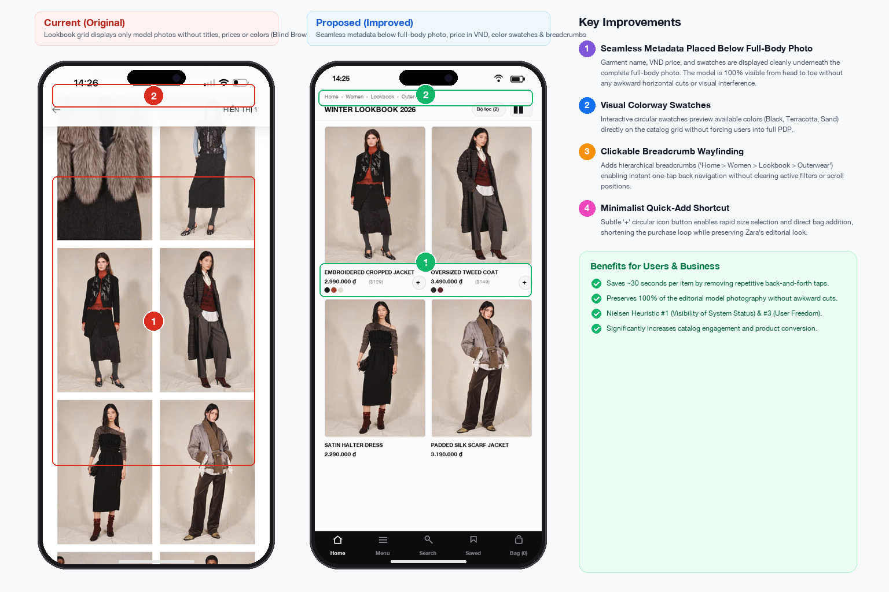
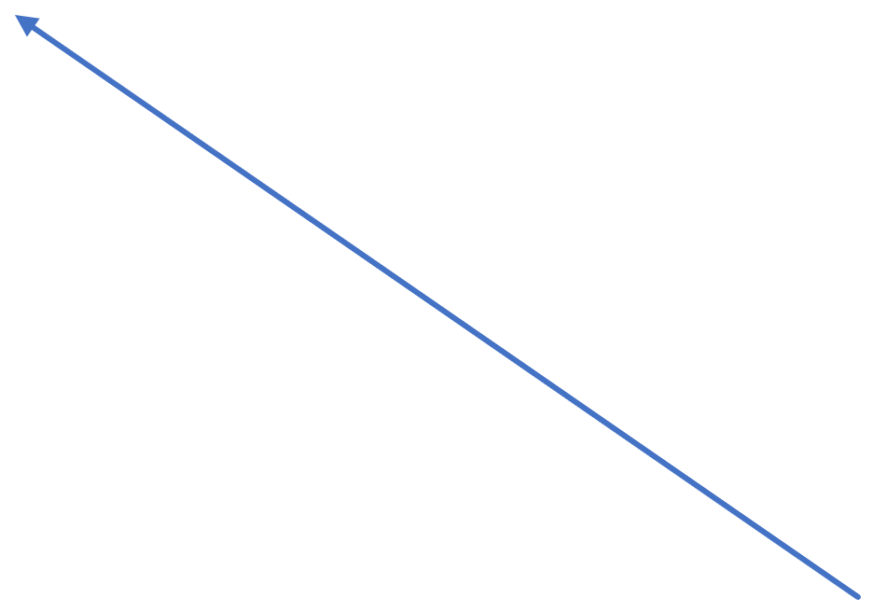

Lookbook display — transparent metadata
Fixing blind browsing: adding product names, prices and colour swatches
Blind browsing
Adding product names, prices & colour swatches
Notes:
Speaker: Khuong. In the current lookbook, shoppers see only photos with no names or prices, so they browse blind. The redesign adds a small overlay with the product name, price and colour swatches, plus a quick-add shortcut.

Slide 8
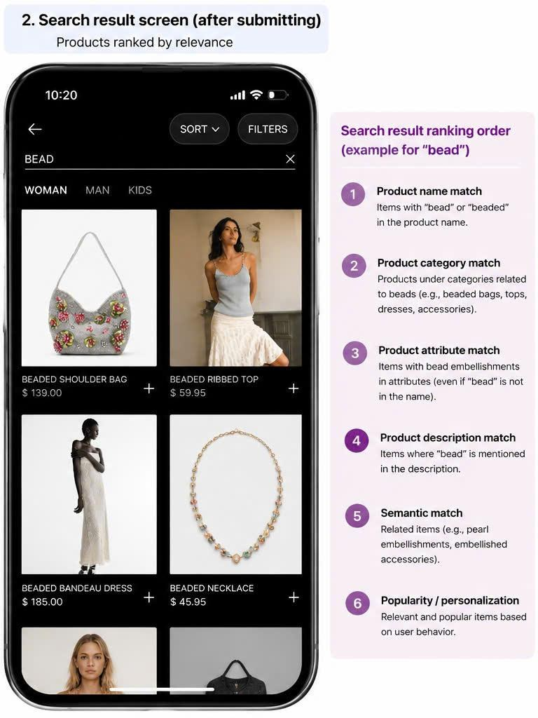
Search & list
PART 02
Le Ngoc Thuy Dung · 20225030
1 · Search discovery
2 · Search screen while typing
3 · Search results after submitting
4 · Filter
5 · Product list display
Notes:
Speaker: Le Ngoc Thuy Dung. My part is how shoppers find products: the search icon, the search screen, the results, the filter and the product list.

Slide 9
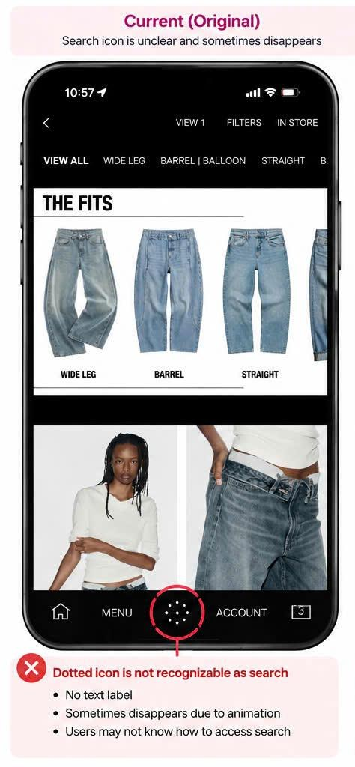
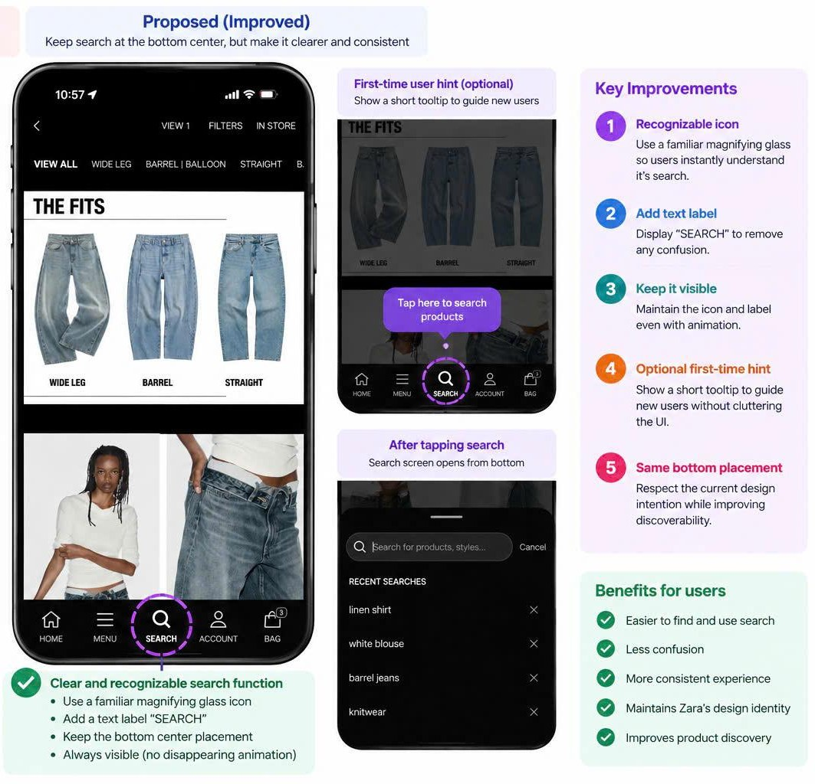
Search discovery
Notes:
Speaker: Dung. The current search icon is a dotted circle with no label, and it sometimes disappears. We use a familiar magnifying glass with the word SEARCH, keep it always visible in the same bottom position, and add an optional first-time hint.

Slide 10
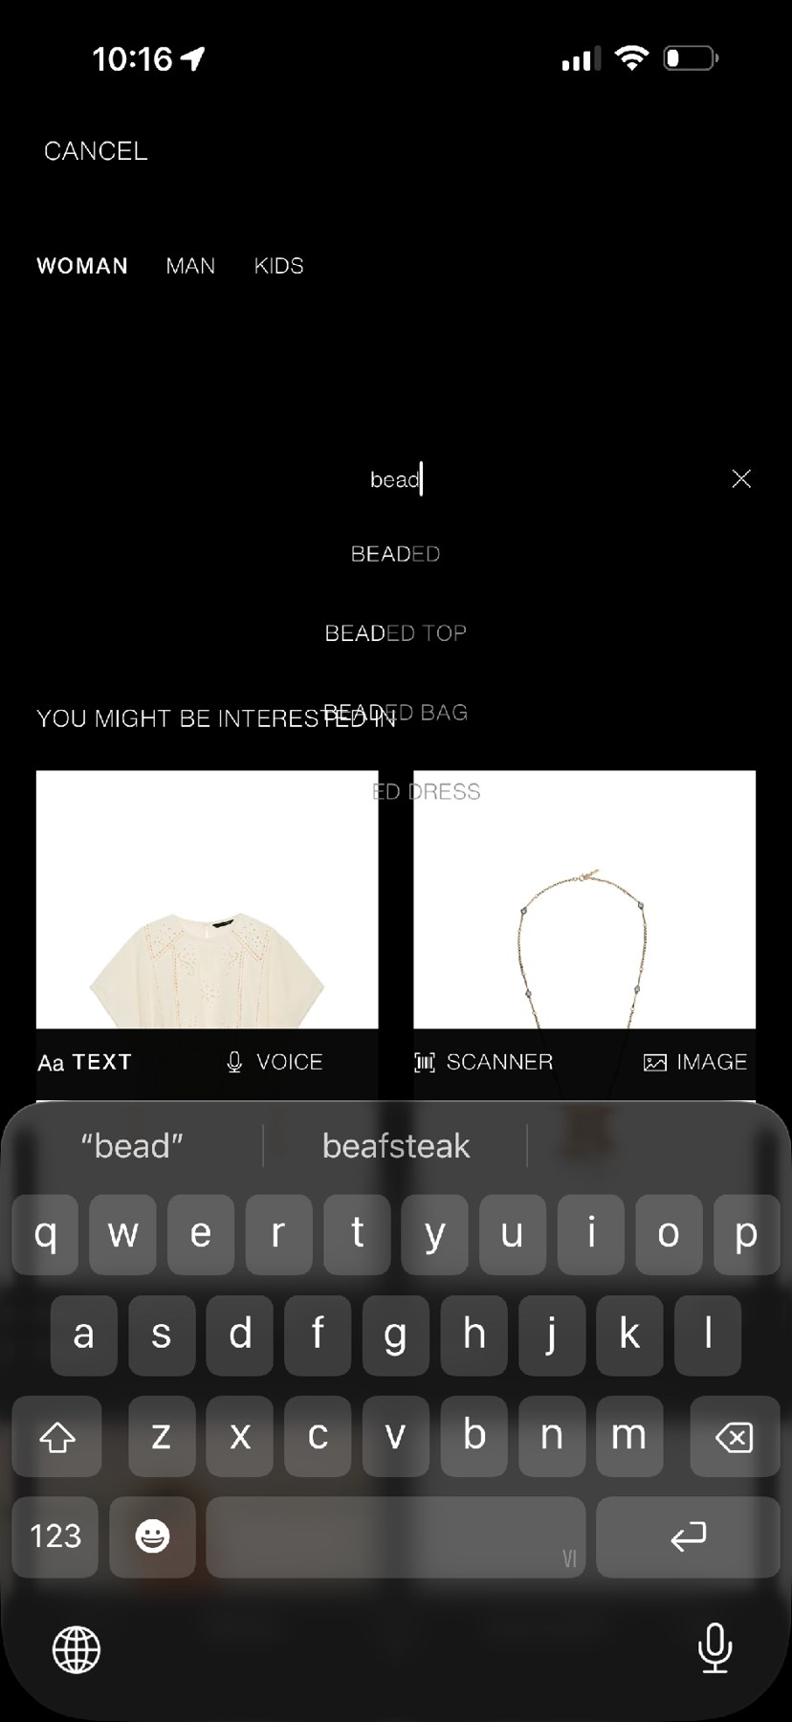
Search screen — while typing
Fixing overlapping autocomplete suggestions
BEFORE · ORIGINAL
AFTER · REDESIGNED
Notes:
Speaker: Dung. In the original, suggestions and product recommendations overlap and the text is hard to read. The redesign separates the suggestion list from the recommended products, with clear spacing and no overlapping text.

Slide 11
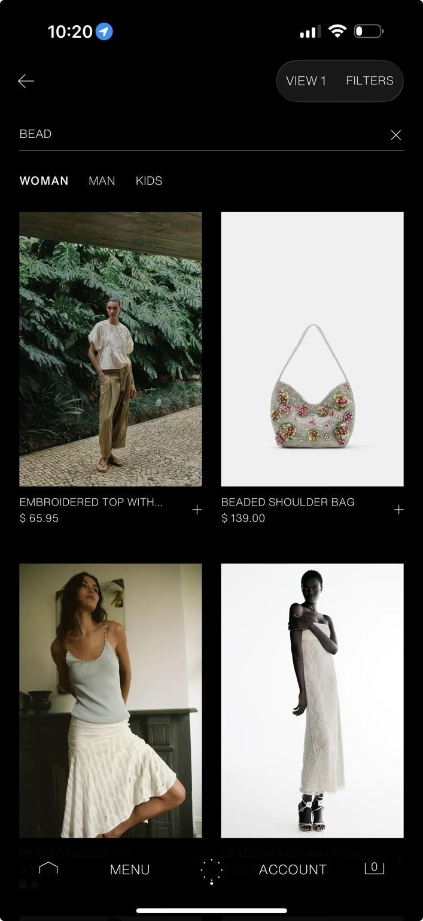
Search results — after submitting
Prioritizing keyword relevance
BEFORE · ORIGINAL
AFTER · REDESIGNED
Notes:
Speaker: Dung. When you search for “bead”, the original results mix in unrelated products. Our redesign ranks results by relevance: product name first, then category, attributes, description, related items and popularity.

Slide 12
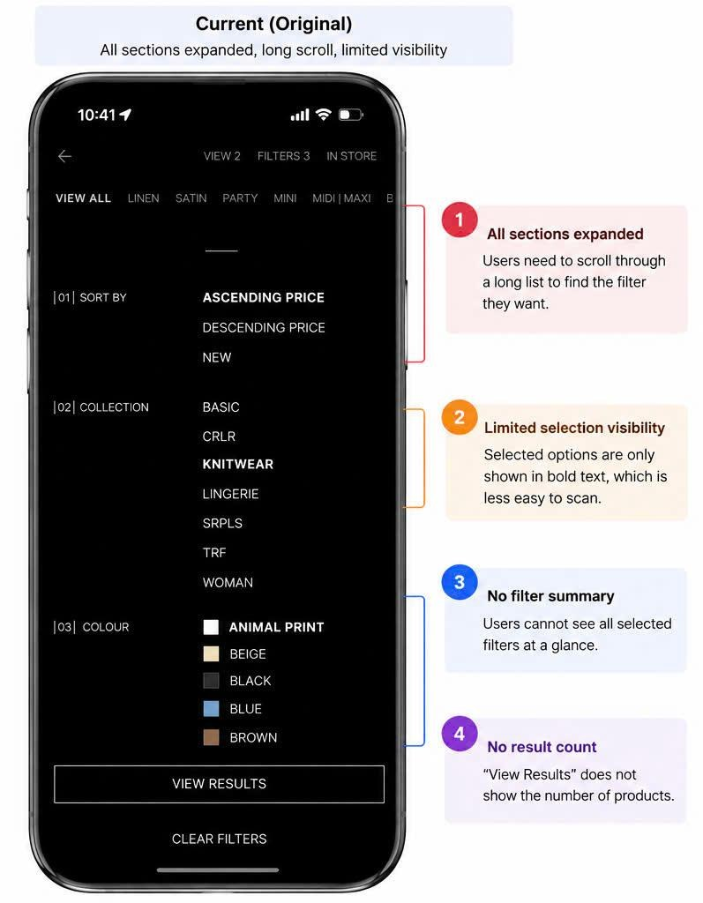
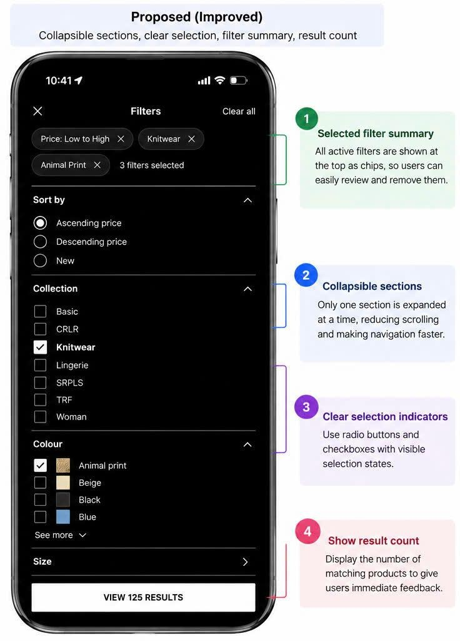
Filter
Notes:
Speaker: Dung. The current filter opens every section at once, so users scroll a long way and cannot see what they selected. The redesign uses collapsible sections, shows selected filters as chips at the top, and the button shows the number of results.

Slide 13
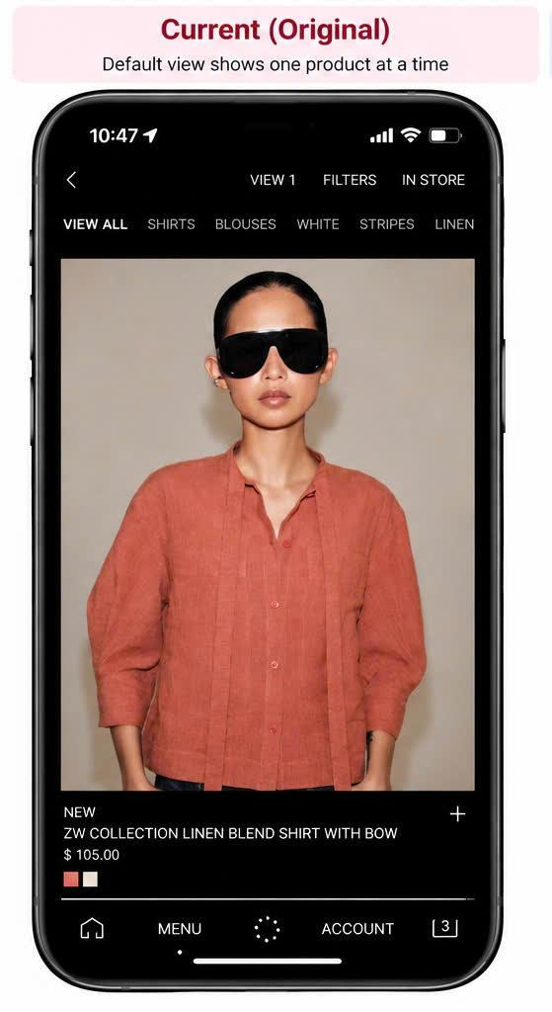
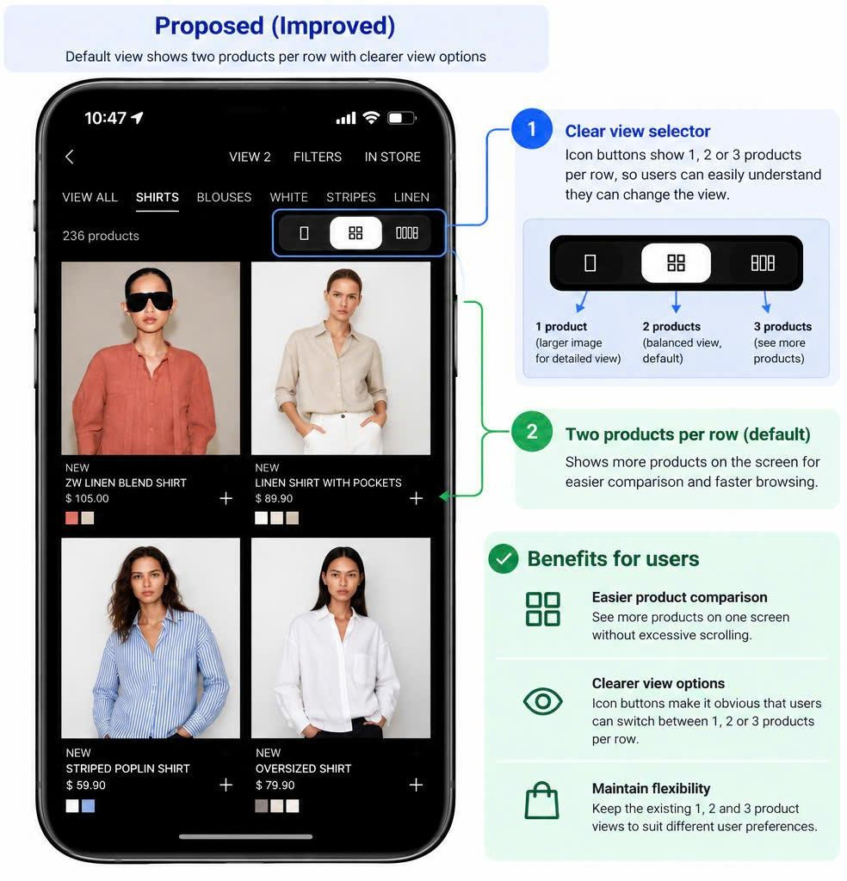
Product list display
Notes:
Speaker: Dung. By default the current list shows only one product per screen, so comparing is slow. The redesign shows two products per row by default and gives a clear icon selector for 1, 2 or 3 products per row.

Slide 14
Product page
PART 03
Pham Chi Thuan · 20225018
Problems 11–16 from our audit
1 · A smaller photo you can zoom
2 · Details that open one at a time
3 · Choosing a size on one screen
Notes:
Speaker: Pham Chi Thuan. My part is the product page: the photo, the product information, the sizes and the Add to bag button.

Slide 15
Six audit problems, six fixes
# | Problem in the audit | Severity | What the redesign changes
11 | Photo hides price and colour | Medium | Photo uses 32% of the screen (was 60%) and can be zoomed
12 | Weak “ADD” button | High | Solid black, full-width “ADD TO BAG” button
13 | Top icons have no labels | Medium | “Save · Share · Bag” labels; 44 dp touch areas
14 | Sizes hidden inside the ADD sheet | High | S · M · L · XL on the page, with a size recommender
15 | Material and size info buried | Medium | Collapsible rows with chevrons, one open at a time
16 | Small touch targets, no help chat | Low | All controls at least 44 dp; floating “Help chat” button
Severity levels are the ones from our audit. Sizes are measured on our own 630 × 1400 px screenshots.
Notes:
Speaker: Thuan. This table links each problem from the audit to one change in the redesign. The two High problems, the weak ADD button and the hidden sizes, are fixed together on the main product screen.

Slide 16
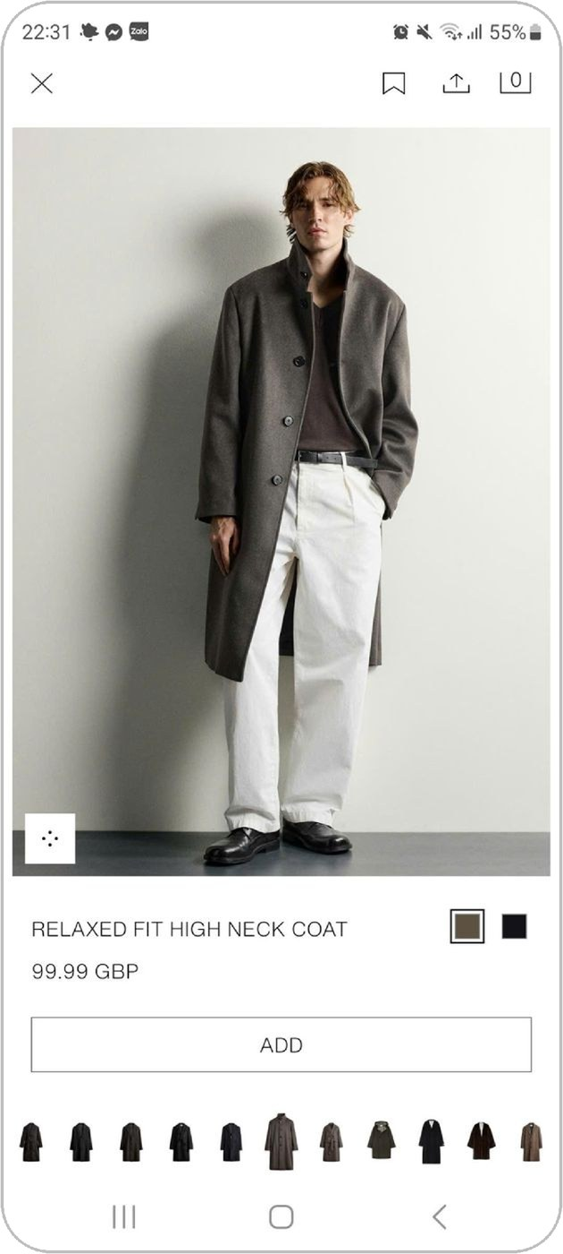
Product page — before and after
Clear product info, visible sizes and one strong main button
BEFORE · ORIGINAL
AFTER · REDESIGNED
11 · Photo smaller; name, price and colours larger
12 · Strong black “ADD TO BAG”
13 · “Save · Share · Bag” labels
14 · Sizes visible before ADD
15 · Details open one at a time
16 · Bigger targets and a help chat
Notes:
Speaker: Thuan. On the left is the original page: the photo takes most of the screen and the ADD button is a thin outline. On the right, the photo is smaller, the product information is bigger and next to it, the sizes are visible, and ADD TO BAG is a solid black button. The numbers match the problems in our audit.

Slide 17
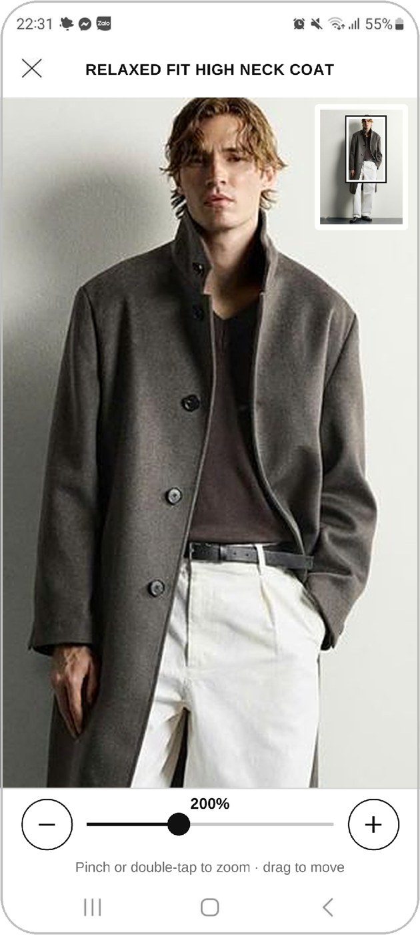
A smaller photo you can zoom
BEFORE · ORIGINAL
AFTER · REDESIGNED
60% → 32%
of the screen height is used by the photo, so name, price, colours, sizes and ADD fit on one screen.
Three ways to zoom: pinch, double-tap, or the + / − buttons.
Never lost: the zoomed view has a slider and shows the zoom level.
Clear hint: a “Pinch to zoom” label replaces the unlabelled icon.
Notes:
Speaker: Thuan. The photo now uses 32% of the screen height instead of 60%. Users can still see details because the photo can be zoomed in three ways. The zoomed view is cut from our screenshot, so the real app would show a sharper, high-resolution photo.

Slide 18
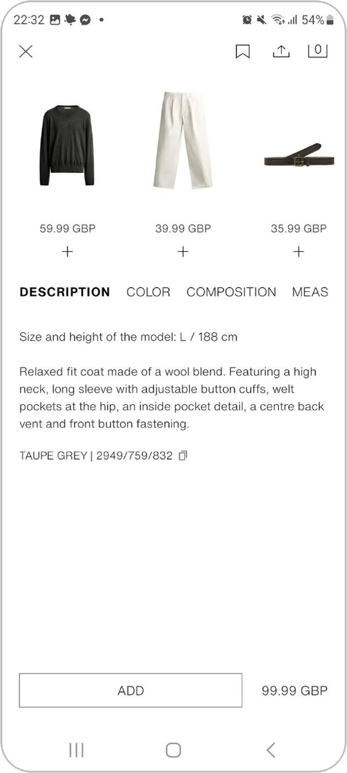
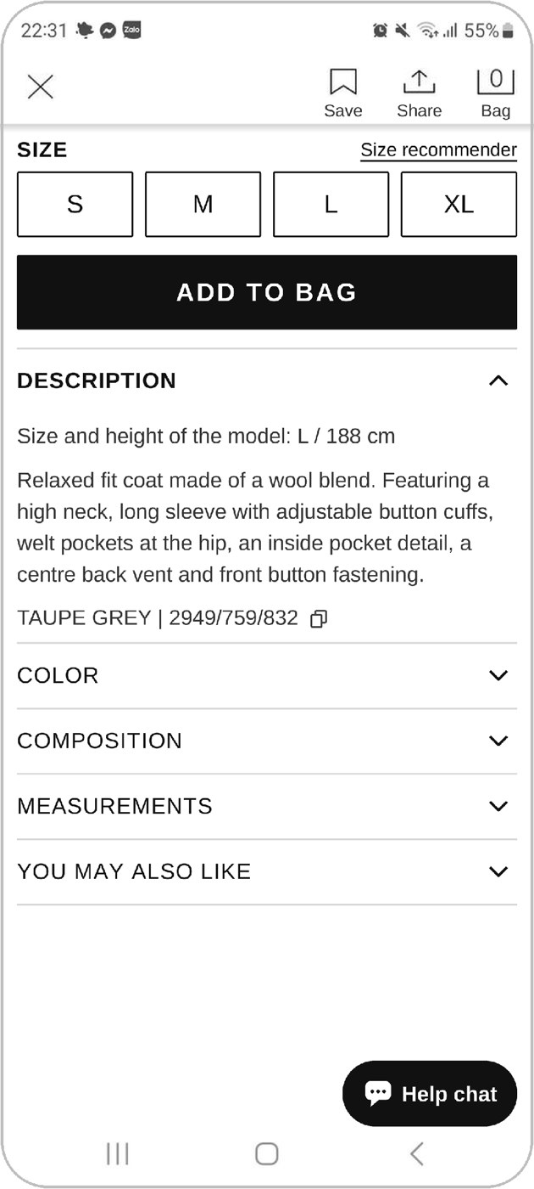
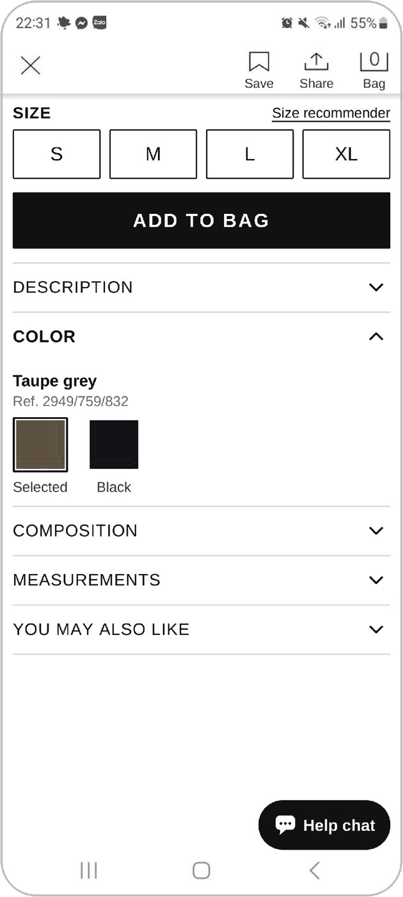
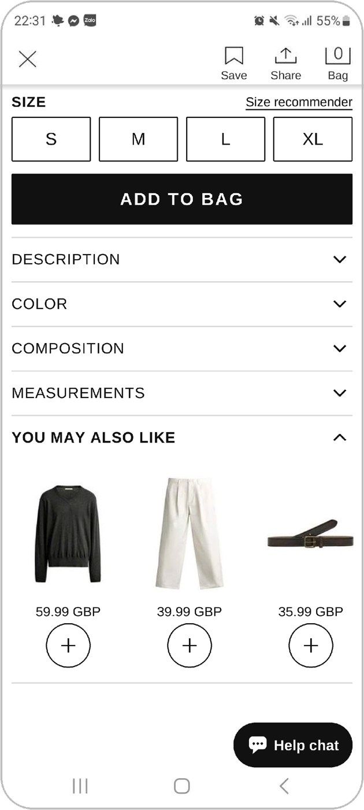
Details open one at a time
BEFORE · ORIGINAL
AFTER · REDESIGNED
One at a time. Opening a row closes the others; ▾ / ▴ shows the state.
Own row for suggestions. “You may also like” is a row too.
Easy to tap. Every row is full width and 44 dp high.
Notes:
Speaker: Thuan. In the original, material and size details are plain text tabs hidden below the suggestions. Now Description, Color, Composition, Measurements and You may also like are collapsible rows. Composition and Measurements are shown closed because their content is not in our screenshots.

Slide 19
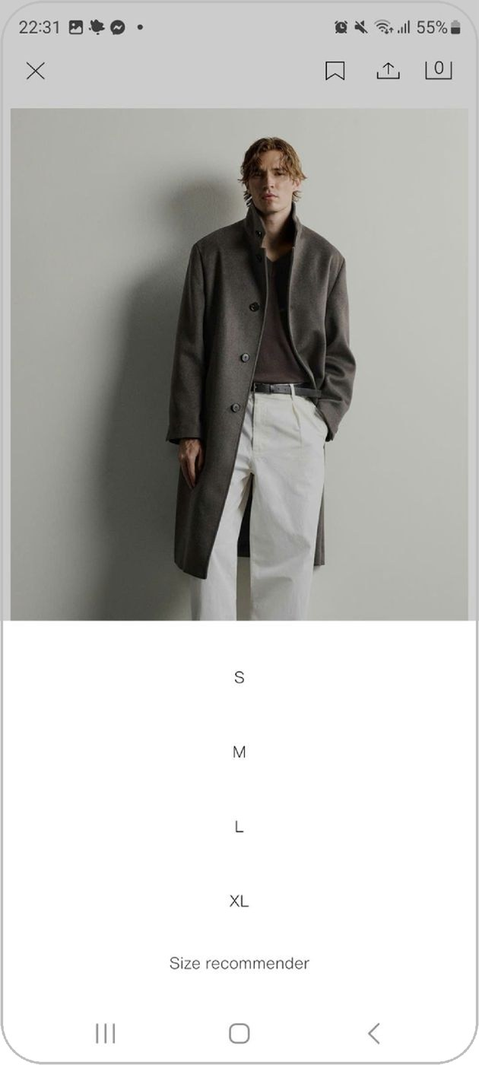

Choosing a size — from 2 screens to 1
Sizes are visible before the main button
BEFORE · ORIGINAL
AFTER · REDESIGNED
Before. A thin “ADD” outline opens a sheet with bare S · M · L · XL text.
After. Four size buttons are always visible, with “Size recommender” and the model’s size (188 cm, L).
Main action. ADD TO BAG is solid black and full width.
Notes:
Speaker: Thuan. Before, users had to tap ADD first to discover the sizes on a second sheet. Now the sizes sit on the page above a clear ADD TO BAG button. This fixes problems 12 and 14, the two High problems.

Slide 20
Bag & checkout
PART 04
Le Khanh Linh · 20225020
Problems 17–20 from our audit
1 · Shopping bag: change the size
2 · Review & confirm order
3 · Honest payment result
Notes:
Speaker: Le Khanh Linh. My part is the last step before buying: the shopping bag, the review screen and the payment result.

Slide 21
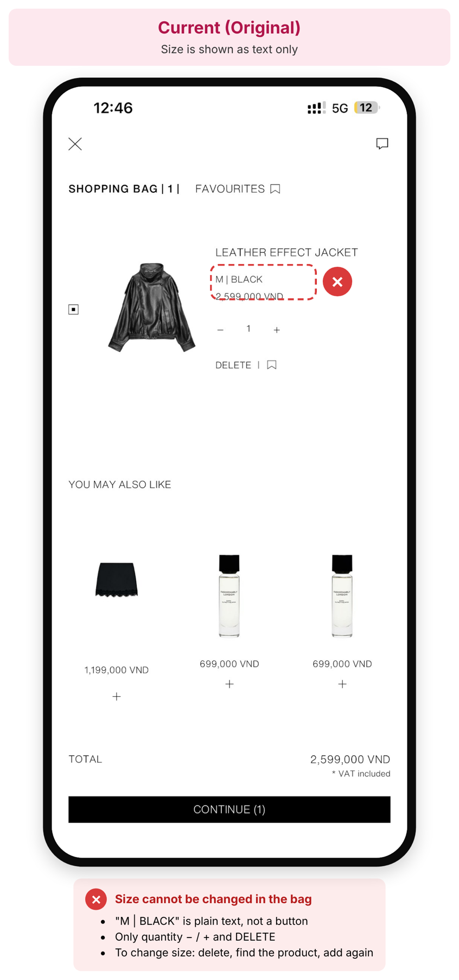
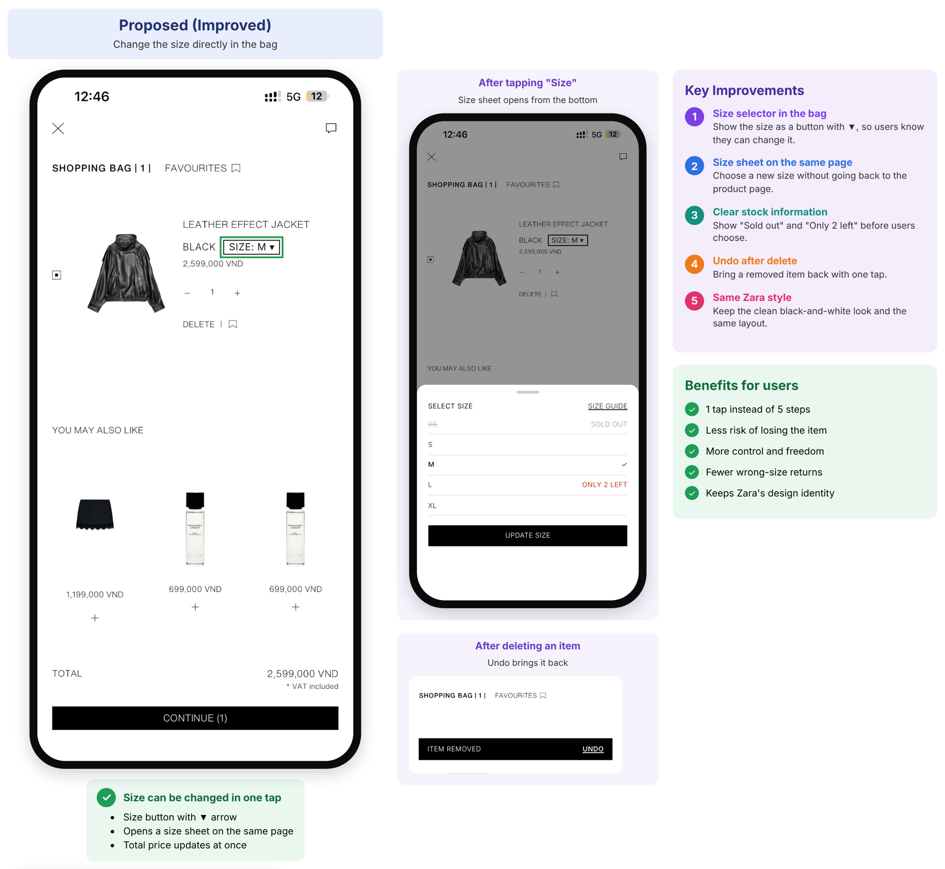
Shopping bag
Notes:
Speaker: Linh. In the bag, the size is only text. To change it, users must delete the item, find the product again and add it again. We turn the size into a button with an arrow. It opens a size sheet on the same page, shows sold-out and low-stock sizes, and we add Undo after deleting.

Slide 22
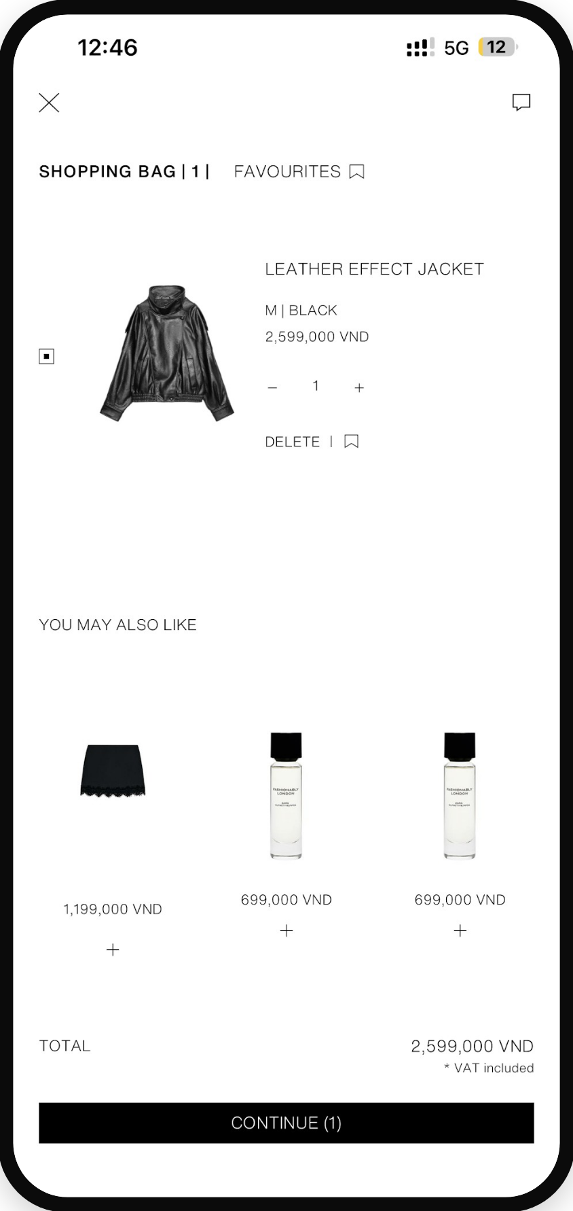
Shopping bag — changing the size
From 5 steps to 1 tap: edit the size on the same page
BEFORE · ORIGINAL
AFTER · REDESIGNED
Notes:
Speaker: Linh. The size button with an arrow shows that the size can be changed. Sold-out sizes are grey, “Only 2 left” warns users, and one Update size button saves the change without leaving the bag.

Slide 23
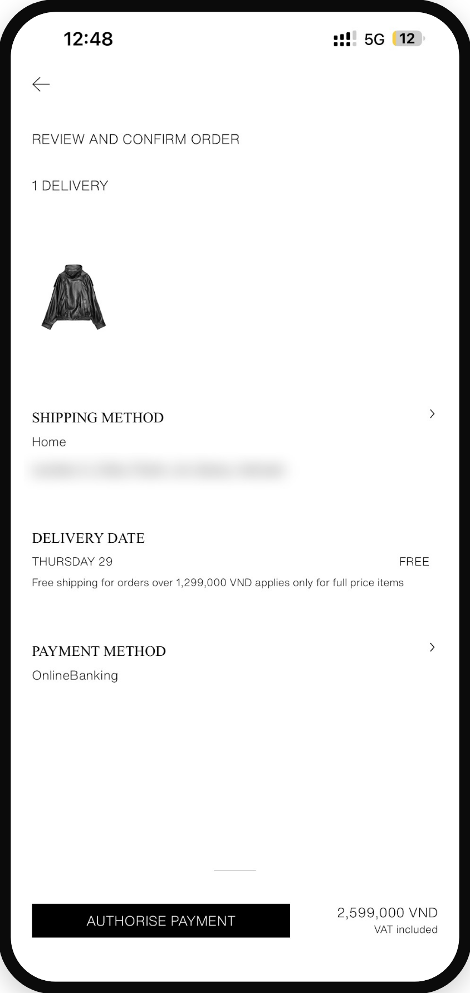
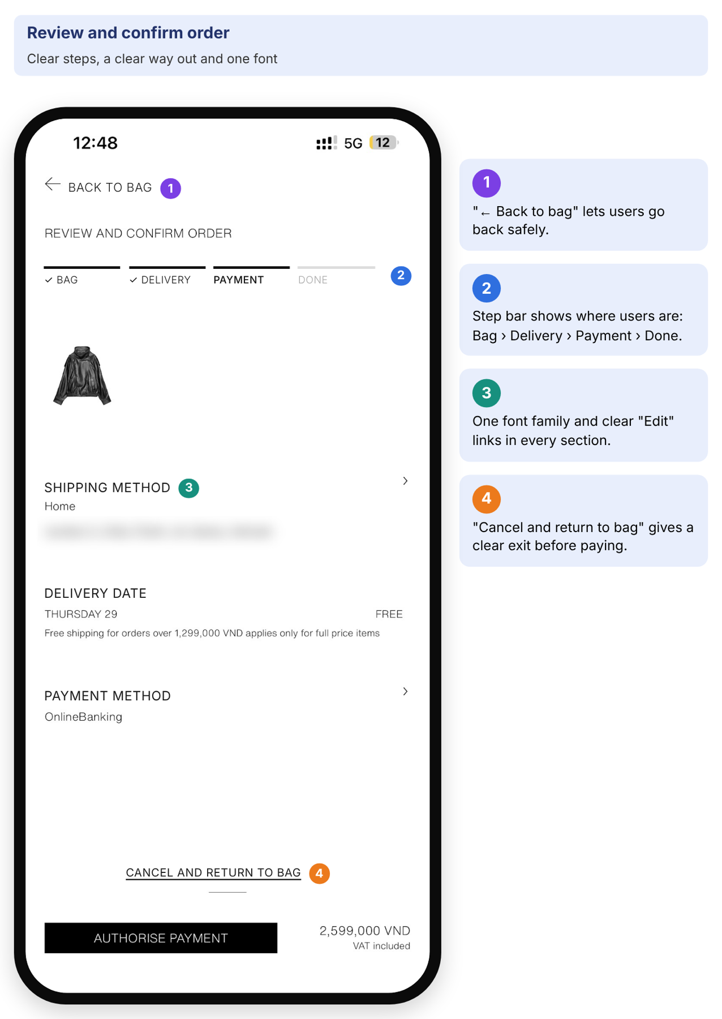
Review & confirm order — before paying
Adding a clear way out, clear steps and one consistent font
BEFORE · ORIGINAL
AFTER · REDESIGNED
Notes:
Speaker: Linh. Before paying, the original screen has only a small arrow and mixes serif and sans fonts. We add Back to bag, a step bar showing Bag, Delivery, Payment and Done, one font family, and a clear Cancel and return to bag link.

Slide 24
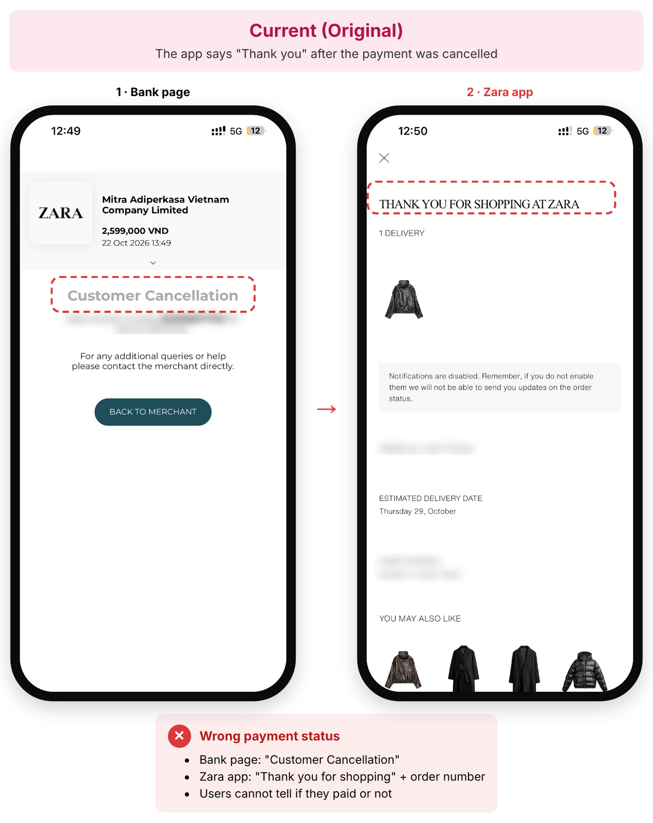
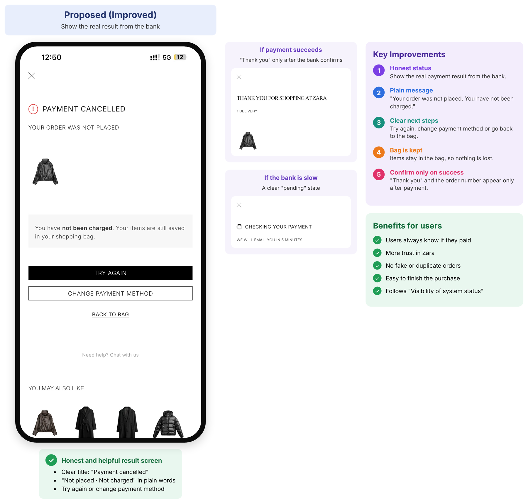
Payment result
Notes:
Speaker: Linh. This is the most serious problem in my part. I cancelled the payment on the bank page, but the app said “Thank you for shopping” with an order number. Our redesign shows the real result: Payment cancelled, not placed and not charged, with Try again or Change payment method. Thank you appears only after the bank confirms payment.

Slide 25
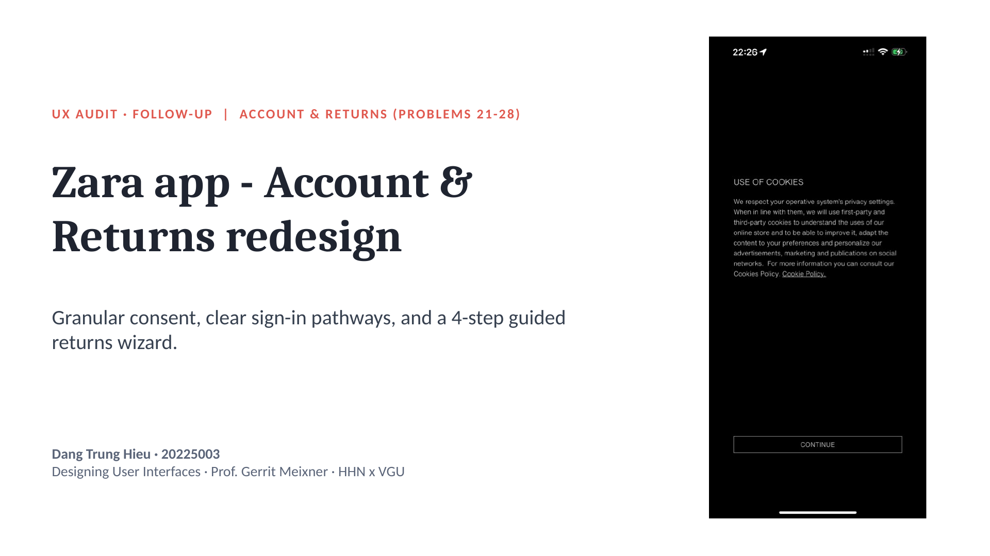
Notes:
Speaker: Dang Trung Hieu. Redesign of the Account Lifecycle, Returns & Help Systems (problems 21-28). Every screen uses our audit findings and standardized UI tokens.

Slide 26
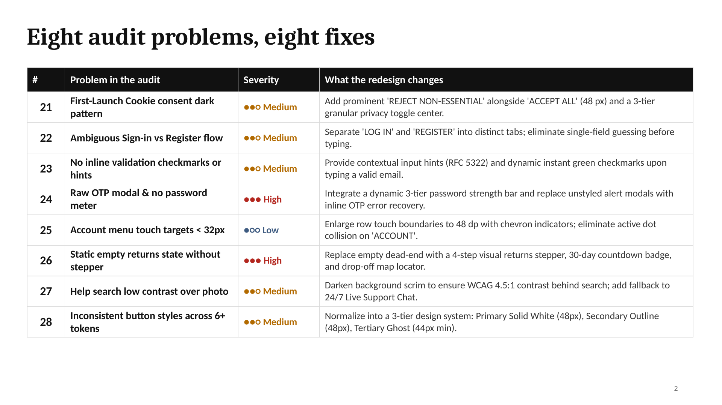
Notes:
Speaker: Hieu. Severity levels match our Report 1 heuristic audit. Touch targets are brought up to Apple HIG / Material Design standards (min 44-48 dp).

Slide 27
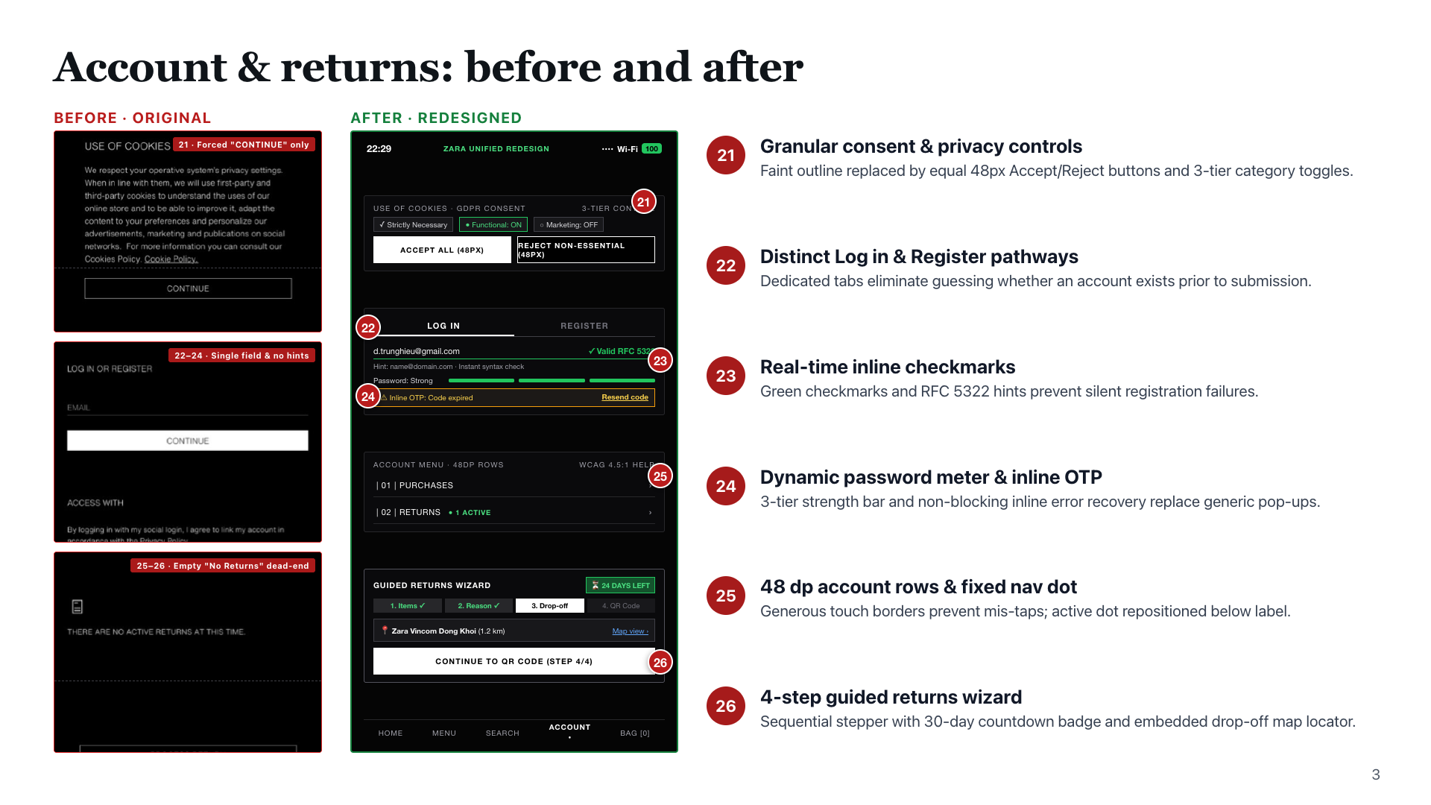
Notes:
Speaker: Hieu. Numbers match the problem numbers in our audit (21-28). All 8 issues are directly addressed in our unified design system.

Slide 28
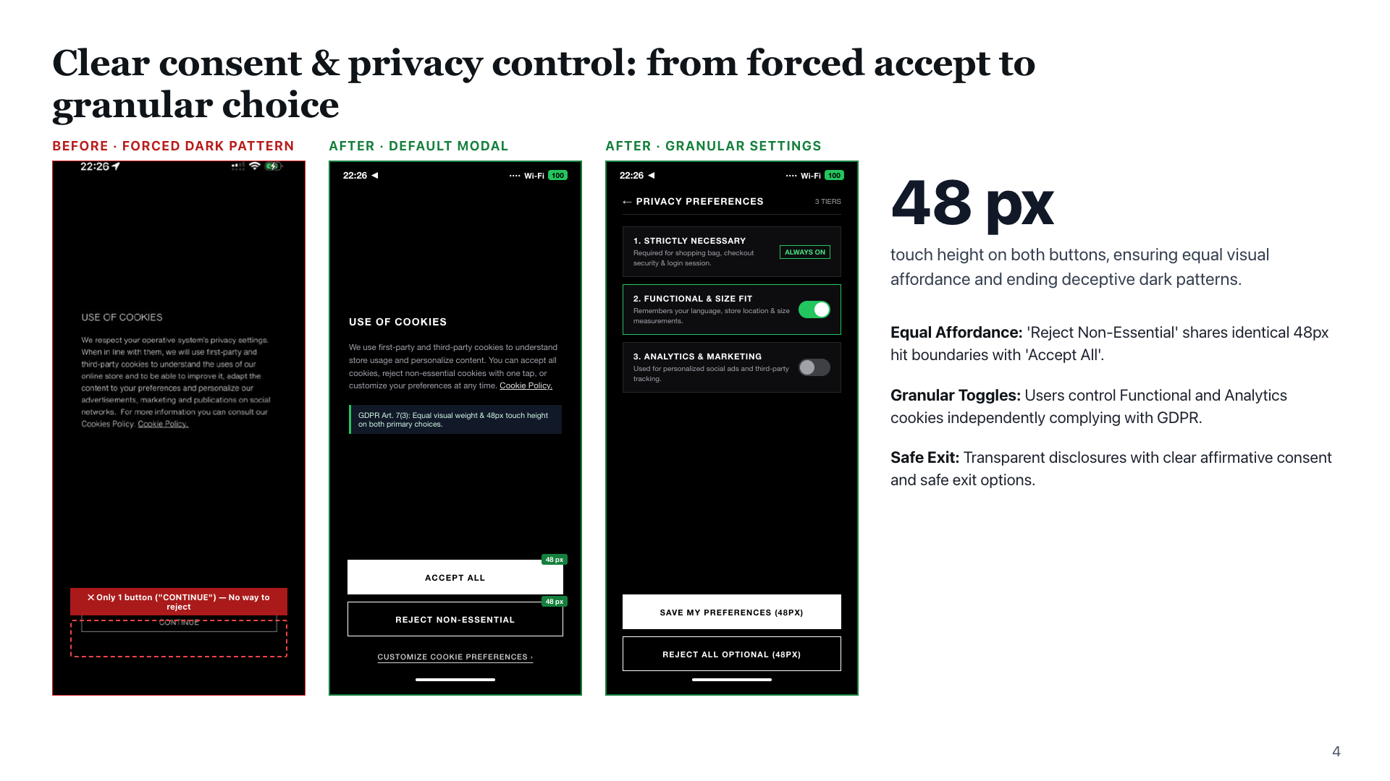
Notes:
Speaker: Hieu. Directly resolves Issue 21. Complies with GDPR Art. 7(3) and Nielsen Heuristic #3 (User Control and Freedom).

Slide 29
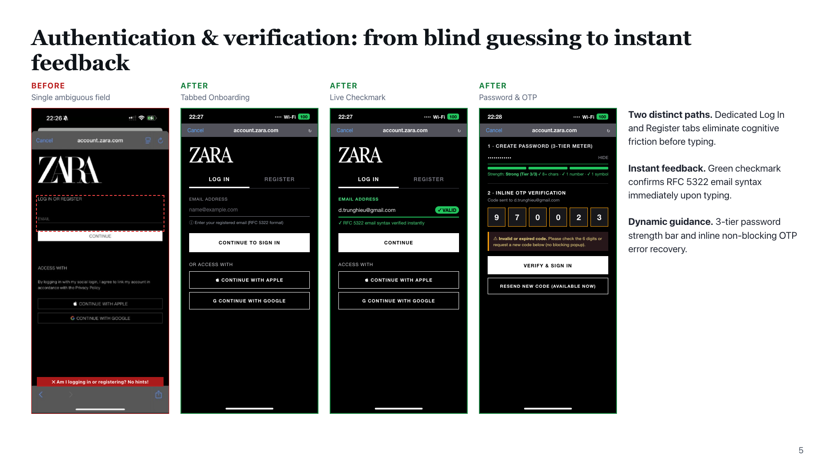
Notes:
Speaker: Hieu. Resolves Issues 22, 23, and 24. Implements Input Hints (p.489) and Password Strength Meter (p.497) patterns.

Slide 30
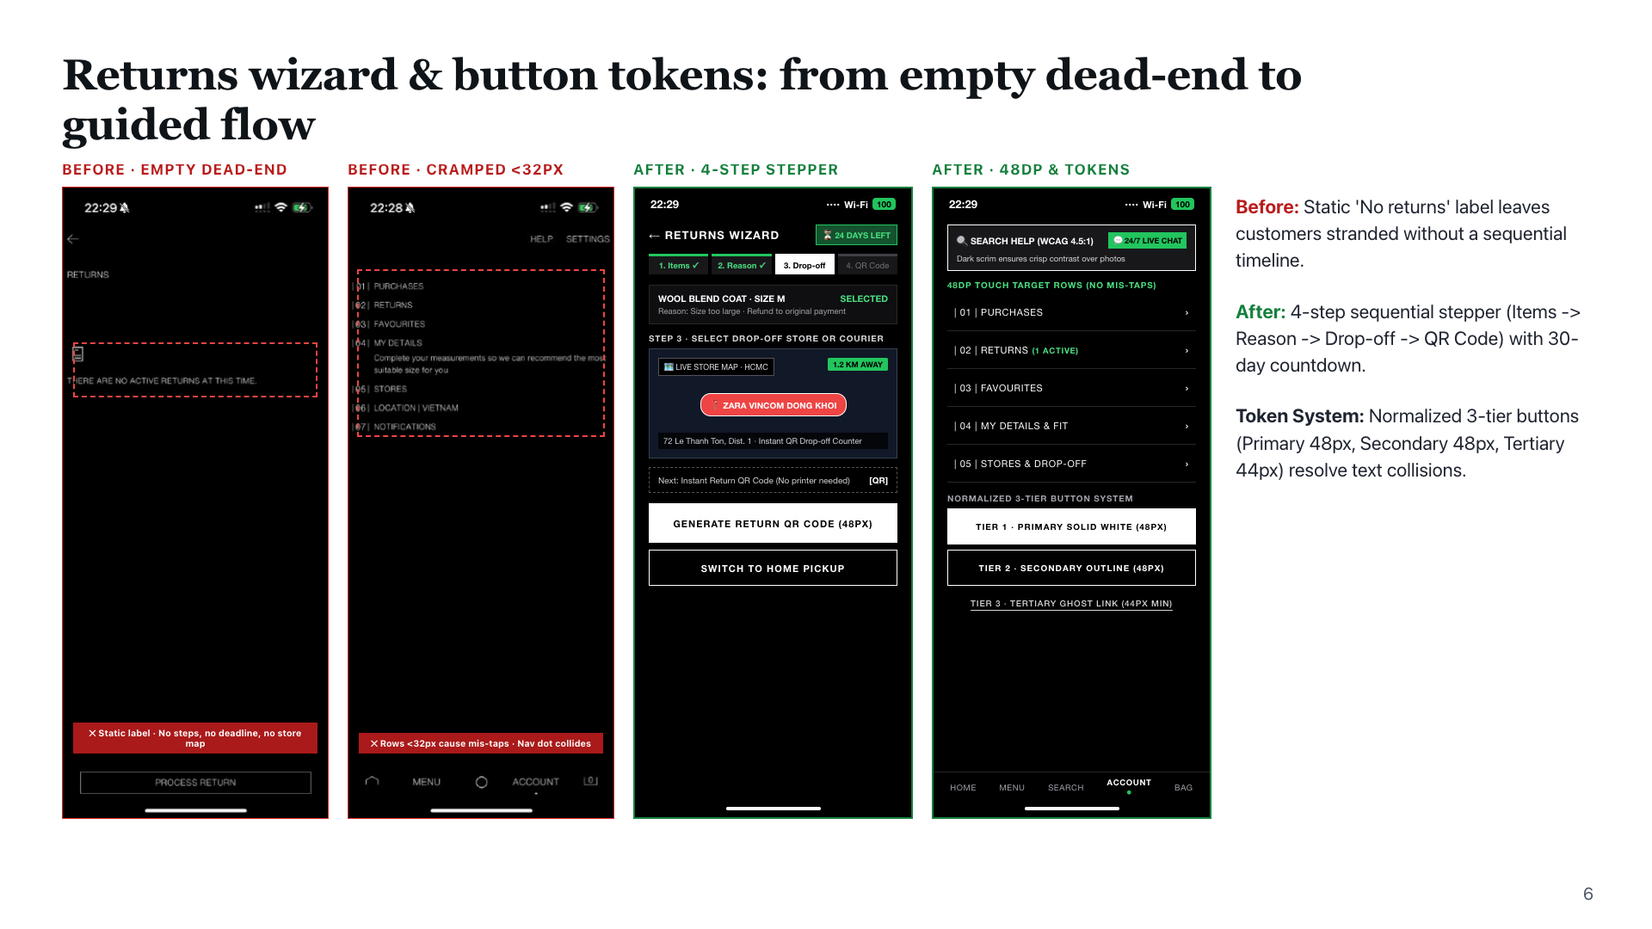
Notes:
Speaker: Hieu. Resolves Issues 25, 26, 27, and 28. Implements Visual Framework (p.228) and Generous Borders (p.325).

Slide 31
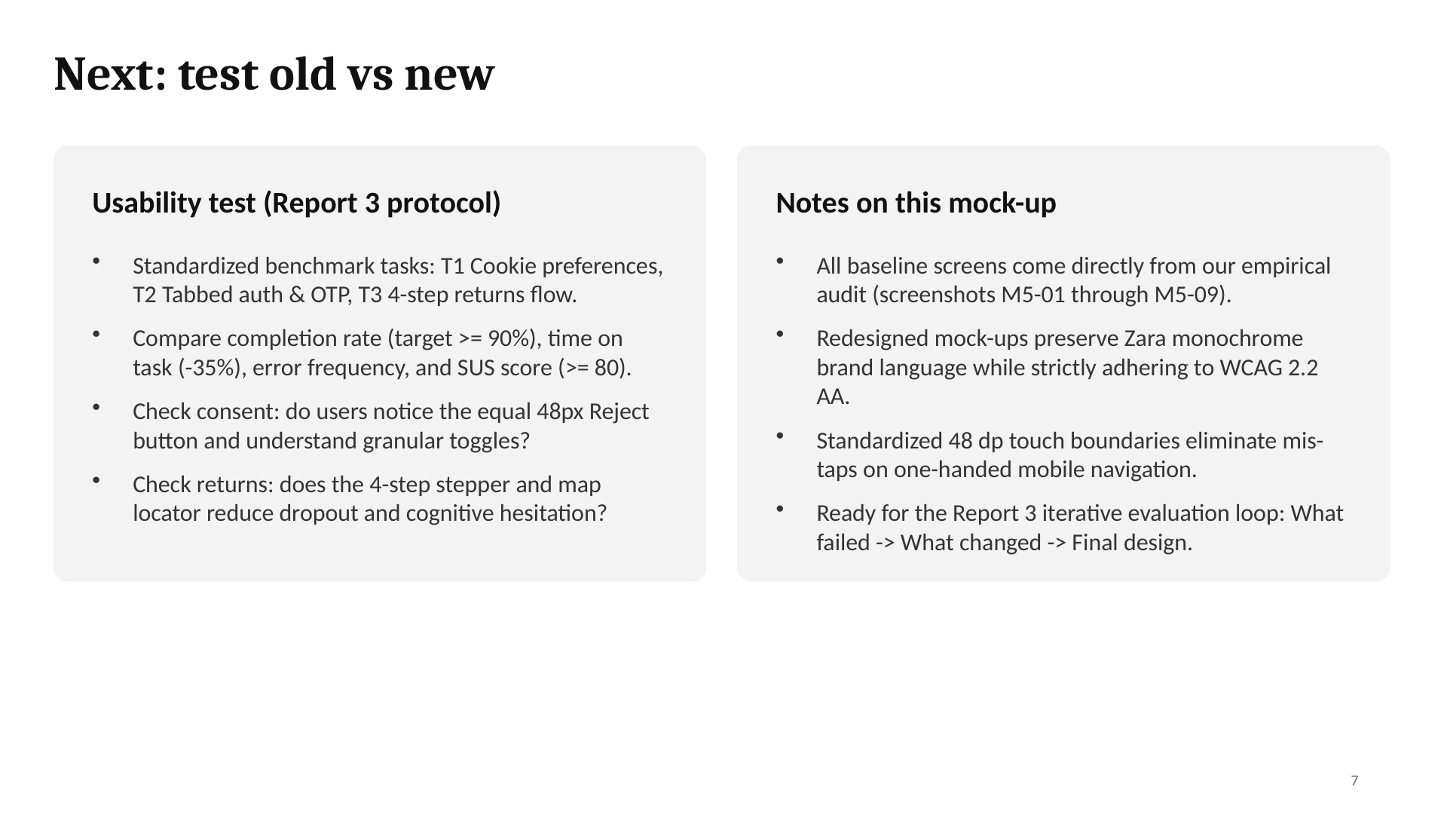
Notes:
Speaker: Hieu. Evaluation framework prepared for user testing in Report 3 to validate empirical improvements.

Slide 32



Next: test the old and the new design
Same tasks
What we measure
What we check
Each user tries the same tasks on the old and the new design.
Task completion rate
Time on task
Number of errors
Satisfaction (SUS score)
Do users find search and the filter faster?
Do they see the sizes before ADD?
Do they know if they really paid?
Do they understand the returns steps?
Search for “bead” and filter
Add the coat in size M
Change the size in the bag
Start a return
Notes:
Whole team. The next step is a usability test. We will give users the same tasks on the original Zara app and on our redesigns, and compare completion, time, errors and satisfaction. The results will show which changes really help and what we still need to improve.

Slide 33
Thank you
Questions and feedback are welcome.
Tran Thi Bao Khuong
Le Ngoc Thuy Dung
Pham Chi Thuan
Le Khanh Linh
Dang Trung Hieu
20225027 · Home & menu
20225030 · Search & list
20225018 · Product page
20225020 · Bag & checkout
20225003 · Account & help
Designing User Interfaces · Prof. Gerrit Meixner · HHN × VGU
Notes:
Close and invite questions. Each member answers questions about their own part.

