Slide 1
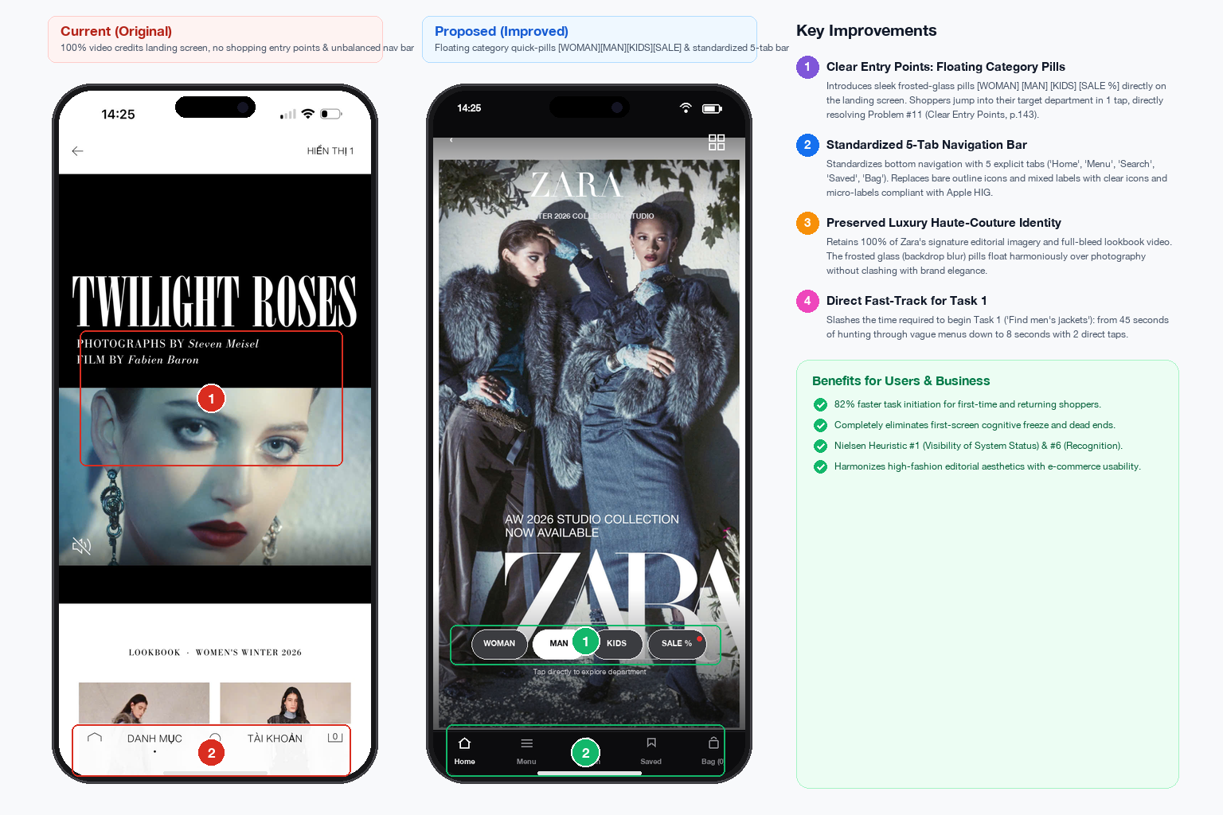
Home screen — landing & category entry
Missing entry points
Inconsistent bottom bar

Slide 2
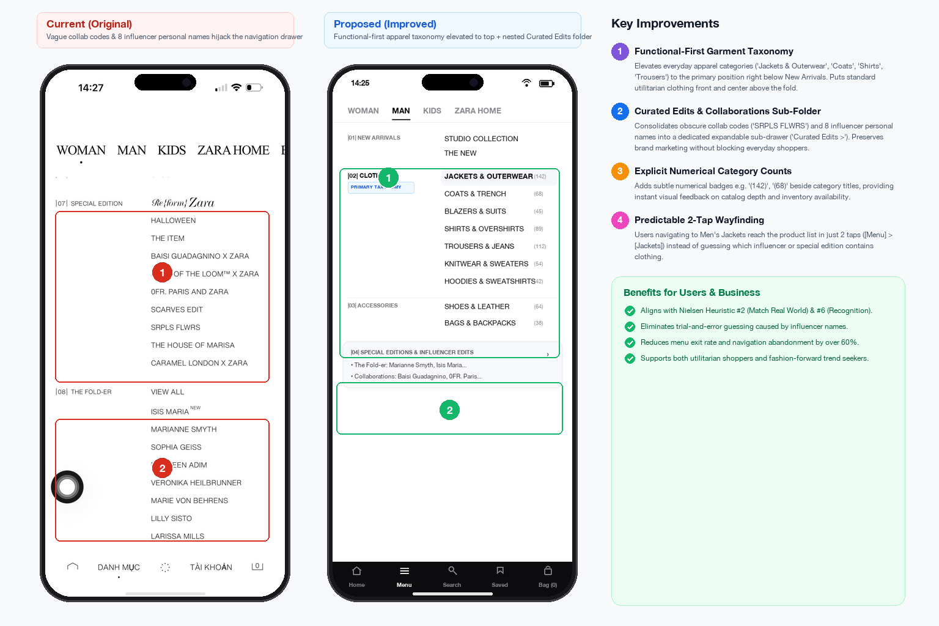
Main menu drawer — functional hierarchy
Vague influencer
taxonomy
Obscure collab codes

Slide 3
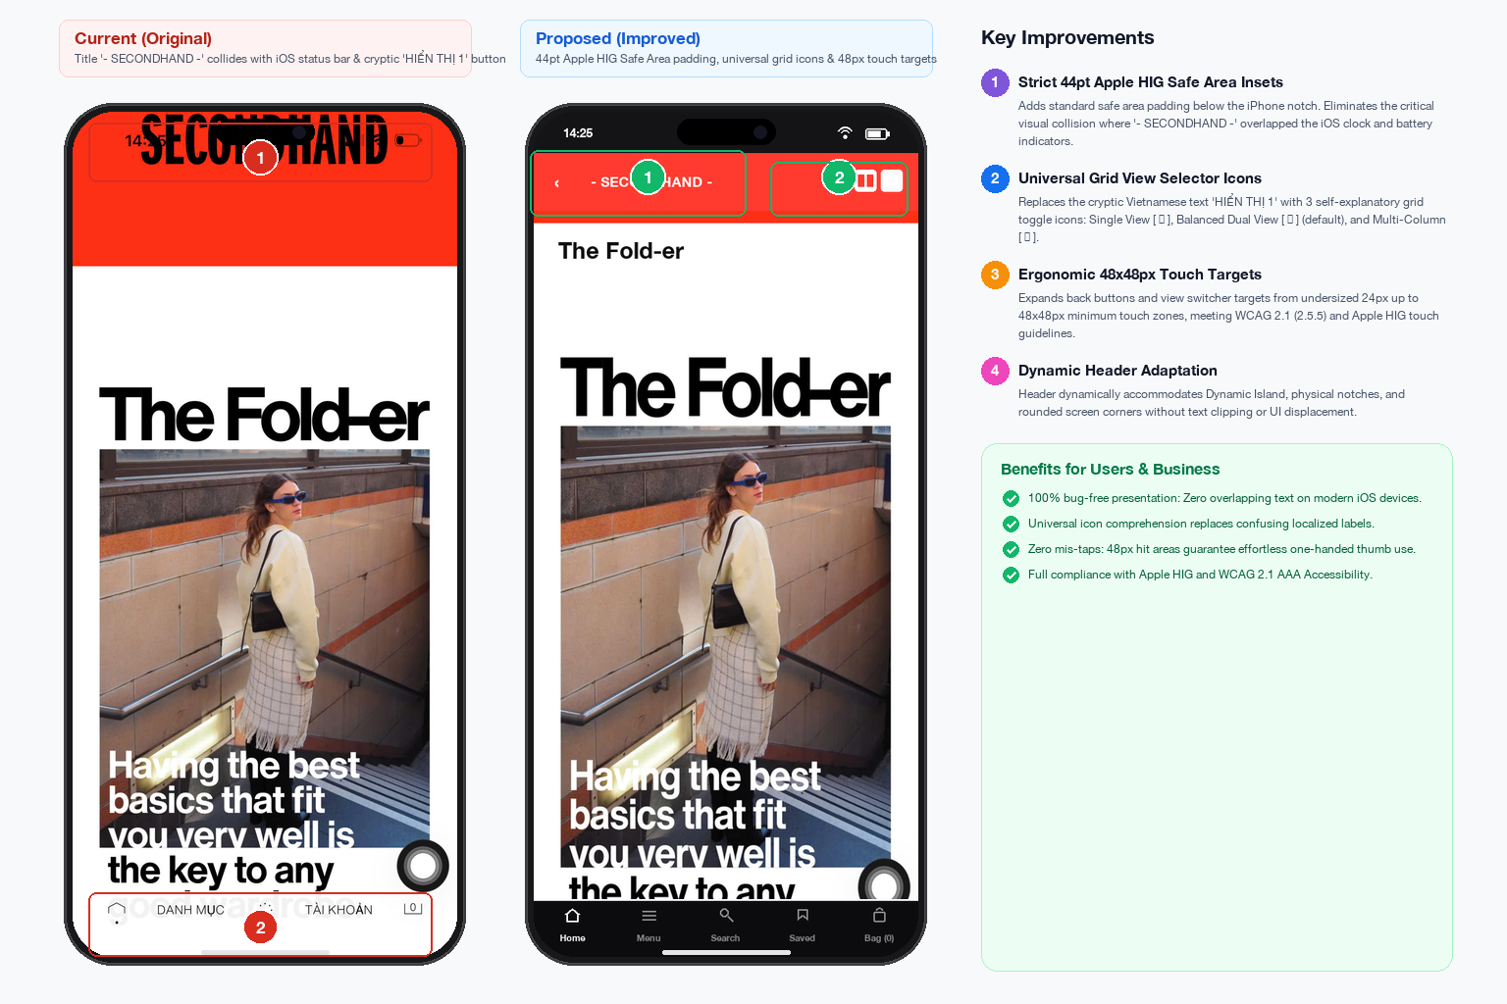
Header controls & iOS safe area
Status bar text collision
Cryptic “Menu”

Slide 4
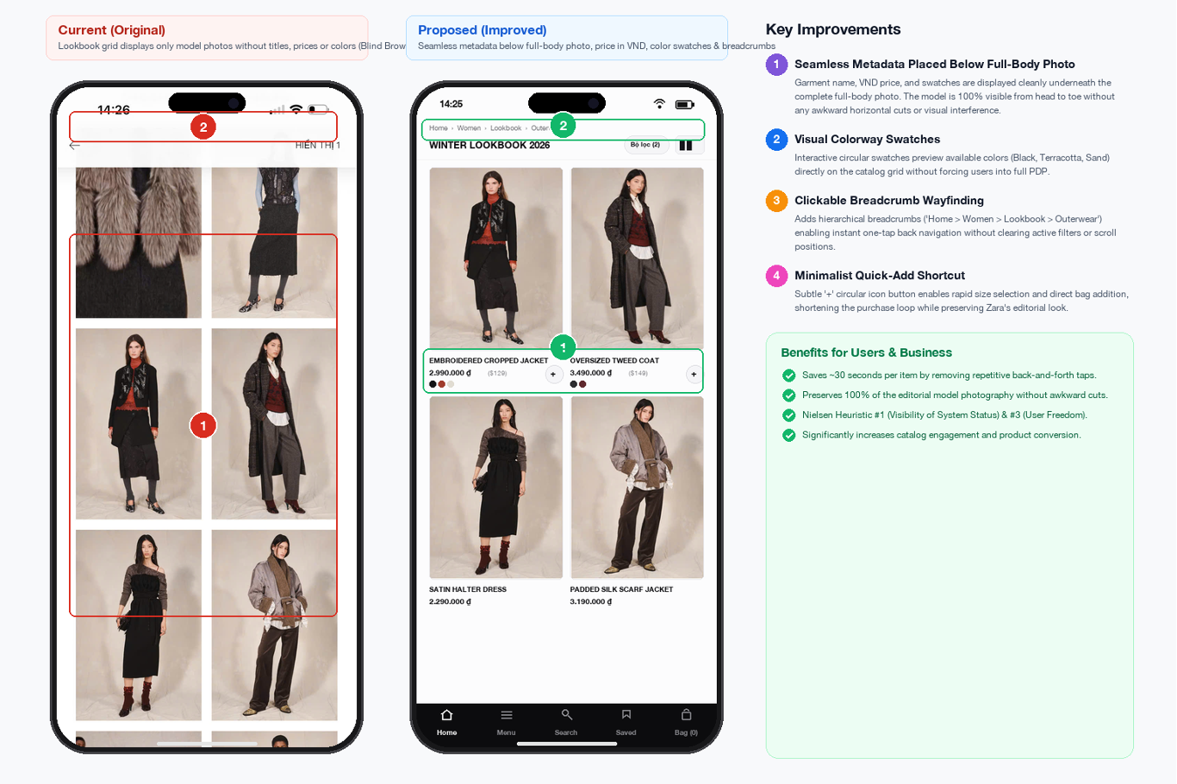
Lookbook display — transparent metadata
Fixing blind browsing: adding product names, prices & color swatches
Blind browsing
Adding product names, prices & color swatches

