Slide 1
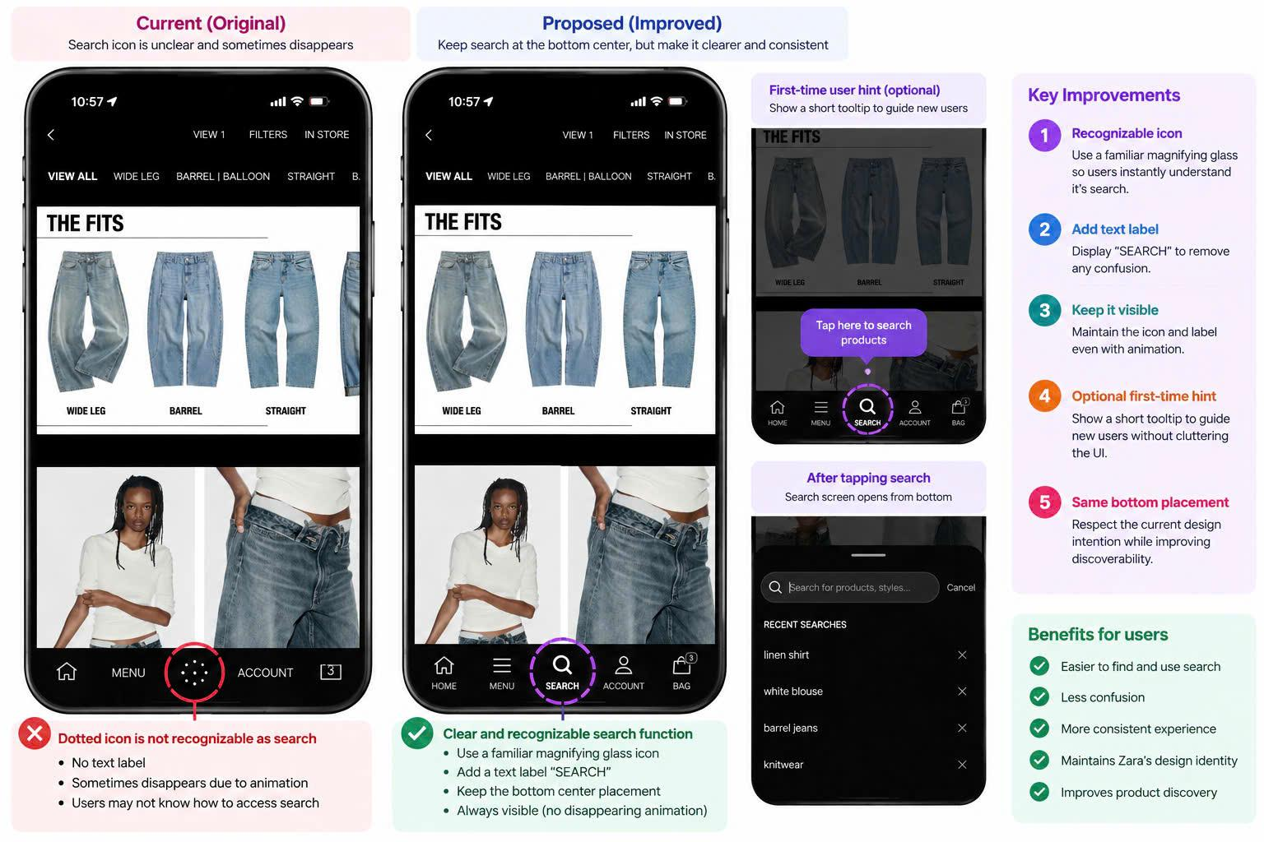
Search Discovery

Slide 2
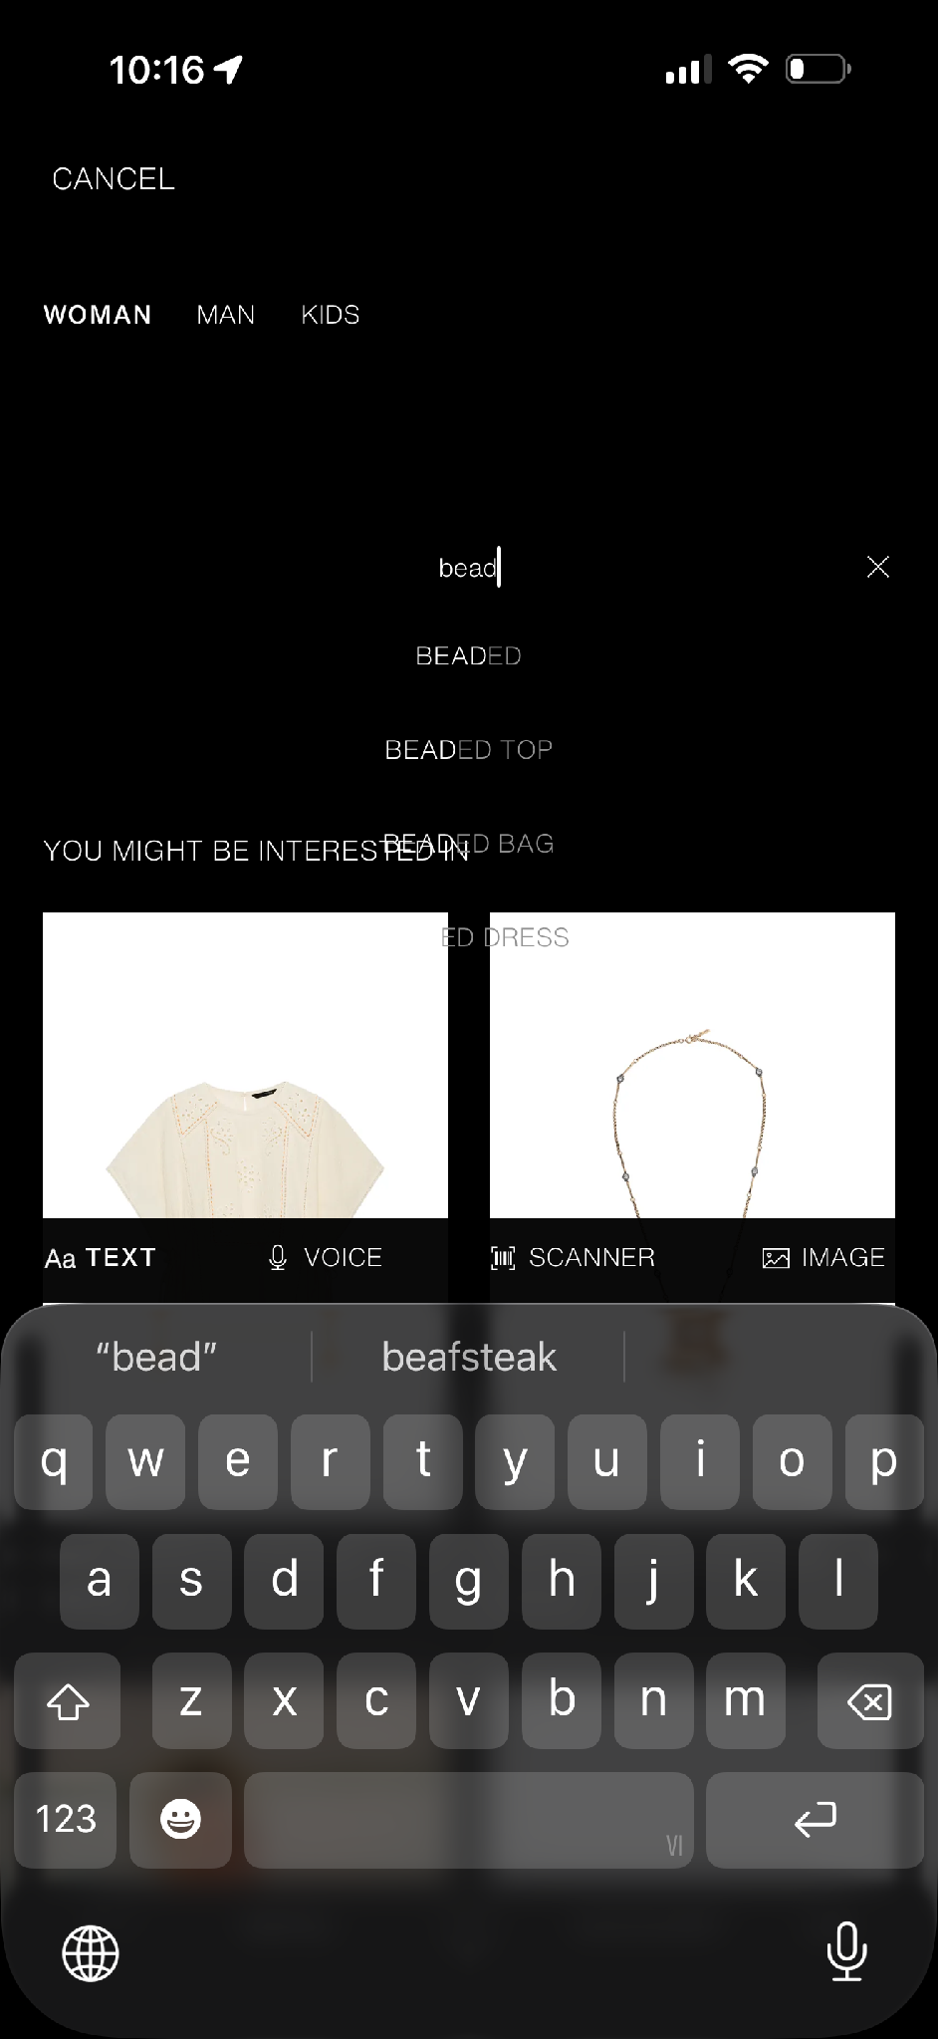
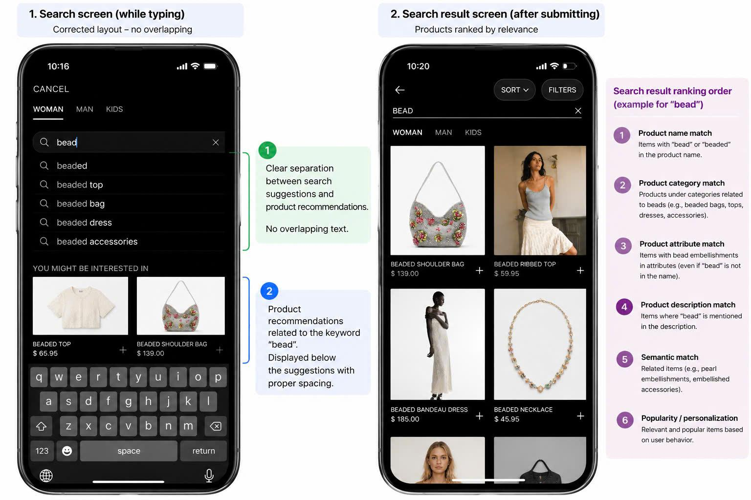
Search screen — while typing
Fixing overlapping autocomplete suggestions
BEFORE · ORIGINAL
AFTER · REDESIGNED

Slide 3
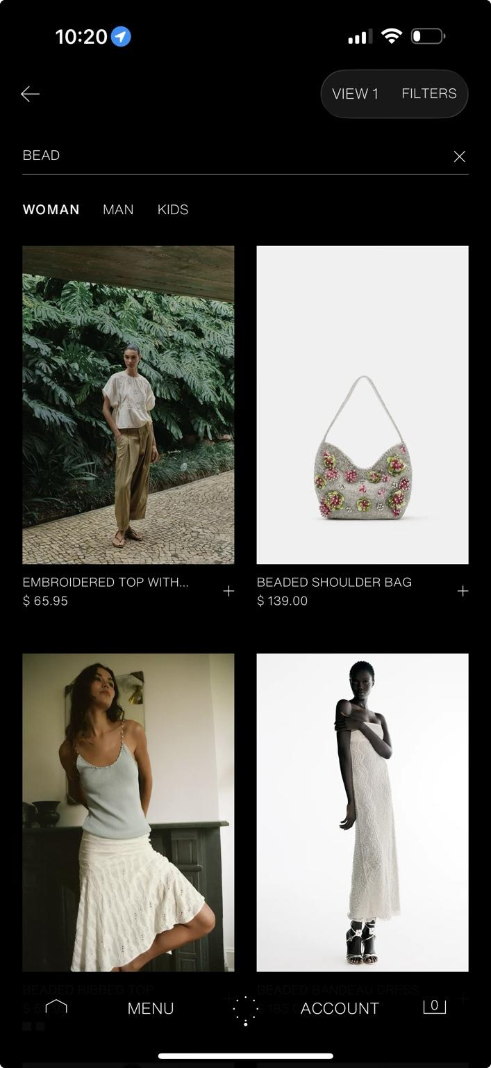
Search results — after submitting
Prioritizing keyword relevance
BEFORE · ORIGINAL
AFTER · REDESIGNED

Slide 4
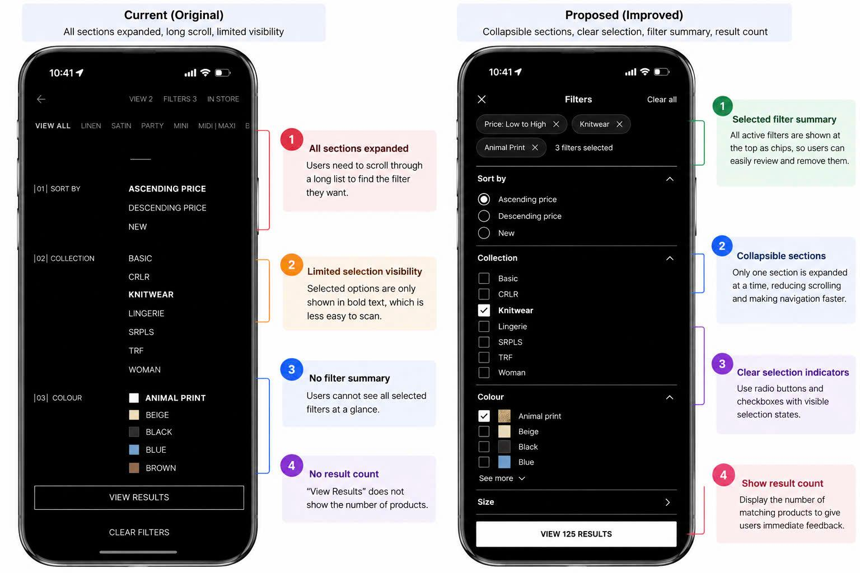
Filter

Slide 5
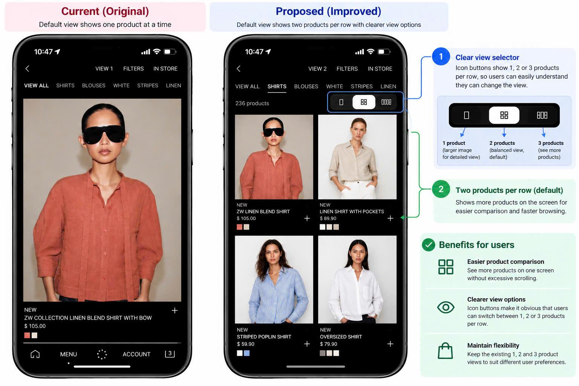
Product list display

