Slide 1
Book Reading WebSite
C# project: SE1303
Instructor: Hapn

Slide 2
Overview
In this slide:
1/System overview
2/Database diagram
3/Use case overview
4/UI

Slide 3
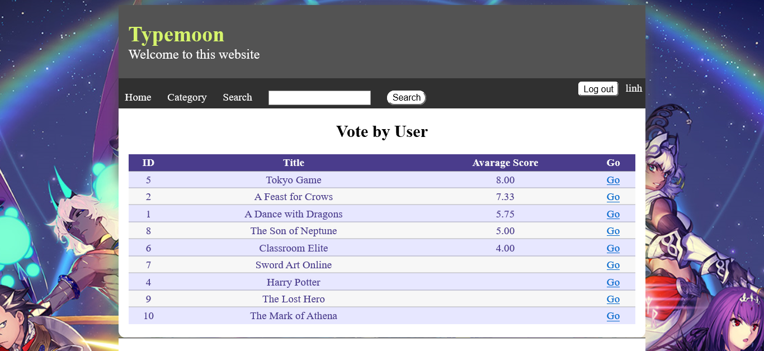
1/System overview
The project team will develop a website of storytelling community where users post their stories related to their feelings, mood. It is not necessary to write stories but instead you can even read the stories written by other people around the world. Users are able to comment and join discussions.

Slide 4
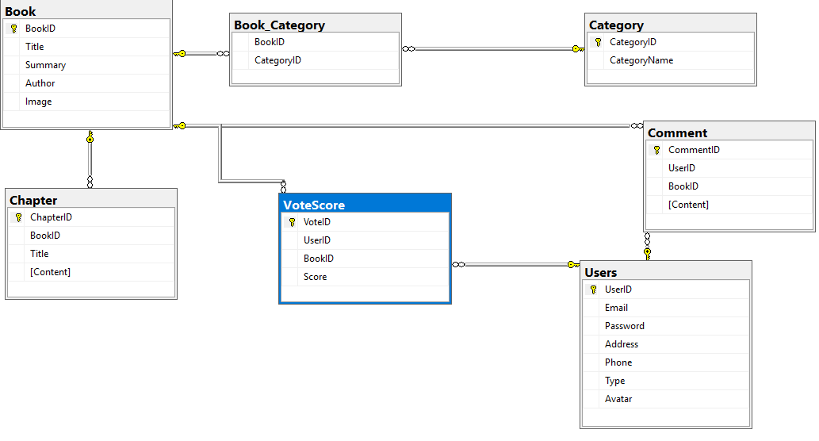
2/Data base diagram
This is an overview of database in our system

Slide 5
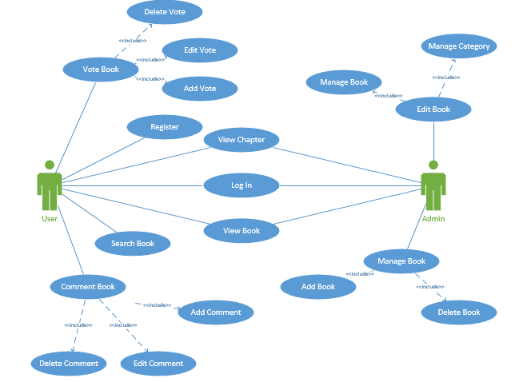
3/Use case overview
This is an overview of use case diagram

Slide 6
4/USER INTERFACE
Home page for User

Slide 7
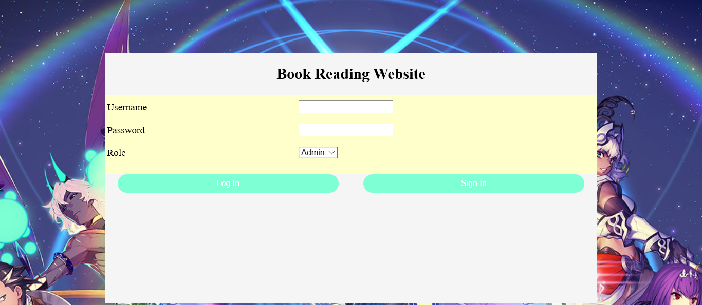
4/USER INTERFACE
Login user interface

Slide 8
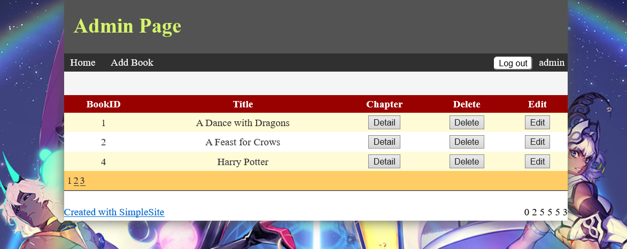
4/USER INTERFACE
Home page for Admin

Slide 9
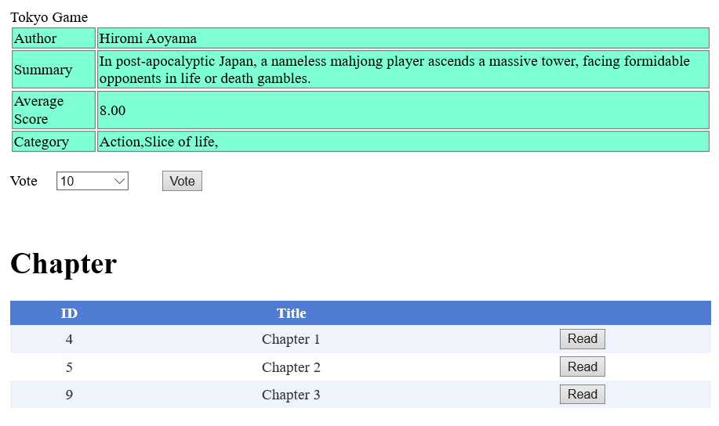
4/USER INTERFACE
User Book Detail

Slide 10

4/USER INTERFACE
Vote Section

Slide 11
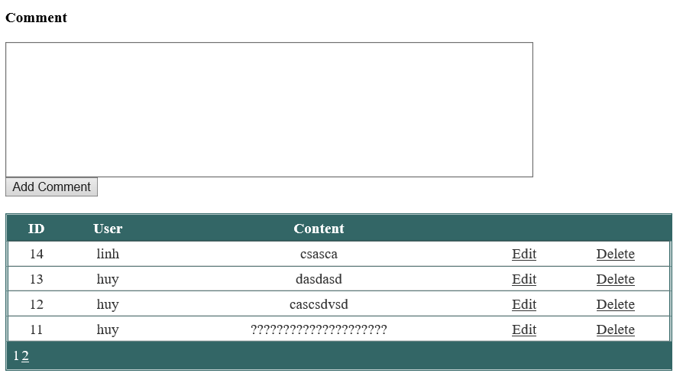
4/USER INTERFACE
Comment Section

Slide 12
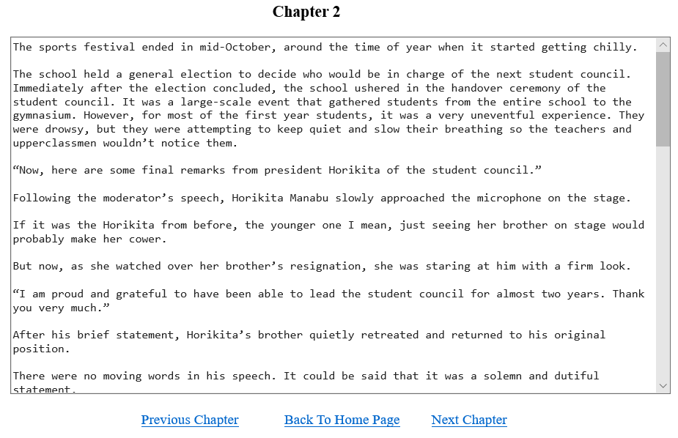
4/USER INTERFACE
Read Book

