Slide 1
Simple Animations
Today’s Topics
  Simple animations
  Buffered graphics
  Animations in Haskell
  Complex animations
  Lifting primitives to animations
  Behaviors
  Type classes, animations, and Behaviors
  Time translation
Reading Assignment
  Haskell School of Expression
    Read chapter 13 - A Module of Simple Animations

Slide 2
Animations
An animation is a “moving” graphic.
  Sometimes we say a time dependent graphic, since where it “moves” to is dependent upon time.
To create the illusion of “movement” we need draw frames with a different picture each frame.
  A frame rate of about 30 frames a second is optimal
  less than 15-20 appears to flicker
  greater than 30 gives no apparent improvement
To draw a frame we need to erase the old frame before drawing the new frame.
All our drawings have been accumulative (we never erase anything, just draw “over” what’s already there).
There exist several strategies for frame drawing.

Slide 3
Buffered graphics
Display devices display the information stored in the video memory.
Buffered graphics use two sets of memory, instantaneously switching from one memory to the other, so quickly that the flicker effect is unobservable.
HI
H
I
THERE
T
H
E
R
E
H
I
This video memory free for
writing while the other is displayed

Slide 4
Haskell interface to buffered graphics
Usual tick rate = 30
times per second
timeGetTime
  timegetTime :: IO Word32
  Returns the current time. This time has no real bearing on anything tangible. It is just a big number, and measures the time in milliseconds. The “difference” between successive calls accurately measures elapsed time.
setGraphic
  setGraphic :: Window -> Graphic -> IO()
  Writes the graphic into the “free” video graphic buffer. At the next frame “tick” what’s in the “free” video buffer will be drawn, and the current buffer will become the free buffer.

Slide 5
Interface to the richer window interface.
Old interface:
openWindow :: String -> Point -> IO Window
e.g. openWindow “title” (width,height)
Richer interface:
openWindowEx :: String -> Maybe Point
Maybe Point -> (Graphic -> DrawFun) ->
Maybe word32 -> IO Window
openWindowEx “title”
(Just(x,y)) -- upper left corner
(Just(width,height))
drawFun
(Just 30) -- refresh rate

Slide 6
Animations in Haskell
type Animation a = Time -> a
type Time = Float
rubberBall :: Animation Shape
rubberBall t = Ellipse (sin t) (cos t)
animate :: String -> Animation Graphic -> IO ()
main1 :: IO ()
main1 = animate "Animated Shape"
(withColor Blue .
shapeToGraphic .
rubberBall)

Slide 7
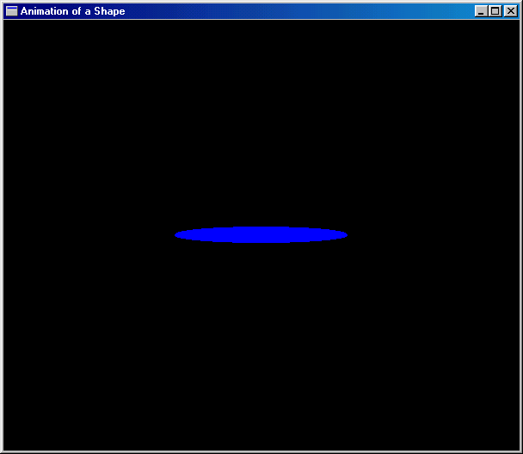
Example
Shape pulses from
this
to this
to this

Slide 8
The animate function
animate :: String -> Animation Graphic -> IO ()
animate title anim
= runGraphics (
do w <- openWindowEx title (Just (0,0)) (Just Win,yWin))
drawBufferedGraphic
t0 <- timeGetTime
let loop =
do t <- timeGetTime
let word32ToInt = fromInteger . toInteger
let ft = intToFloat (word32ToInt(t-t0))/1000
setGraphic w (anim ft)
spaceCloseEx w loop
loop
)

Slide 9
Complex Animations
revolvingBallB :: Behavior Picture
revolvingBallB
= let ball = shape (ell 0.2 0.2)
in reg red (translate (sin time, cos time) ball)
planets :: Animation Picture
planets t
= let p1 = Region Red (Shape (rubberBall t))
p2 = Region Yellow (revolvingBall t)
in p1 `Over` p2
tellTime :: Animation String
tellTime t = "The time is: " ++ show t

Slide 10
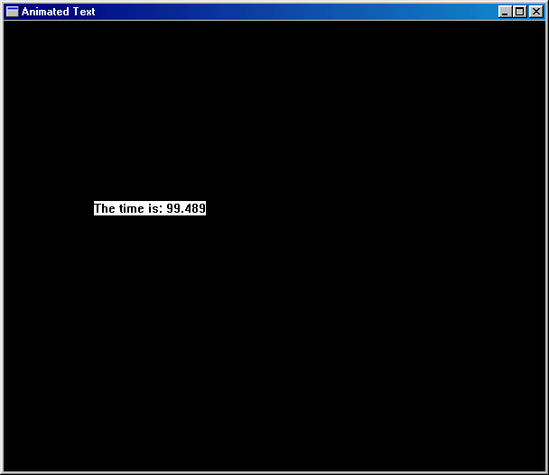
Telling Time
main2 = animate "Animated Text”
tellTime
(return . text (100,200))
The time changes
as time advances

Slide 11
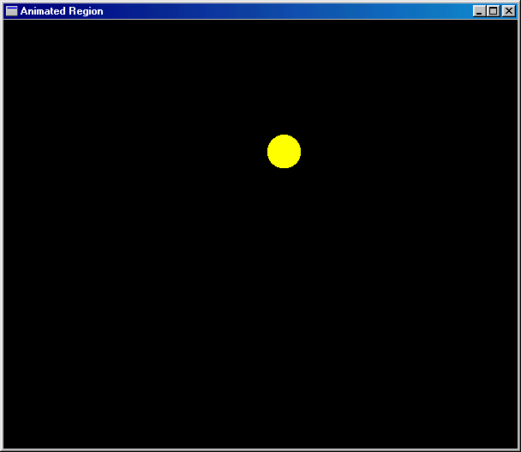
Revolving Circle
regionToGraphic :: Region -> Graphic
regionToGraphic = drawRegion . regionToGRegion
main3 :: IO ()
main3 =
animate "Animated Region"
(withColor Yellow .
regionToGraphic .
revolvingBall)
Ball
rotates

Slide 12
Animating Pictures
Case analysis over
structure of region.
Use the primitives
`overGraphic`
&
emptyGraphic
picToGraphic :: Picture -> Graphic
picToGraphic (Region c r)
= withColor c (regionToGraphic r)
picToGraphic (p1 `Over` p2)
= picToGraphic p1 `overGraphic` picToGraphic p2
picToGraphic (Text v str) = (text (trans v) str)
picToGraphic EmptyPic = emptyGraphic
main4 :: IO ()
main4 = animate "Animated Picture"
(picToGraphic . planets)

Slide 13
Lifting primitives to animations
Its useful to define “time varying” primitives, like Picture
  type Animation a = Time -> a
  type Anim = Animation Picture
  type Time = Float
First an Anim which doesn’t really vary
  emptyA :: Anim
  emptyA t = EmptyPic
Combining time varying pictures
  overA :: Anim -> Anim -> Anim
  overA a1 a2 t = a1 t `Over` a2 t
  overManyA :: [Anim] -> Anim
  overManyA = foldr overA emptyA
Recall
Anim =
Animation Picture =
Time -> Picture
hence the time
parameter t

Slide 14
Time Translation
timeTransA :: (Time -> Time) ->
Animation a -> Animation a
or
timeTransA :: Animation Time ->
Animation a -> Animation a
timeTransA f a t = a (f t)
or
timeTransA f a = a . f
timeTransA (2*) anim -- runs twice as fast
timeTransA (5+) anim -- runs 5 seconds behind

Slide 15
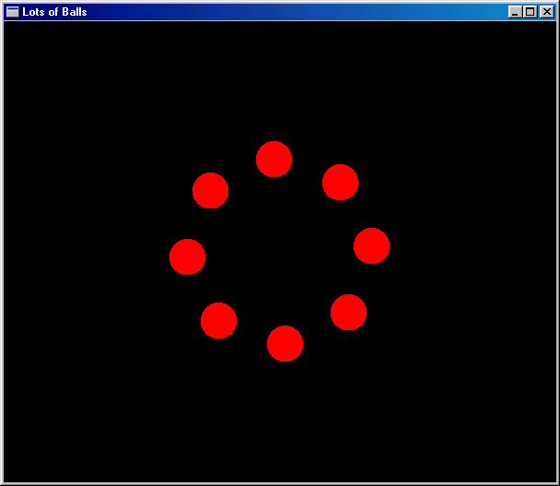
Example
revolvingBallB :: Behavior Picture
revolvingBallB
= let ball = shape (ell 0.2 0.2)
in reg red (translate (sin time, cos time) ball)
main5 :: IO ()
main5 = animateB "Revolving Ball Behavior" revolvingBallB
Ball rotates around screen

Slide 16
Type Classes and Animations
“Polymorphism captures similar structure over different values, while type classes capture similar operations over different structure.”
Capture the similar operations on different things which vary over time with a Haskell Class.
First define a new type:
  newtype Behavior a = Beh (Time -> a)
  newtype like data in Haskell
  doesn’t require the overhead that ordinary data definitions require since there is only 1 constructor function.

Slide 17
Lifting ordinary functions to Behavior’s
lift0 :: a -> Behavior a
lift0 x = Beh (\t -> x)
lift1 :: (a -> b) -> (Behavior a -> Behavior b)
lift1 f (Beh a) = Beh (\t -> f (a t))
lift2 :: (a -> b -> c) ->
(Behavior a -> Behavior b -> Behavior c)
lift2 g (Beh a) (Beh b) = Beh (\t -> g (a t) (b t))
lift3 :: (a -> b -> c -> d) ->
(Behavior a -> Behavior b -> Behavior c -> Behavior d)
lift3 g (Beh a) (Beh b) (Beh c)
= Beh (\t -> g (a t) (b t) (c t))

Slide 18
Making Behavior Instances
instance Eq (Behavior a) where
a1 == a2 = error "Can't compare animations."
instance Show (Behavior a) where
showsPrec n a1 =
error "Can't coerce animation to String."
  The instances for Eq and Show are bogus, but are necessary in order to define the Num class which requires Eq and Show
instance Num a => Num (Behavior a) where
(+) = lift2 (+); (*) = lift2 (*)
negate = lift1 negate; abs = lift1 abs
signum = lift1 signum
fromInteger = lift0 . fromInteger

Slide 19
More Instances
instance Fractional a => Fractional (Behavior a) where
(/) = lift2 (/)
fromRational = lift0 . fromRational
instance Floating a => Floating (Behavior a) where
pi = lift0 pi; sqrt = lift1 sqrt
exp = lift1 exp; log = lift1 log
sin = lift1 sin; cos = lift1 cos
tan = lift1 tan
asin = lift1 asin; acos = lift1 acos
atan = lift1 atan
sinh = lift1 sinh; cosh = lift1 cosh
tanh = lift1 tanh
asinh = lift1 asinh; acosh = lift1 acosh
atanh = lift1 atanh

Slide 20
Time
time :: Behavior Time
time = Beh (\t -> t)
A New Class
class Ani a where
empty :: a
over :: a -> a -> a

Slide 21
Instances for Our types
instance Ani [a] where
empty = []
over = (++)
data Fun a = Fun (a->a)
instance Ani (Fun a) where
empty = Fun id
Fun a `over` Fun b = Fun (a . b)
instance Ani Picture where
empty = EmptyPic
over = Over
instance Ani a => Ani (Behavior a) where
empty = lift0 empty
over = lift2 over
What type is “empty” here?

Slide 22
Things that can turn
class Turnable a where
turn :: Float -> a -> a
instance Turnable Picture where
turn theta (Region c r) =
Region c (turn theta r) -- turn on Regions
turn theta (p1 `Over` p2) = turn theta p1 `Over` turn theta p2
turn theta EmptyPic = EmptyPic
instance Turnable a => Turnable (Behavior a) where
turn theta (Beh b) = Beh(turn theta . b)

Slide 23
Turning Shapes
type Coordinate = (Float,Float)
rotate :: Float -> Coordinate -> Coordinate
rotate theta (x,y) =
(x*c + y*s, y*c - x*s)
where (s,c) = (sin theta,cos theta)
instance Turnable Shape where
turn theta (Polygon ps) =
Polygon (map (rotate theta) ps)
-- lots of missing cases here for
-- turn theta (Rectangle s1 s2) =
-- turn theta (Ellipse r1 r2) =
-- turn theta (RtTriangle s1 s2) =

Slide 24
Turning Regions
instance Turnable Region where
turn theta (Shape sh) = Shape (turn theta sh)
-- lots of missing cases here for
-- turn theta (Translate (u,v) r) =
-- turn theta (Scale (u,v) r) =
-- turn theta (Complement r) =
-- turn theta (r1 `Union` r2) =
-- turn theta (r1 `Intersect` r2) =
-- turn theta Empty = Empty
A final example. See the text pages 209-212
main7 in today’s Haskell code.

