Slide 1
Using Cabal and the Hackage Package Database

Slide 2
Hackage
Hackage is a database of Haskell packages (or modules) written by others and available for public use.
The home page is
http://hackage.haskell.org/packages/hackage.html
Browse what packages are available at:
http://hackage.haskell.org/packages/archive/pkg-list.html

Slide 3
Cabal
Cabal is a utility (written in Haskell) that downloads and installs packages from the Hackage database
Cabal is part of the Haskell Platform so you already have it on your computer

Slide 4
Simple Steps
Open up a shell window (command window on Windows: start -> run -> command)
Update your local copy of what packages are in the database
Type: cabal update
This takes a while, the database is big!
Search for packages that match a search string
Type: cabal list haskore
Type: Install the package you want
Type cabal install haskore-vintage

Slide 5
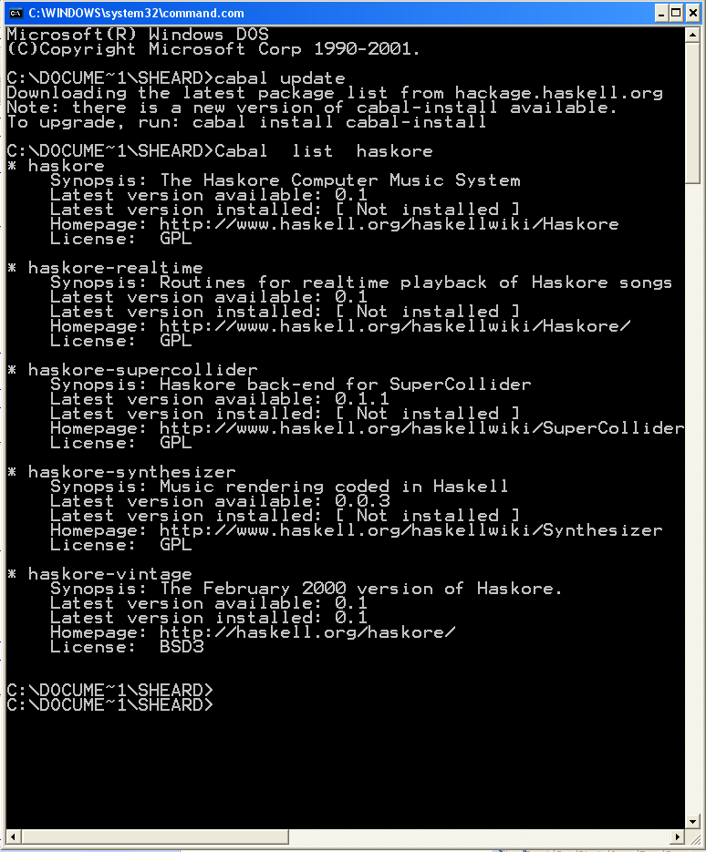

Slide 6
Finding Packages
If you have no idea of the name of the package you want, then cabal list isn’t much help.
Browse the list of packages at the link
http://hackage.haskell.org/packages/archive/pkg-list.html

Slide 7
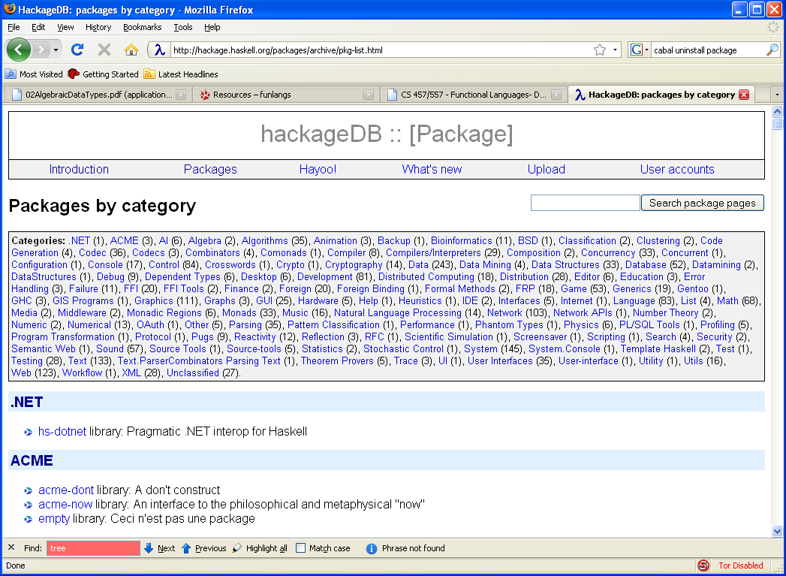
Google style searches supported here

