Slide 1
Data in Haskell

Slide 2
What is data?
Measurements of some kind stored in a computer.
Examples
Simple: numbers, text, truth values …
Structured: sequences, sets, records …
Complex: dictionaries, music, pictures …

Slide 3
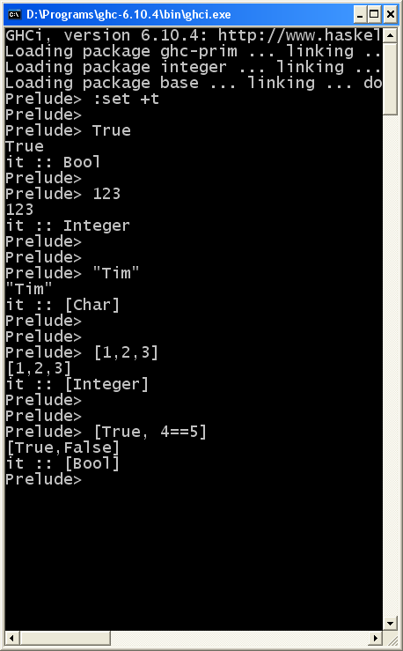
Data in Haskell
Numbers – Int, Integer, Double etc.
23
67.3
Truth Values – Bool
True False
Text – String
“Tim”
“23”
Sequences – List
[1,3,4]
[True,False]

Slide 4
What kinds of Data can we use?
There are many different kinds of data.
Haskell comes with a set of predefined data
For now – Integer, Bool, List, String
Later we will learn how to define our own (new) kinds of data
Stack, Queue, Tree, Table, Hash, …

Slide 5
Operations on data
To do anything interesting we need operations that compute new data from old data
Examples
Integer: div mod (+) (-) (*)
Bool: (&&) (||) not
List: (++) head tail reverse length
Operations come in two forms
Prefix: div 8 2
Infix : 8 * 2
We write surround infix operators with parentheses (*) when we want to talk about them (but not when we use them)

Slide 6
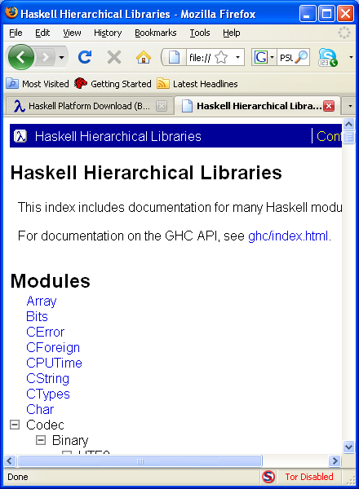
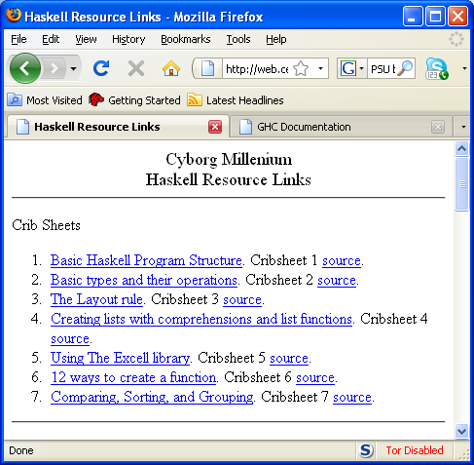
What operations are there?
Many different ways to find operations
Click on the Libraries link from the users guide
Use one of the crib sheets from the Haskell Resource Links

Slide 7
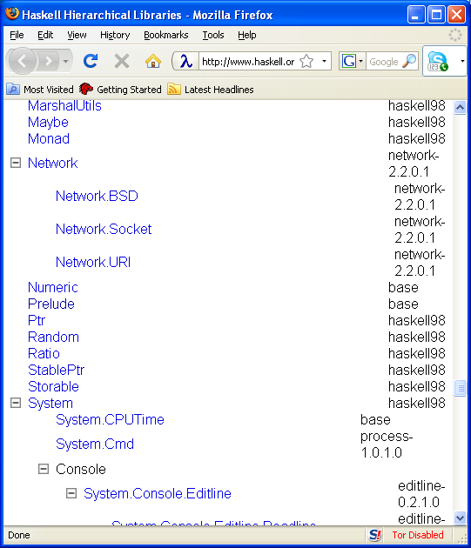
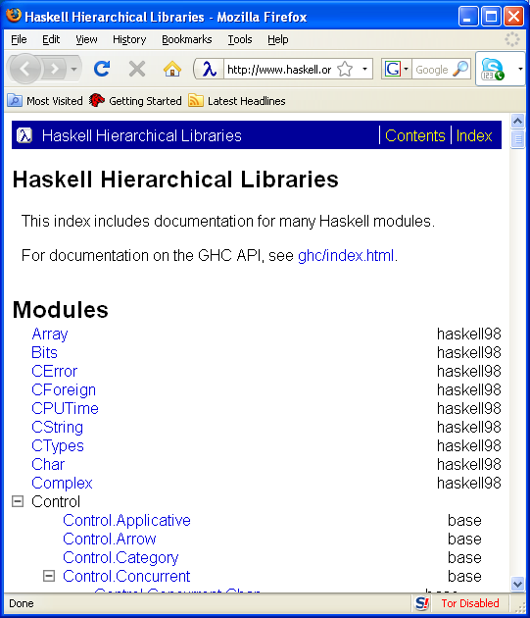
Hierarchical Libraries
Click “Libraries” from the users guide
Slide down to the “Prelude” library

Slide 8
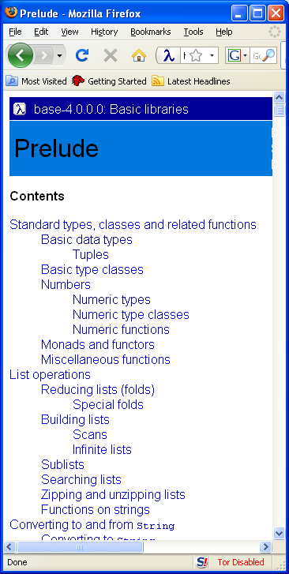
Explore the Prelude
Once the prelude window is found -
Click the links and explore all the predefined operations in Haskell

Slide 9
Naming Values
X = 3 + 4
Name
expression
equality
Many program are just a series of named values.

Slide 10
Using implicit types
Every legal expression has a type.
Examples
Integer
String
Char
Double
[Integer]
Bool

Slide 11
Overloading
Some expressions have more than one type.
The numeric constants are especially bothersome
These will cause you many headaches until you get used to the error messages.
Example
5:: Integer
5:: Double
5:: Int
5:: Num t => t

Slide 12
Commands
Commands cause an action on the world.
Most commonly used commands perform Input and Output.
Read from the key board
getLine, getContents
Print to the console
putStrLn, print
Read from files
readFile, writeFile

Slide 13
Writing functions

Slide 14
Making lists

Slide 15
Example functions
Factorial
99 beer song
Rolling two die
12 days of christmas
Digitval and string to value
Sort maximum, elemIndices, take , drop
Maximum, filter, (++)

