Slide 1
Getting Started with Haskell
Tim Sheard

Slide 2
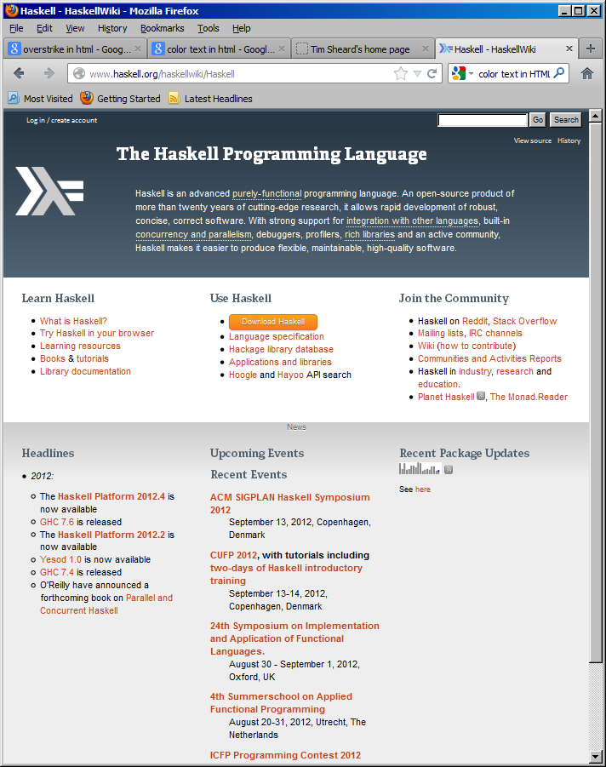
Installing GHCI
We will use Haskell Platform 2012.4
Goto haskell.org
Click on the Haskell platform

Slide 3
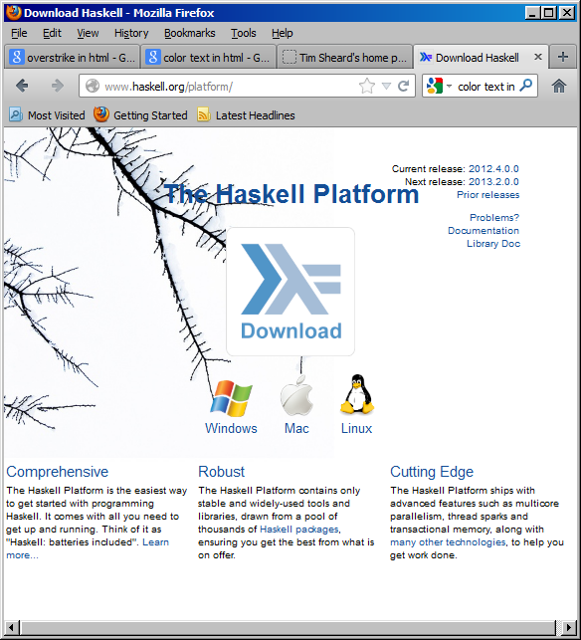
Installing the platform
Choose your operating system
Windows
Mac
Linux
On Debian
apt-get install ghc6
Follow directions
Ask me if you have problems

Slide 4
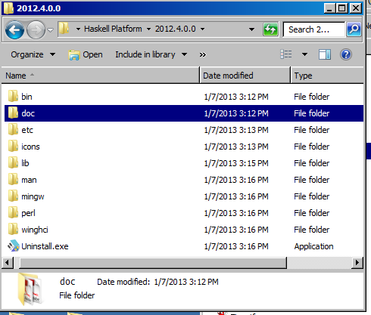
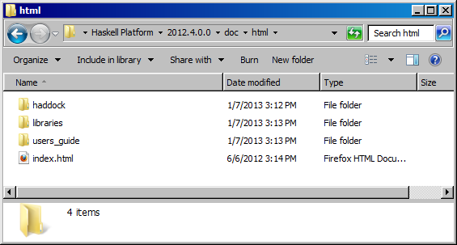
Getting Help
On Windows, in the directory where GHC is installed, there is a directory called “doc”
In this directory is another directory called html, and here there is afile called “index.html”
Book mark this in your browser

Slide 5
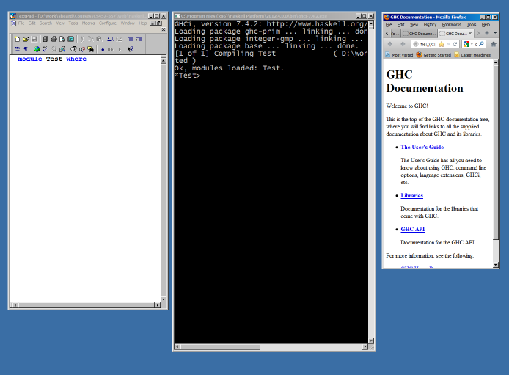
Advice
Arrange your screen with side by side windows
Editor
GHCI
Help

Slide 6
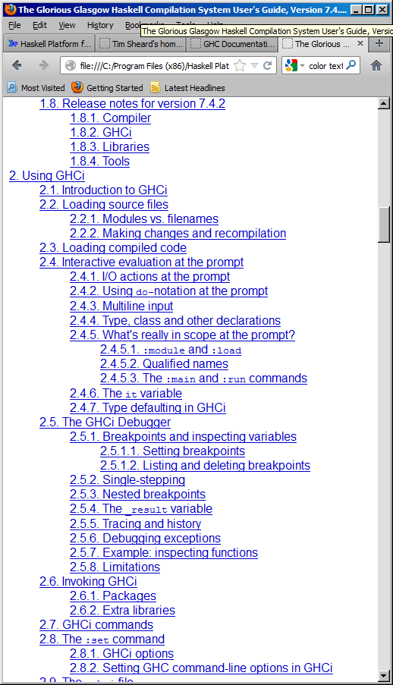
Learning what’s possible
From the index page click on “The Users Guide”
Scroll down to “Using GHCI”
Explore

Slide 7
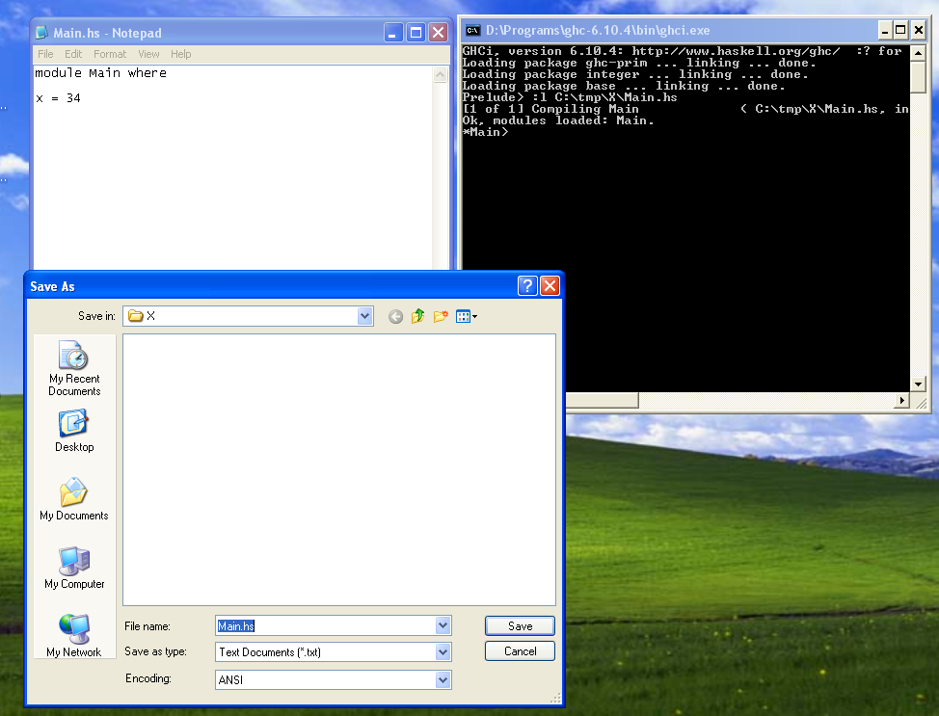
Writing a program
Start up an editor
Start up ghci
Write a program in the editor,
save the file
“open” the file in ghci by using
:l C:\tmp\X\Main.hs

Slide 8
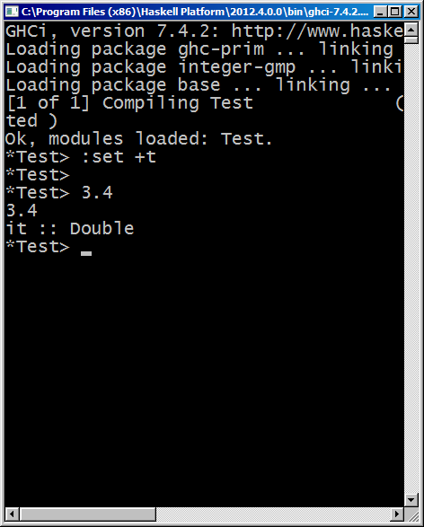
Setting Options
GHCi allows the user to set many options.
I recommend use of the “show type option” especially for new users
:set +t

Slide 9
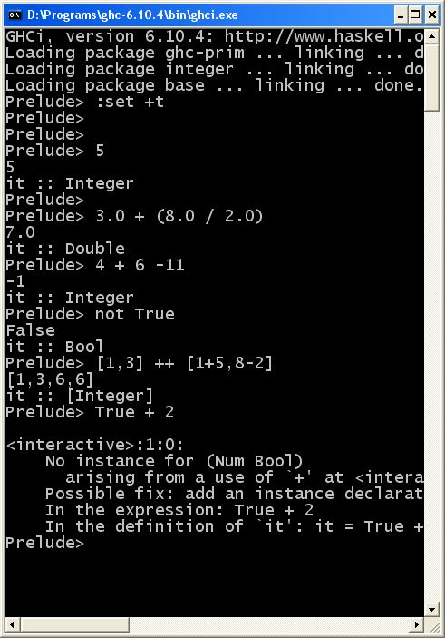
Interaction in Ghci
Type an expression
GHCI checks that it is well formed
Well-typed
Evaluates the expression
Carries out the computation
Prints the result
And the Type

