Slide 1
Testing in Haskell: an introduction to HUnit and QuickCheck
Mark P Jones
Portland State University

Slide 2
Testing, Testing, Testing, …

Slide 3
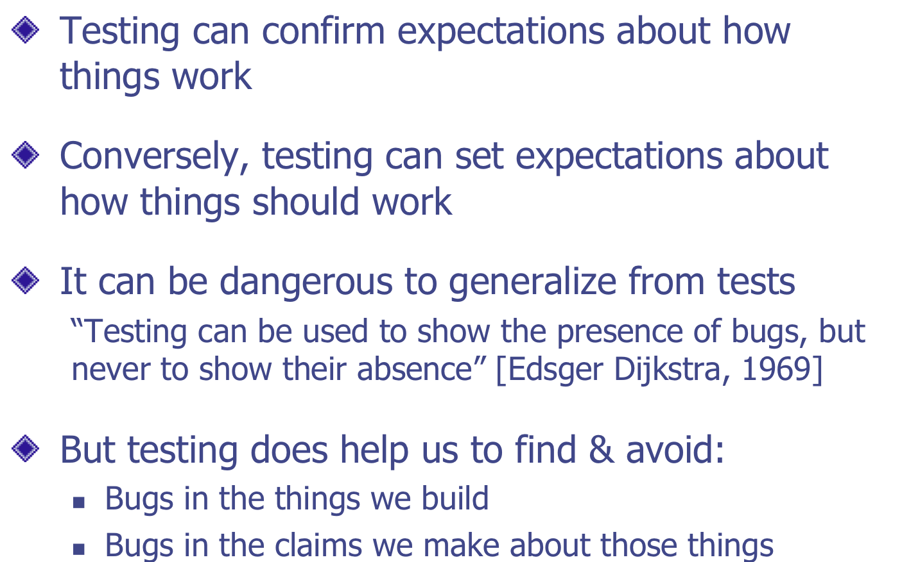
Testing:

Slide 4
Example: filter
filter :: (a -> Bool) -> [a] -> [a]
filter even [1..10] = [2,4,6,8,10]
filter (<5) [1..100] = [1,2,3,4]
filter (<5) [100,99..1] = [4,3,2,1]

Slide 5
Making Tests Executable:
test1 = filter even [1..10] == [2,4,6,8,10]
test2 = filter (<5) [1..100] == [1,2,3,4]
test3 = filter (<5) [100,99..1] == [4,3,2,1]

Slide 6
Making Tests Executable:
test1 = filter even [1..10] == [2,4,6,8,10]
test2 = filter (<5) [1..100] == [1,2,3,4]
test3 = filter (<5) [100,99..1] == [4,3,2,1]
tests = test1 && test2 && test3

Slide 7
Pros:
  Tests are simple functional programs
  Tests are self-checking
Cons:
  Have to run tests manually
  Testing stops as soon as one test fails
  No indication of which test failed
  No summary statistics (e.g., # tests run)
  Harder to handle complex behavior (e.g., testing code that performs I/O actions, raises an exception, …)

Slide 8
Unit Testing in Haskell

Slide 9
Enter HUnit:
A library for unit testing
Written in Haskell
Available from http://hunit.sourceforge.net
(Or from http://hackage.haskell.org)
Built-in to recent versions of Hugs and GHC
Just “import Test.HUnit” and you’re ready!

Slide 10
Defining Tests:
import Test.HUnit
test1 = TestCase (assertEqual
"filter even [1..10]"
(filter even [1..10])
[2,4,6,8,10])
test2 = …
test3 = …
tests = TestList [test1, test2, test3]

Slide 11
Running Tests:
Main> runTestTT tests
Cases: 3 Tried: 3 Errors: 0 Failures: 0
Main>

Slide 12
Detecting Faults:
import Test.HUnit
test1 = TestCase (assertEqual
“filter even [1..10]”
(filter even [1..10])
[2,4,6,9,10])
test2 = …
test3 = …
tests = TestList [test1, test2, test3]

Slide 13
Using HUnit:
Main> runTestTT tests
### Failure in: 0
filter even [1..10]
expected: [2,4,6,8,10]
but got: [2,4,6,9,10]
Cases: 3 Tried: 3 Errors: 0 Failures: 1
Main>

Slide 14
Labeling Tests:
…
tests = TestLabel “filter tests”
$ TestList [test1, test2, test3]

Slide 15
Using HUnit:
Main> runTestTT tests
### Failure in: filter tests:0
filter even [1..10]
expected: [2,4,6,8,10]
but got: [2,4,6,9,10]
Cases: 3 Tried: 3 Errors: 0 Failures: 1
Main>

Slide 16
The Test and Assertion Types:
data Test = TestCase Assertion
| TestList [Test]
| TestLabel String Test
runTestTT :: Test -> IO Counts
assertFailure :: String -> Assertion
assertBool :: String -> Bool -> Assertion
assertEqual :: (Eq a, Show a) =>
String -> a -> a -> Assertion

Slide 17
Problems:
Finding and running tests is a manual process (easily skipped/overlooked)
It can be hard to trim tests from distributed code
We still can’t solve the halting problem ☺

Slide 18
Example: merge
Let’s develop a merge function for combining two sorted lists into a single sorted list:
  merge :: [Int] -> [Int] -> [Int]
  merge = undefined
What about test cases?

Slide 19
Merge Tests:
Simple examples:
  merge [1,5,9] [2,3,6,10] == [1,2,3,5,6,9,10]
One or both arguments empty:
  merge [] [1,2,3] == [1,2,3]
  merge [1,2,3] [] == [1,2,3]
Duplicate elements:
  merge [2] [1,2,3] == [1,2,3]
  merge [1,2,3] [2] == [1,2,3]

Slide 20
Capturing the Tests:
mergeTests
= TestLabel "merge tests”
$ TestList [simpleTests, emptyTests, dupTests]
simpleTests
= TestLabel "simple tests”
$ TestCase (assertEqual "merge [1,5,9] [2,3,6,10]"
(merge [1,5,9] [2,3,6,10])
[1,2,3,5,6,9,10])
emptyTests
= …

Slide 21
Capturing the Tests:
Main> runTestTT mergeTests
Cases: 6 Tried: 0 Errors: 0 Failures: 0
Program error: Prelude.undefined
Main>

Slide 22
Refining the Definition (1):
Let’s provide a little more definition for merge:
  merge :: [Int] -> [Int] -> [Int]
  merge xs ys = []
What happens to the test cases now?

Slide 23
Back to the Tests:
Main> runTestTT mergeTests
### Failure in: merge tests:0:simple tests
merge [1,5,9] [2,3,6,10]
expected: []
but got: [1,2,3,5,6,9,10]
…
Cases: 6 Tried: 6 Errors: 0 Failures: 5
Main>

Slide 24
Refining the Definition (2):
Let’s provide a little more definition for merge:
  merge :: [Int] -> [Int] -> [Int]
  merge xs ys = xs
What happens to the test cases now?

Slide 25
Back to the Tests:
Main> runTestTT mergeTests
### Failure in: merge tests:0:simple tests
merge [1,5,9] [2,3,6,10]
expected: [1,5,9]
but got: [1,2,3,5,6,9,10]
### Failure in: merge tests:2:duplicate elements:0
merge [2] [1,2,3]
expected: [2]
but got: [1,2,3]
Cases: 6 Tried: 6 Errors: 0 Failures: 2
Main>

Slide 26
Refining the Definition (3):
Use type information to break the definition down into multiple cases:
  merge :: [Int] -> [Int] -> [Int]
  merge [] ys = ys
  merge (x:xs) ys = ys

Slide 27
Refining the Definition (4):
Repeat …
  merge :: [Int] -> [Int] -> [Int]
  merge [] ys = ys
  merge (x:xs) [] = x:xs
  merge (x:xs) (y:ys)
  = x:xs

Slide 28
Refining the Definition (5):
Use guards to split into cases:
  merge :: [Int] -> [Int] -> [Int]
  merge [] ys = ys
  merge (x:xs) [] = x:xs
  merge (x:xs) (y:ys)
  | x<y = x : merge xs (y:ys)
  | otherwise = y : merge (x:xs) ys

Slide 29
Back to the Tests:
Main> runTestTT mergeTests
### Failure in: merge tests:2:duplicate elements:0
merge [2] [1,2,3]
expected: [1,2,2,3]
but got: [1,2,3]
### Failure in: merge tests:2:duplicate elements:1
merge [1,2,3] [2]
expected: [1,2,2,3]
but got: [1,2,3]
Cases: 6 Tried: 6 Errors: 0 Failures: 2
Main>

Slide 30
Refining the Definition (6):
Use another guards to add another case:
  merge :: [Int] -> [Int] -> [Int]
  merge [] ys = ys
  merge (x:xs) [] = x:xs
  merge (x:xs) (y:ys)
  | x<y = x : merge xs (y:ys)
  | y<x = y : merge (x:xs) ys
  | x==y = x : merge xs ys

Slide 31
Back to the Tests:
Main> runTestTT mergeTests
Cases: 6 Tried: 6 Errors: 0 Failures: 0
Main>

Slide 32
Modifying the Definition:
Suppose we decide to modify the definition:
  merge :: [Int] -> [Int] -> [Int]
  merge (x:xs) (y:ys)
  | x<y = x : merge xs (y:ys)
  | y<x = y : merge (x:xs) ys
  | x==y = x : merge xs ys
  merge xs ys = xs ++ ys
Is this still a valid definition?

Slide 33
Back to the Tests:
Main> runTestTT mergeTests
Cases: 6 Tried: 6 Errors: 0 Failures: 0
Main>

Slide 34
Lessons Learned:
Writing tests (even before we’ve written the code we want to test) can expose key details / design decisions
A library like HUnit can help to automate the process (at least partially)
Development alternates between coding and testing
Bugs are expensive, running tests is cheap
Good tests can last a long time; continuing use as code evolves

Slide 35
Testing Laws with QuickCheck

Slide 36
Lawful Programming:
How can we give useful information about a function without necessarily having to give all the details of its definition?
Informal description:
  “map applies its first argument to every element in its second argument …”
Type signature:
  map :: (a -> b) -> [a] -> [b]
Laws:
  Normally in the form of equalities between expressions …

Slide 37
Algebra of Lists:
(++) is associative with unit []
  xs ++ (ys ++ zs) = (xs ++ ys) ++ zs
  [] ++ xs = xs = xs ++ []
map preserves identities, distributes over composition and concatenation:
  map id = id
  map (f . g) = map f . map g
  map f (xs ++ ys) = map f xs ++ map f ys

Slide 38
… continued:
filter distributes over concatenation
  filter p (xs ++ ys) = filter p xs ++ filter p ys
filter and map:
  filter p . map f = map f . filter (p . f)
composing filters:
  filter p . filter q = filter r
  where r x = q x && p x

Slide 39
Uses for Laws:
Laws can be used:
To capture/document deep intuitions about program behavior
To support reasoning about program behavior
To optimize or transform programs (either by hand, or in a compiler)
As properties to be tested
As properties to be proved

Slide 40
Wanted! Reward!
However: In the short-term, programmers don’t see any reward for writing laws …
… so they won’t write them.
If programmers can derive some benefit from writing laws, then perhaps they will do it …

Slide 41
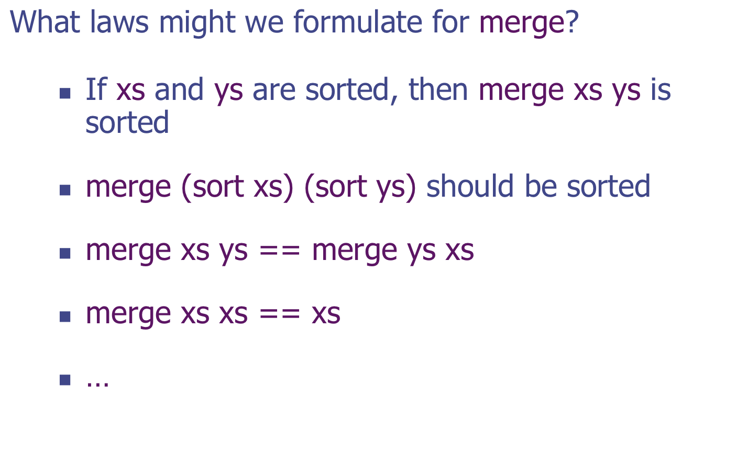
Laws for Merge:

Slide 42
From Laws to Functions:
mergeProp1 :: [Int] -> [Int] -> Bool
mergeProp1 xs ys = sorted xs ==>
sorted ys ==>
sorted (merge xs ys)
(==>) :: Bool -> Bool -> Bool
x ==> y = not x || y
sorted :: [Int] -> Bool
sorted xs = and [ x <= y | (x,y) <- zip xs (tail xs) ]

Slide 43
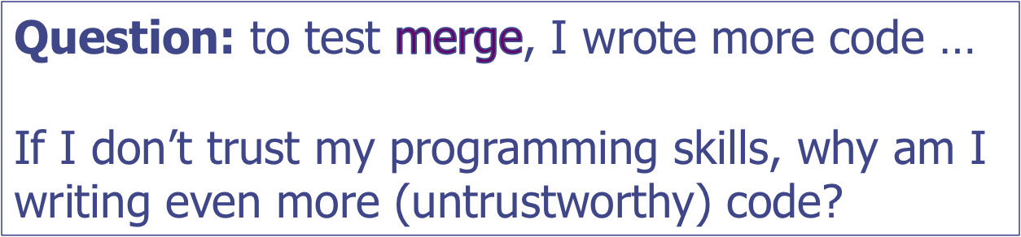
Testing mergeProp1:
Main> mergeProp1 [1,4,7] [2,4,6]
True
Main> mergeProp1 [1,4,7] [2,4,1]
True
Main> sorted [1,4,7]
True
Main> sorted [2,4,1]
False
Main>

Slide 44
Formulate More Tests!
import List(sort)
sortSorts :: [Int] -> Bool
sortSorts xs = sorted (sort xs)
sortedEmpty :: Bool
sortedEmpty = sorted []
sortIdempotent :: [Int] -> Bool
sortIdempotent xs = sort (sort xs) == sort xs

Slide 45
More Laws to Functions:
mergePreservesOrder :: [Int] -> [Int] -> Bool
mergePreservesOrder xs ys
= sorted (merge (sort xs) (sort ys))
mergeCommutes :: [Int] -> [Int] -> Bool
mergeCommutes xs ys
= merge us vs == merge vs us
where us = sort xs
vs = sort ys
etc...

Slide 46
Testing mergeProp1:
Main> mergeCommutes [1,4,7] [2,4,6]
True
Main> mergeCommutes [1,4,7] [2,4,1]
True
Main> mergePreservesOrder [1,4,7] [2,4,6]
True
Main> mergePreservesOrder [1,4,7] [2,4,1]
True
Main>

Slide 47
Automated Testing:
Of course, we can run as many individual test cases as we like:
  Pick a test case
  Execute the program
  Compare actual result with expected result
Wouldn’t it be nice if the environment could help us to go directly from properties to tests?
Wouldn’t it be nice if the environment could run the tests for us automatically too?

Slide 48
QuickCheck:
This is a job for QuickCheck!
“QuickCheck: A Lightweight Tool for Random Testing of Haskell Programs” by Koen Claessen and John Hughes, Chalmers University, Sweden. (Published at ICFP 2000)
In GHC/Hugs: import Test.QuickCheck

Slide 49
Lawful Programming:
reverse :: [a] -> [a]
reverse xs = …
{- reverse satisfies the following:
reverse (xs ++ ys)
==
reverse ys ++ reverse xs
-}

Slide 50
Lawful Programming:
reverse :: [a] -> [a]
reverse xs = …
Laws are type checked as part of the main program source text
prop_RevApp xs ys
= reverse (xs++ys)
==
reverse ys ++ reverse xs
If the laws and the code are inconsistent, then an error will be detected!

Slide 51
Running QuickCheck:
Prelude> :load reverse.hs
Main> reverse [1,2,3]
[3,2,1]
Main> quickCheck prop_RevApp
1
2
3
4
5
6
7
8
9
10
11
12
13
14
15
16
17
18
19
20
21
22
OK, passed 100 tests
Main>

Slide 52
Not All Laws are True:
Main> quickCheck (\b -> b == not b)
Falsifiable, after 0 tests:
True
Main>
Sometimes this points to a bug in the program.
Sometimes this points to a bug in the law.

Slide 53
The Testable Class:
quickCheck :: Testable a => a -> IO a
instance Testable Bool where …
instance (Arbitrary a,
Show a,
Testable b)=> Testable (a -> b)
where …
Indicates an ability to generate arbitrary values of type a.

Slide 54
The Testable Class:
quickCheck :: Testable a => a -> IO a
instance Testable Bool where …
instance (Arbitrary a,
Show a,
Testable b)=> Testable (a -> b)
where …
Indicates an ability to display arguments for counter examples

Slide 55
Generating Arbitrary Values:
arbitrary is a generator of random values
class Arbitrary a where
arbitrary :: Gen a
instance Arbitrary ()
instance Arbitrary Bool
instance Arbitrary Int
instance Arbitrary Integer
instance Arbitrary Float
instance Arbitrary Double
instance (Arbitrary a, Arbitrary b) => Arbitrary (a,b)
instance Arbitrary a => Arbitrary [a]

Slide 56
Quantified or Parameterized?
Main> quickCheck prop_revApp
OK, passed 100 tests.
Main> quickCheck (prop_revApp [1,2,3])
OK, passed 100 tests.
Main>
If you don’t give a specific value for an argument, quickCheck will generate arbitrary (i.e. random) values for you.

Slide 57
QuickCheck-ing merge:
Main> quickCheck mergeCommutes
OK, passed 100 tests.
Main> quickCheck mergePreservesOrder
OK, passed 100 tests.
Main>
So far, so good …

Slide 58
Continued …
mergeProp1 :: [Int] -> [Int] -> Bool
mergeProp1 xs ys = sorted xs ==>
sorted ys ==>
sorted (merge xs ys)
What happens?
  Main> quickCheck mergeProp1
  Falsifiable, after 7 tests:
  [-1,-5,5,4,3,-5]
  [5,-6,2,6,-6,0]
  Main>
Huh?

Slide 59
What went wrong?
Main> sorted [-1,-5,5,4,3,-5]
False
Main> sorted [5,-6,2,6,-6,0]
False
Main> sorted (merge [-1,-5,5,4,3,-5] [5,-6,2,6,-6,0])
False
Main> False ==> False ==> False
False
Main> False ==> (False ==> False)
True
Main>

Slide 60
A Fix! (in fact, infix)
infixr ==>
(==>) :: Bool -> Bool -> Bool
x ==> y = not x || y
What happens?
  Main> quickCheck mergeProp1
  OK, passed 100 tests.
  Main>
Hooray!!!

Slide 61
Are we Happy Now?
mergeProp1 :: [Int] -> [Int] -> Bool
mergeProp1 xs ys = sorted xs ==>
sorted ys ==>
sorted (merge xs ys)
100 tests passed!
But how many of them were trivial (i.e., one or both arguments unsorted)?

Slide 62
Understanding Test Results:
Use the collect combinator:
  mergeProp1sorted xs ys
  = collect (sorted xs, sorted ys) (mergeProp1 xs ys)
Testing:
  Main> quickCheck mergeProp1sorted
  OK, passed 100 tests.
  45% (False,False).
  25% (True,True).
  20% (True,False).
  10% (False,True).
  Main>

Slide 63
Understanding Test Results:
Or use the classify combinator:
  mergeProp1long xs ys
  = classify (length xs > 10) "long"
  $ classify (length xs <= 5) "short"
  $ mergeProp1 xs ys
Testing:
  Main> quickCheck mergeProp1long
  OK, passed 100 tests.
  49% short.
  29% long.
  Main>

Slide 64
Understanding ==>:
The real (==>) operator is not a standard “implies” function of type Bool -> Bool -> Bool
When we test a property p ==> q, QuickCheck will try to find 100 test cases for which p is true, and will test q in each of those 100 cases
If it tries 1000 candidates without finding enough solutions, then it will give up:
  Main> quickCheck (\b -> (b == not b) ==> b)
  Arguments exhausted after 0 tests.
  Main>
QuickCheck can be configured to use different numbers of tests/attempts

Slide 65
Writing Custom Generators:
Instead of generating random values and selecting only some, we can try to generate the ones we want directly:
  sortedList :: Gen [Int]
  sortedList = do ns <- arbitrary
  return (sort ns)

Slide 66
More Examples:
Now we can use QuickCheck’s forAll combinator to define:
prop_mergePreservesOrder = forAll sortedList $ \xs ->
forAll sortedList $ \ys ->
sorted (merge xs ys)
prop_mergeCommutes = forAll sortedList $ \xs ->
forAll sortedList $ \ys ->
merge xs ys == merge ys xs
prop_mergeIdempotent = forAll sortedList $ \xs ->
merge xs xs == xs

Slide 67
Lessons Learned:
QuickCheck is a useful and lightweight tool that encourages and rewards the lawful programmer!
There is a script that automatically runs quickCheck on all of the properties in a file that have names of the form prop_XXX
Interpreting test results may require some care …
“Good” (random) test data can be hard to find …

