Slide 1
Learning to program

Slide 2
Learning to program
One learns to program by doing.
Writing your own programs
Reading others programs
Studying good programs written by others
Getting lots of feedback about your own programs

Slide 3
Peer Evaluation
You can’t learn to program unless you write programs.
You learn to write better programs by getting feedback.
I can’t give enough feedback to a class of any large size.
Peer evaluation is utilizing students to provide feedback to other students about their programs.
This is serious business
Both the program author and the peer evaluator can learn a lot from this practice.

Slide 4
Pair programming
Work in pairs.
Two sets of eyes and brains is better than one.
One person “drives” – works the keyboard.
One person “navigates” – decides strategy and looks for errors.
Switch roles at least every half hour.
Think before you type!

Slide 5
Code walk throughs
The author of a program explains his code line by line to a group evaluators.
The evaluators
ask questions about what they don’t understand
Suggest improvements to code
Suggest code restructuring
Code structure (use of abstractions, functions, modules etc), comments, indentation are all subject to suggesstion.

Slide 6
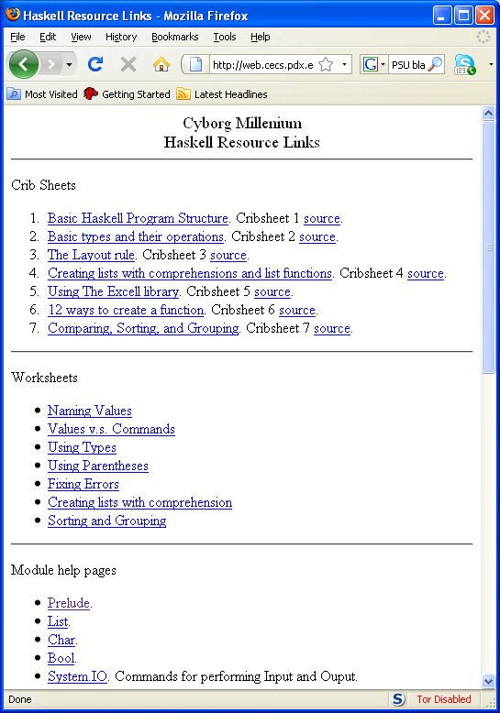
The programming resource link

Slide 7
In class programming worksheets
We will often use worksheets in class
Go to the programming resource link page
Download the worksheet to your own computer
Work in pairs to complete the worksheet.
When your pair is finished. Get up from your table and find a pair that could use some assistance.
Over their shoulder (don’t touch the computer!) help them to finish the worksheet
When everyone is standing we’ll move on to the next unit.

Slide 8
Using resources
Study the resources provided.
Try and recognize what makes a program good.
Learn the “structure” of programs. Many errors are silly misspellings or forgotten punctuation.
Always ask for help! Many times another pair of eyes will immediately see what’s wrong.

