Slide 1
Environments, Stores, and Interpreters

Slide 2
Overview
As we study languages we will build small languages that illustrate language features
We will use two tools
Observational semantic judgements
Small interpreters
These tools convey the same information at different levels of detail.

Slide 3
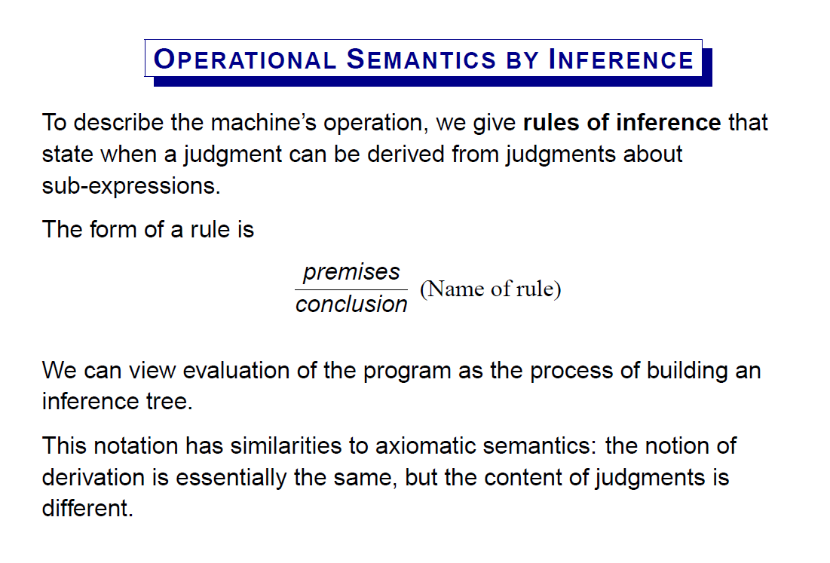

Slide 4
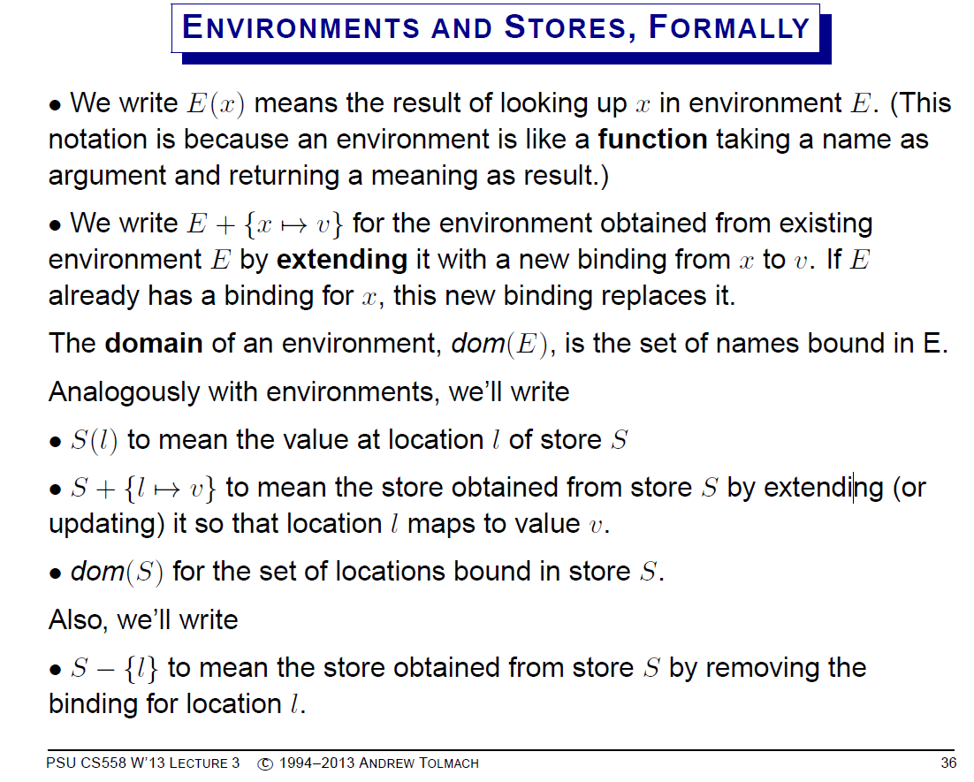

Slide 5
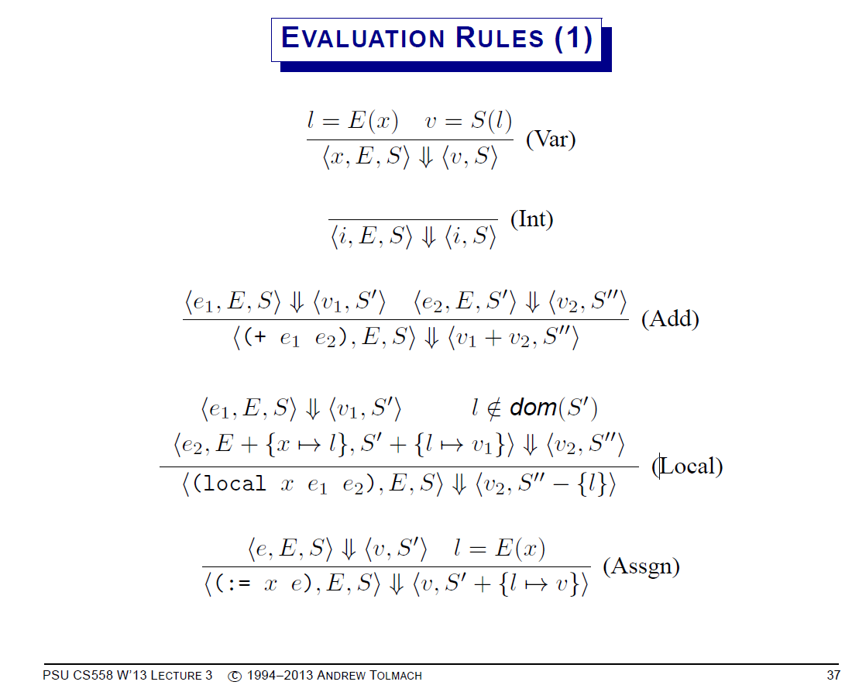

Slide 6
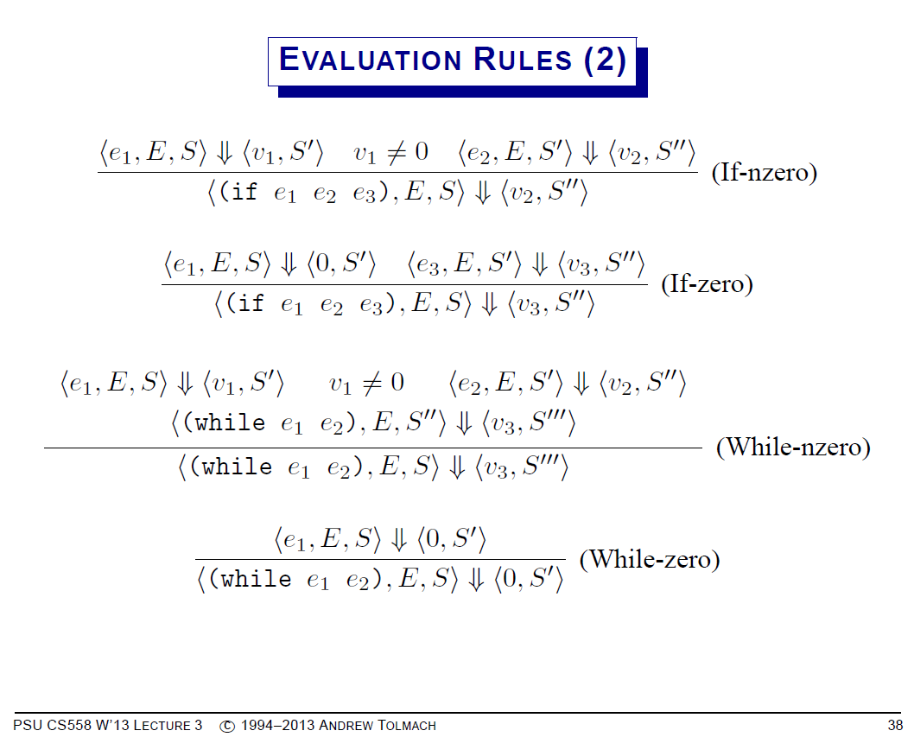

Slide 7
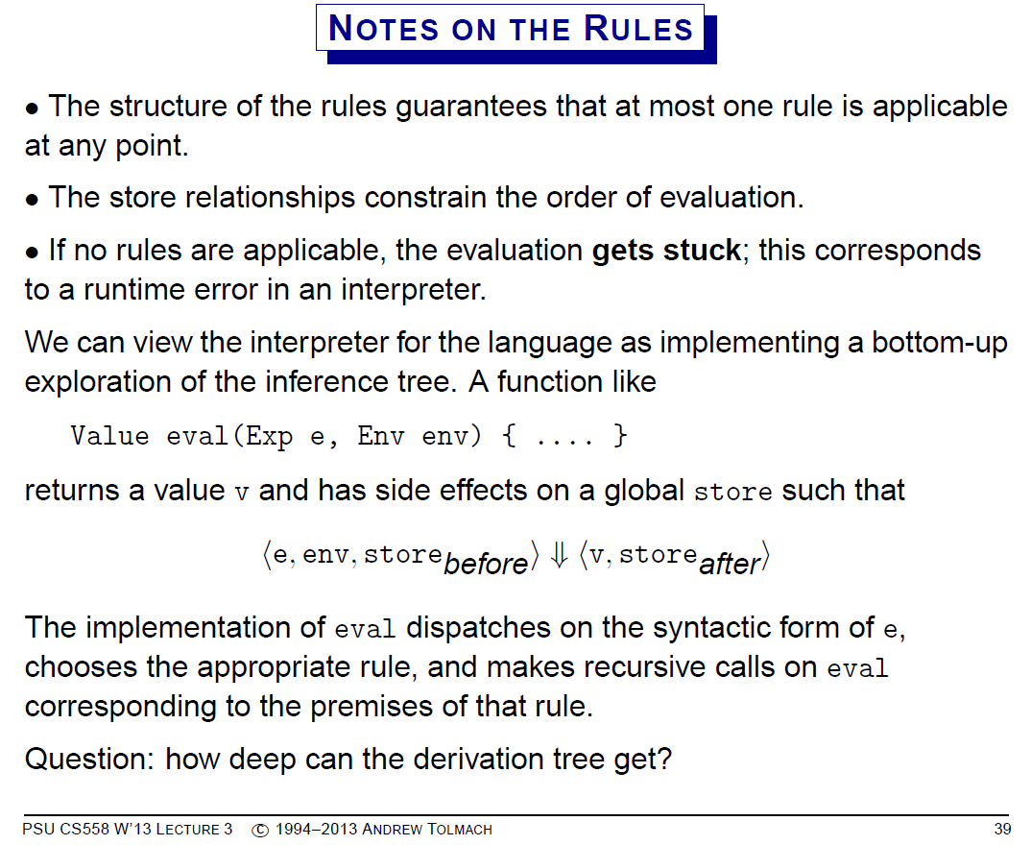

Slide 8
Interpreters
Programs that detail the same issues as an observational semantics
Operations on environments and stores
E(x)
E+{x →v}
Dom(E)
S(l)
S+{l →v}
Dom(S)

Slide 9
Values
type Addr = Int
data Value
= IntV Int -- An Int
| PairV Addr -- Or an address
-- into the heap

Slide 10
Tables in hw3.hs
Tables are like dictionaries storing objects indexed by a key.
-- A table maps keys to objects
data Table key object = Tab [(key,object)]
type Env a = Table String a -- A Table where the key is a String

Slide 11
Lookup and Searching Tables
-- When searching an Env one returns a Result
data Result a = Found a | NotFound
search :: Eq key => key -> [(key, a)] -> Result a
search x [] = NotFound
search x ((k,v):rest) =
if x==k then Found v else search x rest
-- Search a Table
lookUp :: Eq key => Table key a -> key -> Result a
lookUp (Tab xs) k = search k xs

Slide 12
Updating Tables
Update is done by making a new changed copy
-- update a Table at a given key.
update n u ((m,v):rest)
| n==m = (m,u):rest
update n u (r:rest) = r : update n u rest
update n u [] = error
("Unknown address: "++show n++
" in update")

Slide 13
Environments in hw3.hs
-- A Table where the key is a String
type Env a = Table String a
-- Operations on Env
emptyE = Tab [] -- ∅
extend key value (Tab xs) = -- E+{x →v}
Tab ((key,value):xs)
-- E+{x₁ →v_{1,} x₂ →v_{2, … ,} x_{n} →v_{n}}
push pairs (Tab xs) = Tab(pairs ++ xs)

Slide 14
Stores and Heaps
In language E3, the store is implemented by a heap. Heaps are indexed by addresses (int)
type Heap = [Value]
-- State contains just a Heap
data State = State Heap
-- Access the State for the Value
-- at a given Address S(n)
access n (State heap) = heap !! n
(list !! n) is the get element at position n. The first element is at position 0

Slide 15
Allocating on the heap S+{l →v}
-- Allocate a new location in the heap. Intitialize it
-- with a value, and return its Address and a new heap.
alloc :: Value -> State -> (Addr,State)
alloc value (State heap) =
(addr,State (heap ++ [value]))
where addr = length heap
Note that allocation creates a new copy of the heap with one more location

Slide 16
Multiple allocations
(fun f (x y z) (+ x (* y z)))
(@ f 3 5 8)
We need to create 3 new locations on the heap and note where the formal parameters (x,y,z) are stored
E {x → l₁,y → l₂,z → l₃}
S {l₁ → 3,l₂ → 5,l₃ → 8})

Slide 17
Code
bind:: [String] -> [Value] ->
State -> ([(Vname,Addr)],State)
bind names objects state =
loop (zip names objects) state
where loop [] state = ([],state)
loop ((nm,v):more) state =
((nm,ad):xs,state3)
where (ad,state2) = alloc v state
(xs,state3) = loop more state2

Slide 18
Example
bind [a,b,c]
[IntV 3,IntV 7,IntV 1]
(State [IntV 17])
returns the pair
( [(a,1),(b,2),(c,3)]
, State [IntV 17,IntV 3,IntV 7,IntV 1]
)

Slide 19
Heap update
Makes a new copy of the heap with a different object at the given address.
-- Update the State at a given Adress
stateStore addr u (State heap) =
State (update addr heap)
where update 0 (x:xs) = (u:xs)
update n (x:xs) = x : update (n-1) xs
update n [] =
error ("Address "++show addr++
" too large for heap.")

Slide 20
Example
Allocate 1 (St [IntV 3,IntV 7] )
Returns
(2, St [IntV 3,IntV 7,IntV 1] )

Slide 21
The interpreter
It implements the observational rules but has more detail.
It also adds the ability to trace a computation.

Slide 22
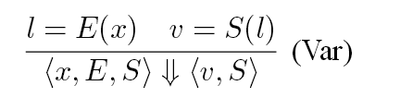
interpE :: Env (Env Addr,[Vname],Exp) -- The function name space
-> Env Addr -- the variable name space
-> State -- the state, a heap
-> Exp -- the Exp to interpret
-> IO(Value,State) -- (result,new_state)
interpE funs vars state exp =
(traceG vars) run state exp where
run state (Var v) =
case lookUp vars v of
Found addr ->
return(access addr state,state)
NotFound ->
error ("Unknown variable: "++v++" in lookup.")
--- … many more cases

Slide 23
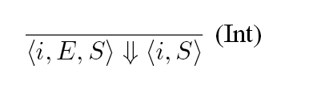
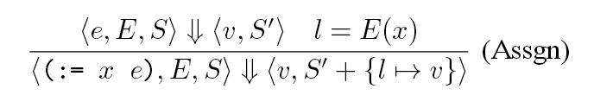
Constant and assignment case
run state (Int n) = return(IntV n,state)
run state (Asgn v e ) =
do { (val,state2) <- interpE funs vars state e
; case lookUp vars v of
Found addr ->
return(val,stateStore addr val state2)
NotFound -> error
("\nUnknown variable: "++
v++" in assignment.") }

Slide 24
Notes on pairs
Pairs are allocated in consecutive locations on the heap
run state (Pair x y) =
do { (v1,s1) <- interpE funs vars state x
; (v2,s2) <- interpE funs vars s1 y
; let (a1,s3) = alloc v1 s2
(a2,s4) = alloc v2 s3
; return(PairV a1,s4)}
a1 and a2 should be consecutive locations

Slide 25
Runtime checking of errors
Numeric operations (+, *, <=, etc) only operate on (IntV n) and must raise an error on (PairV a)
run state (Add x y) =
do { (v1,state1) <- interpE funs vars state x
; (v2,state2) <- interpE funs vars state1 y
; return(numeric state2 "+" (+) v1 v2,state2) }
numeric :: State -> String -> (Int -> Int -> Int) ->
Value -> Value -> Value
numeric st name fun (IntV x) (IntV y) = IntV(fun x y)
numeric st name fun (v@(PairV _)) _ =
error ("First arg of "++name++
" is not an Int. "++showV (v,st))
numeric st name fun _ (v@(PairV _)) =
error ("Second arg of "++name++
" is not an Int. "++ showV (v,st))

